Slide 1
Lecture 4 — Correlation & Regression
Michal Kolář
IMG
Prague, 06/2026
Notes:
Companion theory lecture for
Practical Session 1 (`01_exploratory_data_analysis.ipynb`).
Structured as slide content + speaker notes.
Part I is the general introduction (3 slides);
Part II walks through the concepts students will use in the notebook.

Slide 2
Part I — Measuring association
Notes:
Companion theory lecture for
Practical Session 1 (`01_exploratory_data_analysis.ipynb`).
Structured as slide content + speaker notes.
Part I is the general introduction (3 slides);
Part II walks through the concepts students will use in the notebook.

Slide 3
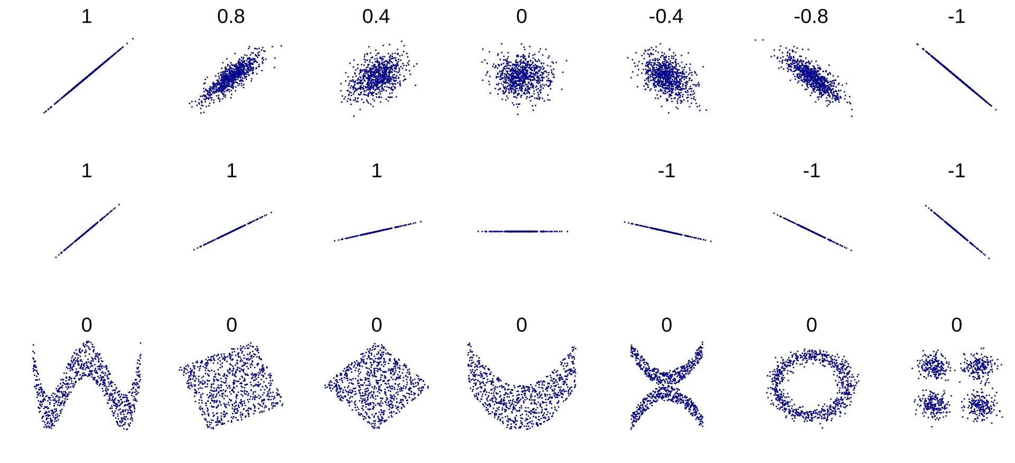
Notes:
Companion theory lecture for
Practical Session 1 (`01_exploratory_data_analysis.ipynb`).
Structured as slide content + speaker notes.
Part I is the general introduction (3 slides);
Part II walks through the concepts students will use in the notebook.

Slide 4
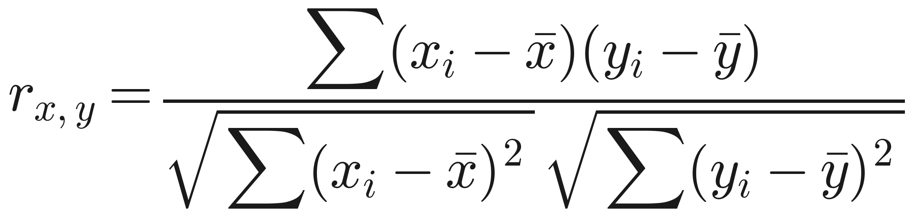
Correlation: Pearson's r
How strongly do two measured variables move together?
Correlation runs from −1 (anti) through 0 (unrelated) to +1; a strong correlate is a predictor, carrying redundant information.
Pearson's r is a standardized covariance — it measures linear association only
Pitfall: a strong non-linear relationship can still give r ≈ 0 — always plot the data.
r = 0 means no linear association — not independence.
Notes:
Covariance measures co-movement but in mixed units; dividing by the two SDs standardises it to [−1, 1]. Hammer 'linear only': r = 0 means no linear association, not independence. The Datasaurus / Anscombe examples — wildly different scatterplots with near-identical r — prove a single number never replaces the plot.

Slide 5
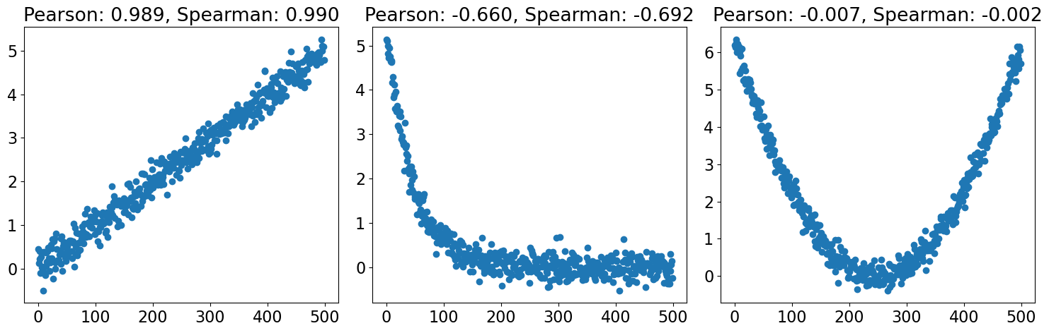
Notes:
Companion theory lecture for
Practical Session 1 (`01_exploratory_data_analysis.ipynb`).
Structured as slide content + speaker notes.
Part I is the general introduction (3 slides);
Part II walks through the concepts students will use in the notebook.

Slide 6
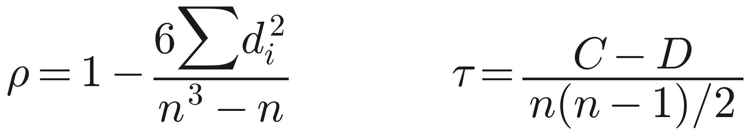
When linear isn't enough: Spearman & Kendall
Rank-based correlations for monotonic relationships.
Spearman's ρ = Pearson computed on the ranks → captures any monotonic relationship.
is the difference between the two ranks of each observation
Kendall's τ = concordant (C) minus discordant (D) pairs, normalized.
Because they use only order, Spearman and Kendall are far less sensitive to outliers and scale.
Ordinal, monotonic-but-non-linear, or outlier-prone → rank methods.
Notes:
Spearman swaps values for ranks then runs Pearson, so a perfect monotonic curve scores ρ = 1 even when non-linear. Kendall counts how often pairs agree in order; using only order, a wild outlier barely moves it. Reach for rank methods when data are ordinal, monotonic-but-non-linear, or outlier-prone.

Slide 7
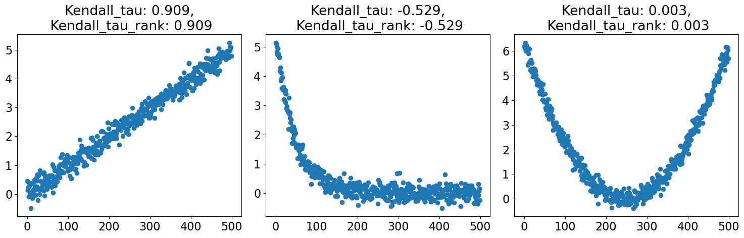
Notes:
Companion theory lecture for
Practical Session 1 (`01_exploratory_data_analysis.ipynb`).
Structured as slide content + speaker notes.
Part I is the general introduction (3 slides);
Part II walks through the concepts students will use in the notebook.

Slide 8

Significance, and the two big caveats
Is the correlation real — and what does it actually mean?
Test H₀: ρ = 0 via a t-test, a permutation test, or Fisher's arctanh transform.
Correlation ≠ causation: nothing about direction, nor whether a hidden confounder drives both.
Spurious correlations are everywhere — apply a critical eye and visualize.
A fitted number is not automatically a causal effect.
Notes:
The t-test is the usual route; the permutation test builds the null by shuffling one variable; Fisher's transform makes r approximately normal for CIs. Then slow down on causation: A–B correlation is equally consistent with A→B, B→A, a common cause C→both, or coincidence. The spurious-correlation gallery makes it stick.

Slide 9
Part II — Modelling a relationship

Slide 10
Regression
Technique used for the modeling and analysis of numerical data
Exploits the relationship between two or more variables so that we can gain information about one of them through knowing values of the other
Regression can be used for prediction, estimation, hypothesis testing, and modeling causal relationships
Y = f(X1, X2)
Y is a dependent variable (or outcome variable, or response variable)
X’s are independent variables (or predictor variables, or explanatory variables)

Slide 11
Linear Regression
Suppose we want to model the dependent variable Y in terms of two predictors, X₁, X₂
Y = f(X₁, X₂)
Typically, we will not have enough data to try to directly estimate f
Therefore, we usually have to assume that f has some restricted form, such as linear
Y = a + bX₁ + cX₂
Correlation is one number; regression is a full predictive model.

Slide 12
Linear Regression is a probabilistic model
Much of mathematics is devoted to studying variables that are deterministically related to one another
But we’re interested in understanding the relationship between variables related in a nondeterministic fashion

Slide 13
Linear Regression is a probabilistic model
Definition: There exists parameters , , and , such that for any fixed value of the independent variable x, the dependent variable y is related to x through the model equation
is a random variable assumed to be
Model the response as a function of predictors plus noise.

Slide 14
graphical interpretation
For example if y is log expression intensity of a gene and x is age then is the average expression intensity in 2 year old children.
We need homoscedasticity

Slide 15
Ordinary Least Squares (OLS) parameter estimation
Point estimates of and are obtained by the principle of least squares
S
Squared residuals → sensitive to outliers

Slide 16
predicted and residual values
Predicted, or fitted, values are values of y predicted by the least- squares regression line obtained by plugging in x₁, x₂, ..., x_{n} into the estimated regression line
Residuals are the deviations of observed and predicted values

Slide 17
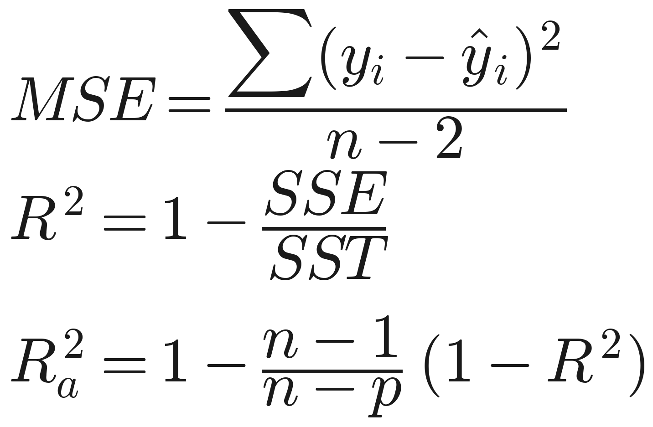
Residuals are useful
They allow us to calculate the error sum of squares (SSE):
Which in turn allows us to estimate (n is the number of observations):
As well as an important statistic referred to as the coefficient of determination
Or its adjusted variant
Plain R² never decreases as predictors are added — hence adjusted R².

Slide 18
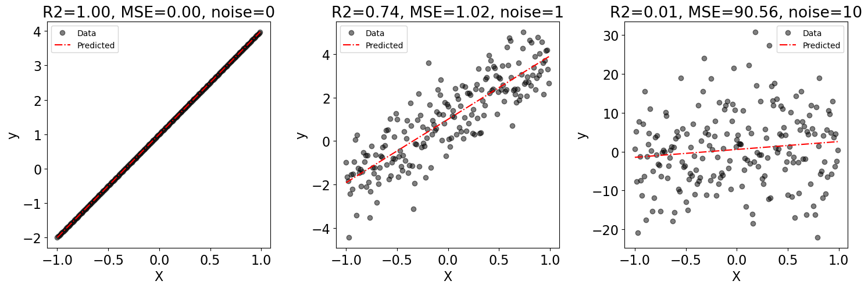
Residuals are useful

Slide 19
IS the explanatory variable explanatory?
we have fitted a model:
significance of influence of X on Y translates to significance of
Hypothesis tests for can be done by simple t-tests:
where t follows an approximate t-distribution with (n - 2) degrees of freedom (n observations, two parameters)
in general and thus

Slide 20
intermezzo
for one sample t-test
for two sample t-test
for linear regression
Always, it is some value independent from the response variable.
It shows depth or breadth of the data

Slide 21
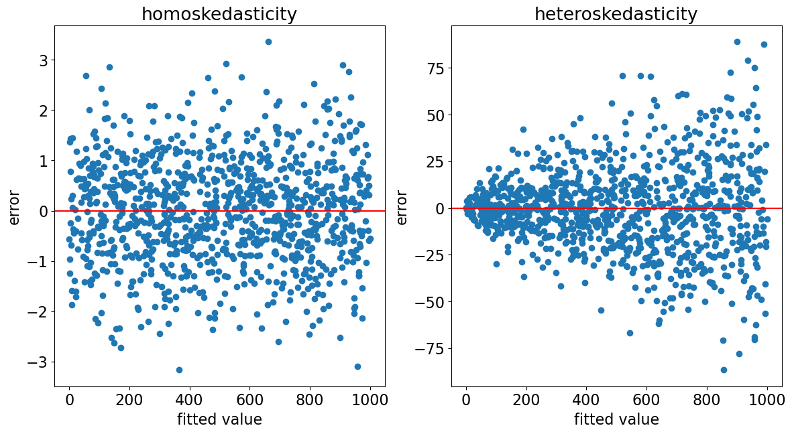
OLS assumptions
The fit is easy; trusting it needs assumptions.
Correct specification and strict exogeneity (errors centred on the truth).
No multicollinearity: redundant predictors make coefficients non-identifiable.
homoscedasticity (constant spread) and no autocorrelation.
Normality is not needed for the fit — but it is needed for CIs and tests.
Normal errors ⇒ OLS coincides with Maximum Likelihood.
Notes:
The recurring theme: validity = assumptions. Multicollinearity mainly corrupts effect-size interpretation (less so pure prediction). Homoscedasticity is broken by, e.g., count data. The normality nuance is key: point estimates are fine without normal errors, but CIs/p-values assume them — and when errors are normal, OLS coincides with Maximum Likelihood (efficient).

Slide 22
Part III — Comparing & extending models

Slide 23
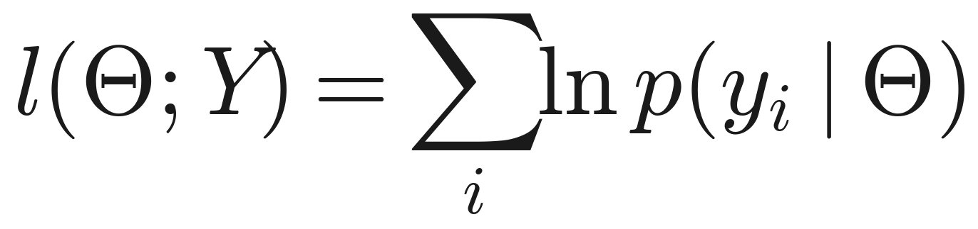
Maximum likelihood
The general estimation principle behind OLS.
Likelihood = how probable the data are under some model parameters Θ; maximise the log-likelihood.
Under Gaussian noise, maximising likelihood = minimising squared residuals → ML ≡ OLS.
Parametric: requires an assumed density — and the gateway to GLMs.
Assume normal errors and ML hands you least squares.
Notes:
ML is the unifying idea: pick the parameters that make what you observed most probable. The punchline: assume normal errors and ML hands you least squares — so OLS is ML under a Gaussian model. Caveat: even with the true family, finite samples won't recover parameters exactly. ML generalises beyond Gaussian via GLMs.

Slide 24
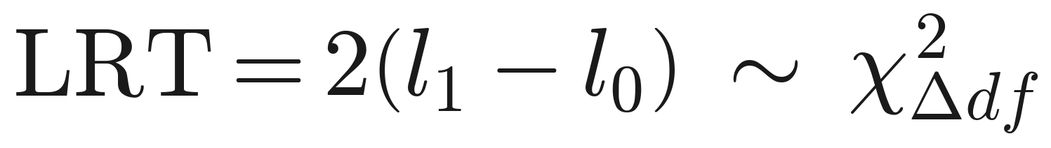
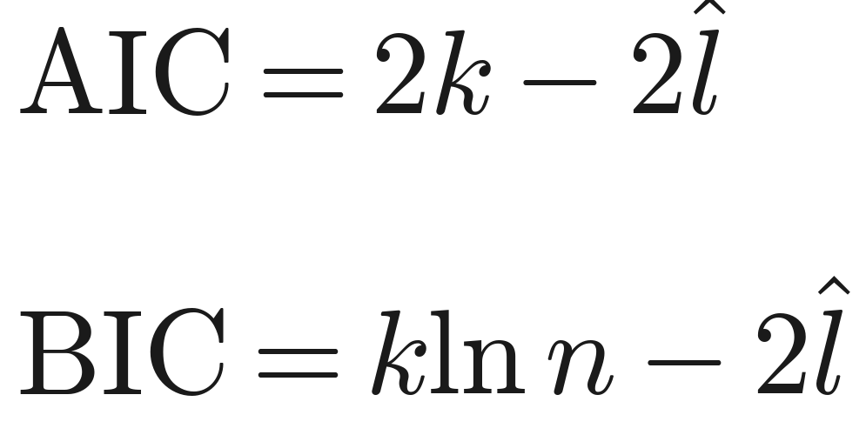
Comparing models
Is the extra parameter worth keeping?
Two models are nested if you can get the simpler one by switching off (fixing to zero) some parameters of the bigger one
Likelihood Ratio Test — for nested models; ~ χ² with df = the parameter difference.
Akaike information criterion (AIC) or Bayesian information criterion (BIC) — compare non-nested models; lower is better, but no clean p-value.
(k = parameters, 𝑛 = observations, 𝑙 = maximised log-likelihood)
Both guard against overfitting: more parameters always fit the training data better.
LRT: does adding this parameter beat chance?
Notes:
The LRT answers a crisp question — does adding this parameter improve the fit beyond chance? — but only for nested models and (here) assuming normal noise. AIC/BIC trade fit against complexity for non-nested candidates. The thread underneath is overfitting, which leads to regularization.

Slide 25
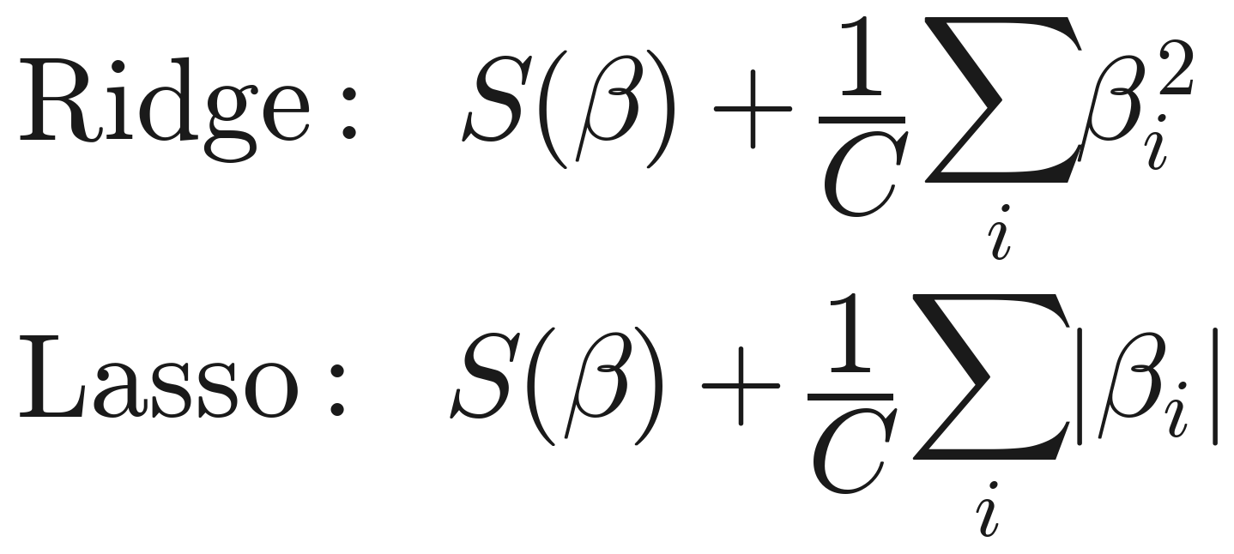
When OLS fails, and regularization
Fixes for broken assumptions — and shrinking complexity.
Heteroscedasticity → transform the data, or Weighted / Generalised Least Squares.
Regularization penalises coefficient size: Lasso (L1) can zero predictors; Ridge (L2) shrinks them.
Choosing the penalty strength C is machine learning (cross-validation) — beyond this course.
S
Lasso selects features; Ridge shrinks smoothly.
Notes:
When spherical-errors fails: a transform or WLS (uncorrelated errors) / GLS (correlated errors). Regularization fights overfitting and multicollinearity by shrinking unimportant coefficients — Lasso can set them exactly to zero (feature selection), Ridge shrinks without eliminating. Tuning C (and Elastic-Net's α) needs proper validation — the doorway to a machine-learning course.

Slide 26
Goodness of fit
How much does the model explain?
MSE — scale-dependent, hard to compare across datasets.
R² — the fraction of variance the model explains (0 to 1).
Adjusted R² penalises extra covariates — required for multiple regression.
Plain R² never decreases as predictors are added — hence adjusted R².
Notes:
R² is the intuitive headline but only ever rises as predictors are added, so it rewards clutter; adjusted R² subtracts a penalty in p and equals R² for a single predictor. Caveat: a high R² does not certify a good model — it can be propped up by a few leverage points or hide a mis-specified form (see diagnostics).

Slide 27
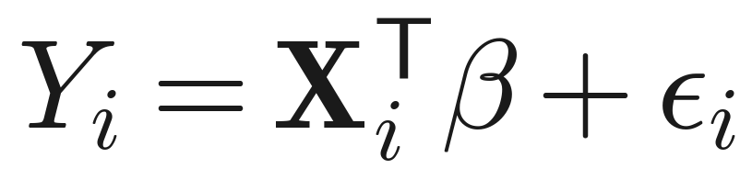
From a number to a model
Model the response as a function of predictors plus noise.
Y = f(X) + ε: a response Y, covariates X, and noise ε; the linear model uses a weighted sum of predictors.
Hat notation: β̂ and Ŷ denote estimates.
“Linear” means linear in the coefficients — so polynomials (x, x², x³) are still linear models.
Correlation is one number; regression is a full predictive model.
Notes:
Contrast with Part I: correlation is one summary number; regression is a predictive model with interpretable coefficients. Linear-in-parameters trips people up — y = β₁x + β₂x² is linear regression on features {x, x²}. GLMs (transform the mean response for counts/categories) are the more powerful generalisation, out of scope here.

Slide 28
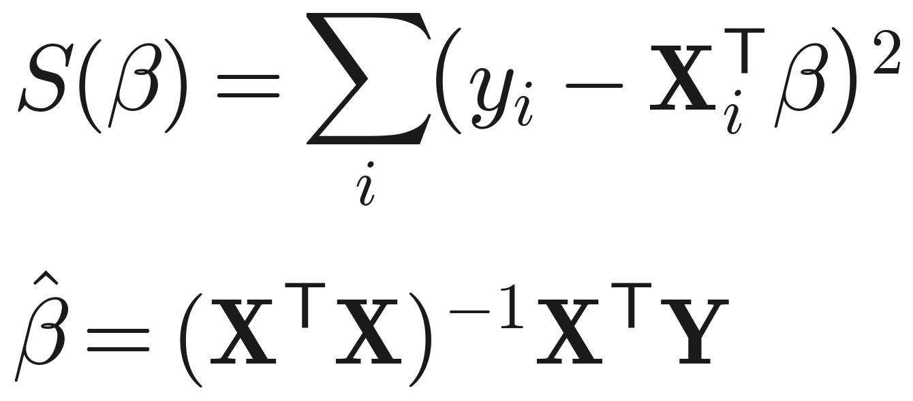
Ordinary Least Squares (OLS)
Fit by minimising the squared residuals.
Objective: minimise the sum of squared residuals; β̂ = argmin S(β).
For an overdetermined system there is a closed-form solution.
Tooling: sm.OLS / smf.ols('y ~ x'); remember add_constant for the intercept.
Squared residuals → sensitive to outliers; needs XᵀX invertible.
Notes:
Squaring penalises large misses heavily, which makes OLS sensitive to outliers. The closed form needs more observations than coefficients (overdetermined) and an invertible XᵀX, which fails under perfect multicollinearity. The common gotcha: forgetting add_constant forces the line through the origin.

Slide 29
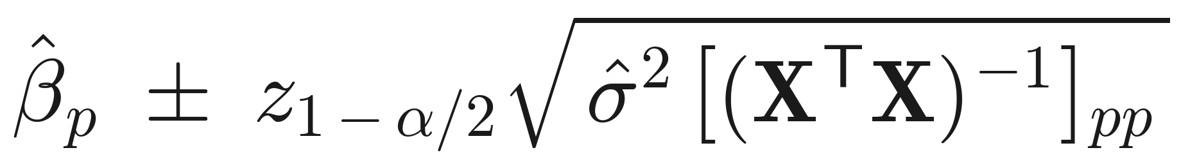
Inference: coefficients & confidence
What each coefficient means, and how sure we are.
Each coefficient = change in Y per unit of that covariate; the intercept = Y when all covariates are 0.
A confidence interval and a t-test of H₀: βₚ = 0 give significance.
Both assume normal noise — a strong, frequently unchecked assumption.
Significant ≠ large: report magnitude and CI, not just the p-value.
Notes:
Interpreting coefficients is the scientific payoff. Flag that std-error, CI and p-value all rest on normal errors (checked via the diagnostics next slide). Reprise the Session-2 mantra: a significant coefficient is not necessarily a large or important one — report magnitude and CI alongside the p-value.

Slide 30
Reading the statsmodels summary
Three panels: fit, coefficients, diagnostics.
Fit: R² / adjusted R²; F-statistic + Prob(F) (all coefficients 0?); AIC / BIC.
Coefficients: coef, std err, t, P>|t|, 95% CI — the inference columns (assume normal errors).
Diagnostics: Omnibus/Jarque–Bera (normality), Durbin–Watson (autocorrelation ≈2), Condition Number (multicollinearity); homoscedasticity → White's test.
Read the diagnostics before believing the coefficients.
Notes:
Give the room a map so the summary stops being a wall of numbers — the diagnostics block is where you check the slide-8 assumptions. Durbin–Watson ≈ 2 means no autocorrelation (below ~1 is bad); a huge condition number flags multicollinearity; low Omnibus/Jarque–Bera p means non-normal residuals. White's test (het_white) for homoscedasticity, H₀ = equal variance.

