Slide 1




Statistics in Python Course
Based on the course https://www.sib.swiss/training/course/20230620_STATP
(Wandrille Duchemin.
Introduction to Statistics with Python
https://doi.org/10.5281/zenodo.15607543)

Slide 2

Statistics in Python Course
Session 1 – Data visualisation & exploration
Session 2 – Distributions & hypothesis testing
Session 3 – Statistical testing, continued
Session 4 – Correlation & regression
https://www.elixir-czech.cz/events/statistics-in-python-06-2026

Slide 3

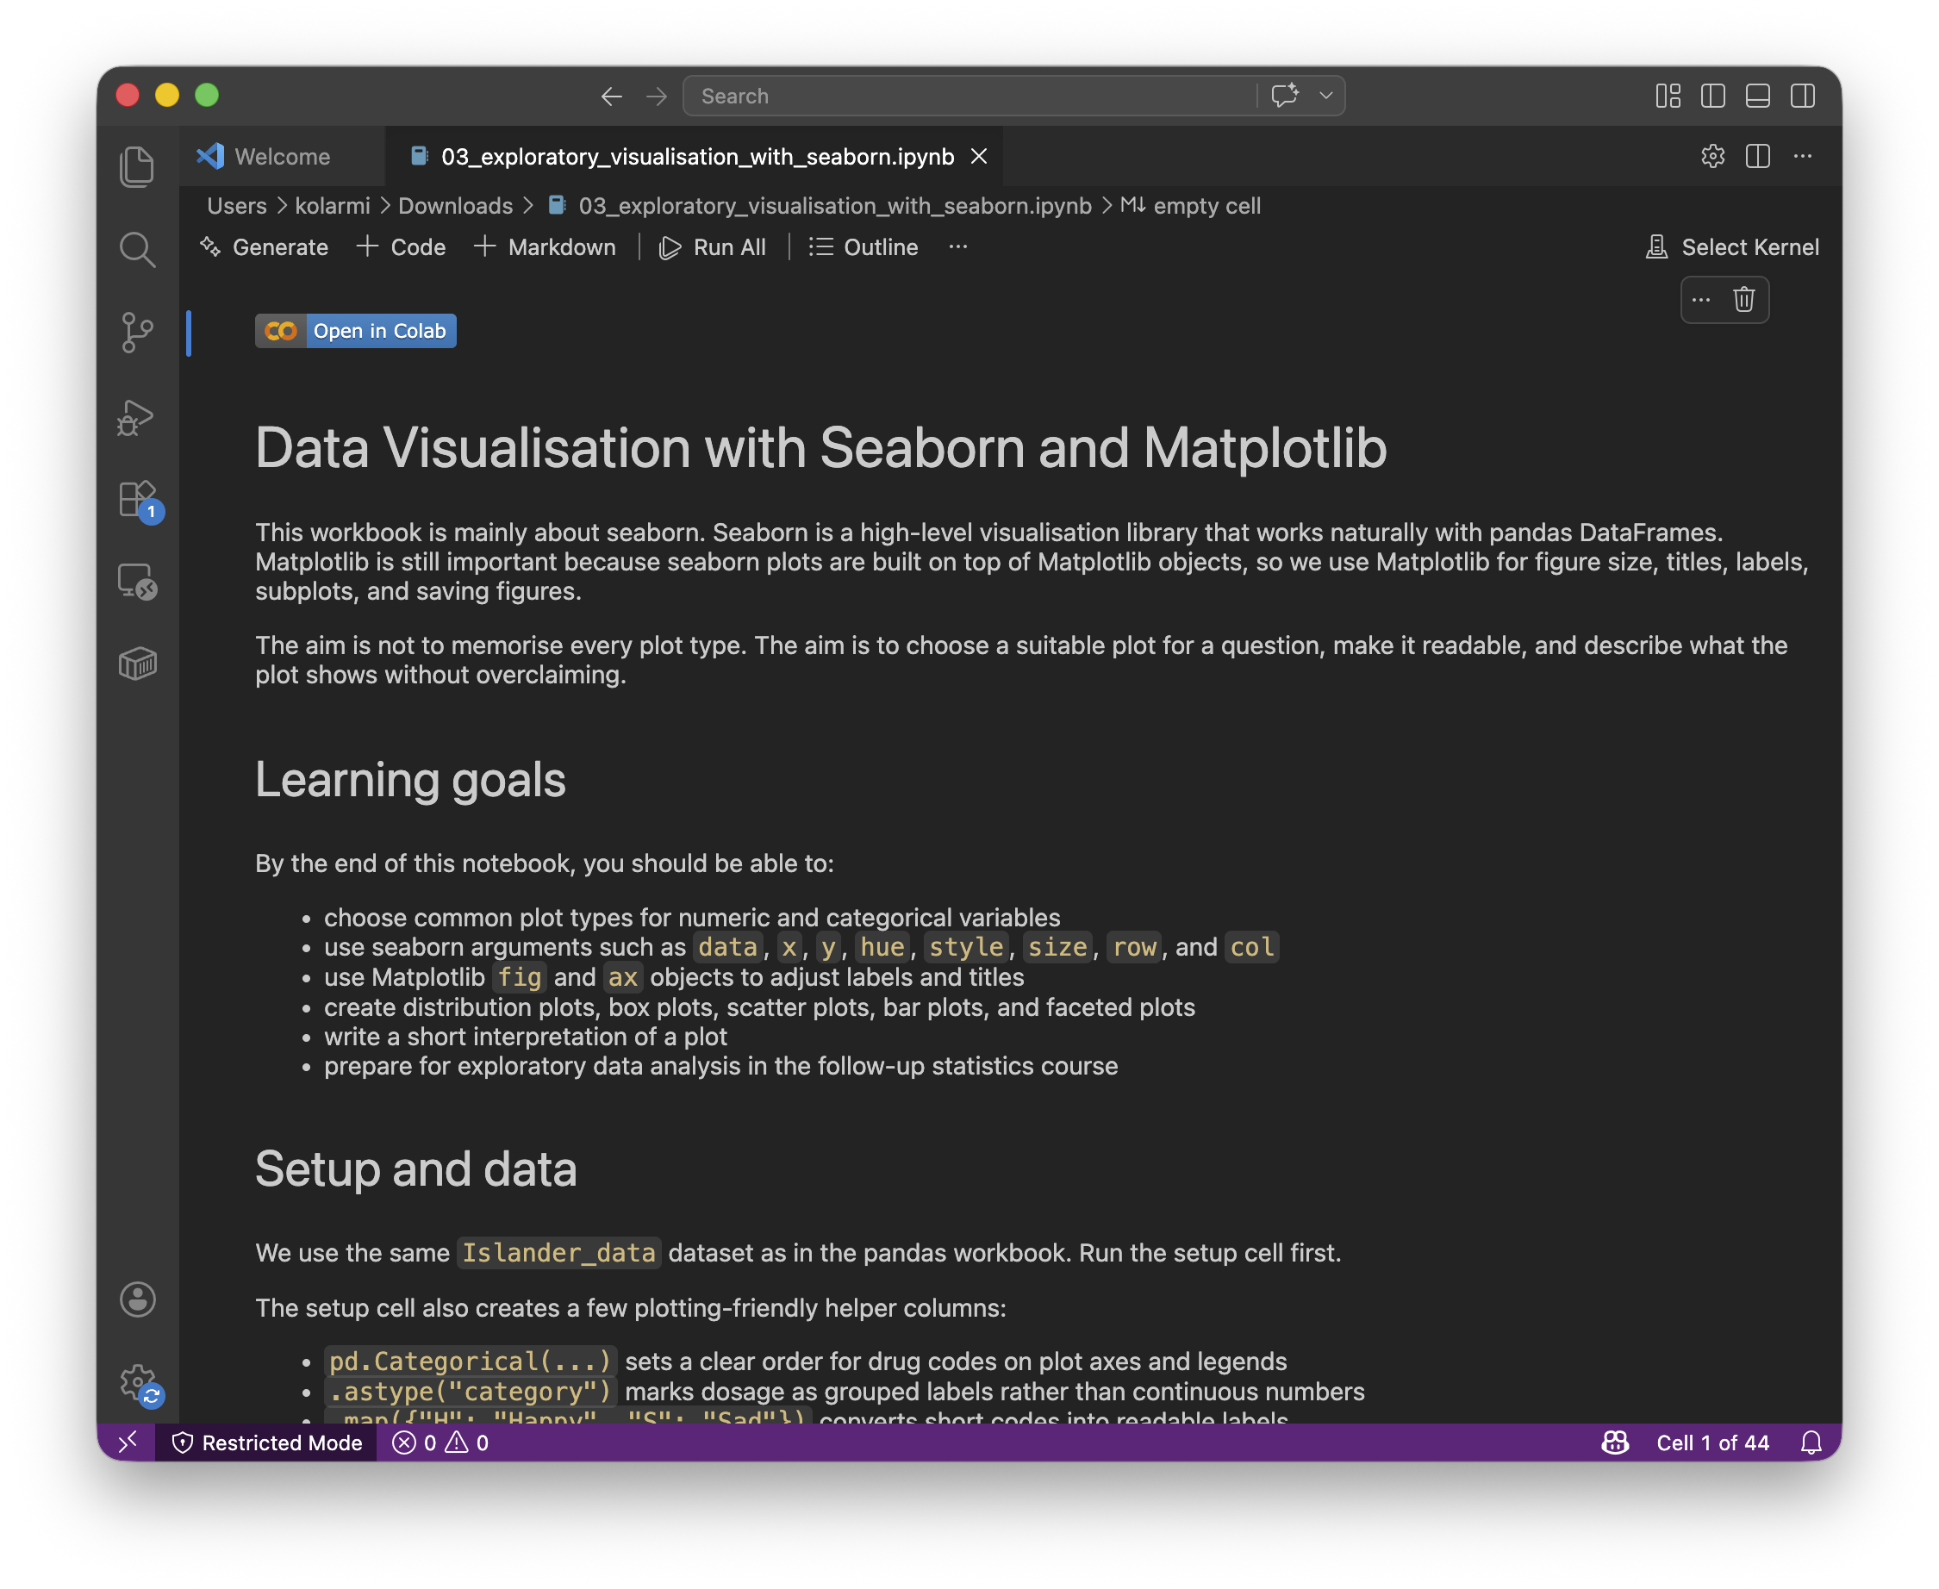

Metacentrum & Elixir CZ
Accessible to academic community
ondemand.metacentrum.cz
hub.cloud.e-infra.cz
colab.research.google.com
or locally with VS Code

Slide 4
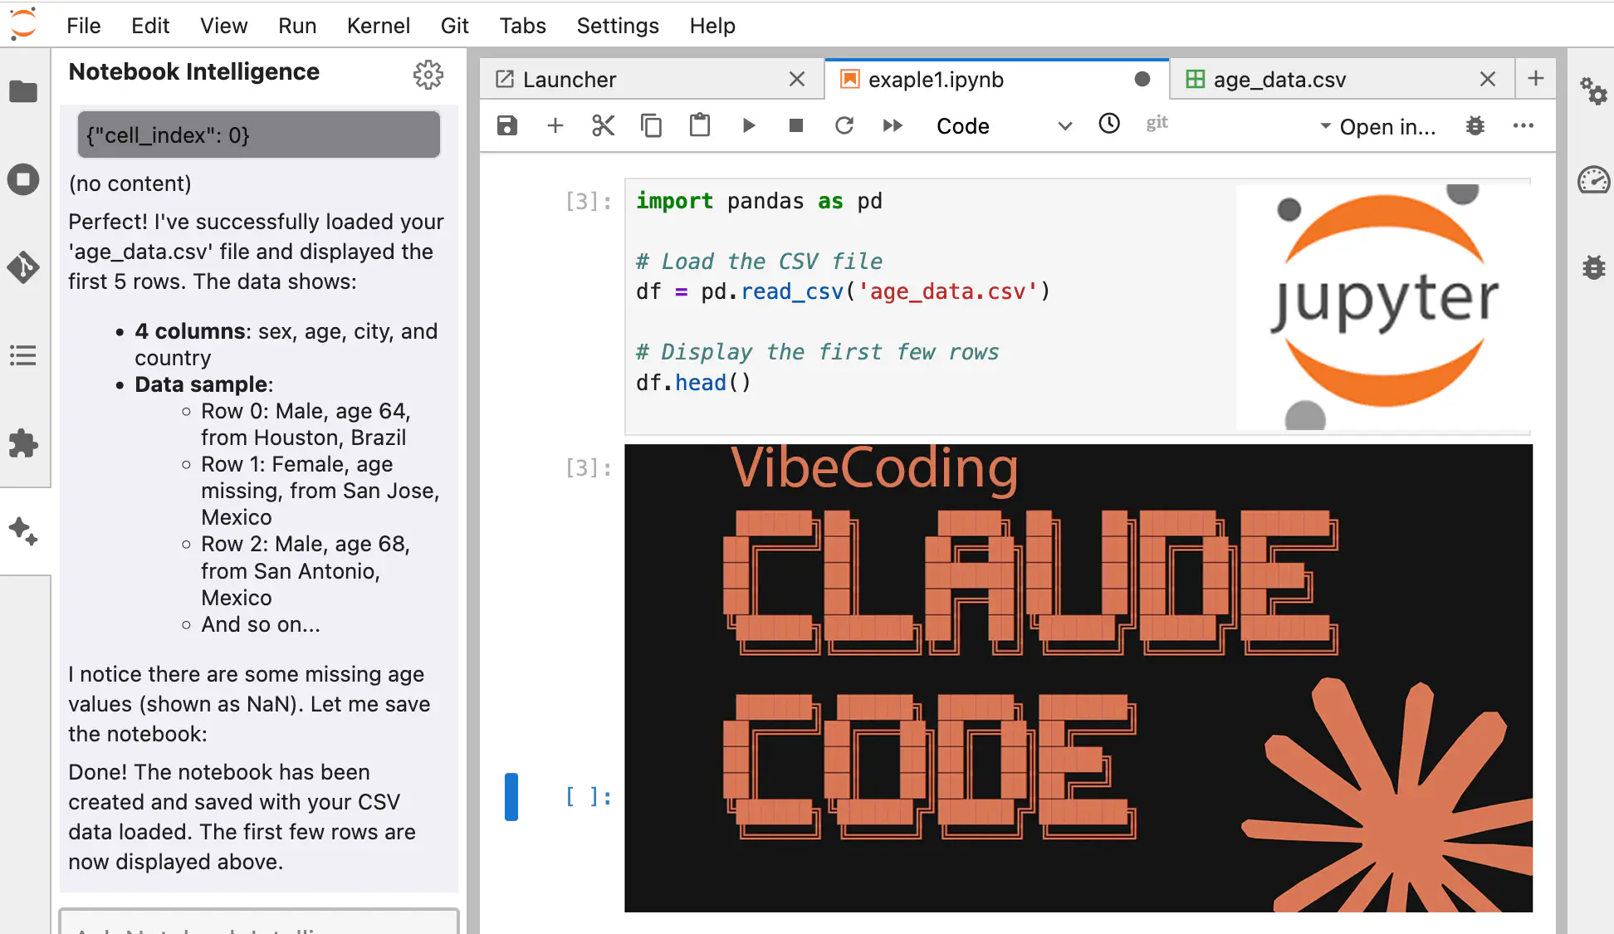
Vibe coding
hub.cloud.e-infra.cz
colab.research.google.com
or locally with VS Code

Slide 5



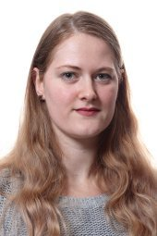



Course on scRNA-seq Data Analysis
Trainers
Jan Kubovčiak
Mathys Delattre
Vojtěch Melichar
Lucie Pfeiferová
Michal Kolář
Helpers
Eva Rohlová
Kateřina Večerková

Slide 6
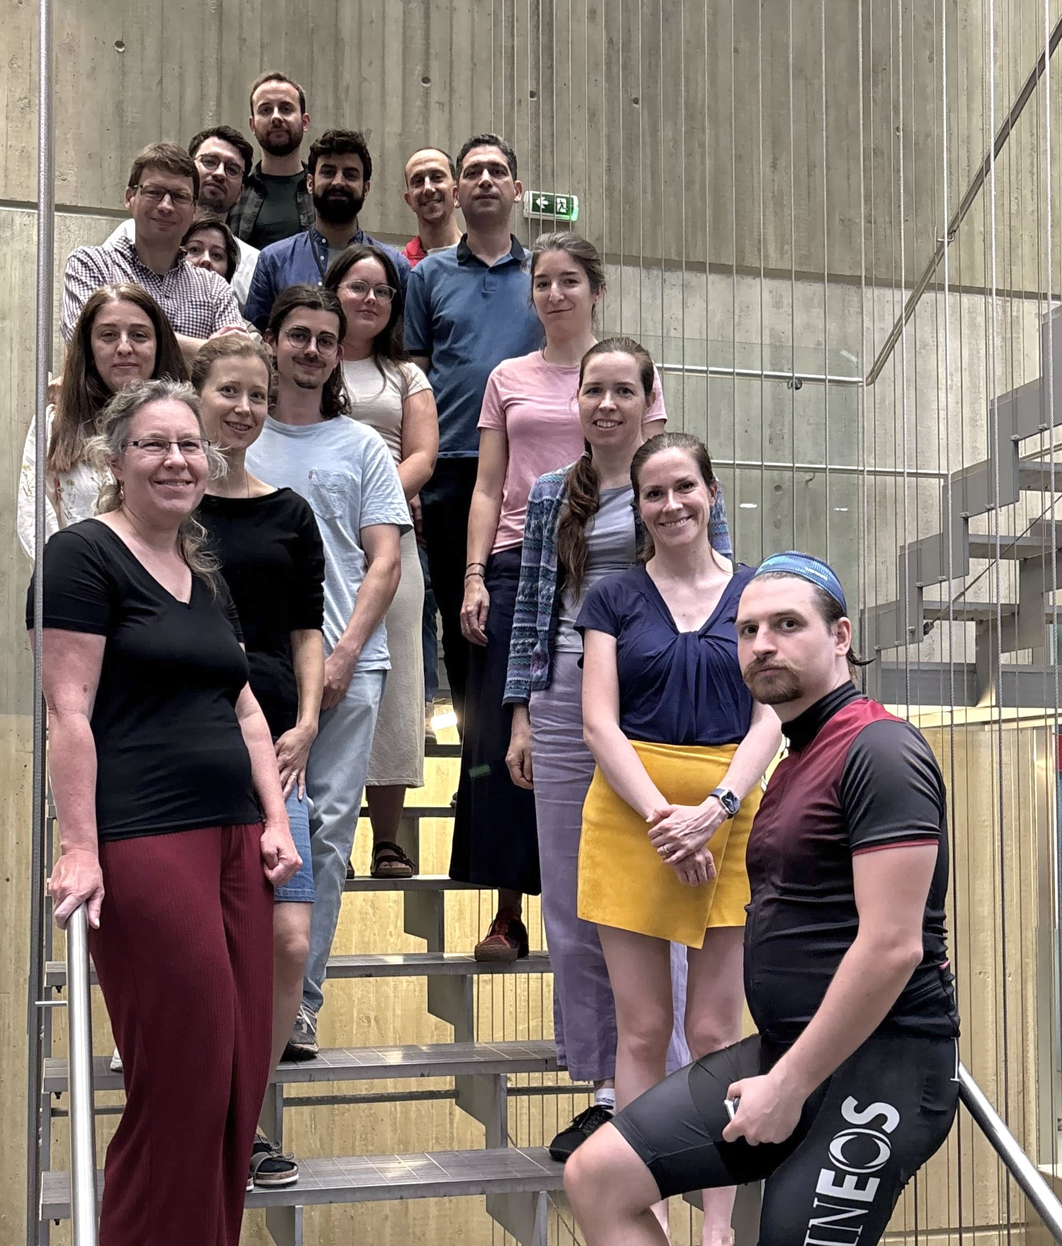

Please provide your feedback
Photo
https://forms.gle/maNtCd4oXf7DLq5y7

