Slide 1

第四次分享
汇报人：张晓晓

Slide 2
Literature
Lv, W., Zheng, J., Luan, M., Shi, M., Zhu, H., Zhang, M., . . . Jiang, Y. (2015). Comparing the evolutionary conservation between human essential genes, human orthologs of mouse essential genes and human housekeeping genes. Brief Bioinform, 16(6), 922-931. doi:10.1093/bib/bbv025
Chen, L., Zhang, Y. H., Wang, S., Zhang, Y., Huang, T., & Cai, Y. D. (2017). Prediction and analysis of essential genes using the enrichments of gene ontology and KEGG pathways. PLoS One, 12(9), e0184129. doi:10.1371/journal.pone.0184129

Slide 3
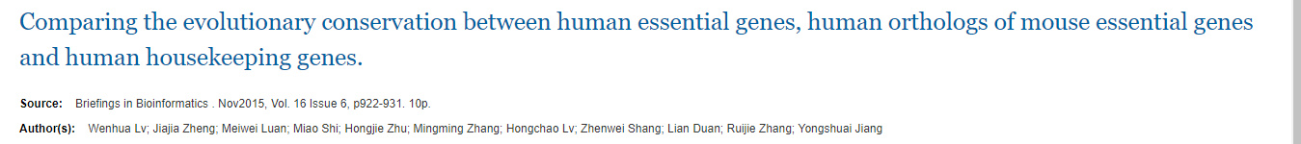
Q:
a.
What is the relationship of evolutionary conservation between human essential genes and human housekeeping genes?
b.
Should we substitute human orthologs of mouse essential genes for human essential genes?

Slide 4

Materials
Human housekeeping genes(3804 genes) http://www.tau.ac.il/~elieis/HKG/
Strict human essential gene set(120 genes)http://www.pnas.org/content/105/19/6987/suppl/DCSupplemental
Human essential gene set obtained by large-scale experiments(1394 genes) OGEEdb
The mouse essential genes(2981 genes) MGI database (http://www.informatics.jax.org/)
The human–other species orthologous gene ftp://ftp.ensembl.org/pub/release-69/mysql/ensembl_mart_69
The protein sequences of humans and the 21 other species Ensembl BioMart(http://www.ensembl.org/biomart/martview)
HapMap genotype data ftp://ftp.ncbi.nih.gov/hapmap
1000 genomes genotype data http://ftp.ncbi.nlm.nih.gov/1000genomes/

Slide 5

Methods
Human essential genes
& Human housekeeping genes
The human orthologous genes
of mouse essential genes
Evolutionary rate (dN/dS)
long-term evolutionary features
Protein sequence identity
SNP density
short-term evolutionary features
Degree of LD

Slide 6

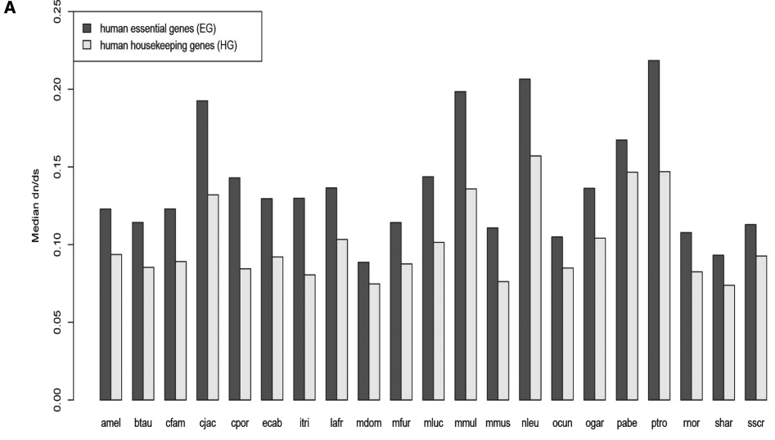
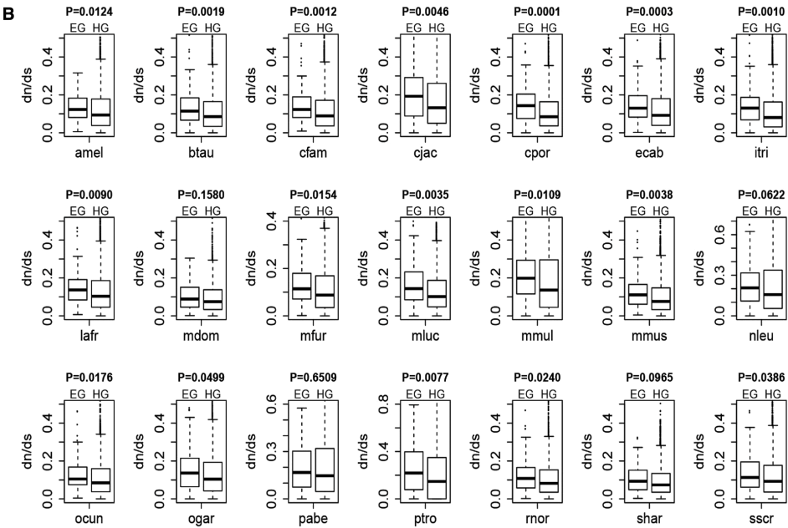
Evolutionary rate(dN/dS)

Slide 7
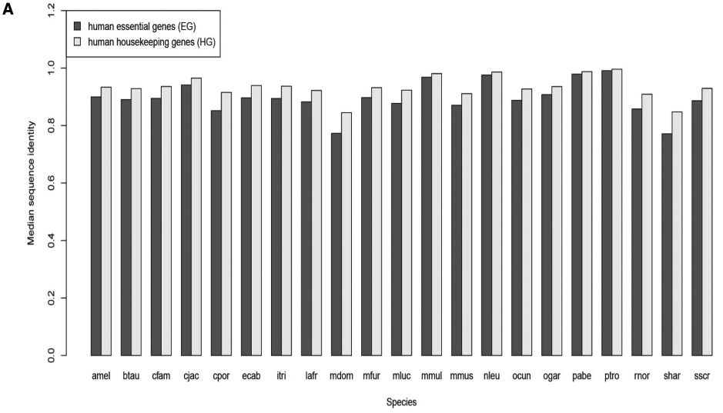
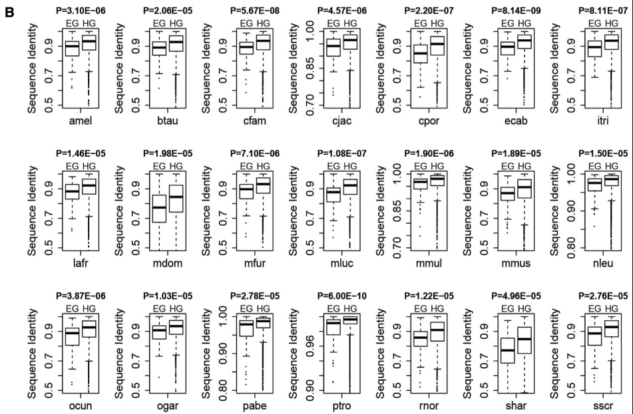
Protein sequence identity

Slide 8
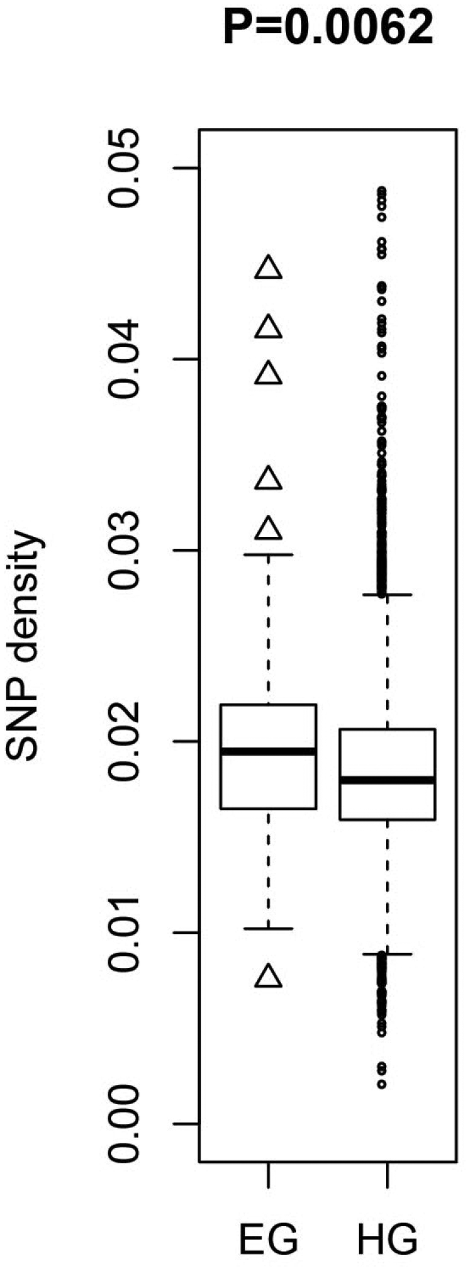
SNP density

Slide 9
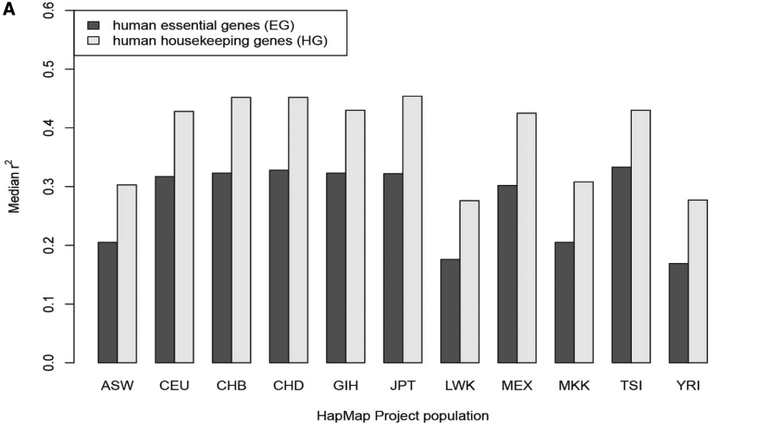
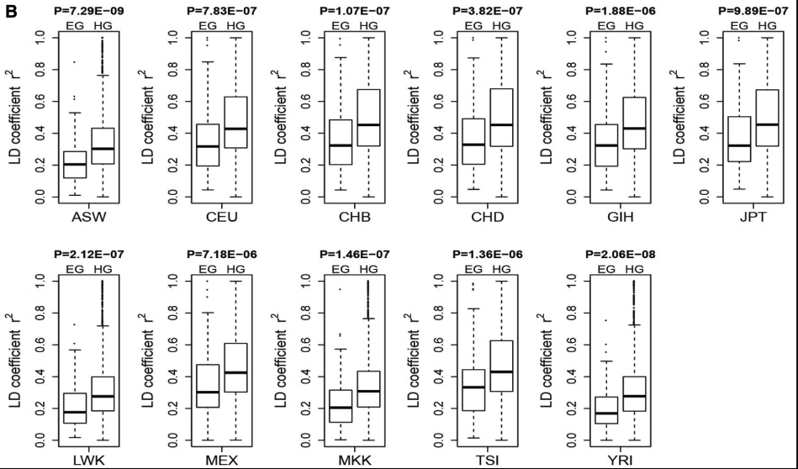
Degree of LD

Slide 10
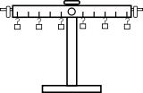
EG HG
For the long-term evolutionary features
(1) evolutionary rates: human EG > human HG
(2) protein sequence identities : human EG had < human HG
For the short-term evolutionary characteristics
(3) SNP densities : human EG > human HG
(4) LD degrees : human EG had < human HG

Slide 11

Human orthologs of mouse essential genes Human essential genes
MGI 2981 human orthologs of mouse essential genes
-758 common genes
3046 human housekeeping genes
2223 human orthologs of mouse essential genes
For long-term features
evolution rate (dN/dS), human orthologs of mouse essential genes
For short-term features
the human orthologs of mouse essential genes，LD degree SNP density
Its irrationality to substitute human orthologs of mouse essential genes for real human essential genes.

Slide 12

Conclusions
They compared the evolutionary conservation between housekeeping and essential genes.
The human housekeeping genes had higher evolutionary conservation than the human essential genes.
It is not suitable for simply replacing human essential genes with human orthologs of mouse essential genes.

Slide 13

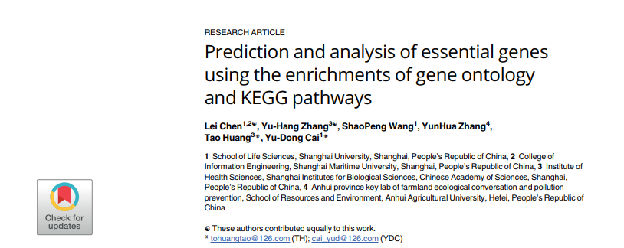
Notes:
这篇文献是利用基因在GO term、KEGGpathway的富集情况来预测鉴定是否是必需基因

Slide 14

EG : DNA replication，gene translation, gene transcription and substance transportation
Functional experimental methods:
gene direct deletion and transposon-based randomized mutagenesis(Gene-trap RNAi, CRISPR/Cas9)
Machine learning algorithms:
support vector machine (SVM), neural networks, Naïve Bayes, and decision trees
Identify important GO terms and KEGG pathways that can be important indicators for distinguishing essential and non-essential genes, and at the same time a classification model was built using these GO terms and KEGG pathways.

Slide 15
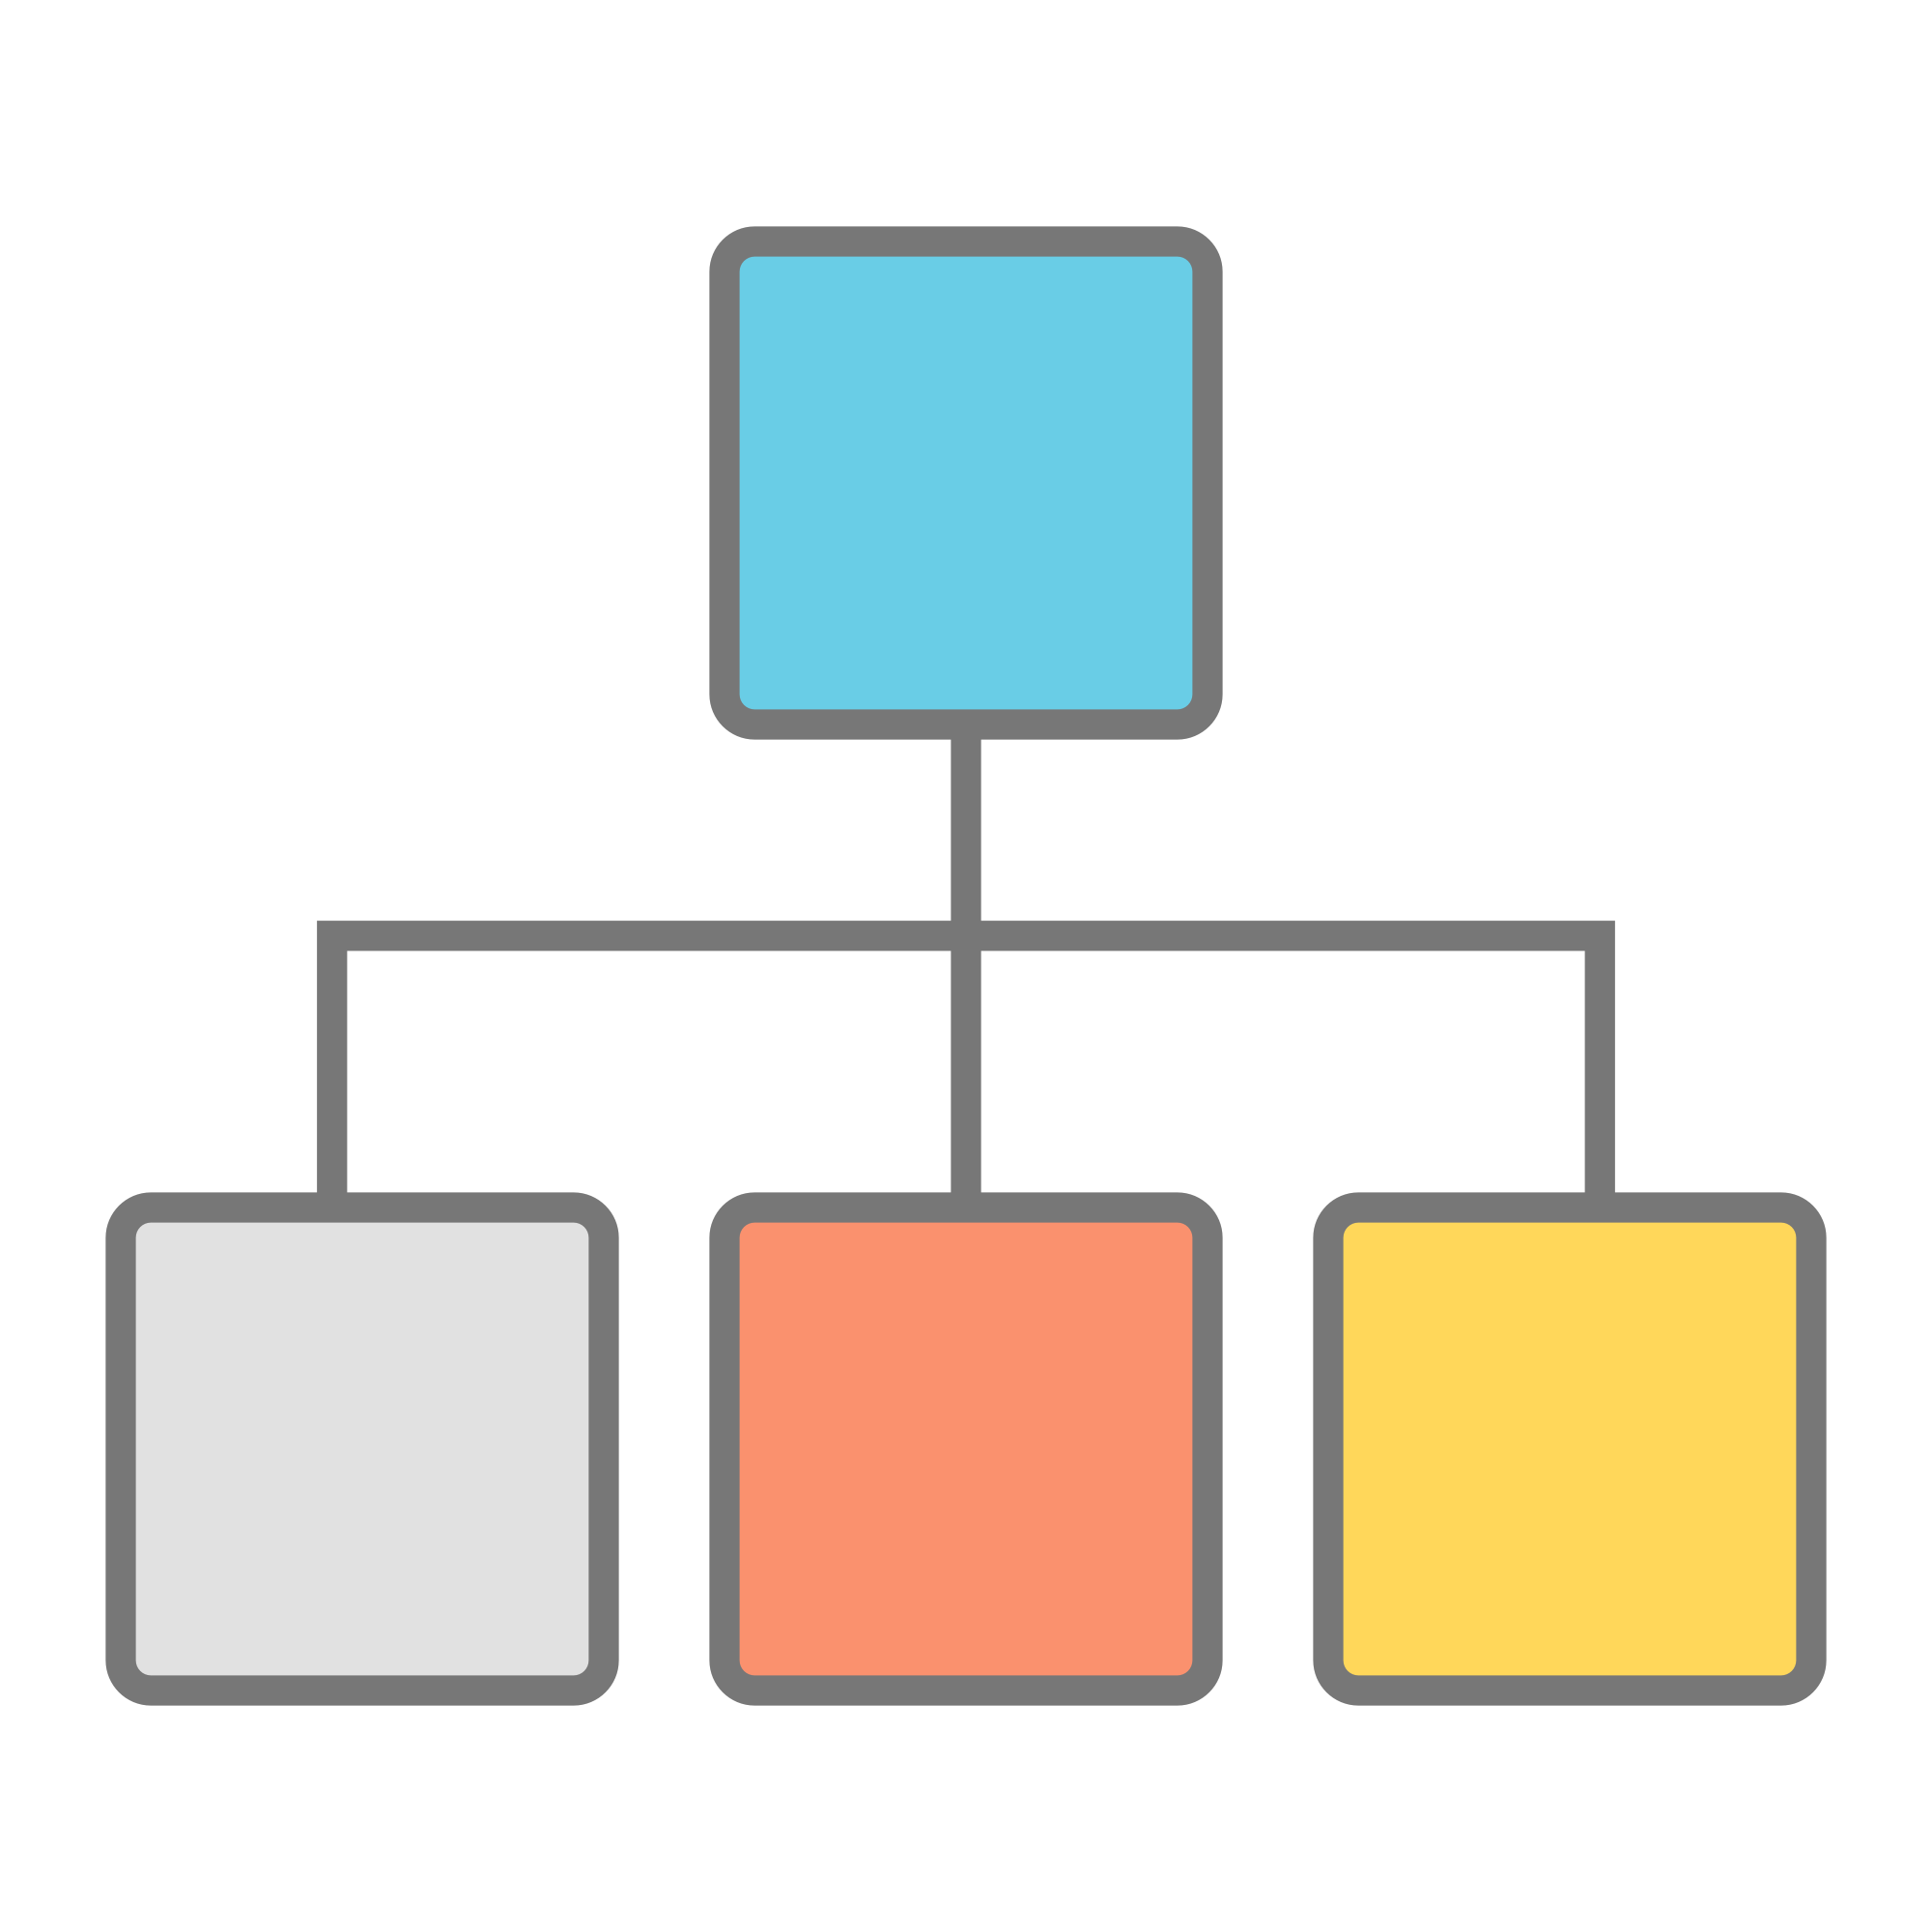
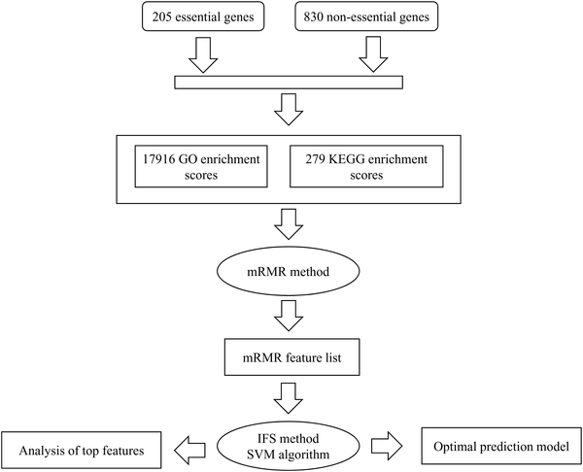
Fig 1. Flow chart of the whole procedure for investigating essential and non-essential genes.
Chen L, Zhang YH, Wang S, Zhang Y, Huang T, et al. (2017) Prediction and analysis of essential genes using the enrichments of gene ontology and KEGG pathways. PLOS ONE 12(9): e0184129. https://doi.org/10.1371/journal.pone.0184129
https://journals.plos.org/plosone/article?id=10.1371/journal.pone.0184129

Slide 16

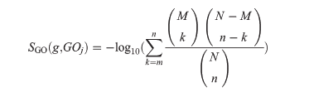
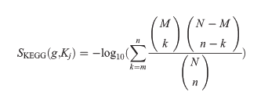
GO enrichment score
KEGG enrichment score
M
k
n
超几何分布检验
N
k
给定一个基因g, GO term : GOj; M表示 ：GOj 的注释基因集，n 表示 ：在string蛋白质互作网络中的g 和g 的邻近基因集； m ： 和 的交集。
N人类基因总数。
N

Slide 17





mRMR
互信息
最大相关
最小冗余

Slide 18

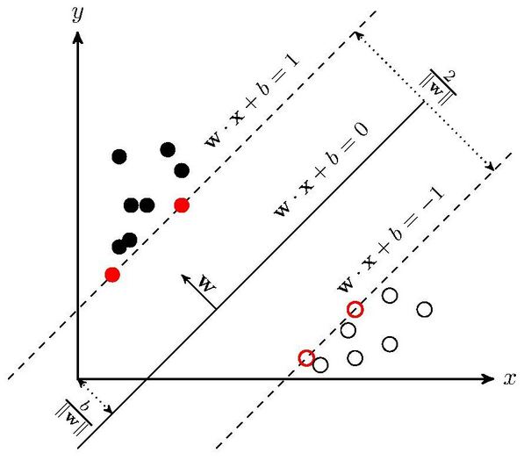




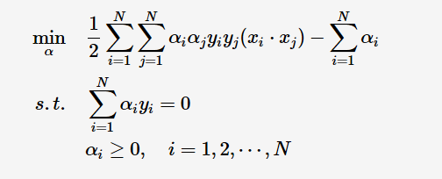
IFS method + SVM algorithm
SVM algorithm
Fi = {f1,f2,⋯,fi} (5≤i≤500)
evaluated by ten-fold cross-validation
原问题
拉格朗日
对偶问题
借助KKT条件求最小值
Weka- SMO

Slide 19

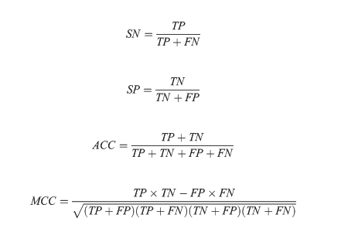
true positive (TP), true negative (TN), false positive (FP), false negative (FN)
sensitivity (SN), specificity (SP), accuracy (ACC)
Matthews correlation coefficient (MCC)

Slide 20
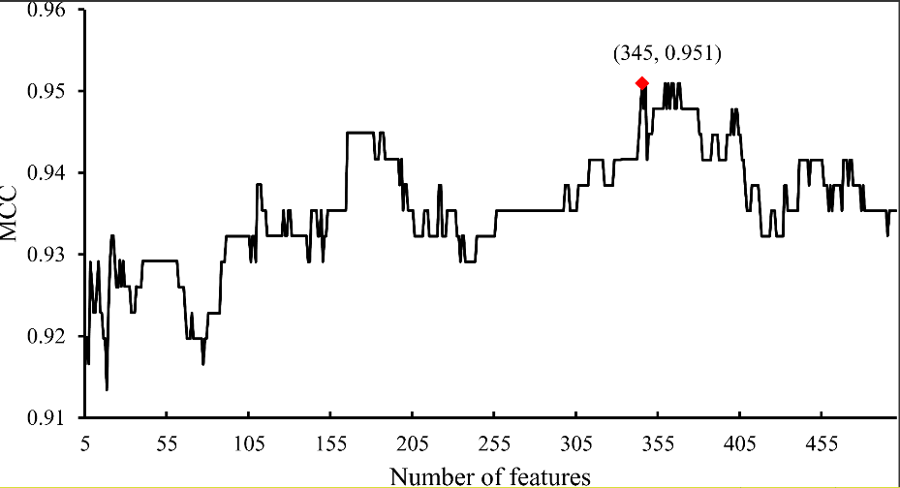
Fig 2. The IFS curve using the MCC as its Y-axis and the number of features participating in classification as its X-axis.
Table 1. The SN, SP, ACC, and MCC yielded by the optimal SVM prediction model and the model using features of KEGG enrichment scores.

Slide 21
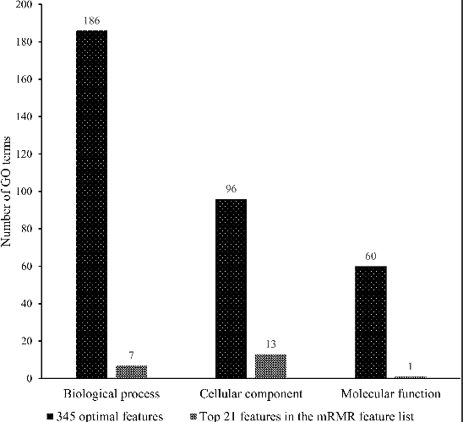
Fig 3. Distribution of the corresponding GO terms of the optimal features and top 21 features in the mRMR features in the three groups.
https://doi.org/10.1371/journal.pone.0184129.g003

Slide 22

This study was to propose a prediction model for classification of essential and non-essential genes.
2,576 genes were predicted to be essential genes
DNA-binding protein prediction, detection of tubule boundary ,
methylation site prediction , phosphorylation site prediction,
and protein-protein interaction prediction

Slide 23
Thank You for Listening!

