Slide 1

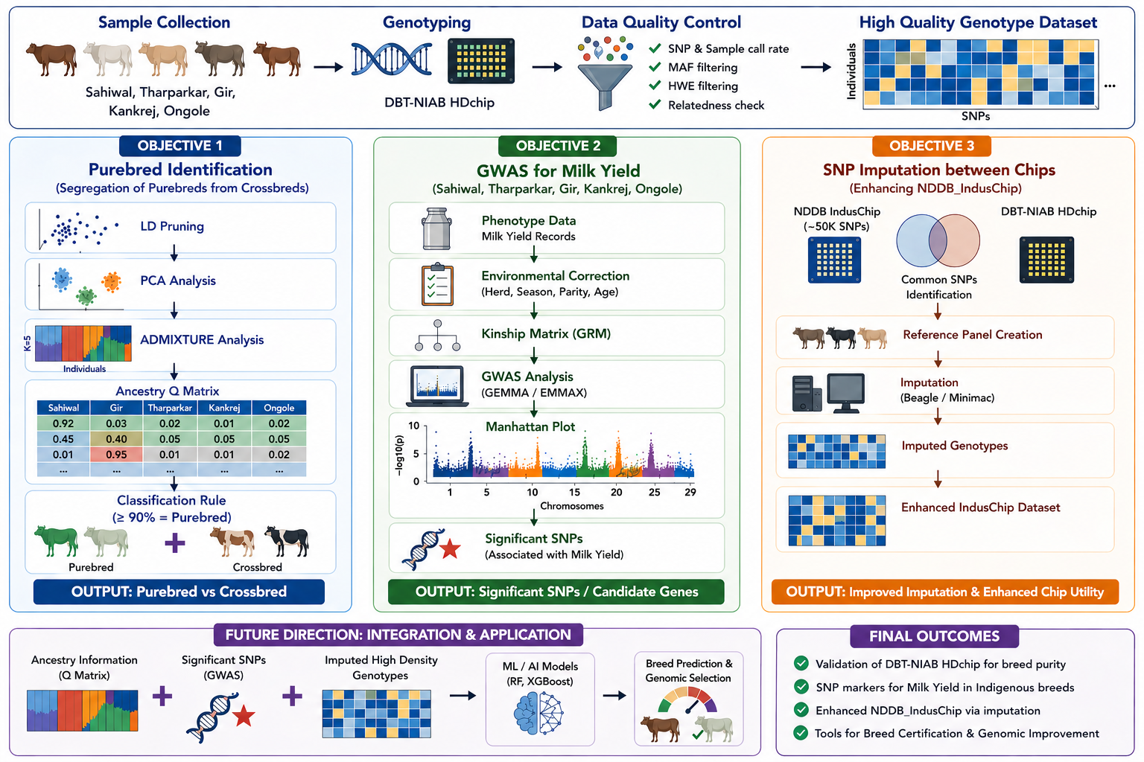
VALIDATION OF DBT- NIAB SNP CHIP FOR BREED IDENTIFICATION AND PRELIMINARY GENOME-WIDE ASSOCIATION STUDIES OF MILK YIELD

Slide 2
Objective
Objective 1
To validate the DBT-NIAB_Hdchip for its ability to identify purebreds in a larger population and to segregate purebreds from crossbreds.
Objective 2
To identify SNPs that are associated with milk yield in Indigenous breeds: Sahiwal, Tharparkar, Gir, Kankrej and Ongole
Objective 3
To identify genotypes that can be imputed between the NDDB Indus chip and the NIAB HD chip for enhancing the ability of the NDDB_IndusChip.

Slide 3
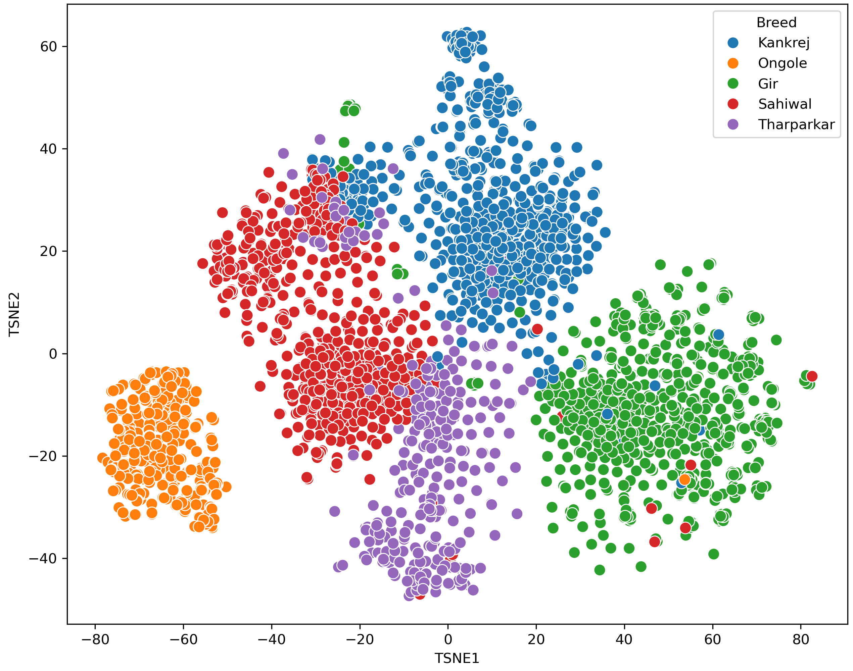
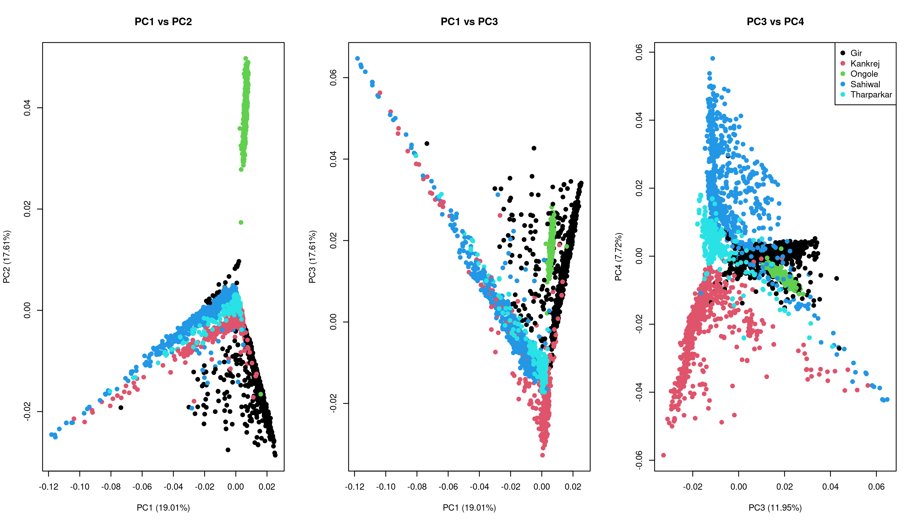
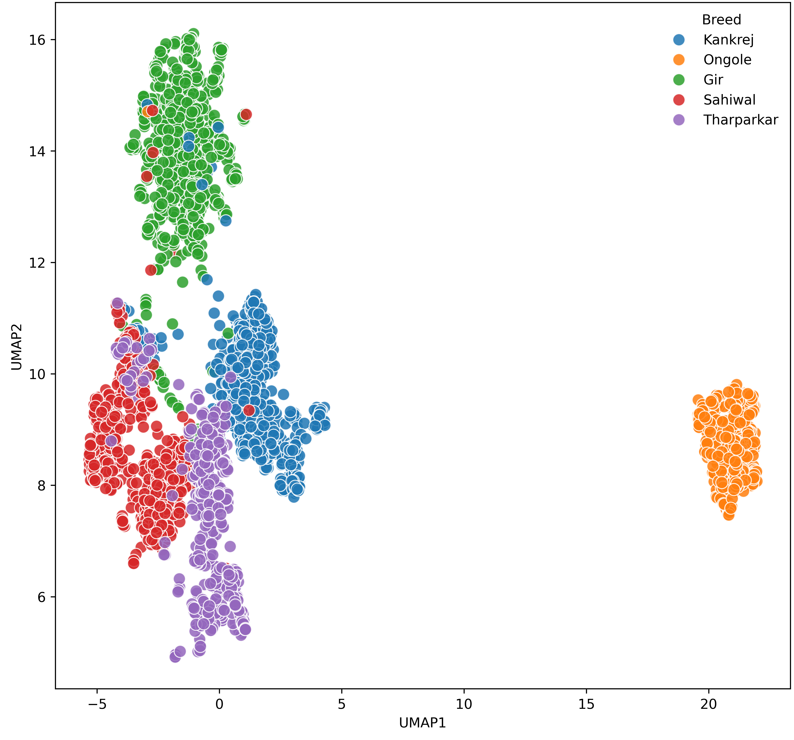
Objective 1 : To validate the DBT-NIAB_Hdchip for its ability to identify purebreds in a larger population and to segregate purebreds from crossbreds.
Breed | Targeted Number | Blood Samples | DNA Extracted | Rejected | Genotyped
Gir | 1000 | 1681 | 1587 | 560 | 1027
Sahiwal | 1000 | 1227 | 1188 | 183 | 1005
Kankrej | 1000 | 1218 | 1198 | 267 | 931
Tharparkar | 500 | 535 | 527 | 22 | 505
Ongole | 500 | 463 | 452 | 5 | 447
Total | 4000 | 5,124 | 4952 | 1037 | 3915
3

Slide 4
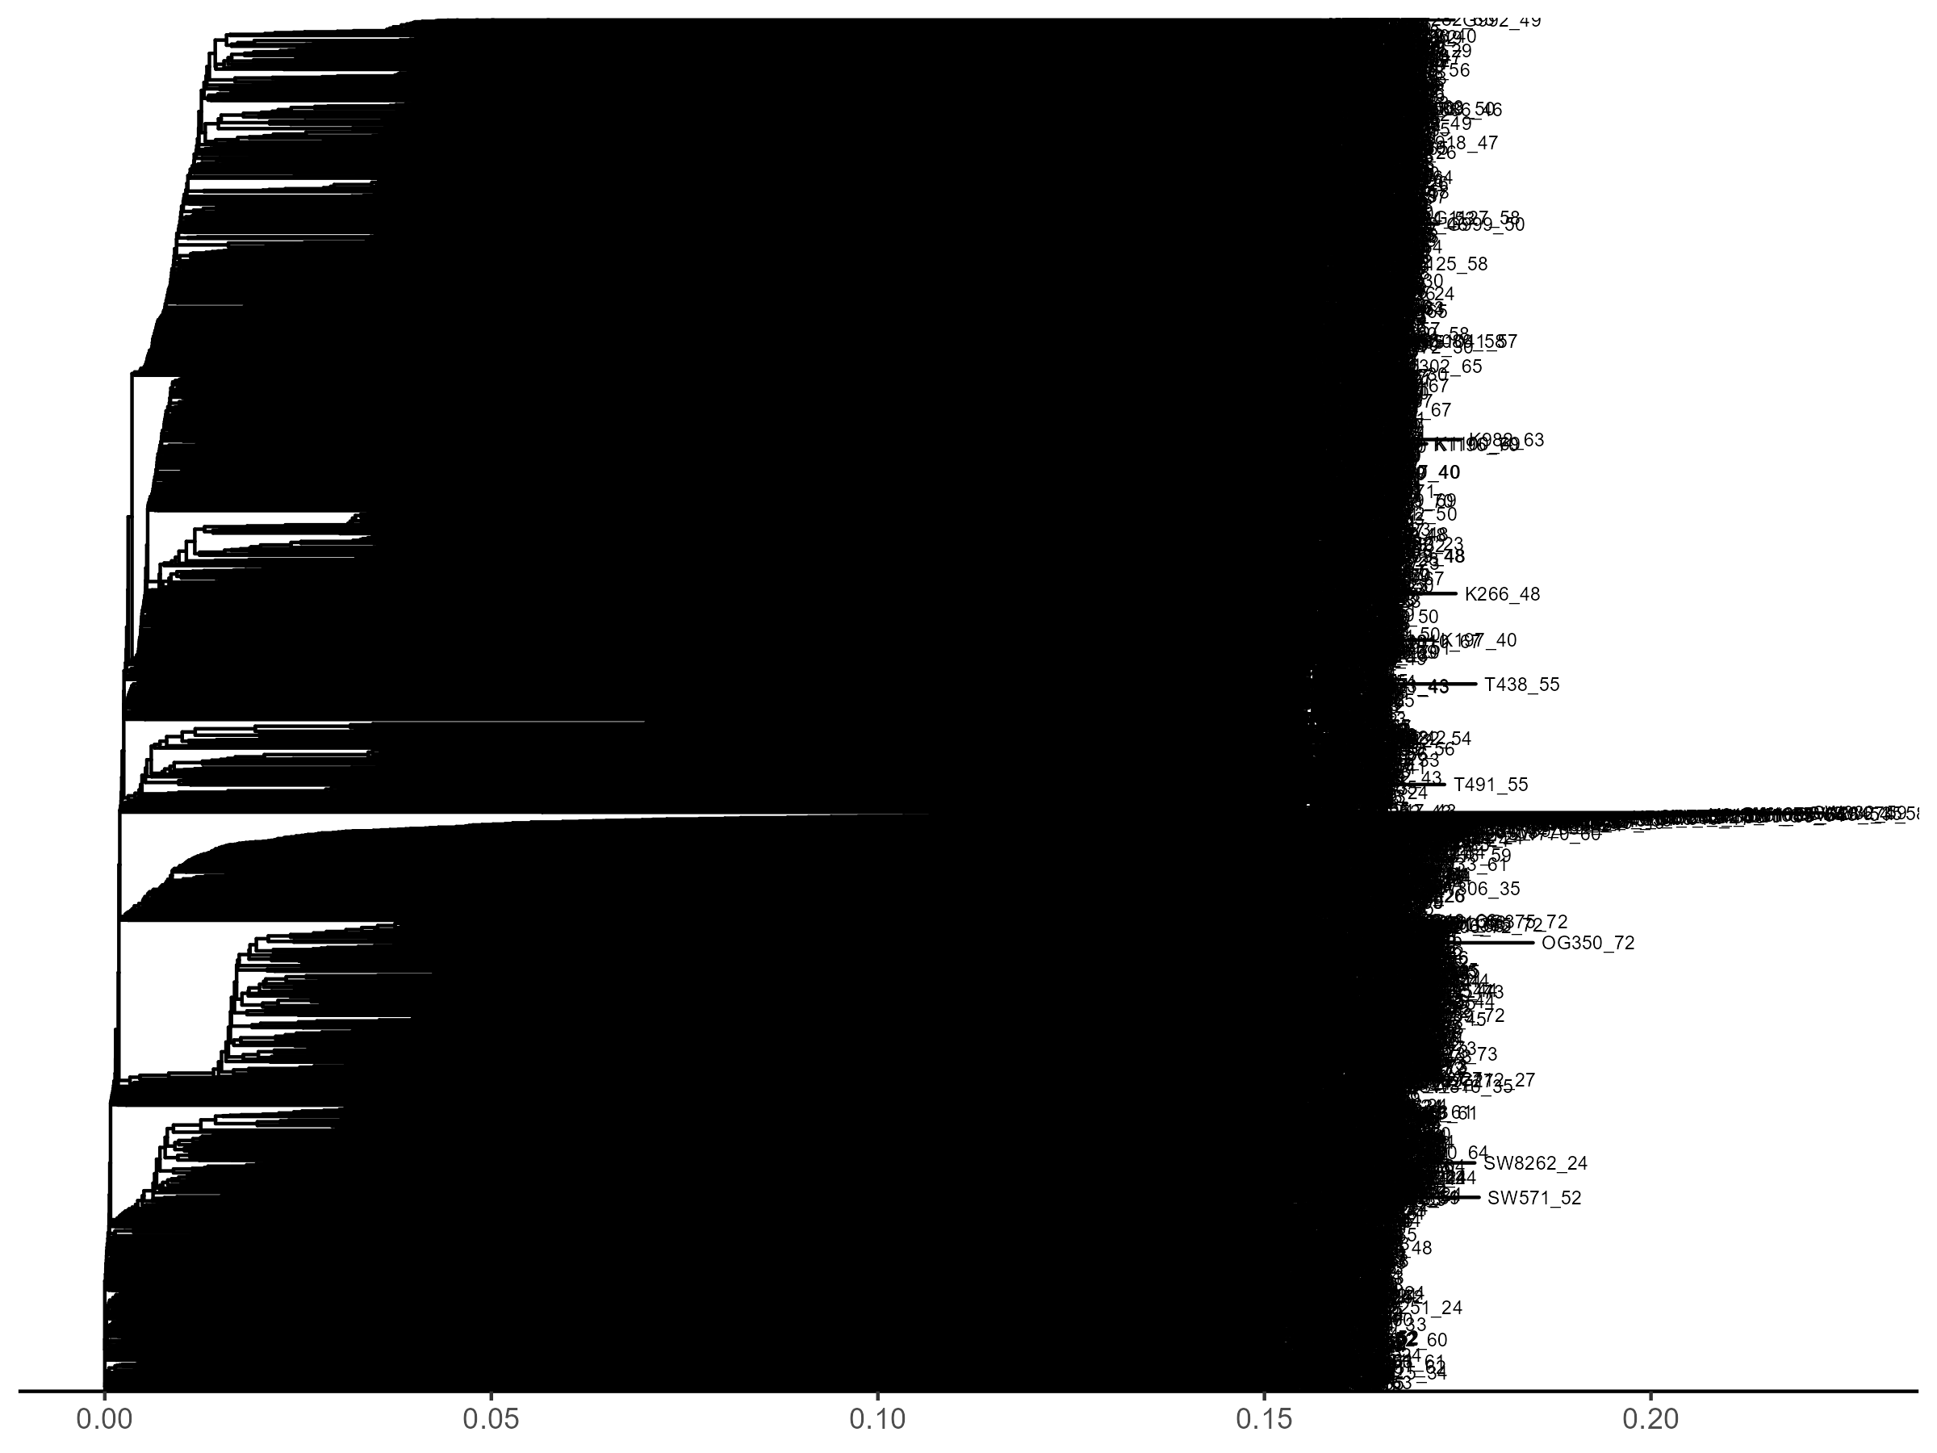
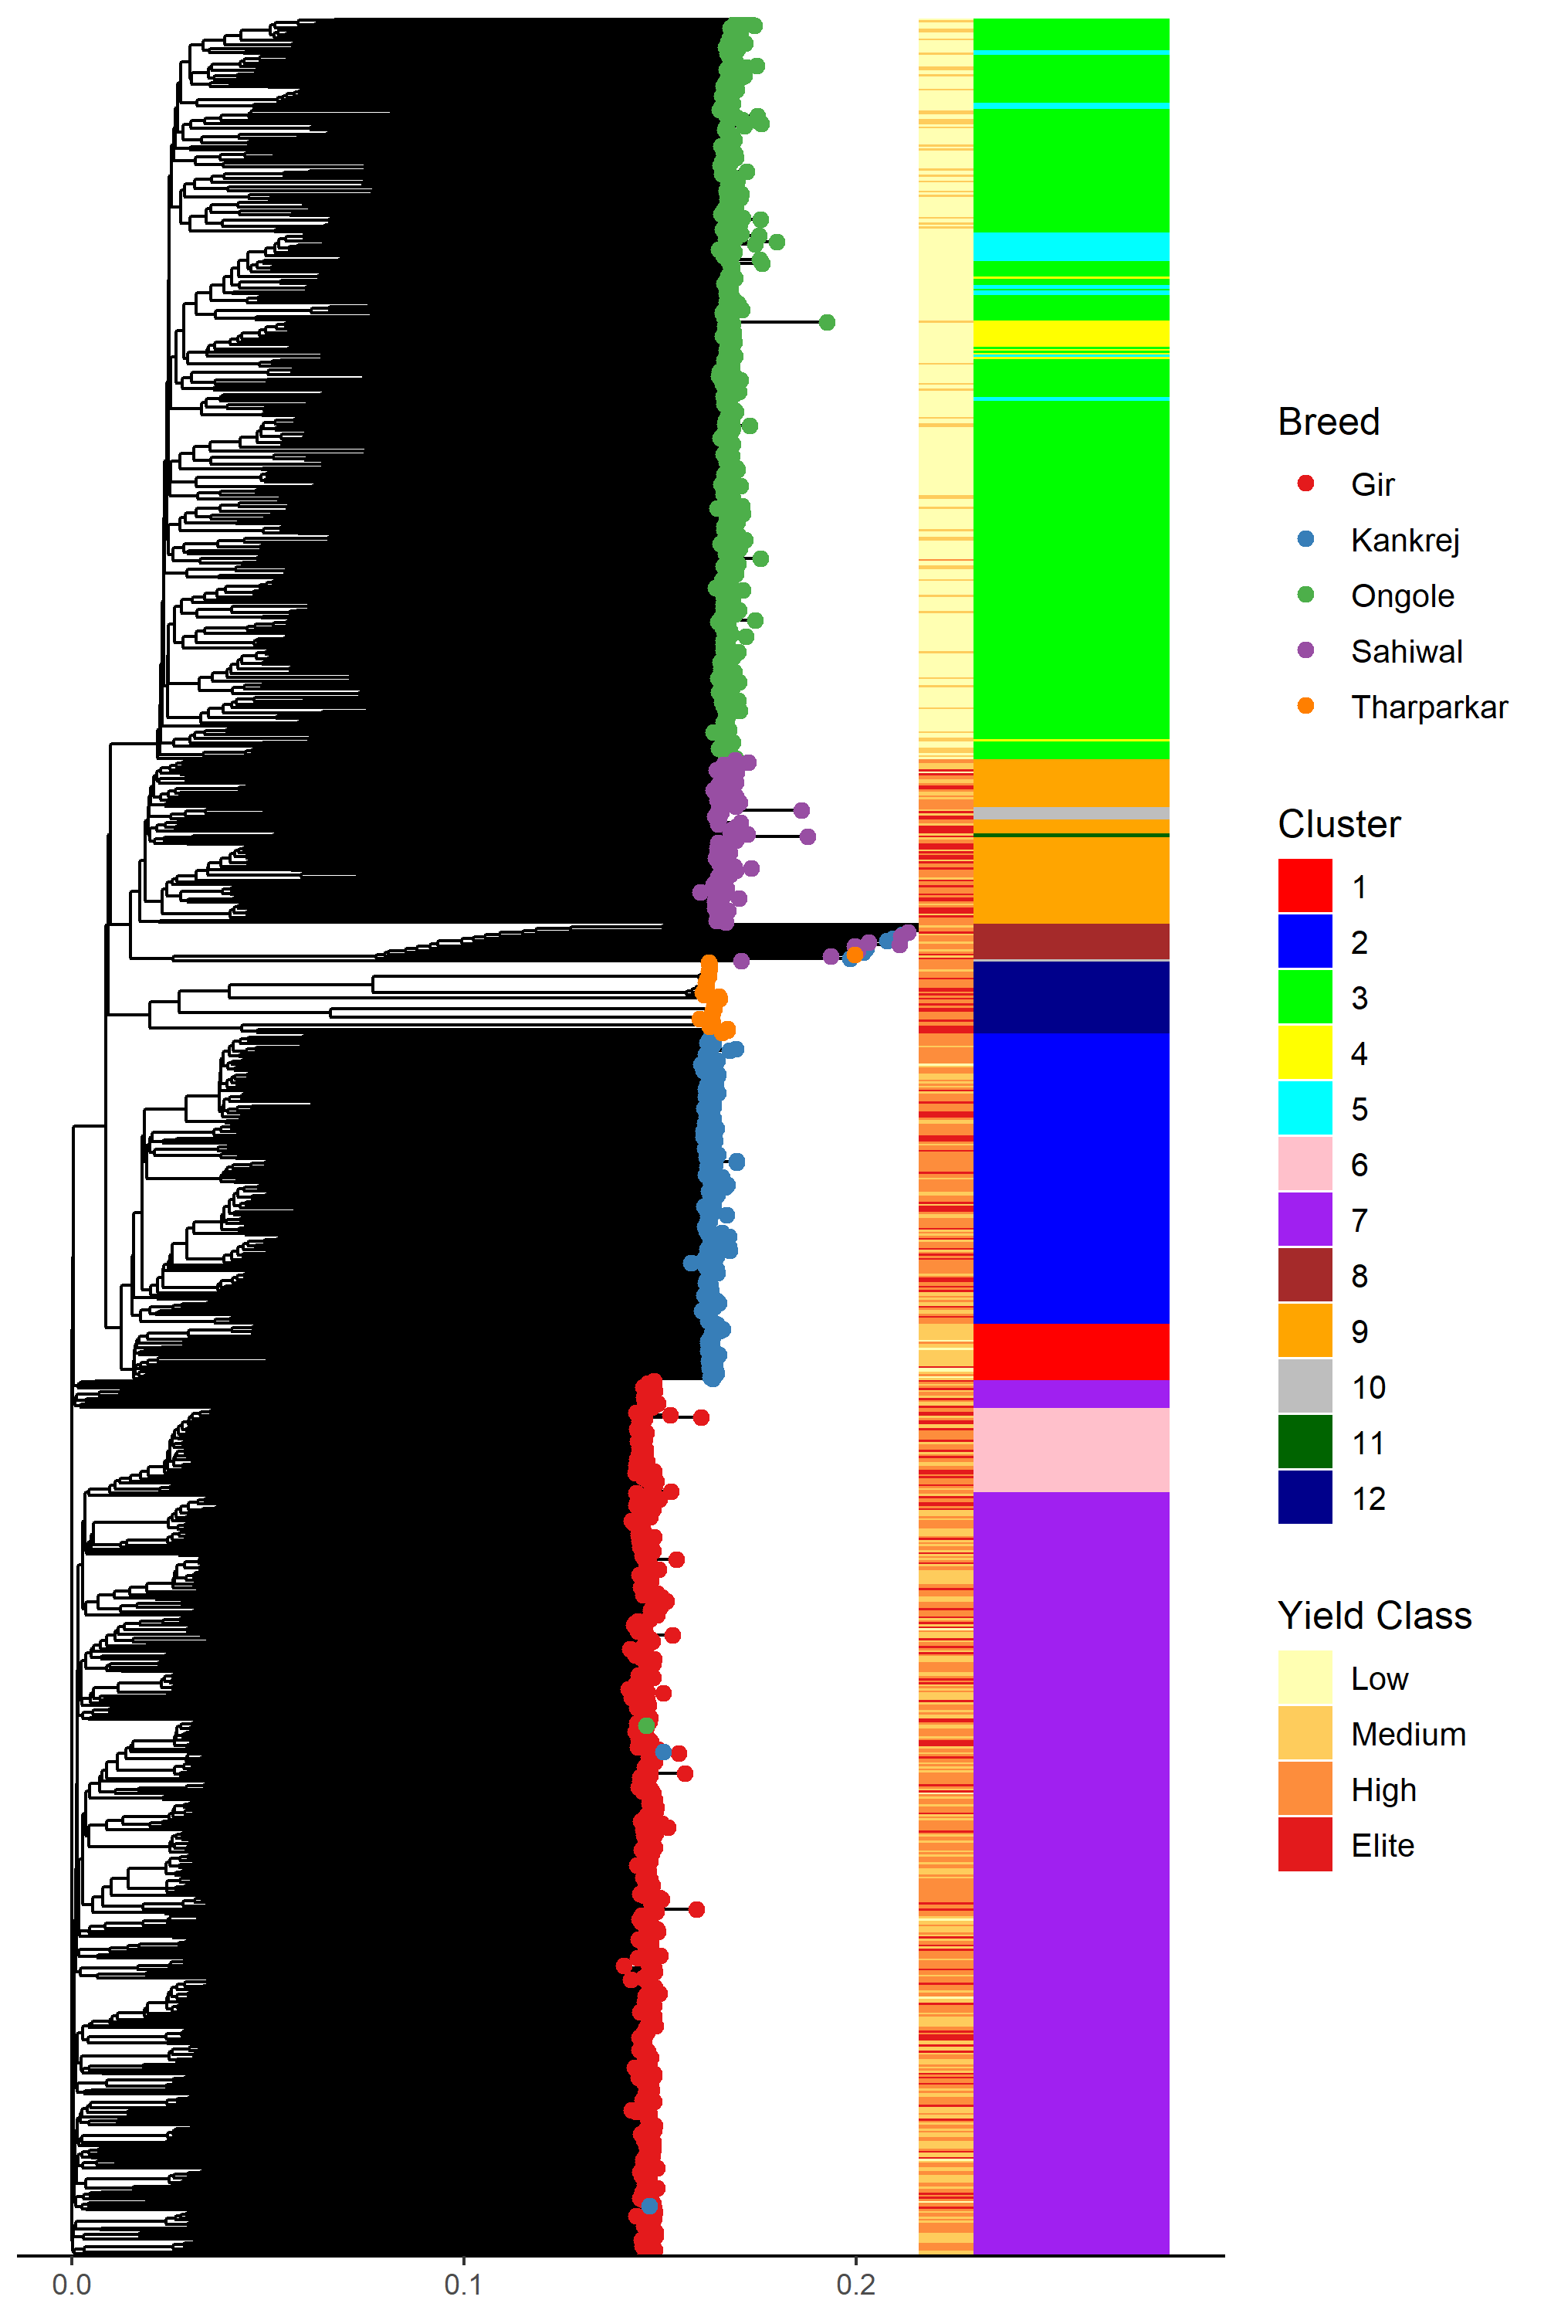
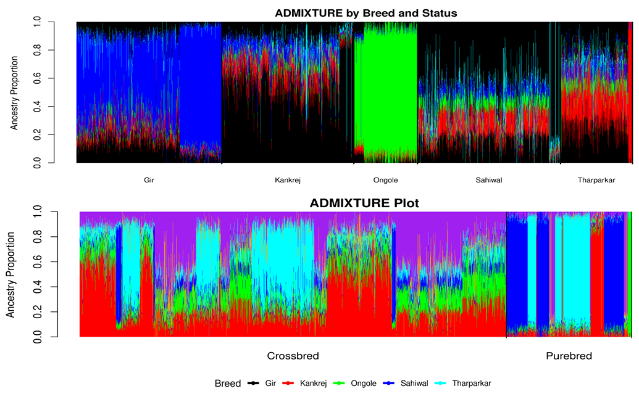
3

Slide 5
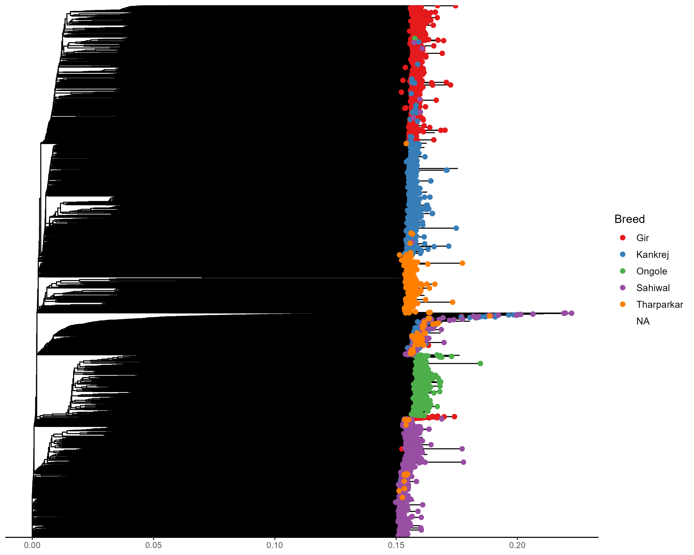
3

Slide 6
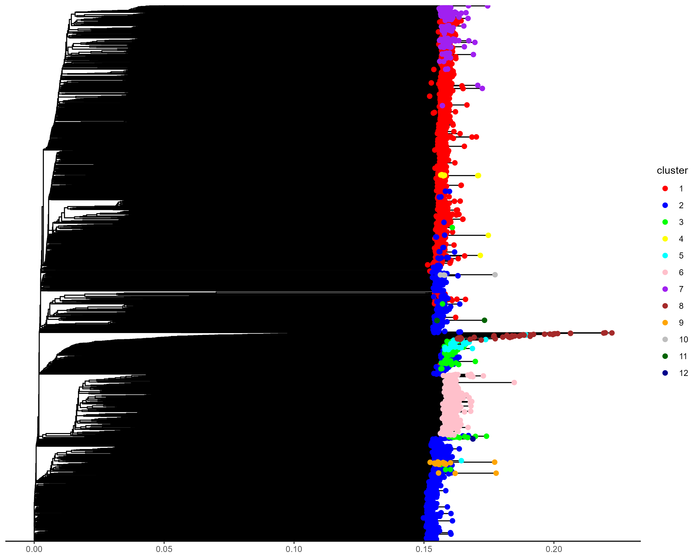
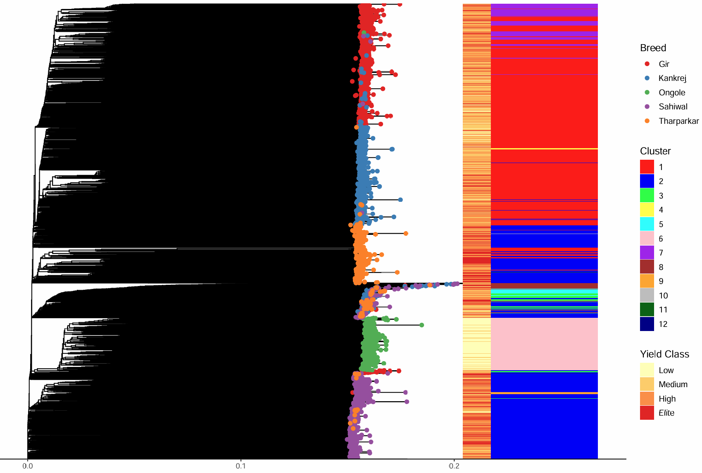
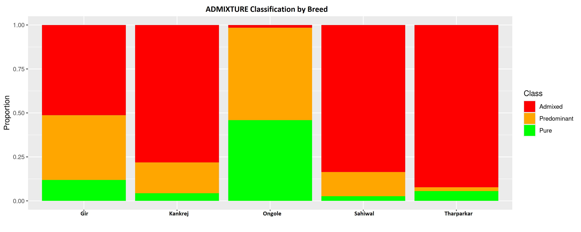
Objectives -1
Breed | Genotype (After QC) | Purebred |  | Crossbred
 |  | Pure | Predominant | Admixture | Highly Admixture
Gir | 1021 | 121 | 376 | 524 | 0
Sahiwal | 1004 | 27 | 138 | 839 | 161
Kankrej | 927 | 40 | 163 | 724 | 0
Tharparkar | 505 | 28 | 11 | 466 | 0
Ongole | 447 | 205 | 235 | 7 | 0
Total | 3904 | 421 | 923 | 2560 | 161
3

Slide 7
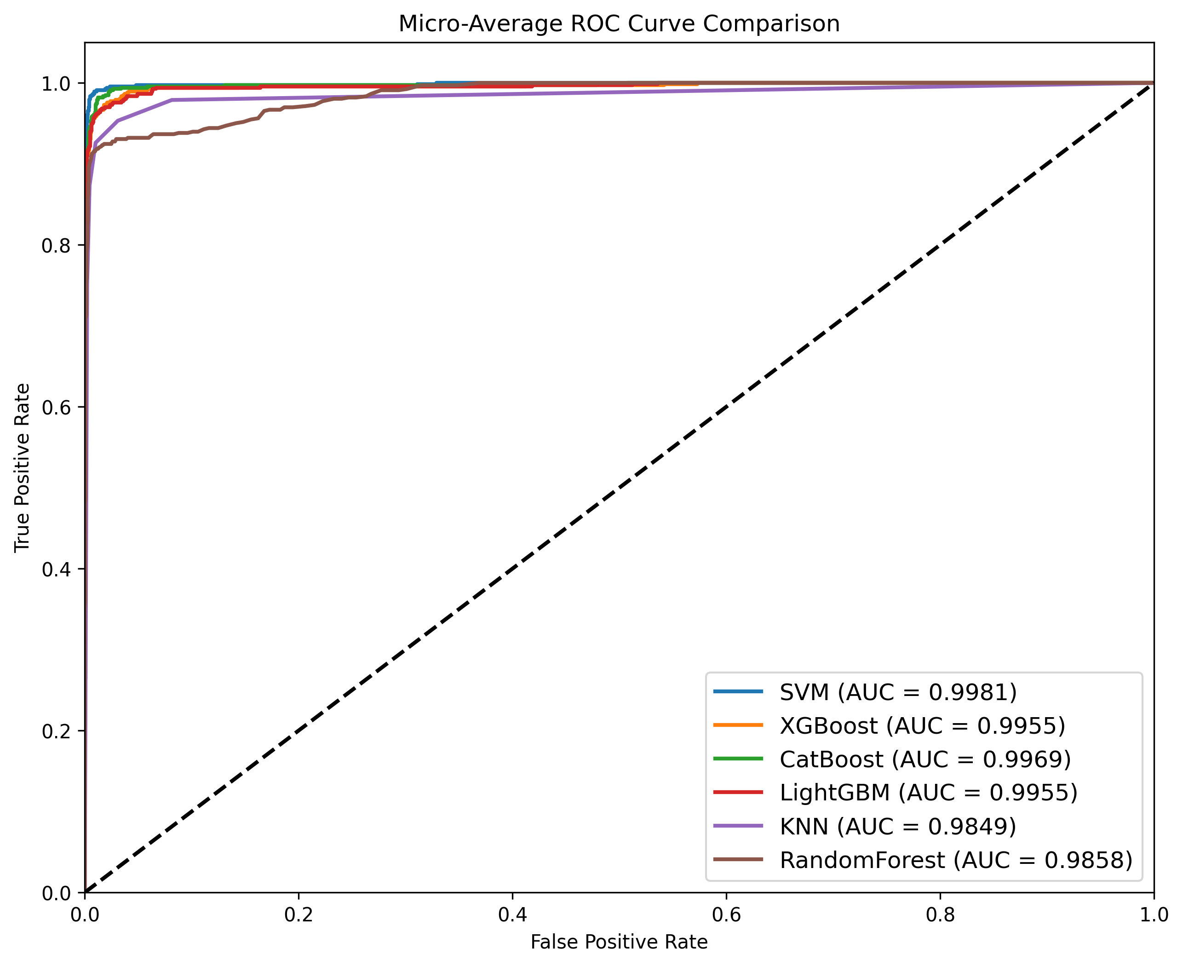
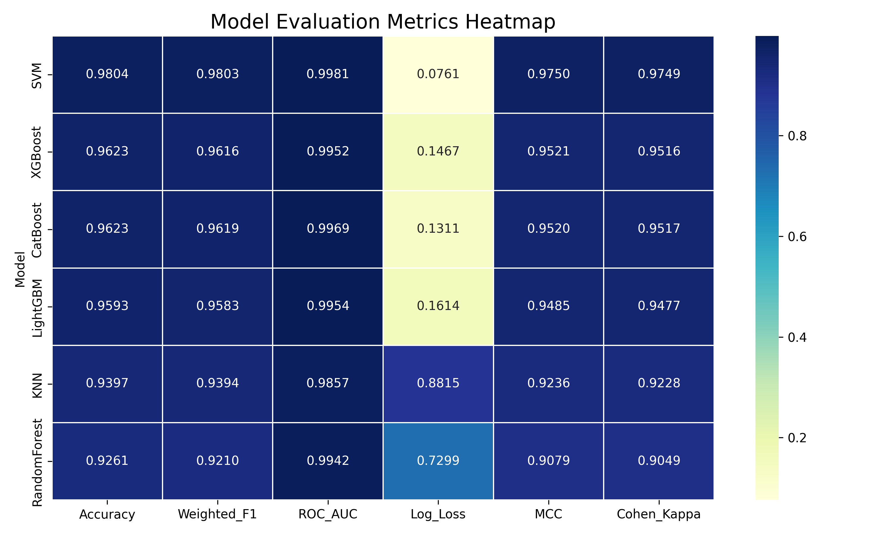
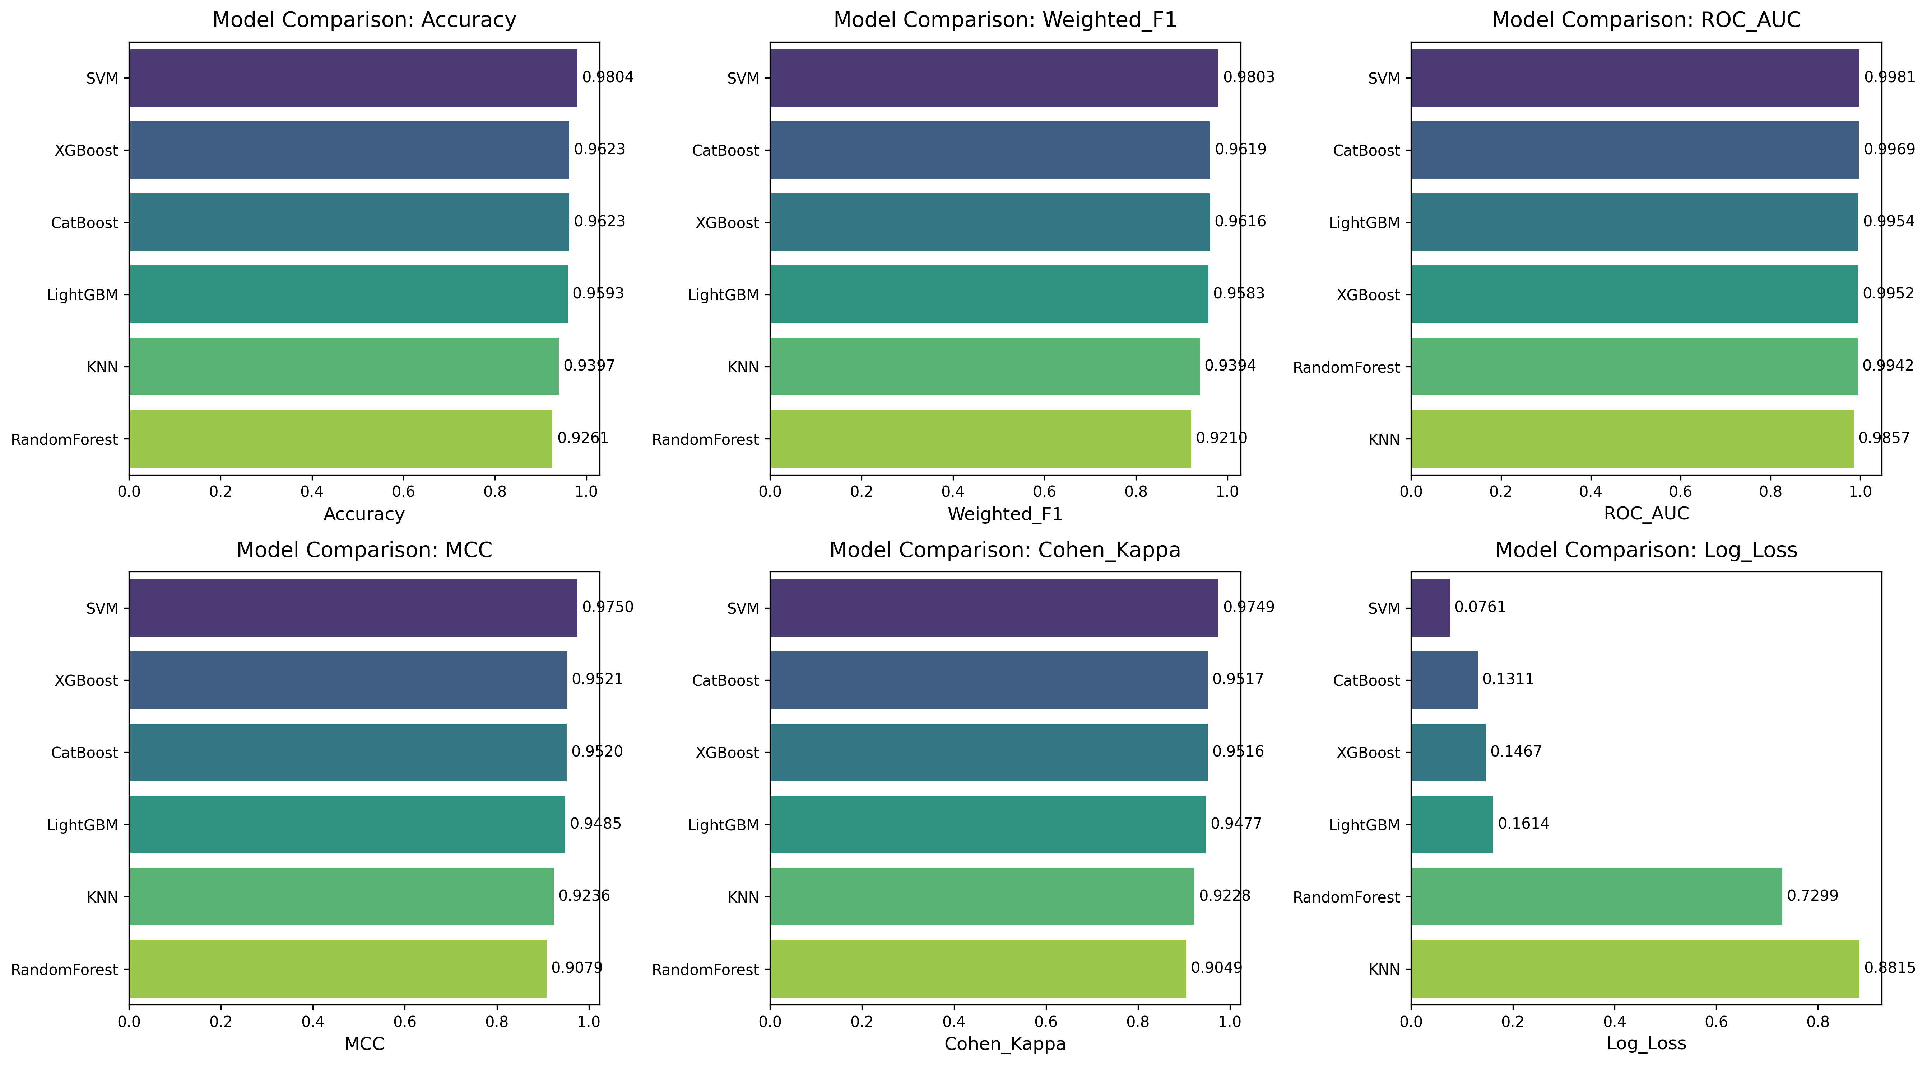
ML Models for Breed Identification
3

Slide 8
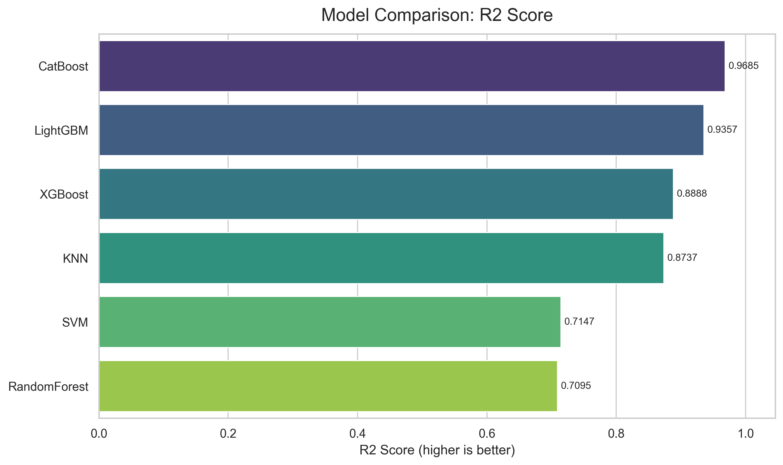
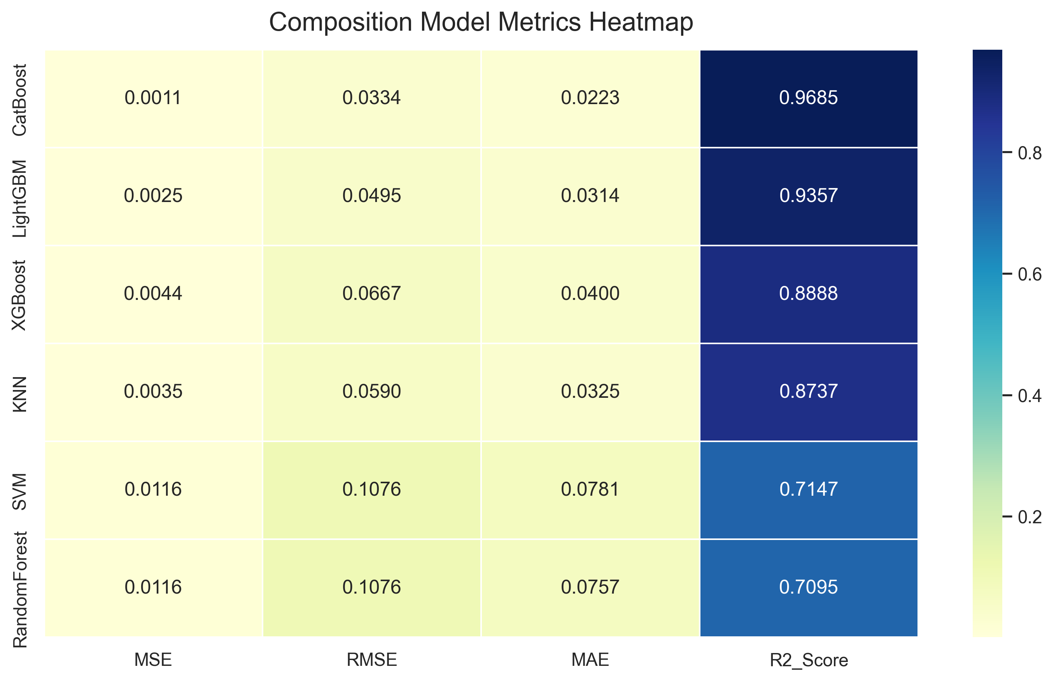
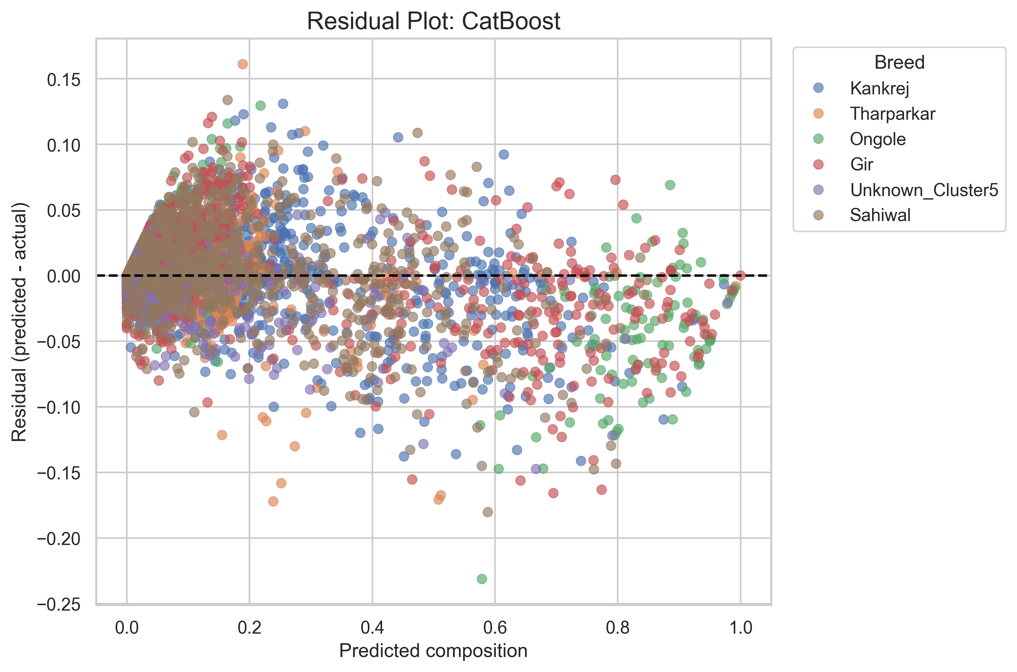
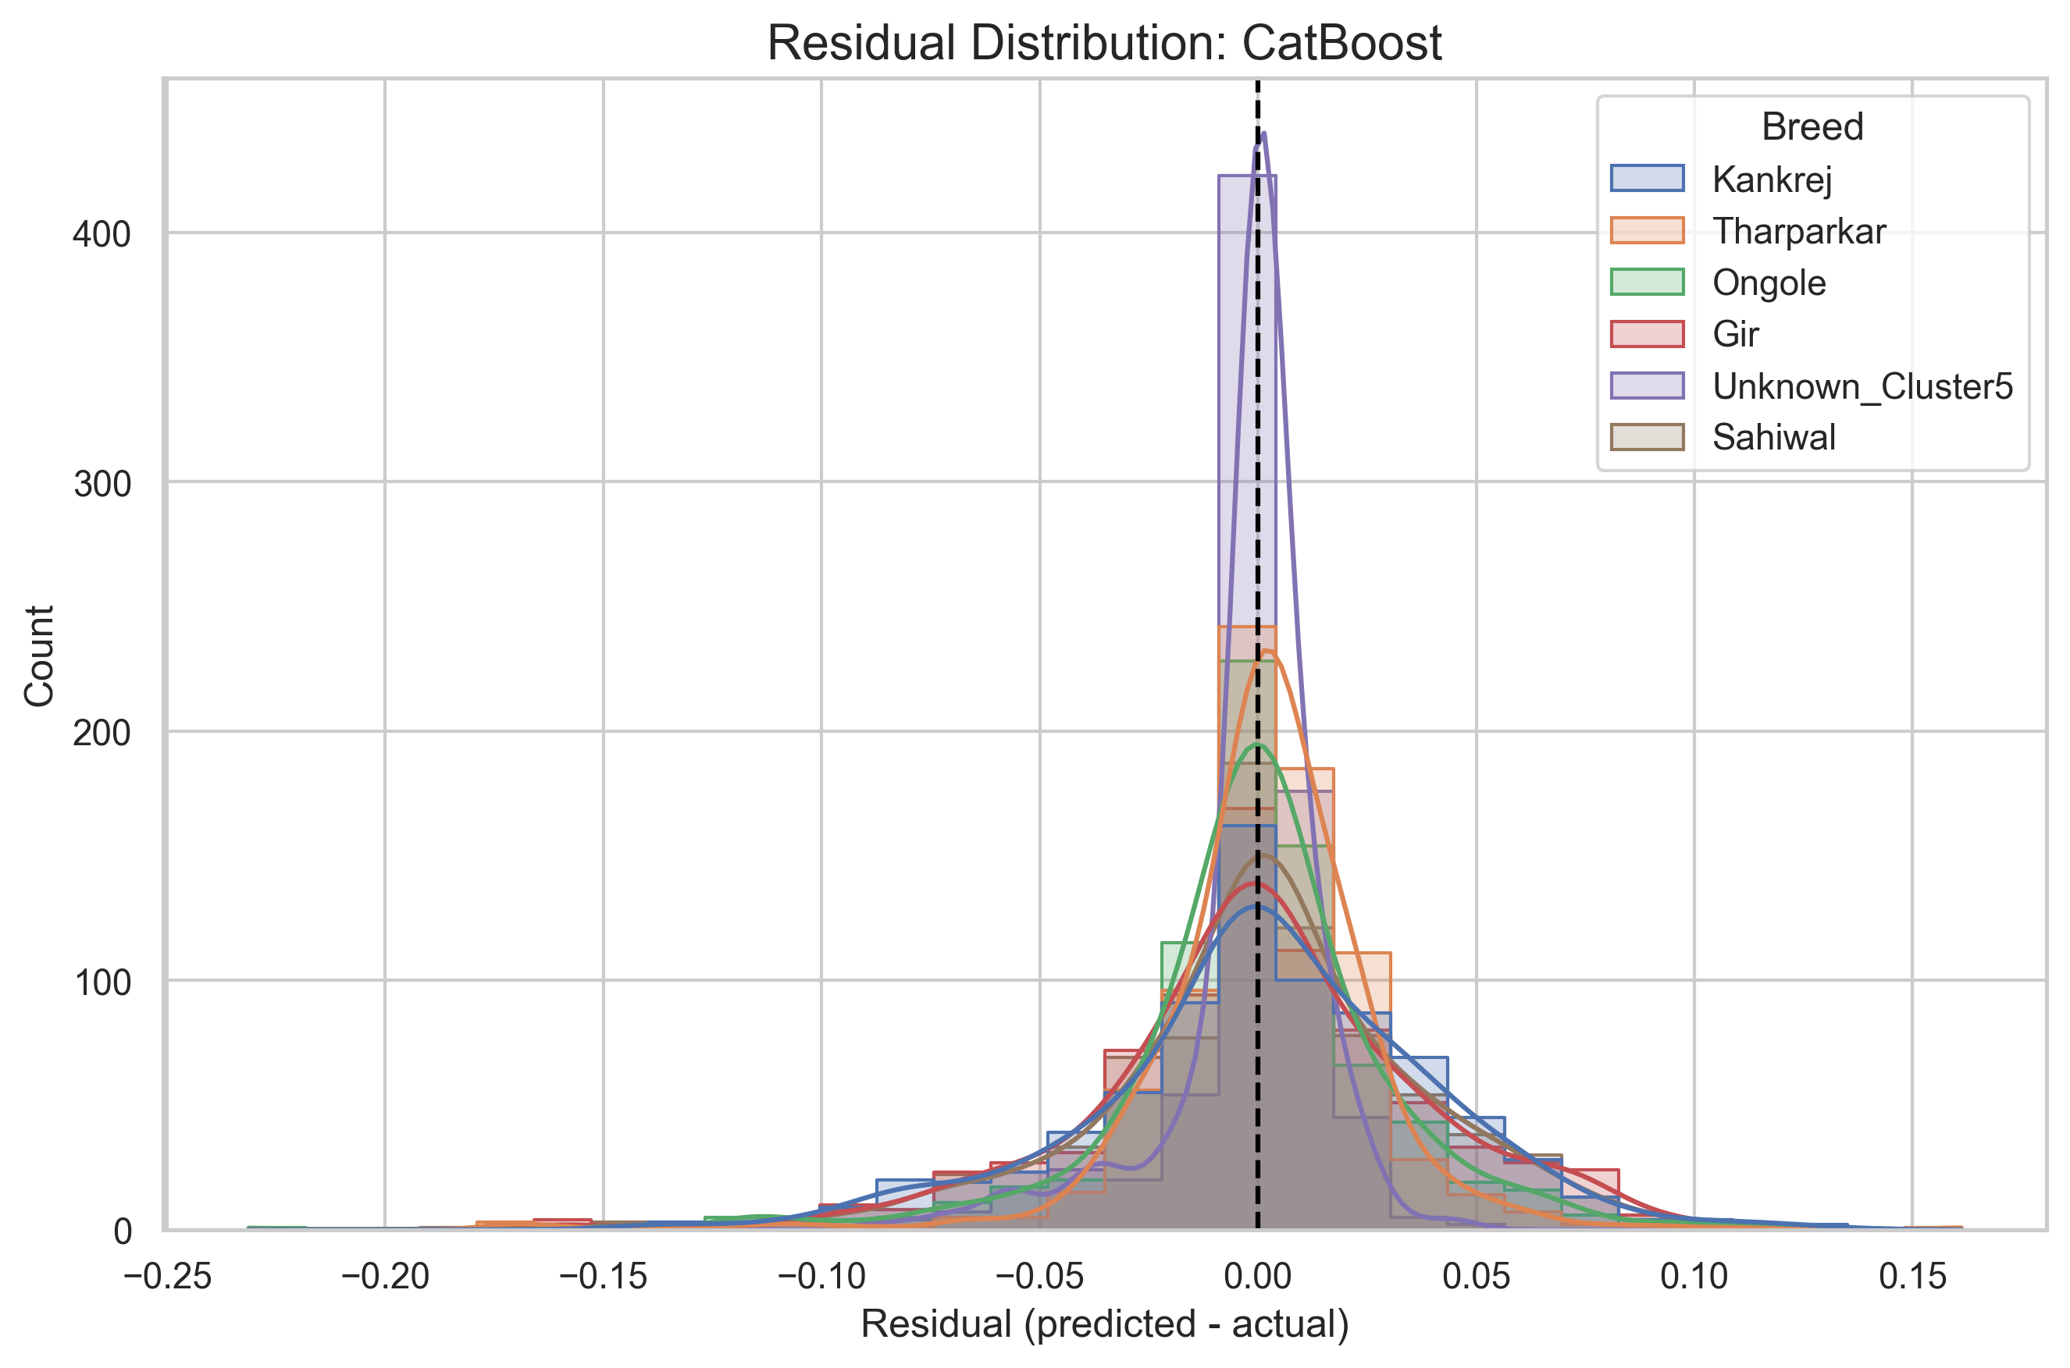
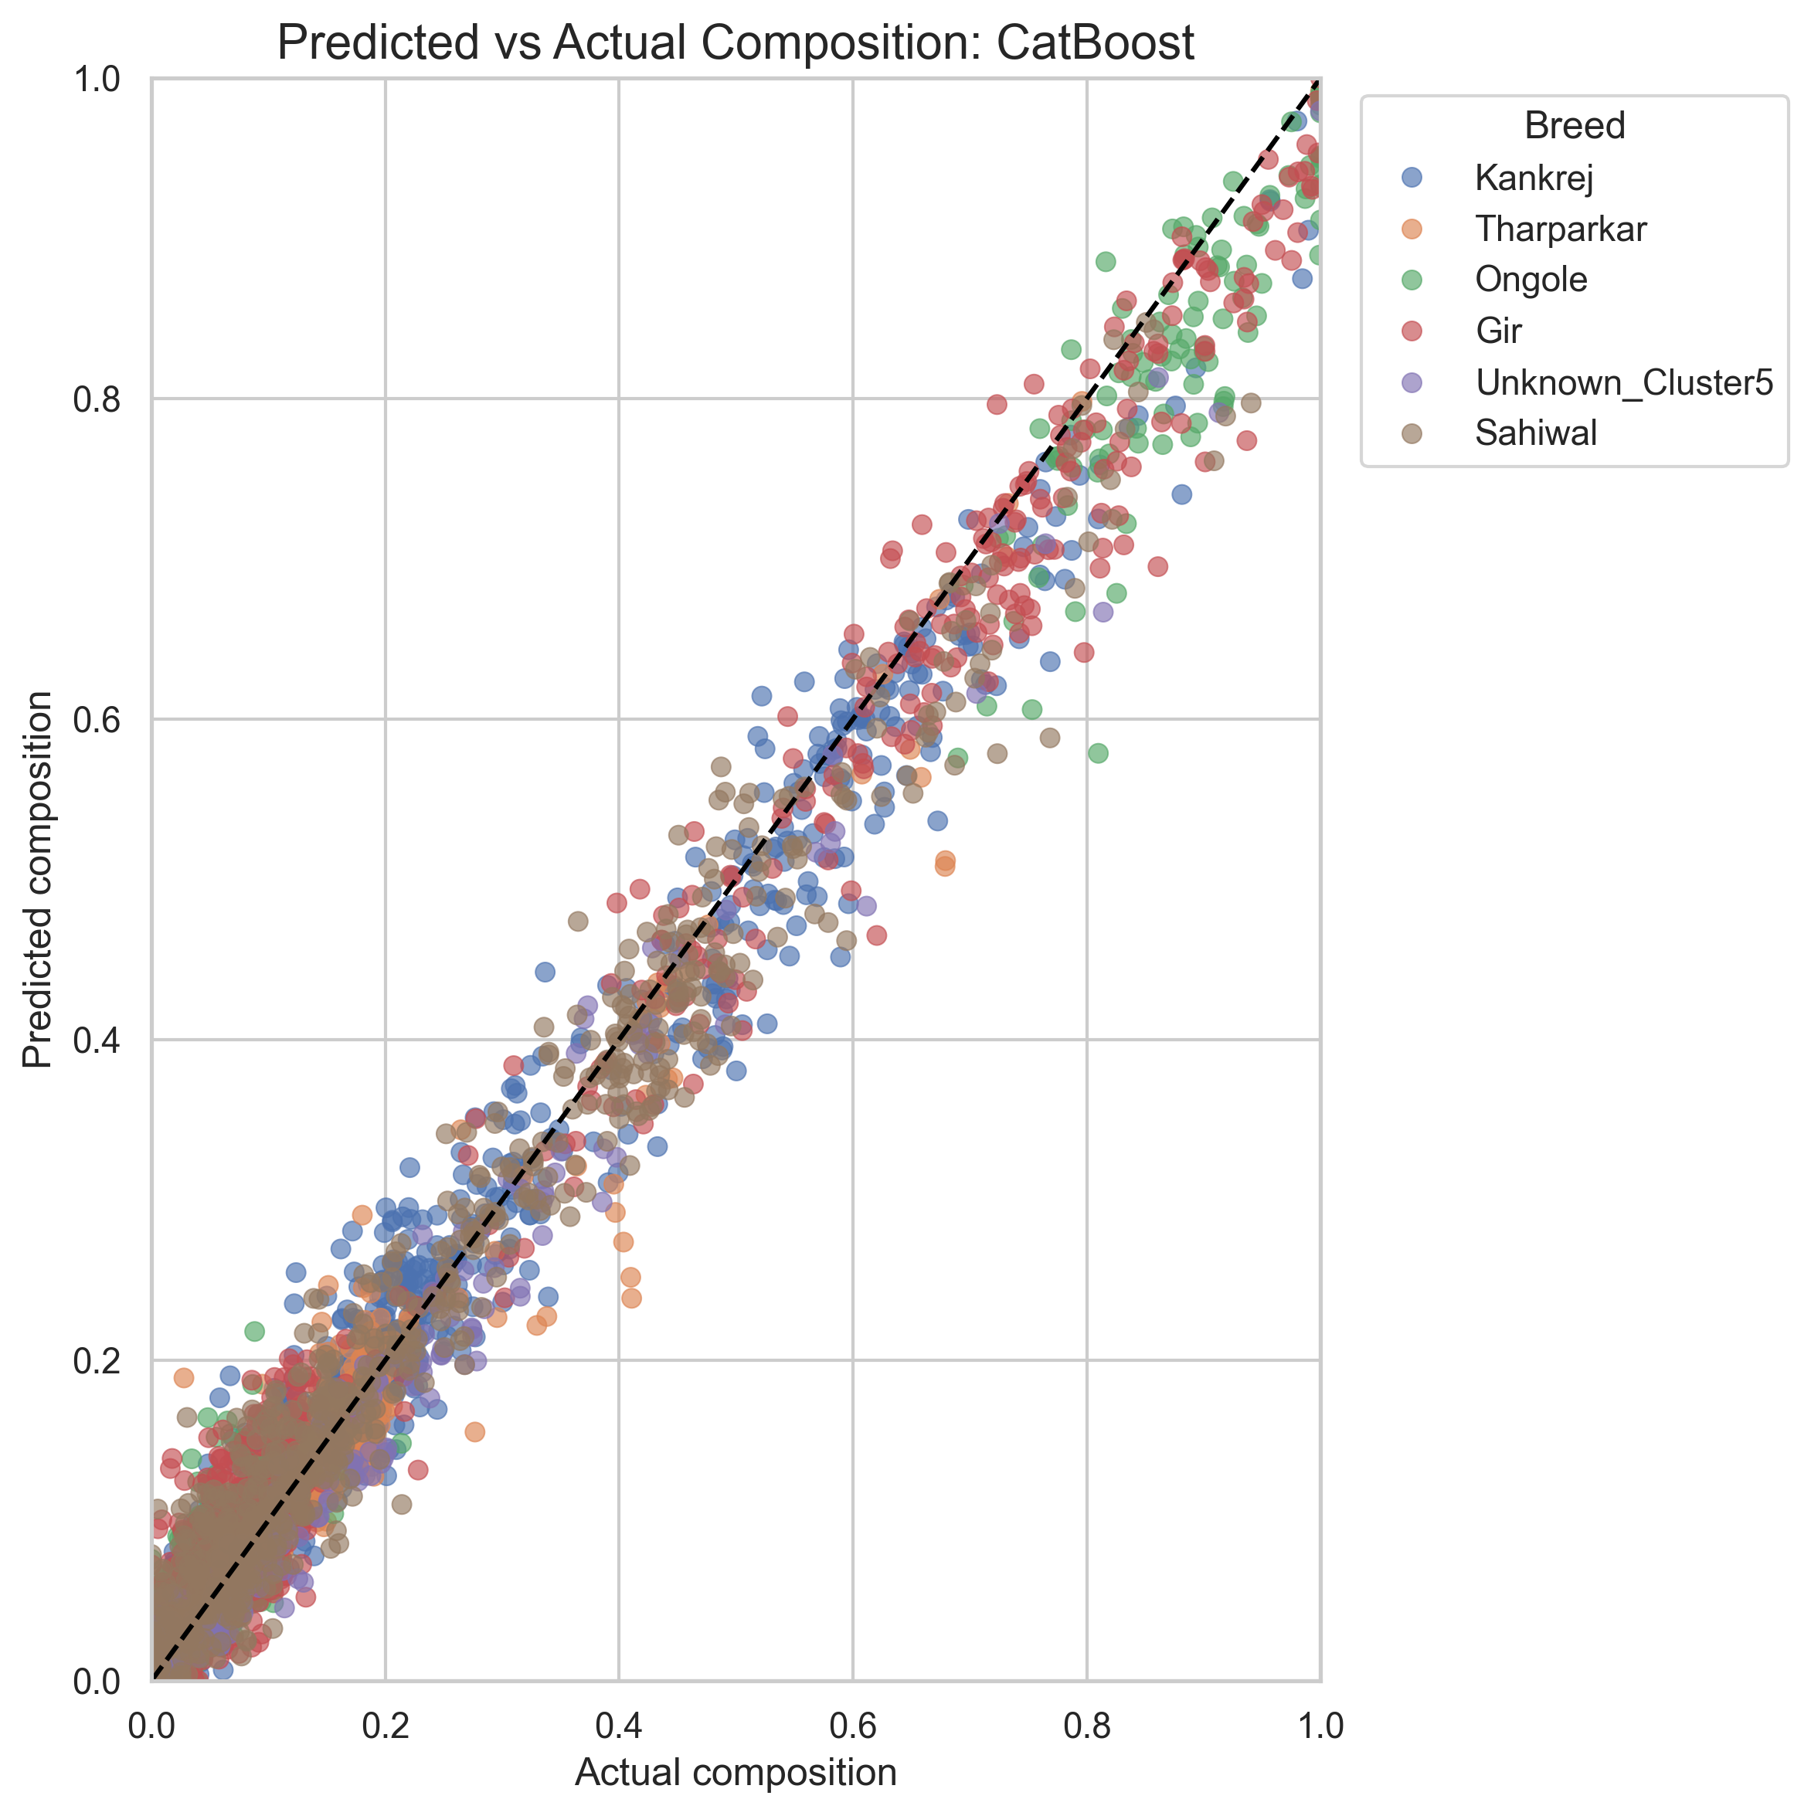
ML Models Breed Composition
3

Slide 9
Outcome Snapshot
Objective 1:
  Breed composition was revealed for each individual, and the identified Pure reference population (421), Predominant (923), Admixture (2560), and highly admixed (161).
  GAU-AI: ML-enabled breed identification and breed composition prediction platform (https://github.com/bioinfokushwaha/GAU-AI)
  Genomic services for breed authentication: breed identification, breed composition and breed purity
Objective 2:
  Identified high confidence 7567 SNPs
  Identified link to mammary gland development and metabolic pathways
  Validated fat metabolism-associated SNPs in high and low milking breeds using Pyromark Q48.
  GAU-Net: Animal health and production data collection portal (https://bioinfo.niab.org.in/GAUNet )
Objective 3:
  Overall average imputation accuracy 83%; Tharparkar ( 90%), Kankrej (85%) and Sahiwal (74%).
  Establishment of a cost-effective strategy for genomic improvement of indigenous cattle

