Slide 1

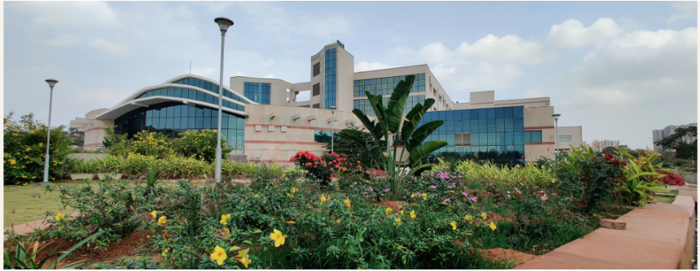
NIAB
Dr. Shailesh Sharma
Scientist-E

Slide 2
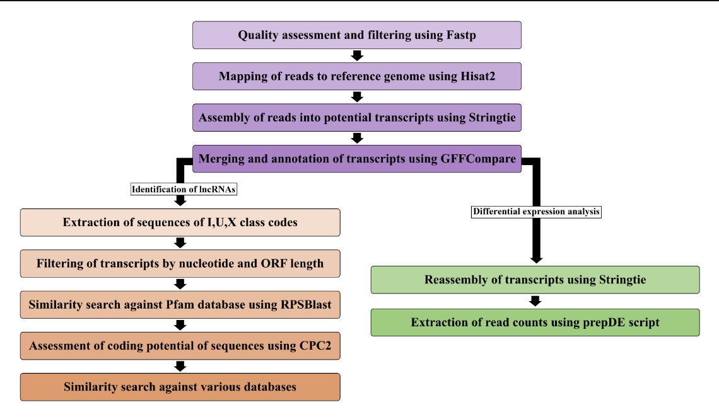
Pipeline of identification and differential expression of lncRNAs and genes

Slide 3
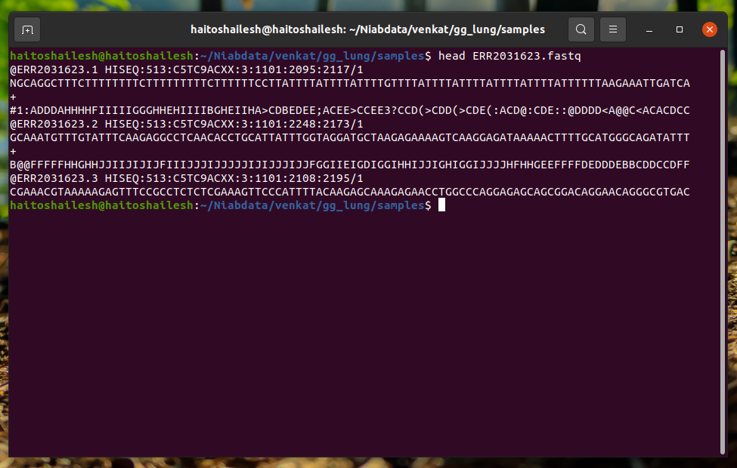
Quality Filtering- FASTP
l
Command: fastp -i sample_input.fastq -o output_clean.fastq -j output.json -h output.html

Slide 4
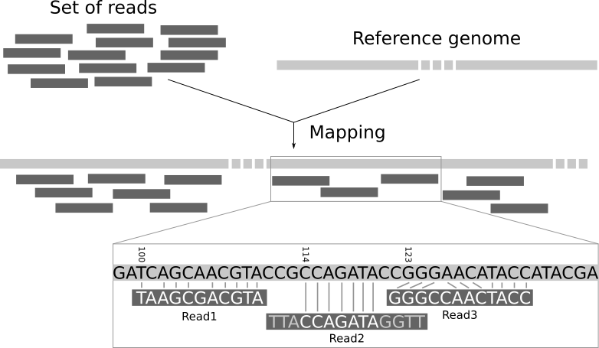
MAPPING READS TO GENOME – HISAT2

Slide 5
Mapping Reads to the Genome - HISAT2
Command: hisat2 -build test.fasta output_file_name
NOTE: To build the genome reference file for hisat2 mapping we have to use –build flag. The output file of –build is the input genome file for futher hisat2 step.
Command: hisat2 –q –dta –summary –file summary.txt –p threads –x file_path.fasta –U sample_input.fasta –S output.sam
HISAT2 is a fast and sensitive alignment program for mapping next-generation sequencing reads (both DNA and RNA) to a population.

Slide 6
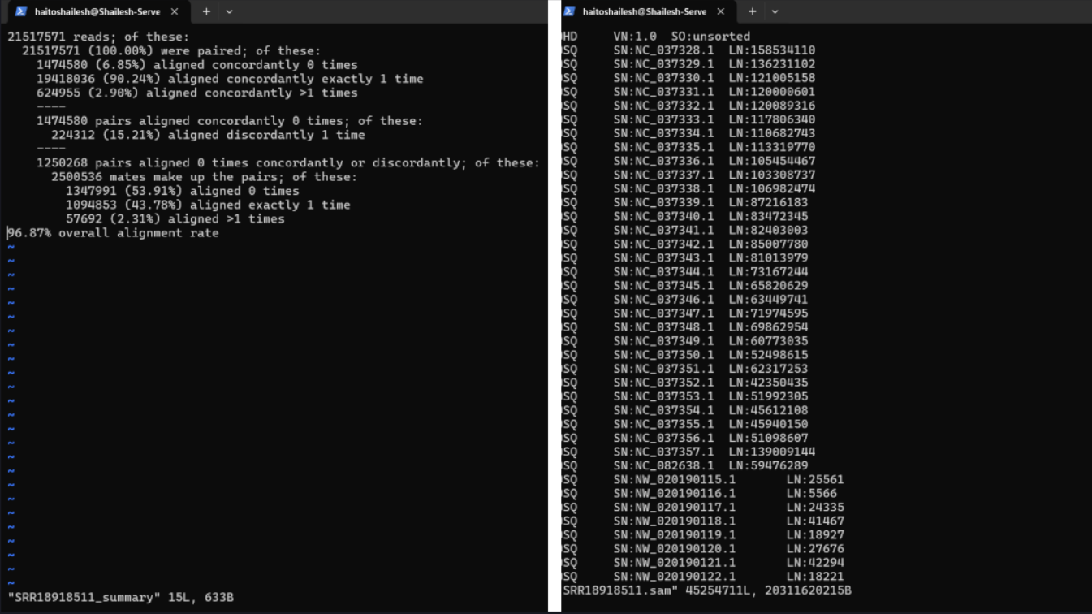
output file of Hisat2 :

Slide 7
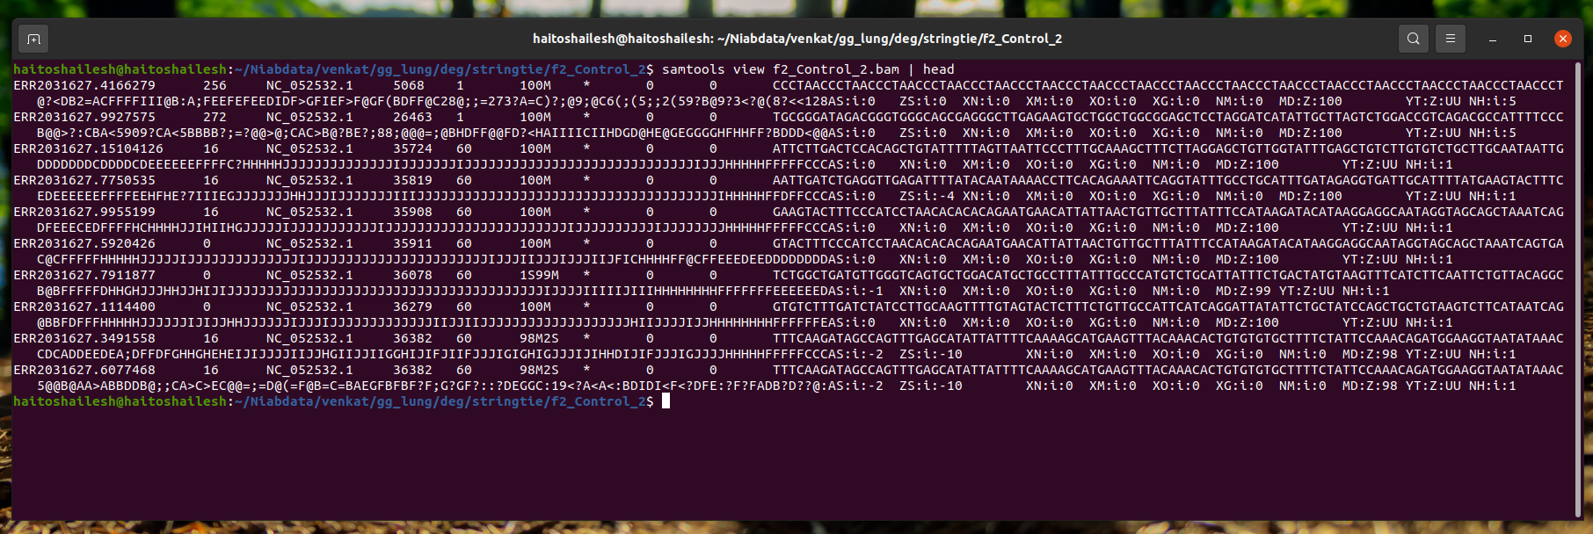
Conversion of sam file to bam
Command : samtools sort -O BAM -o output_file.bam sam_file.sam

Slide 8
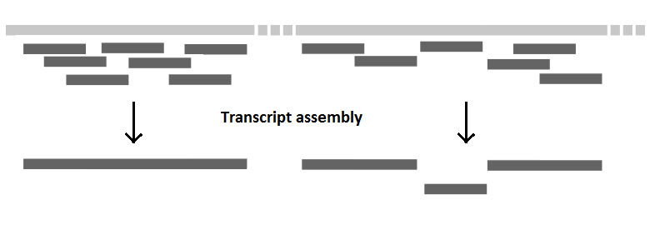
Assembly of transcripts using Stringtie
Command: stringtie sample.bam –G ref_genome_file_path.gff –o output_file.gtf

Slide 9
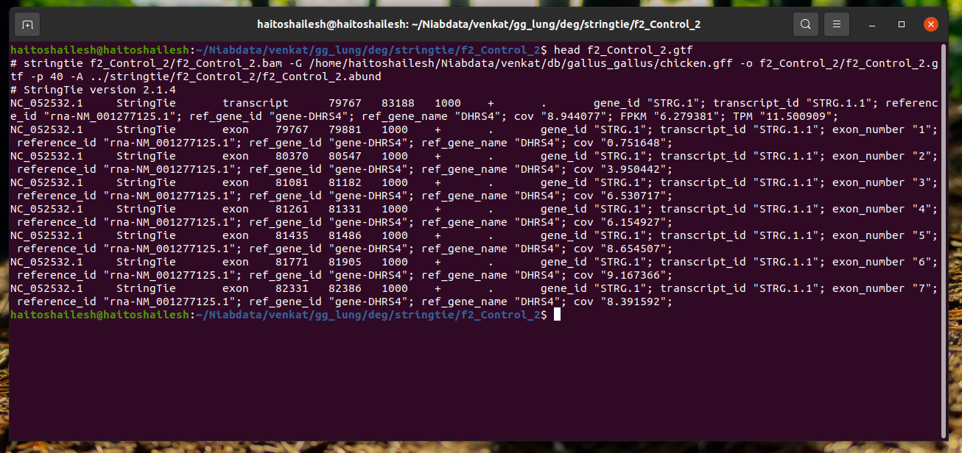
output file of stringtie:

Slide 10
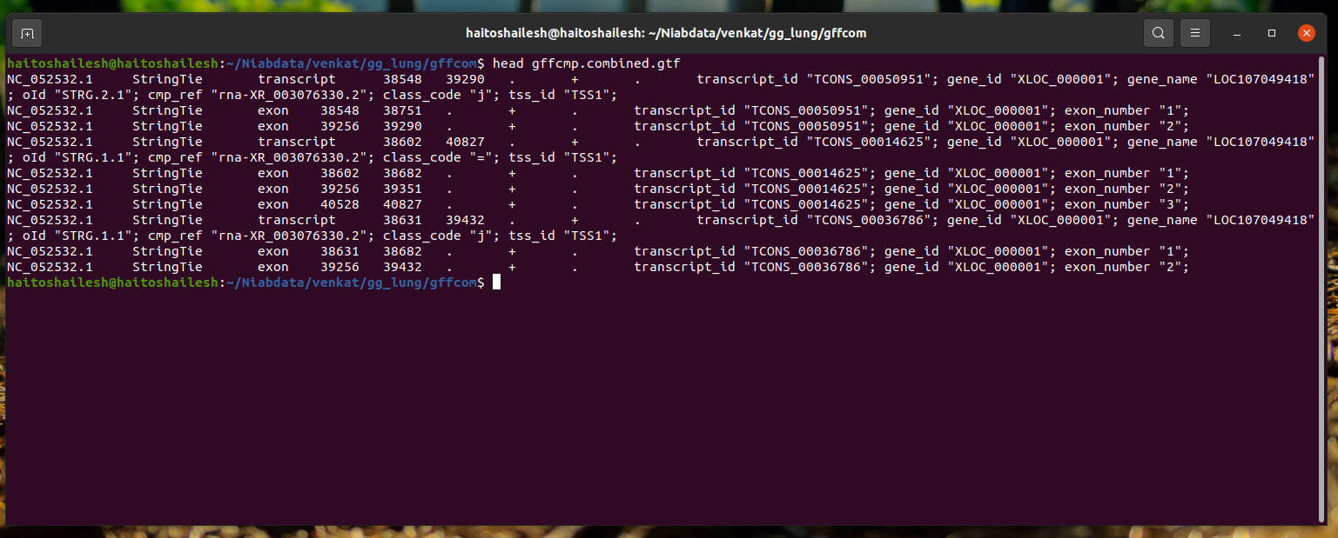
Transcript Annotation GFFCompare
Command : gffcompare –r ref_genome.gff –s ref_genome.fasta –I sample_path.txt
GFFcompare: Tool used for comparing transcripts with reference genome file (.fasta and .gff). Where we will get gffcmp.combined.gtf file from which we are going to extract class codes.

Slide 11
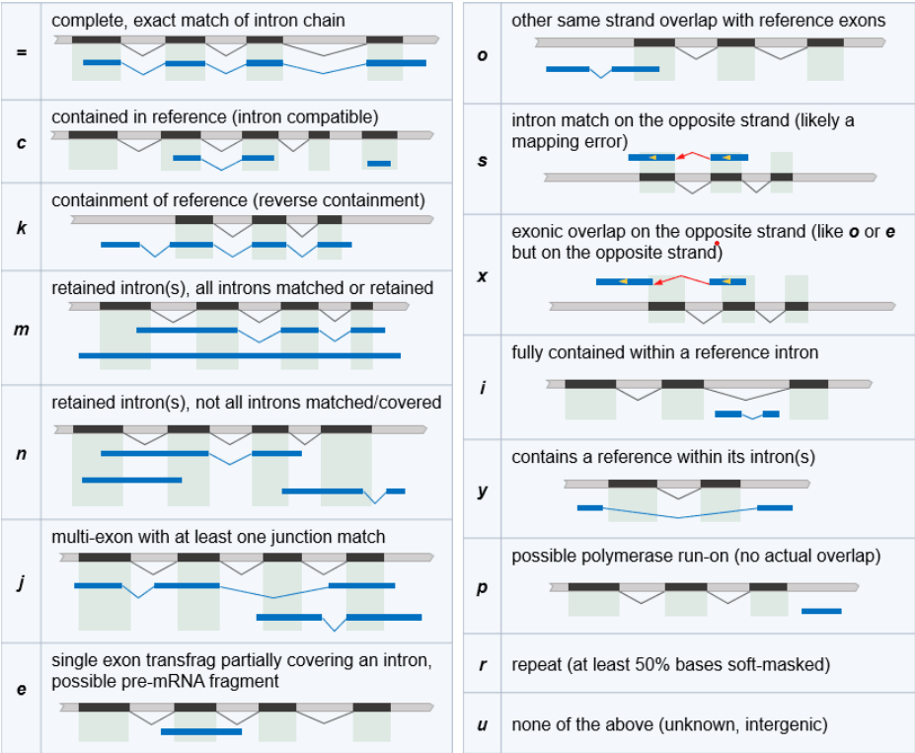
Extraction of sequences of i, u and x class:
Screenshot showing different types of class codes

Slide 12
LENGTH AND ORF FILTER
Sequence length filter:​
​
Long non-coding RNAs are generally of length greater than 200. So we remove sequences with length less than 200.
ORF filter:​
Sequences with ORFs of length greater than 300 are generally considered as protein coding, thus we remove sequences with ORF greater than 300.​

Slide 13
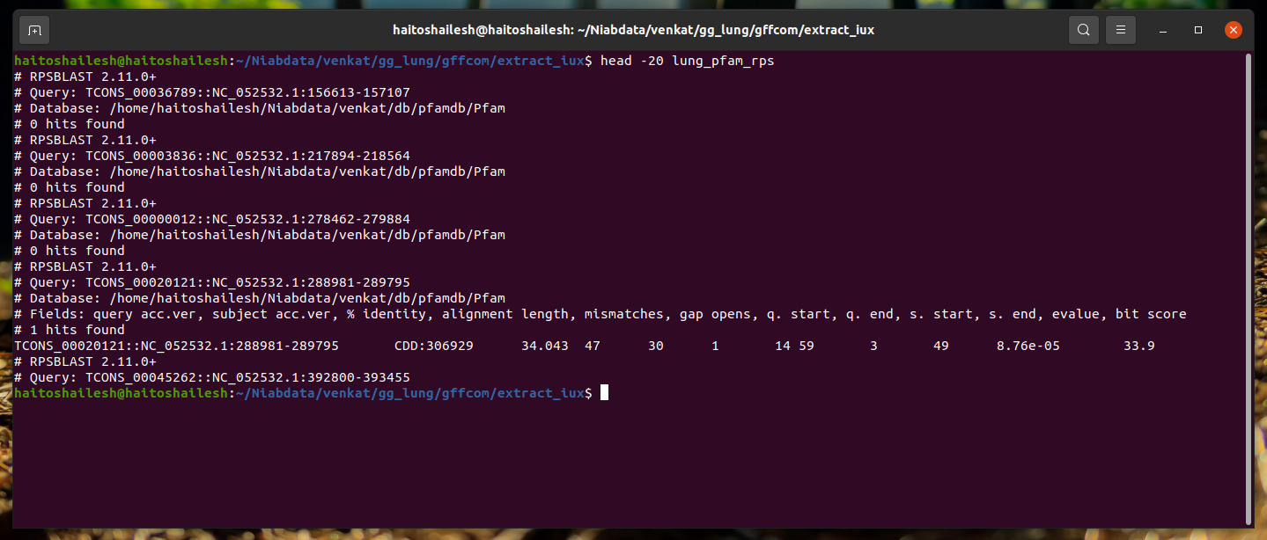
Protein Family Filter- PFAM -RPSBLAST
Command: rpsblast –db path_of_database –query –out -evalue

Slide 14
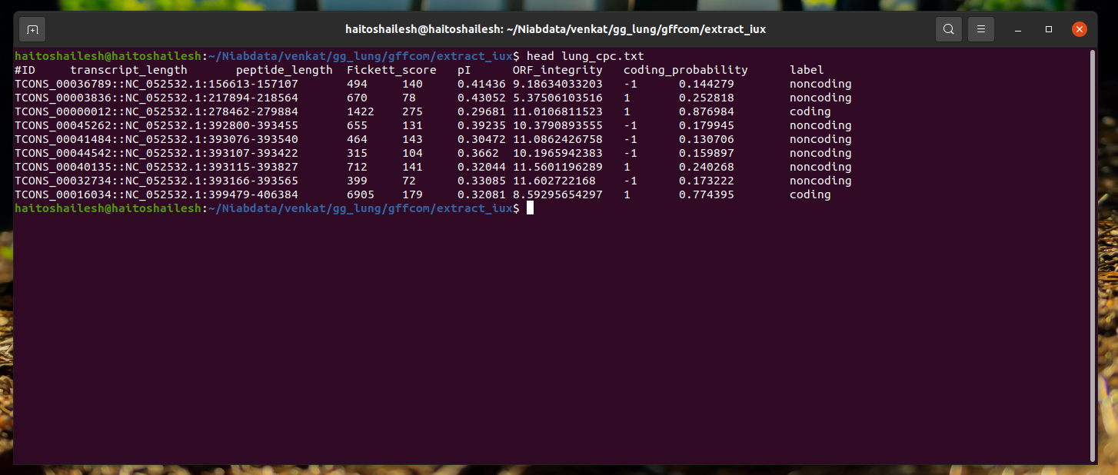
CODING POTENTIAL ANALYSIS – CPC2
Command: CPC2.py -i input.fasta -o output_file

Slide 15


