Slide 1
Genomic Variant Calling
&
Annotation
Sarwar Azam
NIAB

Slide 2
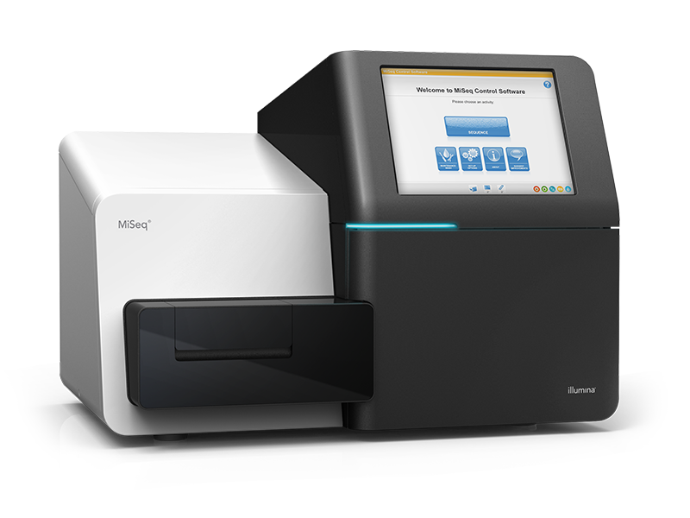
Overview
FASTQ file: Raw NGS read
Variant Filtering
Variant annotation
Variant visualisation
SAM/BAM file: Aligned NGS read
Sequencing
&
Base Calling
VCF file: Genomic Variant file

Slide 3
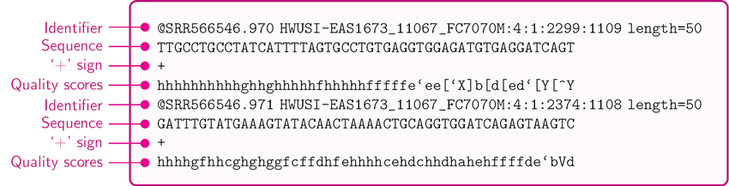
RAW Data (FASTQ File)
The raw data from a sequencing machine are most widely provided as FASTQ files, which include sequence information, similar to FASTA files, but additionally contain further information, including sequence quality information.

Slide 4

Quality control : Why ?
On the basis of the information contained in the FASTQ files it is possible to carry out a quality control and possibly improve the raw data to avoid errors in the downstream analysis.
By performing QC at the beginning of the analysis, chances encountering any contamination, bias, error, and missing data are minimized.

Slide 5
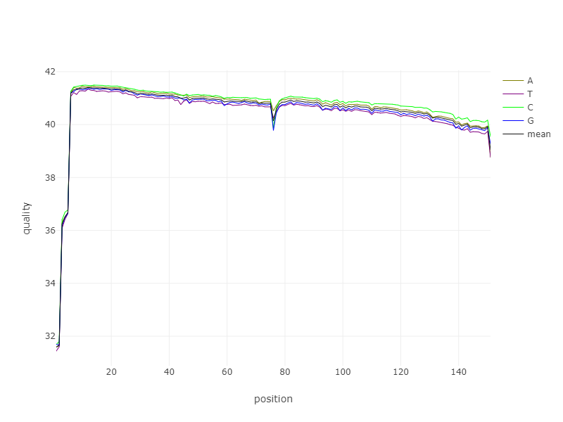

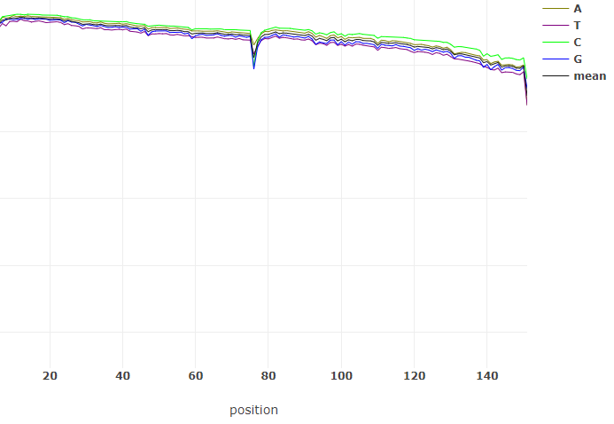
Pre-processing FASTQ File
Remove non-genomic sequences
Quality trimming (Remove quality <40)

Slide 6
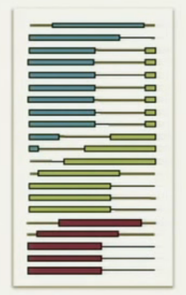
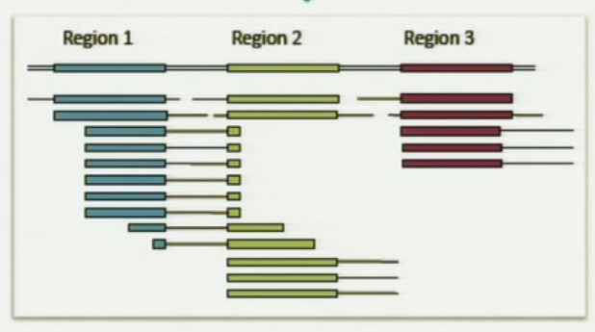
Mapping to Reference
Reference Genome
Read mapping is the process of locating a read by comparing its sequence to a reference sequence
Mapping Algorithm
Reference Genome
Mapped to Reference
pre-processed reads
SAM file

Slide 7
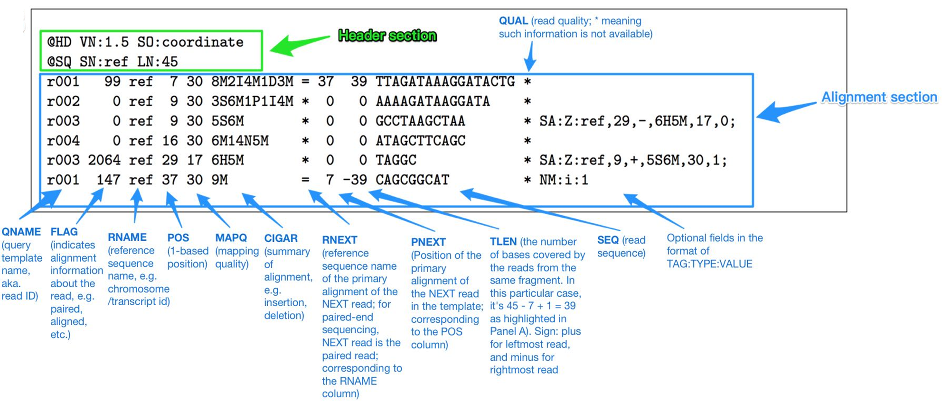
SAM file Format
SAM stands for Sequence Alignment Map format
TAB-delimited text format with a header section ,and alignment section

Slide 8
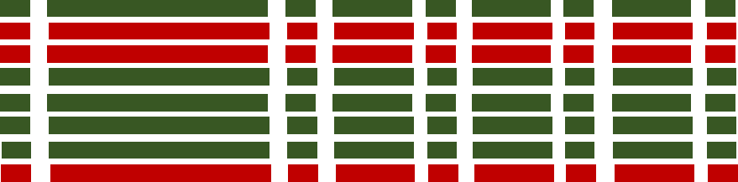
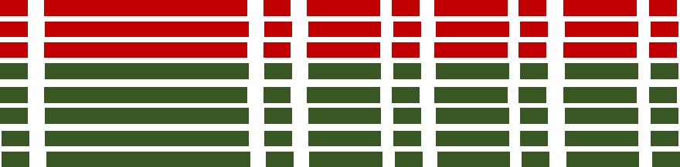
Sorting SAM File
Sorting SAM file will rearrange the alignment records in SAM file based on a specific sorting criterion, resulting in a new SAM file with the aligned data in the desired order.
This sorting ensures that the alignment data is organized in a coherent order, making it easier to analyze and process downstream
Unsorted SAM
Sorted SAM
BAM file

Slide 9
BAM file Format
SAM files are typically converted to BAM (Binary Alignment Map) which is the binary representation of SAM and keeps exactly the same information as SAM
Can not be opened like a text file
Can be sorted by chromosomal coordinates ,This procedure allows for indexing the BAM. Index sorted alignment enables to efficiently retrieve all reads aligning to a locus

Slide 10
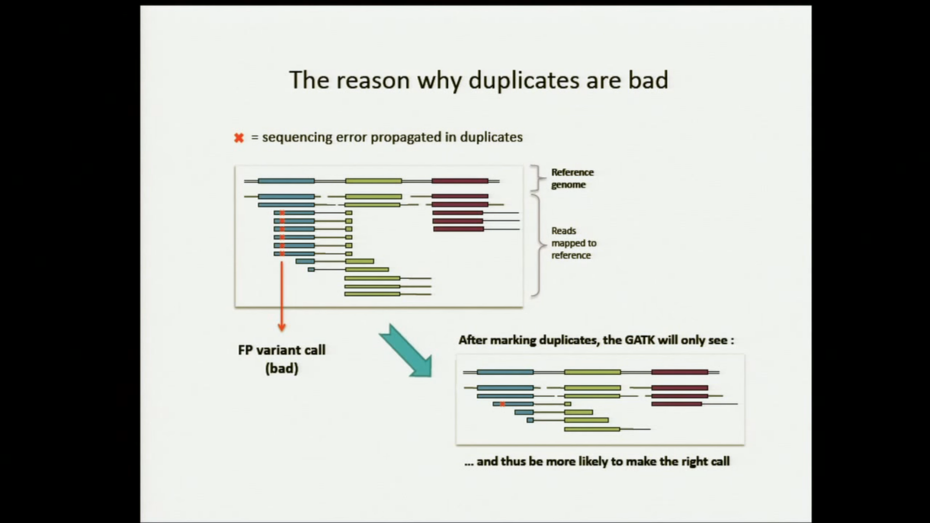
Marking Duplicates
Reference Genome
Mapped to Reference
The markduplicates identify these reads, So that the variant calling tools know they should ignore them
Marking Duplicates
AddOrReplaceReadGroups (read group ) used as an identifier that groups reads together ,The read group ID will be unique across multiple bam files

Slide 11
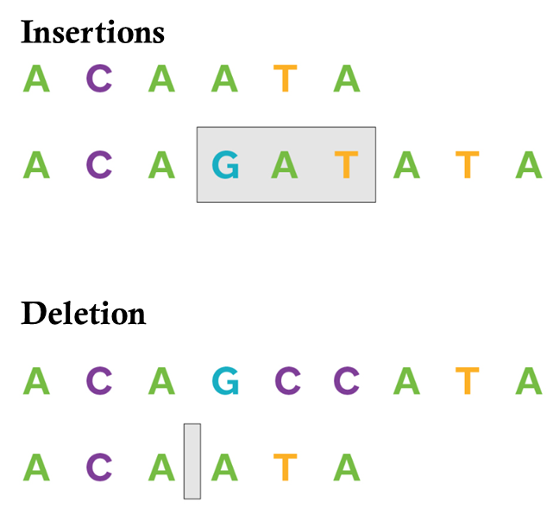
Variants
A change in the genomic sequences compared with the reference genomic sequences
Single Nucleotide Polymorphisms (SNPs): SNPs are the most common type of sequence variant and involve a single nucleotide change in the DNA sequence.
Insertions and Deletions (indels): Indels involve the insertion or deletion of one or more nucleotides in the DNA sequence. They can range in size from a single nucleotide to large insertions or deletions
Structural Variants (SVs): SVs are larger-scale genomic alterations that can involve rearrangements, inversions, or translocations of DNA segments.
Repeat Expansions: Repeat expansions involve the expansion of repetitive DNA sequences
Copy Number Variations (CNVs): CNVs are large-scale changes in the number of copies of a particular DNA segment.

Slide 12
Variants Calling
Variant calling is the process of identifying differences between the sequencing reads and a reference genome
Input File –BAM
Output File- VCF
GATK
Variants Calling
Freebayes

Slide 13
Variants Calling using GATK
Raw Reads
Consolidate GVCFs
VCF
SNPs
Indels
Map to reference
GVCF
Soring SAM file
Variant Analysis &
Filtering
Variant calling per Sample
Mark Duplicates
Pre-processing
Variant Discovery
Evaluation

Slide 14
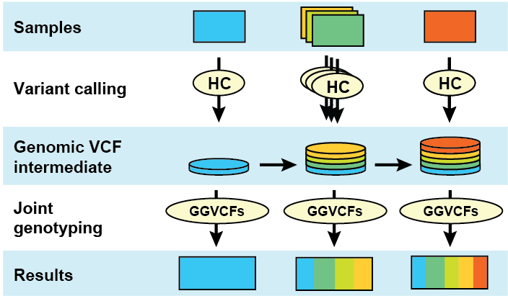
HaplotypeCaller
Combine GVCFs
VCF

Slide 15
Variants Calling using Freebayes
Raw Reads
VCF
SNPs
Indels
Map to reference
Freebayes Software
Soring SAM file
Variant Analysis &
Filtering
Mark Duplicates
Pre-processing
Variant Discovery
Evaluation

Slide 16
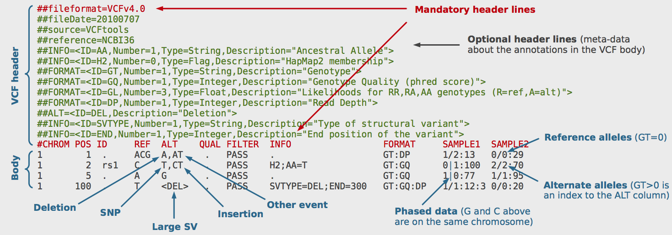
VCF file Format
Variant Caller Format file (VCF) is a very raw output of the variant calling process. It contains the chromosomal coordinates of the mutations, useful information to extrapolate the type of mutation, the name of the sample etc.

Slide 17
Variants Filtering
Next-generation sequencing generates thousands of sequence variants that must be filtered and prioritized for Interpretation .
Variants Filtration
Technical Filtration
Technical quality of variants
VAF cutoff
Read depth cutoff
Variant quality score cutoff
Biological Filtration
Remove known germline variants in population
Remove non-coding and synonymous variants

Slide 18
Variants Annotations
Once the analysis-ready VCF is produced, the genomic variants can then be annotated using a variety of tools and a variety of transcript sets
The aim of all functional annotation tools is to annotate information of the variant effects/consequences, majorly includes:
Listing which genes/transcripts are affected.
Determination of the consequence on protein sequence.
Correlation of the variant with known genomic annotations (e.g., coding sequence, intronic sequence, noncoding RNA, regulatory regions, etc.)
matching known variants found in variant databases

Slide 19
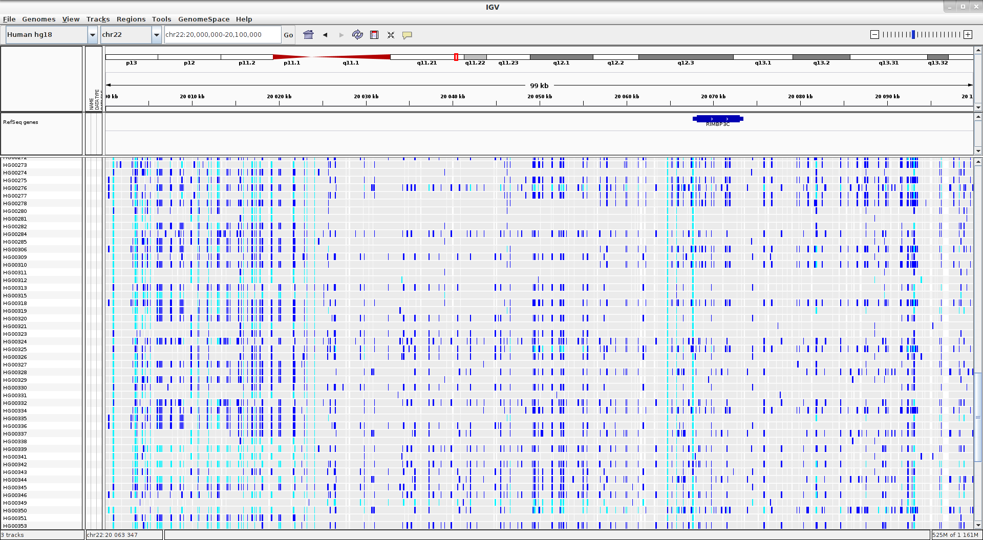
Variant visualisation
IGV (Integrative Genomics Viewer) is high-performance visualization tool for interactive exploration of large ,integrated genomics datasets, supporting a wide variety of data types.

Slide 20
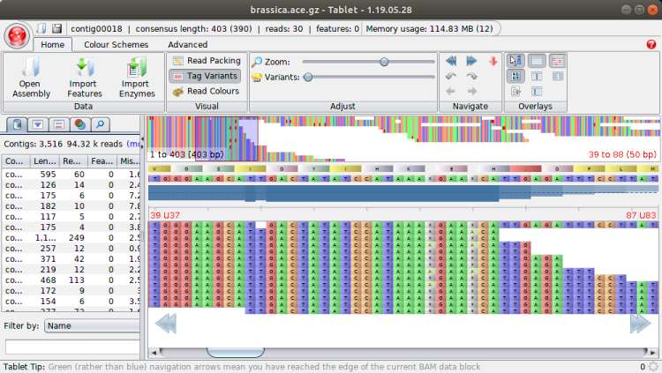

Slide 21
THANK YOU

