Slide 1
Introduction to R
Sandeep Kushwaha
NIAB, Hyderabad, India

Slide 2

Introduction to R
  R is a language and environment for statistical computing, graphics, representation and reporting
  First introduced in 1993, designed by Ross Ihaka and Robert Gentleman (University of Auckland, New Zealand, Under GNU Project)
  Similar to the S language and environment (John Chambers, Rick Becker and Allan Wilks developed at Bell Laboratories/AT&T)
  R is an interpreted computer language
    Allows modular programming using functions.
    Allows integration of programs written in C, C++, .NET, Python or FORTRAN.

Slide 3
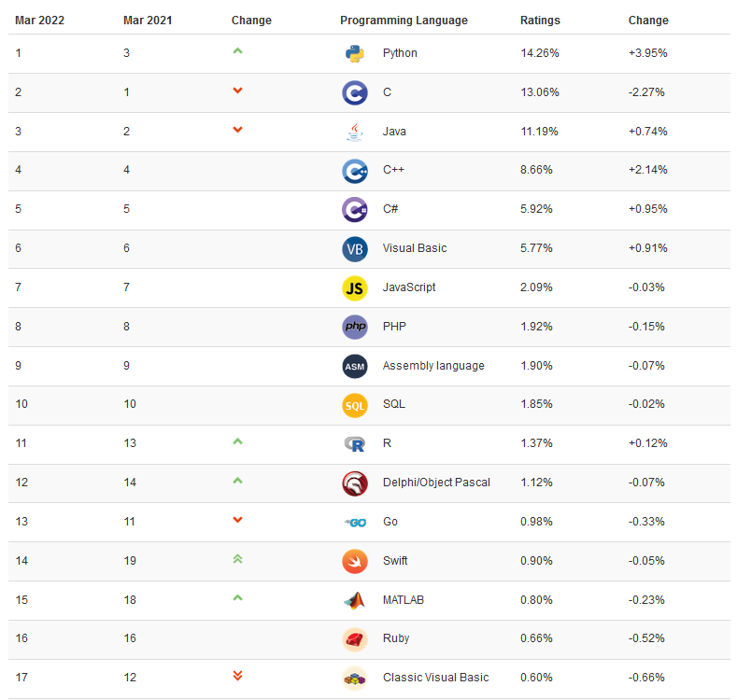
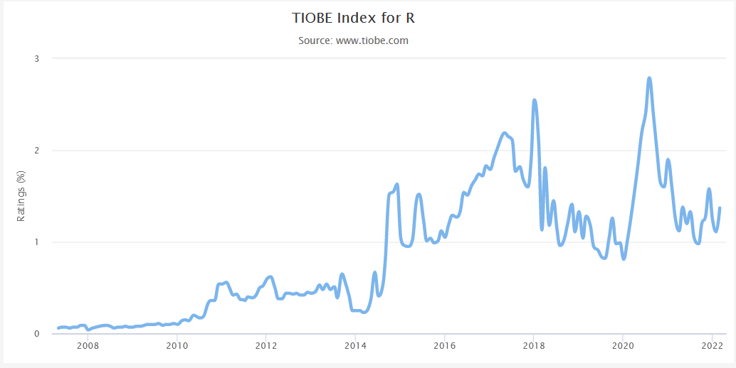
R Popularity Index and Growth

Slide 4
What R does and does not
Data handling and storage: numeric, textual
matrix algebra
hash tables and regular expressions
high-level data analytic and statistical functions
classes (“OO”)
Graphics
programming language: loops, branching, subroutines
is not a database, but connects to DBMSs
has no graphical user interfaces, but connects to Java, TclTk
Language interpreter can be very slow, but allows to call own C/C++ code
no spreadsheet view of data, but connects to Excel/MsOffice
no professional/commercial support
R is world’s most widely used statistics programming language.
  Number one choice of data scientists and supported by a vibrant and talented community of contributors.
  R is taught in universities and deployed in mission critical business applications

Slide 5
Why R for Biologist?
The life of a biologist revolves around manipulation of tables, text and numbers
  R is centred around the dataframe object: dataframes are essentially tables.
  R functions and libraries that can manipulate data frames in powerful ways without programming
Easy calculation of statistical parameters, tests and models
  R functions and libraries for computational statistics (without programming)
Beautiful, straightforward and plotting
  R functions and libraries for interactive and non-interactive plotting
Runs uniformly on all operating systems
It’s Free

Slide 6

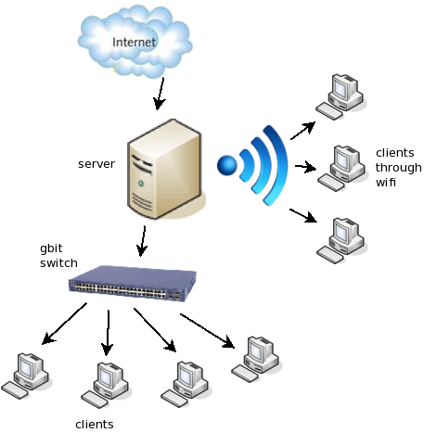
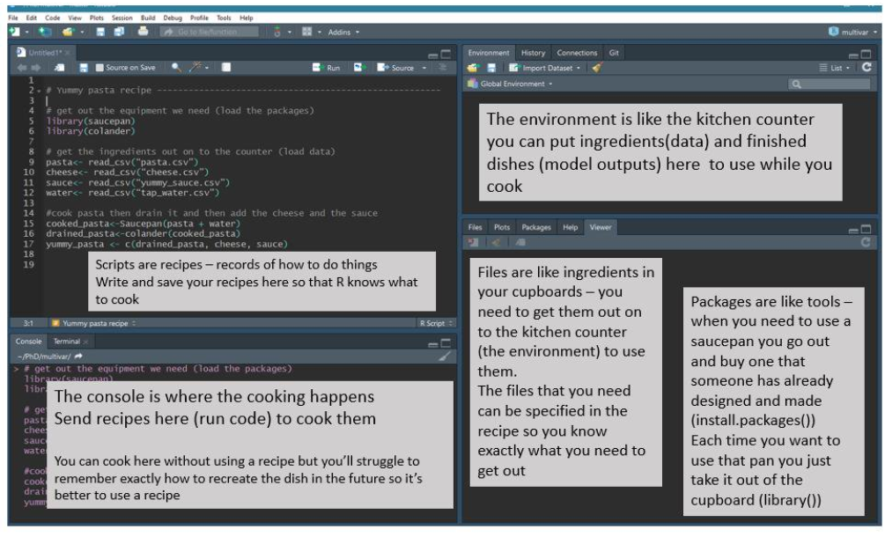
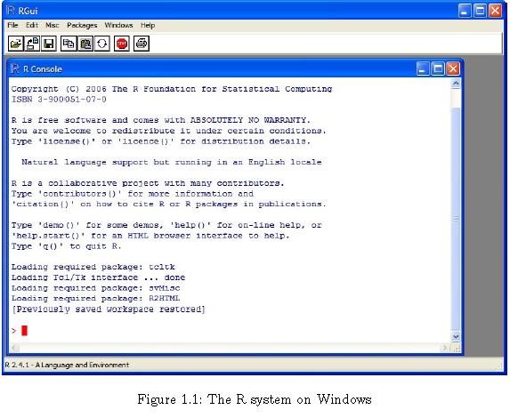
How to work on R Interfaces
Two means of working
  Logged into computer and work locally. When you logon in this manner you have a full GUI environment.
  OR connect remotely to one of the servers (whether from home or at the labs). When you logon in this manner you have a command line (or text based) environment.

Slide 7
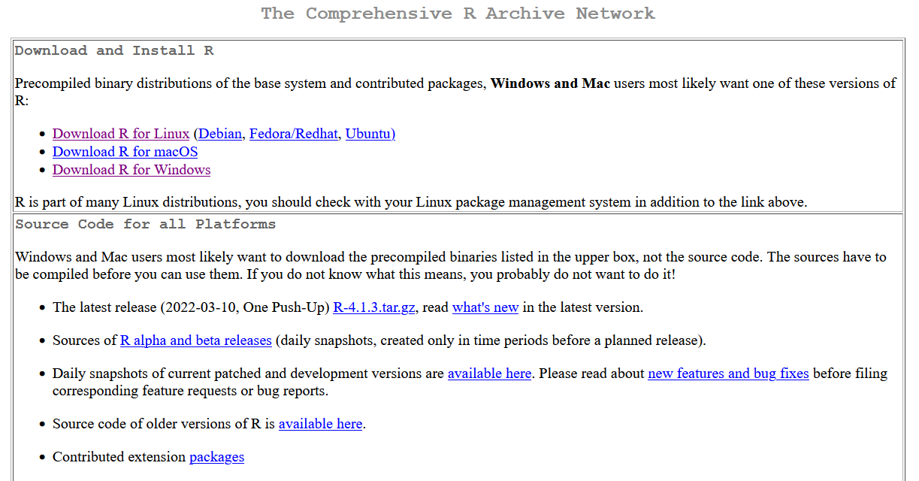
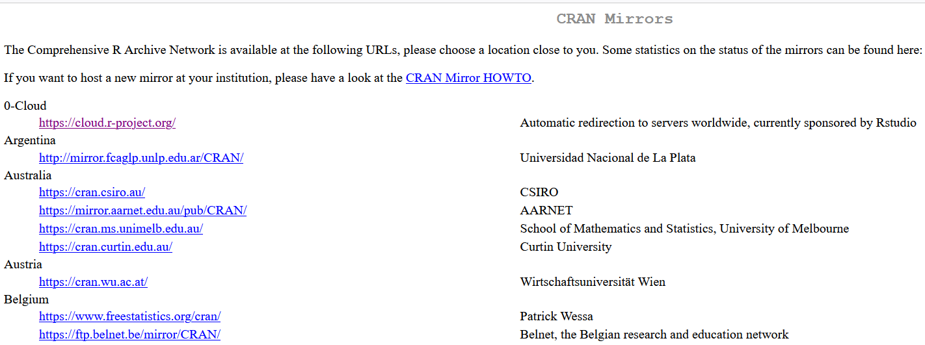
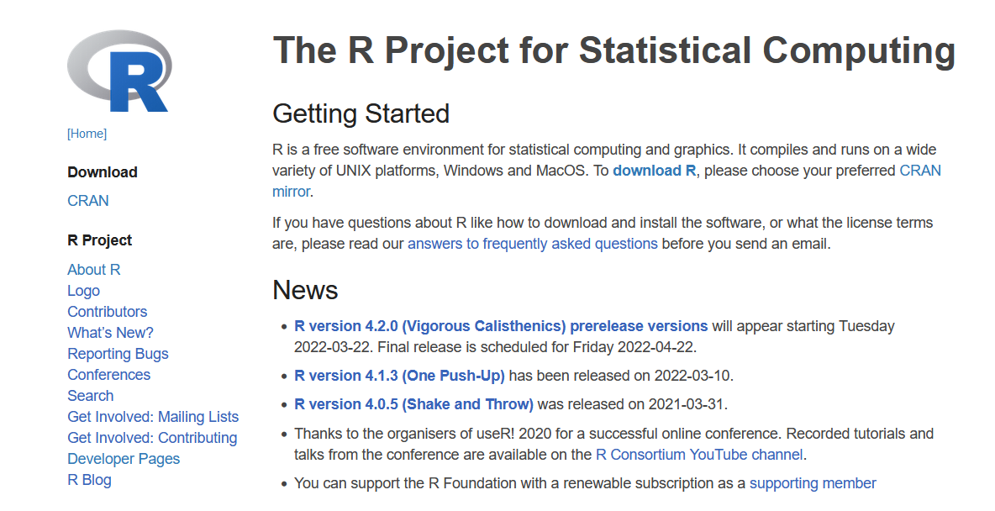

How can you work with R
1. Local: windows/Linux/Mac user: You should install latest R Version
Notes:
To start in course, we need unix terminal.
There are many ways to get unix terminel on windows but we will choose easiest path

Slide 8

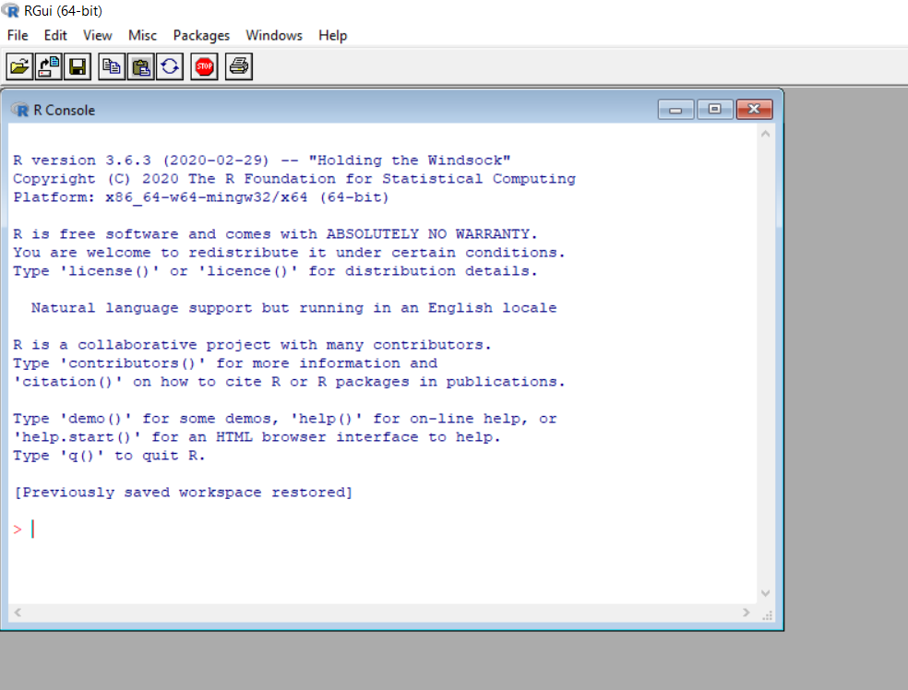

Slide 9
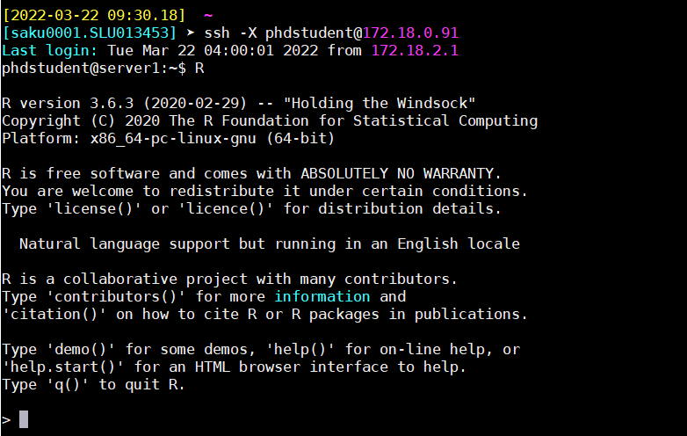
Work on servers
ssh -X phdstudent2023@172.18.0.91
Passwd:phdstudent2023_123
Notes:
To start in course, we need unix terminal.
There are many ways to get unix terminel on windows but we will choose easiest path

Slide 10
1. General R functions to know
help.start ( ) ## General Help in browser
help() / ? # help function
  Example: Let's explore the lm function ( Fitting Linear Models)
  help(lm)
  ?lm
apropos ("lm") # List of all functions containing string lm
example (lm) # This will show the example of lm function
library() # To see a list of all installed packages
help(package=“MASS”) # To get information about packages
data() # To see available data-sets in R

Slide 11
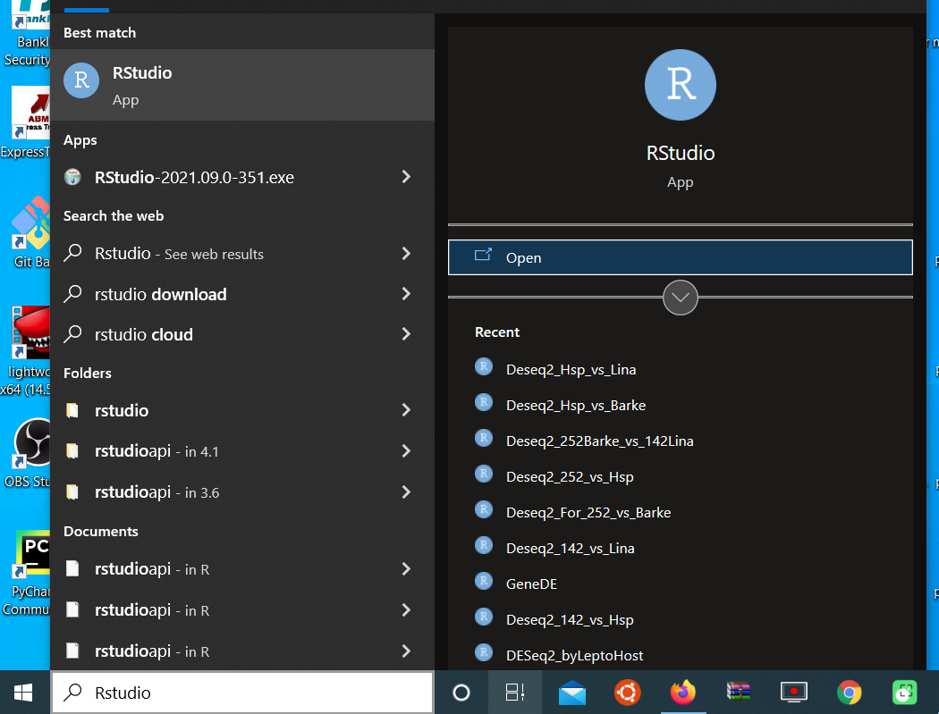
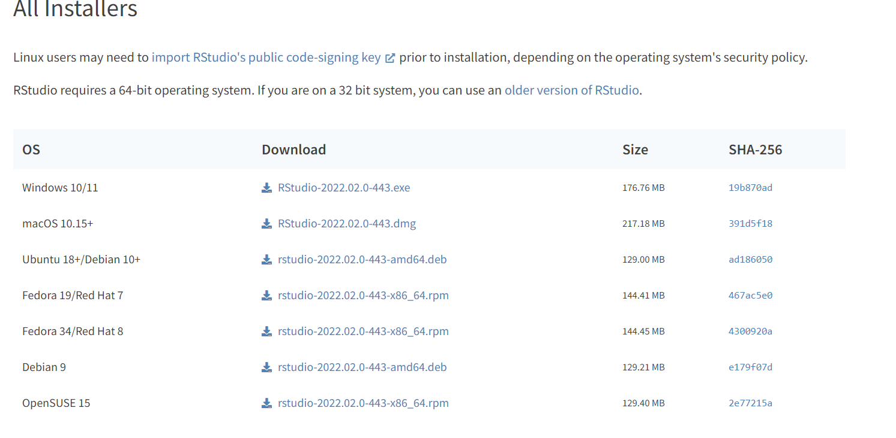


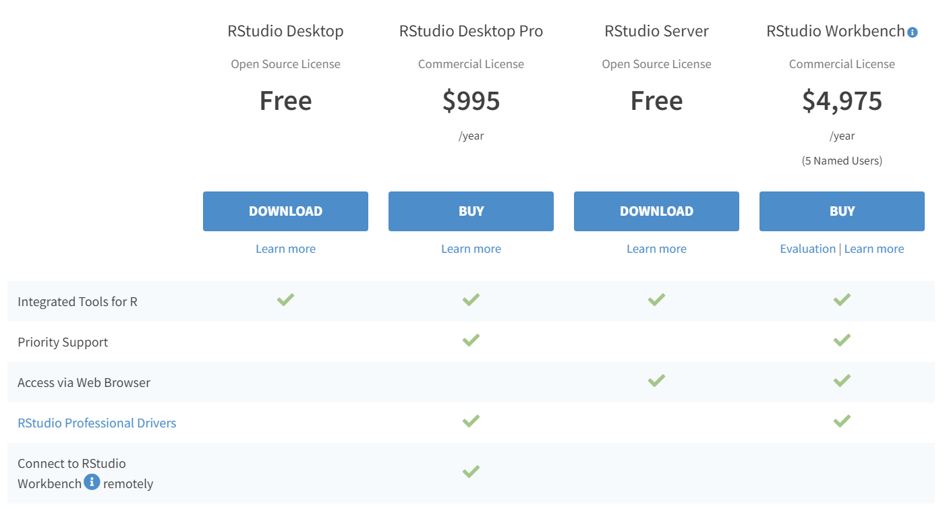
RStudio: Installation and Working
Notes:
DF: shows available and used disk space on
df -h shows disk space in human-readable format
df -a shows the file system's complete disk usage even if the Available field is 0
df -T shows the disk usage along with each block's filesystem type (e.g., xfs, ext2, ext3, btrfs, etc.)
df -i shows used and free inodes
DU: shows the disk usage of files, folders
du -h shows disk usage in human-readable format for all directories and subdirectories
du -a shows disk usage for all files
du -s provides total disk space used by a particular file or directory
memory
//proc/meminfo/vmstat
htop/top

Slide 12
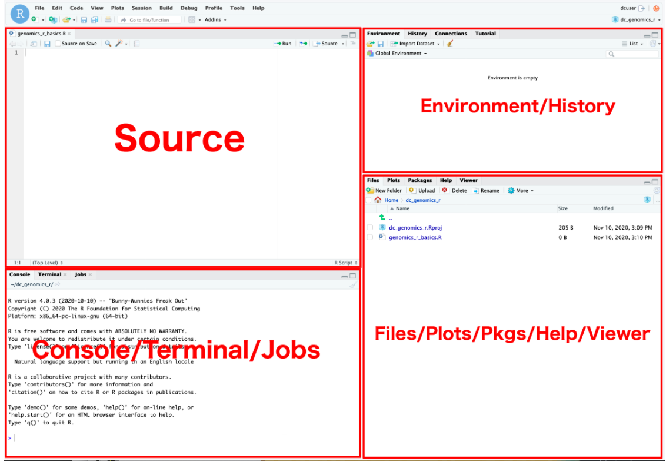
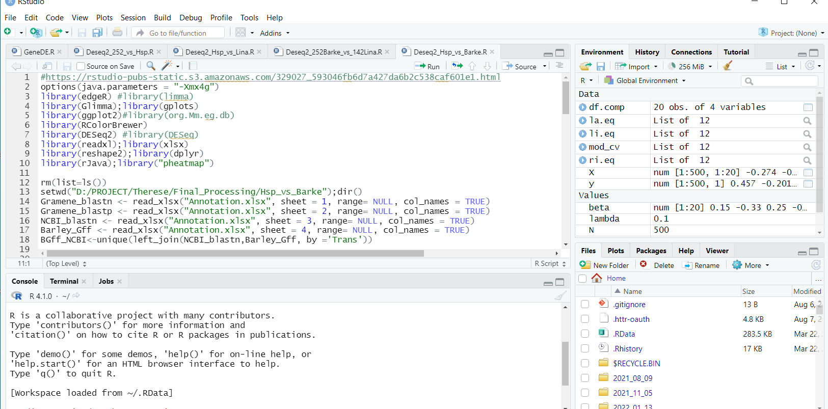

Slide 13
Useful Short-cuts for R-Studio
Zoom Source Editor | : Ctrl+Shift+1 | : Ctrl+Shift+1
Zoom console | : Ctrl+Shift+2 | : Ctrl+Shift+1
Zoom RStudio Resources and help | : Ctrl+Shift+3 | : Ctrl+Shift+3
Zoom workspace and environment | : Ctrl+Shift+4 | : Ctrl+Shift+4
Setting Working directory:

Slide 14
Data objects in R
Very important to understand,
Use and manipulate on a day-to-day basis in R.
Dealing with data conversions is one of the sources of frustration for beginners.
Data Objects in R
a. Variable
b. Vectors (numerical, character, logical)
c. Matrices
d. Data frames
e. Lists
For easy learning and best understanding, our main focus is to learn about data object's
# Creation and Accessing
# sub-setting and deletion
# Basic arithmetical and logical operations
Notes:
tar [-czvf] name-of-archive.tar.gz stuff
tar -cjvf archive.tar.bz2 stuff
-z: Compress the archive with gzip
-c: Create an archive
-j bz2 compression
-v: Display progress in the terminal while creating the archive, also known as “verbose” mode. The v is always optional in these commands, but it’s helpful.
-f: Allows you to specify the filename of the archive.
x: extract files
-C: extract the contents of the archive to a specific directory
-k, keep source file
--totals
gzip
gzip {filename}
gzip mydata.doc
gzip -d {.gz file}
gzip -d mydata.doc.gz
gunzip {.gz file}
gunzip mydata.doc.gz
bzip2
bzip2 {filename}
bzip2 mydata.doc
bzip2 -d {.bz2-file}
bzip2 -d mydata.doc.bz2
bunzip2 {.bz2-file}
bunzip mydata.doc.gz
zip
zip {.zip-filename} {filename-to-compress}
zip mydata.zip mydata.doc
unzip {.zip file}
unzip file.zip
tar
tar [-czvf] name-of-archive.tar.gz stuff
tar -cjvf archive.tar.bz2 stuff
tar -xzvf archive.tar.gz
tar -xjvf archive.tar.bz2
14

Slide 15
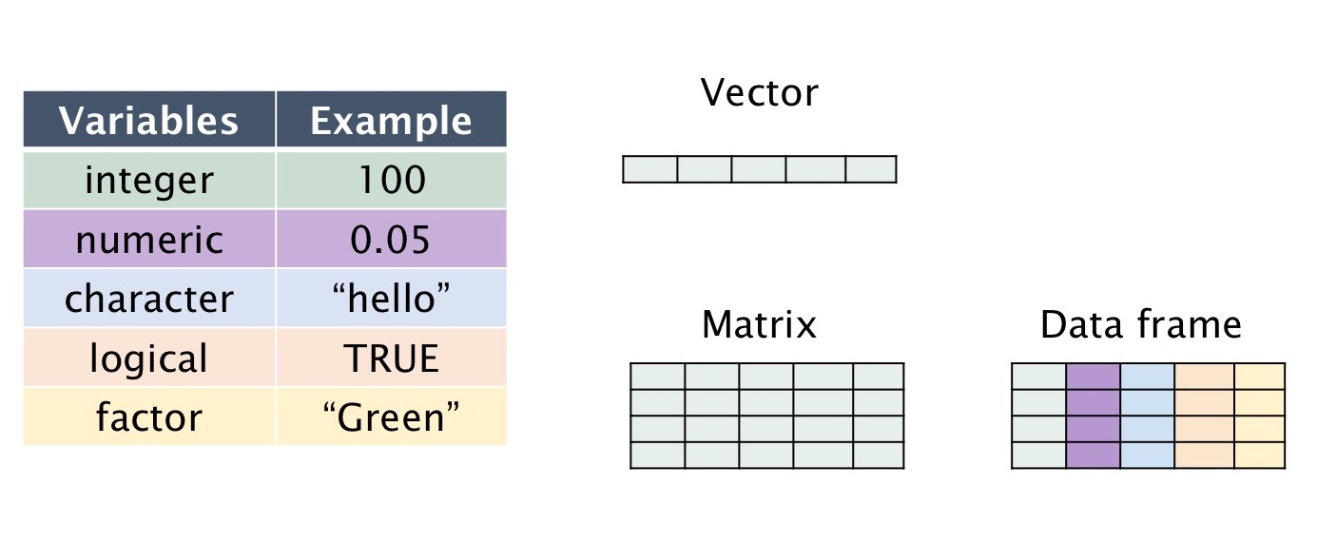
R Variable
Variable creation # Variable naming (letter, digit . and _)
# To declare a variable: use the `<-` (leftward, rightward)
OR `=` (equal)
name_of_variable <- value; value -> name_of_variable; name_of_variable = value
Access of variable value: print() or cat() # cat() can print multiple items together.
x <- 3; x y=5; y
3->x1; x1 z="R is great"; z
l <- TRUE; l
print (x); cat (x,y) #Note: class function : class(x); class(y); class(z); class(l)
To deletion of variable rm(x); x; rm (y,z); y;z
To find variable in workspace ls() ; #OR print(ls())
Notes:
tar [-czvf] name-of-archive.tar.gz stuff
tar -cjvf archive.tar.bz2 stuff
-z: Compress the archive with gzip
-c: Create an archive
-j bz2 compression
-v: Display progress in the terminal while creating the archive, also known as “verbose” mode. The v is always optional in these commands, but it’s helpful.
-f: Allows you to specify the filename of the archive.
x: extract files
-C: extract the contents of the archive to a specific directory
-k, keep source file
--totals
gzip
gzip {filename}
gzip mydata.doc
gzip -d {.gz file}
gzip -d mydata.doc.gz
gunzip {.gz file}
gunzip mydata.doc.gz
bzip2
bzip2 {filename}
bzip2 mydata.doc
bzip2 -d {.bz2-file}
bzip2 -d mydata.doc.bz2
bunzip2 {.bz2-file}
bunzip mydata.doc.gz
zip
zip {.zip-filename} {filename-to-compress}
zip mydata.zip mydata.doc
unzip {.zip file}
unzip file.zip
tar
tar [-czvf] name-of-archive.tar.gz stuff
tar -cjvf archive.tar.bz2 stuff
tar -xzvf archive.tar.gz
tar -xjvf archive.tar.bz2
15

Slide 16
Basic operation
# Arithematic operations
x+y; # + : Addition
x-y; # - : Subtraction
x*y; # * : Multiplication
y/x; # / : Division
x^2 ; # ^ or ** : Exponentiation
y%%x; # %% : Modulus (Remainder from division)
y%/%x ; # %/% : Integer Division
# Logical operation
x < 8 # < :less than
x <= 8 # <= :less than or equal to
y > 3 # > :greater than
y >= 3 # >= :greater than or equal to
x == 3 # == :exactly equal to
x!= 3 # != :not equal to
x > 2 | x < 1 # x | y :x OR y
x > 2 & x < 1 # x & y :x AND y

Slide 17
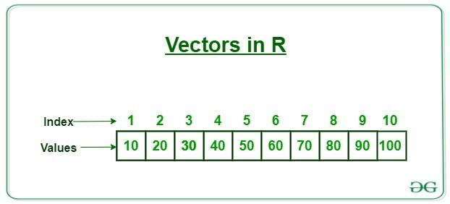
2. R Vector
# One-dimensional array.
# A vector can have all the basic data type such as
# logical, integer, double, complex, character and raw (mix of all)
# The simplest way to build a vector in R, is to use the c command with ( ).
# A. Vector Syntax
name_of_vector <- c(value1, value2,....n)
# Single/ Multiple Elements Vector
# Rules for vector naming: Same as variable
# B. Access of vector elements
# Elements of a vector can be accessed using indexing [ ]
# Indexing starts with position 1
Vec_num <- (15); Vec_num[1]; Vec_num[2]
Vec_num <- c(15, 17, 19) # numeric vector
Vec_num
Notes:
tar [-czvf] name-of-archive.tar.gz stuff
tar -cjvf archive.tar.bz2 stuff
-z: Compress the archive with gzip
-c: Create an archive
-j bz2 compression
-v: Display progress in the terminal while creating the archive, also known as “verbose” mode. The v is always optional in these commands, but it’s helpful.
-f: Allows you to specify the filename of the archive.
x: extract files
-C: extract the contents of the archive to a specific directory
-k, keep source file
--totals
gzip
gzip {filename}
gzip mydata.doc
gzip -d {.gz file}
gzip -d mydata.doc.gz
gunzip {.gz file}
gunzip mydata.doc.gz
bzip2
bzip2 {filename}
bzip2 mydata.doc
bzip2 -d {.bz2-file}
bzip2 -d mydata.doc.bz2
bunzip2 {.bz2-file}
bunzip mydata.doc.gz
zip
zip {.zip-filename} {filename-to-compress}
zip mydata.zip mydata.doc
unzip {.zip file}
unzip file.zip
tar
tar [-czvf] name-of-archive.tar.gz stuff
tar -cjvf archive.tar.bz2 stuff
tar -xzvf archive.tar.gz
tar -xjvf archive.tar.bz2
17

Slide 18
# Character vector
Vec_chr <- c("a", "b", "c") ; Vec_chr
# logical vector
Vec_logi <- c(FALSE, FALSE, TRUE) ; Vec_logi
# Mix vector
Vec_exp <- c('yellow',5,TRUE) # if one/more values are character, all DT will be characters
print(Vec_exp)
#Note: class function
class(Vec_num); class(Vec_chr); class(Vec_logi); class(Vec_exp);
# Some methods for quick vector creation
Vec_cr <- 1:10; print(Vec_cr)
Vec_cr <- 1.5:5.6; print(Vec_cr)
Notes:
tar [-czvf] name-of-archive.tar.gz stuff
tar -cjvf archive.tar.bz2 stuff
-z: Compress the archive with gzip
-c: Create an archive
-j bz2 compression
-v: Display progress in the terminal while creating the archive, also known as “verbose” mode. The v is always optional in these commands, but it’s helpful.
-f: Allows you to specify the filename of the archive.
x: extract files
-C: extract the contents of the archive to a specific directory
-k, keep source file
--totals
gzip
gzip {filename}
gzip mydata.doc
gzip -d {.gz file}
gzip -d mydata.doc.gz
gunzip {.gz file}
gunzip mydata.doc.gz
bzip2
bzip2 {filename}
bzip2 mydata.doc
bzip2 -d {.bz2-file}
bzip2 -d mydata.doc.bz2
bunzip2 {.bz2-file}
bunzip mydata.doc.gz
zip
zip {.zip-filename} {filename-to-compress}
zip mydata.zip mydata.doc
unzip {.zip file}
unzip file.zip
tar
tar [-czvf] name-of-archive.tar.gz stuff
tar -cjvf archive.tar.bz2 stuff
tar -xzvf archive.tar.gz
tar -xjvf archive.tar.bz2
18

Slide 19
seq function
#Vec_cr <- seq(start digit, end digit, "difference in numbers " by = 0.4)
Vec_cr <- seq(5, 9, by = 0.4); print(Vec_cr)
#C. slicing/subsetting of vector.
1. by giving position of single element
vec_slice <- c(1,2,3,4,5,6,7,8,9,10)
vec_slice[2]
2. By giving range of elements
vec_slice[1:5]
# D. Deletion of vector
rm(Vec_num); Vec_num
rm (Vec_chr,Vec_logi); Vec_chr; Vec_logi
Notes:
tar [-czvf] name-of-archive.tar.gz stuff
tar -cjvf archive.tar.bz2 stuff
-z: Compress the archive with gzip
-c: Create an archive
-j bz2 compression
-v: Display progress in the terminal while creating the archive, also known as “verbose” mode. The v is always optional in these commands, but it’s helpful.
-f: Allows you to specify the filename of the archive.
x: extract files
-C: extract the contents of the archive to a specific directory
-k, keep source file
--totals
gzip
gzip {filename}
gzip mydata.doc
gzip -d {.gz file}
gzip -d mydata.doc.gz
gunzip {.gz file}
gunzip mydata.doc.gz
bzip2
bzip2 {filename}
bzip2 mydata.doc
bzip2 -d {.bz2-file}
bzip2 -d mydata.doc.bz2
bunzip2 {.bz2-file}
bunzip mydata.doc.gz
zip
zip {.zip-filename} {filename-to-compress}
zip mydata.zip mydata.doc
unzip {.zip file}
unzip file.zip
tar
tar [-czvf] name-of-archive.tar.gz stuff
tar -cjvf archive.tar.bz2 stuff
tar -xzvf archive.tar.gz
tar -xjvf archive.tar.bz2
19

Slide 20
# E. Vector manipulation ( Arithematic and Logical operations)
Two vectors of same length can be added, subtracted, multiplied or divided
Operation perform element to elements of vectors
# Arithematic operations # Logical operations
# + : Addition # < :less than
# - : Subtraction # <= :less than or equal to
# * : Multiplication # > :greater than
# / : Division # >= :greater than or equal to
# ^ or ** : Exponentiation # == :exactly equal to
# %% : Modulus (Remainder from division) # x OR y
# x AND y
x<-c(1,3,5,7,9);x
y<-c(2,4,6,8,10);y vec_logi <- c(1:10)
x+y; vec_logi >5
x-y;
x*y; # Add multiple condition
y/x; # vec_logi >5 & vec_logi < 8
y%%x # Logical statements wrapped inside the [].
x^2 ; # variable_name[(conditional_statement).....]
x^y; vec_logi[vec_logi>5];
vec_logi[vec_logi >5 & vec_logi < 8]
vec_logi[(vec_logi>5) & (vec_logi<7)]

