Slide 1
Spatiotemporal Topological Denoising for Identifying Robust Features in Longitudinal Data
Zhe LIU

Slide 2
Introduction

Slide 3
Background
Longitudinal data is essential in clinical and biomedical research, as it captures the dynamic evolution of subjects through repeated measurements over time.
While this data offers a unique perspective on disease trajectories, the inherent complexity of such datasets poses significant challenges for traditional feature selection methods, creating a bottleneck in identifying robust, clinically actionable biomarkers.

Slide 4
Traditional feature selection approaches
Existing feature selection approaches—ranging from standard wrapper methods to basic filtering techniques—often fail to address two critical limitations when applied to longitudinal data:
Neglect of Temporal Dependencies: Traditional algorithms typically assume that observations are independent and identically distributed (i.i.d.).
  However, longitudinal data is defined by strong temporal correlations.
  By treating them as independent features, these methods fail to capture meaningful temporal patterns and are prone to overfitting.
Lack of Robustness to Noise:
  Clinical data is frequently plagued by measurement errors, batch effects, and erratic trajectories arising from patient heterogeneity.
  Most conventional methods lack a dedicated denoising mechanism, often misinterpreting these random fluctuations as significant biological signals.
  This results in the selection of spurious features that lack generalizability and biological interpretability

Slide 5
Objective
To overcome these challenges, we introduce the Spatiotemporal Topological Denoising (STTD) framework.
Unlike conventional methods, STTD moves beyond simple correlation analysis by integrating a dual-stream architecture:
  Spatial Topological Stream: Utilizes Shared Nearest Neighbor (SNN) clustering to identify and weight samples based on their density in the feature space, effectively identifying samples that are potentially noisy.
  Temporal Trajectory Stream: Aligns data to score the consistency of trajectories, thereby filtering out erratic, non-physiological fluctuations.
By fusing these streams, the STTD framework reconstructs a robust feature space prior to selection, enabling the identification of biomarkers that are not only statistically significant but also biologically consistent across time.

Slide 6
Methods

Slide 7
SOTA methods
1. BiMM forest combines a binary mixed model framework with feature selection methods like backward elimination or stepwise selection (wrapper methods) to handle clustered and longitudinal binary outcomes ^{[1]}.
2. The Exh-CFS-Gr method applies correlation-based feature selection within each group of temporally related features (conceptual + constructed longitudinal features) using exhaustive search (maximizing relevance with the class label and minimizing redundancy among features), then merges the selected subsets for final output ^{[2]}.
3. Select features by maximizing a temporal margin, prioritizing those whose weighted values best distinguish differences between time points, thereby capturing meaningful temporal patterns ^{[3]}.

Slide 8
Results

Slide 9
Data Availability
Dataset | Description | Data source
Korea COVID-19 | Longitudinal data with inflammatory and immune-related protein profiling and bulk TCR/BCR sequencing collected from COVID-19 patients during hospitalization, from admission to discharge. | The Clinical and Omics Data Archive (CODA) for researchers with approved access. (Jo et al., 2022)
Japan T2D | Clinical and metabolic profiles measured longitudinally in T2D patients (0M, 1M, 3M, 12M) | Figshare (Sakura et al. and Tomonaga et al.)
KARE T2D
PE

Slide 10
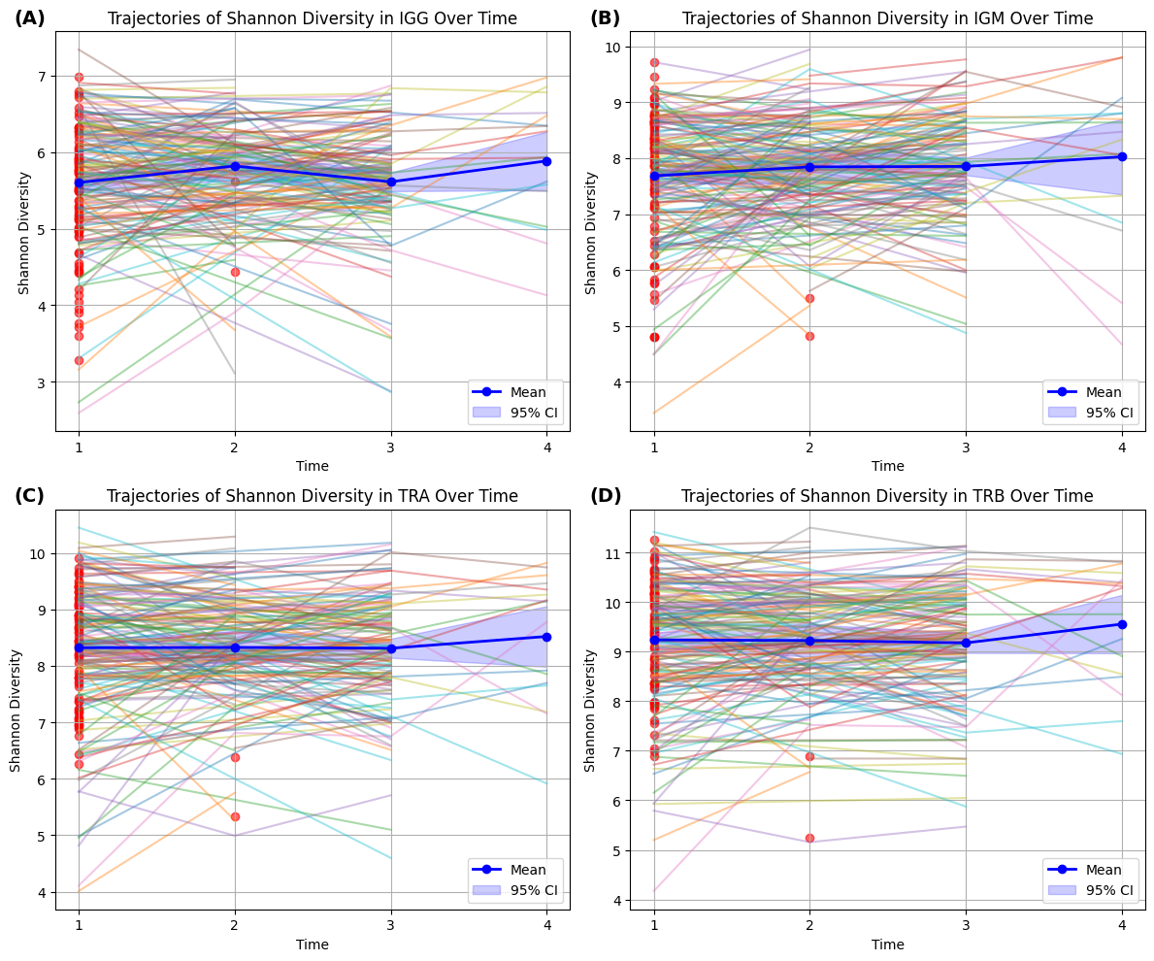
EDA-Trajectories and Frequency Distribution (COVID-19)
# measures per sample | # sample
1 | 83
2 | 152
3 | 10
4 | 12
Table 1 Distribution of Measurement Frequency Across Samples
Figure 1 Trajectories of clonal diversity for Individuals
The red dots indicate samples with only a single observation. The colored lines represent the trajectories of clonal diversity for each subject across BCR-IGG, BCR-IGM, TCR-alpha, and TCR-beta. The blue line denotes the overall mean trajectory, and the shaded area represents the 95% confidence interval.

Slide 11
EDA-Description of COVID-19 Dataset
Category | Description
Cytokines / Inflammatory factors | e.g., IL-6, TNF-alpha, IL-1 beta, IFN-gamma; involved in inflammation and immune response.
Chemokines | e.g., CCL2, CXCL10, CCL5; regulate leukocyte migration.
Growth factors | e.g., VEGF, EGF, FGF2; involved in angiogenesis, tissue repair, and cell proliferation.
Proteases / Inhibitors | e.g., MMP-2, MMP-9, TIMP-1; regulate matrix degradation.
Acute phase proteins | e.g., CRP, SAA, LBP; reflect systemic inflammatory state.
Immune regulatory factors | e.g., CD14, CD23, BCMA; involved in immune recognition and response regulation.
Complement system-related proteins | e.g., C1q, C2, C5a, Properdin; involved in innate immunity.
Metabolic and endocrine markers | e.g., Leptin, Adipsin, Insulin, GH; reflect metabolic state.
Coagulation and vascular function proteins | e.g., Protein C, Thrombomodulin, vWF; reflect coagulation and vascular function.
Tissue remodeling and structural proteins | e.g., Collagen I, Lumican, Galectin-3; involved in structural maintenance and fibrosis.
Supplementary Table 1 Protein Categories Represented in the Korea COVID-19 Dataset
This dataset comprises a diverse panel of protein biomarkers, including cytokines, growth factors, and metabolic indicators, that collectively characterize the inflammatory and immune response in COVID-19 patients .

Slide 12
EDA-Description of JP Diabetes Dataset
Category | Variable Name
Basic Information | Sex, age
Lifestyle Habits | Drinking habit, Smoking habit
Metabolic Indicators | BMI, HbA1c (NGSP*), HDL-C, LDL-C, Triglyceride, Uric acid, Creatinine, eGFR
Blood & Biochemical Markers | ALT, AST, Cl, Na, K, Hematocrit, Hemoglobin, White blood cell, Platelet, Red blood cell
Blood Pressure | Diastolic blood pressure, Systolic blood pressure
Kidney Function & Urinary Tests | BUN, Urinary protein, Urinary sugar
Health History | History of angina pectoris, arteriosclerosis obliterans, cerebral infarction, dyslipidemia, heart failure, hypertension, hyperuricemia, kidney disease, liver disease, myocardial infarction
Other Measurements | Body height, Body weight, GTP
Supplementary Table 2 Metabolic Profiles Represented in the Japan T2D Dataset

Slide 13
EDA-Description of KARE T2D Dataset
Category | Example Columns
Demographics | Sex, age, BMI
Amino Acids | Alanine, Arginine, Asparagine, Aspartate, Glutamate, Glycine, Valine, etc.
Acylcarnitines & Lipid Metabolism | Acetylcarnitine, Butanoyl_carnitine, Hexanoyl_carnitine, Lauroyl_carnitine, etc.
Choline/Methylation Pathway | Betaine, Choline, Dimethylglycine__DMG_, TMAO, sn_glycerol_3_phosphocholine
Nucleotide Metabolism | Inosine, Xanthine, Hypoxanthine, Uridine, Xanthosine
Energy/Organic Acids | Lactate, Succinate, Creatine, Pyroglutamic_acid, Urea, etc.
Other Metabolites | Cysteine, Methionine, Kynurenine, Trigonelline, Taurine, etc.

Slide 14
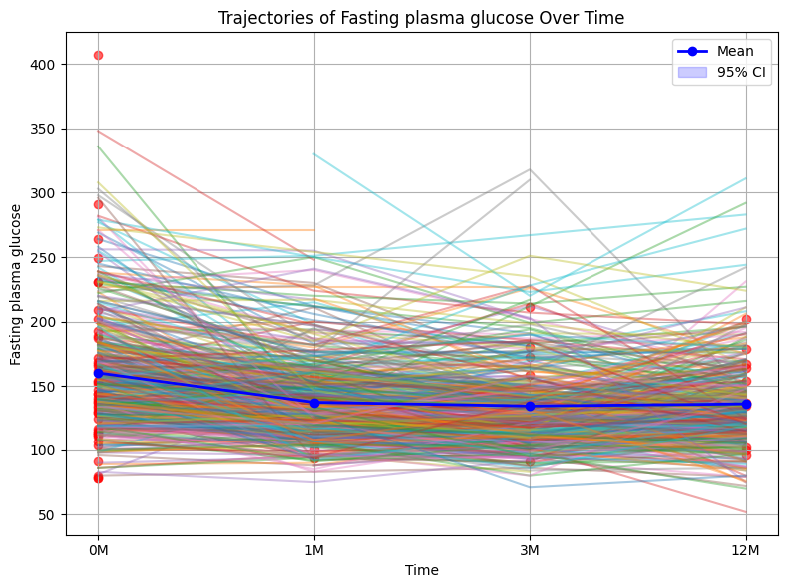
EDA-Trajectories and Frequency Distribution (JP FPG)
Measurements Per Subject | Count of Subject (COVID-19) | Count of Subject (T2D)
1 | 83 | 77
2 | 152 | 84
3 | 10 | 141
4 | 12 | 298
Total | 257 | 600
Pre-processing:
799 subjects, 2015 observations, and 59 features.
Removed features with more than 20% NA (leaving 44 features).
Removed observations with more than 20% NA (leaving 1860 observations).
For imputation, categorical variables were filled with the global mode, and continuous variables were filled with the KNN mean.
Figure x: Trajectories of fasting plasma glucose for individuals The red dots represent samples with only one observation.

Slide 15
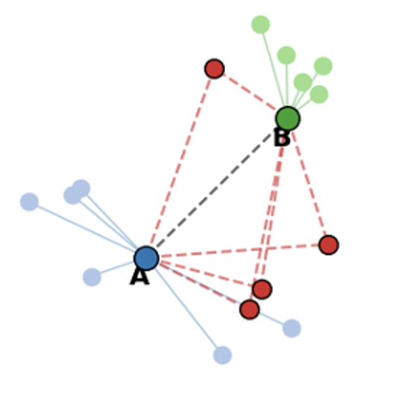
Shared Nearest Neighbors (SNN) ^{[5]}
A similarity and clustering method based on shared k-nearest neighbors is proposed.
Similarity is defined as: the more neighbors two points share in their respective k-nearest neighbor lists, the more similar they are.
For clustering, if two points are in each other’s neighbor lists and share at least kₜ neighbors (a threshold), they are assigned to the same cluster.

Slide 16
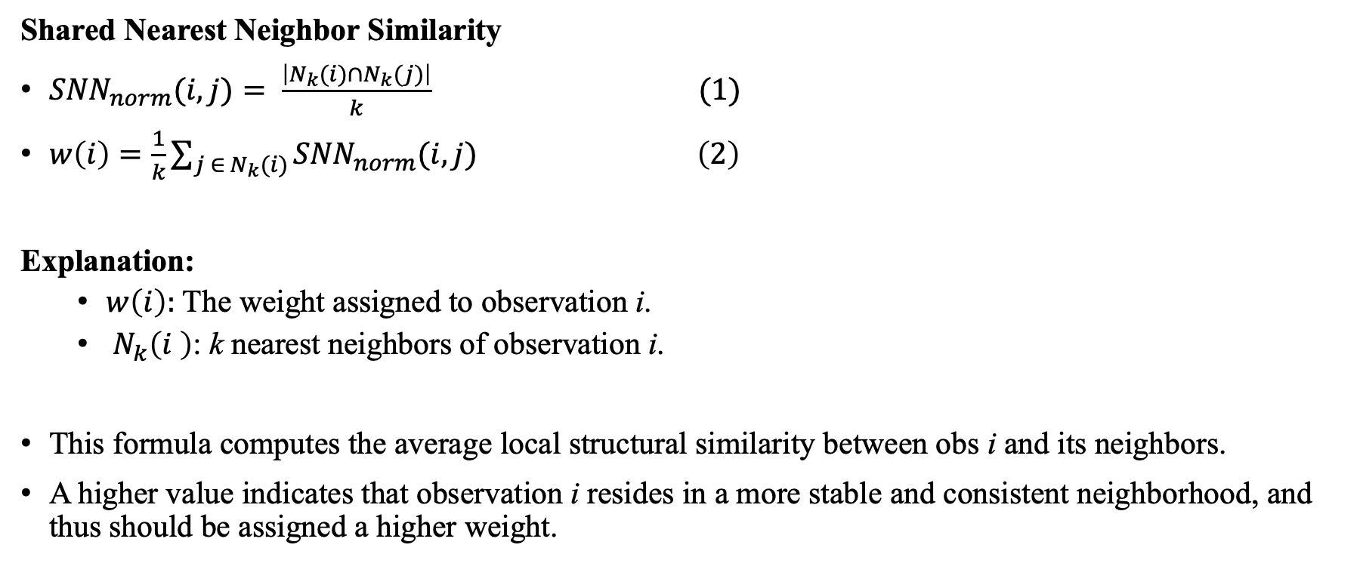
SNN-based Weighting Strategy
Shared Nearest Neighbor Similarity
${SNN}_{norm}(i,j)= \frac{\left|N_{k}(i)∩N_{k}(j)\right|}{k} (1)$
$w\left(i\right)=\frac{1}{k}\sum_{j ∈{ N}_{k}(i)}{{SNN}_{norm}(i,j)} \left(2\right)$
Explanation:
  $w\left(i\right):$ The weight assigned to observation i.
  ${ N}_{k}\left(i \right)$: k nearest neighbors of observation i.
This formula computes the average local structural similarity between obs i and its neighbors.
A higher value indicates that observation i resides in a more stable and consistent neighborhood, and thus should be assigned a higher weight.

Slide 17
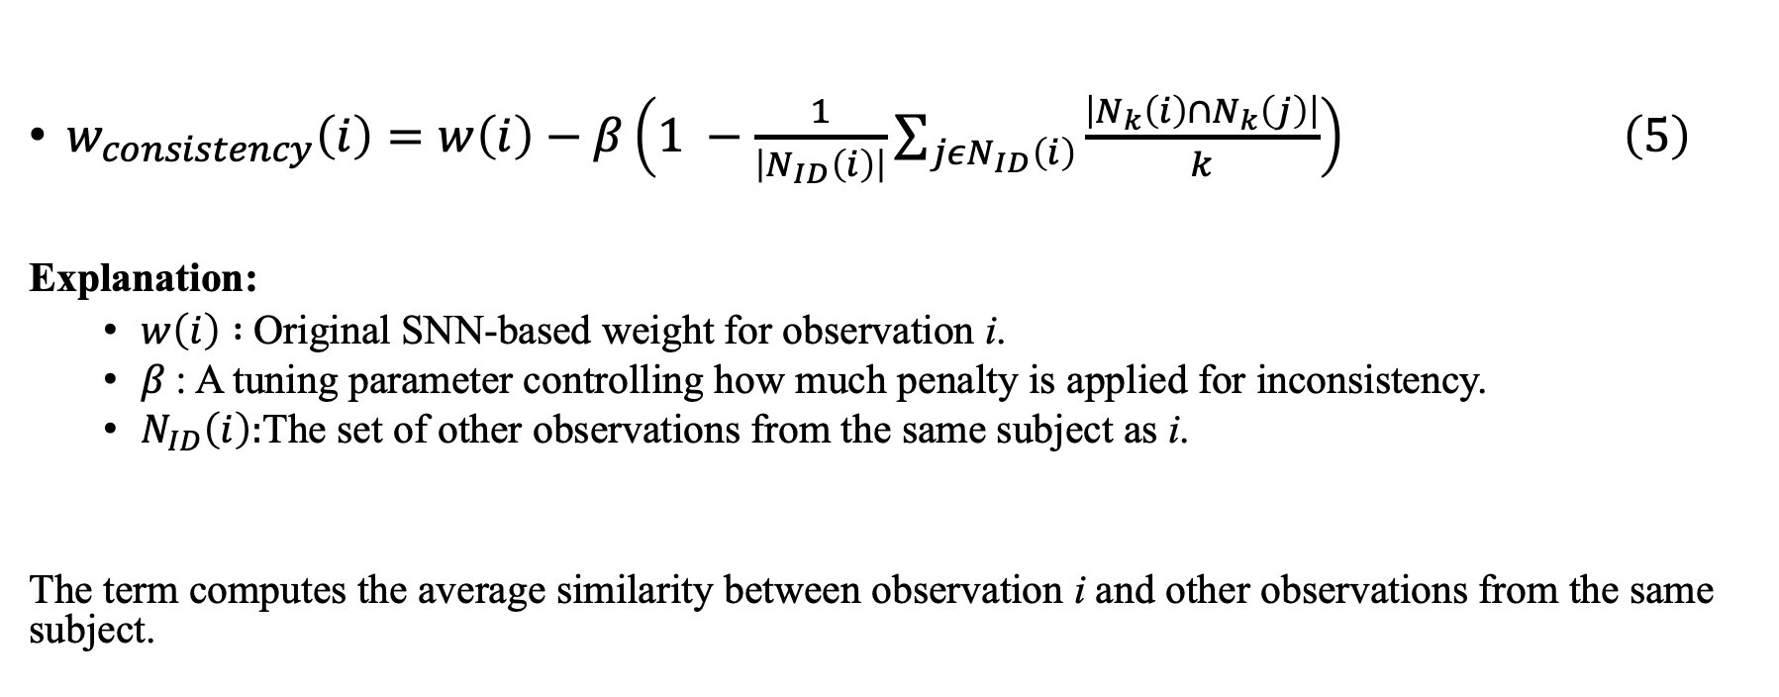
Consistency-adjusted SNN weighting strategy
$w_{consistency}\left(i\right)=w\left(i\right)−β\left(1 −\frac{1}{\left|N_{ID}\left(i\right)\right|}\sum_{jεN_{ID}\left(i\right)}{\frac{\left|N_{k}\left(i\right)∩N_{k}\left(j\right)\right|}{k}}\right) \left(5\right)$
Explanation:
  $w\left(i\right) :$Original SNN-based weight for observation i.
  $β$: A tuning parameter controlling how much penalty is applied for inconsistency.
  $N_{ID}\left(i\right):$The set of other observations from the same subject as i.
The term computes the average similarity between observation i and other observations from the same subject.

Slide 18
Evaluation for Weighting Strategies
Training/Test Set Division (subject-level splitting)
  Selected 80% of the unique subject IDs for the training set and assigned all corresponding observations to it, while the remaining 20% of subject IDs were used for the test set .
Feature section methods:
  LASSO (features with non-zero coefficients)
  Random Forest (Top Features Contributing to 98% Cumulative Importance)
Prediction models
  Linear mixed-effect models (random intercept model -LMM1 , random slope model -LMM2, and random intercept and slope model -LMM3)
  XGBoost
  Random Forest (RF)
  Support Vector Regression (SVR)
Notes:
/ˈliːkɪdʒ/

Slide 19
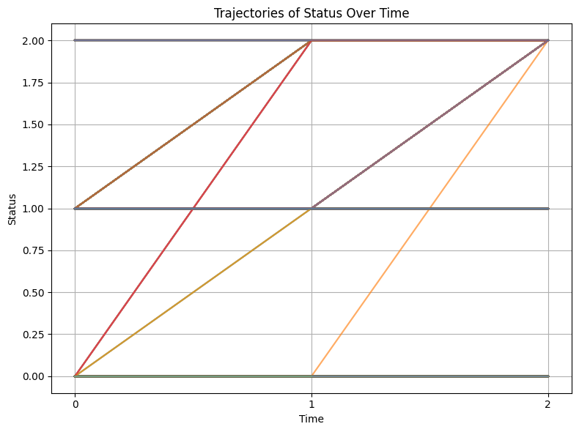
EDA – Trajectories and Dataset (KARE T2D)
# measures per sample | # sample
2 | 27
3 | 664
Total | 691
Pattern | Frequency
0-0-0 | 316
1-1-1 | 157
2-2-2 | 64
1-1-2 | 56
1-2-2 | 52
0-2-2 | 11
0-1-2 | 6
0-0-2 | 2
0-0 | 12
1-1 | 7
2-2 | 7
0-1 | 1
Total | 691
Distribution of Measurement Counts per Sample
Status | #observation
0 | 994
1 | 656
2 | 396
Total | 2046
Figure 1: Trajectories of T2D status for Individuals
0- Control; 1- pre-T2D; 2- T2D
Distribution of Diabetes Status Across Observations
Longitudinal Status Transition Patterns

Slide 20
Reason for assigning different weight to observations
“ Existing methods in feature selection typically only consider the importance of features, without accounting for the varying importance of individual samples. In other words, all samples are treated with equal weight. This approach fails to highlight the contribution of high-quality samples and does not reduce the impact of noisy or anomalous samples, which can limit the performance of learning algorithms.” [1] Liang Y, Gan J, Chen Y, et al. Unsupervised feature selection algorithm based on dual manifold re-ranking[J]. arXiv preprint arXiv:2410.20388, 2024.
Not all samples are equally important, some observations may be noisy or unreliable=> Observations near the edges of the data distribution may be less representative and lower in quality.

Slide 21
Task Overview
Dataset | Description | Value
Korea COVID-19 | Predict BCR/TCR clonal diversity (IGG, IGM, TCR-α/β) ~ inflammatory and immune-related proteins | Reflects adaptive immune function and aids understanding of recovery or vaccine response
Japan T2D | Predict fasting plasma glucose (FPG) ~ clinical and metabolic profiles | Supports early screening and monitoring when direct glucose tests are limited

Slide 22
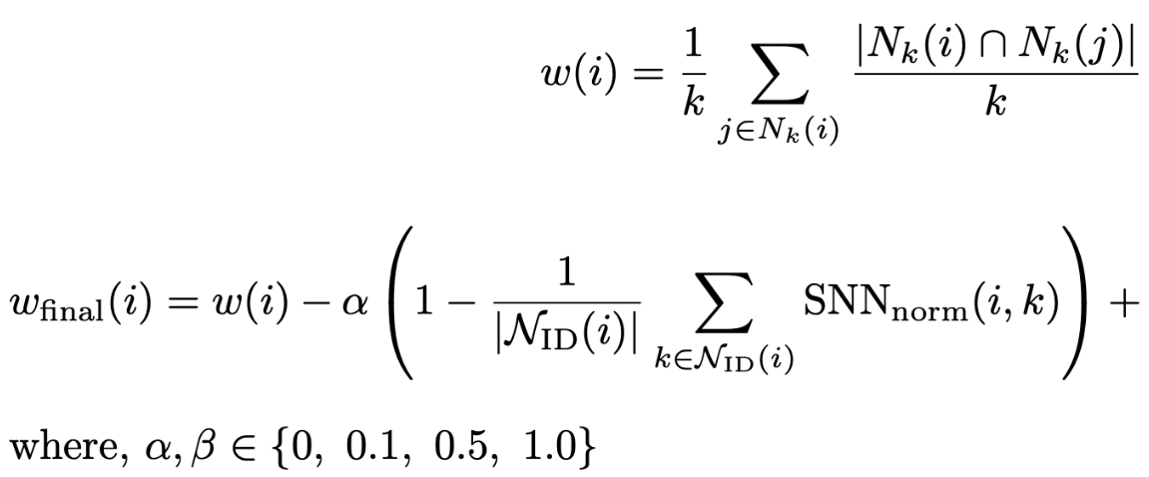

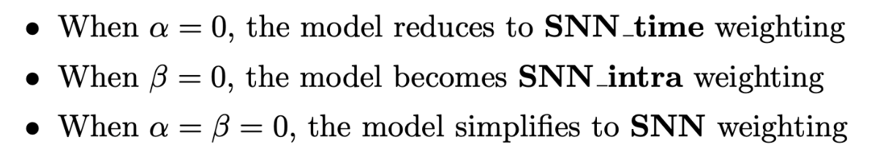
Consistency and time-adjusted SNN weighting (CTSNN)

Slide 23
Consistency and time-adjusted SNN weighting (CTSNN)

Slide 24
Reference
[1] Speiser J L. A random forest method with feature selection for developing medical prediction models with clustered and longitudinal data[J]. Journal of biomedical informatics, 2021, 117: 103763.
[2] Pomsuwan T, Freitas A A. Feature selection for the classification of longitudinal human ageing data[C]//2017 IEEE International Conference on Data Mining Workshops (ICDMW). IEEE, 2017: 739-746.
[3] Lou Q, Obradovic Z. Analysis of temporal high-dimensional gene expression data for identifying informative biomarker candidates[C]//2012 IEEE 12th International Conference on Data Mining. IEEE, 2012: 996-1001.
[4] Ngufor C, Van Houten H, Caffo B S, et al. Mixed effect machine learning: A framework for predicting longitudinal change in hemoglobin A1c[J]. Journal of biomedical informatics, 2019, 89: 56-67.
[5] Jarvis R A, Patrick E A. Clustering using a similarity measure based on shared near neighbors[J]. IEEE Transactions on computers, 1973, 100(11): 1025-1034.

