Slide 1
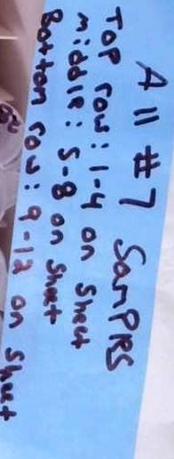
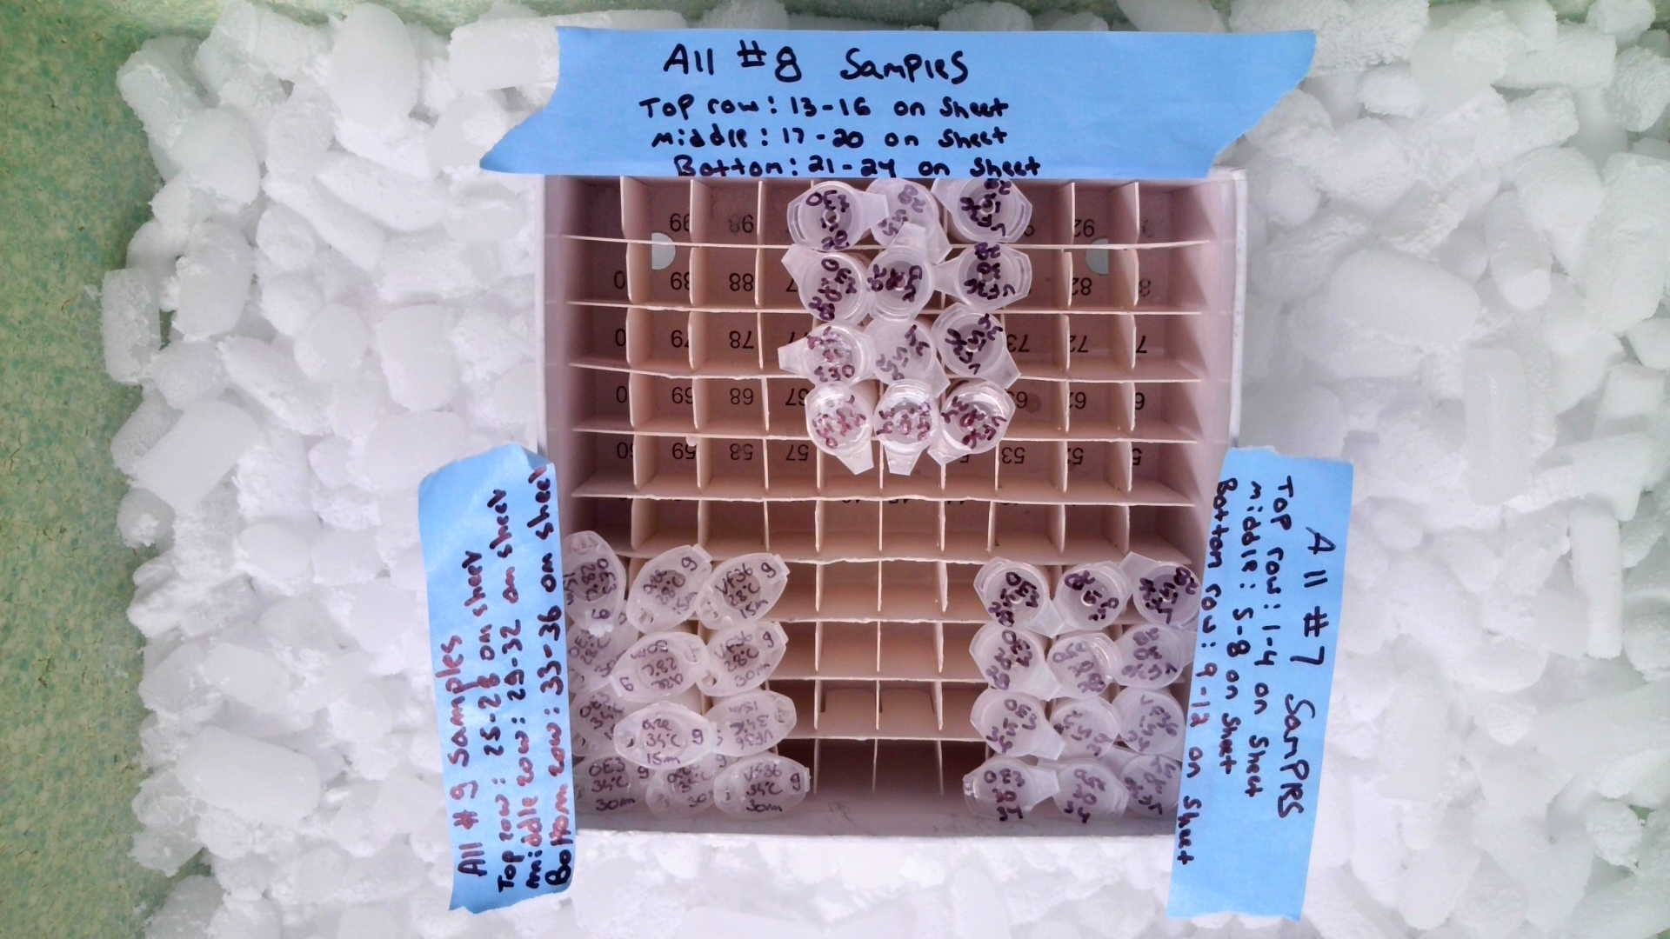
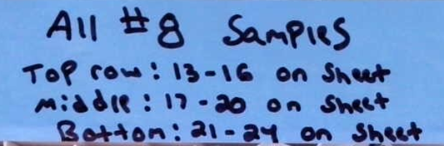
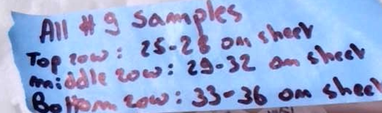
Samples #1-36

Slide 2
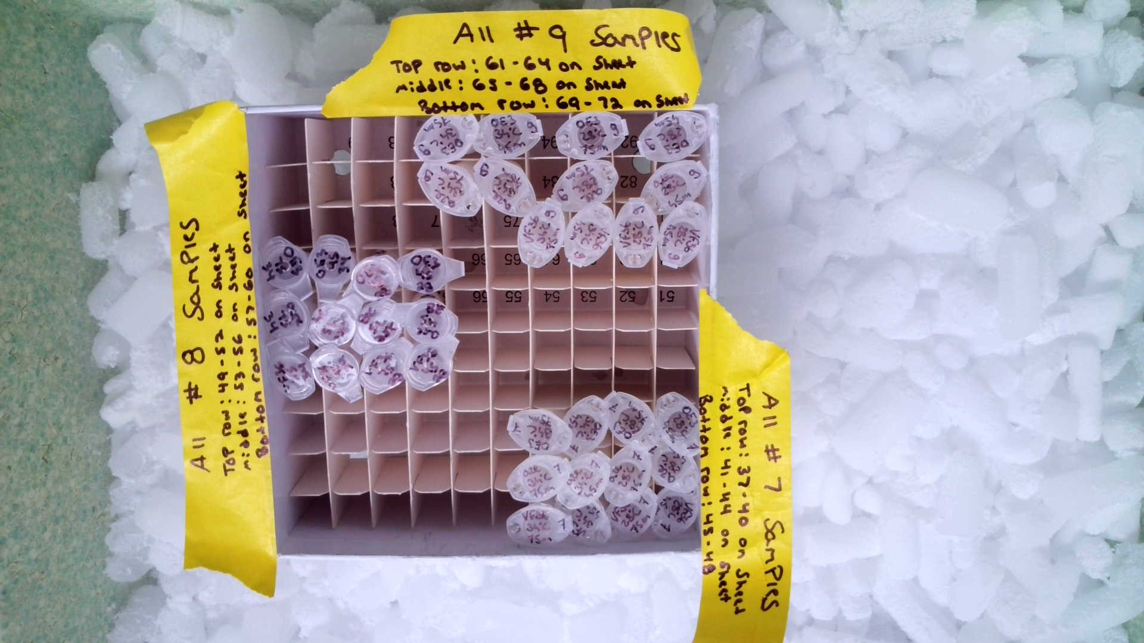
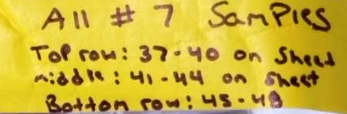
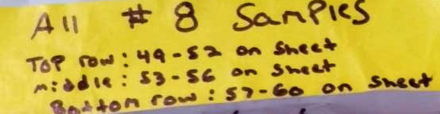
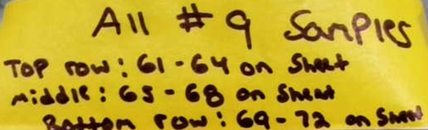
Samples #37-72

Slide 3
4 VF36 samples
4 are samples
4 OE3 samples

Slide 4
3 VF36
1 VF36 2 are
2 are 1 OE3
3 OE3

Slide 5
4 VF36 samples
4 are samples
4 OE3 samples

