Slide 1
UMMC BIOINFORMATICS COLLABORATIVE
INTEREST MEETING
FEBRUARY 6, 2018
Dr. Lavanya Challagundla, Robert Gilmore, & Shaurita Hutchins

Slide 2

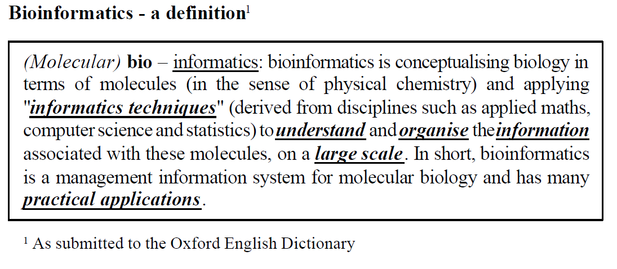
WHAT IS BIOINFORMATICS?

Slide 3
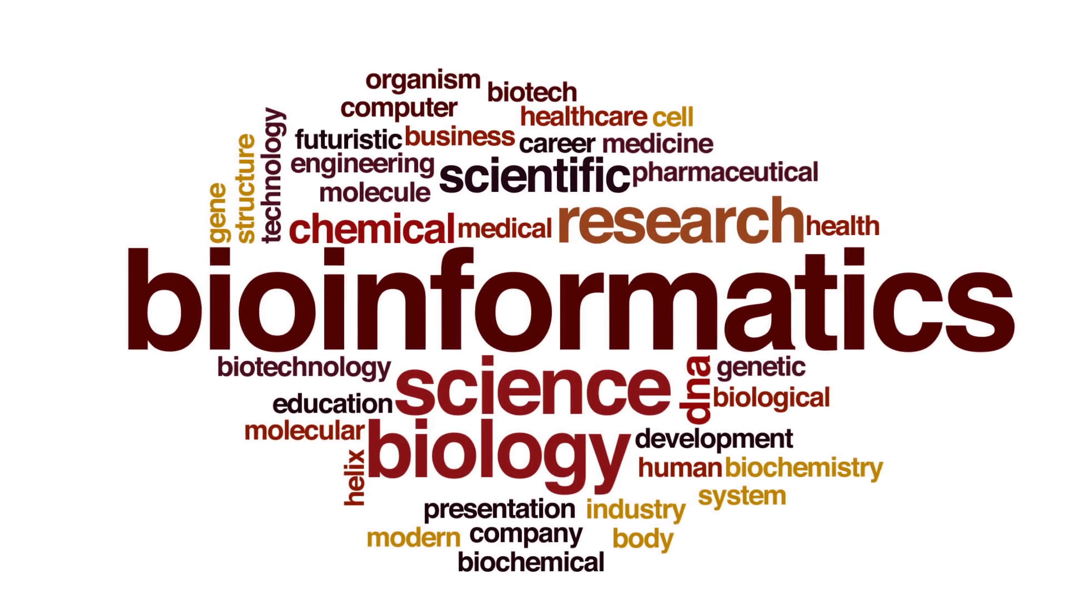
WHAT IS BIOINFORMATICS?

Slide 4
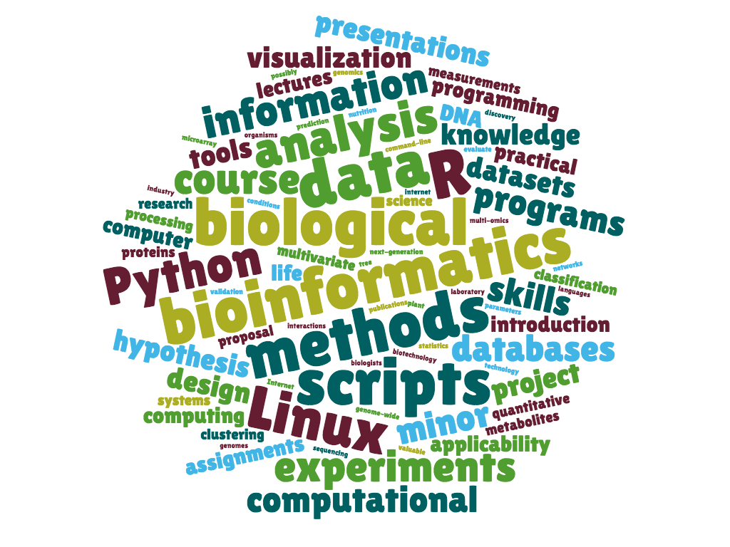
WHAT IS BIOINFORMATICS?

Slide 5
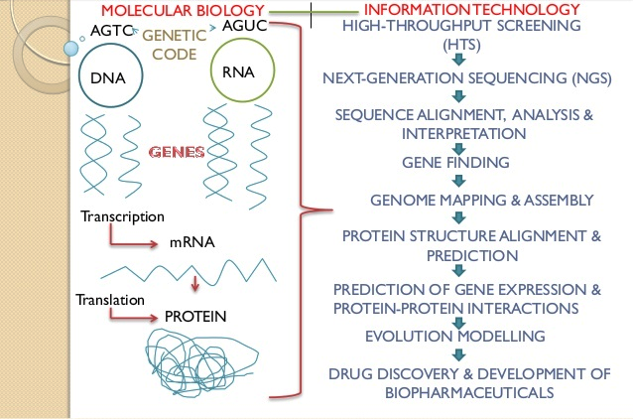
WHAT IS BIOINFORMATICS?

Slide 6
WHY A BIOINFORMATICS “COLLABORATIVE”?
Lack of a strong computational infrastructure at UMMC
Data storage issues, software installation issues
Lack of access to existing resources
Lack of opportunities for collaboration
Lack of standards for Bioinformatics-related research
Existing pipelines, workflows, do’s/dont’s
Lack of a coalition or united voice

Slide 7
GOALS
Organize a Bioinformatics community at UMMC and to promote collaboration and knowledge-sharing and ultimately, harness the ingenuity of current faculty, staff, students
Become a chapter of the MidSouth Computational Biology and Bioinformatics Society
Invite distinguished speakers to discuss their research and for education/informational sessions.
Foster interdepartmental collaborations
Expose students, faculty, and staff to current topics and tools in Bioinformatics
Notes:
Clinicians

Slide 8
CREATING A COMMUNITY
Using our SLACK team as a means of informal communication
tinyurl.com/ummcbc
SLACK provides group and private messaging, creating channels, sharing documents, and numerous integrations (GitHub, Email, Google, etc.)
GitHub Organization
github.com/ummc-bc
Documentation of events/meetings, blog, and collaborative projects.
Blog/Website
ummc-bc.github.io
Demo currently available
Notes:
Slack - short slack demo
GitHub - short repository walkthrough; show blog/website
#github-favorites - https://github.com/grabear/awesome-rshiny
#github-favorites - https://github.com/grunwaldlab/metacoder
DM: HI SHAURITA, THANKS FOR TESTING THIS OUT WITH ME LIVE
commit mettings repo: Create README.md (Create copy/paste template)

Slide 9
SHARING KNOWLEDGE
Sharing pipelines, code, and documentation
Sharing Bioinformatics tools internally created
Creating an index of tools available
Making currently available UMMC resources (from software to datasets to server access) more transparent
Sharing skillsets by collaborating on projects
Notes:
Mention git/GitHub Enterprise

Slide 10
Examples
Currently working with microbiome data from the Genomics Core
Xiao Zhang (PhD. student in Neuroscience) needed a heatmap
For us it was unclear how to proceed
After trial and error, we discovered BIOM, Nephele, and heat-trees
Created robust analysis, resulting in better data analysis and visualization
GitHub/GitLab for UMMC
These tools could be used for standardizing the microbiome workflow
Xiao’s GitHub Page (ask for permission)
Notes:
Mention git/GitHub Enterprise.
GitHub Link: https://github.com/grabear/XZ-Stress-Microbiome
Add GitLab link.

Slide 11

WHAT IS MCBIOS?
MidSouth Computational Biology and Bioinformatics Society
Mississippi Chapter
Previously at Ole Miss under Dr. Dawn Wilkins in the Deptartmentof Computer and Information Science & currently inactive
Provides an opportunity for networking
Strengthening of the greater Bioinformatics community
The 15th Annual MCBIOS Conference
March 29 - 31, 2018
Genomics and Big Data
Starkville, MS
Notes:
Will give us the ability to invite speakers and will give others opportunities to speak at MCBIOS conferences.

Slide 12
MEETING TYPES
Seminars
To expose UMMC faculty, staff, & students to relevant research & resources
Ben Pharr – Interim Director of the MCSR - TBD
Seminar to all UMMC faculty, staff, students & potentially a private workshop for a smaller group
Article or research discussion meetings (journal club format)
To cover bioinformatics methods & how they’re used to answer specific biological questions
Workshops
To learn new technologies
To learn best practices given current (UMMC) infrastructure
Notes:
https://mcsr.olemiss.edu/

Slide 13
POTENTIAL TOPICS
Cloud Computing
“Big Data” Storage and Management
Data Analysis & Visualization
Novel Bioinformatics Tools & Methods
Utilization of the Mississippi Center for Supercomputing Research (MCSR)
Discussion of projects encompassing Next-Generation Sequencing (NGS), RNASeq, Phylogenetics, Genomics, Proteomics, Whole-Genome Sequencing
Notes:
Amazon AWS
Hardware - MCSR; UMMC comput servers
R - shiny; Python - Dash; Plotly
Phylogenetic Analysis; GWAS

Slide 14
FEEDBACK AND FURTHER DISCUSSIONS
SLACK - tinyurl.com/ummcbc
GitHub - github.com/ummc-bc

Slide 15

Dr. Lavanya Challagundla
Dr. Robert Hester
Dr. Eric Vallender – Bioinformatics Collaborative Advisor

