Slide 1
Model Designs | Two factors - interaction model
drug genotype
sample1 Pink WT
sample2 Pink WT
sample3 Pink MUT
sample4 Pink MUT
sample5 White WT
sample6 White WT
sample7 White MUT
sample8 White MUT
Design:
~ drug + genotype + drug:genotype
Null hypothesis:
Pink vs White (WT)
𝛽₁ = 0
Pink vs White (MUT)
𝛽₁ + 𝛽₃ = 0
WT vs MUT (White)
𝛽₂ = 0
WT vs MUT (Pink)
𝛽₂ + 𝛽₃ = 0
Interaction (“Difference of differences”):
𝛽₃ = 0
𝛽₃
𝛽₁
𝛽₁
𝛽₂
𝛽₂
𝛽₀
WT
MUT

Slide 2
Model Designs | Two factors - interaction model
SampleName | Status | TimePoint
SRR7657878 | Infected | d11
SRR7657881 | Infected | d11
SRR7657880 | Infected | d11
SRR7657874 | Infected | d33
SRR7657882 | Uninfected | d33
SRR7657872 | Infected | d33
SRR7657877 | Uninfected | d11
SRR7657876 | Uninfected | d11
SRR7657879 | Uninfected | d11
SRR7657883 | Uninfected | d33
SRR7657873 | Infected | d33
SRR7657875 | Uninfected | d33
Design:
~ TimePoint + Status + TimePoint:Status

Slide 3
Model Designs | Two factors - interaction model
Design:
~ TimePoint + Status + TimePoint:Status
Model:
Y = 𝛽₀ + 𝛽₁ T_{d33} + 𝛽₂ S_{Inf} + 𝛽₃ T_{d33} S_{Inf} + 𝞊
- d11
- d33
𝛽₀ → Expression in uninfected mice at day 11
𝛽₃
𝛽₁ → Effect of moving to day 33
𝛽₂
𝛽₂ → Effect of being infected
𝛽₁
𝛽₁
𝛽₂
𝛽₃ → Additional change due to interaction of time and infection
𝛽₀
Uninfected
Infected

Slide 4
Model Designs | Two factors - interaction model
Design:
~ TimePoint + Status + TimePoint:Status
- d11
Coefficient names in DESeq2
- d33
𝛽₀ : Intercept
𝛽₃
𝛽₁ : TimePoint_d33_vs_d11
𝛽₂
𝛽₂ : Status_Infected_vs_Uninfected
𝛽₁
𝛽₁
𝛽₂
𝛽₃ : TimePointd33.StatusInfected
𝛽₀
Uninfected
Infected

Slide 5
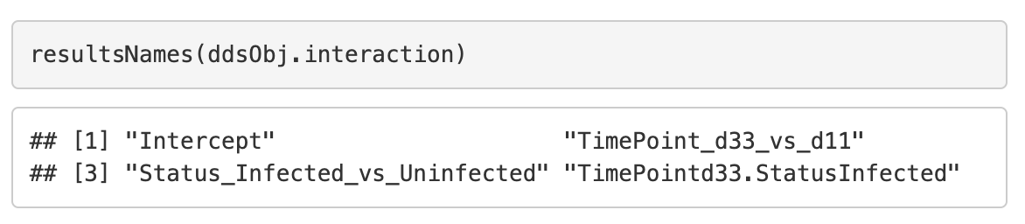
Model Designs | Two factors - interaction model
Design:
~ TimePoint + Status + TimePoint:Status
- d11
Coefficient names in DESeq2
- d33
𝛽₀ : Intercept
𝛽₃
𝛽₁ : TimePoint_d33_vs_d11
𝛽₂
𝛽₂ : Status_Infected_vs_Uninfected
𝛽₁
𝛽₁
𝛽₂
𝛽₃ : TimePointd33.StatusInfected
𝛽₀
Uninfected
Infected

Slide 6
Model Designs | Two factors - interaction model
Design:
~ TimePoint + Status + TimePoint:Status
- d11
Contrast: d33 vs d11 when Uninfected
- d33
Gene Expression:
Uninfected d11 = 𝛽₀
Uninfected d33 = 𝛽₀ + 𝛽₁
𝛽₃
𝛽₂
𝛽₁
𝛽₁
𝛽₂
𝛽₀
Uninfected
Infected

Slide 7
Model Designs | Two factors - interaction model
Design:
~ TimePoint + Status + TimePoint:Status
- d11
Contrast: d33 vs d11 when Uninfected
- d33
Gene Expression:
Uninfected d11 = 𝛽₀
Uninfected d33 = 𝛽₀ + 𝛽₁
--------------------------------------------
d33 vs d11 when Uninfected = (𝛽₀ + 𝛽₁ ) - 𝛽₀ = 𝛽₁
𝛽₃
𝛽₂
𝛽₁
𝛽₁
𝛽₂
𝛽₀
Uninfected
Infected

Slide 8
Model Designs | Two factors - interaction model
Design:
~ TimePoint + Status + TimePoint:Status
- d11
Contrast: d33 vs d11 when Uninfected
- d33
Gene Expression:
Uninfected d11 = 𝛽₀
Uninfected d33 = 𝛽₀ + 𝛽₁
--------------------------------------------
d33 vs d11 when Uninfected = (𝛽₀ + 𝛽₁ ) - 𝛽₀ = 𝛽₁
𝛽₃
𝛽₂
𝛽₁
𝛽₁
𝛽₂
𝛽₀
Uninfected
Infected

Slide 9
Model Designs | Two factors - interaction model
Design:
~ TimePoint + Status + TimePoint:Status
- d11
Contrast: d33 vs d11 when Uninfected
- d33
Gene Expression:
Uninfected d11 = 𝛽₀
Uninfected d33 = 𝛽₀ + 𝛽₁
--------------------------------------------
d33 vs d11 when Uninfected = (𝛽₀ + 𝛽₁ ) - 𝛽₀ = 𝛽₁
𝛽₁ : TimePoint_d33_vs_d11
𝛽₃
𝛽₂
𝛽₁
𝛽₁
𝛽₂
𝛽₀
Uninfected
Infected

Slide 10
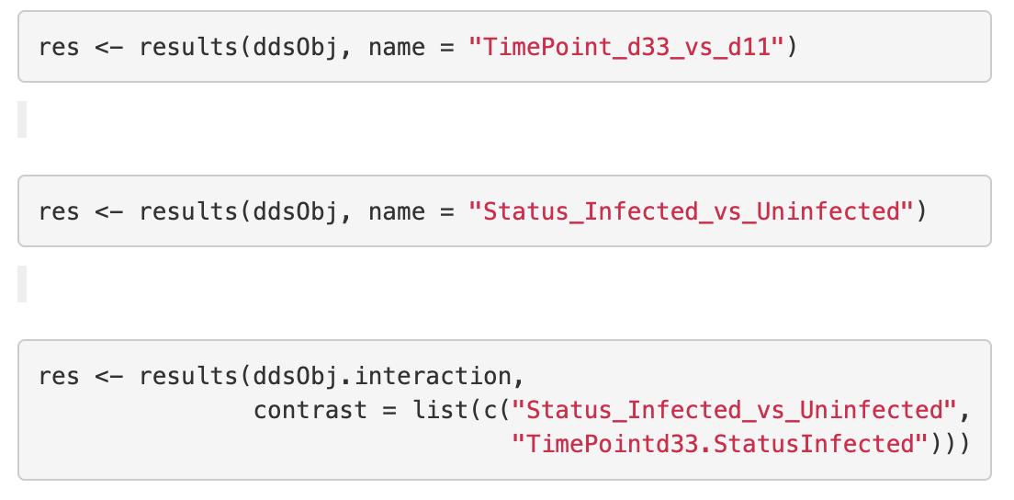
Model Designs | Two factors - interaction model
Design:
~ TimePoint + Status + TimePoint:Status
- d11
Contrast: d33 vs d11 when Uninfected
- d33
Gene Expression:
Uninfected d11 = 𝛽₀
Uninfected d33 = 𝛽₀ + 𝛽₁
--------------------------------------------
d33 vs d11 when Uninfected = (𝛽₀ + 𝛽₁ ) - 𝛽₀ = 𝛽₁
𝛽₁ : TimePoint_d33_vs_d11
𝛽₃
𝛽₂
𝛽₁
𝛽₁
𝛽₂
𝛽₀
Uninfected
Infected

Slide 11
Model Designs | Two factors - interaction model
Design:
~ TimePoint + Status + TimePoint:Status
- d11
Contrast: Infected vs Uninfected at d11
- d33
Gene Expression:
Uninfected d11 = 𝛽₀
Infected d11 = 𝛽₀ + 𝛽₂
𝛽₃
𝛽₂
𝛽₁
𝛽₁
𝛽₂
𝛽₀
Uninfected
Infected

Slide 12
Model Designs | Two factors - interaction model
Design:
~ TimePoint + Status + TimePoint:Status
- d11
Contrast: Infected vs Uninfected at d11
- d33
Gene Expression:
Uninfected d11 = 𝛽₀
Infected d11 = 𝛽₀ + 𝛽₂
--------------------------------------------
Infected vs Uninfected = (𝛽₀ + 𝛽₂ ) - 𝛽₀ = 𝛽₂
𝛽₃
𝛽₂
𝛽₁
𝛽₁
𝛽₂
𝛽₀
Uninfected
Infected

Slide 13
Model Designs | Two factors - interaction model
Design:
~ TimePoint + Status + TimePoint:Status
- d11
Contrast: Infected vs Uninfected at d11
- d33
Gene Expression:
Uninfected d11 = 𝛽₀
Infected d11 = 𝛽₀ + 𝛽₂
--------------------------------------------
Infected vs Uninfected = (𝛽₀ + 𝛽₂ ) - 𝛽₀ = 𝛽₂
𝛽₃
𝛽₂
𝛽₁
𝛽₁
𝛽₂
𝛽₀
Uninfected
Infected

Slide 14
Model Designs | Two factors - interaction model
Design:
~ TimePoint + Status + TimePoint:Status
- d11
Contrast: Infected vs Uninfected at d11
- d33
Gene Expression:
Uninfected d11 = 𝛽₀
Infected d11 = 𝛽₀ + 𝛽₂
--------------------------------------------
Infected vs Uninfected = (𝛽₀ + 𝛽₂ ) - 𝛽₀ = 𝛽₂
𝛽₂ : Status_Infected_vs_Uninfected
𝛽₃
𝛽₂
𝛽₁
𝛽₁
𝛽₂
𝛽₀
Uninfected
Infected

Slide 15
Model Designs | Two factors - interaction model
Design:
~ TimePoint + Status + TimePoint:Status
- d11
Contrast: Infected vs Uninfected at d11
- d33
Gene Expression:
Uninfected d11 = 𝛽₀
Infected d11 = 𝛽₀ + 𝛽₂
--------------------------------------------
Infected vs Uninfected = (𝛽₀ + 𝛽₂ ) - 𝛽₀ = 𝛽₂
𝛽₂ : Status_Infected_vs_Uninfected
𝛽₃
𝛽₂
𝛽₁
𝛽₁
𝛽₂
𝛽₀
Uninfected
Infected

Slide 16
Model Designs | Two factors - interaction model
Design:
~ TimePoint + Status + TimePoint:Status
- d11
Contrast: Infected vs Uninfected at d33
- d33
Gene Expression:
Uninfected d33 = 𝛽₀ + 𝛽₁
Infected d33 = 𝛽₀ + 𝛽₁ + 𝛽₂ + 𝛽₃
𝛽₃
𝛽₂
𝛽₁
𝛽₁
𝛽₂
𝛽₀
Uninfected
Infected

Slide 17
Model Designs | Two factors - interaction model
Design:
~ TimePoint + Status + TimePoint:Status
- d11
Contrast: Infected vs Uninfected at d33
- d33
Gene Expression:
Uninfected d33 = 𝛽₀ + 𝛽₁
Infected d33 = 𝛽₀ + 𝛽₁ + 𝛽₂ + 𝛽₃
--------------------------------------------
Infected vs Uninfected = (𝛽₀ + 𝛽₁ + 𝛽₂ + 𝛽₃ ) - (𝛽₀ + 𝛽₁) = 𝛽₂ + 𝛽₃
𝛽₃
𝛽₂
𝛽₁
𝛽₁
𝛽₂
𝛽₀
Uninfected
Infected

Slide 18
Model Designs | Two factors - interaction model
Design:
~ TimePoint + Status + TimePoint:Status
- d11
Contrast: Infected vs Uninfected at d33
- d33
Gene Expression:
Uninfected d33 = 𝛽₀ + 𝛽₁
Infected d33 = 𝛽₀ + 𝛽₁ + 𝛽₂ + 𝛽₃
--------------------------------------------
Infected vs Uninfected = (𝛽₀ + 𝛽₁ + 𝛽₂ + 𝛽₃ ) - (𝛽₀ + 𝛽₁) = 𝛽₂ + 𝛽₃
𝛽₃
𝛽₂
𝛽₁
𝛽₁
𝛽₂
𝛽₀
Uninfected
Infected

Slide 19
Model Designs | Two factors - interaction model
Design:
~ TimePoint + Status + TimePoint:Status
- d11
Contrast: Infected vs Uninfected at d33
- d33
Gene Expression:
Uninfected d33 = 𝛽₀ + 𝛽₁
Infected d33 = 𝛽₀ + 𝛽₁ + 𝛽₂ + 𝛽₃
--------------------------------------------
Infected vs Uninfected = (𝛽₀ + 𝛽₁ + 𝛽₂ + 𝛽₃ ) - (𝛽₀ + 𝛽₁) = 𝛽₂ + 𝛽₃
𝛽₂ : Status_Infected_vs_Uninfected
𝛽₃ : TimePointd33.StatusInfected
𝛽₃
𝛽₂
𝛽₁
𝛽₁
𝛽₂
𝛽₀
Uninfected
Infected

Slide 20
Model Designs | Two factors - interaction model
Design:
~ TimePoint + Status + TimePoint:Status
- d11
Contrast: Infected vs Uninfected at d33
- d33
Gene Expression:
Uninfected d33 = 𝛽₀ + 𝛽₁
Infected d33 = 𝛽₀ + 𝛽₁ + 𝛽₂ + 𝛽₃
--------------------------------------------
Infected vs Uninfected = (𝛽₀ + 𝛽₁ + 𝛽₂ + 𝛽₃ ) - (𝛽₀ + 𝛽₁) = 𝛽₂ + 𝛽₃
𝛽₂ : Status_Infected_vs_Uninfected
𝛽₃ : TimePointd33.StatusInfected
𝛽₃
𝛽₂
𝛽₁
𝛽₁
𝛽₂
𝛽₀
Uninfected
Infected

