Slide 1


Models and contrasts in R/DESeq2
Starting at 14:30
In collaboration with:

Slide 2
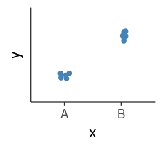
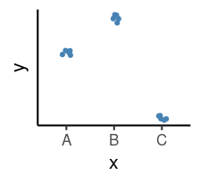
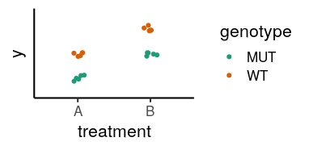
Outline
How to interpret linear models coefficients
categorical variables & model matrix
How to specify models in R using the “formula syntax”
How to interpret the results of different model designs
One factor, 3 levels
Two factors, additive
Two factors, interaction
How DESeq2 reports its results and how to interpret them
y ~ x

Slide 3
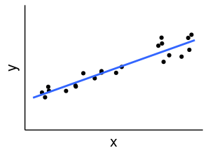
Linear Models in R
A model is a simplified representation of how we think different variables relate to each other.
Linear models are the most commonly used in statistical inference.
Y = 𝛽₀ + 𝛽₁ X
Intercept
Slope

Slide 4
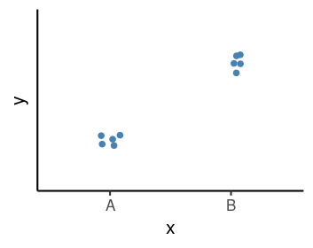
Linear Models in R | Categorical Variables
x
<factor>
sample1 A
sample2 A
sample3 A
sample4 B
sample5 B
sample6 B

Slide 5
Linear Models in R | Categorical Variables
x
<factor>
sample1 A
sample2 A
sample3 A
sample4 B
sample5 B
sample6 B
Model:
Y = 𝛽₀ + 𝛽₁ X_{B}
𝛽₀ = average of the reference group
𝛽₁ = difference to the reference group
𝛽₁
𝛽₀

Slide 6
Linear Models in R | Categorical Variables
x xB
<factor>
sample1 A 0
sample2 A 0
sample3 A 0
sample4 B 1
sample5 B 1
sample6 B 1
Model:
Y = 𝛽₀ + 𝛽₁ X_{B}
𝛽₀ = average of the reference group
𝛽₁ = difference to the reference group
𝛽₁
𝛽₀
Indicator / Dummy variable
Example:
𝛽₀ = 5; 𝛽₁ = 3
Y = 5 + 3 * X_{B}
3 * 0 = 5 if “A”
3 * 1 = 8 if “B”
Y = 5 +

Slide 7
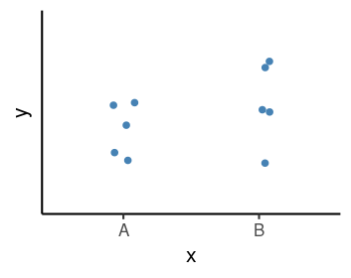
Linear Models in R | Null Hypothesis Testing
How compatible is my data with a “boring” hypothesis?
Null hypothesis: 𝛽₁ = 0
Model:
Y = 𝛽₀ + 𝛽₁ X_{B}
𝛽₀ = average of the reference group
𝛽₁ = difference to the reference group
𝛽₁
𝛽₀
𝛽₁
𝛽₀
Test statistic: 𝛽₁ / σ_{𝛽1}
(our estimate divided by the uncertainty in that estimate)
P-value calculated from the test statistic
Low p-value indicates that the data are not very compatible with the null hypothesis.

Slide 8
Linear Models in R | Null Hypothesis Testing
How compatible is my data with a “boring” hypothesis?
Null hypothesis: 𝛽₁ = 0
Model:
Y = 𝛽₀ + 𝛽₁ X_{B}
𝛽₀ = average of the reference group
𝛽₁ = difference to the reference group
𝛽₁
𝛽₀
𝛽₁
Exercise 1
𝛽₀
Test statistic: 𝛽₁ / σ_{𝛽1}
(our estimate divided by the uncertainty in that estimate)
P-value calculated from the test statistic
Low p-value indicates that the data are not very compatible with the null hypothesis.

Slide 9
Linear Models in R | Model Specification
x
<factor>
sample1 A
sample2 A
sample3 A
sample4 B
sample5 B
sample6 B
Model:
Y = 𝛽₀ + 𝛽₁ X_{B}
𝛽₀ = average of the reference group
𝛽₁ = difference to the reference group
𝛽₁
𝛽₀
Formula syntax in R:
outcome ~ predictors

Slide 10
Linear Models in R | Model Specification
Formula syntax in R:
outcome ~ predictors
Model:
Y = 𝛽₀ + 𝛽₁ X_{B}
𝛽₀ = average of the reference group
𝛽₁ = difference to the reference group
𝛽₁
𝛽₀
Intercept
xB
x
<factor>
sample1 A
sample2 A
sample3 A
sample4 B
sample5 B
sample6 B
1 0
1 0
1 0
1 1
1 1
1 1
Design
formula
~ x
Model
Matrix

Slide 11
Linear Models in R | Model Specification
Formula syntax in R:
outcome ~ predictors
Model:
Y = 𝛽₀ + 𝛽₁ X_{B}
𝛽₀ = average of the reference group
𝛽₁ = difference to the reference group
𝛽₁
𝛽₀
Intercept
xB
x
<factor>
sample1 A
sample2 A
sample3 A
sample4 B
sample5 B
sample6 B
Example in R worksheet:
“Model Specification - Formula Syntax”
1 0
1 0
1 0
1 1
1 1
1 1
Design
formula
Model
Matrix
~ x

Slide 12
Linear Models in R | Model Specification
Formula syntax in R:
outcome ~ predictors
Model:
Y = 𝛽₀ + 𝛽₁ X_{B}
𝛽₀ = average of the reference group
𝛽₁ = difference to the reference group
𝛽₁
𝛽₀
Intercept
xB
x
<factor>
sample1 A
sample2 A
sample3 A
sample4 B
sample5 B
sample6 B
1 0
1 0
1 0
1 1
1 1
1 1
1*𝛽₀ + 0*𝛽₁
1*𝛽₀ + 0*𝛽₁
1*𝛽₀ + 0*𝛽₁
1*𝛽₀ + 1*𝛽₁
1*𝛽₀ + 1*𝛽₁
1*𝛽₀ + 1*𝛽₁
Design
formula
Model
Matrix
𝛽₀
𝛽₁
~ x

Slide 13
Linear Models in R | Model Specification
Formula syntax in R:
outcome ~ predictors
Model:
Y = 𝛽₀ + 𝛽₁ X_{B}
𝛽₀ = average of the reference group
𝛽₁ = difference to the reference group
𝛽₁
𝛽₀
Exercise 2 (worksheet)
Intercept
xB
x
<factor>
sample1 A
sample2 A
sample3 A
sample4 B
sample5 B
sample6 B
1 0
1 0
1 0
1 1
1 1
1 1
1*𝛽₀ + 0*𝛽₁
1*𝛽₀ + 0*𝛽₁
1*𝛽₀ + 0*𝛽₁
1*𝛽₀ + 1*𝛽₁
1*𝛽₀ + 1*𝛽₁
1*𝛽₀ + 1*𝛽₁
Design
formula
Model
Matrix
𝛽₀
𝛽₁
~ x

Slide 14
Common Designs
One factor, 2 levels
One factor, 3 levels
Two factors
Define our model with formula syntax
Categorical variables are encoded as indicator variables in a model matrix
R does this for us
Interpret coefficients to define hypothesis of interest

Slide 15
Common Designs | One factor, 3 levels
drug
sample1 Pink
sample2 Pink
sample3 Pink
sample4 Yellow
sample5 Yellow
sample6 Yellow
sample7 White
sample8 White
sample9 White
Design:
Model matrix
~ drug
(Intercept) drugPink drugYellow
1 1 1 0
2 1 1 0
3 1 1 0
4 1 0 1
5 1 0 1
6 1 0 1
7 1 0 0
8 1 0 0
9 1 0 0
Null hypothesis:
Pink vs White
𝛽₁ = 0
Yellow vs White
𝛽₂ = 0
Yellow vs Pink
𝛽₂ - 𝛽₁ = 0
𝛽₁
𝛽₂
Expr = 𝛽₀ + 𝛽₁drug_{Pink} + 𝛽₂drug_{Yellow}
𝛽₀

Slide 16
Model Designs | Two factors - additive model
drug genotype
sample1 Pink WT
sample2 Pink WT
sample3 Pink MUT
sample4 Pink MUT
sample5 White WT
sample6 White WT
sample7 White MUT
sample8 White MUT
Design:
Model Matrix:
~ drug + genotype
(Intercept) drugPink genotypeMUT
1 1 1 0
2 1 1 0
3 1 1 1
4 1 1 1
5 1 0 0
6 1 0 0
7 1 0 1
8 1 0 1
Null hypothesis:
Pink vs White drug
𝛽₁ = 0
WT vs MUT genotype
𝛽₂ = 0
𝛽₁
𝛽₁
Expr = 𝛽₀ + 𝛽₁drug_{Pink} + 𝛽₂genotype_{MUT}
𝛽₂
𝛽₂
𝛽₀
WT
MUT

Slide 17
Model Designs | Two factors - additive model
drug genotype
sample1 Pink WT
sample2 Pink WT
sample3 Pink MUT
sample4 Pink MUT
sample5 White WT
sample6 White WT
sample7 White MUT
sample8 White MUT
Design:
Model Matrix:
~ drug + genotype
(Intercept) drugPink genotypeMUT
1 1 1 0
2 1 1 0
3 1 1 1
4 1 1 1
5 1 0 0
6 1 0 0
7 1 0 1
8 1 0 1
Exercise 3 (worksheet)
Null hypothesis:
Pink vs White drug
𝛽₁ = 0
WT vs MUT genotype
𝛽₂ = 0
𝛽₁
𝛽₁
Expr = 𝛽₀ + 𝛽₁drug_{Pink} + 𝛽₂genotype_{MUT}
𝛽₂
𝛽₂
𝛽₀
WT
MUT

Slide 18
Model Designs | Two factors - interaction model
drug genotype
sample1 Pink WT
sample2 Pink WT
sample3 Pink MUT
sample4 Pink MUT
sample5 White WT
sample6 White WT
sample7 White MUT
sample8 White MUT
Design:
~ drug + genotype
Expr = 𝛽₀ + 𝛽₁ drug_{Pink} + 𝛽₂ genotype_{MUT}
𝛽₁
𝛽₁
𝛽₂
𝛽₂
𝛽₀
WT
MUT

Slide 19
Model Designs | Two factors - interaction model
drug genotype
sample1 Pink WT
sample2 Pink WT
sample3 Pink MUT
sample4 Pink MUT
sample5 White WT
sample6 White WT
sample7 White MUT
sample8 White MUT
Design:
~ drug + genotype
Expr = 𝛽₀ + 𝛽₁ drug_{Pink} + 𝛽₂ genotype_{MUT}
𝛽₁
𝛽₁
𝛽₂
𝛽₂
𝛽₀
WT
MUT

Slide 20
Model Designs | Two factors - interaction model
drug genotype
sample1 Pink WT
sample2 Pink WT
sample3 Pink MUT
sample4 Pink MUT
sample5 White WT
sample6 White WT
sample7 White MUT
sample8 White MUT
Design:
~ drug + genotype + drug:genotype
Expr = 𝛽₀ + 𝛽₁ drug_{Pink} + 𝛽₂ genotype_{MUT} + 𝛽₃ drug_{Pink}genotype_{MUT}
Null hypothesis:
Pink vs White (WT)
𝛽₁ = 0
Pink vs White (MUT)
𝛽₁ + 𝛽₃ = 0
WT vs MUT (White)
𝛽₂ = 0
WT vs MUT (Pink)
𝛽₂ + 𝛽₃ = 0
Interaction (“Difference of differences”):
𝛽₃ = 0
𝛽₃
𝛽₁
𝛽₁
𝛽₂
𝛽₂
𝛽₀
WT
MUT

Slide 21
Model Designs | Two factors - interaction model
drug genotype
sample1 Pink WT
sample2 Pink WT
sample3 Pink MUT
sample4 Pink MUT
sample5 White WT
sample6 White WT
sample7 White MUT
sample8 White MUT
Design:
~ drug + genotype + drug:genotype
Expr = 𝛽₀ + 𝛽₁ drug_{Pink} + 𝛽₂ genotype_{MUT} + 𝛽₃ drug_{Pink}genotype_{MUT}
Null hypothesis:
Pink vs White (WT)
𝛽₁ = 0
Pink vs White (MUT)
𝛽₁ + 𝛽₃ = 0
WT vs MUT (White)
𝛽₂ = 0
WT vs MUT (Pink)
𝛽₂ + 𝛽₃ = 0
Interaction (“Difference of differences”):
𝛽₃ = 0
𝛽₃
𝛽₁
𝛽₁
Exercise 4
𝛽₂
𝛽₂
𝛽₀
WT
MUT

Slide 22
Model Designs | Two factors - interaction model
drug genotype
sample1 Pink WT
sample2 Pink WT
sample3 Pink MUT
sample4 Pink MUT
sample5 White WT
sample6 White WT
sample7 White MUT
sample8 White MUT
Design:
~ drug + genotype + drug:genotype
Model Matrix:
(Intercept) drugPink genotypeMUT drugPink:genotypeMUT
1 1 1 0 0
2 1 1 0 0
3 1 1 1 1
4 1 1 1 1
5 1 0 0 0
6 1 0 0 0
7 1 0 1 0
8 1 0 1 0
𝛽₃
𝛽₁
𝛽₁
Expr = 𝛽₀ + 𝛽₁ drug_{Pink} + 𝛽₂ genotype_{MUT} + 𝛽₃ drug_{Pink}genotype_{MUT}
𝛽₂
𝛽₂
𝛽₀
WT
MUT

Slide 23
Model Specification in DESeq2
Create DESeqDataSet object
Add model design:
design(dds) ← ~ treatment
Fit the statistical model dds ← DESeq(dds)
Check coefficients for hypothesis testing resultsNames(dds)
𝛽₁
𝛽₂
𝛽₀
A
B
C

Slide 24
Model Specification in DESeq2
Create DESeqDataSet object
Add model design:
design(dds) ← ~ treatment
Fit the statistical model dds ← DESeq(dds)
Check coefficients for hypothesis testing resultsNames(dds)
𝛽₁
𝛽₂
𝛽₀
A
B
C
 | Null Hypothesis
B vs A | 𝛽₁ = 0
C vs A | 𝛽₂ = 0
C vs B | 𝛽₂ - 𝛽₁ = 0

Slide 25
Model Specification in DESeq2
Create DESeqDataSet object
Add model design:
design(dds) ← ~ treatment
Fit the statistical model dds ← DESeq(dds)
Check coefficients for hypothesis testing resultsNames(dds)
DESeq coefficient names:
𝛽₀ → Intercept
𝛽₁ → treatment_B_vs_A
𝛽₂ → treatment_C_vs_A
𝛽₁
𝛽₂
𝛽₀
A
B
C
 | Null Hypothesis
B vs A | 𝛽₁ = 0
C vs A | 𝛽₂ = 0
C vs B | 𝛽₂ - 𝛽₁ = 0

Slide 26
Model Specification in DESeq2
Create DESeqDataSet object
Add model design:
design(dds) ← ~ treatment
Fit the statistical model dds ← DESeq(dds)
Check coefficients for hypothesis testing resultsNames(dds)
Extract test results for the null hypothesis results(dds, contrast = list(“name_of_coefficient”))
DESeq coefficient names:
𝛽₀ → Intercept
𝛽₁ → treatment_B_vs_A
𝛽₂ → treatment_C_vs_A
𝛽₁
𝛽₂
𝛽₀
A
B
C
 | Null Hypothesis | DESeq contrast
B vs A | 𝛽₁ = 0 | list(“treatment_B_vs_A”)
C vs A | 𝛽₂ = 0 | list(“treatment_C_vs_A”)
C vs B | 𝛽₂ - 𝛽₁ = 0 | list(“treatment_C_vs_A”, “treatment_B_vs_A”)

Slide 27
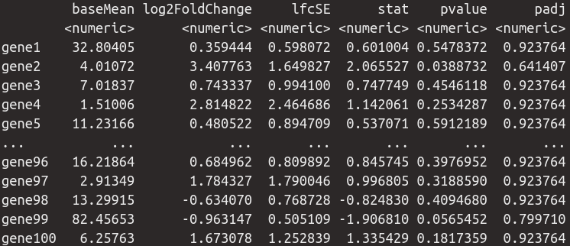
Model Specification in DESeq2 | Interpreting the Results
results(dds, contrast = list(“treatment_B_vs_A”))
baseMean → Mean across all samples
log2FoldChange → log₂(B/A) i.e. the difference between treatments
lfcSE → the standard error of the log2FoldChange
stat → the test statistic = log2FoldChange/lfcSE
pvalue → the p-value of the Wald test
padj → the p-value adjusted for multiple testing (false discovery rate)

Slide 28
Model Specification in DESeq2 | Interpreting the Results
results(dds, contrast = list(“treatment_B_vs_A”))
𝛽₁
𝛽₂
𝛽₀
A
B
C
baseMean → Mean across all samples
log2FoldChange → log₂(B/A) i.e. the difference between treatments
lfcSE → the standard error of the log2FoldChange
stat → the test statistic = log2FoldChange/lfcSE
pvalue → the p-value of the Wald test
padj → the p-value adjusted for multiple testing (false discovery rate)
← Our 𝛽 !!

Slide 29
Model Specification in DESeq2 | Interpreting the Results
results(dds, contrast = list(“treatment_B_vs_A”))
Exercise 5
𝛽₁
𝛽₂
𝛽₀
A
B
C
baseMean → Mean across all samples
log2FoldChange → log₂(B/A) i.e. the difference between treatments
lfcSE → the standard error of the log2FoldChange
stat → the test statistic = log2FoldChange/lfcSE
pvalue → the p-value of the Wald test
padj → the p-value adjusted for multiple testing (false discovery rate)
← Our 𝛽 !!

Slide 30
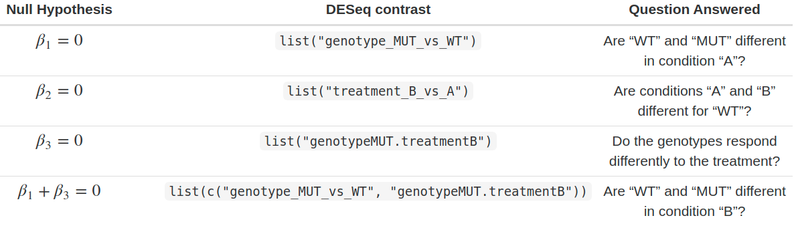
Model Specification in DESeq2 | Setting Contrasts
𝛽₃
𝛽₁
𝛽₁
𝛽₂
𝛽₂
𝛽₀
A
B

Slide 31
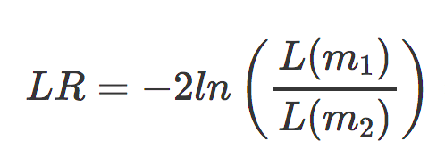
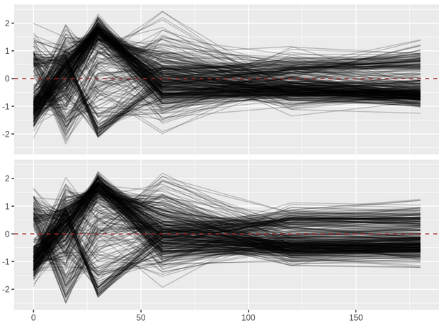
Model Specification in DESeq2 | Likelihood-ratio Test
The default test in DESeq2 is the Wald test, testing for null hypothesis that LFC = 0
And alternative is the Likelihood Ratio Test
WT
Example:
design(dds) ← ~ genotype + timepoint + genotype:timepoint
dds ← DESeq(dds, test = “LRT”,
reduced = ~ genotype)
Mutant
Timepoint

Slide 32
Conclusions
Differential expression tests are based on linear models, where the gene expression is modelled as an outcome of several variables of interest (e.g. treatment, genotype, infection status, etc.).
Linear models use indicator or dummy variables to encode categorical variables in a model matrix.
To define models in R/DESeq2 we use the formula syntax: ~ variables
Some common models are:
Single factor: ~ variable1
Two factor, additive: ~ variable1 + variable2
Two factor, interaction: ~ variable1 + variable2 + variable1:variable2
Interpreting our model coefficients allows us to define hypothesis/comparisons/contrasts of interest.
In DESeq2 we use the `results()` function to obtain the log2(fold-change) in gene expression between groups of interest ("contrast").

