Slide 1

Models And Contrasts In R And Deseq2

Slide 2
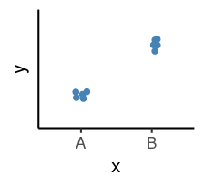
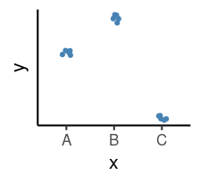
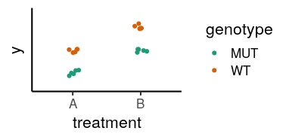
Outline
How to interpret linear models coefficients
categorical variables & model matrix
How to specify models in R using the “formula syntax”
How to interpret the results of different model designs
One factor, 3 levels
Two factors, additive
Two factors, interaction
How DESeq2 reports its results and how to interpret them
y ~ x

Slide 3
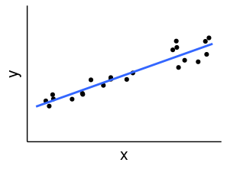
Linear Model
A model is a simplified representation of how we think different variables relate to each other.
Linear models are the most commonly used in statistical inference.
Y = 𝛽₀ + 𝛽₁ X + 𝞊
Intercept
Slope
Errors
X = Independent variable
Y = Dependent variable

Slide 4
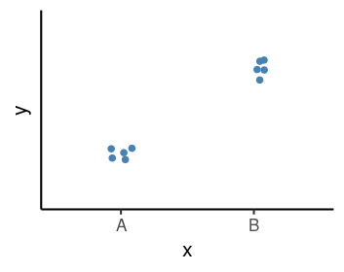
Linear Models in R | Categorical Variables
x
<factor>
sample1 A
sample2 A
sample3 A
sample4 B
sample5 B
sample6 B

Slide 5
Linear Models in R | Categorical Variables
Model:
Y = 𝛽₀ + 𝛽₁ X_{B} + 𝞊
𝛽₀ = average of the reference group
𝛽₁ = difference to the reference group
x
<factor>
sample1 A
sample2 A
sample3 A
sample4 B
sample5 B
sample6 B
𝛽₁
𝛽₀

Slide 6
Linear Models in R | Categorical Variables
x xB
<factor>
sample1 A 0
sample2 A 0
sample3 A 0
sample4 B 1
sample5 B 1
sample6 B 1
Model:
Y = 𝛽₀ + 𝛽₁ X_{B} + 𝞊
𝛽₀ = average of the reference group
𝛽₁ = difference to the reference group
𝛽₁
𝛽₀
Indicator / Dummy variable
Example:
𝛽₀ = 5; 𝛽₁ = 3
Y = 5 + 3 * X_{B}
3 * 0 = 5 if “A”
3 * 1 = 8 if “B”
Y = 5 +

Slide 7
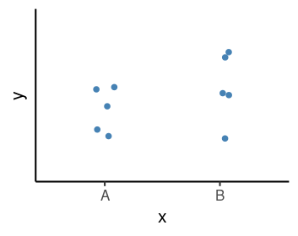
Linear Models in R | Null Hypothesis Testing
How compatible is my data with a “boring” hypothesis?
Null hypothesis: 𝛽₁ = 0
Model:
Y = 𝛽₀ + 𝛽₁ X_{B} + 𝞊
𝛽₀ = average of the reference group
𝛽₁ = difference to the reference group
𝛽₁
𝛽₀
Test statistic: 𝛽₁ / σ_{𝛽1}
(our estimate divided by the uncertainty in that estimate)
P-value calculated from the test statistic
Low p-value indicates that the data are not very compatible with the null hypothesis.
𝛽₁
𝛽₀

Slide 8
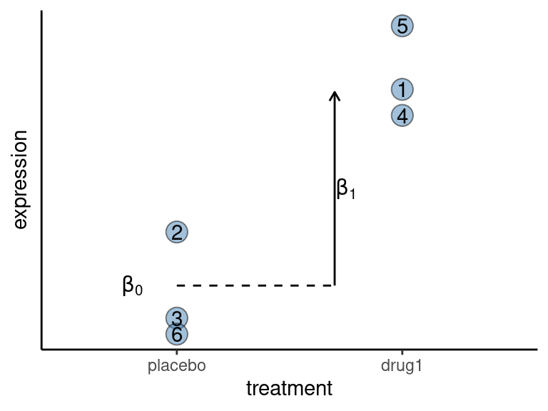
Thought Experiment
Write a model compatible with the plot above, which shows the effect of a drug on gene expression.
Biologically speaking, what do each of the 𝛽 coefficients in your model mean?
What is the null hypothesis for testing for an effect of the treatment on the gene’s expression?
Write the values for the indicator variable for each sample (the numbers in the points are sample ID).

Slide 9
Linear Models in R | Model Specification
x
<factor>
sample1 A
sample2 A
sample3 A
sample4 B
sample5 B
sample6 B
Model:
Y = 𝛽₀ + 𝛽₁ X_{B} + 𝞊
𝛽₀ = average of the reference group
𝛽₁ = difference to the reference group
𝛽₁
𝛽₀
Formula syntax in R:
outcome ~ predictors

Slide 10
Linear Models in R | Model Specification
Formula syntax in R:
outcome ~ predictors
Model:
Y = 𝛽₀ + 𝛽₁ X_{B} + 𝞊
𝛽₀ = average of the reference group
𝛽₁ = difference to the reference group
𝛽₁
𝛽₀
Intercept
xB
x
<factor>
sample1 A
sample2 A
sample3 A
sample4 B
sample5 B
sample6 B
Design
formula
~ x
Model
Matrix
1 0
1 0
1 0
1 1
1 1
1 1

Slide 11
Linear Models in R | Model Specification
Formula syntax in R:
outcome ~ predictors
Model:
Y = 𝛽₀ + 𝛽₁ X_{B}
𝛽₀ = average of the reference group
𝛽₁ = difference to the reference group
𝛽₁
𝛽₀
Intercept
xB
x
<factor>
sample1 A
sample2 A
sample3 A
sample4 B
sample5 B
sample6 B
1 0
1 0
1 0
1 1
1 1
1 1
1*𝛽₀ + 0*𝛽₁
1*𝛽₀ + 0*𝛽₁
1*𝛽₀ + 0*𝛽₁
1*𝛽₀ + 1*𝛽₁
1*𝛽₀ + 1*𝛽₁
1*𝛽₀ + 1*𝛽₁
Design
formula
Model
Matrix
𝛽₀
𝛽₁
~ x

Slide 12
Common Designs
One factor, 2 levels
One factor, 3 levels
Two factors
Define our model with formula syntax
Categorical variables are encoded as indicator variables in a model matrix
R does this for us
Interpret coefficients to define hypothesis of interest

Slide 13
Common Designs | One factor, 3 levels
drug
sample1 Pink
sample2 Pink
sample3 Pink
sample4 Yellow
sample5 Yellow
sample6 Yellow
sample7 White
sample8 White
sample9 White
Design:
Model matrix
~ drug
(Intercept) drugPink drugYellow
1 1 1 0
2 1 1 0
3 1 1 0
4 1 0 1
5 1 0 1
6 1 0 1
7 1 0 0
8 1 0 0
9 1 0 0
Null hypothesis:
Pink vs White
𝛽₁ = 0
Yellow vs White
𝛽₂ = 0
Yellow vs Pink
𝛽₂ - 𝛽₁ = 0
𝛽₁
𝛽₂
𝛽₀

Slide 14
Model Designs | Two factors - additive model
drug genotype
sample1 Pink WT
sample2 Pink WT
sample3 Pink MUT
sample4 Pink MUT
sample5 White WT
sample6 White WT
sample7 White MUT
sample8 White MUT
Design:
Model Matrix:
~ drug + genotype
(Intercept) drugPink genotypeMUT
1 1 1 0
2 1 1 0
3 1 1 1
4 1 1 1
5 1 0 0
6 1 0 0
7 1 0 1
8 1 0 1
𝛽₁
Null hypothesis:
Pink vs White drug
𝛽₁ = 0
WT vs MUT genotype
𝛽₂ = 0
𝛽₁
𝛽₂
𝛽₂
𝛽₀
WT
MUT

Slide 15
Model Designs | Two factors - interaction model
drug genotype
sample1 Pink WT
sample2 Pink WT
sample3 Pink MUT
sample4 Pink MUT
sample5 White WT
sample6 White WT
sample7 White MUT
sample8 White MUT
Design:
~ drug + genotype + drug:genotype
Null hypothesis:
Pink vs White (WT)
𝛽₁ = 0
Pink vs White (MUT)
𝛽₁ + 𝛽₃ = 0
WT vs MUT (White)
𝛽₂ = 0
WT vs MUT (Pink)
𝛽₂ + 𝛽₃ = 0
Interaction (“Difference of differences”):
𝛽₃ = 0
𝛽₃
𝛽₁
𝛽₁
𝛽₂
𝛽₂
𝛽₀
WT
MUT

Slide 16
Model Specification in DESeq2
Create DESeqDataSet object
Add model design:
design(dds) ← ~ treatment
Fit the statistical model dds ← DESeq(dds)
Check coefficients for hypothesis testing resultsNames(dds)
𝛽₁
𝛽₂
𝛽₀
A
B
C

Slide 17
Model Specification in DESeq2
Create DESeqDataSet object
Add model design:
design(dds) ← ~ treatment
Fit the statistical model dds ← DESeq(dds)
Check coefficients for hypothesis testing resultsNames(dds)
DESeq coefficient names:
𝛽₀ → Intercept
𝛽₁ → treatment_B_vs_A
𝛽₂ → treatment_C_vs_A
𝛽₁
𝛽₂
𝛽₀
A
B
C
 | Null Hypothesis
B vs A | 𝛽₁ = 0
C vs A | 𝛽₂ = 0
C vs B | 𝛽₂ - 𝛽₁ = 0

Slide 18
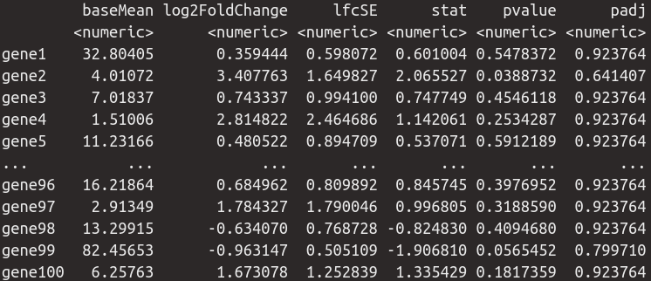
Model Specification in DESeq2 | Interpreting Results
results(dds, contrast = list(“treatment_B_vs_A”))
baseMean → Mean across all samples
log2FoldChange → log₂(B/A) i.e. the difference between treatments
lfcSE → the standard error of the log2FoldChange
stat → the test statistic = log2FoldChange/lfcSE
pvalue → the p-value of the Wald test
padj → the p-value adjusted for multiple testing (false discovery rate)

Slide 19
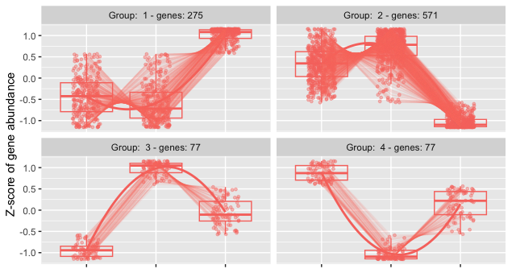
Likelihood-ratio Test
The default test in DESeq2 is the Wald test, testing for null hypothesis that LFC = 0
The Likelihood Ratio Test is an alternative when evaluating expression change across more than two levels. Can be especially useful in analyzing time course experiments.
The test determines if the increased likelihood of the data using the extra terms in the full model is more than expected if those extra terms are truly zero.
Outputs can be used to identify gene clusters
exhibiting particular patterns across samples.
Useful tutorials: 1, 2

Slide 20
Conclusions
Differential expression tests are based on linear models, where the gene expression is modelled as an outcome of several variables of interest (e.g. treatment, genotype, infection status, etc.).
Linear models use indicator or dummy variables to encode categorical variables in a model matrix.
To define models in R/DESeq2 we use the formula syntax: ~ variables
Some common models are:
Single factor: ~ variable1
Two factor, additive: ~ variable1 + variable2
Two factor, interaction: ~ variable1 + variable2 + variable1:variable2
Interpreting our model coefficients allows us to define hypothesis/comparisons/contrasts of interest.
In DESeq2 we use the `results()` function to obtain the log2(fold-change) in gene expression between groups of interest ("contrast").

