Slide 1


Analysis of RNA-seq data
Day 3 recap

Slide 2
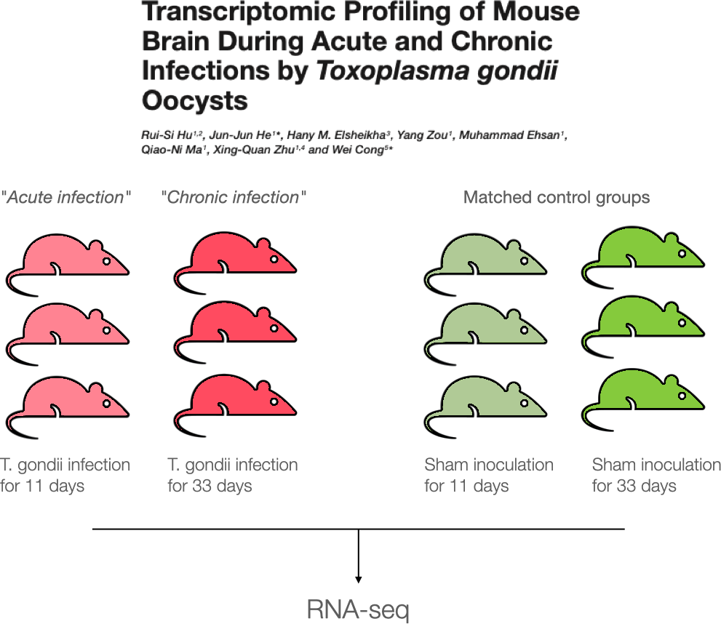
Case Study

Slide 3
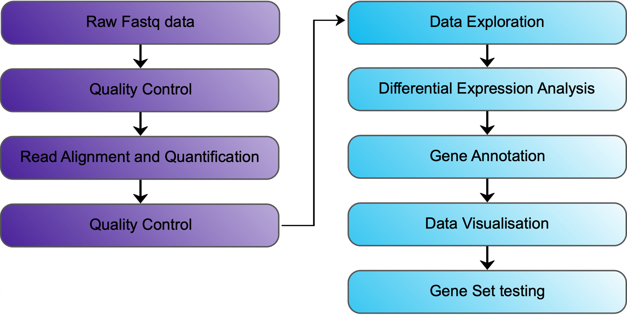
Bioinformatics Analysis Workflow

Slide 4
DESeq2 | Models and Hypothesis Testing | Two-Factor Interaction Model
Formula syntax:
~ Status + TimePoint + Status:TimePoint
~ Status * TimePoint
Null hypothesis:
Infected vs Uninfected (d11)
𝛽₁ = 0
Infected vs Uninfected (d33)
𝛽₁ + 𝛽₃ = 0
d33 vs d11 (Uninfected)
𝛽₂ = 0
d33 vs d11 (Infected)
𝛽₂ + 𝛽₃ = 0
Interaction (“Difference of differences”)
𝛽₃ = 0
𝛽₃
𝛽₁
𝛽₁
𝛽₂
𝛽₂
𝛽₀
Un
d11
In
d11
Un
d33
In
d33

Slide 5
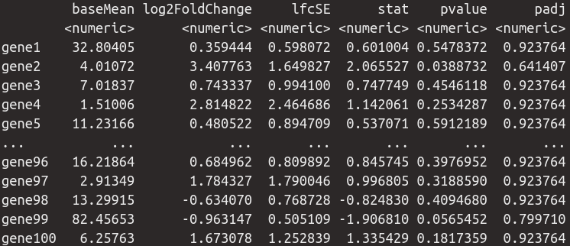
DESeq2 | Models and Hypothesis Testing | Summary
Consider Experimental Design – Knowledge of the biology
QC your analysis at every stage
Select the simplest appropriate model for your data which best describes the majority of genes
Know when to visit a bioinformatician or statistician.

