Slide 1

Statistics of RNA-seq analysis
Notes:
In this session we’re going to cover some of the main statistical concepts that are relevant to differential expression analysis in RNA-seq data. We will also talk a little bit about experimental design and how it can impact the analysis of these data.
This is not a deep statistics lecture, but rather a brief overview of the key concepts.

Slide 2
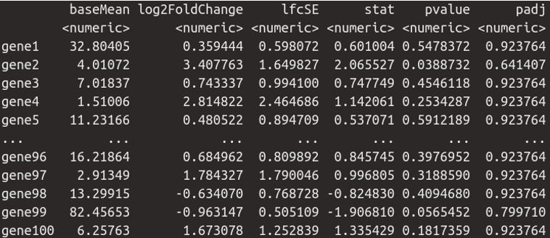
Differential expression output from DESeq2
baseMean = Average gene expression
log2FoldChange = effect size (Estimated log₂ fold change between the two conditions)
lfcSE = Standard error (uncertainty) of the log₂ fold change estimate
stat = Statistic (Wald statistic = log2FoldChange / lfcSE)
pvalue = p-value for the null hypothesis that true log₂ fold change = 0
padj = Adjusted p-value (after multiple-testing correction, e.g. Benjamini–Hochberg FDR)
Notes:
In particular, our primary objective is to understand the meaning of the main output we will get from our differential expression analysis with DESeq2, which is a results table illustrated here (we will cover this in detail in a practical later in the course).

Slide 3
Outline
Experimental Design
General Statistical Concepts
Statistical aspects specific to bulk RNA-seq analysis

Slide 4
Outline
Experimental Design
Statistical Concepts - Bite size statistics
Statistical aspects of bulk RNA-seq analysis

Slide 5
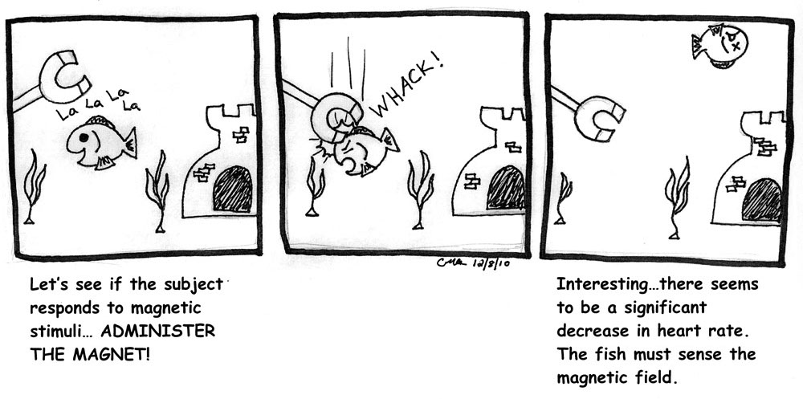

Slide 6
Consequences of Poor Experimental Design
Inability to answer the questions we would like to answer
Cost of experimentation.
Limited & Precious material, esp. clinical samples.
Immortalization of data sets in public databases and methods in the literature. Our bad science begets more bad science.
Ethical concerns of experimentation: animals and clinical samples.

Slide 7
A Well-Designed Experiment
Should have
Clear objectives
Focus and simplicity
Sufficient power
Randomised comparisons
And be
Precise
Unbiased
Amenable to statistical analysis
Reproducible

Slide 8
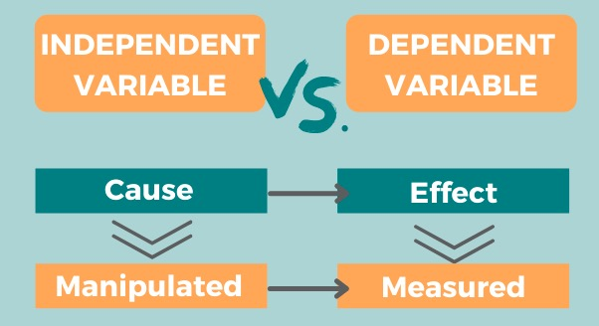
Variables in the experiment
Independent variable also called as Input or Predictor or Explanatory variable
Dependent variables also called as output or Response variable
Based on the type of measurements both Independent and Dependent variables further classified …
Continuous: Height, weight, Microarray intensities
Discontinuous: RNAseq counts
Categorical : Sex, color (Categorical independent variables also called as factors)

Slide 9
Sources of Variation
dependent variable = f ( independent variable ) + noise
Biological
Technical
Biological “noise”
Biological processes are inherently stochastic
Single cells, cell populations, individuals, organs, species….
Timepoints, cell cycle, synchronized vs. unsynchronized
Technical noise
Reagents, antibodies, temperatures, pollution
Platforms, runs, operators
Replication is required to capture variance

Slide 10
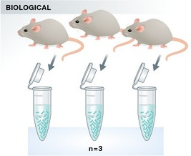
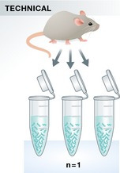
Types of Replication
Biological replication:
In vivo:
Patients
Mice
In vitro:
Different cell lines
Re-growing cells (passages)
Technical replication:
Experimental protocol
Measurement platform (i.e. sequencer)

Slide 11
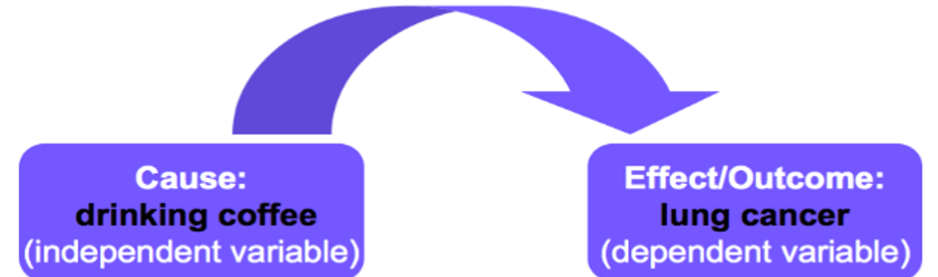
Confounding Factors
Also known as extraneous, hidden, lurking or masking factors, or the third variable or mediator variable.
May mask an actual association or falsely demonstrate an apparent association between the independent & dependent variables.
Hypothetical Example would be a study of coffee drinking and lung cancer.

Slide 12

Confounding Factors
Also known as extraneous, hidden, lurking or masking factors, or the third variable or mediator variable.
May mask an actual association or falsely demonstrate an apparent association between the independent & dependent variables.
Hypothetical Example would be a study of coffee drinking and lung cancer.

Slide 13
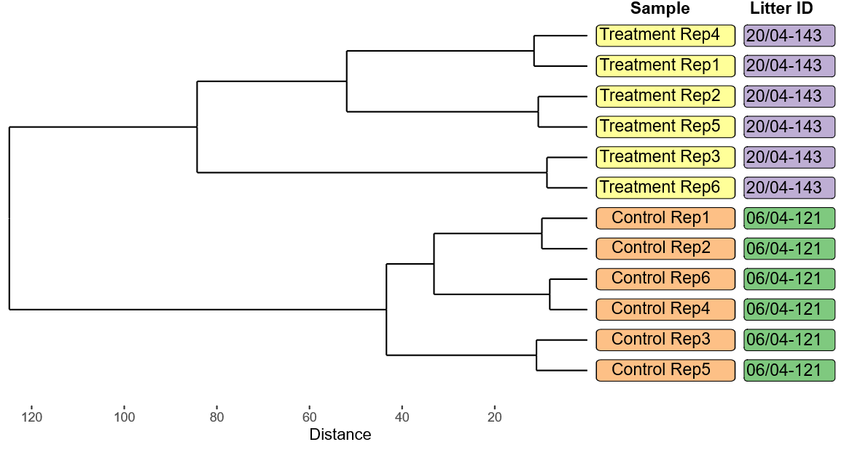
Batch Effects
Batch effects can occur when subsets of samples processed in a way that systematically differs from the ways in which other subsets of the samples processed
Batch effects are problematic if they are confounded with the experimental variable.

Slide 14
Solutions
Write it all down!!!!!!!!
Controlling technical effects:
Randomisation
Batch effects that are randomly distributed across experimental variables can be controlled for
Statistical analyses assume randomised comparisons
May not see issues caused by non-randomised comparisons
Make every decision random not arbitrary
Caveat: over-randomization can increase error
Blinding
Especially important where subjective measurements are taken
Potentially multiple degrees of blinding (eg. double-blinding)

Slide 15
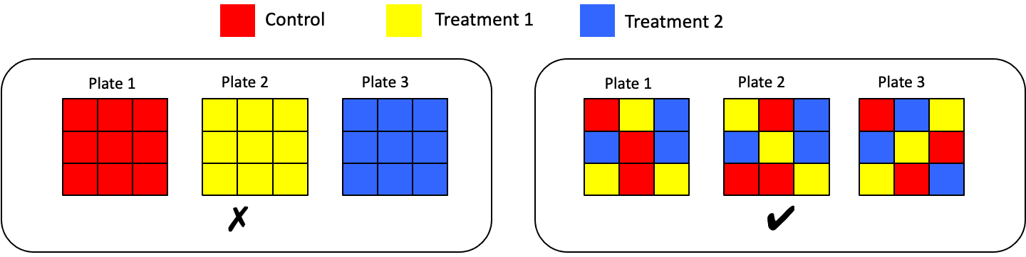
Randomised Block Design
Blocking is the arranging of experimental units in groups (blocks) that are similar to one another.
Each plate contains spatially randomised equal proportions of:
Control
Treatment 1
Treatment 2
controlling plate effects.
Block what you can, randomize what you can not.

Slide 16
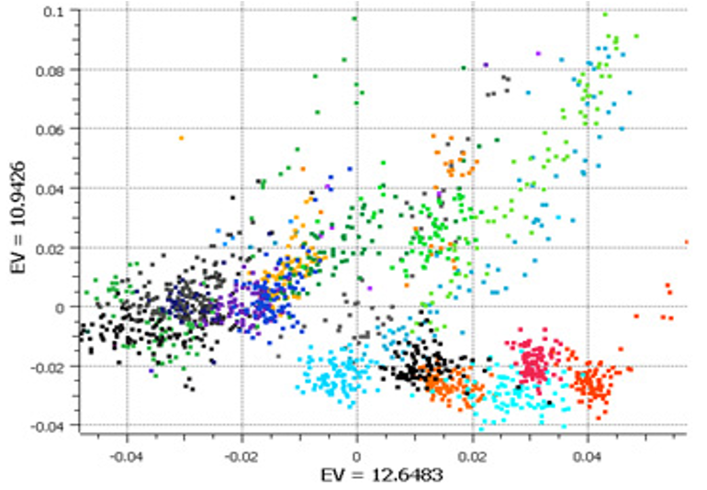

Randomised Block Design
Good design example: Alzheimer’s study from GlaxoSmithKline
Plate effects by plate
Left PCA plot show large plate effects.
Each colour corresponds to a different plate

Slide 17
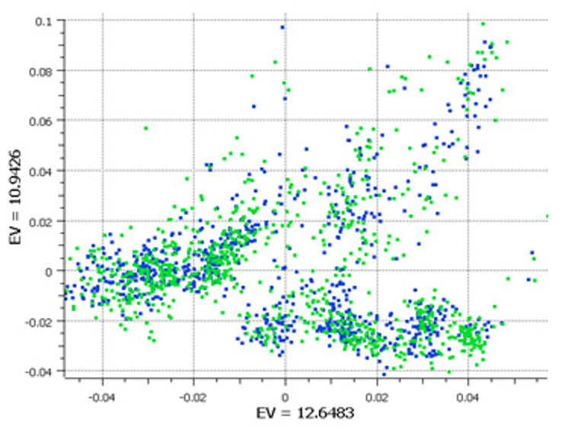
Randomised Block Design
Good design example: Alzheimer’s study from GlaxoSmithKline
Plate effects by plate
Left PCA plot show large plate effects.
Each colour corresponds to a different plate
Plate effects by case/control
Right PCA plot shows each plate cluster contains equal proportions of cases (blue) and controls (green).

Slide 18
Experimental Controls
Ideal : Everything is identical across conditions except the variable you are testing
Negative controls: is a sample or condition where no effect is expected.
Ensures that observed positives are real, not artifacts
qPCR: Sample with no DNA
CRISPR: Cells transfected with non-targeting guide RNA
Positive controls: sample or condition that is known to produce a positive (expected) result.
Helps in your reagents and instruments are working properly
qPCR: DNA containing the target gene known to amplify
Technical controls: samples or reagents experiment to help you detect technical errors, biases that are not biological
ERCC spike-ins in RNA-seq: Detect differences in library prep, Normalization
PhiX174 DNA spike-in (Illumina): Check sequencing accuracy, base-calling quality, and color balance

Slide 19
Examples of Experimental Controls
Wild-type organism (knockouts)
Inactive siRNA (silencing)
Vehicle (treatments)
Spike-ins (quantification/normalisation)
“Gold standard” data points
Multi-level controls: e.g. contrast Vehicle/Input vs. Treatment/Input

Slide 20
Outline
Experimental Design
Statistical Concepts
Statistical aspects of bulk RNA-seq analysis

Slide 21
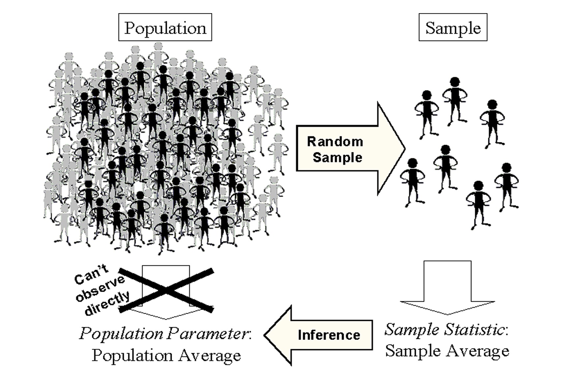
Basics on inferential statistics and hypothesis testing
Two important parameters
Mean
Variance
Population mean and variance are unknow and are constants
Estimated using sample
Estimated mean and variance used for inferring population parameters

Slide 22


Basics on inferential statistics and hypothesis testing
Inference means two things:
Estimating population parameters
Testing hypothesis regarding the population distribution
Null Hypothesis (H₀)
Assumption about the population distribution and its parameters (mean, variance, etc)
inference
Population: the complete set of individuals that we are interested in
Sample: smaller set of individuals that is representative of the population
Variable: what we are interested in measuring
Slide content adapted from Matt Castle
Notes:
Inference means two things: estimating population parameters and testing hypothesis regarding the population distribution.

Slide 23
Basics on inferential statistics and hypothesis testing
Null Hypothesis (H₀)
Assumption about the population distribution and its parameters (mean, variance, etc)
Choose test
Based on data and H₀
Calculate test statistic, interpret results
Slide content adapted from Matt Castle
Notes:
Inference means two things: estimating population parameters and testing hypothesis regarding the population distribution.

Slide 24
A simple example
A neurologist is testing the effect of a drug on response time by injecting 100 rats with a unit dose of the drug subjecting each to neurological stimulus and recording its response time. The neurologist knows that the mean response time for rats not injected with the drug is 1.2 seconds. The mean of the 100 injected rats response times is 1.05 seconds with the sample standard deviation of 0.5 seconds. Do you think that the drug has an effect on response time ?
H₀: Drug has no effect on response time
H₁: Drug has an effect on response time
Example adapted from Sal Khan

Slide 25
A simple example
A neurologist is testing the effect of a drug on response time by injecting 100 rats with a unit dose of the drug subjecting each to neurological stimulus and recording its response time. The neurologist knows that the mean response time for rats not injected with the drug is 1.2 seconds. The mean of the 100 injected rats response times is 1.05 seconds with the sample standard deviation of 0.5 seconds. Do you think that the drug has an effect on response time ?
H₀: µ = 1.2 s
H₁: µ ≠ 1.2 s
Example adapted from Sal Khan
Notes:
We assume that the sampling distribution is normal - we have 100 observations, that's not an unreasonable assumption to make. If we assume the null hypothesis is true, the mean of the sampling distribution will be the same as the population mean, which is 1.2 seconds.

Slide 26
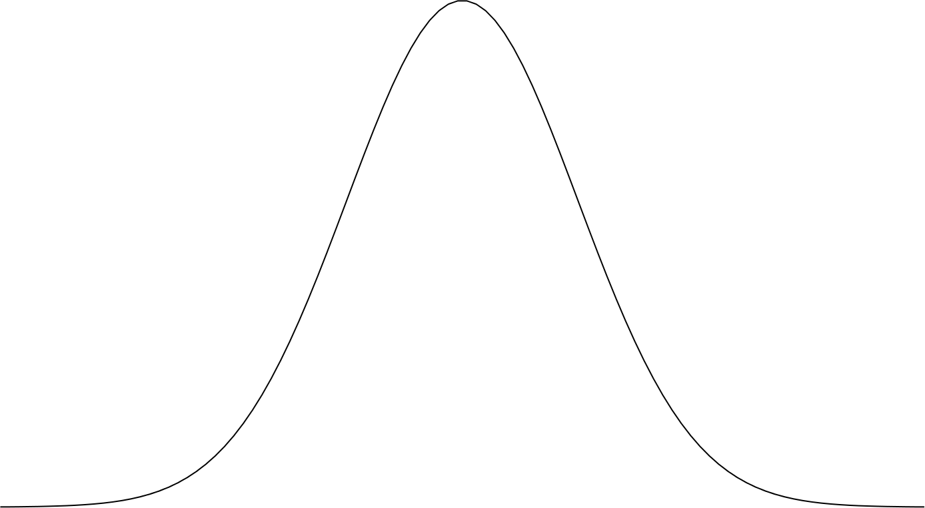
A simple example
A neurologist is testing the effect of a drug on response time by injecting 100 rats with a unit dose of the drug subjecting each to neurological stimulus and recording its response time. The neurologist knows that the mean response time for rats not injected with the drug is 1.2 seconds. The mean of the 100 injected rats response times is 1.05 seconds with the sample standard deviation of 0.5 seconds. Do you think that the drug has an effect on response time ?
H₀: µ = 1.2 s
H₁: µ ≠ 1.2 s
Assume H₀:
µ = 1.2 s
Example adapted from Sal Khan
Notes:
We assume that the sampling distribution is normal - we have 100 observations, that's not an unreasonable assumption to make. If we assume the null hypothesis is true, the mean of the sampling distribution will be the same as the population mean, which is 1.2 seconds.

Slide 27
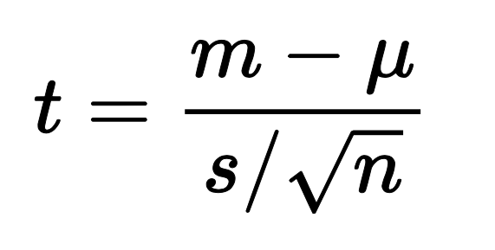
A simple example
A neurologist is testing the effect of a drug on response time by injecting 100 rats with a unit dose of the drug subjecting each to neurological stimulus and recording its response time. The neurologist knows that the mean response time for rats not injected with the drug is 1.2 seconds. The mean of the 100 injected rats response times is 1.05 seconds with the sample standard deviation of 0.5 seconds. Do you think that the drug has an effect on response time ?
H₀: µ = 1.2 s
H₁: µ ≠ 1.2 s
Calculate test statistic
Assume H₀:
µ = 1.2 s
Example adapted from Sal Khan
Notes:
We assume that the sampling distribution is normal - we have 100 observations, that's not an unreasonable assumption to make. If we assume the null hypothesis is true, the mean of the sampling distribution will be the same as the population mean, which is 1.2 seconds.

Slide 28




A simple example
A neurologist is testing the effect of a drug on response time by injecting 100 rats with a unit dose of the drug subjecting each to neurological stimulus and recording its response time. The neurologist knows that the mean response time for rats not injected with the drug is 1.2 seconds. The mean of the 100 injected rats response times is 1.05 seconds with the sample standard deviation of 0.5 seconds. Do you think that the drug has an effect on response time ?
H₀: µ = 1.2 s
H₁: µ ≠ 1.2 s
1.05
1.2
Calculate test statistic
0.5
100
Assume H₀:
µ = 1.2 s
Example adapted from Sal Khan
Notes:
We assume that the sampling distribution is normal - we have 100 observations, that's not an unreasonable assumption to make. If we assume the null hypothesis is true, the mean of the sampling distribution will be the same as the population mean, which is 1.2 seconds.

Slide 29
A simple example
A neurologist is testing the effect of a drug on response time by injecting 100 rats with a unit dose of the drug subjecting each to neurological stimulus and recording its response time. The neurologist knows that the mean response time for rats not injected with the drug is 1.2 seconds. The mean of the 100 injected rats response times is 1.05 seconds with the sample standard deviation of 0.5 seconds. Do you think that the drug has an effect on response time ?
H₀: µ = 1.2 s
H₁: µ ≠ 1.2 s
Calculate test statistic
= - 3
Assume H₀:
µ = 1.2 s
Example adapted from Sal Khan
Notes:
We assume that the sampling distribution is normal - we have 100 observations, that's not an unreasonable assumption to make. If we assume the null hypothesis is true, the mean of the sampling distribution will be the same as the population mean, which is 1.2 seconds.

Slide 30
A simple example
A neurologist is testing the effect of a drug on response time by injecting 100 rats with a unit dose of the drug subjecting each to neurological stimulus and recording its response time. The neurologist knows that the mean response time for rats not injected with the drug is 1.2 seconds. The mean of the 100 injected rats response times is 1.05 seconds with the sample standard deviation of 0.5 seconds. Do you think that the drug has an effect on response time ?
H₀: µ = 1.2 s
H₁: µ ≠ 1.2 s
Calculate test statistic
= - 3
Assume H₀:
This means that the sample mean (1.05) is 3 standard deviations away from the mean
-3𝝈
-2𝝈
-1𝝈
𝝈
2𝝈
3𝝈
µ = 1.2 s
Example adapted from Sal Khan

Slide 31
A simple example
A neurologist is testing the effect of a drug on response time by injecting 100 rats with a unit dose of the drug subjecting each to neurological stimulus and recording its response time. The neurologist knows that the mean response time for rats not injected with the drug is 1.2 seconds. The mean of the 100 injected rats response times is 1.05 seconds with the sample standard deviation of 0.5 seconds. Do you think that the drug has an effect on response time ?
H₀: µ = 1.2 s
H₁: µ ≠ 1.2 s
Calculate test statistic
= - 3
Assume H₀:
This means that the sample mean (1.05) is 3 standard deviations away from the mean
68 %
What is the probability of observing a test statistic as extreme as 3?
95 %
99.7 %
-3𝝈
-2𝝈
-1𝝈
𝝈
2𝝈
3𝝈
µ = 1.2 s
Example adapted from Sal Khan

Slide 32


A simple example
A neurologist is testing the effect of a drug on response time by injecting 100 rats with a unit dose of the drug subjecting each to neurological stimulus and recording its response time. The neurologist knows that the mean response time for rats not injected with the drug is 1.2 seconds. The mean of the 100 injected rats response times is 1.05 seconds with the sample standard deviation of 0.5 seconds. Do you think that the drug has an effect on response time ?
H₀: µ = 1.2 s
H₁: µ ≠ 1.2 s
Calculate test statistic
= - 3
p-value
0.003
Assume H₀:
This means that the sample mean (1.05) is 3 standard deviations away from the mean
68 %
What is the probability of observing a test statistic as extreme as 3?
95 %
99.7 %
-3𝝈
-2𝝈
-1𝝈
𝝈
2𝝈
3𝝈
µ = 1.2 s
Example adapted from Sal Khan
Notes:
If the null hypothesis is true, then there is 1 in 300 chance to observe a mean response time of 1.05.

Slide 33
A simple example
A neurologist is testing the effect of a drug on response time by injecting 100 rats with a unit dose of the drug subjecting each to neurological stimulus and recording its response time. The neurologist knows that the mean response time for rats not injected with the drug is 1.2 seconds. The mean of the 100 injected rats response times is 1.05 seconds with the sample standard deviation of 0.5 seconds. Do you think that the drug has an effect on response time ?
H₀: µ = 1.2 s
H₁: µ ≠ 1.2 s
Calculate test statistic
= - 3
p-value
0.003
Assume H₀:
This means that the sample mean (1.05) is 3 standard deviations away from the mean
68 %
What is the probability of observing a test statistic as extreme as 3?
95 %
99.7 %
We reject the null hypothesis!
-3𝝈
-2𝝈
-1𝝈
𝝈
2𝝈
3𝝈
µ = 1.2 s
Example adapted from Sal Khan
Notes:
If the null hypothesis is true, then there is 1 in 300 chance to observe a mean response time of 1.05.

Slide 34




A simple example
Constructed the null and alternative hypothesis about the population
A neurologist is testing the effect of a drug on response time by injecting 100 rats with a unit dose of the drug subjecting each to neurological stimulus and recording its response time. The neurologist knows that the mean response time for rats not injected with the drug is 1.2 seconds. The mean of the 100 injected rats response times is 1.05 seconds with the sample standard deviation of 0.5 seconds. Do you think that the drug has an effect on response time ?
H₀: µ = 1.2 s
H₁: µ ≠ 1.2 s
Calculate test statistic
= - 3
Obtained p-value
Calculated test statistic
p-value
0.003
Assume H₀:
This means that the sample mean (1.05) is 3 standard deviations away from the mean
68 %
What is the probability of observing a test statistic as extreme as 3?
95 %
99.7 %
Reached a conclusion
-3𝝈
-2𝝈
-1𝝈
𝝈
2𝝈
3𝝈
We reject the null hypothesis!
µ = 1.2 s
Example adapted from Sal Khan
Notes:
If the null hypothesis is true, then there is 1 in 300 chance to observe a mean response time of 1.05.

Slide 35
Key Concepts - Hypothesis Testing
All statistical tests are based on assumptions!
All statistics can be wrong
Statistical tests are probabilistic in nature
There is always a chance that the result is wrong (even when all assumptions met perfectly):
Either significant result when no difference (Type I),
Or insignificant results when there is an actual difference (Type II)
Slide content adapted from Matt Castle

Slide 36
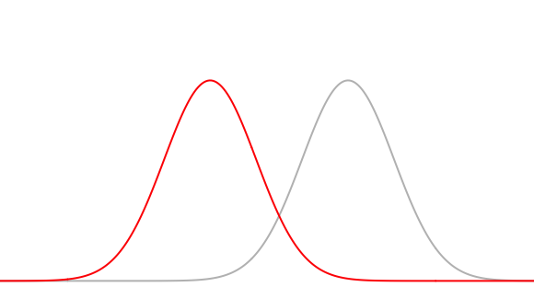
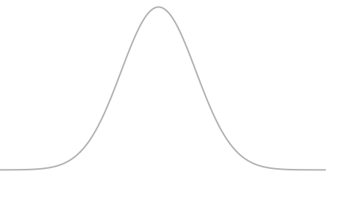
Type I and Type II Errors
H₀: µ = 1.2 s
H₁: µ ≠ 1.2 s
Suppose H₁ true:
if p-value > ⍺ → do not reject H₀
if p-value < ⍺ → reject H₀ in favour of H₁
Depending on your sampling, you might fail to reject H₀
⍺=0.05 → the type I error, the probability of rejecting
H₀ when H₀ is correct
µ = 1.2 s
Notes:
Type I error is easy - when you decide to do a statistical test, you need to decide before hand what your significance threshold would be. At what error rate you will reject the null hypothesis - 0.05 is a common choice depending on the field. This value is actually your probability of rejecting the null hypothesis even if it's true. In this plot, your significance levels is the red shaded area, and you took a sample and its mean falls into this shaded area, then you reject the null hypothesis. And if your null hypothesis is actually true, you would be committing a Type I error without knowing about it. If we go back to the example we have discussed, this was the probability distribution with mean of 1.2 seconds.

Slide 37

Type I and Type II Errors
H₀: µ = 1.2 s
H₁: µ ≠ 1.2 s
Suppose H₁ true:
if p-value > ⍺ → do not reject H₀
if p-value < ⍺ → reject H₀ in favour of H₁
β → the type II error, the probability of not rejecting
H₀ when H₁ is correct
⍺=0.05 → the type I error, the probability of rejecting
H₀ when H₀ is correct
µ = 1.2 s
µ = 1.05 s
µ = 1.2 s
Notes:
Type I error is easy - when you decide to do a statistical test, you need to decide before hand what your significance threshold would be. At what error rate you will reject the null hypothesis - 0.05 is a common choice depending on the field. This value is actually your probability of rejecting the null hypothesis even if it's true. In this plot, your significance levels is the red shaded area, and you took a sample and its mean falls into this shaded area, then you reject the null hypothesis. And if your null hypothesis is actually true, you would be committing a Type I error without knowing about it. If we go back to the example we have discussed, this was the probability distribution with mean of 1.2 seconds.

Slide 38

Type I and Type II Errors
H₀: µ = 1.2 s
H₁: µ ≠ 1.2 s
Suppose H₁ true:
if p-value > ⍺ → do not reject H₀
if p-value < ⍺ → reject H₀ in favour of H₁
β → the type II error, the probability of not rejecting
H₀ when H₁ is correct
1- β → Power is the probability that we actually detect
an effect that exists
⍺=0.05 → the type I error, the probability of rejecting
H₀ when H₀ is correct
µ = 1.2 s
µ = 1.05 s
µ = 1.2 s
Notes:
Power is directly associated with Type I error, if you nudge this line to the left, in other words, if you increase your Type I error, you increase your power. Another way to boost power is to increase sample sizes, if you have larger sample sizes these sampling distributions would be steeper, the variance would be lower. There are

Slide 39
Power Analysis
Effect Size (δ)
Sample Size (n)
The four concepts are linked
If we know three, we can work out the forth
Power calculation: Aim is to define the probability (1- β) to detect an effect size of interest (δ) at the ⍺ level with a sample size of n biological replicates
Sample size calculation: Aim is to define the sample size (n) allowing to detect an effect size of interest (δ) at the α level with a given probability (1 − β).
Significance Level (⍺)
Power (1 − β)

Slide 40
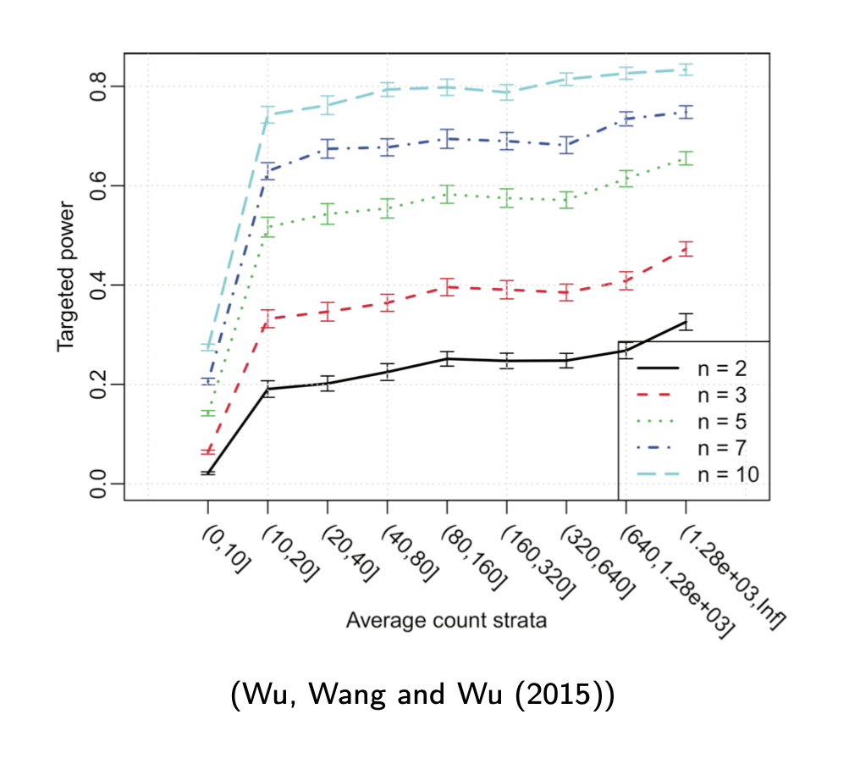
Power Analysis in Differential Expression Analysis

Slide 41
Outline
Experimental Design
Statistical Concepts - Bite size statistics
Statistical aspects of bulk RNA-seq analysis

Slide 42
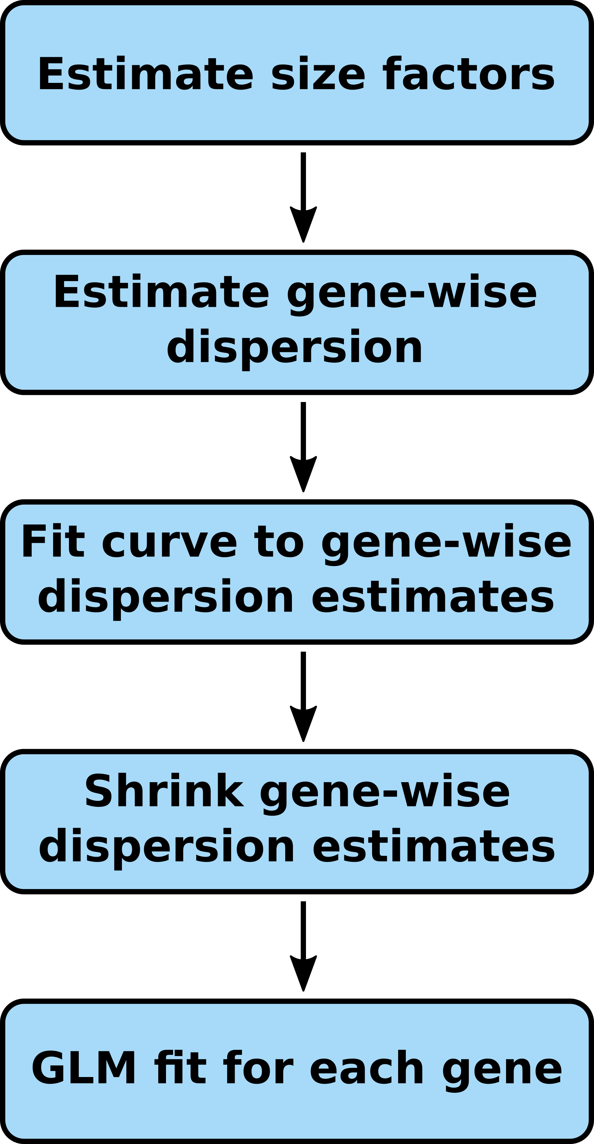
DESEQ2 workflow

Slide 43
Normalisation
Read counts between the samples varies because of various reasons …
Library Size – different sequence depth between samples
Gene properties - Length, GC content, sequence
Library composition - Quantification is relative, changes in relative abundance for one gene will affect the relative abundances of other genes. “Composition Bias”

Slide 44
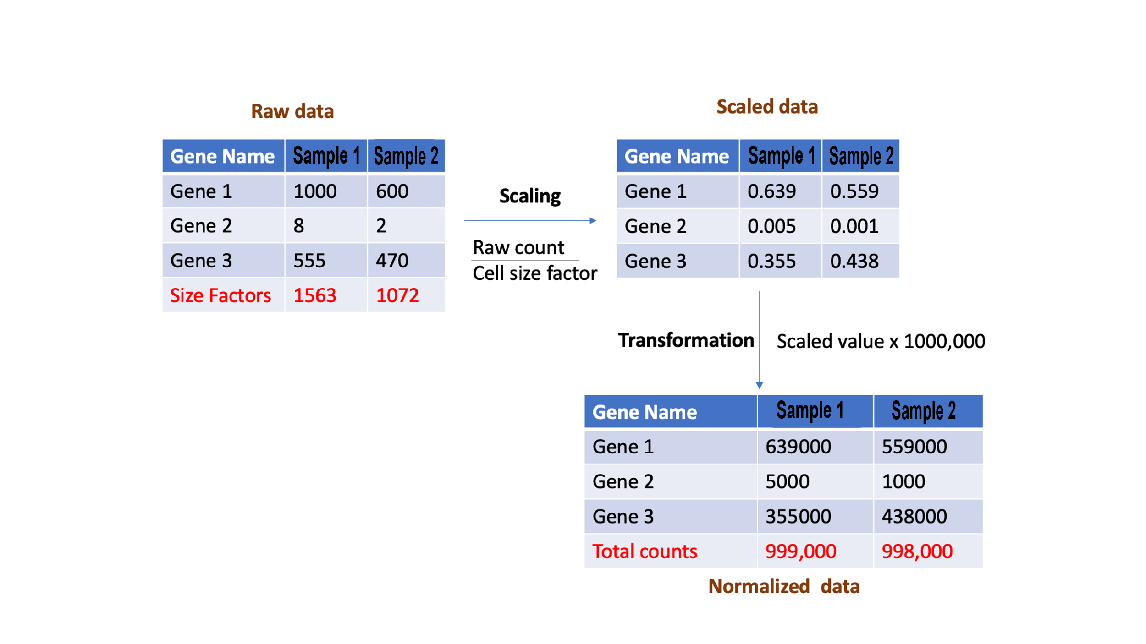
Depth bias

Slide 45
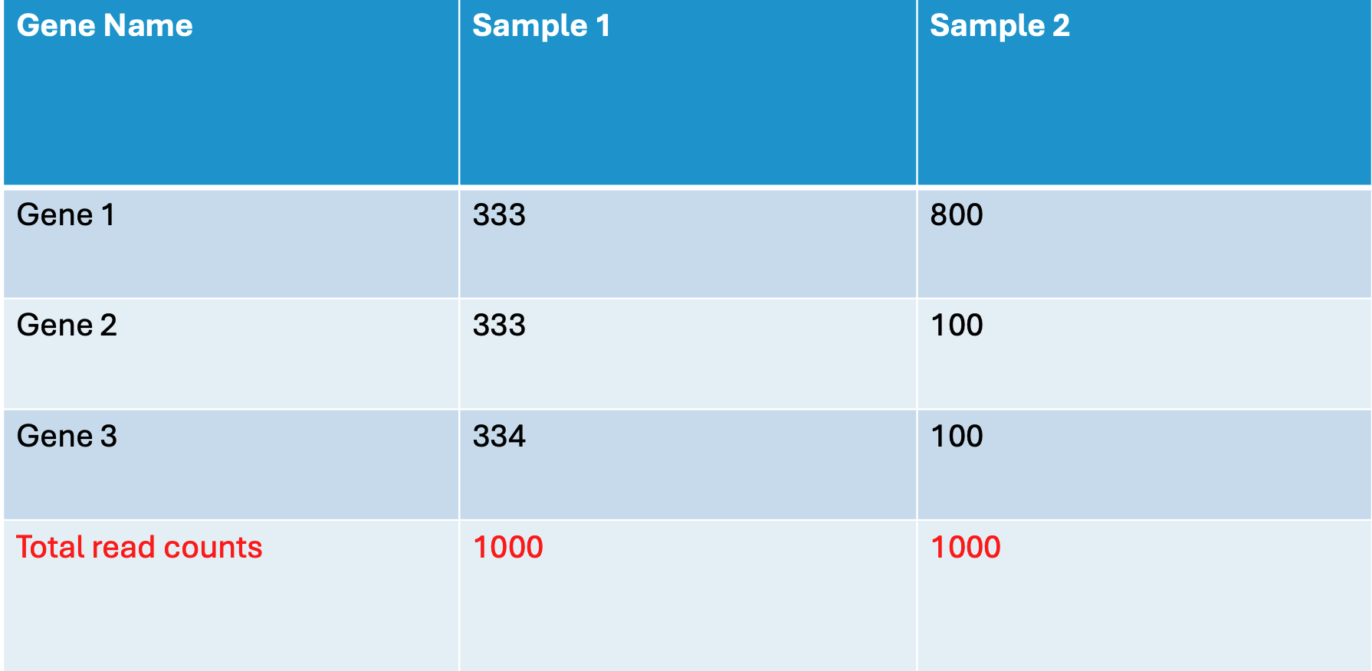
Composition bias

Slide 46
General principles behind normalisation
Normalization has two steps
Scaling
First get size factors or normalization factors
Usually one size factor per sample
Scale the counts by dividing the raw counts of a sample with sample specific size factor
Transformation: Transform the data after scaling
Per million
log2
Normalization removes technical variance but not biological variance
Normalization helps in making two samples comparable

Slide 47
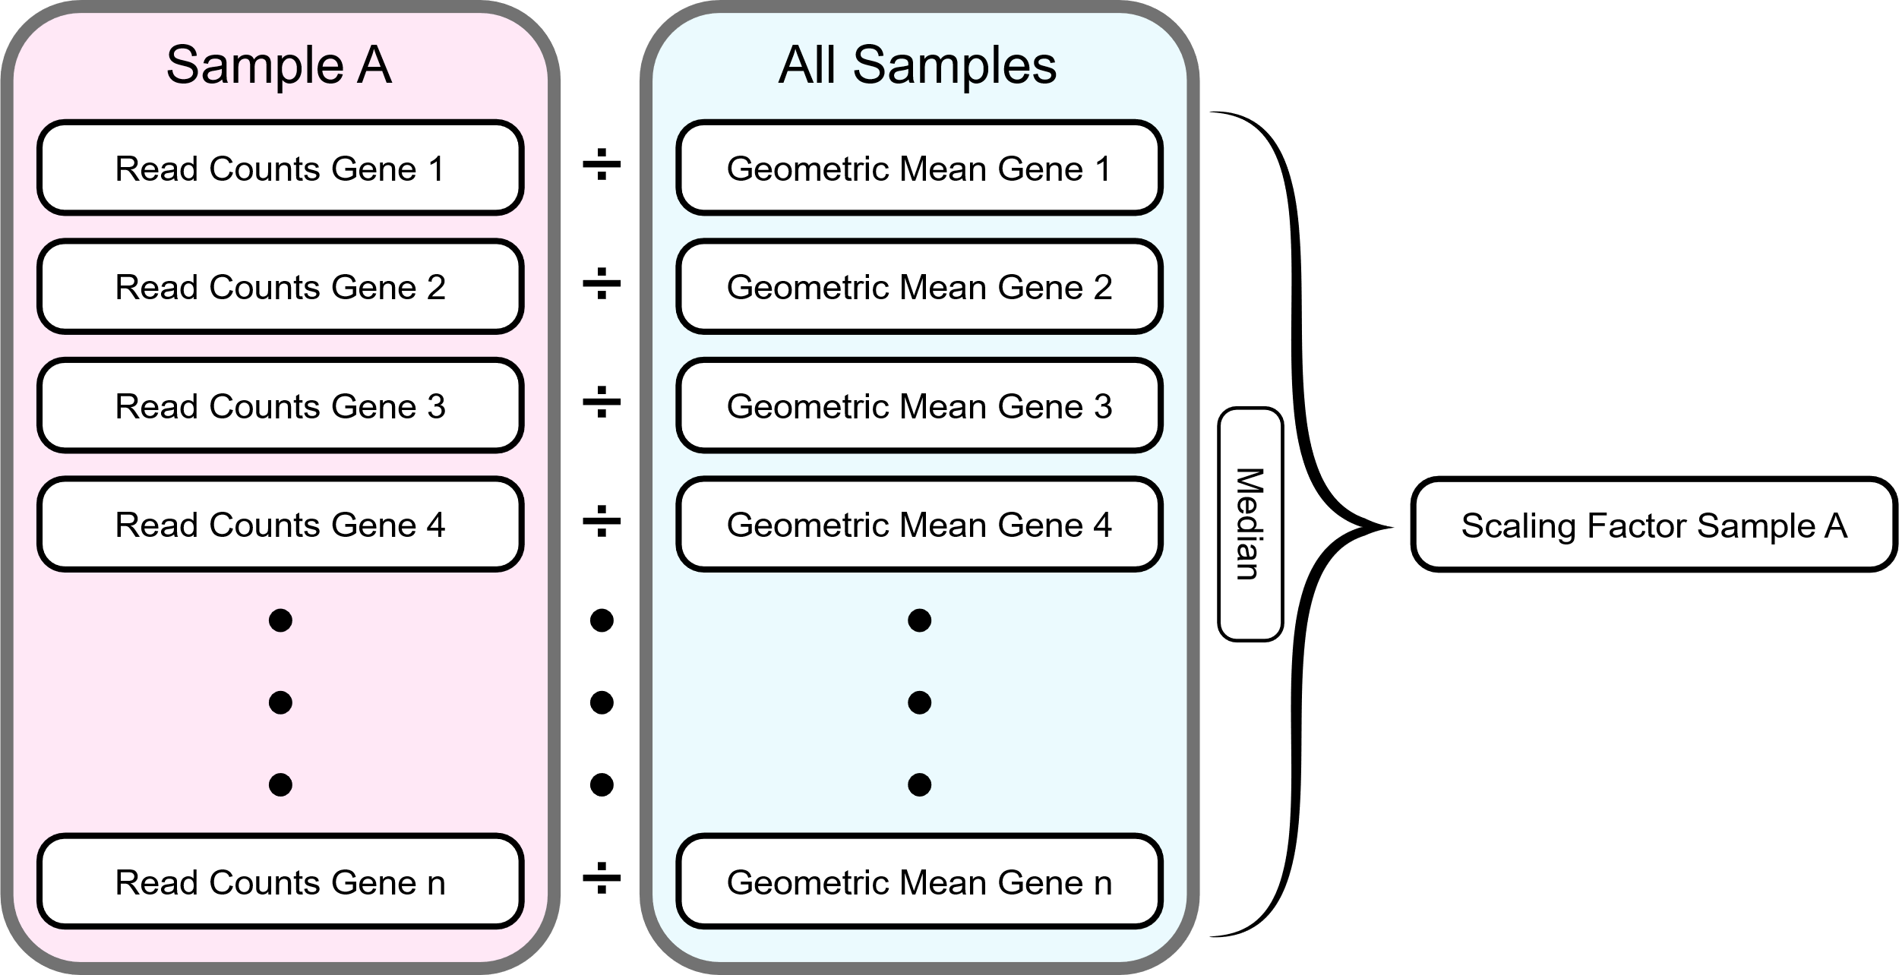
DESeq2 Normalisation
Geometric mean is calculated for each gene across all samples.
The counts for a gene in each sample is then divided by this mean.
The median of these ratios in a sample is the size factor (normalization factor) for that sample.
DESEq2 normalization corrects for library size and RNA composition bias
Composition bias: Arises for examples when only a small number of genes are very highly expressed in one sample but not in the other.

Slide 48
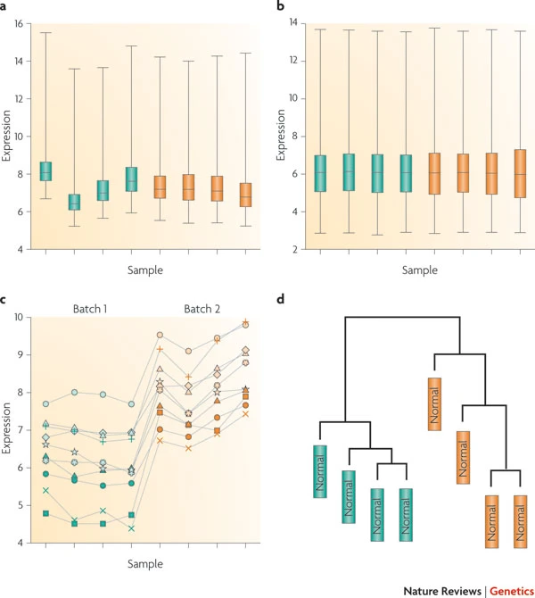
Normalisation and Batch effects
Batch effects introduce systematic biases, systematically overestimating or underestimating.
Normalisation can only remove small random biases between the samples but not systematic biases
One can mitigate batch effects with clever experimental design
Include reference samples between batches
Include batch as a co factor in the linear modelling
Leek JT et al. Nat Rev Genet. 2010 Oct;11(10):733-9. doi: 10.1038/nrg2825.
Notes:
Batch effects are systematic, systematically overestimating or underestimating.

Slide 49
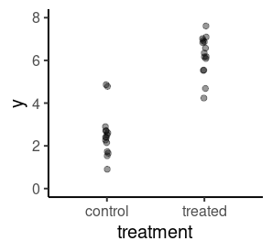
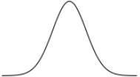
Statistical Aspects of Differential Expression Analysis
Linear Modeling
Model the expression of each gene as linear combination of explanatory factors (eg. treatment, age, sex, batch etc.)
Notes:
We could use a model just as the one we talked about earlier, assuming a normal distribution as the data generating process to model our data.

Slide 50
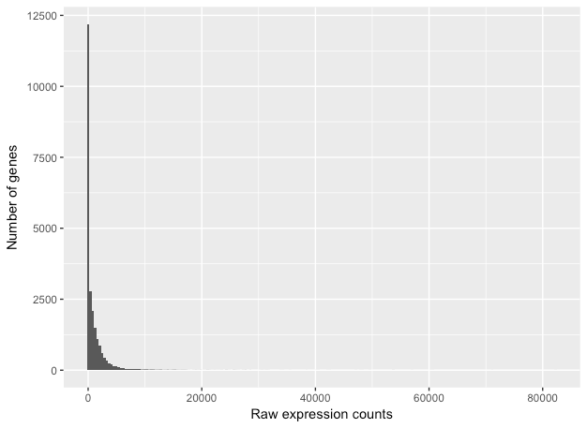
Statistical Aspects of Differential Expression Analysis
Characteristics of RNA-seq data
This plot illustrates some common features of RNA-seq count data:
a low number of counts associated with a large proportion of genes
a long right tail due to the lack of any upper limit for expression
large dynamic range
Looking at the shape of the histogram, we see that it is not normally distributed.

Slide 51
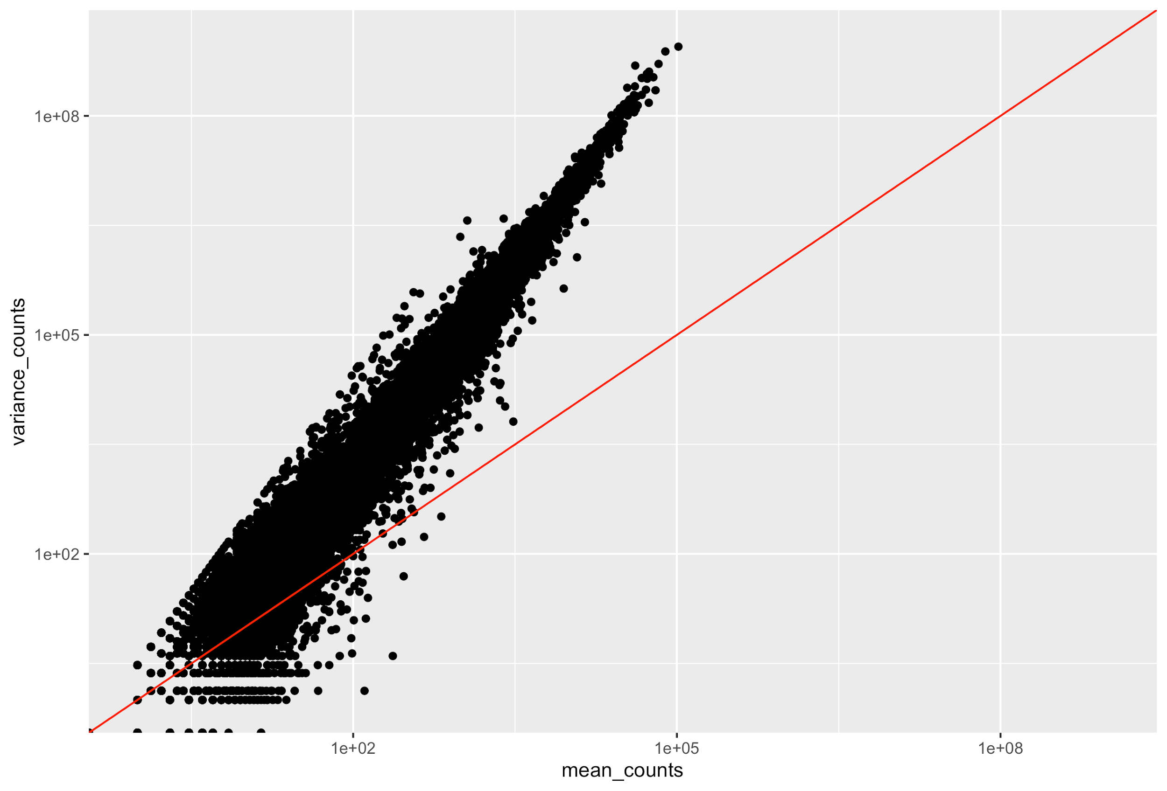
Statistical Aspects of Differential Expression Analysis
Characteristics of RNA-seq data
To assess the properties of the data we are working with, we can look at the mean-variance relationship.
For the genes with high mean expression, the variance across replicates tends to be greater than the mean (scatter is above the red line).
Essentially, the Negative Binomial is a good approximation for data where the mean < variance, as is the case with RNA-Seq count data.

Slide 52
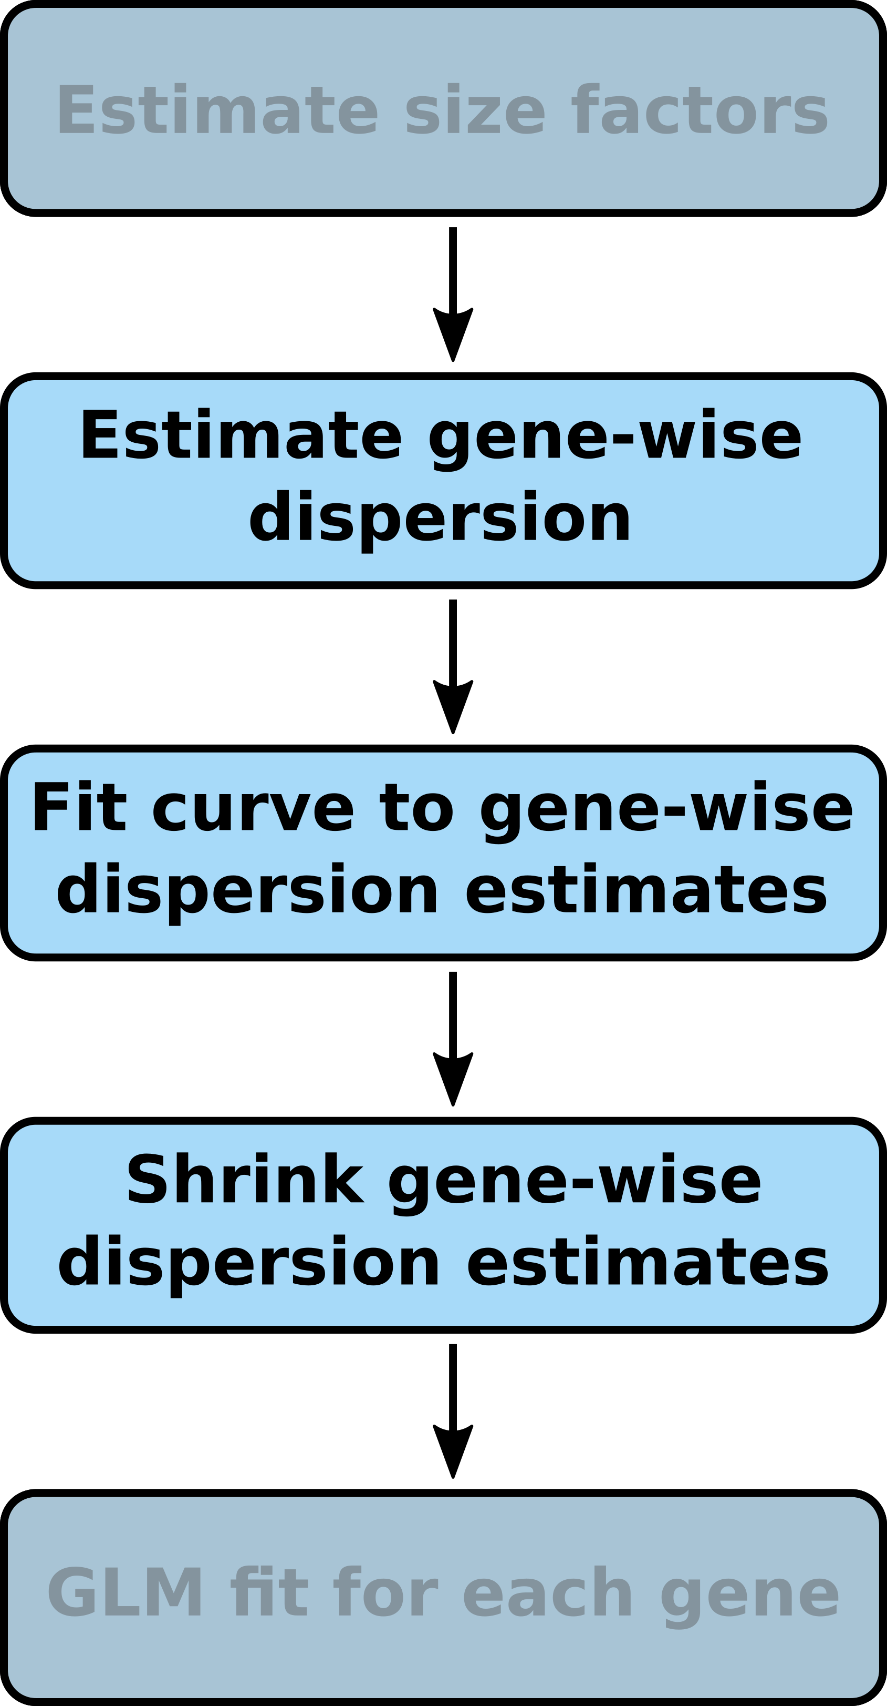
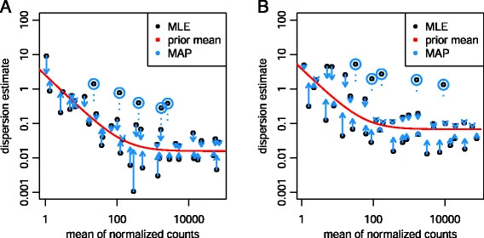
Statistical Aspects of Differential Expression Analysis
How we estimate dispersion in DESEQ2
Notes:
Estimating the dispersion parameter can be difficult with a small number of samples
DESeq2 models the variance as the sum of technical and biological variance
Estimate dispersion for each gene
‘Share’ dispersion information between genes to obtain fitted estimate
Shrink gene-wise estimates towards the fitted estimates

Slide 53
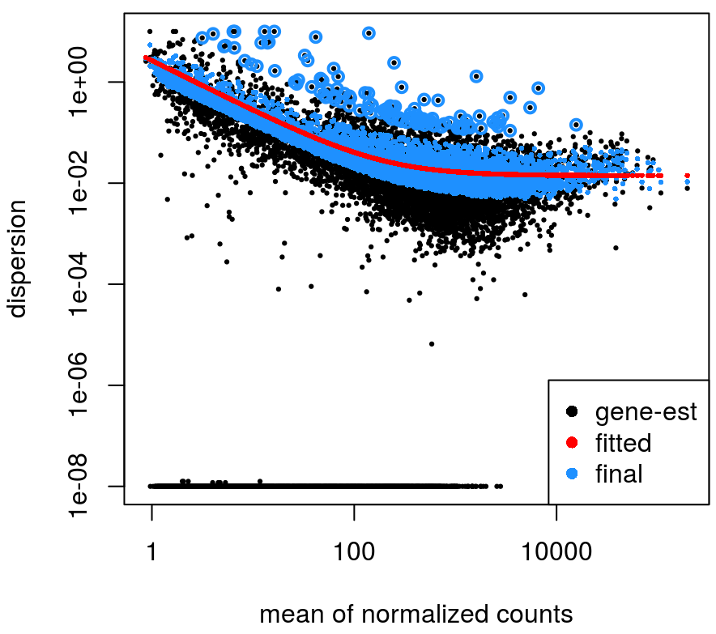
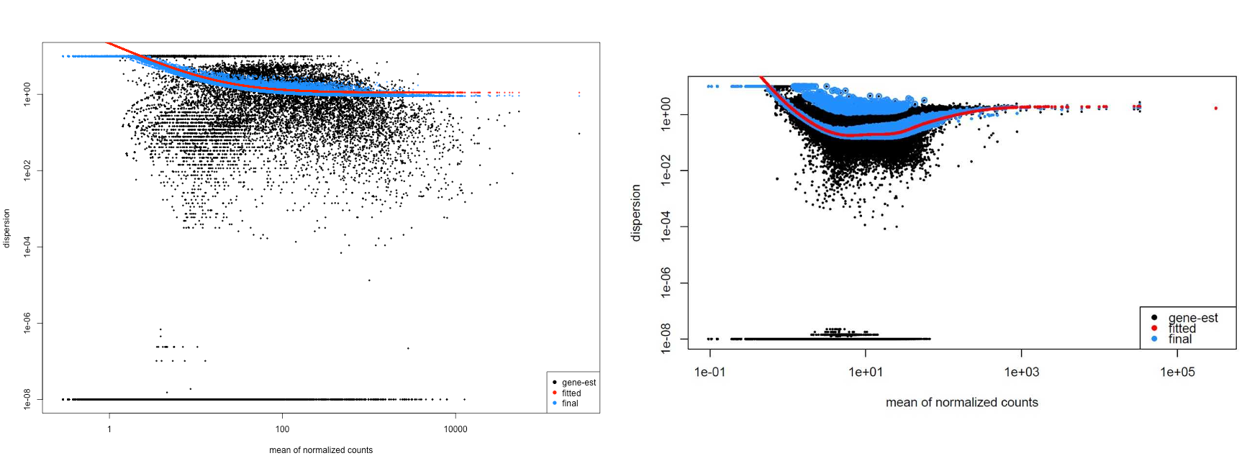
Good:
Bad:

Slide 54


Statistical Aspects of Differential Expression Analysis
Summary:
Use negative binomial linear regression to model gene expression in RNA-seq
Calculate size factors for each sample to account for differences in sequencing depth and transcript composition between samples
Estimate dispersion for each gene by “borrowing” information across genes for more precise estimates when sample sizes are small (as is typical in RNA-seq experiments)
Estimate model coefficients which are used to define test hypothesis (𝞫_{i} = 0)
counts - expression of the gene
𝞫_{i} - parameters we want to estimate from the data
𝞫₀ - the “intercept” (the value of expression when all other parameters are set at a reference level)
ɸ - the “dispersion” (uncertainty) of our model (also estimated from the data)
s - scaling factor (sequencing depth and transcript composition)
Description of DESeq2 model: Love, Huber & Anders (2014)

Slide 55
DESEQ2 workflow

Slide 56
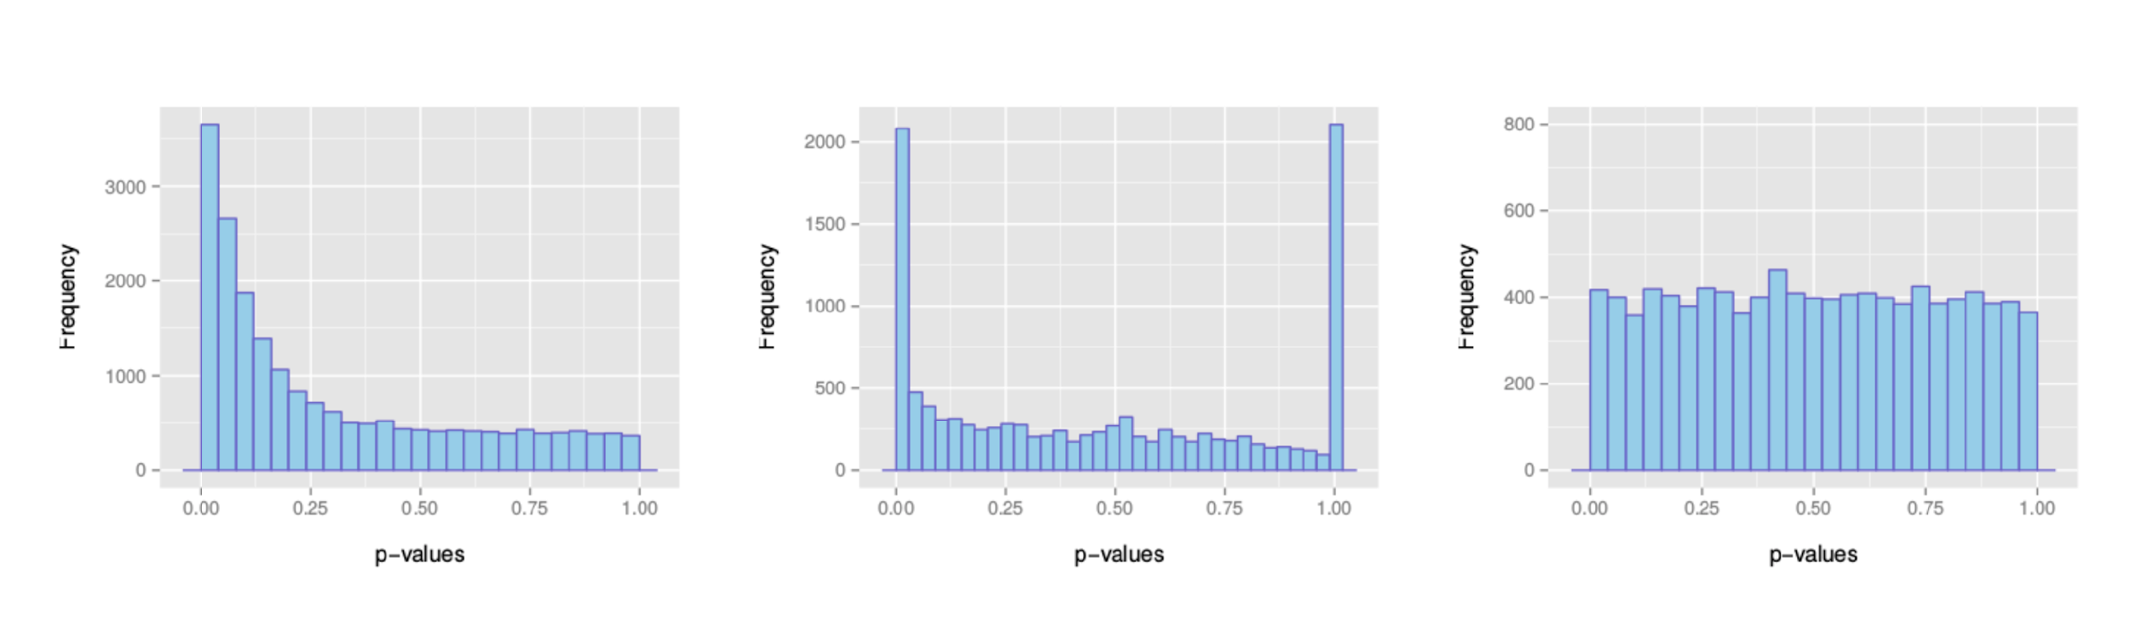
P-value Histograms
Examples of expected overall distribution
: the most desirable shape
: very low counts genes usually have large p-values
: do not expect positive tests after correction

Slide 57
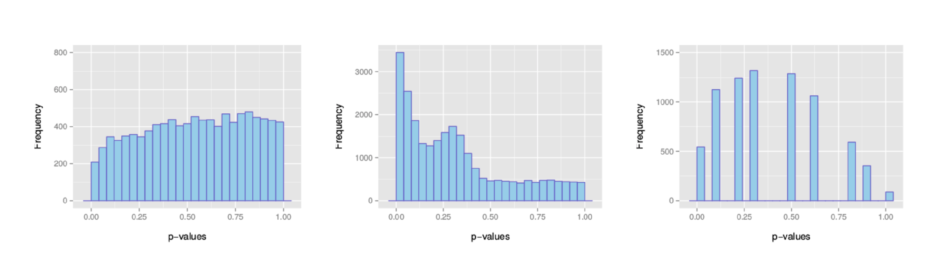
P-value Histograms
Examples of unexpected overall distribution
: indicates a batch effect (confounding hidden variables)
: the test statistics may be inappropriate (due to strong correlation structure for instance)
: discrete distribution of p-values : unexpected

Slide 58
Multiplicity Correction
A gene with a significance cut-off of α = 0.05, means there is a 5% chance it is a false positive.
If we test for 20,000 genes for differential expression at α = 0.05, we would expect to find 1,000 genes by chance
If we found 3000 genes to be differentially expressed total, roughly one third of our genes are false positives!
The more genes we test, the more we inflate the false positive rate. This is the multiple testing problem.

Slide 59
Multiplicity Correction
Bonferroni: The adjusted p-value is calculated by: p*k (k = total number of tests). This is a very conservative approach
FDR/Benjamini-Hochberg: Benjamini and Hochberg (1995) defined the concept of FDR and created an algorithm to control the expected FDR below a specified level given a list of independent p-values.

Slide 60
Conclusions
Assumptions assumptions assumptions

