Slide 1

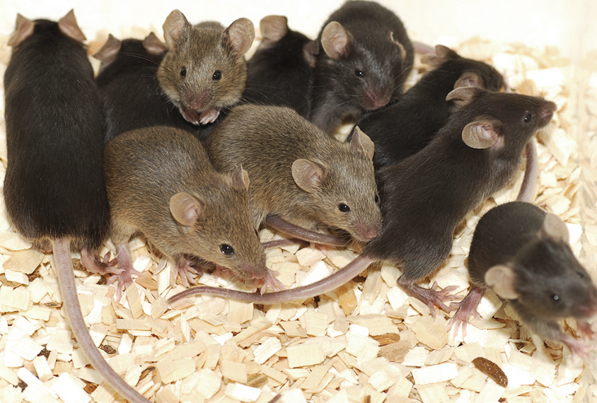


Flow chart of the statistical design
Experimental groups
Vehicle
Carboplatin
Nivolumab
Carbo + nivolumab
Gender | Tumor volume
Female | High
 | Low
Male | High
 | Low
Batch 1: April
Batch 2: May
Experimental groups
Experimental groups
Experimental groups
Experimental groups
Baseline and 1st week: daily by Mark
2nd week: daily by Peter
Tumour volume (mm³) assessment

