Slide 1


Introduction to Statistical Analysis
Cancer Research UK Cambridge Institute – October 24th, 2025
Luca Porcu & Chandra Chilamakuri (Bioinformatics core)

Slide 2
Timeline
Morning (9.30-12.30)
Basic concepts of Statistics
Exercises
Data types and descriptive statistics
Online quiz
Central limit theorem (CLT)
Simulations
Inferential statistics: estimation
Simulations
Lunch
Afternoon (13.30-17.00)
Inferential statistics: hypothesis testing
Exercises
Inferential statistics: one-sample tests
Exercises
Inferential statistics: two-sample tests
Exercises
Group based exercises and discussion

Slide 3
Basic concepts of Statistics
sample
pvalue
statistic
point estimation
confidence interval
hypothesis testing
outlier
likelihood
09.30 - 09.45
probability

Slide 4

Random experiment
Tossing a coin 100 times
H = p
T = 1 - p
Model generating data
Parameter
Data
Toss number | 1 | 2 | 3 | … | … | … | … | … | 99 | 100
Result | H | T | T | … | … | … | … | … | H | T

Slide 5
Components of a statistical model
systematic and
random (unpredictable) components of a statistical model

Slide 6
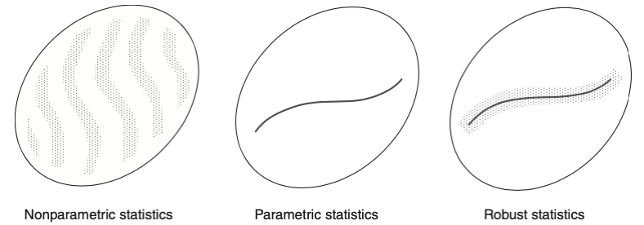
Parametric, nonparametric and robust statistics
allows all possible statistical models and reduces the ignorance about them only by one or a few dimensions
allows only a very thin subset of all statistical models, but information is completely captured by few parameters
allows a full (namely fu!l-dimensional) neighborhood of a parametric model, thus being more realistic and yet, providing the same advantages as a strict parametric model
EHampel FR, Ronchetti E, Rousseeuw PJ, Stahel WA.
Robust Statistics: The Approach Based on Influence Functions. New York: Wiley; 1986.

Slide 7


Basic statistical concepts

Slide 8
Exercises
http://bioinformatics-core-shared-training.github.io/IntroductionToStats

Slide 9
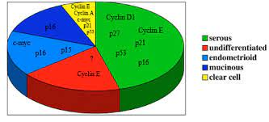
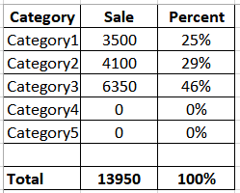
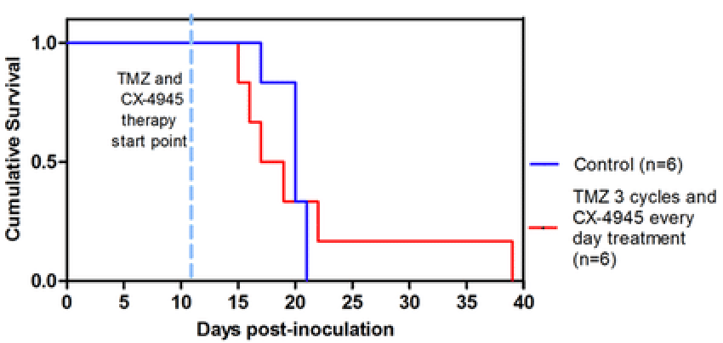
Descriptive Statistics
Median
Range
Data types and descriptive statistics
10.15 - 10.35

Slide 10
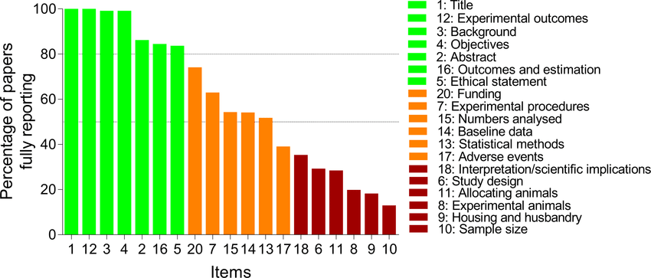
Descriptive statistics
Here, the data are analyzed on their own terms, essentially without extraneous assumptions.
The principal aim is the organization and summarization of the data in ways that bring out their main features and clarify their underlying structure.
Median
Range
E.L. Lehmann, George Casella, Theory of Point Estimation, Second Edition

Slide 11
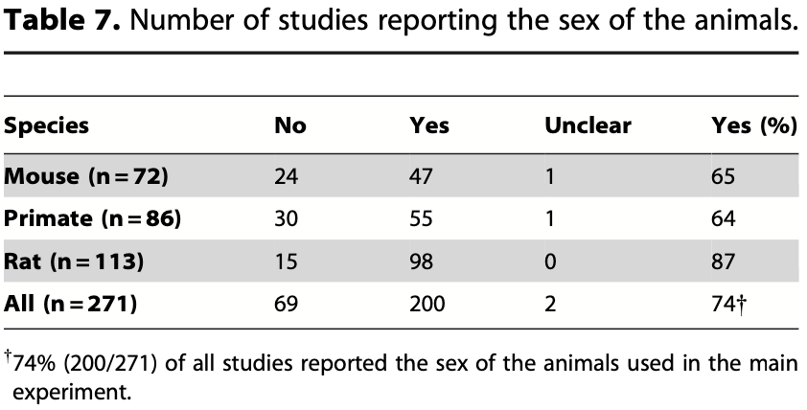
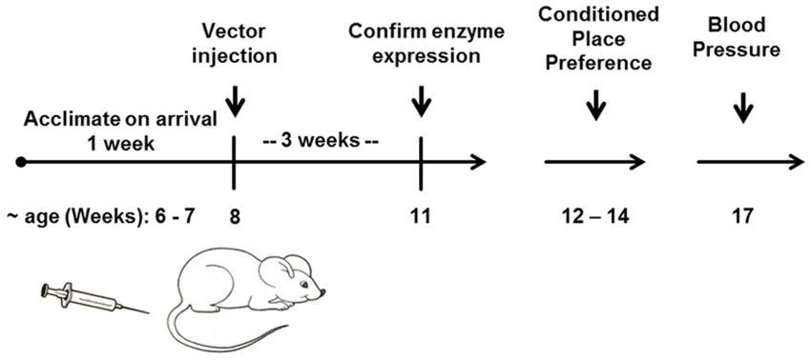
Why is descriptive statistics important?
Baseline data
(e.g. strain, sex, age, weight, housing)
† Kilkenny C, Parsons N, Kadyszewski E, Festing MFW, Cuthill IC, et al. (2009) Survey of the Quality of Experimental Design, Statistical Analysis and Reporting of Research Using Animals. PLoS ONE 4(11): e7824. doi:10.1371/journal.pone.0007824
Experimental design
(e.g. sample size, blocking, treatment)
Outcomes (e.g. sample distribution,
length of follow-up, number of events,
reasons for right-censoring)

Slide 12

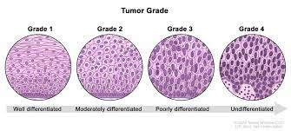
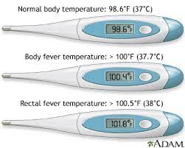

Data types
Complexity
Qualitative
Binary/dichotomous
Nominal
Ordinal
Quantitative
Interval scale (arbitrary zero point)
Ratio scale (meaningful zero point)

Slide 13
Data types
Complexity
Qualitative
Binary/dichotomous
Nominal
Ordinal
Quantitative
Number of metastases
Discrete
Continuous

Slide 14
Descriptive statistics, univariate analysis
Nominal data, measures of central tendency
Histotype | N | %
Serous | 48 | 41.7
Undifferentiated | 22 | 19.1
Endometrioid | 21 | 18.3
Mucinous | 16 | 13.9
Clear cell | 8 | 7.0
Serous is the mode.
The mode is the category that appears most often in a set of data values.
Pie chart

Slide 15
Descriptive statistics, univariate analysis
Ordinal data, measures of central tendency
Grading | N | %
G1 | 48 | 45.7
G2 | 18 | 17.1
G3 | 23 | 21.9
G4 | 16 | 15.2
G1 is the mode.
G2 is the median.
The median is the category separating the higher half from the lower half of a data sample.

Slide 16
Descriptive statistics, univariate analysis
Discrete data, measures of central tendency
N. of metastases | N | %
0 | 20 | 16.3
1 | 45 | 36.6
2 | 30 | 24.4
3 | 12 | 9.8
4 | 10 | 8.1
5 | 5 | 4.1
6 | 1 | 0.8
1 is the modal number of metastases.
1 is the median number of metastases.
1.7 is the mean number of metastases.

Slide 17
Descriptive statistics, univariate analysis
Continuous data, measures of central tendency
Weight (kg) | N (%) | N/10kg
0 -| 50 | 10 (5.7) | 2
50 -| 60 | 10 (5.7) | 10
60 -| 70 | 23 (13.1) | 23
70 -| 80 | 45 (25.7) | 45
80 -| 90 | 40 (22.9) | 40
90 -| 130 | 47 (26.9) | 11.8
70 -| 80 is the modal interval.
70 -| 80 is the median interval.
81.4 kg is the mean weight of patients.

Slide 18
Descriptive statistics, univariate analysis
Properties of the mean
Quantitative data, measures of central tendency
⅀_{i} (a_{i} - 𝞵) = 0
⅀_{i} (a_{i} - 𝞵)² < ⅀_{i} (a_{i} - x)², x ≠ 𝞵
Linearity: 𝞵(a⋅x₁,…,a⋅x_{n}) = a⋅𝞵(x₁,…, x_{n})
𝞵(x₁+b,…,x_{n}+b) = 𝞵(x₁,…, x_{n})+b
Associative property:
𝞵(x₁,…,x_{m}; y₁,…,y_{n}) =
{m⋅𝞵(x₁,…, x_{m})+n⋅𝞵(y₁,…,y_{n})}/(m+n)

Slide 19
Descriptive statistics, univariate analysis
Measures of heterogeneity
Qualitative data, measures of dispersion
, Shannon diversity index
Measures of variability
Quantitative data, measures of dispersion
(⅀_{i} |a_{i} - M|)/n, where M is a measure of central tendency
√[(⅀_{i} |a_{i} - M|²)/n], if M = 𝞵, it is called standard deviation (𝛔)
Interquartile range (IQR)

Slide 20
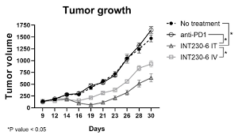
Descriptive statistics, bivariate analysis
ID mouse | Day 21, mm ³ | Day 23, mm ³
M101 | 260 | 270
M102 | 234 | 240
M103 | 400 | 470
M104 | 345 | 350
M105 | 450 | 460
M106 | 200 | 250
M107 | 500 | 510

Slide 21
Descriptive statistics, bivariate analysis
Take home message:
Paired data are not independent. They correlate.

Slide 22
Online quiz
http://bioinformatics-core-shared-training.github.io/IntroductionToStats

Slide 23
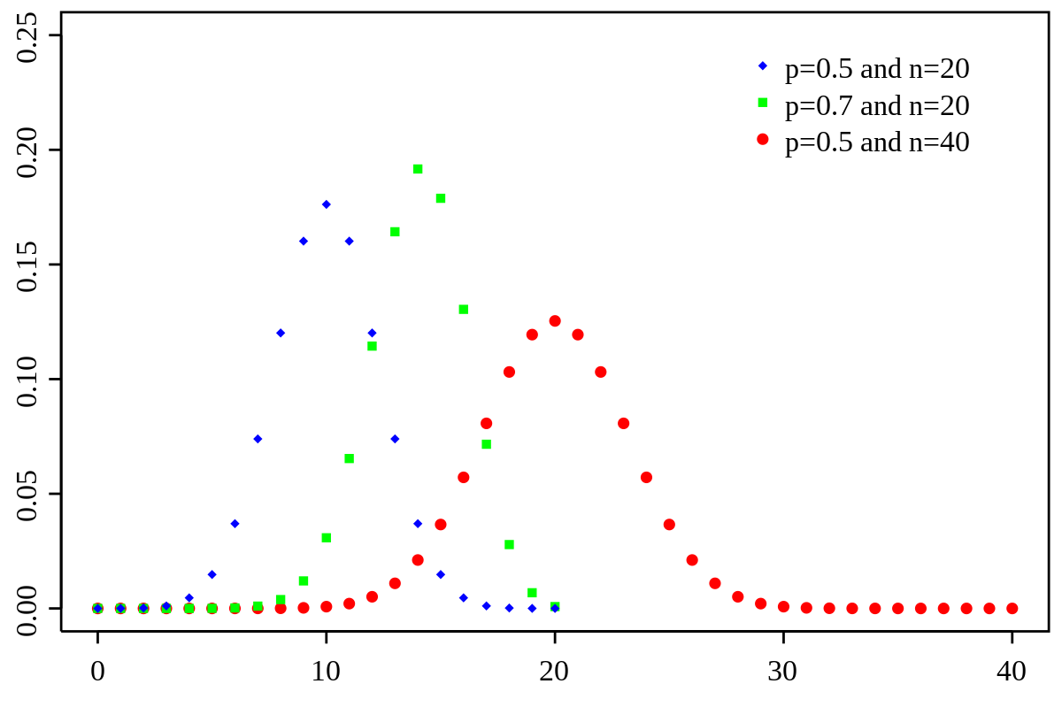

Inferential Statistics
1) Statistical distribution
2) Data generation
3) Frequentist inference
Basic concepts
11.10 - 11.20

Slide 24

Frequentist inference
Additional slide
Random events.
Empirical phenomena which have the following two features:
1. They do not have deterministic regularity (i.e. observations
of them do not always yield the same outcome)
2. They possess some statistical regularity, indicated by the statistical stability of their frequencies.
Shiryaev Albert N., Probability-1, Third Edition

Slide 25
Frequentist inference
Additional slide
Mathematical analysis of random events.
Random events are more or less adequately described by statistical distributions (e.g. normal distribution).
Statistical regularity is captured by parameters of statistical distributions (e.g. mean and standard deviation of the normal distribution).

Slide 26
Probability distribution
Additional slide
Def: In probability theory and statistics, a probability distribution is the mathematical function that gives the probabilities of occurrence of different possible outcomes for an experiment.
Prob_{k}
Prob_{i}
Prob_{i} could be interpreted as parameters of a general statistical distribution
Prob_{j}
Outcome
https://en.Wikipedia.org/wiki/Probability_distribution, 15th August 2024

Slide 27
Binomial distribution
Def: the binomial distribution with parameters n and p is the discrete statistical distribution of the number of successes in a sequence of n independent trials. Each trial (Bernoulli trial) has a binary outcome: success with probability p and failure with probability 1-p.
n = 20
p = 0.40
Assumptions of the binomial distribution
- The outcome of each trial is binary (0/1)
- Each Bernoulli trial is independent (i.e. the outcome of each trial does not depend on the outcome of the other trials)
- The probability of success p is constant (i.e. it does not change for each trial)

Slide 28
Poisson distribution
Def: the Poisson distribution with parameter 𝞴 is the discrete probability distribution of the number of events that occur randomly and uniformly in a fixed time interval or in a given area.
𝞴 = 4
Assumptions of the Poisson distribution
The outcome is a count [0,1,…,k,…]
Independence of events: the occurrence of one event does not affect the probability that another event will occur
Two events cannot occur at exactly the same instant in time or at the same point of
the given area
Events occur at a uniform rate over the entire time period or area. 𝞴 is the expected (mean) number of events per time/area unit

Slide 29
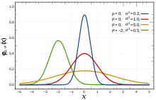
Normal distribution
Def: a normal distribution or Gaussian distribution is a type of continuous probability distribution. It is determined by two parameters (𝛍, 𝛔).
the parameter 𝛍 is the mean or expectation of the distribution (and also its median and mode)
the parameter 𝛔 is its standard deviation
Aidan Lyon, Why are Normal Distributions Normal?, The British Journal for the Philosophy of Science 2014 65:3, 621-649

Slide 30
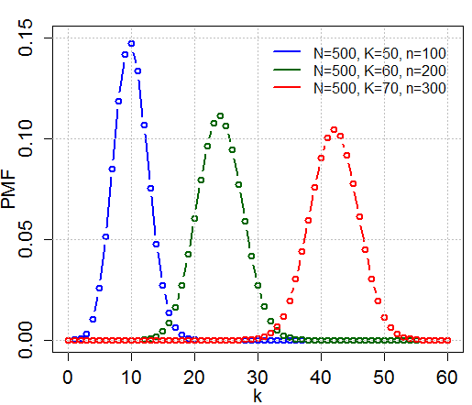
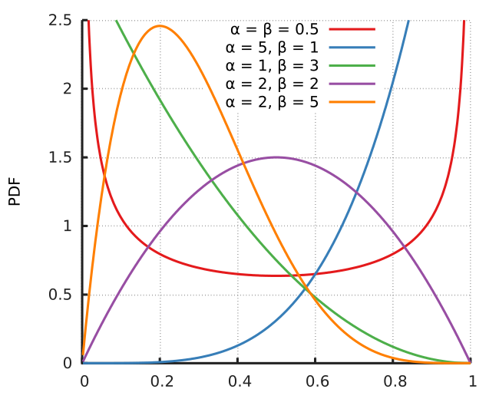
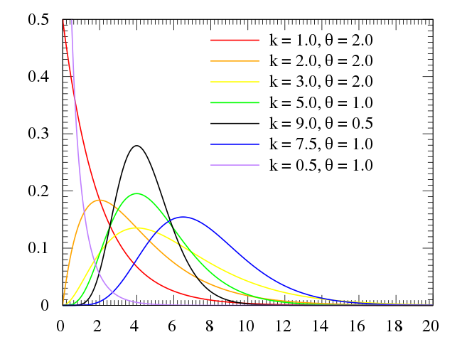
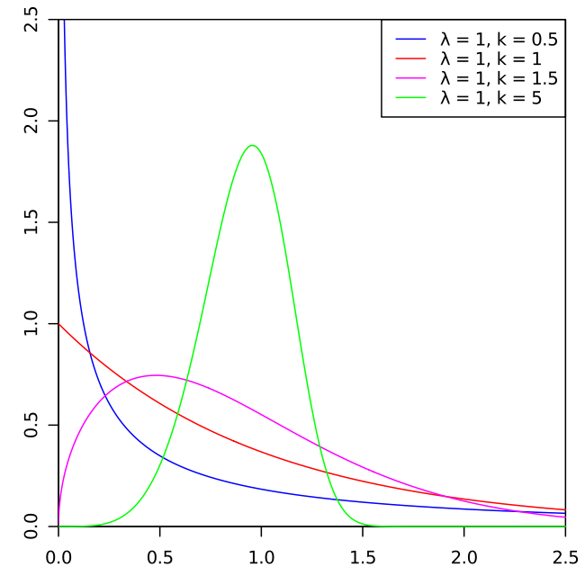
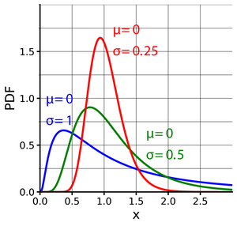
Other statistical distributions
Additional slide
Hypergeometric distribution
Beta distribution
Gamma distribution
Log-normal distribution
Weibull distribution

Slide 31
Frequentist inference in terms of statistical distributions
Here, it is assumed that data are generated by a statistical distribution with parameters 𝛈,𝛉,…,𝛙.
The principal aim is to infer information about 𝛈,𝛉,…,𝛙.
1) Statistical distribution
3) Frequentist inference
2) Data generation
E.L. Lehmann, George Casella, Theory of Point Estimation, Second Edition

Slide 32


Frequentist inference in terms of populations
Population
Sample
Data (x₁, x₂,…, x_{n})
Population described by parameters (e.g., μ, σ, π)
Inferential statistics (e.g., sample mean, std, p)
Statistical target

Slide 33
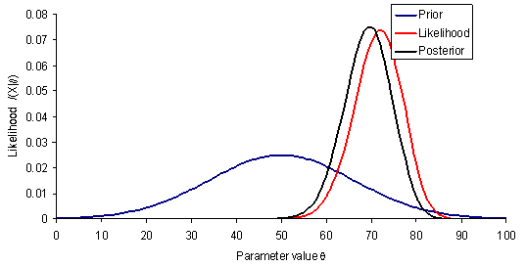
Bayesian inference
Additional slide
The basic paradigm of bayesian statistics
Initial beliefs concerning a parameter 𝜭 of interest are expressed as a prior distribution
Evidence from further data is summarized by a likelihood function for the parameter 𝜭
Using Bayes theorem (i.e. normalized product of the prior and the likelihood) initial beliefs are updated to form the posterior distribution, on the basis of which conclusions on the parameter 𝜭 should be drawn
D.J. Spiegehalter et al., Bayesian Approaches to Randomized Trials, J.R. Statist. Soc. A (1994) 157, Part 3, pp. 357-416

Slide 34
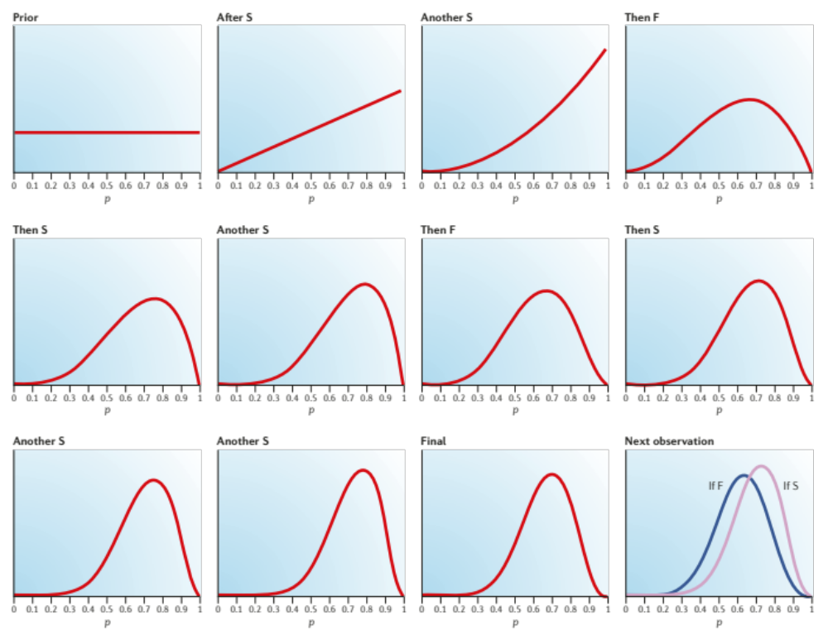
A practical example of bayesian inference
Additional slide
Berry DA. Bayesian clinical trials. Nat Rev Drug Discov. 2006 Jan;5(1):27-36. doi: 10.1038/nrd1927. PMID: 16485344

Slide 35
Data analysis: bayesian inference
Additional slide
The recourse to the prior distribution on the parameters of a model is questionable. There is in fact a major step from the notion of an unknown parameter to the notion of a random parameter.
Edwards A.W.F., Likelihood (Expanded Edition), 1992

Slide 36
Inferential Statistics
1) Statistical distribution
2) Data generation
3) Frequentist inference
CLT and 95% CIs
11.20 - 11.45

Slide 37
Central limit theorem (CLT)
Let X₁,…,X_{n} be independent and identically distributed random variables with mean 𝛍 and standard deviation 𝛔
The sample mean ẋ is a statistic obtained by calculating the arithmetic average of the values of X₁,…,X_{n} in a sample
CLT: ẋ is distributed as N (𝛍, 𝛔/√(n)) as the sample size n gets larger

Slide 38
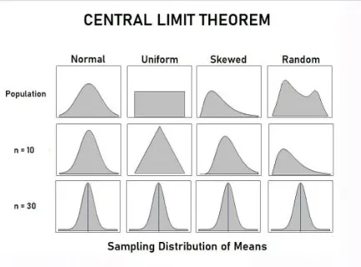
Central limit theorem (CLT)
Central limit theorem
The usefulness of the CLT is that the distribution of sample means approaches normality regardless of the distribution of the population

Slide 39
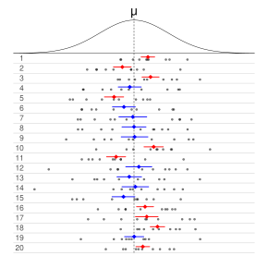
Confidence intervals (CIs)
In frequentist inference, a confidence interval (CI) is a range of estimates for an unknown parameter Θ.
It is computed at a designated confidence level (e.g., 95% CI). The confidence level represents the long-run proportion of CIs that theoretically contain the true value of the parameter Θ.
For example, out of all intervals computed at the 95% level, 95% of them should contain the parameter’s true value.
https://en.wikipedia.org/wiki/Confidence_interval, 15th August 2024

Slide 40

Confidence intervals for the normal distribution
Normal data, 𝛔 known: one sample z-confidence interval
Sample mean ẋ is exactly distributed according to N (𝛍, 𝛔/√(n))
95% CI = ẋ + z_{0.975} ∙ 𝛔/√(n), where z_{0.975} ≃ 1.96
If you do not know 𝛔…

Slide 41
Student’s t-distribution
Let x₁,…,x_{n} be independent and identically distributed observations from a normal distribution with mean 𝜇 and std 𝜎.
The sample mean and unbiased sample standard deviation are given by:
ẋ = (x₁+…+x_{n})/n [biological signal collected in the sample]
std² = (1/(n-1)) 𝝨_{i} (x_{i} – x_{m})² [noise collected in the sample]
(ẋ - 𝜇) / (std / √n) ∼ t_{n-1} is distributed according to a Student’s t-distribution with n-1 degrees of freedom
The t-statistic has a probability distribution that not depends on the unknown 𝜎

Slide 42
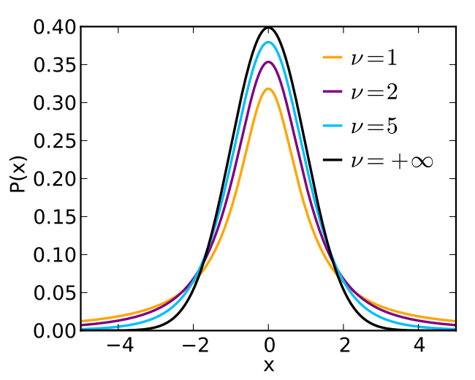
Student’s
t-distribution

Slide 43
Confidence intervals for the normal distribution
Normal data, 𝛔 unknown: one sample t-confidence interval
Sample mean ẋ - 𝛍 is exactly distributed according to [std/√(n)] ∙ t_{n-1}
95% CI = ẋ + t_{n-1, 0.975} ∙ std/√(n). We use the t-tables to obtain these “critical” values
If data are not normally distributed…

Slide 44
Consequence of CLT
t-distribution methods are robust when the sample size is large (n > 30). The data should not have extreme outliers or evidence of severe skewness.
For small samples it is risky to use t-confidence intervals. Only use if you are sure the population is roughly normally distributed, and the sample has no outliers and very little skew. Otherwise, other methods (e.g. bootstrap, data transformation) should be used.

Slide 45
Simulations
Exercises
http://bioinformatics-core-shared-training.github.io/IntroductionToStats/practical.html
Shiny web application
https://bioinformatics.cruk.cam.ac.uk/apps/stats/central-limit-theorem

Slide 46
Inferential Statistics
1) Statistical distribution
2) Data generation
3) Frequentist inference
Hypothesis testing
13.30 - 13.45

Slide 47
Hypothesis Testing
A hypothesis is a statement about the population(s).
Example n.1: Carboplatin induced response in at least 70% of NSCLC patients
Example n.2: The mean pressure is the same in C57BL/6J and DBA/2J mice
Example n.3: The two populations A and B have the same height distribution
The goal of a hypothesis test is to decide, based on data collected, which of two complementary hypotheses is true.
Example n.1: H₀: RR < 0.70; H₁: RR > 0.70
Example n.2: H₀: 𝛍₁ = 𝛍₂; H₁: 𝛍₁ ≠ 𝛍
Example n.3: H₀: D_{A} = D_{B}; H₁: D_{A} ≠ D_{B}

Slide 48
Hypothesis Testing
H₀: null hypothesis
H₁: alternative hypothesis
There is no symmetry between H₀ and H₁:
Pro cedure
1st step: We assume H₀ to be true
2st step: The strength of evidence provided by the data against H₀ is measured
3st step: If a contradiction is found, H₁ is accepted.
If a contradiction is not found, the method of proof fails and the hypothesis H₀ could be either true or false

Slide 49
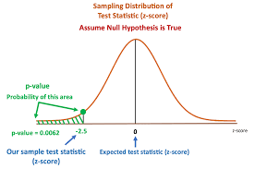
Strength of evidence provided by the data
Pro cedure
Data: x₁,…,x_{n}
Test statistic: t_{s} = f(x₁,…,x_{n})
Distribution of the test statistic under H₀:
The p-value is the statistical index used to measure the strength of evidence against H₀.

Slide 50
The two types of errors in hypothesis testing
 |  | Decision
 |  | Accept H₀ | Reject H₀
Truth | H₀ | Correct decision | Type I error (𝜶)
 | H₁ | Type II error (𝜷) | Correct decision
If the hypothesis test incorrectly decides to reject H₀, then the test has made a Type I error (i.e. false positive decision)
If the hypothesis test incorrectly decides to not reject H₀, then the test has made a Type II error (i.e. false negative decision)

Slide 51
Type I error (𝛂) and p-value
H₀: θ = 0, θ ∈ {0, 1, 2}
H₁: θ = 1,2
Distribution of the test statistic under H₀:
t_{s} | 1 | 2 | 3 | 4
Prob (t_{s} | H₀) | 0.980 | 0.005 | 0.005 | 0.010
P-value | 1.00 | 0.01 | 0.01 | 0.020
An α significance level (e.g. 0.05) is simply a decision rule as to which p-values will cause one to reject the null hypothesis. In other words, it is merely a decision point as to how weird the data must be before rejecting the null model. If the p-value is less than or equal to α, the null is rejected. Implicitly, an α level determines what data would cause one to reject H₀ and what data will not cause rejection. The α level rejection region is defined as the set of all data points that have a p-value less than or equal to α.

Slide 52
Statistical power (1-𝛃)
The power (1-𝜷) of a hypothesis test is the probability to reject the null hypothesis (H₀) if H₁ is true. It is a function of alternative simple hypotheses.
Distribution of the test statistic under H₀:
Rejection region of the test with α significance level= 0.05
t_{s} | 1 | 2 | 3 | 4
Prob (t_{s} | H₀) | 0.980 | 0.005 | 0.005 | 0.010
P-value | 1.00 | 0.010 | 0.010 | 0.020
Distribution of the test statistic under H₁:
t_{s} | 1 | 2 | 3 | 4
Prob (t_{s} | θ = 1) | 0.100 | 0.200 | 0.200 | 0.500
Prob (t_{s} | θ = 2) | 0.098 | 0.001 | 0.001 | 0.900
(1-𝜷 | θ = 1) = 0.900
(1-𝜷 | θ = 2) = 0.902

Slide 53
Statistical power
Additional slide
Statistical power
Biological signal
Sample size
Significance level (𝛂)
Biological noise

Slide 54
Distribution-free tests
Additional slide
A distribution-free test is one which makes no assumptions about the precise form of the sampled population or the assumptions are never so elaborate as to imply a population whose distribution is completely specified.
Distribution-free tests | Distribution-dependent tests
Sign test | One-sample Student’s t-test
Wilcoxon signed-rank test | Two-sample Student’s t-test
Wilcoxon rank-sum test | Unequal variance t-test (i.e. Welch’s t-test)
Bradley, J.V. (1968) Distribution-Free Statistical Tests. Prentice-Hall, Englewood Cliffs, NJ
Kendall, M.G. and R.M.Sundrum, Distribution-Free Methods and Order Properties, Review of the International Statistical Institute, 3 (1953), 124-134

Slide 55
Exercises
http://bioinformatics-core-shared-training.github.io/IntroductionToStats

Slide 56
Inferential Statistics
1) Statistical distribution
2) Data generation
3) Frequentist inference
One-Sample tests
14.15 - 14.40

Slide 57
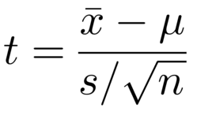
One-sample Student’s t-test
Assumptions: 1. the data are continuous
2. sample data have been randomly sampled from a population
3. independent observations x_{i}, i=1,…,n
4. the population is normally distributed
Hypotheses to test:
H₀: mean of the population distribution 𝛍 = 𝛍₀
H₁: 𝛍 ≠ 𝛍₀
Test statistic:
ẋ = sample mean
s = sample standard deviation

Slide 58
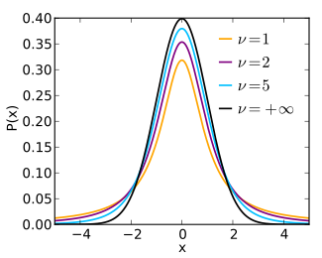
One-sample Student’s t-test
Distribution of the test statistic under H₀:
t-distribution with n-1 degrees of freedom

Slide 59
Sign test
Assumptions: 1. the data are continuous
2. sample data have been randomly sampled from a population
3. independent observations x_{i}, i=1,…,n
Hypotheses to test:
H₀: median of the population distribution 𝜽 = 𝜽₀
H₁: 𝜽 ≠ 𝜽₀
Test statistic: number of values above (or below) 𝜽₀.

Slide 60
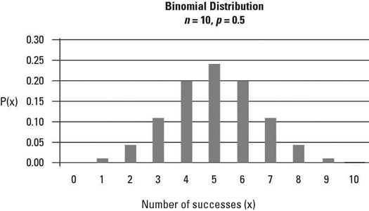
Sign test
Distribution of the test statistic: binomial distribution, X ∼ Bin (n, 0.5)
In case of values equal to 𝜽₀, discard these values and apply the sign test only to values above or below 𝜽₀.

Slide 61
Wilcoxon signed-rank test
Assumptions: 1. the data are continuous
2. sample data have been randomly sampled from a population
3. independent observations x_{i}, i=1,…,n
4. the population distribution is symmetric
Hypotheses to test:
H₀: median/mean of the population distribution 𝜽 = 𝜽₀
H₁: 𝜽 ≠ 𝜽₀
Test statistic: sum of positive signed ranks (ranks⁺).

Slide 62
Wilcoxon signed-rank test
n: 3
Raw data: 67, -12, 55
𝜽₀: 50
Absolute differences: 5, 17, 62
Signed ranks: +1, +2, -3
Test statistic: +3
Distribution of the test statistic: P(+1,+2,+3) = P(+1,+2,-3) = P(+1,-2,+3) =
P(+1,-2,-3) = P(-1,+2,+3) = P(-1,+2,-3) =
P(-1,-2,+3) = (-1,-2,-3)= 1/8, hence…

Slide 63
Wilcoxon signed-rank test
Distribution of the test statistic:
Sum of ranks⁺ | 0 | 1 | 2 | 3 | 4 | 5 | 6
Probability | 1/8 | 1/8 | 1/8 | 2/8 | 1/8 | 1/8 | 1/8
Two-sided p-value: 1.0
One-sided p-value: 5/8=0.625
At the significance level 𝛂 of 0.05, we can’t reject the null hypothesis (𝜽=50).

Slide 64
Take home message
Additional slide
The Wilcoxon signed-rank test is more powerful than the sign test because it makes use of the magnitudes of the differences rather than just their sign.
It should be the preferred method, but it makes a stronger assumption: the distribution of the differences is symmetric.
In case this assumption is doubtful, the sign test should be used. Graphical display is recommended.

Slide 65
Take home message
Additional slide
The one-sample location test could be used for paired data samples.
Each paired data is summarized by their difference and one-sample location test is applied to differences.
Experimental unit | Paired data | Difference
1 | 23-55 | -32
… | … | …
k | 107-100 | 7

Slide 66
Exercises
Exercises
http://bioinformatics-core-shared-training.github.io/IntroductionToStats/practical.html
Shiny web application
https://bioinformatics.cruk.cam.ac.uk/stats/shinystats/

Slide 67
Inferential Statistics
1) Statistical distribution
2) Data generation
3) Frequentist inference
Two-Sample tests
15.20 - 15.45

Slide 68
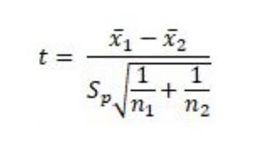
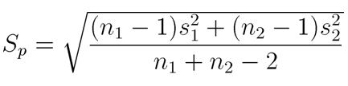
Two-sample Student’s t-test
Assumptions: 1. data are continuous
2. random sampling from the two populations
3. independent observations x_{i}, i=1,…,n₁ and y_{j}, j=1,...,n₂
4. the two population distributions are normal
5. equal variances s₁² and s₂²
Hypotheses to test:
H₀: 𝛍₁= 𝛍₂
H₁: 𝛍₁ ≠ 𝛍₂
Test statistic:
where
The statistic t has a Student's t distribution with n₁+n₂-2 degrees of freedom.

Slide 69
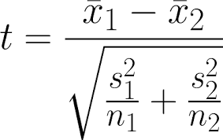
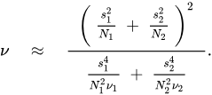
Unequal variance t-test (i.e. Welch’s t-test)
Assumptions: 1. data are continuous
2. random sampling from the two populations
3. independent observations x_{i}, i=1,…,n₁ and y_{j}, j=1,...,n₂
4. the two population distributions are normal
Hypotheses to test:
H₀: 𝛍₁= 𝛍₂
H₁: 𝛍₁ ≠ 𝛍₂
Test statistic:
The statistic t has a Student's t distribution with degrees of freedom:
where 𝜈_{i}= n_{i} - 1, i=1,2

Slide 70
Student’s t-test and Welch’s t-test
Additional slide
n₁ | n₂ | s₁ | s₂ | t-test ⋆ | Unequal ⋆
11 | 11 | 1 | 1 | 0.052 | 0.051
11 | 11 | 4 | 1 | 0.064 | 0.054
11 | 21 | 1 | 1 | 0.052 | 0.051
11 | 21 | 4 | 1 | 0.155 | 0.051
11 | 21 | 1 | 4 | 0.012 | 0.046
25 | 25 | 1 | 1 | 0.049 | 0.049
25 | 25 | 4 | 1 | 0.052 | 0.048
⋆ Type I error rate for the t-test and unequal variance t-test with nominal type I error of 0.05
When sample sizes are unequal, the Type I error probabilities of the Student’s t-test is decidedly influenced by unequal variances. Similar results have been found for type II error probabilities and statistical power.

Slide 71
Take home message
Additional slide
Student's t-test is robust under violation of homogeneity of variance provided sample sizes are equal.
When sample size are unequal the type I error, type II error and statistical power of the Student’s t-test are decidedly influenced by unequal variances.
Even when the variances are identical, the Welch’s t-test performs well in terms of type I error, type II error and statistical power.

Slide 72
Take home message
Additional slide
Unless an argument based on logical, physical, or biological grounds can be made as to why the variances are very likely to be identical for the two populations, the Welch’s t-test should be applied.
It is not recommended to pre-test for equal variances and then choose between Student's t-test or Welch's t-test ⋆ .
Graphical display is recommended to qualitatively evaluate the
difference between sample variances.
⋆ Zimmerman DW. A note on preliminary tests of equality of variances. Br J Math Stat Psychol. 2004 May;57(Pt 1):173-81. doi: 10.1348/000711004849222. PMID: 15171807

Slide 73
If the assumption of normality of the underlying populations is violated?

Slide 74
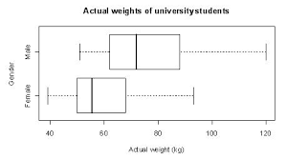
Wilcoxon rank-sum test
Assumptions: 1. data are ordinal or continuous
2. random sampling from the two populations
3. independent observations x_{i}, i=1,…,n₁ and y_{j}, j=1,...,n₂
Hypotheses to test:
H₀: the population distributions are the same (G=F).
H₁: G ≠ F (two-sided H₁) or G < F ⋆ (one-sided H₁) or G > F ∘ (one-sided H₁).
⋆ G is shifted to the left of F
∘ G is shifted to the right of F
Test statistic: sum of ranks from one of the two groups.

Slide 75
Calculation of the test statistic
ID mouse | Group | Outcome | Rank | Sum rank | Average rank | Sum of ranks
1 | A | 0 | 1 | 10 | 2.5 | Group A: | 162.5
5 | A | 0 | 2 |  |  | Group B: | 302.5
8 | A | 0 | 3
14 | A | 0 | 4
6 | A | 1 | 5 | 45 | 7.5
9 | A | 1 | 6
11 | A | 1 | 7
12 | A | 1 | 8
15 | A | 1 | 9
21 | B | 1 | 10
2 | A | 2 | 11 | 50 | 12.5
7 | A | 2 | 12
24 | B | 2 | 13
25 | B | 2 | 14
3 | A | 3 | 15 | 126 | 18
13 | A | 3 | 16
16 | B | 3 | 17
20 | B | 3 | 18
23 | B | 3 | 19
26 | B | 3 | 20
29 | B | 3 | 21
4 | A | 4 | 22 | 120 | 24
17 | B | 4 | 23
18 | B | 4 | 24
19 | B | 4 | 25
28 | B | 4 | 26
22 | B | 5 | 27 | 55 | 27.5
30 | B | 5 | 28
27 | B | 7 | 29 | 29 | 29
10 | A | 8 | 30 | 30 | 30

Slide 76
Distribution of the test statistic
Group 1, ranks | 3,4,5 | 2,4,5 | 1,4,5 | 2,3,5 | 1,3,5
Test statistic | 12 | 11 | 10 | 10 | 9
Probability under H₀ | 0.1 | 0.1 | 0.1 | 0.1 | 0.1
n₁ = 3 n₂ = 2
Group 1, ranks | 2,3,4 | 1,3,4 | 1,2,4 | 1,2,3 | 1,2,5
Test statistic | 9 | 8 | 7 | 6 | 8
Probability under H₀ | 0.1 | 0.1 | 0.1 | 0.1 | 0.1
Simulation: rank j as the same probability to be assigned to one
group or the other.
For large samples, a normal approximation with known mean and variance can be applied.

Slide 77
Distribution-free tests vs t-tests
Additional slide
Situations which may suggest the use of distribution-free tests:
When one outcome has a distribution other than normal.
When the data are ordered with many ties or are rank ordered.
When the data has notable outliers.
When there is a small sample size.

Slide 78
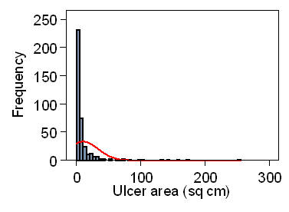
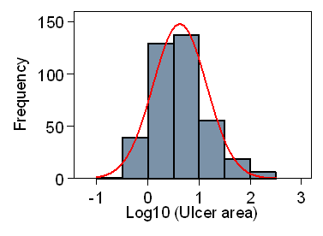
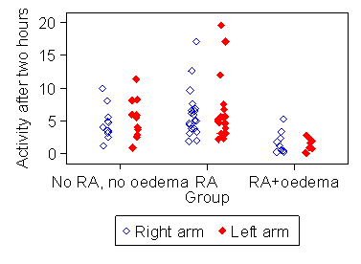
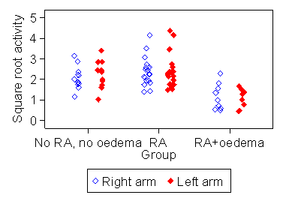
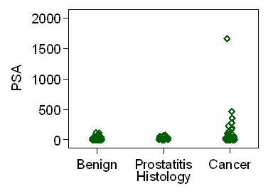
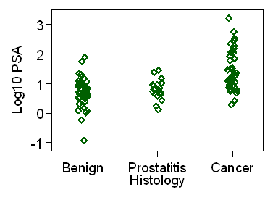
Data transformations
Additional slide
We can transform the data mathematically…
to make them fit the normality
more closely
to obtain more similar variances
to handle outliers

Slide 79
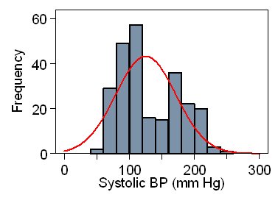
The most common used transformations
Additional slide
We can transform the data mathematically into…
1. the logarithm (x_{i} > 0, i=1,…n)
2. the square root (x_{i} > 0, i=1,…n)
3. the reciprocal (x_{i} > 0, i=1,…n)
Take home message:
These transformations could be useful to obtain normality, similar variance and handling outliers
The best choice depends on the relationship between variability and mean. Graphical display of data is useful to choose the
best transformation
Not all data can be transformed successfully

Slide 80
Hypothesis to be tested after data transformations
Additional slide
Assumptions: 1. Student’s t-test assumptions or
2. Welch’s t-test assumptions
Hypotheses to test:
H₀: The population distributions are the same (G=F) ⋆ ⋆
H₁: G ≠ F (two-sided H₁) or G < F ⋆ (one-sided H₁) or G > F ∘ (one-sided H₁)
⋆ G is shifted to the left of F
∘ G is shifted to the right of F
⋆ ⋆ Previous data transformations are monotonic. Hence,
G=F on the natural scale if and only if G=F on the transformed scale
Test statistic: Student’s test statistic or Welch’s test statistic

Slide 81
Hypothesis to be tested after data transformations
Additional slide
Log-normal distribution
Properties of the log-normal distribution
Mean log-normal: exp(𝝁 + 𝝈² / 2)
Median log-normal: exp(𝝁)
Consequences
If 𝝁₁ = 𝝁₂ then Median₁ = Median₂
If 𝝁₁ = 𝝁₂ and 𝝈₁ ≠ 𝝈₂ then Mean₁ ≠ Mean₂

Slide 82
Exercises
Exercises
http://bioinformatics-core-shared-training.github.io/IntroductionToStats/practical.html
Shiny web application
https://bioinformatics.cruk.cam.ac.uk/stats/shinystats/

