Slide 1
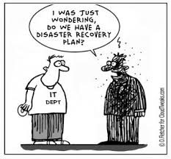
Managing Your Research Data
Data Structure and Formatting

Slide 2
Reproducible Research
At some point in the future someone might want to repeat your analysis for themselves or re-use your data
This will most likely be you!
Assuming that you'll be able to remember all the steps involved in generating the data is dangerous
Making sure that everything is well documented is crucial
Documentation should cover not only the methods used, but the files used as input and any transformations performed on them

Slide 3
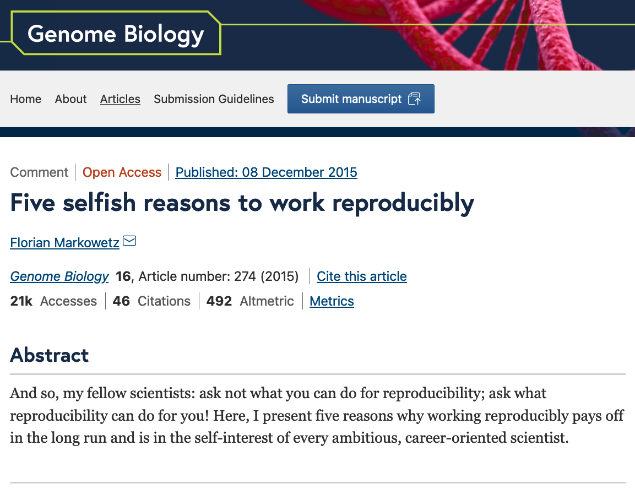

Reproducible Research
Five selfish reasons to work reproducibly – Florian Markowetz (CRUK)
YouTube video of Florian presenting this in a talk

Slide 4
Reproducible Research
Probably the most (in)famous example of failure to reproduce a study, which actually put people's lives at risk and rallied statisticians into action - Keith Baggerly's lecture on the scandal is a must-see.
Retraction Watch

Slide 5
Are spreadsheets programs like Excel evil?
… Not necessarily …
Often much more convenient to eye-ball a spreadsheet and get an overall impression of your data
But they have limitations making them not ideal for large-scale analyses
Doing things by-hand increases the chances of mistakes, such as copy-and-paste errors
Languages such as R or Python cannot read all files as if by magic

Slide 6
Data Validation in Excel for data entry
Excel and other spreadsheets have a data validation feature
e.g. In Excel
Select a column
In the menu bar, choose Data then Validation…
You can then choose to limit the acceptable entries in the column to:
Integer or decimal number
A numeric range
List of possible text values
Limited length text
Date or time

Slide 7
Less helpful features in Excel
When identifiers are long integers Excel converts them to exponents
1000000 = 1e06
Issue with Illumina microarray chip IDs
Excel can convert gene names to dates
SEPT2 (Septin 2) → ‘2-Sep’
MARCH1 (Membrane-Associated Ring Finger (C3HC4) 1, E3 Ubiquitin Protein Ligase) → ‘1-Mar’
Conversion of ID codes!

Slide 8
Data Handling rules
Rule 1 - Never work directly on the raw data
Rule 2 - Maintain consistency
Rule 3 - Don't use 0 to mean missing
Rule 4 - Fill in all the cells
Rule 5 - Make it rectangular
Rule 6 - Do your data entry in a timely fashion

Slide 9
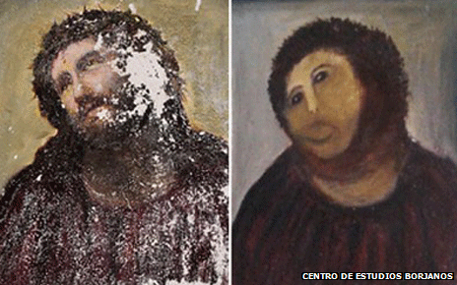
Data Handling rules
Rule 1 - Never work directly on the raw data

Slide 10
Data Handling rules
Rule 1 - Never work directly on the raw data
Hard to reverse all the manual steps performed
Keep the original data somewhere safe
Make a copy of the original and work on that
Ideally write protect the original to avoid it being altered or overwritten

Slide 11
Data Handling rules
Rule 1 - Never work directly on the raw data
Write protection:
Mac
Right click on the file in Finder
Select “Get Info”
Sharing and permission
Under the “Privilege” column select “Read only”
Windows
Right click on the file in Windows Explorer
Properties
General tab
Attributes
Select the box for “read only”

Slide 12
Data Handling rules
Rule 2 - Maintain consistency
How many inconsistencies can you spot?
Patient ID | Sex | Date of Diagnosis | Tumour Size
Patient_1 | M | 01-01-2013 | 3.1 cm
Patient_2 | f | 04-18-1998 | 1.5
Patient_3 | Male | 1st of April 2004 | 10.5
Patient_4 | Female | NA | 67
Patient_5 | F | 2010/03/12 | 4.2 cm
Patient_6 | F |  | 3.6 cm
Patient_7 | M | 1994-11-05 | 23.2 mm

Slide 13
Data Handling rules
Rule 2 - Maintain consistency
Consistency: F, female, f, fem, 2, …
Units - cm or mm; days, months or years
You can introduce inconsistencies without realising it, e.g. blank spaces (whitespace) at the end of text - "Male " is not the same as "Male”
Controlled vocabularies – standardize text entry option
Use data validation where possible
Document choices you make in a README file

Slide 14
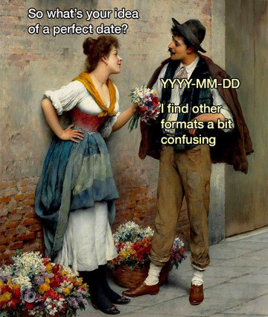
Data Handling rules
Rule 2 - Maintain consistency
A note on dates:
The formatting for dates varies widely e.g.:
2nd May 2023
02-05-2023
2/5/2023
5-2-2023
May 2nd 2023
The clearest is to use YYYY-MM-DD
i.e. 2023-05-02
This is international standard ISO 8601

Slide 15
Data Handling rules
Rule 2 - Maintain consistency
Corrected Data Table
Patient ID | Sex | Date of Diagnosis | Tumour Size (mm)
Patient_1 | M | 2013-01-01 | 31
Patient_2 | F | 1998-04-18 | 15
Patient_3 | M | 2004-04-01 | 10.5
Patient_4 | F | NA | 67
Patient_5 | F | 2010-03-12 | 42
Patient_6 | F | NA | 36
Patient_7 | M | 1994-11-05 | 23.2

Slide 16
Data Handling rules
Rule 3 – Don't use 0 to mean missing
Zero values are data!
Sometimes extreme values such as 999 are sometimes used
“NA” is okay, except if NA is a valid category in your data
Languages such as R or Python will recognise NA as a missing value and will ignore it in analyses
Another option is to leave the cell empty
You need to be careful with blank spaces
Does it mean the data weren’t collected or was it a data entry error?

Slide 17
Data Handling rules
Rule 4 - Fill in all the cells
Sample ID | Date | Value
Sample_1 | 2015-06-14 | 213
Sample_2 |  | 76.5
Sample_3 | 2015-06-18 | 32
Sample_4 |  | 120.3
Sample_5 |  | 109
Sample_6 | 2015-06-20 | 95.6
Sample_7 |  | 143

Slide 18
Data Handling rules
Rule 4 - Fill in all the cells
It is tempting to make the table look cleaner by not repeating some values
Fill in all cells!
otherwise, problems when sorting
Empty cell:
missing value?
value meant to be repeated multiple times?
Make sure it’s clear that the data is missing and not unintentionally left blank

Slide 19
Data Handling rules
Rule 4 - Fill in all the cells
Sample ID | Date | Value
Sample_1 | 2015-06-14 | 213
Sample_2 | 2015-06-14 | 76.5
Sample_3 | 2015-06-18 | 32
Sample_4 | 2015-06-18 | 120.3
Sample_5 | 2015-06-18 | 109
Sample_6 | 2015-06-20 | 95.6
Sample_7 | 2015-06-20 | 143

Slide 20
Data Handling rules
Rule 5 - Make it rectangular
Analysis software expects a very rigid shape of data with rows and columns
Each column is a variable being examined
Each row is an observation
A concept commonly known as tidy data

Slide 21
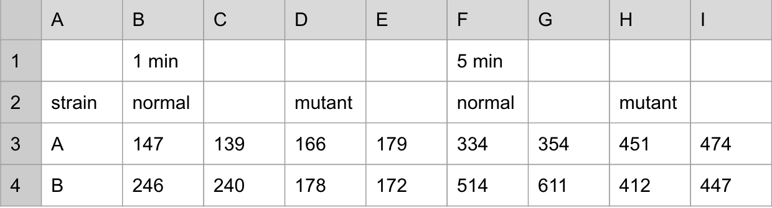
Data Handling rules
Rule 5 - Make it rectangular

Slide 22
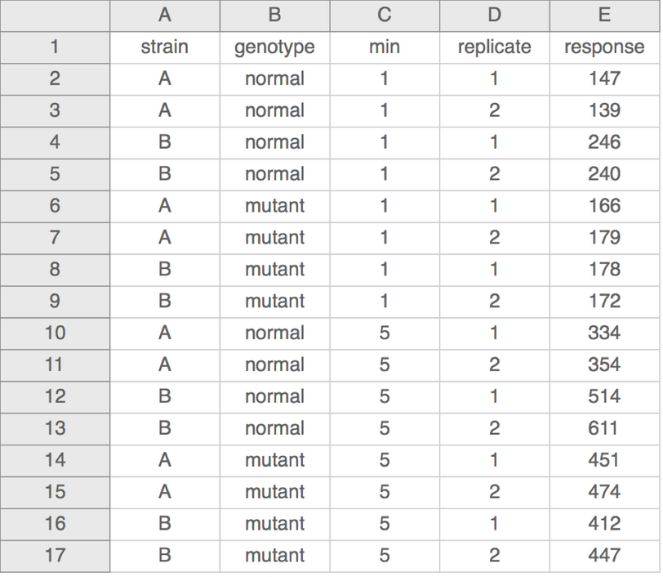
Data Handling rules
Rule 5 - Make it rectangular

Slide 23
Data Handling rules
Rule 6 – Do your data entry in a timely fashion
It is tempting to focus on data collection and leave data entry to later date
This can lead to problems if your records are not perfect
Lab/Field notebooks can be easily damaged or lost

Slide 24
Data Handling rules
Rule 1 - Never work directly on the raw data
Rule 2 - Maintain consistency
Rule 3 - Don't use 0 to mean missing
Rule 4 - Fill in all the cells
Rule 5 - Make it rectangular
Rule 6 - Do your data entry in a timely fashion

Slide 25
Additional best practices
Don’t put too much information in one cell
1 cell = 1 piece of information
Don’t include units such as "30 g" → "g" in the column name
http://unitsofmeasure.org/ucum.html
Write notes in a separate column or data dictionary or metadata
"0 (below threshold)”
Design for machine readability
No calculations
Don’t use highlighting or font/fill colours to indicate data

Slide 26
Practical
Download the file patient_data.txt to your computer
Open it in Excel or any other spreadsheet software
This is a simulated, but representative, example of bad data
Spend a few minutes identifying problems with the data
In the next session we will look at the software OpenRefine, which we can use to clean up the problems with the data table.

