Slide 1
Managing your Research Data Introduction: - Data Management plans - Data formatting - File management - Data sharing & backup

Slide 2
And what is ‘Data’ ?
Raw instrument readings
Processed data
Analysed data
Genomic data
Microscopic photos, Western blot images and measurement
Spreadsheets
Data Formats/Metadata
Videos
Surveys and interviews
Field notes
Maps
Lab books
Physical samples
Protocols
Software
Graphs/Figures
It’s basically anything you produce in the course of your research and is the ‘bed-rock’ of your findings!
Notes:
Explain FAIR principles

Slide 3
What is a Data Management Plan?
A short document (typically 2-3 pages) which contains information about:
Data sources
Data input methods (validation)
- Back up strategies (Consider & select option(s))
Plans for data sharing (Suitable repository & appropriate access controls – FAIR data principles)
Ethical/legal restrictions (e.g. Patient Data)
- Who is responsible for the data
Researcher needs to write a DMP before the project begins
Notes:
Findable
- easily discoverable
Accessible
- no restriction to access
Interoperable
- doesn’t rely on one specific type of software
Reusable
- is clearly licensed

Slide 4

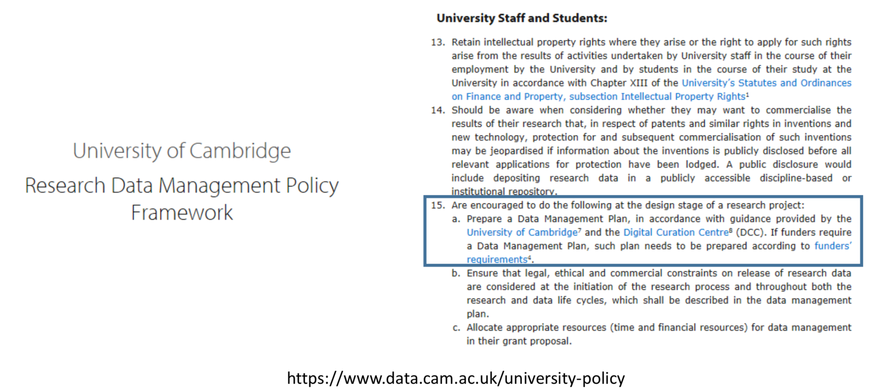
Why do I need a Data Plan?
To protect your science
Re-usable data
Reproducible better science
To help your future you and your current colleagues
Because major funders require it
University policy
Legal requirements e.g. use of personal data or confidentiality agreements
http://www.dcc.ac.uk/resources/data-management-plans
www.data.cam.ac.uk/DMPsupport
www.data.cam.ac.uk/funders

Slide 5
Data Protection issues
The legislation imposes requirements for use of personal data, but most research will be subject to one of two exemptions:
1) Research purposes – used where:
The standard provisions would seriously impair research
No damage or distress to data subjects
No individual decision-making about data subjects
Safeguards are in place
2) Academic expression - used where:
Complying with the standard provisions would be incompatible with the academic purpose
There will be a publication in the public interest
Patient identifiable Data (has more requirements)
Even more sensitive
Protects patients living and deceased unlike Data Protection Act which focuses upon living.
Very seldom allowed to breach except in interests of patients health and well-being
https://digital.nhs.uk/data-and-information/looking-after-information

Slide 6
Data protection requirements upon researchers
Know and communicate your legal basis (research)
Be transparent with data subjects (research)
Process accurately and only what you need (research)
Keep personal data secure (research)
Process fairly, considering any ethical risks to the data subject (research)
Comply with institutional accountability processes, e.g. ethical review (research and academic expression)
Storage of Personal data
Personal data may only be used under the research exemption if appropriate security measures are taken.
Ideally this will be prompt anonymization or pseudonymisation.
Ensure that portable systems or devices are fully encrypted.
Ensure physical security for hard copy data. (More about storage and backup later in course)
Handling Personal data
If possible, don’t collect it!
Gain informed, preferably open and written, consent. See UK Data Service for examples.
Anonymise data Remove identifiers, Aggregate results, Generalise a variable, Remove outliers
Use managed access repositories

Slide 7

Where to go for further help
and advice on your Data
Your local IT Support desk
UIS
https://www.uis.cam.ac.uk
Tweets as @CamOpenData
https://www.data.cam.ac.uk
Data Champions
https://www.data.cam.ac.uk/intro-data-champions
NB I have used materials from OSC in this slidedeck

Slide 8
Guidance
Institutional website, e.g:
University Research Ethics website:
https://www.research-integrity.admin.cam.ac.uk/research-ethics
NHS Health Research Authority
https://www.hra.nhs.uk/hra-guidance-general-data-protection-regulation/
UK Data Service FAQs
https://www.ukdataservice.ac.uk/media/621794/gdpr-faqs.pdf
Notes:
WHAT ABOUT INDUSTRY?

Slide 9
Online courses:
Mantra from Edinburgh Uni
https://mantra.edina.ac.uk/
Foster Open Science
https://www.fosteropenscience.eu/
UK Data Service
https://www.ukdataservice.ac.uk/manage-data/training

