Slide 1
Managing Your Research Data
Best Practices in Research Data Management for the Biological Sciences
2nd May 2023
Abigail Edwards
Ashley Sawle

Slide 2
Introduction
Data Management Plans
Data structure and formatting
File management
Data sharing & backup

Slide 3
Managing Your Research Data
Data Management Plans

Slide 4
What is a Data Management Plan?
A short document (2-3 pages) which contains information about:
Data sources
Data input methods (validation)
Back up strategies (Consider & select option(s))
Plans for data sharing (Suitable repository & appropriate access controls – FAIR data principles)
Ethical/legal restrictions (e.g. Patient Data)
Who is responsible for the data
Researcher needs to write a DMP before the project begins

Slide 5

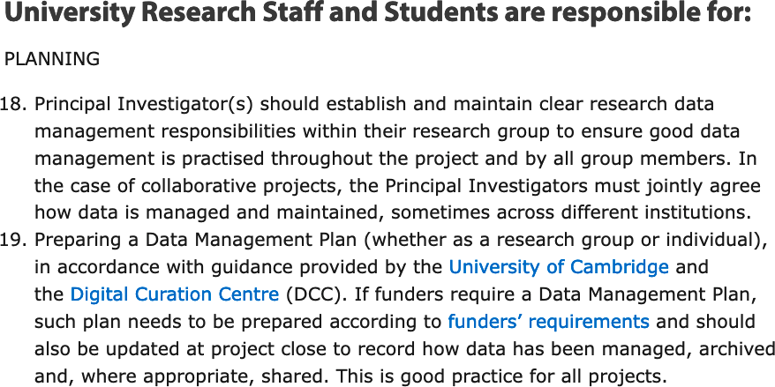
Why do I need a Data Plan?
To protect your science
Re-usable data
Reproducible better science
To help your future you and your current colleagues
Major funders require it
University policy
Legal requirements e.g. use of personal data or confidentiality agreements
University of Cambridge
Research Data Management Policy Framework
Digital Curataion Centre – Data Management Plans
UoC – Data Management Plan Support Service
UoC – Funder’s Policies

Slide 6
The Data Protection Act 2018
The legislation imposes requirements for use of personal data, but most research will be subject to one of two exemptions:
1) Research purposes – used where:
The standard provisions would seriously impair research
No damage or distress to data subjects
No individual decision-making about data subjects
Safeguards are in place
2) Academic expression - used where:
Complying with the standard provisions would be incompatible with the academic purpose
There will be a publication in the public interest

Slide 7
Patient Identifiable Data
Has more data protection requirements
Even more sensitive
Protects patients living and deceased unlike Data Protection Act which focuses upon living
Very seldom allowed to breach except in interests of patients health and well-being
NHS Digital - Data security and information governance

Slide 8
Data protection requirements for researchers
Know and communicate your legal basis (research)
Be transparent with data subjects (research)
Process accurately and only what you need (research)
Keep personal data secure (research)
Process fairly, considering any ethical risks to the data subject (research)
Comply with institutional accountability processes, e.g. ethical review (research and academic expression)

Slide 9
Storage of Personal data
Personal data may only be used under the research exemption if appropriate security measures are taken
Ideally this will be prompt anonymization or pseudonymisation
Ensure that portable systems or devices are fully encrypted
Ensure physical security for hard copy data.
More about storage and backup later in the course

Slide 10
Handling Personal data
If possible, don’t collect it!
Gain informed, preferably open and written, consent. See UK Data Service for examples.
Anonymise data - Remove identifiers, Aggregate results, Generalise a variable, Remove outliers
Use managed access repositories

Slide 11

Where to go for further help and advice
Your local IT support desk
Office of Scholarly Communications (UoC)
Data Champions (UoC)
University Information Services (UoC)
University Research Ethics website (UoC)
NHS Health Research Authority
UK Data Service - The Data Protection Act and GDPR

Slide 12
Further online courses
University of Edinburgh - MANTRA
Foster Open Science e-learning portal
UK Data Service Training

