Slide 1
File and Data Management
Based on Slides by Jing Su

Slide 2
Introduction
Why file management of your research data is important
Specific techniques for organizing your research data,
File structures
File naming
Version control
Storage
Focuses on research data, also applies to other types of files
Notes:
Why file organization of your research data is important
Specific techniques for organizing your research data,
including developing plans for:
– File structures - where to put data so you won’t lose it
(including tips on embedding metadata)
– File naming - what to call data so you know what it is
– A bit on version control - keeping track of data
• Will also include opportunities for:
– Small group discussion
– Exercise for organizing your own data
• Focuses on research data, but applies to other types of files as well

Slide 3
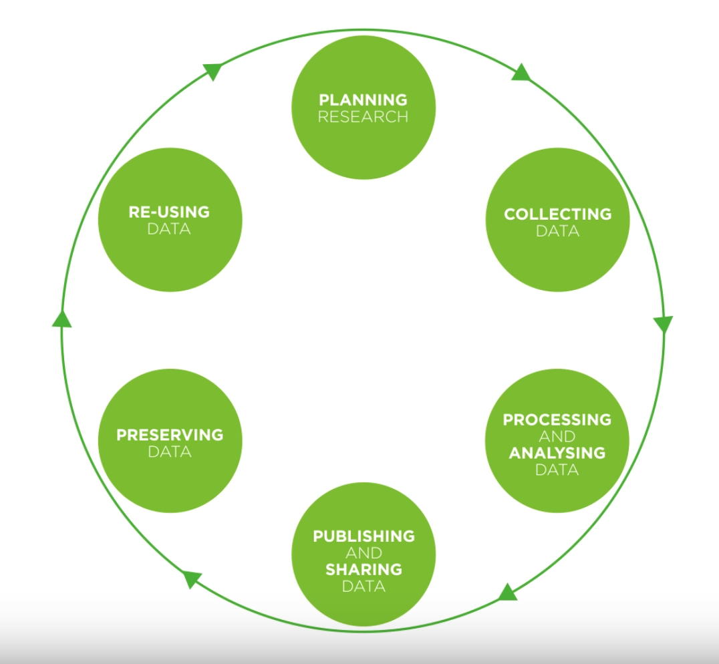
Research Data Lifecycle
Lifecycle: https://www.youtube.com/watch-wjFMMQD3UA&feature=youtu.be
Notes:
- Diagram to explain when to collect and how the data is used through the project etc..
- Data management plan, checklist

Slide 4
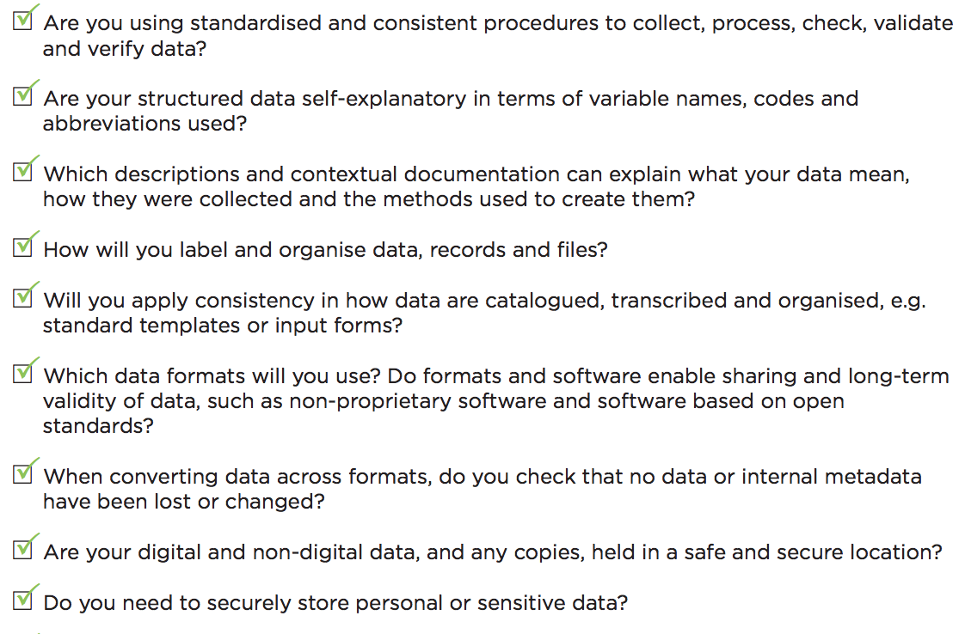
Data Management Checklist 1/2
Notes:
Why file organization of your research data is important
Specific techniques for organizing your research data,
including developing plans for:
– File structures - where to put data so you won’t lose it
(including tips on embedding metadata)
– File naming - what to call data so you know what it is
– A bit on version control - keeping track of data
• Will also include opportunities for:
– Small group discussion
– Exercise for organizing your own data
• Focuses on research data, but applies to other types of files as well

Slide 5
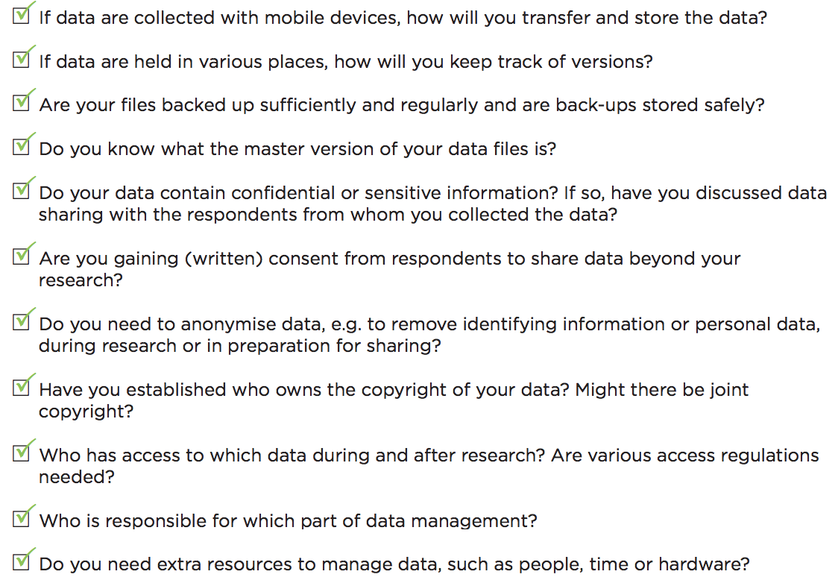
Data Management Checklist 2/2
Notes:
Why file organization of your research data is important
Specific techniques for organizing your research data,
including developing plans for:
– File structures - where to put data so you won’t lose it
(including tips on embedding metadata)
– File naming - what to call data so you know what it is
– A bit on version control - keeping track of data
• Will also include opportunities for:
– Small group discussion
– Exercise for organizing your own data
• Focuses on research data, but applies to other types of files as well

Slide 6
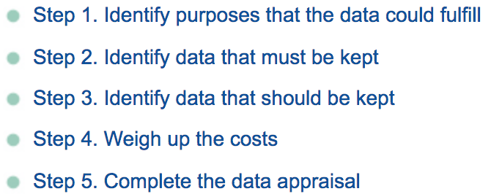
Data Management Checklist
What types of data and for how long?
Five steps to decide what data to keep
• Who will be responsible to collect and document the data?
Roles and responsibilities. Legal and ethical obligations and right. Plan and consent to share.
• How to document different types of data?
Study-level, Data-level, and Metadata
Wet lab: Electronic Lab Notebook (ELN)
Computational: large size sequencing data, consortium data (TCGA, ICGC)
Notes:
1.1 Data type and sources
- What types of data, samples, physical collections, code, software, curriculum materials
and other materials will be produced in the course of the project?
- including a brief description of each type of data to be generated, e.g. experimental,
qualitative, raw, processed
- Which data you will share and at what stage (raw, processed, reduced, analyzed)
- if you are using data from other sources, provide a brief description, including content,
source, any any conditions required for obtaining and using that data. If you combine existing
data with your own, describe the relationship between the data sets.

Slide 7
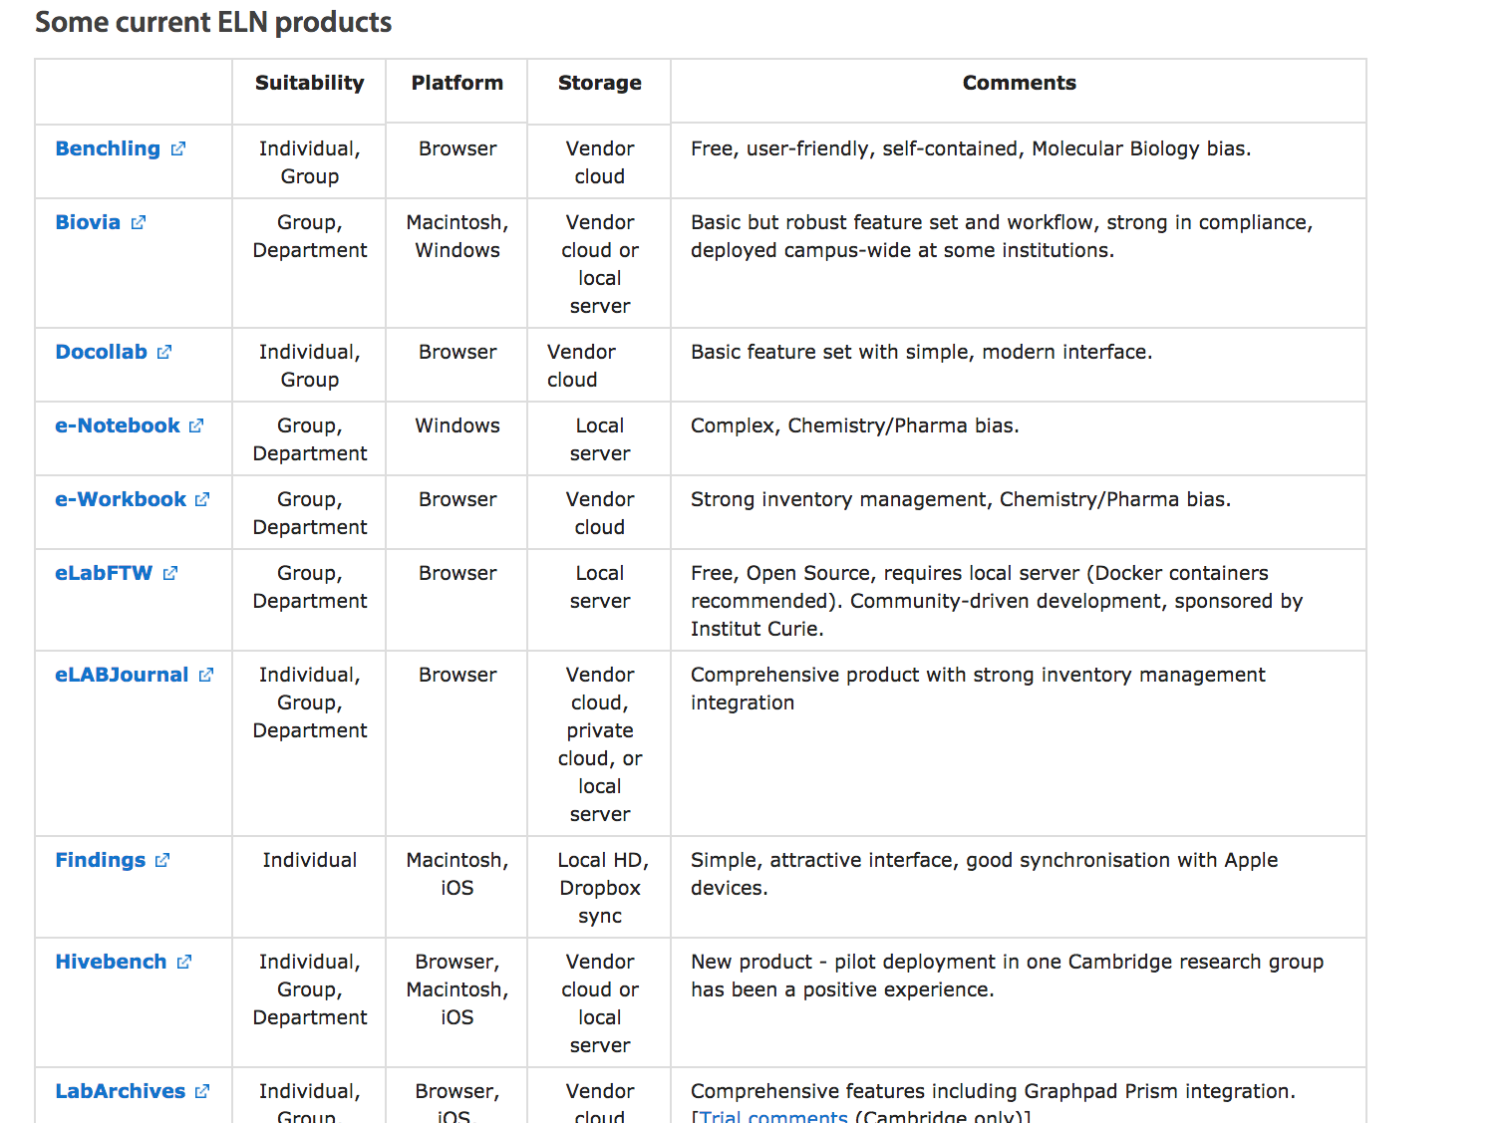
Data Management Checklist
Notes:
1.1 Data type and sources
- What types of data, samples, physical collections, code, software, curriculum materials
and other materials will be produced in the course of the project?
- including a brief description of each type of data to be generated, e.g. experimental,
qualitative, raw, processed
- Which data you will share and at what stage (raw, processed, reduced, analyzed)
- if you are using data from other sources, provide a brief description, including content,
source, any any conditions required for obtaining and using that data. If you combine existing
data with your own, describe the relationship between the data sets.

Slide 8
Formats: Data type and sources
File formats currently recommended by UK Data Archive for long term preservation for research data
Notes:
Why file organization of your research data is important
Specific techniques for organizing your research data,
including developing plans for:
– File structures - where to put data so you won’t lose it
(including tips on embedding metadata)
– File naming - what to call data so you know what it is
– A bit on version control - keeping track of data
• Will also include opportunities for:
– Small group discussion
– Exercise for organizing your own data
• Focuses on research data, but applies to other types of files as well

Slide 9
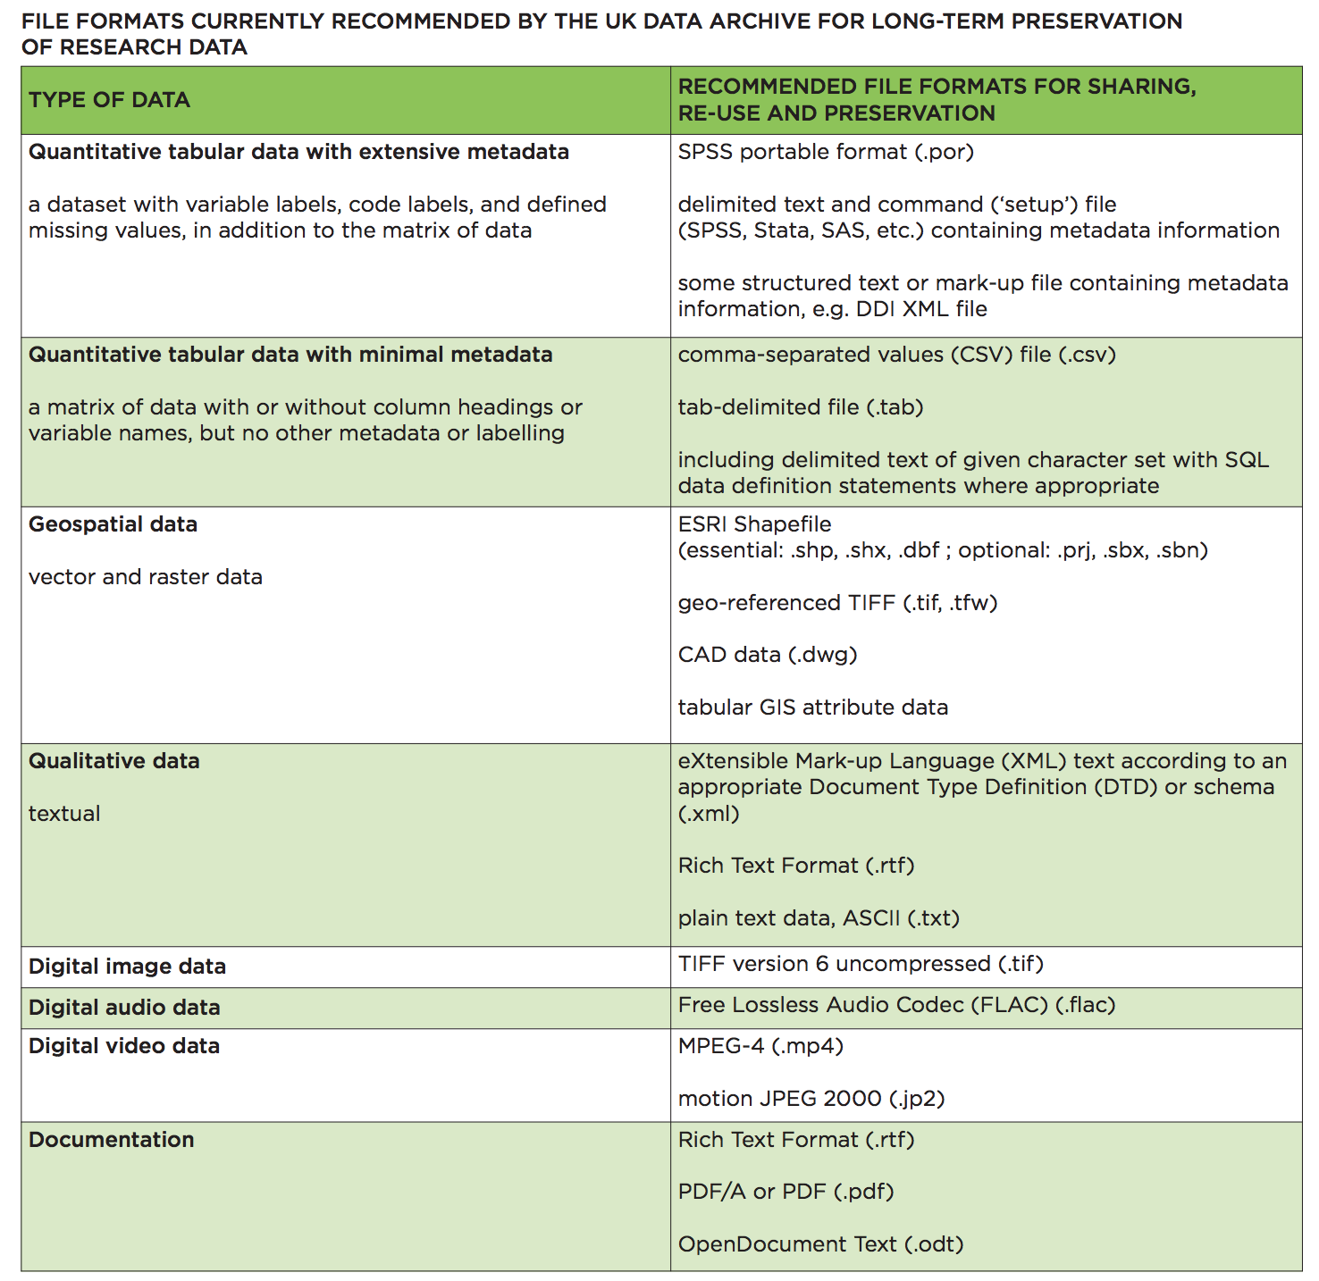
Notes:
Why file organization of your research data is important
Specific techniques for organizing your research data,
including developing plans for:
– File structures - where to put data so you won’t lose it
(including tips on embedding metadata)
– File naming - what to call data so you know what it is
– A bit on version control - keeping track of data
• Will also include opportunities for:
– Small group discussion
– Exercise for organizing your own data
• Focuses on research data, but applies to other types of files as well

Slide 10
File Naming Conventions
Make file names unique
Include most important identifying information of the project:
project name
acronym, or research data name
study title
location information
researcher initials
date (consistently formatted, e.g. YYYYMMDD)
version
Use underscores to separate elements; avoid special characters, spaces and periods.
Use leading zeros when incorporating numbers to enable sorting (a sequence of 1-100 should be numbered 001-100).
File names should be short enough to be readable, while still conveying enough pertinent information
Notes:
Why file organization of your research data is important
Specific techniques for organizing your research data,
including developing plans for:
– File structures - where to put data so you won’t lose it
(including tips on embedding metadata)
– File naming - what to call data so you know what it is
– A bit on version control - keeping track of data
• Will also include opportunities for:
– Small group discussion
– Exercise for organizing your own data
• Focuses on research data, but applies to other types of files as well

Slide 11
File Naming Conventions Examples
The Good: DryValleySoil_ICPOES_20101115_JDSv2.dat
DryValleySoil, project name
ICPOES, instrument name
20101115 date of sample created
JDS, initials of the scientist
V2, second version
The Bad: my Data @DryValley November 15 2010.v2.dat
The Ugly:
Can you understand/use these data files? Would anyone 5 years from now?
• SrvMthdDraft.doc
• SrvMthdFinal.doc
• SrvMthdLastOne.doc
• SrvMthdRealVersion.doc
Use content-or descriptive information
Notes:
content-specific or descriptive information

Slide 12
Batching Renaming Tools
Windows:
• Ant Renamer: http://www.antp.be/software/renamer
• Bulk Rename Utility: http://www.bulkrenameutility.co.uk/
• PSRenamer: http://www.powersurgepub.com/products/psrenamer.html
Mac:
• PSRenamer: http://www.powersurgepub.com/products/psrenamer.html
• Renamer4Mac : http://renamer4mac.com/
• Name Mangler: http://manytricks.com/namemangler/
Linux/Unix:
• GNOME Commander: http://www.nongnu.org/gcmd/
• PSRenamer: http://www.powersurgepub.com/products/psrenamer.html
• Use grep, sed and awk to search for and change
Notes:
Why file organization of your research data is important
Specific techniques for organizing your research data,
including developing plans for:
– File structures - where to put data so you won’t lose it
(including tips on embedding metadata)
– File naming - what to call data so you know what it is
– A bit on version control - keeping track of data
• Will also include opportunities for:
– Small group discussion
– Exercise for organizing your own data
• Focuses on research data, but applies to other types of files as well

Slide 13
Version Control
Aim: Keep raw data untouched and reverse to earlier version
Save an untouched copy of the raw data, work on save untouched copy
Use a file naming convention (like v001, v002 or v1_0, v1_2, v2_0
Use a directory structure naming convention that includes version information
Date can be part of the file name, e.g.
2012-02-27_Template_soil _testing.xlsx
Append the author’s name to the file name, e.g.
Template_soil _testing_modified_by_AH.xlsx
Add a version number after reach major edit, e.g.
Template_soil _testing_v03.xlsx
Directory top-level folders should include the project title, unique identifier, and date (year), but the files themselves should be well-described independent of the directory structure.
Version control tools:
Wet lab: Electronic Lab Notebooks/Box/LIMS
Dry lab: Git (GitHub/GitLab), Subversion (SVN)
Notes:
Why file organization of your research data is important
Specific techniques for organizing your research data,
including developing plans for:
– File structures - where to put data so you won’t lose it
(including tips on embedding metadata)
– File naming - what to call data so you know what it is
– A bit on version control - keeping track of data
• Will also include opportunities for:
– Small group discussion
– Exercise for organizing your own data
• Focuses on research data, but applies to other types of files as well

Slide 14
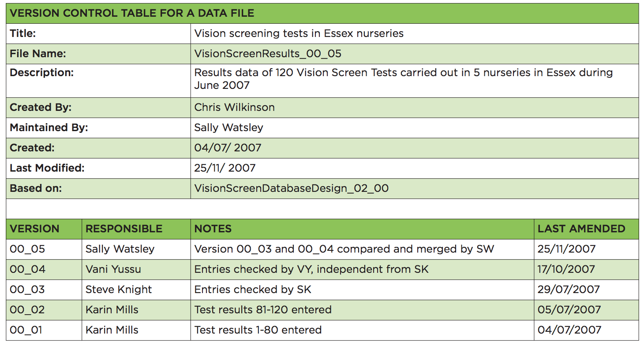
Version Control Example
Notes:
Why file organization of your research data is important
Specific techniques for organizing your research data,
including developing plans for:
– File structures - where to put data so you won’t lose it
(including tips on embedding metadata)
– File naming - what to call data so you know what it is
– A bit on version control - keeping track of data
• Will also include opportunities for:
– Small group discussion
– Exercise for organizing your own data
• Focuses on research data, but applies to other types of files as well

Slide 15
Folder Structure
Methods of organising electronic material
Hierarchical: Items organised in folders and sub-folders
Tag-based: Each item assigned one or more tags
Hybrid combination of hierarchical and tag-based
Notes:
Why file organization of your research data is important
Specific techniques for organizing your research data,
including developing plans for:
– File structures - where to put data so you won’t lose it
(including tips on embedding metadata)
– File naming - what to call data so you know what it is
– A bit on version control - keeping track of data
• Will also include opportunities for:
– Small group discussion
– Exercise for organizing your own data
• Focuses on research data, but applies to other types of files as well

Slide 16
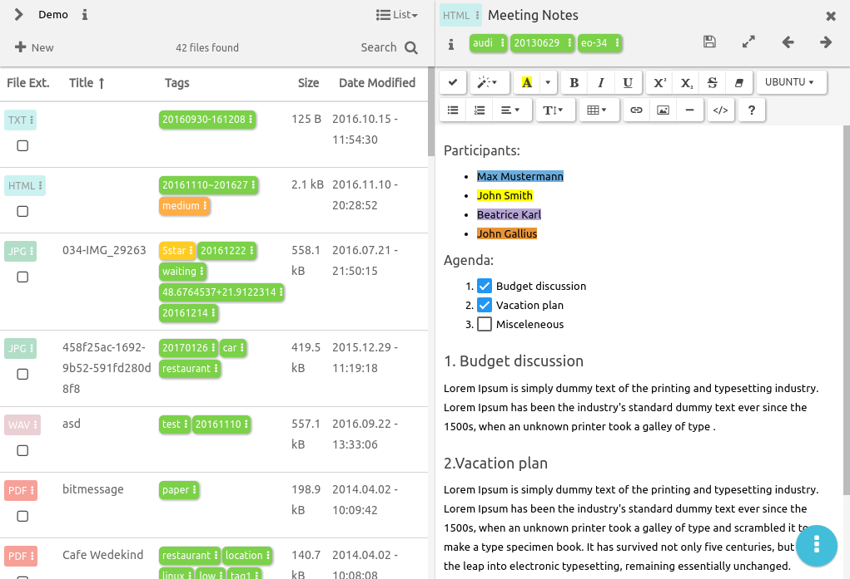
Folder Structure Examples – Tag-based
Notes:
Tag-based systems: benefits
• Items can go in more than one category
– Moreover, multiple types of category can be used
• Many people find tagging quicker and easier
than hierarchical filing
• When collaborating, can be easier to combine
than hierarchical systems
14
Tag-based systems: drawbacks
• Not how operating systems store files
• If material isn’t tagged properly when first
acquired, it can be hard to find later
• There’s a risk of inconsistent tagging
• And of similarly named categories getting
mixed
• Less good at representing the structure of
information
Creating a tag-based system
• Possible tools include:
• Bibliographic software
– EndNote, Zotero, Mendeley...
• Image management programs
– Flickr, Picasa...
• Google tools
• See our guide to Tagging and Finding Your
Files: http://libguides.mit.edu/metadataTools/

Slide 17
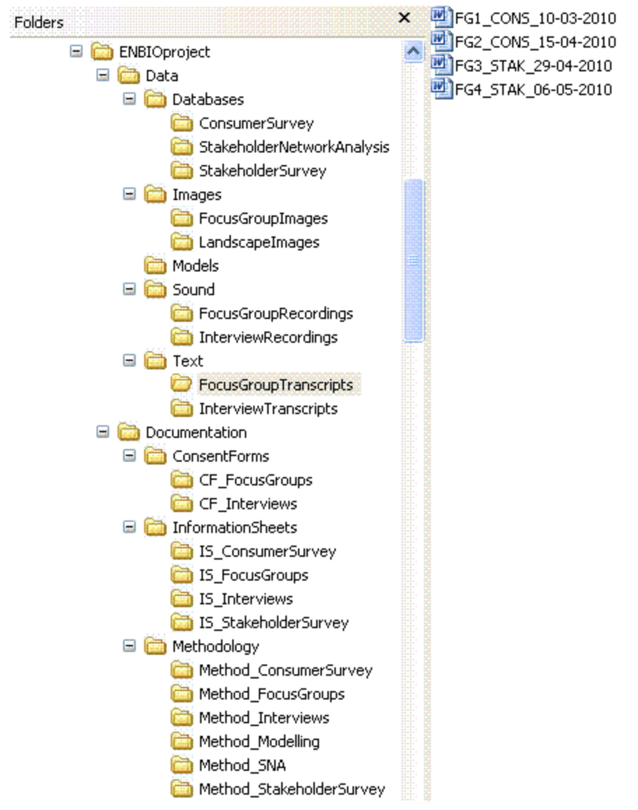
Folder Structure Examples – Hierarchical
Notes:
benefits
• Familiar and widely used
• Good at representing the structure of
information
– Constructing the hierarchy can itself be a helpful
exercise
• Similar items are stored together
• Sub-folders can function as task lists
• Great for location-based finding
12
Hierarchical systems: drawbacks
• Surprisingly hard work to set up and maintain
– ‘a heavyweight cognitive activity’
• Can be hard to get the right balance between
breadth and depth
• Items can only go in one place
• Time consuming to reorganise if the hierarchy
becomes out of date
Tips for managing a hierarchical
system
• In Windows, Windows Explorer is a good tool
• If possible, avoid overlapping categories
– Find other ways of linking items
• Don’t let your folders get too big – or
your structure get too deep
– Create separate folders for older (no longer
active) material

Slide 18
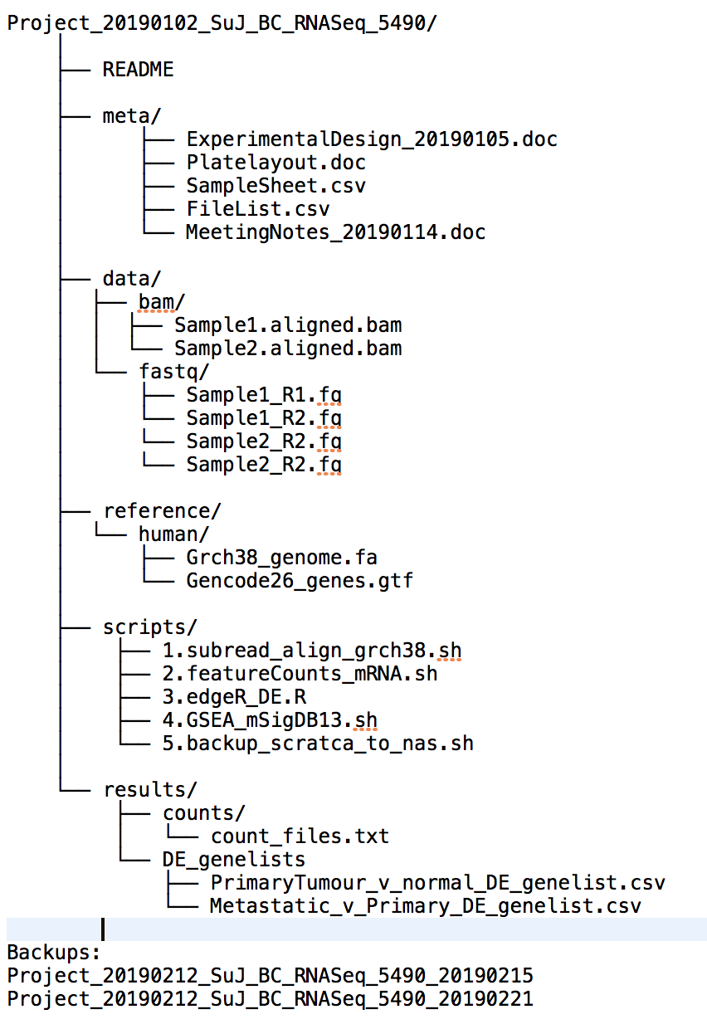
Notes:
Why file organization of your research data is important
Specific techniques for organizing your research data,
including developing plans for:
– File structures - where to put data so you won’t lose it
(including tips on embedding metadata)
– File naming - what to call data so you know what it is
– A bit on version control - keeping track of data
• Will also include opportunities for:
– Small group discussion
– Exercise for organizing your own data
• Focuses on research data, but applies to other types of files as well

Slide 19
