Slide 1

Welcome to the CRUK Cambridge Institute Bioinformatics Core’s course on
‘Managing your Research Data’
Your Trainers today are: Mark Fernandes (mark.Fernandes@cruk.cam.ac.uk)
Jing Su
Anne Pajon
We will be using an electronic whiteboard (Etherpad)
Please log onto your computer and access: https://public.etherpad-mozilla.org/p/2019-2-26-cruk-ci-myrd

Slide 2
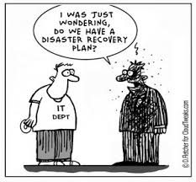
Data Formatting Issues
Managing Your Research Data–
Best practices in Research Data Management
for the Biological Sciences

Slide 3
Reproducible Research
At some point in the future, someone, somewhere, might want to repeat your analysis for themselves or re-use your data.
which will most likely be you!
Assuming that you'll be able to remember all the steps involved is dangerous, so making sure that everything is well-documented is key.
The documentation involves not only the methods used, but the files used as input and any transformations performed on them.

Slide 4
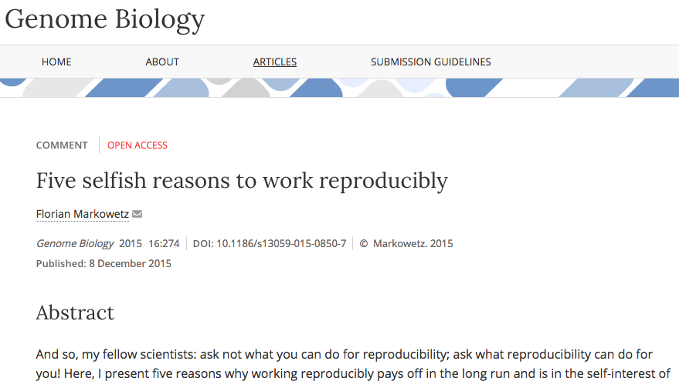
Five selfish reasons
Florian Markowetz has a great talk on why we should work reproducibly
There is a Genome Biology paper that you should read.

Slide 5
A famous example
Probably the most (in)famous example of failure to reproduce a study, which actually put people's lives at risk and rallied statisticians into action
Keith Baggerly's lecture on the scandal is a must-see. https://www.youtube.com/watch?v=7gYIs7uYbMo
If that wasn’t enough to give you sleepless nights – Visit http://retractionwatch.com

Slide 6
Are spreadsheets programs like Excel evil?
....Not necessarily.
Often much more convenient to eye-ball a spreadsheet and get an overall impression of your data.
But they have limitations making them not ideal for large-scale analyses.
Doing things by-hand only invites you to make copy-and-paste errors etc.
R cannot read all files as if by magic

Slide 7
Helpful Data Validation features in Excel
Excel data validation feature
Select a column
In the menu bar, choose “Data”
Validation
Integer or decimal number
Range
List of possible values
Limited length text

Slide 8
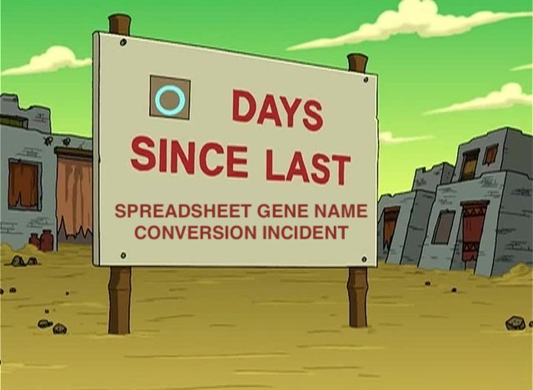
Less helpful features in Excel
When identifiers are long integers
1000000 = 1e06
Issue with Illumina microaray chip IDs
Excel can convert gene names to dates
SEPT2 (Septin 2) → ‘2-Sep’
MARCH1 (Membrane-Associated Ring Finger (C3HC4) 1, E3 Ubiquitin Protein Ligase) → ‘1-Mar’
Conversion of Study ID codes! ☹

Slide 9

Data Handling rules:
In TV’s NCIS, Special Agent Leroy ‘Jethro’ Gibbs has a set of rules. Failure to observe Gibbs Rules
results in a ‘Gibbs Slap’ We’re not that cruel but here are some rules to follow when dealing
with your data.
Image credit:
https://saisoto.deviantart.com/art/Gibbs-Slap-173459786

Slide 10
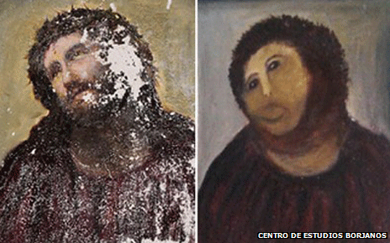
Rule 1 -Never work directly on the raw data
http://www.inquisitr.com/309687/jesus-painting-restoration-goes-wrong-well-intentioned-old-lady-destroys-100-year-old-fresco/

Slide 11
Rule 1 -Never work directly on the raw data
Hard to reverse all the manual steps performed and invites errors
Store the original data somewhere safe
see later on today (OpenRefine exercise)

Slide 12
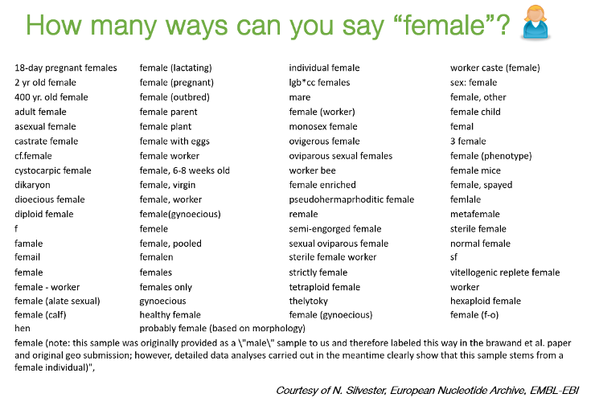
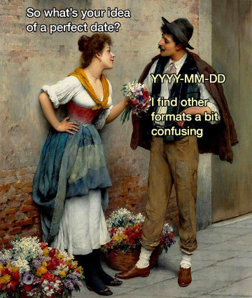
Example 1 – How many inconsistencies can you spot?
Patient ID | Sex | Date of Diagnosis | Tumour Size
1 | M | 01-01-2013 | 3.1
2 | f | 04-18-1998 | 1.5
3 | Male | 1st of April 2004 | 105
4 | Female | NA | 67
5 | F | 2010/03/12 | 4.2
6 | F |  | 3.6
7 | M | 1994-11-05T08:15:30-05:00 | 232

Slide 13
Rule 2 - Maintain consistency

Slide 14
Example 1 – applying Rule 2
Consistency: F, female, f, fem, 2, …
Units
cm or mm; days, months or years
You can introduce inconsistencies without realising it
blank spaces (whitespace) at the end of text
"Male " is not the same as "Male"
Document choices you make about units in a README file

Slide 15
Regarding dates
credit: @myusuf3

Slide 16
Example 1 – corrected using Rule 2
Patient ID | Sex | Date of Diagnosis | Tumour Size
001 | M | 2013-01-01 | 3.1
002 | F | 1998-04-18 | 1.5
003 | M | 2004-04-01 | 1.05
004 | F | NA | 0.67
005 | F | 2010-03-12 | 4.2
006 | F | NA | 3.6
007 | M | 1994-11-05 | 2.32

Slide 17
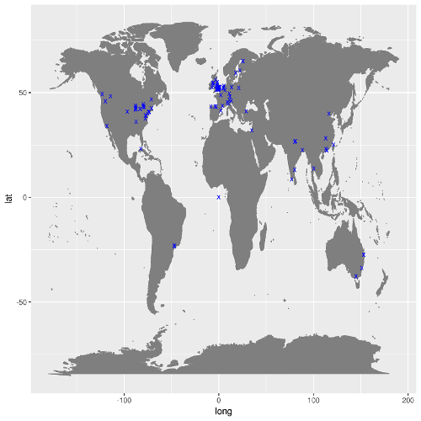
Rule 3 – Missing values
Figure showing locations of visitors to my Prostate Cancer data portal

Slide 18
Rule 3 - Don't use 0 to mean missing
Zero values are data!
Sometimes extreme values such as 999 are sometimes used
NA is Ok, but what if NA is a valid category in your data?
R will recognise NA as a missing value and can ignore it in calculations
Safest to leave the cell empty
but you need to be careful with blank spaces

Slide 19
Rule 4 - Fill in all the cells
Example 2
Patient ID | Date | Value
1 | 2015-06-14 | 213
2 |  | 76.5
3 | 2015-06-18 | 32
4 |  | 120.3
5 |  | 109
6 | 2015-06-20
7 |  | 143

Slide 20
Rule 4 - Fill in all the cells
It is tempting to make the table look cleaner by not repeating some values
Fill in all cells!
otherwise, problems when sorting
Empty cell:
missing value?
value meant to be repeated multiple times?
Make sure it’s clear that the data is missing and not unintentionally left blank

Slide 21
Example 2 Corrected using Rule 4
Patient ID | Date | Value
1 | 2015-06-14 | 213
2 | 2015-06-14 | 76.5
3 | 2015-06-18 | 32
4 | 2015-06-18 | 120.3
5 | 2015-06-18 | 109
6 | 2015-06-20
7 | 2015-06-20 | 143

Slide 22
Rule 5 - Make it rectangular
The computer expects a very rigid shape of data with rows and columns
Each column is a variable being examined
Each row is an observation
A concept commonly known as tidy data

Slide 23
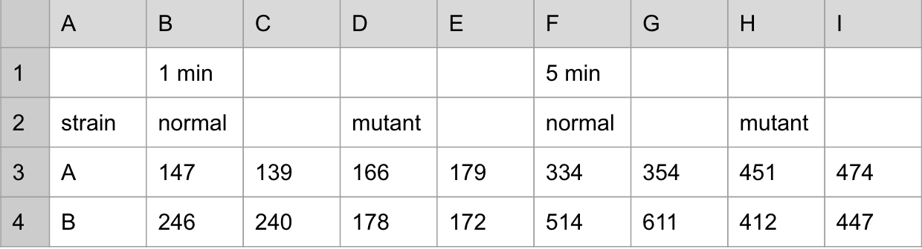
Rule 5 - Make it rectangular

Slide 24
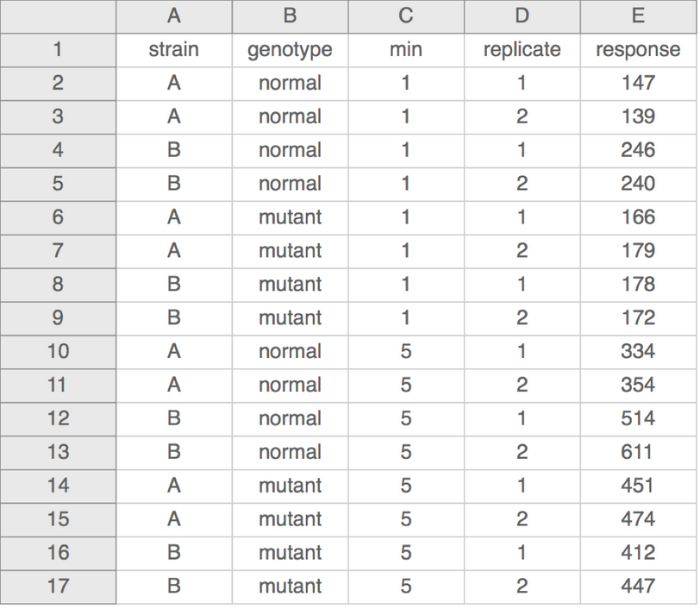
Rule 5 - Make it rectangular

Slide 25
More
Don’t put too much information in one cell
1 cell = 1 piece of information
Don’t include units such as "30 g" → "g" in the column name
http://unitsofmeasure.org/ucum.html
Write notes in a separate column or data dictionary or metadata
"0 (below threshold)"

Slide 26
More
Don’t put too much information in one cell
1 cell = 1 piece of information
Don’t include units such as "30 g" → "g" in the column name
http://unitsofmeasure.org/ucum.html
Write notes in a separate column or data dictionary or metadata
"0 (below threshold)”
Design for machine readability
NO calculations
NO font colours
NO highlighting
Computer doesn’t need or recognize it!

Slide 27
Recapping the ‘Rules’
Rule 1 -Never work directly on the raw data
Rule 2 - Maintain consistency
Rule 3 - Don't use 0 to mean missing
Rule 4 - Fill in all the cells
Rule 5 - Make it rectangular

Slide 28
Write Protection
Mac
Right click on the file in Finder
Select “Get Info”
Sharing and permission
Privilege
Read only
Write Protection
Windows
Right click on the file in Windows Explorer
Properties
General tab
Attributes
Select the box for “read only”

Slide 29
Practical - Practice (makes perfect)
Look at the file patient-data.txt
a simulated, but representative, example of bad data
discuss with your neighbours (around 5 minutes)
The next step is to look at how to clean the data with Open Refine
NB If you are planning to use your own laptop then you will need to install the free package ‘OpenRefine’ from http://openrefine.org .

Slide 30
Practical - Project proposals looking for a data plan (DataLine?)
(Discuss these in pairs – what considerations do you think a Funder needs?)
Consented patient tumour samples will be analysed for particular SNPs. Sequencing will be done externally with computational analysis carried out in-house. A paper will be written and the experimental data shared.
GP practices will get patients to fill in questionnaires relating to lifestyle and diet and to provide biological samples to analysed at researchers lab for bio-markers of cardiac disease.
An archaeological dig is to be organised in North Walsham where it is anticipated that Roman remains will be uncovered. Finds will be verified by other national experts, site data will be stored for use by other academics and the findings made publicly available.
A trial is planned of a new anti-depressant to help treat patients. One group will be given the new drug in their combination therapy and the other group will receive an existing one. A comparative analysis of transcripted patient interviews will be undertaken.

