Slide 1

Welcome to the CRUK Cambridge Institute
Bioinformatics Core’s course on ‘Avoiding Data Disasters’
Your Trainers today are:
Mark Fernandes (mark.Fernandes@cruk.cam.ac.uk)
Jing Su
Anne Pajon
We will be using an electronic whiteboard (Etherpad)
Please log onto your computer and access:
https://public.etherpad-mozilla.org/p/2018-2-23-cruk-ci-add

Slide 2
Welcome to the School of Clinical Medicine’s E-Learning suite
No Eating or Drinking in the suite! We have booked an area in the adjoining corridor with refreshments for a Tea break.
We are not aware of any planned Fire-drills so if the alarm sounds we will treat it as a real fire and evacuate.
Ladies and Gentlemans toilets are situated on the level below us (Descend via spiral staircase or lift)
If you are planning to use your own laptop then you will need to install the free package ‘OpenRefine’ from http://openrefine.org .
If you are having difficulties please stick the Red/pink post-it
on the back of your display and one of us will come to help you ASAP

Slide 3
Timetable(ish)
12:30 – 13:10 Introduction & Data formatting* (MF)
13:10 - 14:40 OpenRefine practical (Live coding) (MF+JS+AP)
14:40 – 15:00 Break
15:00– 15:40 File management* (JS)
15:40 – 16:20 Backup & Sharing* (AP)
16:20 - 16:30 Wrap-up & close
* includes 5 mins to write on Etherpad & 5 min look at input

Slide 4
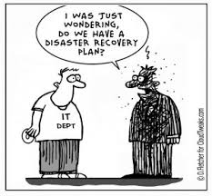
Data Formatting Issues
Avoiding data disasters –
Best practices in Research Data Management
for the Biological Sciences
Feb 23rd 2018

Slide 5
Reproducible Research
At some point in the future, someone, somewhere, might want to repeat your analysis for themselves or re-use your data.
  which will most likely be you!
Assuming that you'll be able to remember all the steps involved is dangerous, so making sure that everything is well-documented is key.
The documentation involves not only the methods used, but the files used as input and any transformations performed on them.

Slide 6
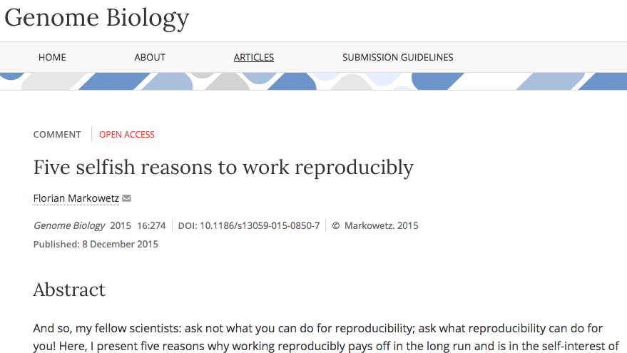
Five selfish reasons
Florian Markowetz has a great talk on why we should work reproducibly
There is a Genome Biology paper that you should read.

Slide 7
A famous example
Probably the most (in)famous example of failure to reproduce a study, which actually put people's lives at risk and rallied statisticians into action
Keith Baggerly's lecture on the scandal is a must-see.
https://www.youtube.com/watch?v=7gYIs7uYbMo
If that wasn’t enough to give you sleepless nights –
Visit http://retractionwatch.com

Slide 8
Are spreadsheets programs like Excel evil?
....Not necessarily.
Often much more convenient to eye-ball a spreadsheet and get an overall impression of your data.
But they have limitations making them not ideal for large-scale analyses.
Doing things by-hand only invites you to make copy-and-paste errors etc.
R cannot read all files as if by magic

Slide 9
Helpful Data Validation features in Excel
Excel data validation feature
Select a column
  In the menu bar, choose “Data”
  Validation
Integer or decimal number
Range
List of possible values
Limited length text

Slide 10
Less helpful features in Excel
When identifiers are long integers
  1000000 = 1e06
  Issue with Illumina microaray chip IDs
Excel can convert gene names to dates
  SEPT2 (Septin 2) → ‘2-Sep’
  MARCH1 (Membrane-Associated Ring Finger (C3HC4) 1, E3 Ubiquitin Protein Ligase) → ‘1-Mar’

Slide 11

Data Handling rules:
In TV’s NCIS, Special Agent Leroy
‘Jethro’ Gibbs has a set of rules.
Failure to observe Gibbs Rules
results in a ‘Gibbs Slap’
We’re not that cruel but here are
some rules to follow when dealing
with your data.
Image credit:
https://saisoto.deviantart.com/art/Gibbs-Slap-173459786

Slide 12
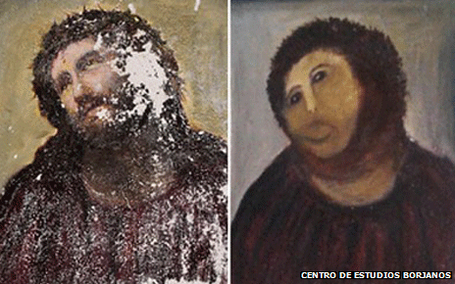
Rule 1 -Never work directly on the raw data
http://www.inquisitr.com/309687/jesus-painting-restoration-goes-wrong-well-intentioned-old-lady-destroys-100-year-old-fresco/

Slide 13
Rule 1 -Never work directly on the raw data
Hard to reverse all the manual steps performed and
invites errors
Store the original data somewhere safe
  see later on today

Slide 14
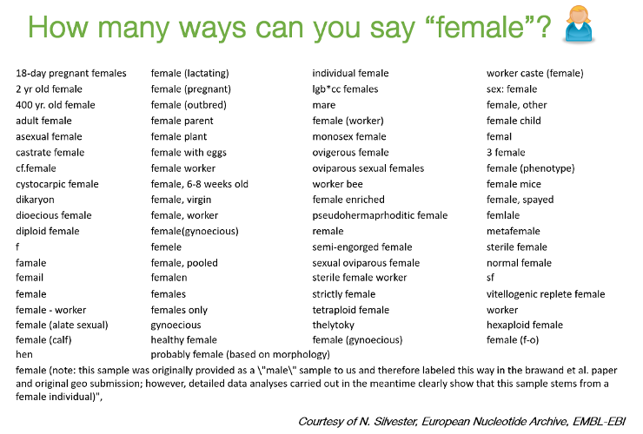
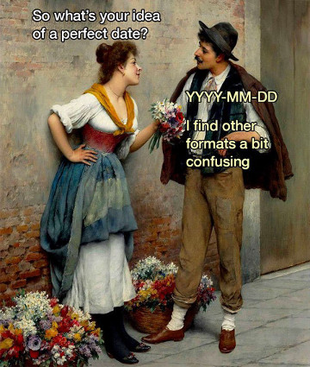
Example 1 – How many inconsistencies can you spot?
Patient ID | Sex | Date of Diagnosis | Tumour Size
1 | M | 01-01-2013 | 3.1
2 | f | 04-18-1998 | 1.5
3 | Male | 1st of April 2004 | 105
4 | Female | NA | 67
5 | F | 2010/03/12 | 4.2
6 | F |  | 3.6
7 | M | 1994-11-05T08:15:30-05:00 | 232

Slide 15
Rule 2 - Maintain consistency

Slide 16
Example 1 – applying Rule 2
Consistency: F, female, f, fem, 2, …
Units
  cm or mm; days, months or years
You can introduce inconsistencies without realising it
  blank spaces (whitespace) at the end of text
  "Male " is not the same as "Male"
Document choices you make about units in a README file

Slide 17
Regarding dates
credit: @myusuf3

Slide 18
Example 1 – corrected using Rule 2
Patient ID | Sex | Date of Diagnosis | Tumour Size
001 | M | 2013-01-01 | 3.1
002 | F | 1998-04-18 | 1.5
003 | M | 2004-04-01 | 1.05
004 | F | NA | 0.67
005 | F | 2010-03-12 | 4.2
006 | F | NA | 3.6
007 | M | 1994-11-05 | 2.32

Slide 19
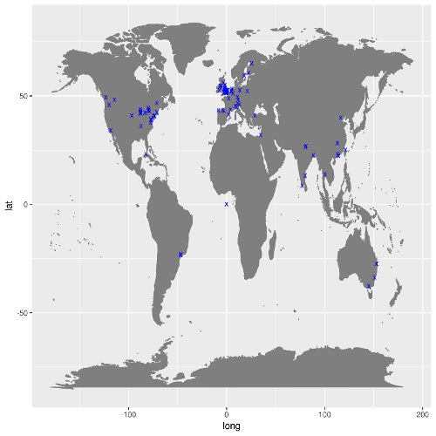
Rule 3 – Missing values
Figure showing locations of visitors to my Prostate Cancer data portal

Slide 20
Rule 3 - Don't use 0 to mean missing
Zero values are data!
  Sometimes extreme values such as 999 are sometimes used
NA is Ok, but what if NA is a valid category in your data?
  R will recognise NA as a missing value and can ignore it in calculations
Safest to leave the cell empty
  but you need to be careful with blank spaces

Slide 21
Rule 4 - Fill in all the cells
Example 2
Patient ID | Date | Value
1 | 2015-06-14 | 213
2 |  | 76.5
3 | 2015-06-18 | 32
4 |  | 120.3
5 |  | 109
6 | 2015-06-20
7 |  | 143

Slide 22
Rule 4 - Fill in all the cells
It is tempting to make the table look cleaner by not repeating some values
Fill in all cells!
  otherwise, problems when sorting
Empty cell:
  missing value?
  value meant to be repeated multiple times?
Make sure it’s clear that the data is missing and not unintentionally left blank

Slide 23
Example 2 Corrected using Rule 4
Patient ID | Date | Value
1 | 2015-06-14 | 213
2 | 2015-06-14 | 76.5
3 | 2015-06-18 | 32
4 | 2015-06-18 | 120.3
5 | 2015-06-18 | 109
6 | 2015-06-20
7 | 2015-06-20 | 143

Slide 24
Rule 5 - Make it rectangular
The computer expects a very rigid shape of data with rows and columns
Each column is a variable being examined
Each row is an observation
A concept commonly known as tidy data

Slide 25
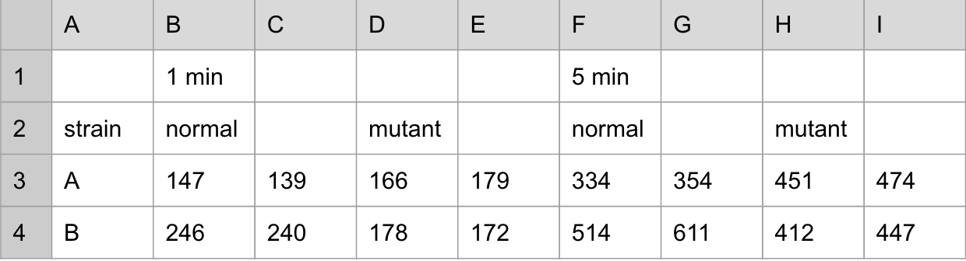
Rule 5 - Make it rectangular

Slide 26
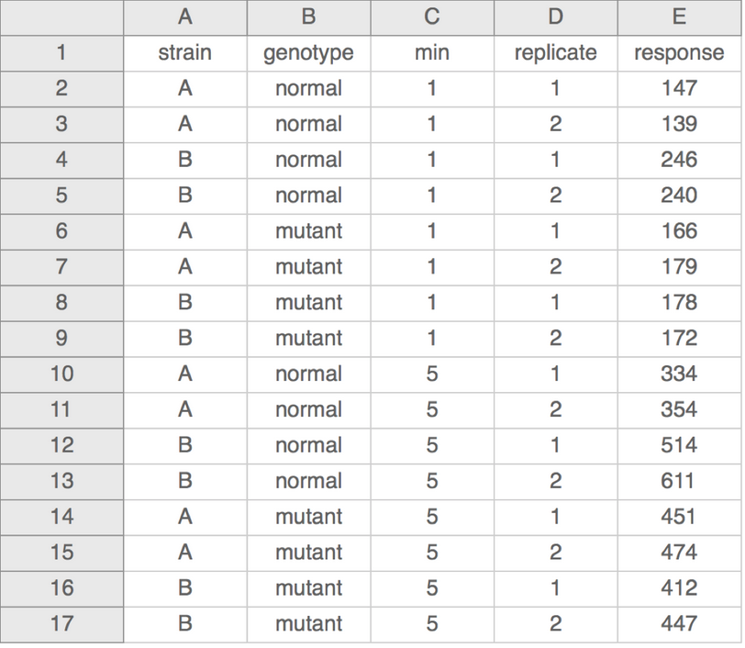
Rule 5 - Make it rectangular

Slide 27
More
Don’t put too much information in one cell
  1 cell = 1 piece of information
Don’t include units such as "30 g" → "g" in the column name
  http://unitsofmeasure.org/ucum.html
Write notes in a separate column or data dictionary or metadata
  "0 (below threshold)"

Slide 28
More
Don’t put too much information in one cell
  1 cell = 1 piece of information
Don’t include units such as "30 g" → "g" in the column name
  http://unitsofmeasure.org/ucum.html
Write notes in a separate column or data dictionary or metadata
"0 (below threshold)”
NO calculations
NO font colours
NO highlighting
Computer doesn’t recognize it!

Slide 29
Recapping the ‘Rules’
Rule 1 -Never work directly on the raw data
Rule 2 - Maintain consistency
Rule 3 - Don't use 0 to mean missing
Rule 4 - Fill in all the cells
Rule 5 - Make it rectangular

Slide 30
Write Protection
Mac
Right click on the file in Finder
Select “Get Info”
Sharing and permission
Privilege
Read only
Write Protection
Windows
Right click on the file in Windows
Explorer
Properties
General tab
Attributes
Select the box for “read only”

Slide 31
Practice (makes perfect)
Look at the file patient-data.txt
  a simulated, but representative, example of bad data
  discuss with your neighbours (around 5 minutes)
The next step is to look at how to clean the data with Open Refine

