Slide 1
RNA-seq data analysis: transcriptome assembly and differential expression analysis
Ashley Sawle (Ashley.Sawle@cruk.cam.ac.uk)
Guillermo Parada (guillermo.parada@sanger.ac.uk)

Slide 2
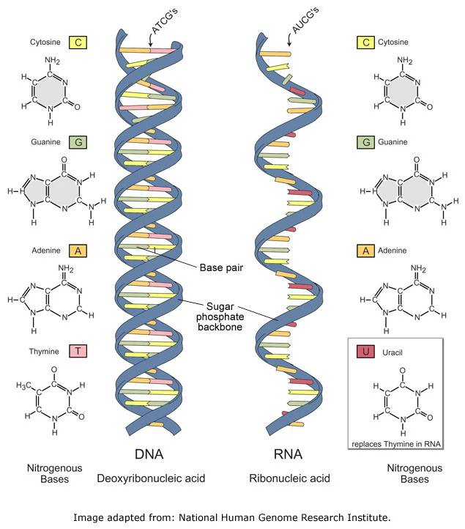
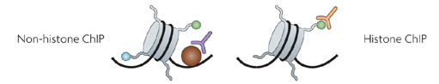
HTS Applications - Overview
DNA Sequencing
Genome Assembly
DNA methylation
ChIP-sequencing
Transcription Factor Binding Sites
RNA-sequencing
Transcriptome Assembly
Gene Expression
SNPs
Differential Expression
Chromatin Modification Regions

Slide 3
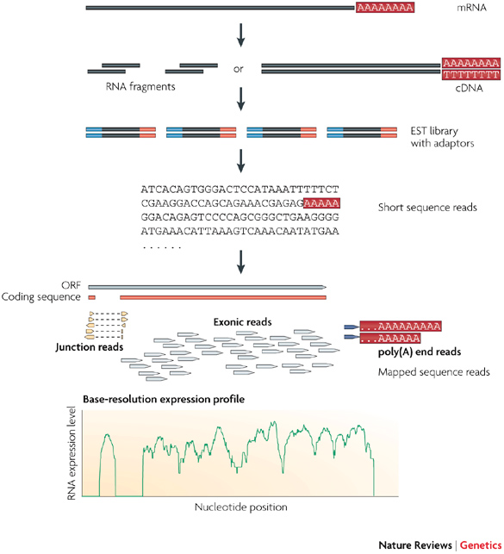
RNA-seq workflow
Library Preparation
Sequencing
Bioinformatics Analysis
Step1
Step2
Step3
Image adapted from: Wang, Z., et al. (2009), Nature Reviews Genetics, 10, 57–63.

Slide 4
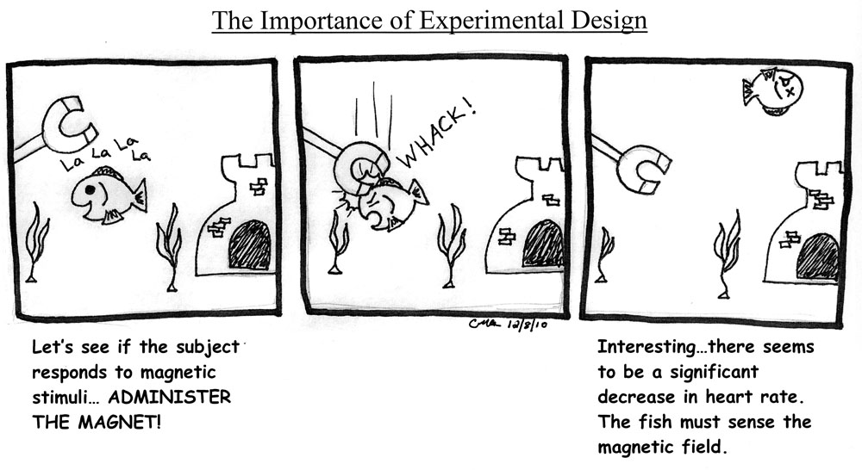
Designing the right experiment
Comic by Christine Ambrosino http://www.hawaii.edu/fishlab/Nearside.htm

Slide 5
Designing the right experiment
The design of the experiment is the first step and it is obviously determinant for all downstream analyses
You have to evaluate all the eventualities and limitations of available technologies, designing the experiment according to your goals

Slide 6
Designing the right experiment
COVERAGE: How many reads do we need?
The coverage is defined as C = ( R_{length} x R_{num} ) / A_{length}
R_{length} = length in nucleotides of the reads
R_{num} = number of sequenced reads
A_{length} = number of nucleotides of sequenced subject (genome, transcriptome, exome)
The amount of sequencing needed for a given sample is determined by the goals of the experiment and the nature of the RNA sample.
Sims et al. Nature Reviews Genetics 15, 121–132 (2014)

Slide 7
Designing the right experiment
READ LENGTH: long or short reads?
The answer depends again on the experiment:
Read length is inversely proportional to the multi-mappability of a read, in a sample of 50 nt reads there is a small fraction (<0.01 %) that can be mapped to multiple positions of the human genome.
GENOME RESEQUENCING
De novo TRANSCRIPTOME
TRANSCRIPTOME seq
ChIP seq

Slide 8
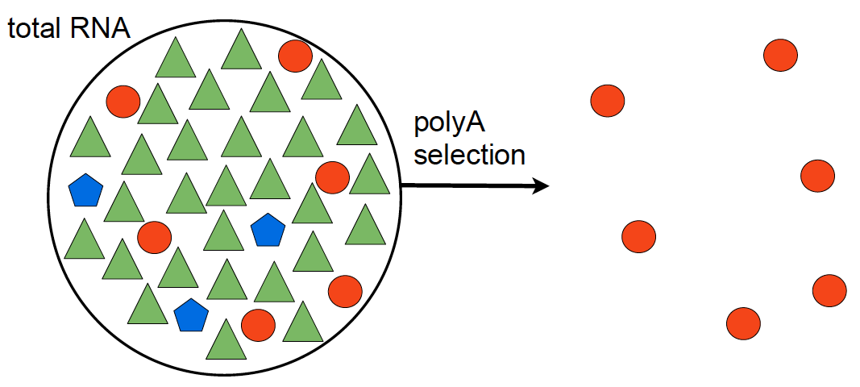
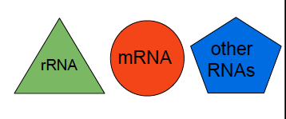
Step1 – Library Preparation

Slide 9
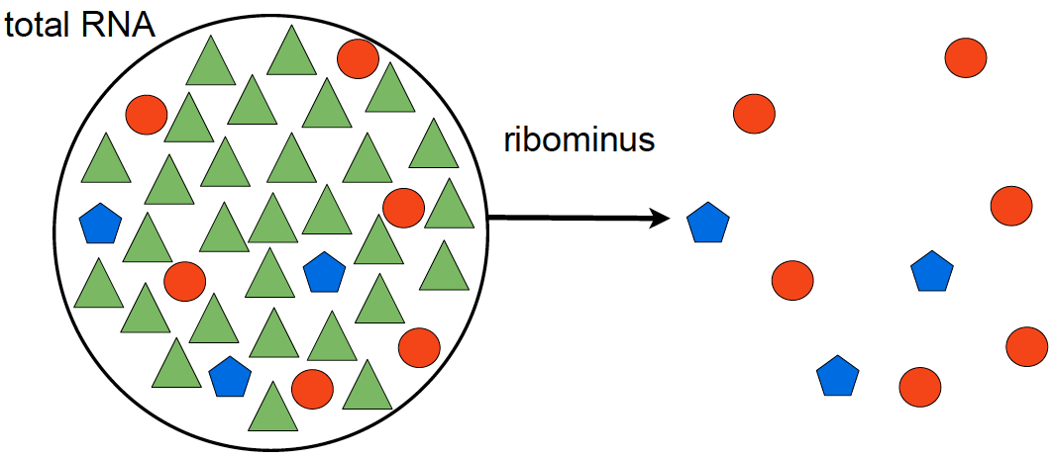
Step 1 – Library Preparation
polyA selection
ribominus selection
poly(A+)-transcripts:
mRNAs
immature microRNAs
snoRNAs
non poly(A+)-transcripts:
mRNAs
histone mRNAs
tRNAs
other small RNAs
Notes:
snoRNAs (synthesized by RNA polymerase II).
histone mRNAs (generated by RNA polymerase II)
small RNAs generated by RNA polymerase III

Slide 10
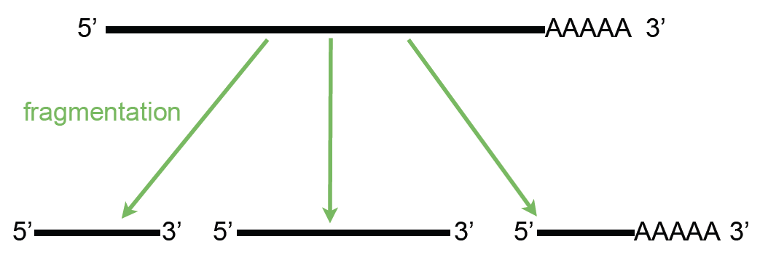
Step 1 – Library Preparation

Slide 11
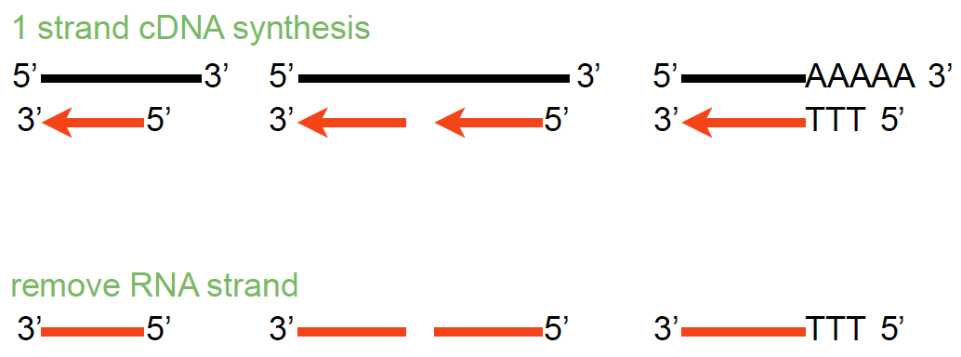
Step 1 – Library Preparation

Slide 12
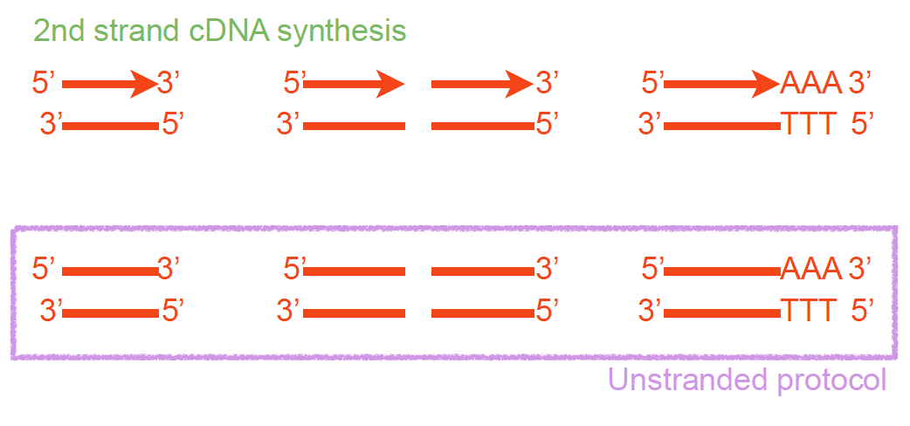
Step 1 – Library Preparation

Slide 13
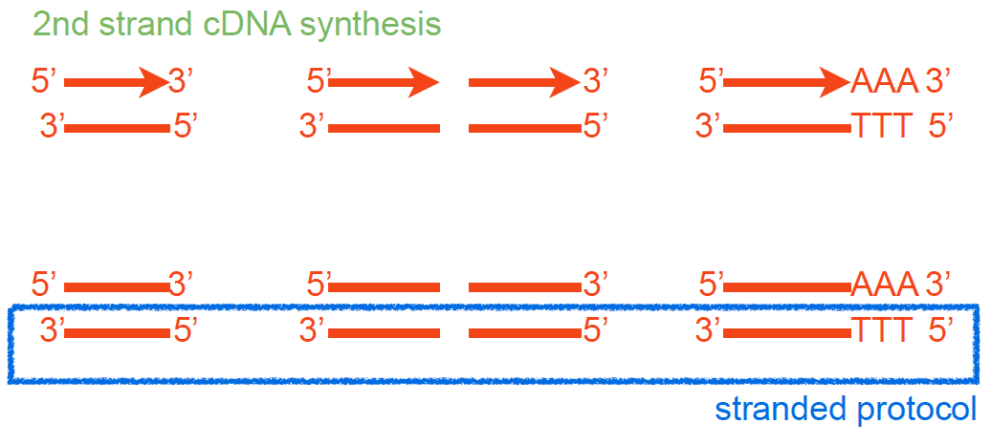
Step 1 – Library Preparation
Parkhomchuk, D., et al. (2009), Nucleic Acids Res, 37 (18), e123.

Slide 14
Step 1 – Library Preparation
Fragmented cDNA
cDNA with adaptors
Size selection
PCR amplification
Notes:
Popy T magnetic beads used for polyA selection
RNA Mg and heat ; alkaline hydrolysis or nebulization) hydrojet - 200 – 500bp and cDNA fragmentation (DNase I treatment or sonication).
End repair after RT, addd A, adaptor ( contain seq compliment to the oligo in the flowcells and seq primer site)

Slide 15
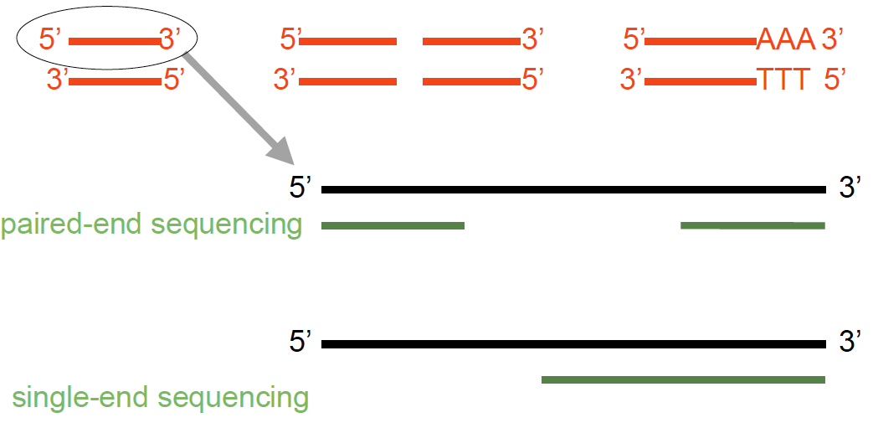
Step 2 – Sequencing

Slide 16
Single- vs paired-end sequencing
my_sequence.fastq
@HWI-BRUNOP16X_0001:1:1:1466:1018#0/1
AAGGAAGTGCTTGTCTGGCTAACACAGCNAGNCACGTGAC
+
aVfbe`^^^_TTTSSdffffdfffabbZbbfebafbbbbb
SE
my_sequence_1.fastq
@HWI-BRUNOP16X_0001:1:1:1278:989#0/1
NAAATTTCGAATTTCTGTGAAGTAAGCATCTTCTTTGTCAT
+
BJJGGKIINN^^^^^QQNTUQOOTTTRTOTY^^Y^\\^^^\
PE
my_sequence_2.fastq
@HWI-BRUNOP16X_0001:1:1:1278:989#0/2
AACCCACACAGGAGAGCAGCCTTACAGATGCAAATACTGTG
+
]K___fffffggghgeggggggdgggggfgggggegggghh
Notes:
Now it’s important to distinguish between SE and PE data
SE data is generated just as we described
The main difference with PE is that here we are using two different adaptors
And we are sequencing the molecule from both ends (and we know which end is)
This has the main advatage that we can obtain more information without having to sequence longer reads
For RNA-seq though PE data provides more information: splicing events
Also, for DNA-seq, SVs
In terms of output, different fastq files
Read names
Although the pipeline is the same, we’ll probably have to hange some options in the software we execute, as we’ll see

Slide 17
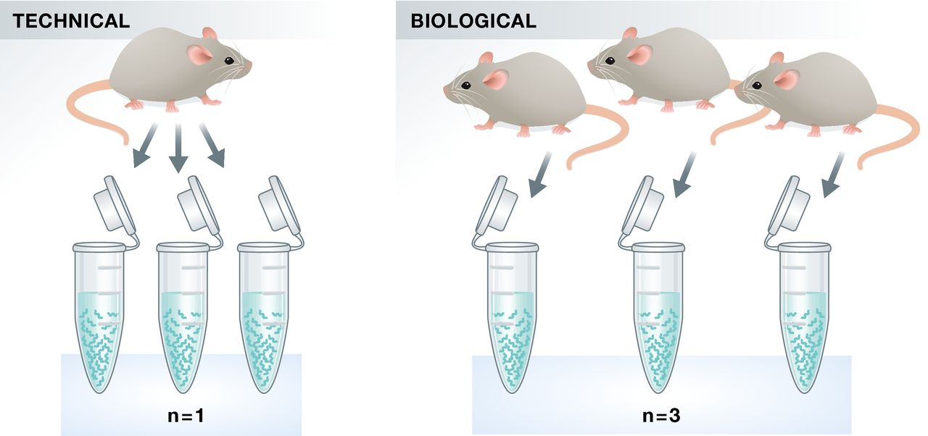
Replicates – do I need them?
10.15252/embj.201592958 | Published online 21.09.2015 The EMBO Journal (2015) e201592958

Slide 18

Replicates – do I need them?
Technical
Same biological sample – same conditions
measure technical variation
Library preparation
and sequencing
Technical replicate1
Library preparation
and sequencing
Technical replicate2

Slide 19
Replicates – do I need them?
Biological
Different biological sample – same conditions
measure biological variation
Library preparation
and sequencing
Biological replicate1
Library preparation
and sequencing
Biological replicate2

Slide 20
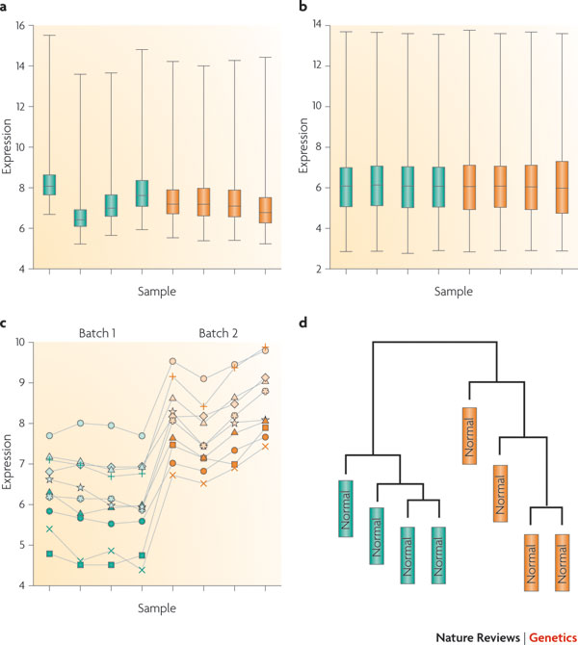
Controlling batch effects
Batch effects are sub-groups of measurements that have qualitatively different behavior across conditions and are unrelated to the biological or scientific variables in a study
Leek et al. Nature Reviews Genetics 11, 733-739 (October 2010) | doi:10.1038/nrg2825
Notes:
*What is a flow cell, what is a lane
Imagine we have 4 samples, and we want to generate 8 replicates for each of them
One of the first experimental designs that might come to our mind is this one: 1 flow cell for each sample
This is a very dangerous design, because if we were to perform DE analysis on its results,
We wouldn’t be sure if the differences that we detect are because of the conditions or because of the fact that the samples were sequenced separately
In other words, we are introducing a bias and making our lifes more difficult

Slide 21
Controlling batch effects
Library
preparation
Sequencing
Analysis
Library
preparation
Sequencing
Analysis
Library
preparation
Sequencing
Analysis

Slide 22
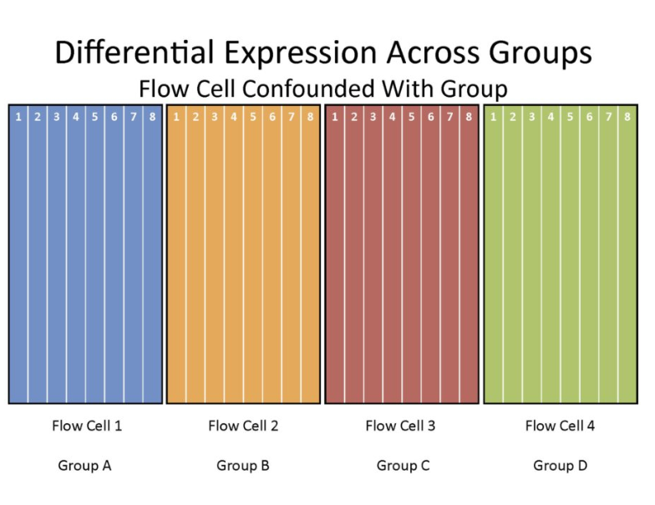
Example of experimental design
Notes:
*What is a flow cell, what is a lane
Imagine we have 4 samples, and we want to generate 8 replicates for each of them
One of the first experimental designs that might come to our mind is this one: 1 flow cell for each sample
This is a very dangerous design, because if we were to perform DE analysis on its results,
We wouldn’t be sure if the differences that we detect are because of the conditions or because of the fact that the samples were sequenced separately
In other words, we are introducing a bias and making our lifes more difficult

Slide 23
Example of experimental design
Notes:
*What is a flow cell, what is a lane
Imagine we have 4 samples, and we want to generate 8 replicates for each of them
One of the first experimental designs that might come to our mind is this one: 1 flow cell for each sample
This is a very dangerous design, because if we were to perform DE analysis on its results,
We wouldn’t be sure if the differences that we detect are because of the conditions or because of the fact that the samples were sequenced separately
In other words, we are introducing a bias and making our lifes more difficult

Slide 24
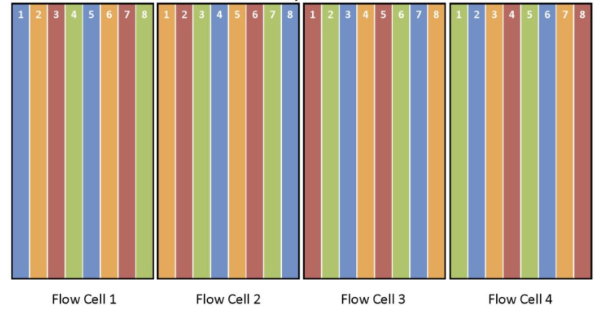
...better experimental design
Randomize samples with respect to the flow cell
Notes:
A more correct approach would be this one, in which the replicates have been randomly distributed across the 4 flow cells
However, if we want to be very picky and have a closer look, we can still see that there might be a lane effect.
For example,
Blue 1 and 5 vs 2 and 6 – are the differences due to the conditions or to the different lane within the flow cell?

Slide 25
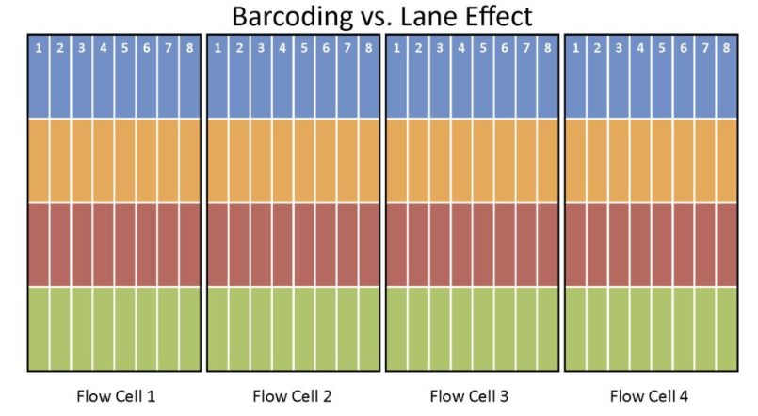
...even better experimental design
Notes:
An even better experimental design would be this one
Barcode all the samples and let them cover all the lanes in all the flowcells

Slide 26
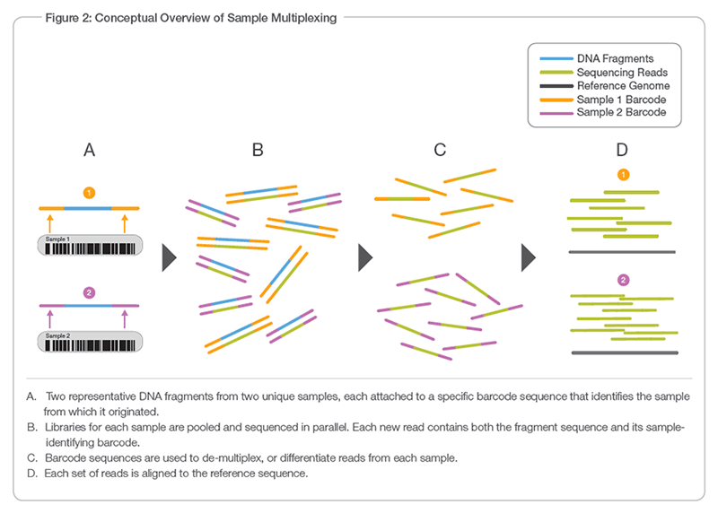
Multiplexing to prevent batch effects

