Slide 1
INTRODUCTION TO EXPERIMENTAL DESIGN
Slides adapted from Experimental Design Course, CRUK

Slide 2
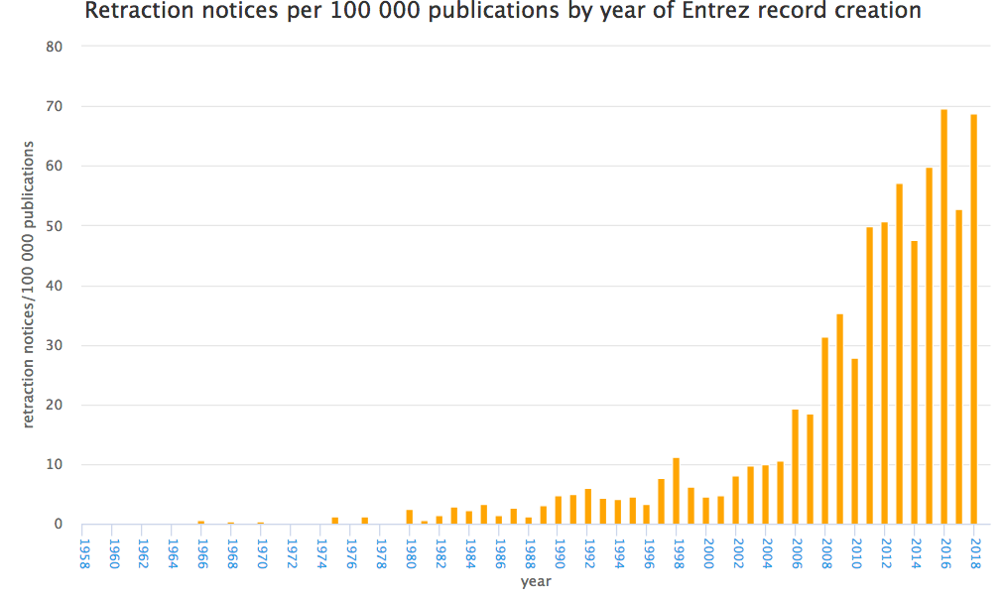
Crisis in Reproducible Research
http://neilfws.github.io/PubMed/pmretract/pmretract.html

Slide 3
Consequences of Poor Experimental Design…
Cost of experimentation.
Limited & Precious material, esp. clinical samples.
Immortalization of data sets in public databases and methods in the literature. Our bad science begets more bad science.
Ethical concerns of experimentation: animals and clinical samples.

Slide 4
A Well-Designed Experiment:
Should have
Clear objectives
Focus and simplicity
Sufficient power
Randomised comparisons
And be
Precise
Unbiased
Amenable to statistical analysis
Reproducible

Slide 5
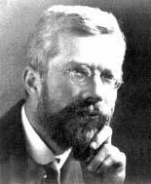
Ronald A. Fisher(1890-1962)
“To consult the statistician after an experiment is finished is often merely to ask him to conduct a post mortem examination. He can perhaps say what the experiment died of.”
“… VERY OFTEN, … THE MOST ELABORATE STATISTICAL REFINEMENTS POSSIBLE COULD INCREASE THE PRECISION BY ONLY A FEW PERCENT, YET A DIFFERENT DESIGN INVOLVING LITTLE OR NO ADDITIONAL EXPERIMENTAL LABOUR MIGHT INCREASE THE PRECISION TWO-FOLD, OR FIVE-FOLD OR EVEN MORE."

Slide 6
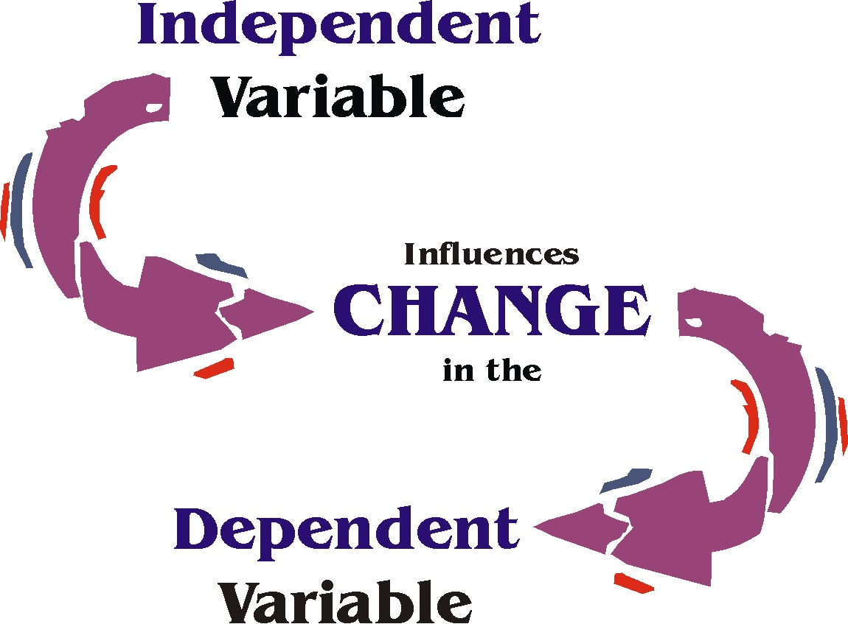
Experimental Factors
Factors: aspects of experiment that change and influence the outcome of the experiment
e.g. time, weight, drug, gender, ethnicity, country, plate, cage etc.
Variable type depends on type of measurement:
Categorical (nominal) , e.g. gender
Categorical with ordering (ordinal), e.g. tumour grade
Discrete, e.g. shoe size, number of cells
Continuous, e.g. body weight in kg, height in cm
Independent and Dependent variables
Independent variable (IV): what you change
Dependent variable (DV): what changes due to IV
“If (independent variable), then (dependent variable)”

Slide 7
Sources of Variation
Biological “noise”
Biological processes are inherently stochastic
Single cells, cell populations, individuals, organs, species….
Timepoints, cell cycle, synchronized vs. unsynchronized
Technical noise
Reagents, antibodies, temperatures, pollution
Platforms, runs, operators
Consider in advance and control
Replication required to capture variance

Slide 8
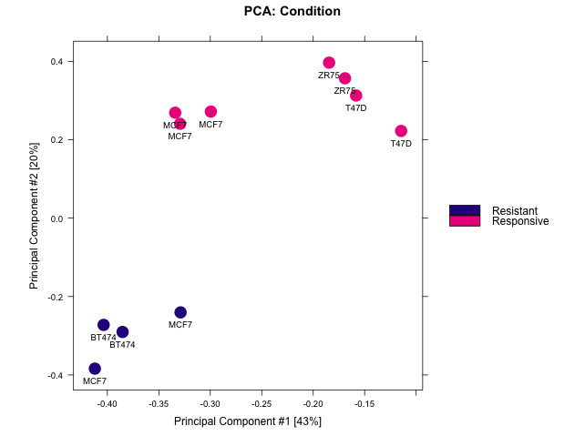
Types of Replication
Biological replication:
In vivo:
Patients
Mice
In vitro:
Different cell lines
Re-growing cells (passages)
Technical replication:
Experimental protocol
Measurement platform (i.e. sequencer)

Slide 9
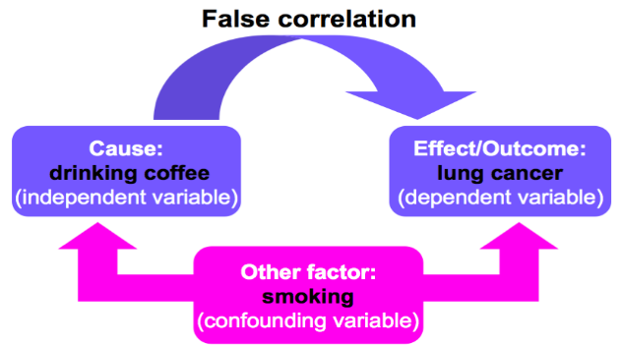
Confounding Factors
Also known as extraneous, hidden, lurking or masking factors,
or the third variable or mediator variable.
May mask an actual association or falsely demonstrate an apparent association between the independent & dependent variables.
Hypothetical Example would be a study of coffee drinking and lung cancer.
False association

Slide 10
Solutions
Consider alternative explanations
Control technical effects:
Randomisation
Statistical analyses assume randomised comparisons
May not see issues caused by non-randomised comparisons
Make every decision random not arbitrary
Caveat: over-randomization can increase error
Blinding
Especially important where subjective measurements are taken
Potentially multiple degrees of blinding (eg. double-blinding)

Slide 11
Randomised Block Design
Blocking is the arranging of experimental units in groups (blocks) that are similar to one another.
RBD across plates so that each plate contains spatially randomised equal proportions of:
Control
Treatment 1
Treatment 2
controlling plate effects.
Control
Treatment 1
Treatment 2
Plate 1
Plate 2
Plate 3
Plate 1
Plate 2
Plate 3
✔
✗

Slide 12
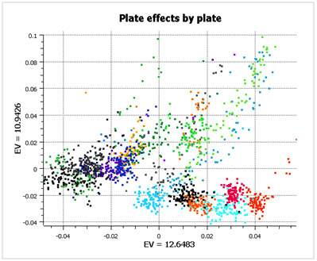
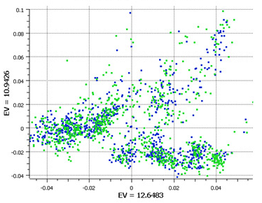
Randomised Block Design
Good design example: Alzheimer’s study from GlaxoSmithKline
Plate effects by plate
Plate effects by case/control
Left PCA plot show large plate effects.
Each colour corresponds to a different plate
Right PCA plot shows each plate cluster
contains equal proportions of
cases (blue) and controls (green).
http://blog.goldenhelix.com/?p=322
c

Slide 13
Experimental Controls
Controlling errors
Type I: FP
Negative controls: should have minimal or no effect
Type II: FN
Positive controls: known effect
Technical controls
Detect/correct technical biases
Normalise measurements (quantification)

Slide 14
Examples of Experimental Controls
Wild-type organism (knockouts)
Inactive siRNA (silencing)
Vehicle (treatments)
Spike-ins (quantification/normalisation)
“Gold standard” datapoints
Multi-level controls
e.g. contrast Vehicle/Input vs. Treatment/Input

Slide 15
Design Issues: Sequencing Experiments
Platforms
Library preps
Multiplexing and pooling strategies
Single-end vs paired end
Sequencing depth
Coverage
Lanes
Validation
Knock-downs
Pull-downs

Slide 16
Practicals
RNA-seq: Effects of mutant vs wildtype HHEX in liver and brain development
People will be divided into groups and will be allocated to breakout rooms.

