Slide 1
DAY 2. A beginners guide to solving biological problems in R
Robert Stojnić (rs550), Laurent Gatto (lg390),
Rob Foy (raf51), John Davey (jd626) and Dávid Molnár (dm516)
Original slides by Ian Roberts and Robert Stojnić

Slide 2
Day 2
Schedule
Statistics
Writing scripts
3. Writing functions
4. Data analysis examples
5. Graphics

Slide 3
Statistics
1

Slide 4
Built-in support for statistics
R is a statistical programming language
  Classical statistical tests are built-in
  Statistical modeling functions are built-in
  Regression analysis is fully supported
  Additional mathematical packages are available
    MASS, Waves, sparse matrices, etc

Slide 5

Distribution functions
mostly commonly used distributions are built-in, functions have stereotypical names, e.g. for normal distribution:
  pnorm - cumulative distribution for x
  qnorm - inverse of pnorm (from probability gives x)
  dnorm - distribution density
  rnorm - random number from normal distribution
available for variety of distributions: punif (uniform), pbinom (binomial), pnbinom (negative binomial), ppois (poisson), pgeom (geometric), phyper (hyper-geometric), pt (T distribution), pf (F distribution) ...

Slide 6
Distribution functions
- 10 random values from the Normal distribution with mean 10 and standard deviation 5:
rnorm(10,mean=10,sd=5)
- The probability of drawing 10 from this distribution:
dnorm(10,mean=10,sd=5)
[1] 0.07978846
dnorm(100,mean=10,sd=5)
[1] 3.517499e-72
- The probability of drawing a value smaller than 10:
pnorm(10,mean=10,sd=5)
[1] 0.5
- The inverse of pnorm:
qnorm(0.5,mean=10,sd=5)
[1] 10
- How many standard deviations for statistical significance?
qnorm(0.95,mean=0,sd=1)
[1] 1.644854

Slide 7
Two sample tests
Basic data analysis
Comparing 2 variances
  Fisher's F test
var.test()
Comparing 2 sample means with normal errors
  Student's t test
t.test()
Comparing 2 means with non-normal errors
  Wilcoxon's rank test
wilcox.test()
Comparing 2 proportions
  Binomial test
prop.test()
Correlating 2 variables
  Pearson's / Spearman's rank correlation
cor.test()
Testing for independence of 2 variables in a contingency table
  Chi-squared
chisq.test()
  Fisher's exact test
fisher.test()

Slide 8
Comparison of 2 data sets example
Basic data analysis
Men, on average, are taller than women.
  The steps
  1. Determine whether variances in each data series are different
      Variance is a measure of sampling dispersion, a first estimate in determining the degree of difference
        Fisher's F test
  2. Comparison of the mean heights.
      Determine probability that mean heights really are drawn from different sample populations
        Student's t test, Wilcoxon's rank sum test

Slide 9
1. Comparison of 2 data sets
Fisher's F test
Read in the data file into a new object, heightData
heightData<-read.csv("1.5_heightData.csv")
attach the data frame so we don't have to refer to it by name all the time:
attach(heightData)
Do the two sexes have the same variance?
var.test(Female,Male)
F test to compare two variances
data: Female and Male
F = 1.0073, num df = 99, denom df = 99, p-value = 0.9714
alternative hypothesis: true ratio of variances is not equal to 1
95 percent confidence interval:
0.6777266 1.4970241
sample estimates:
ratio of variances
1.00726

Slide 10
2. Comparison of 2 data sets
Student's t test
Student's t test is appropriate for comparing the difference in mean height in our data. We need a one-tailed test.
  Remember a t test = difference in two sample means
standard error of the difference of the means
t.test(Female,Male, alternative="less",var.equal=TRUE)
Two Sample t-test
data: Female and Male
t = -8.4508, df = 198, p-value = 3.109e-15
alternative hypothesis: true difference in means is less than 0
95 percent confidence interval:
-Inf -0.5079986
sample estimates:
mean of x mean of y
5.168725 5.800214

Slide 11
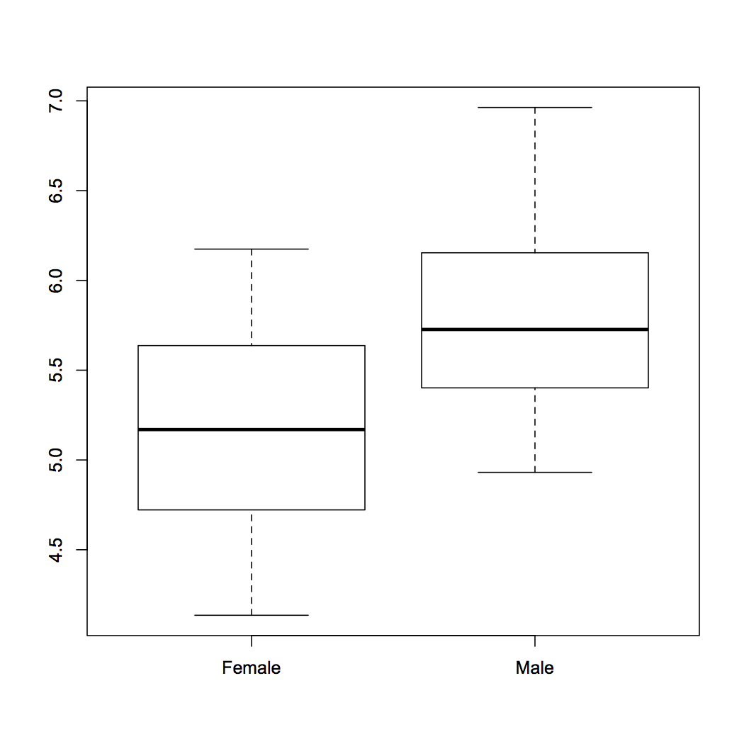
3. Comparison of 2 data sets
Review findings
> boxplot(heightData)

Slide 12
Linear regression
Basic data analysis
Linear modeling is supported by the function lm()
  example(lm) # the output assumes you know a fair bit about the subject
lm is really useful for plotting lines of best fit to XY data in order to determine intercept, gradient & Pearson's correlation coefficient
  This is very easy in R
Three steps to plotting with a best fit line
  Plot XY scatter-plot data
  Fit a linear model
  Add best fit line data to plot with abline() function

Slide 13
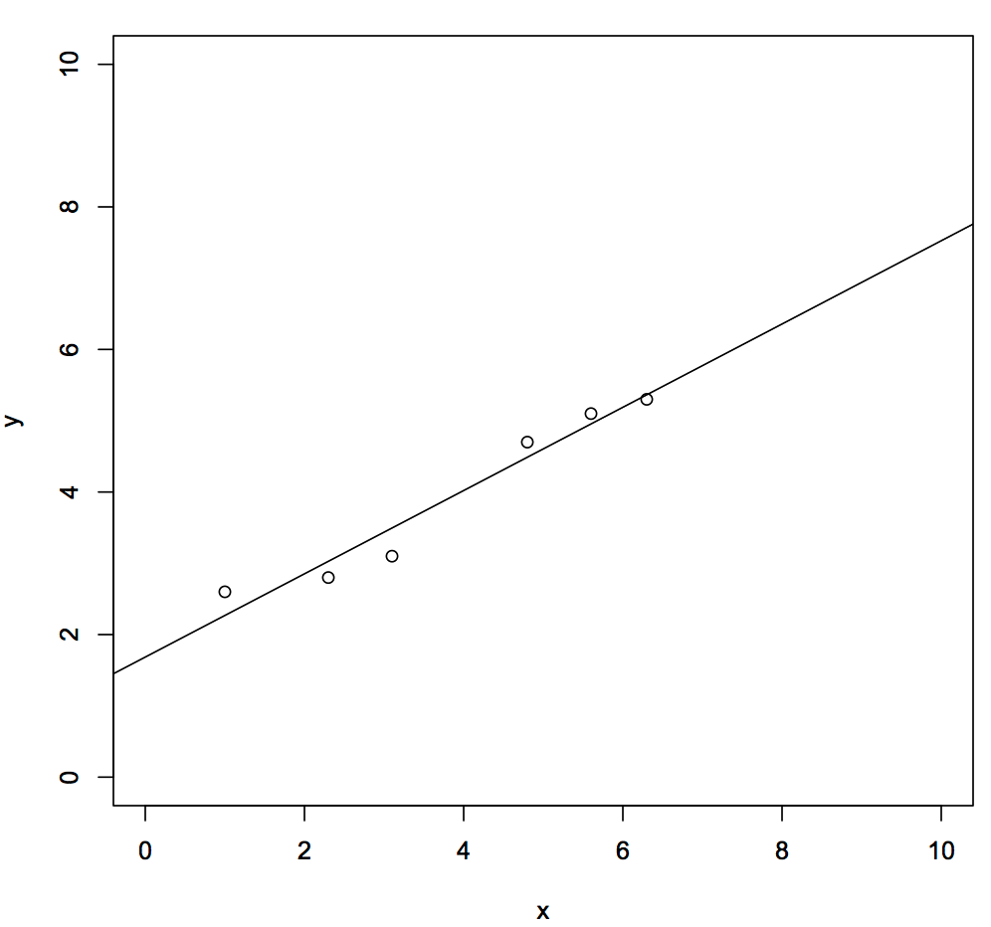
Typical linear regression analysis
Basic data analysis
X
Y
> x<-c(1, 2.3, 3.1, 4.8, 5.6, 6.3)
> y<-c(2.6, 2.8, 3.1, 4.7, 5.1, 5.3)
> plot(y~x, xlim=c(0,10),ylim=c(0,10))
1.0
2.6
2.3
2.8
3.1
3.1
Note formula notation
( y is given by x )
4.8
4.7
5.6
5.1
> myModel<-lm(y~x)
> abline(myModel)
6.3
5.3
Get the coefficients of the fit from:
summary.lm(myModel) and
coef(myModel)
resid(myModel)
fitted(myModel)
Get QC of fit from
plot(myModel)
Find out about the fit data from
names(myModel)

Slide 14
Modelling formulae
R has a very powerful formula syntax for describing statistical models.
Suppose we had two explanatory variables x and z and one response variable y.
We can describe a relationship between, say, y and x using a tilde ~, placing the response variable on the left of the tilde and the explanatory variables on the right:
> y~x
It is very easy to extend this syntax to do multiple regressions, ANOVAs, to include interactions, and to do many other common modelling tasks. For example:
> y~x # If x is continuous, this is linear regression
> y~x # If x is categorical, this is ANOVA
> y~x+z # If x and z are continuous, this is multiple regression
> y~x+z # If x and z are categorical this is a two-way ANOVA
> y~x+z+x:z # : is the symbol for the interaction term
> y~x*z # * is a shorthand for x+z+x:z

Slide 15
The linear model object
Basic data analysis
Summary data describing the linear fit is given by
  summary(myModel)
> summary(myModel)
Call:
lm(formula = y ~ x)‏
Residuals:
1 2 3 4 5 6
0.33159 -0.22785 -0.39520 0.21169 0.14434 -0.06458
Coefficients:
Estimate Std. Error t value Pr(>|t|)
(Intercept) 1.68422 0.29056 5.796 0.0044 **
x 0.58418 0.06786 8.608 0.0010 **
---
Signif. codes: 0 '***' 0.001 '**' 0.01 '*' 0.05 '.' 0.1 ' ' 1
Residual standard error: 0.3114 on 4 degrees of freedom
Multiple R-squared: 0.9488, Adjusted R-squared: 0.936
F-statistic: 74.1 on 1 and 4 DF, p-value: 0.001001
Y intercept
Gradient
Good fit: would happen 1 in 1000 by chance
R^2 , with pValue

Slide 16
Exercise
The coin toss
To learn how the distribution functions work, try simulating tossing a fair coin 100 times and then show that it is fair.
We can model a coin toss using the binomial distribution. Use the rbinom function to generate a sample of 100 coin tosses. Look up the binomial distribution help page to find out what arguments this function needs.
How many heads or tails were there in your sample? You can do this in two ways; either select the number of successes using indices, or convert your sample to a factor and get a summary of the factor.
If we toss a coin 50 times, what is the probability that we get exactly 25 heads? What about 25 heads or less? Use dbinom and pbinom to find out.
The argument to dbinom is a vector, so try calculating the probabilities for getting any number of coin tosses from 0 to 50 in fifty trials using dbinom. Plot these probabilities using plot. Does this plot remind you of anything?

Slide 17
Coin toss answers
To simulate a coin toss, give rbinom a number of observations, the number of trials for each observation, and a probability of success:
> coin.toss<-rbinom(100, 1, 0.5)
Because we only specified one trial per observation, we either have an outcome of 0 or 1 successes. To get the number of successes, use indices or a factor to look up the number of 1s in the coin.toss vector (your numbers will vary):
> length(coin.toss[coin.toss==1])
[1] 50
> summary(factor(coin.toss))
0 1
50 50

Slide 18
Coin toss answers
The probability of getting exactly 25 heads from 50 observations of a fair coin:
> dbinom(25, 50, 0.5)
The probability of getting 25 heads or less from 50 observations of a fair coin:
> pbinom(25, 50, 0.5)
The probabilities for getting all numbers of coin tosses from 0 to 50 in fifty trials:
> dbinom(0:50, 50, 0.5)
To plot this distribution, which should resemble a normal distribution:
> plot(dbinom(0:50, 50, 0.5))

Slide 19
Exercise
Linear modelling example
Mice have varying numbers of babies in each litter. Does the size of the litter affect the average brain weight of the offspring? We can use linear modelling to find out. (This example is taken from John Maindonald and John Braun's book Data Analysis and Graphics Using R (CUP, 2003), p140-143.)
Install and load the DAAG package. The litters data frame is part of this package. Take a look at it. How many variables and observations does it have? Does summary tell you anything useful? What about plot?
Are any of the variables correlated? Look up the cor.test function and use it to test for relationships.
Use lm to calculate the regression of brain weight on litter size, brain weight on body weight, and brain weight on litter size and body weight together.
Look at the coefficients in your models. How is brain weight related to litter size on its own? What about in the multiple regression? How would you interpret this result?

Slide 20
Linear modelling answers
To install and load the package and look at litters:
> install.packages("DAAG")
> library(DAAG)
> litters
> summary(litters)
> plot(litters)
To calculate correlations between variables:
> attach(litters)
> cor.test(brainwt, lsize)
> cor.test(bodywt, lsize)
> cor.test(brainwt, bodywt)

Slide 21
Linear modelling answers
To calculate the linear models:
> lm(brainwt~lsize)
Call:
lm(formula = brainwt ~ lsize)
Coefficients:
(Intercept) lsize
0.447000 -0.004033
> lm(brainwt~bodywt)
Call:
lm(formula = brainwt ~ bodywt)
Coefficients:
(Intercept) bodywt
0.33555 0.01048
> lm(brainwt~lsize+bodywt)
Call:
lm(formula = brainwt ~ lsize + bodywt)
Coefficients:
(Intercept) lsize bodywt
0.17825 0.00669 0.02431
Interpretation: brain weight decreases as litter size increases, but brain weight increases proportional to body weight (when bodywt is held constant, the lsize coefficient is positive: 0.00669). This is called 'brain sparing'; although the offspring get smaller as litter size increases, the brain does not shrink as much as the body.

Slide 22
Writing custom scripts for data analysis
2

Slide 23
The R scripting language
Scripting
A script is a series of instructions that when executed sequentially automates a task
  A script is a good solution to a repetitive problem
  The art of good script writing is
    understanding exactly what you want to do
    expressing the steps as concisely as possible
    making use of error checking
    including descriptive comments
R is a powerful scripting language, and embodies aspects found in most standard programming environments
  procedural statements
  loops
  functions
  conditional branching
Scripts may be written in any standard text editor, e.g. notepad, gedit, kate
  We will use RStudio

Slide 24
Colony forming experiment
We have been asked by some collaborators to analyse some trial data to see if an experiment will work.
We are interested in the behaviour of a gene, X, which is involved in a cell proliferation pathway.
This pathway causes cells to proliferate in the presence of a compound, Z.
Gene X turns the pathway off, reducing cell proliferation.
Our collaborators want to test what happens when we knock down X in the presence of Z.
To do this, they want to grow cell colonies in the presence of Z, with or without X, and count the number of colonies that result.

Slide 25
Initial trial
Our collaborators have sent us a first batch of test data, growing colonies in different concentrations of compound Z, and replicating each Z concentration three times.
Does increasing concentration of Z have an effect on colony growth?
We want to do the following:
  Load the data into R
  Plot the data to inspect it
  Calculate an Analysis of Variance to see if growth is influenced by Z concentration
  Calculate the mean growth for each level of Z concentration, to see the direction of change
  (We will ignore full post hoc testing)

Slide 26
Initial trial exercise
The initial trial data is in the file 2.1_colony_trial.csv. Load this file into R using the command we learnt yesterday.
Plot the data using a formula, to see how Z affects colony Count. Recall how we did this yesterday with linear modelling, with independent variable x and dependent variable y:
plot(y~x)
Calculate an analysis of variance for the data. The R function for ANOVA is aov(), which works like lm() for linear modelling – recall this from yesterday:
summary(lm(y~x))
There are four concentrations of Z, and each concentration has been replicated three times. What is the mean colony count for each concentration? See if you can figure out a way to calculate this with what we learned yesterday. You will need to use logical indexing and you may want to use a for loop.

Slide 27
Importing data
Use read.csv to load the data:
colony<-read.csv("2.1_colony_trial.csv")
The data frame has three columns, Z, Replicate and Count. We want to know how Z affects the number of colonies (Count). To do this, we need to summarise the data over all replicates for each concentration of Z.
We will attach the data frame to our workspace, so we can refer to the variables without referring to the data frame all the time:
attach(colony)
(We will also detach colony from the workspace at the end of our script.)

Slide 28
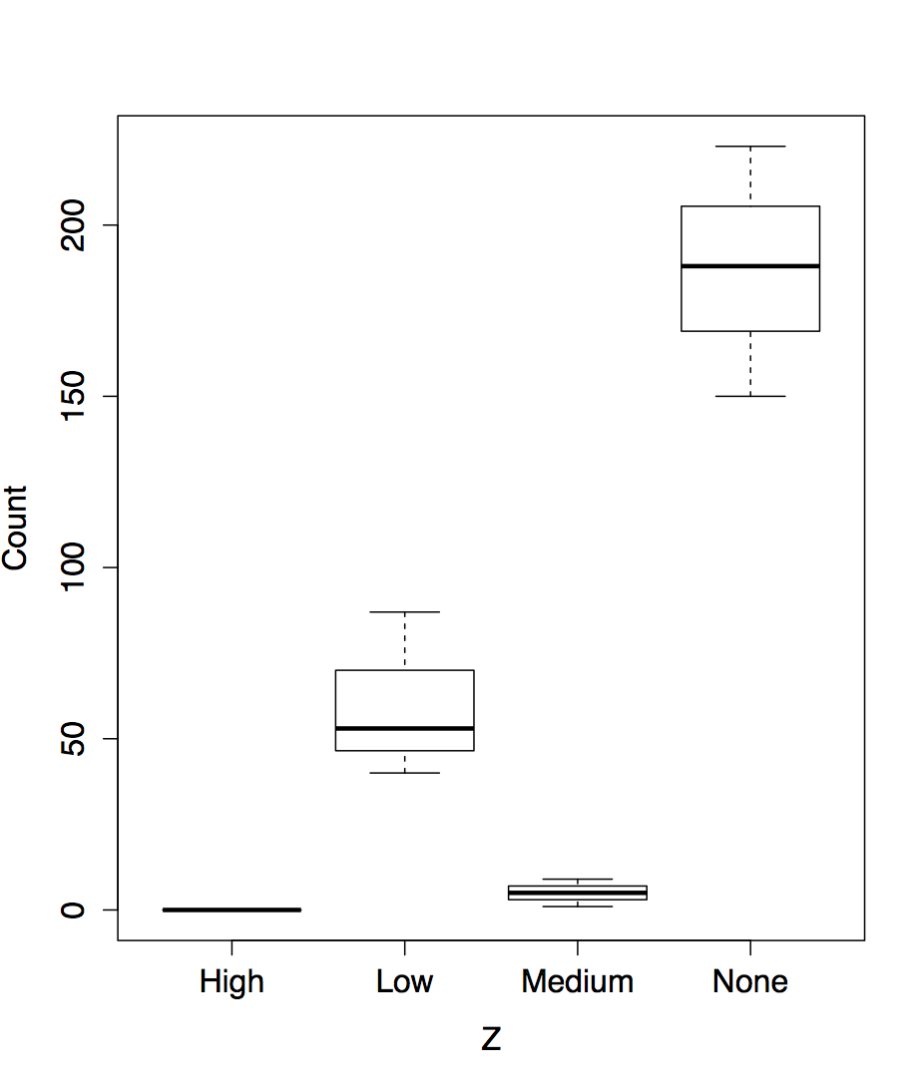
Plotting
We want to plot the colony growth in response to changing Z concentration.
Z is the explanatory variable, and Count is the response variable.
We don't want to plot replicates separately here, but get R to summarise each Z concentration over all replicates.
We can call plot using the same formula syntax we learnt yesterday:
plot(Count~Z)

Slide 29
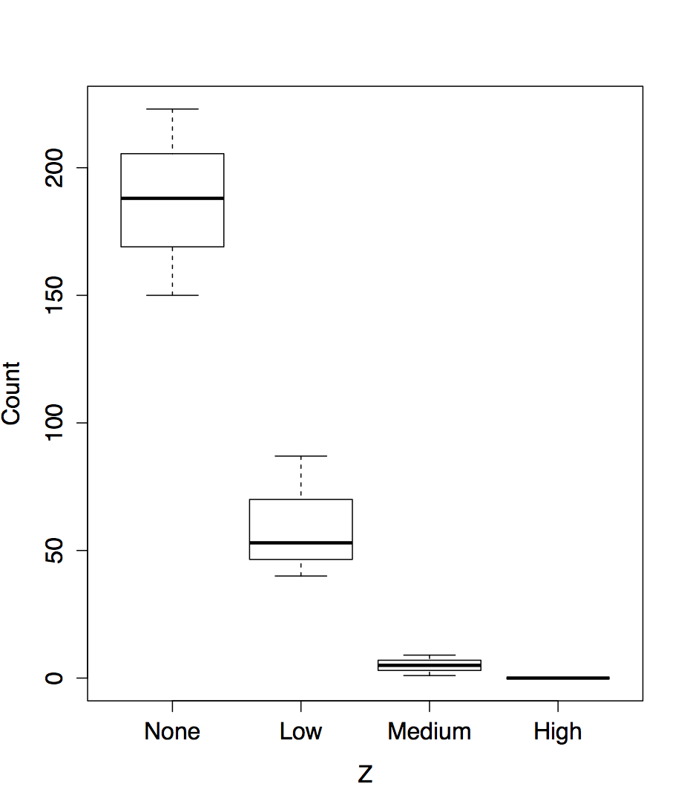
Plotting
We can improve on this. Firstly, we want to order the Z categories. Z is a factor, so we need to supply new levels to this factor in the colony data frame:
Z <- factor(Z, levels=c("None","Low","Medium","High"))
plot(Count~Z)

Slide 30
Analysis of Variance
We can use the same formula syntax to calculate an analysis of variance:
colony.aov<-aov(Count~Z)
summary(colony.aov)
Df Sum Sq Mean Sq F value Pr(>F)
Z 3 68154 22718 46.89 2.02e-05 ***
Residuals 8 3876 484
---
Signif. codes: 0 ‘***’ 0.001 ‘**’ 0.01 ‘*’ 0.05 ‘.’ 0.1 ‘ ’ 1
This tells us what we can already see from the plot, that there is a highly significant relationship between Z concentration and colony growth.
We would like to investigate this relationship. For example, we might want to calculate the mean colony count for each concentration of Z.

Slide 31
Calculating group means
We can calculate a mean for a particular group like this:
> mean(colony[Z=="None",]$Count)
[1] 187
> mean(colony[Z=="Low",]$Count)
[1] 60
> mean(colony[Z=="Medium",]$Count)
[1] 5
> mean(colony[Z=="High",]$Count)
[1] 0
We could generalise this with a for loop:
for (z in levels(Z)) {
print(mean(colony[Z==z,]$Count))
}
[1] 187
[1] 60
[1] 5
[1] 0
But there is a better way.

Slide 32
The tapply function
a brief digression
The apply family of functions allow us to group data by variable and calculate something for each group.
Assume we have the following data for heights of 5 males and females:
data <- data.frame(gender=c("Male", "Male", "Female",
"Female", "Female"), height=c(6, 6.1, 5.8, 6, 5.95))
gender height
1 Male 6.00
2 Male 6.10
3 Female 5.80
4 Female 6.00
5 Female 5.95
How can we get mean height of males and females separately?
  tapply() lets us do exactly this:
tapply( data$height, data$gender, mean )
data groups function

Slide 33
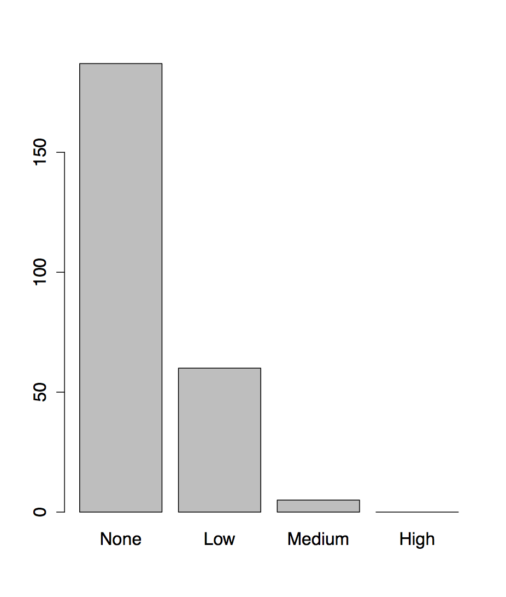
Using tapply on colony
We can use tapply to calculate group means on colony like this:
> colony.means<-tapply( Count, Z, mean )
> colony.means
None Low Medium High
187 60 5 0
> barplot(colony.means)

Slide 34
A complete script
We now have a complete script to analyse this data:
# Load data, order Z and plot
colony<-read.csv("2.1_colony_trial.csv")
colony$Z<-factor(colony$Z,c("None","Low","Medium","High"))
attach(colony)
plot(Count~Z)
# Analysis of Variance
colony.aov<-aov(Count~Z)
print(summary(colony.aov))
# Calculate group means
colony.means<-tapply(Count,Z,mean)
print(colony.means)
barplot(colony.means)
detach(colony)
Make sure you can source your commands (or the file 2.1_colony_1.R) from Rstudio and generate the results and plot.

Slide 35
User functions
3

Slide 36
Introducing ...
User functions
All R commands are function calls.
Functions take some input, perform calculations on that input, and return some output.
EG sqrt is a function that takes a value, calculates the square root of the value, and returns the square root.
aov takes a formula referring to some data, calculates the analysis of variance for that data, and returns the model it calculated.
We can define our own functions. User functions extend the capabilities of R by adapting or creating new tasks that are tailored to your specific requirements.
User functions are objects, just like vectors and data frames. This has a few useful implications.

Slide 37
Defining a new function
A function has a name, arguments, procedural steps, and a return value.
sqXplusX <- function(x){
x^2 + x
}
sqXplusX is the function name
x is the single argument to this function and it exists only within the function
everything between brackets { } are procedural steps
the last calculated value is the function return value. We can call return explicitly:
sqXplusX <- function(x){
return(x^2 + x)
}
After defining the function, we can use it:
> sqXplusX(10)
[1] 110

Slide 38
Named and default arguments
We can generalise our function by adding a second argument.
powXplusX <- function(x, power=2){
x^power + x
}
The power argument has a default value of 2; if we don't supply a power when we call the function, x will be squared.
Arguments without default value are required, those with default values are optional.
> powXplusX(10)
[1] 110
> powXplusX(10, 3)
[1] 1010
> powXplusX(x=10, power=3)
[1] 1010
arguments matched based on position
arguments matched based on name

Slide 39
Calculation with user functions
User functions can be used wherever a built in function can be used:
a <- matrix(1:100, ncol=10, byrow=TRUE) # make some dummy data
sqXplusX(a)
Functions are R objects, just like a vector or a data frame, and exist in our workspace:
> sqXplusX
function(x) x^2+x

Slide 40
Variable scope
Objects created in functions are not available to the global environment unless returned. They are limited to the scope of the function.
> addone<-function(x) {x<-x+1; x}
> x<-1
> addone(x)
[1] 2
> x
[1] 1
The x in the global environment has nothing to do with the x declared in the function, and is unchanged by the call to the function. To update the global x, we would need to assign the return value of the function:
> x<-addone(x)
A function can only return one object, but that object can be a list, so if you have many objects to return, package them up into a list first.

Slide 41
Script / function tips
User functions
If your script repeats the same command with different values more than twice, you should consider writing a function to generalise that command.
Writing functions makes your code more easily understandable because they encapsulate a procedure into a well-defined boundary with consistent input/output
Functions should only do one thing. If a function is doing multiple tasks, try to split it up into multiple functions. This rule of thumb means functions tend to be short, not more than around one or two screens of code.
Look at other functions to get ideas for how to write your own …
  Display function code by entering the function’s name without brackets.

Slide 42
Checking input and reporting errors
A function should fail gracefully if it does not receive valid input when it is called. We can use if statements to check for appropriate input.
R has two useful commands to tell the user something is wrong. warning prints a message and continues to run the function. stop ends the function after printing the message.
For example, we might rewrite our powXplusX function to check that the power argument is a whole number:
powXplusX<-function(x,power=2) {
if (power %% 1 != 0) stop("Power should be a whole number")
x^power+x
}
> powXplusX(10,3)
[1] 1010
> powXplusX(10,3.5)
Error in powXplusX(10, 3.5) : Power should be a whole number

Slide 43
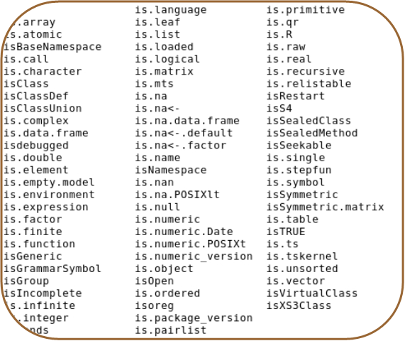
Checking input and reporting errors
R has a very useful set of functions called the is family, which check the type of input values. For example:
sqXplusX <- function(x){
if (is.numeric(x)) {
x^2 + x
} else {
stop("Input should be numeric")
}
}
> sqXplusX(10)
[1] 110
> sqXplusX("ten")
Error in sqXplusX("ten") : Input should be numeric
The is.family

Slide 44
Checking input and reporting errors
Here's another, more concise way to do the same thing:
sqXplusX <- function(x){
if (!is.numeric(x)) stop ("Input should be numeric")
x^2 + x
}
This is not only shorter, but it also gets all the error checking out of the way before the main processing steps.
You may also find the %in% command useful, which checks to see if the elements of one vector are present in another:
> levels(colony$Z)
[1] "None" "Low" "Medium" "High"
> "Low" %in% colony$Z
[1] TRUE
> "Zero" %in% colony$Z
[1] FALSE
> c("None","Low") %in% colony$Z
[1] TRUE TRUE

Slide 45
Temperature conversion exercise
User functions
Centigrade to Fahrenheit conversion is given by F = 9/5 * C +32.
Write a function that converts between temperatures.
The function should take two named arguments:
temperature (t) is numeric
units (unit) is character
Both arguments should have appropriate default values.
The function should report an appropriate error if inappropriate values are given.
if( !is.numeric(t) ) { .... }
if( !(unit %in% c("c","f")) ){...}
The function should print out the temperature in Fahrenheit if given in Centigrade, and vice versa.

Slide 46
Building the solution
It is difficult to write large chunks of code. Instead, start with something that works and build upon it.
E.g. to solve the temperature conversion exercise:
  write a skeleton function definition (eg just a name and brackets)
  add appropriate argument names and defaults
  write code to convert Centigrade into Fahrenheit and check it works
  write code to convert Fahrenheit to Centigrade and check it works
  add error checking code, including the checks from the previous slide, and any others you can think of
  write a set of test calls to confirm that your function handles correct and incorrect input
If you get stuck, call us to help you!

Slide 47
Temperature conversion exercise script
convTemp<-function(t=0,unit="c"){ # convTemp is defined as a new user function requiring two arguments, t and unit, the default values are 0 and "c", respectively.
if ( !is.numeric(t) ) stop("Non numeric temperature entered")
if ( !(unit %in% c("c","f"))){
stop("Unrecognized temperature unit. Enter (c)entigrade or (f)ahrenheit.")
}
converted<-0
# Conversion for centigrade
if ( unit=="c" ) {
converted <- 9/5 * t + 32
}
# Conversion for Fahrenheit
if(unit=="f"){
converted <- 5/9 * (t-32)
}
converted
}
> convTemp(t=-273,unit="c")
[1] -459.4
Example code:
2.2_convtemp.R

Slide 48
Advanced data processing
4

Slide 49
Combining data from multiple sources
Gene clustering example
R has powerful functions to combine heterogeneous data into a single data set
Gene clustering example data:
  five sets of differentially expressed genes from various experimental conditions
  file with names of experimentally verified genes
Gene clustering exercise:
  combine this dataset into a single table and cluster to see which conditions are similar
  repeat the clustering but only on a subset of experimentally verified genes

Slide 50
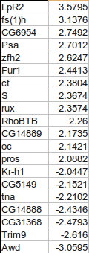
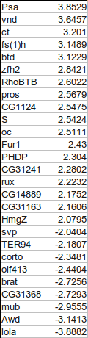
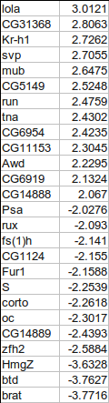
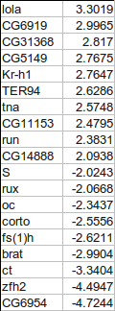
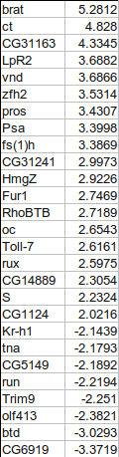
Combining gene tables
input files have two columns: gene names and fold change
we want to combine all five tables into a single table, with 0 for missing values
+
+
+
+

Slide 51
Gene clustering
Script walkthrough 1
To make the big table we first need to find out all the genes present in at least one of the files
Make sure not to use factors in read.delim()
# start with en empty collection of genes
genes <- c()
for( fileNum in 1:5 ){
# load in files 2.3_DiffGenes1.tsv ...
t <- read.delim(paste("2.3_DiffGenes", fileNum, ".tsv", sep=""),
as.is=TRUE, header=FALSE)
# label the input columns to help code readability
names(t) <- c("gene", "expression")
genes <- union(genes, t$gene)
}
# for tidiness order our genes by name
genes <- sort(genes)
genes # show all genes
when loading in character data
use as.is=TRUE to prevent it being
converted to factors!
union() is a set operation, combines
two vectors by eliminating duplicates.
There are also intersect() and setdiff()
Example code:
2.3_geneClustering.R

Slide 52
Gene clustering
Script walkthrough 2
Using the complete list of genes, we can create the big table and fill in the values:
# make the destination table [rows = unique genes, cols = file numbers]
values <- matrix(0, nrow=length(genes), ncol=5)
rownames(values) <- genes # name the rows with the complete gene names
for(fileNum in 1:5){
# read in the file again
t <- read.delim(paste("2.3_DiffGenes", fileNum, ".tsv", sep=""),
as.is=TRUE, header=FALSE)
names(t) <- c("gene", "expression")
# match the names of the genes to the rows in our big table
index <- match(t$gene, rownames(values))
# copy the expression levels
values[index,fileNum] <- t$expression
}
match() returns the index of first argument in the second, i.e. index of input file genes in the big table
we use index to pick the rows in such way that they match the gene order in the input file

Slide 53
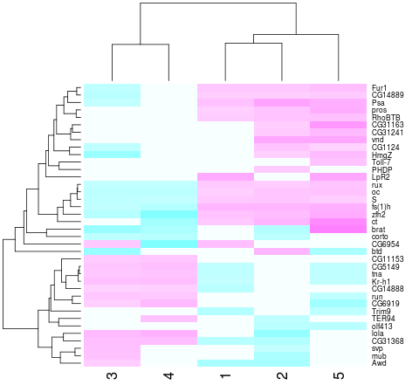
Gene clustering
Script walkthrough 3
Now we can do hierarchical clustering:
heatmap(values, scale="none", col = cm.colors(256))
Values from the matrix
are colour-coded.
Rows and columns
are re-arranged according to similarity

Slide 54
Gene clustering
Script walkthrough 4
In a second part of our analysis, we want to produce the same heatmap but only based on a list of experimentally verified genes
The problem is data is not formatted in the most convenient way:
genes | citation
oc,run,RhoBTB,CG5149,CG11153,S,Fur1 | Segal et al, Development 2001
tna,Kr-h1,rux | Krejci et al, Development 2002

Slide 55
Gene clustering
Script walkthrough 5
We load in this table, and only extract the gene names, then we use them to select a subset of values matrix
# load in the tab-delimited file with genes and citations
t.exp <- read.delim("2.3_ExperimentalGenes.tsv", as.is=TRUE)
# split all gene names by "," and then flatten it out into a single vector
experim.genes <- unlist( strsplit(t.exp$genes, ",") )
# redo the heatmap by using just the genes in the experimentally verified set
is.experimental <- rownames(values) %in% experim.genes
heatmap(values[ is.experimental, ], scale="none", col = cm.colors(256))
unlist() flattens out a nested
list into a single vector
strsplit() splits a vector of strings by a custom
split character (","). The result is a list of split
values for each element of the input vector

Slide 56
Gene clustering review
We load in the five tables twice - first to collect gene names, then to load expression values
Based on expression table (values) we construct a clustered heatmap first on the whole set of genes, then on a selected subset
Go through the code, try it out it and understand it
Try answering the following questions:
  what is rownames(values) ?
  why is rownames(values)[index] and t$gene giving the same output?
  what is the difference between rownames(values) %in% experim.genes and experim.genes %in% rownames(values)
Example code:
2.3_geneClustering.R

Slide 57
Graphics
5

Slide 58
Starting out with R graphics
Graphics
R provides several mechanisms for producing graphical output
  Functionality depends on the level at which the user seeks interaction with R
    graphics systems, packages, devices & engines
High level graphics
  Functions compute an appropriate chart based up on the information provided. Optional arguments may tailor the chart as required
    Interaction is at traditional graphics system level. The user isn’t required to know much about anything
Low level graphics
  The user interacts with the drawing device to build up a picture of the chart piece by piece.
    This fine granular control is only required if you seek to do something exceptional
R graphics produces plots using a painter’s model
  Elements of the graph are added to the canvas one layer at a time, and the picture built up in levels. Lower levels are obscured by higher levels, allowing for blending, masking and overlaying of objects.

Slide 59
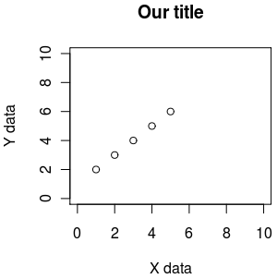
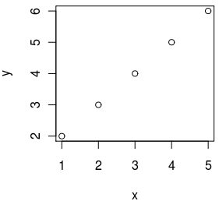
Essential plotting - plot()
plot() is the main function for plotting, it takes x,y values to plot and also lots of graphical parameters (see ?par for all of them)
default plotting
custom plotting
x <- 1:5
y <- 2:6
plot(x,y)
x <- 1:5
y <- 2:6
plot(x,y, xlab="X data", ylab="Y data", xlim=c(0,10), ylim=c(0,10), main="Our title")

Slide 60
R graphics uses a painter’s model
x <- seq(-2, 2, 0.1)
y <- sin(x)
1
2
3
plot(y~x, ylim=c(-1.5,1.5), xlim=c(-2.5,2.5), col="red" ,pch=16, cex=1.4)
lines(y~x, ylim=c(-1.5,1.5), xlim=c(-2.5,2.5), col="blue", lty=1,lwd=2)
rect(-2.5,0,2.5,-1.5, col="white", border="white")
xlim, ylim = axis limits
col = line colour
pch = plotting character [example(points)]
cex = character expansion [scaling factor]
lty = line type
lwd = line width
rect = rectangle
Example code:
14_painterModel.R

Slide 61
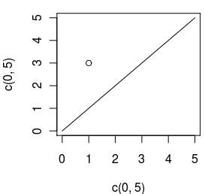
Plotting x,y data - plot(), points(), lines()
plot() is used to start a new plot, accepts x,y data, but also data from some objects (like linear regression). Use the parameter type to draw points, lines, etc (see ?plot)
points() is used to add points to an existing plot
lines() is used to add lines to an existing plot
plot(c(0, 5), c(0, 5), type="l") # draw as line from (0,0) to (5,5)
points(1, 3) # add a point at 1,3

Slide 62
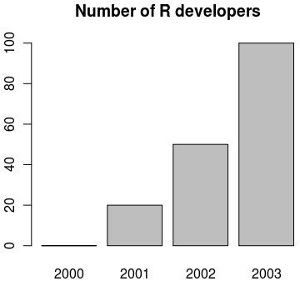
Making bar plots - barplot()
visualizing a vector of data can be done with bar plots, using function barplot()
data <- c("2000"=0, "2001"=20, "2002"=50, "2003"=100)
barplot(data, main="Number of R developers")

Slide 63
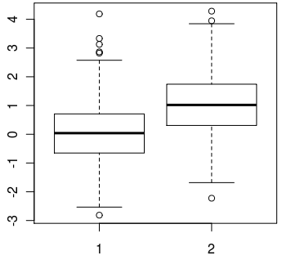
Making box plots - boxplot()
when a spread of data needs to be visualised, we can use boxplots with function boxplot()
data1 <- rnorm(1000, mean=0)
data2 <- rnorm(1000, mean=1)
boxplot(data1, data2)

Slide 64
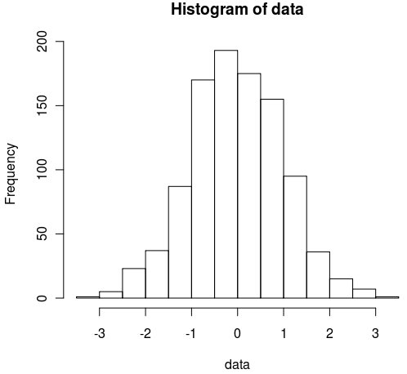
Making histograms - hist()
when we need to look at the distribution of data, we can visualize it using histograms with function hist()
data <- rnorm(1000)
hist(data)

Slide 65
Typical plotting workflow
Set the plot layout and style - par()
  Set the number of plots you want per page
  Set the outer margins of the figure region
    The distance between the edge of the page and the figure region, or between adjacent plots if there are multiple figures per page
  Set the inner margins of the plot
    The distance between the plot axes and the labels & titles
  Set the styles for the plot
    Colours, fonts, line styles and weights
Draw the plot - plot(x,y, …)‏

Slide 66
Setting graphics layout and style - par()
par() Top level graphics function
  parameter specifies various page settings. These are inherited by subordinate functions, if no other styles are set.
    Specific colours and styles may be set globally with par, but changed ad hoc in plotting commands
    The global setting will remain unchanged, and reused in future plotting calls.
  par sets the size of page and figure margins
    Margin spacing is in ‘lines’
  par is responsible for controlling the number of figures that are plotted on a page
  par may set global colouring of axes, text, background, foreground, line styles (solid/dashed), if figures should be boxed or open etc. etc.
type par() to get a list of top down settings which may be set globally

Slide 67
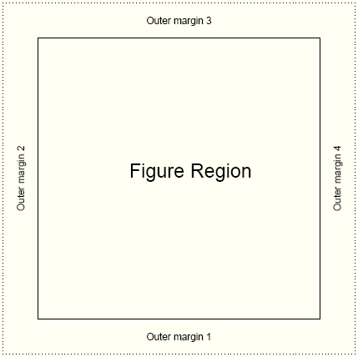
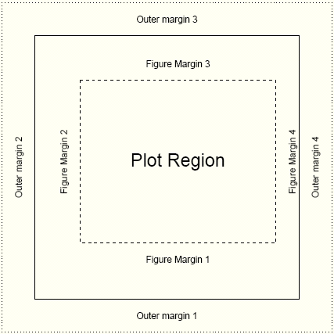
Page settings with par
Graphics
par(mfrow=c(1,1))
one figure on page
par(oma=c(2,2,2,2))
equal outer margins
par(mar=c(5,4,4,2))
Sets space for x & y labels, a main title, and a thin margin on the right
Numbering: bottom, left, top, right

Slide 68
Page layout plot exercise
Graphics
oma 1 line here
par(mfrow=c(2,2))
2 x 2 figures per page
par(oma=c(1,0,1,0)
1 line spacing top and bottom
par(mar=c(4,2,4,2))
4 lines at bottom & top
2 lines left & right
par(bg="lightblue",fg="darkgrey")
light blue background
dark grey spots
par(pch=16,cex=1.4)
Large circles for spots
Execute 4 times with different colors:
plot(1:10)
box("figure",lty=3,col="blue")
Draw a blue dashed line around plot
box("outer",lty=1,lwd=3,
col="green")
Draw a green solid line around figure
mar 4 lines here
mar 2 lines here
See how the figure margins overlap
Using painter’s model
15_parExample.R

Slide 69
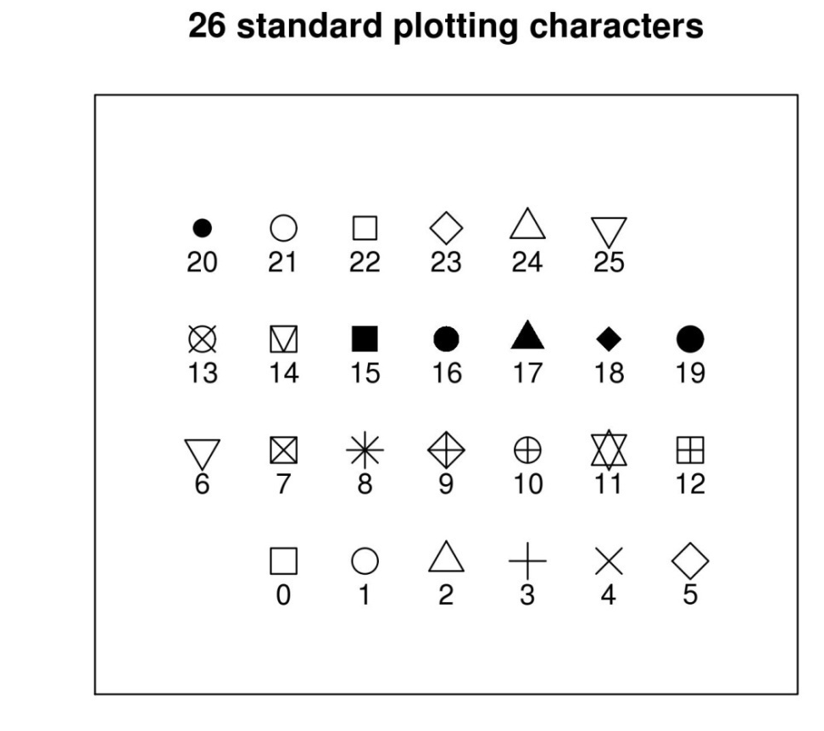
Plotting characters for plot()
size and orientation
pch= ...
Sets one of the 26 standard plotting character used.
Can also use characters, such as "."
cex= ...
Character expansion. Sets the scaling factor of the printing character
las= ...
Axes label style. 1 normal, 2 rotated 90º
4 styles (0-3)

Slide 70
Plotting characters exercise
Graphics
16_plottingChars.R
xCounter<-1
yCounter<-1
plotChar<-0
plot(NULL, xlim=c(0,8), ylim=c(0,5),xaxt="n",
yaxt="n",ylab="",xlab=""
,main="26 standard plotting characters")
while (plotChar < 26){
if(xCounter < 7){
xCounter <- xCounter+1
} else {
xCounter <- 1
yCounter <- yCounter+1
}
points(xCounter,yCounter,pch=plotChar, cex=2)
text(xCounter,(yCounter-0.3),plotChar)
plotChar <- plotChar+1
}
X-Y coordinates,
Plotting character index counter
Sets up an empty plotting area.
Axis scale limits, xlim, ylim
Don't draw axis ticks, xaxt, yaxt="n"
Don't annotate axis, xlab, ylab=""
Set a main title, main
We want to print the characters in a
7 x 4 grid. The if statement sets up the character plotting coordinates such that each time x =7, make it 1 again and increment the y axis by 1 at the same time
While loop counts up to 25
(0 to 25 = 26 iterations)
And cycles through each pch available

Slide 71
Annotating the plot
plot accepts main title, subtitle, X label, Y label as standard arguments
plot(x, y, main="...", sub="...", xlab="...", ylab="...")
mtext(text="…", side= …)
  allows text to be written directly into the margin of a plot
text(x,y,labels="…")
  allows text to be written in the plot at x,y
legend(x,y, legend=…)
  produces a legend for the plot

Slide 72
Use of colour in R
Graphics
Colour is usually expressed as a hexadecimal code of Red, Green, and Blue counterparts
  No good for humans.
R supports numerous colour palettes which are available through several "colour" functions.
  colours() # get inbuilt names of known colours
    RGB primaries may take on a decimal intensity value of 0 to 255
      255 is #FF in hexidecimal
        White is #FF FF FF
        Black is #00 00 00
  rgb() # converts red green blue intensities to colour
    Strangely, likes decimalized intensities (ie. 0 is black, 1 is white)
> rgb(1,1,1)
[1] "#FFFFFF"
> par(mfrow=c(2,2))
> plot(1:10,col="#FF00FF")
> plot(1:10,col=rgb(1,0,1))
> plot(1:10,col="magenta")

Slide 73
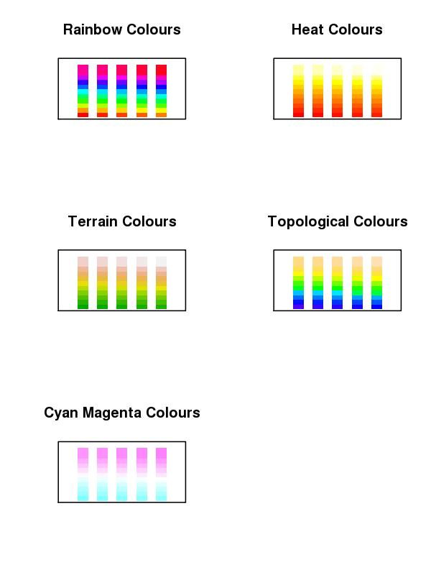
Colour Ramps & Palettes
Graphics
Heatmaps use colour depth to convey data values. Cold colours are typically low values, and light colours are high state values. This is a colour ramp.
R supports numerous graded colour charts. Specify n, to set the number of gradations required in the palette
rainbow(n)
heat.colors(n)
terrain.colors(n)
topo.colors(n)
cm.colors(n)
19_colourCharts.R
You can specify a user defined palette of indexed colours:
palette(rainbow(7)) # creates 7 indexed colours (1:7) based on # rainbow palette R O Y G B I V !!!

Slide 74
Colour packages: RColorBrewer
Graphics
This add on package provides a series of well defined colour palettes. The colours in these palettes are selected to permit maximum visual discrimination
Access the RColorBrewer library functions ...
library("RColorBrewer")
  Check out the available palettes
display.brewer.all(n=NULL, type="all", select=NULL, exact.n=TRUE)
  Define your own palette based on one of RColorBrewers'
myCol<-brewer.pal(n,"...") # n=number of colours, "..." is the palette name

Slide 75
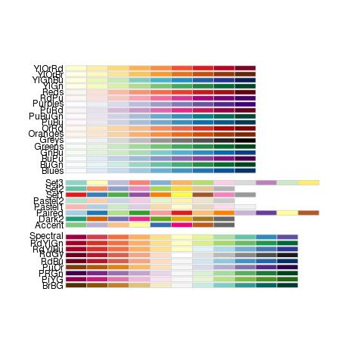
RColorBrewer named palettes
Graphics

Slide 76
Saving plots to files
Unless specified, R plots all graphics to the screen
To send plots to a file, you need to set up an appropriate graphics device …
postscript(file="a_name.ps", …)‏
pdf(file="…pdf", …)
jpeg(file=" …jpg", …)‏
png(file=" ….png", …)
    Each graphics device will have a specific set of arguments that dictate characteristics of the outputted file
      height=, width=, horizontal=, res=, paper=
        Top tip: jpg, A4 @ 300 dpi, portrait, size in pixels
        jpg(file="my_Figure.jpg", height=3510, width=2490, res=300)
        Postscript & pdf work in inches by default, A4 = 8.3" x 11.7"
Graphics devices need closing when printing is finished
dev.off()
for example:
png("tenPoints.png", width=300, height=300)
plot(1:10)
dev.off()

Slide 77
Thoughts when plotting to a file
Graphics
Its very tempting to send all graphical output to a pdf file. Caution!
  For high resolution publication quality images you need postscript. Set up postscript file capture with the following function
postscript("a_file.ps",paper="a4")
    postscript images can be converted to JPEG using ghostscript (free to download) for low resolution lab book photos and talks
  PDF images will grow too large for acrobat to render if plots contain many data points (e.g. Affymetrix MA plots)‏
  Automatically send multiple page outputs to separate image files using …file="somename%02d.jpg"
  Don’t forget to close graphics devices (i.e. the file) by using
    dev.off()

Slide 78
Plotting exercise
Graphics
Exercise:
  Make a full A4 page figure comprising of 6 plots: 2 each of XY plot (plot()), barchart (barplot()) and box plots (boxplot())
  The two version of each plots should consistent of: the default plot and a customised plot (change for instance colours, range, captions...)
  Output the completed 6-panel figure to: screen, jpeg, postscript and pdf file
Suggested route to solution:
1. Generate some plotting data appropriate for each type of plot
2. Write the code to produce the six plots, once plotting the data by using default plotting, one with some customisations you want
3. To output the plot to screen, jpeg, postscript and pdf you will need to redo the plot multiple times - create a function to do a plotting and call it by redirecting graphical output to screen, jpeg file, poscript file and pdf file
20_6PanelPlotScript.R

Slide 79
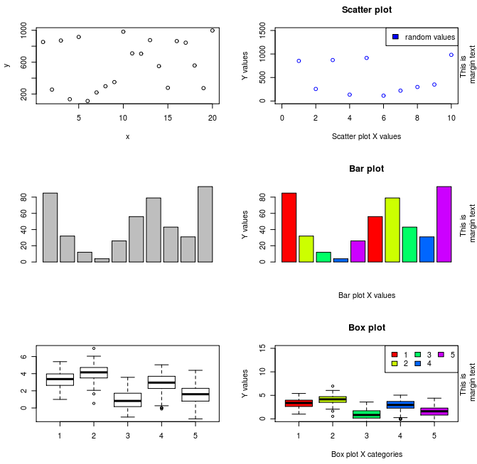
6 Panel plots exercise
Graphics

Slide 80
References
Official documentation on:
  http://cran.r-project.org/manuals.html
A good repository of R recipes:
  Quick-R: http://www.statmethods.net/
Don't forget that many packages come with tutorials (vignettes)
Website of this course:
  http://logic.sysbiol.cam.ac.uk/teaching/Rcourse/
R forums (stackoverflow & official):
  http://stackoverflow.com/questions/tagged/r
  http://news.gmane.org/gmane.comp.lang.r.general
Plenty of textbooks to choose from, comprehensive list + reviews:
  http://www.r-project.org/doc/bib/R-books.html

Slide 81
Thanks for your attention!
END OF COURSE

