Slide 1

INTRODUCTION TO EXPERIMENTAL DESIGN AT CRUK-CI
16 January 2024
tinyurl.com/cruk-edesign

Slide 2

Agenda
What is an Experiment?
Why perform experiments?
systematic vs random error
Why Experimental Design Matters?
Classification of bias
selection, assessment, performance (after start of treatment)
BAD examples from literature
(END with we are not born to design exp)
Experimental design process at CRUK-CI

Slide 3
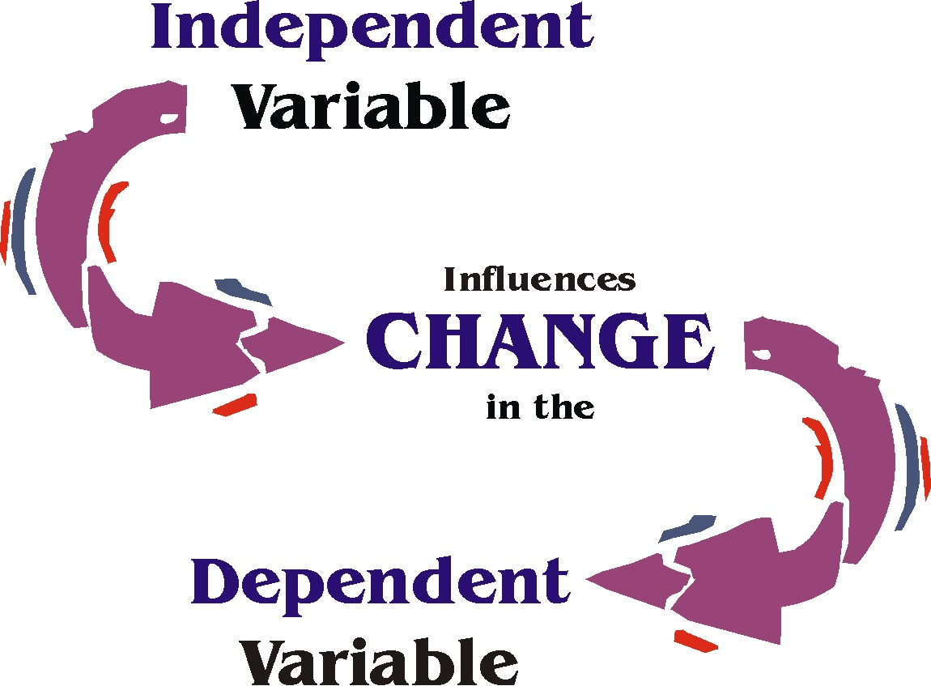
What is an Experiment?
An experiment is a scientific procedure used to test a hypothesis or investigate a phenomenon.
To detect and estimate causal relationship (effect) between independent variable (treatment/ exposure) and a dependent variable (outcome)
A survey is not an experiment!
The assignment of treatment/exposure is under the control of the investigator. An observational study is not an experiment because researcher does not control treatment assignment

Slide 4
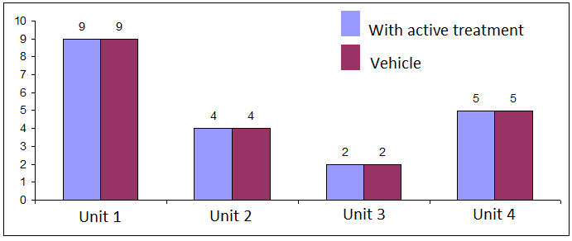
What do we mean with effect?
N° of metastasis
Each unit exhibits a response that is observed some time after treatment/exposure
Definition of “no effect”: each unit would exhibit the same value of the response whether assigned to treatment or control. If changing the treatment/exposure assigned to a unit changed that unit’s response then certainly the treatment/exposure has at least some effect

Slide 5
Why Perform Experiments?
Exploratory experiments: Aim to generate hypotheses.
They normally involves looking for patterns in the data
with less emphasis on formal testing of hypotheses.
Confirmatory experiments: Aim to demonstrate hypothesis.

Slide 6
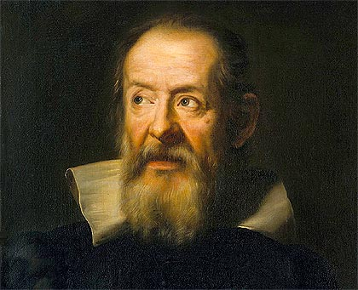
Confirmatory experiments: the traditional scientific method of biology and medicine
Experimental research proceeds by hypotheses formulated on the basis of previous or new knowledge and then tested.
Question:
Does serotonin affect blood pressure in mice?
Answer:
Trial
TRUE
FALSE
“Sensate esperienze e certe dimostrazioni”
Galileo Galilei, father of modern science

Slide 7
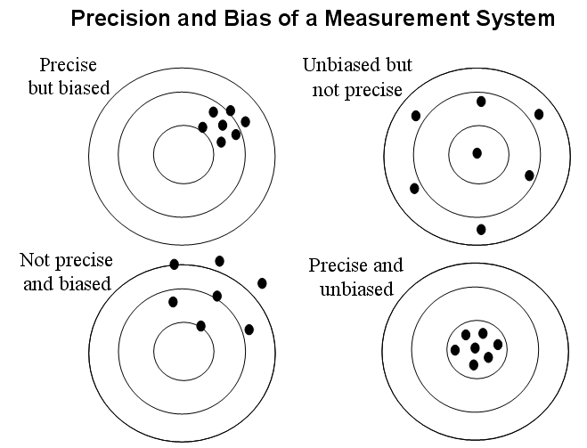
Random vs Systematic Error
Random error: It cannot be predicted with certainty but could be described probabilistically
Systematic error (i.e. bias): It cannot be predicted with certainty, it could not be described probabilistically or with other mathematical tools

Slide 8
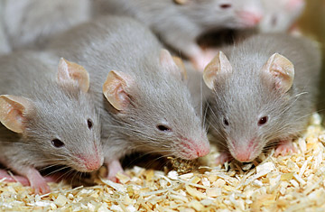
An Example of Systematic Error
If age > 8 months
Active treatment
If age < 8 months
Vehicle
As a result any observed treatment effects could be due to the difference in animal ages rather than any effect of the drug. The treatment effect is said to be confounded with the effect of age and hence we cannot tell whether the effect observed is due to treatment or age.

Slide 9
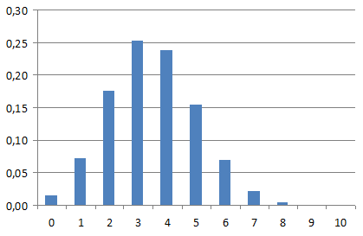
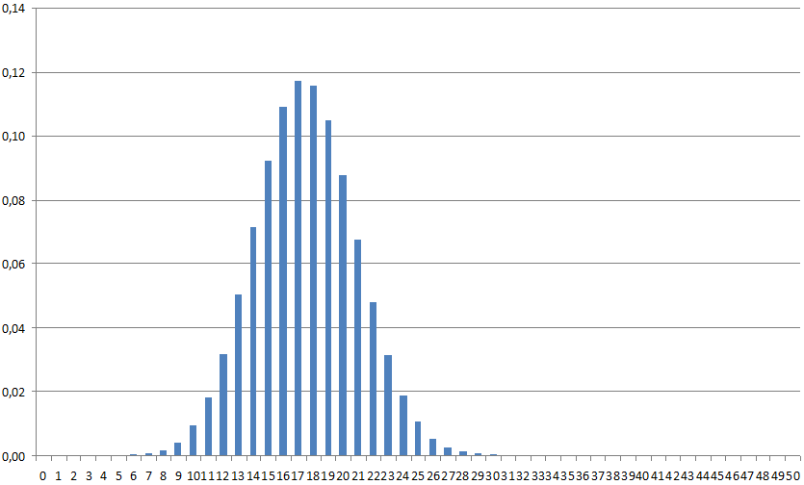
An Example of Random Error
Θ: Probability of tumour shrinkage due to an antitumor compound in a population of female lab rats of type F344
Θ: 35%
Cohort of 10 rats
Cohort of 50 rats

Slide 10
Why Experimental Design Matters?
Random error
Random error
Treatment
ACTIVE GROUP
Subjects
Randomly
Assigned
Systematic error due to treatment. The goal is to detect and estimate this systematic error!!!
CONTROL GROUP
Random error
No Treatment
Random error
Random error
“In a perfect experiment all the variability should be random excluding that caused by the treatment/exposure (systematic error)”

Slide 11
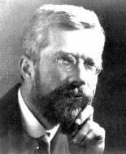
Definition of internal validity for an experiment
The differences observed between experimental groups allocated to different interventions may, apart from random error, be attributed to the treatment/exposure (i.e. treatment/exposure effect) under investigation
What Fisher taught us about lack of internal validity
van der Worp HB, Howells DW, Sena ES, Porritt MJ, Rewell S, et al. (2010) Can Animal Models of Disease Reliably Inform Human Studies? PLoS Med 7(3): e1000245. doi:10.1371/journal.pmed.1000245

Slide 12
Ronald A. Fisher(1890-1962)
“To consult the statistician after an experiment is finished is often merely to ask him to conduct a post mortem examination. He can perhaps say what the experiment died of.”

Slide 13
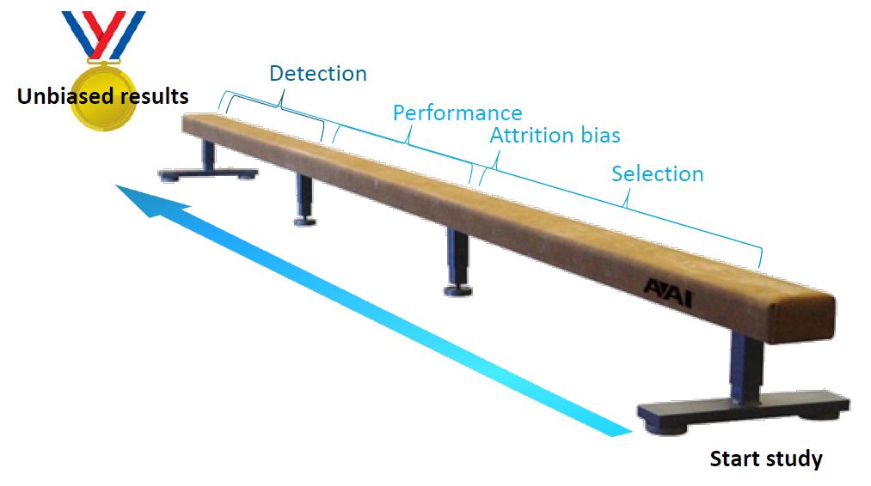
Classification of Biases and Solutions
Blinding and randomization
Randomization
Peter Jüni, Douglas G Altman, Matthias Egger, Assessing the quality of controlled clinical trials, BMJ 2001;323:42–6

Slide 14
SELECTION BIAS
If age > 8 months
Active treatment
If age < 8 months
Vehicle

Slide 15
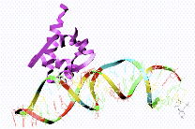
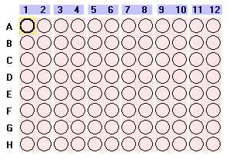
PERFORMANCE BIAS
RNA Extraction
Day1, Plate 1
Day2, Plate 2
Day3, Plate 3
Control
Treatment 1
Treatment 2
The difference between Control, Treatment 1
and Treatment 2 is confounded by day and plate.

Slide 16


DETECTION BIAS
Active treatment
Vehicle

Slide 17

Bad Design Issues
17

Slide 18
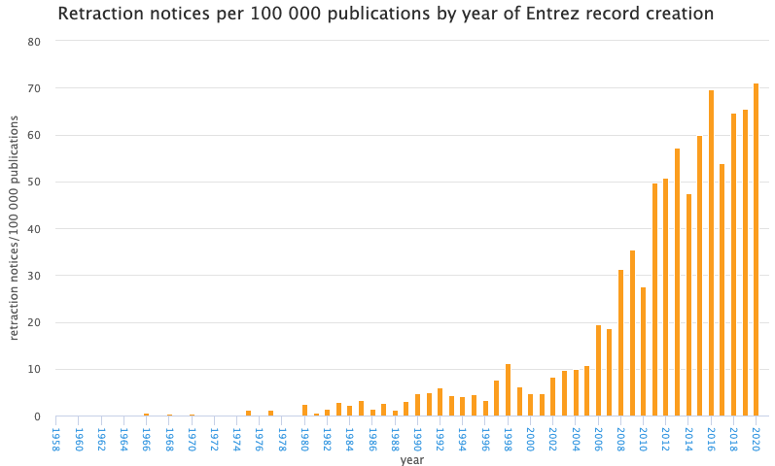
Crisis in Reproducible Research
http://neilfws.github.io/PubMed/pmretract/pmretract.html

Slide 19
47 of 53 high-profile cancer studies were not reproducible!

Slide 20
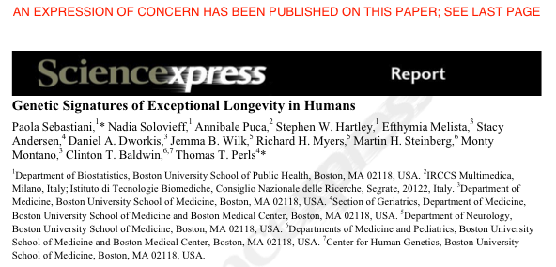
GWAS study: 800 centenarians vs. controls
Found 150 SNPs predicting centenarians with 77 % accuracy
Problem: they used different SNP chips for centenarians and controls
Retracted in 2011 following independent review and QC of data
http://www.the-scientist.com/blog/display/57558/

Slide 21
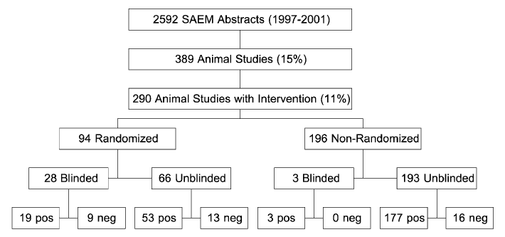
A shocking result
Classification of studies present at the Society for Academic Emergency Medicine (SAEM) annual meetings from 1997 to
2001
The Odds Ratios (ORs) of reporting a significant difference:
RND- vs RND+: 3.4; 95%CI: 1.7 to 6.9
BLD- vs BLD+: 3.2; 95%CI: 1.4 to 7.7
(RND- & BLD-) vs (RND+ & BLD+): 5.2; 95%CI: 2.0 to 13.5
These results suggest that failure to blind and randomise lead to bias!!!
Bebarta V et al. Emergency Medicine Animal Research: Does Use of Randomization and Blinding Affect the Results? ACAD EMERG MED, June 2003, Vol.10, n.6

Slide 22
Better statistics and reporting is needed
Poor reporting
1. Weight of evidence
2. Reproducibility
Poor internal validity
False pos/neg experiments
Reproducibility
⁽¹⁾ Kilkenny, C., Parsons, N., Kadyszewski, E., Festing, M. F., Cuthill, I. C., Fry, D., Hutton, J. and Altman, D. G. (2009) Survey of the quality of experimental design, statistical analysis and reporting of research using animals. PLoS One, 4, e7824

Slide 23
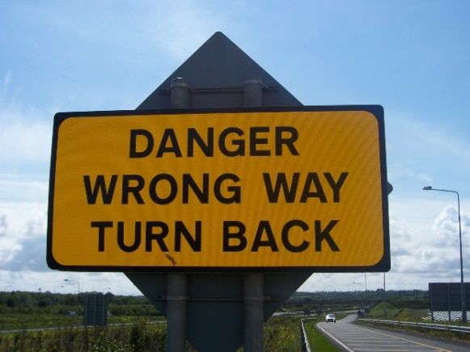
Consequences of Poor Experimental Design…
Cost of experimentation. We have a responsibility to CRUK donors!
Limited & Precious material, esp. clinical samples.
Immortalization of data sets in public databases and methods in the literature. Our bad science begets more bad science.
Ethical concerns of experimentation: animals and clinical samples.
Wrong way to preclinical and
above all clinical research

Slide 24
A Well-Designed Experiment:
Should have
TARGET POPULATION : I SAW an UPREGULATED GENE IS NOT A SCIENTIFIC STATEMENT
Clear objectives : AND endpoints (FOR EACH OBJECTIVE AT LEAST ONE ENDPOINT)
Focus and simplicity
GOOD CONTROL OF VARIABILITY USING RANDOMIZATION, BLOCKING AND BLINDING
And be
ABSENCE OF SYSTEMATIC ERROR EXCLUDING THAT CAUSED BY TREATMENT/EXPOSURE
Reproducible
EXTERNAL VALIDITY YOU MUST BE WORRIED IF AND HOW BIOLOGICAL SIGN IS TRANSLATED IN CLINICS. THIS IS YOUR FINAL GOAL!!!

Slide 25
Absence of biases is a necessary but not sufficient condition for good preclinical research
Key methodological issues are put into doubt by variability of experimental results, observations, measurements and preclinical models

Slide 26
Definition of Reproducibility
Methods Reproducibility: the provision of enough detail about study procedures and data so the same procedures on the same data could, in theory or in actuality, be exactly repeated
Results Reproducibility: obtaining the same results from the conduct of an independent study whose procedures are as closely matched to the original experiment as possible
Steven N. Goodman, Daniele Fanelli, John P. A. Ioannidis What does research reproducibility mean? (2016) Science Translational Medicine 8 (341), 341ps12

Slide 27
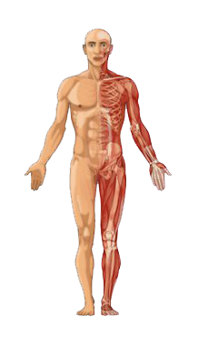
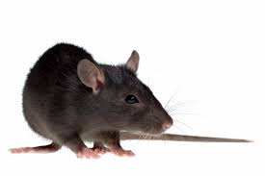
Definition of External Validity
The extent to which preclinical models provide a correct basis for generalisations to the human condition
How do we translate preclinical research into clinical benefit?

Slide 28
Experimental Design process at CRUK-CI
28

Slide 29
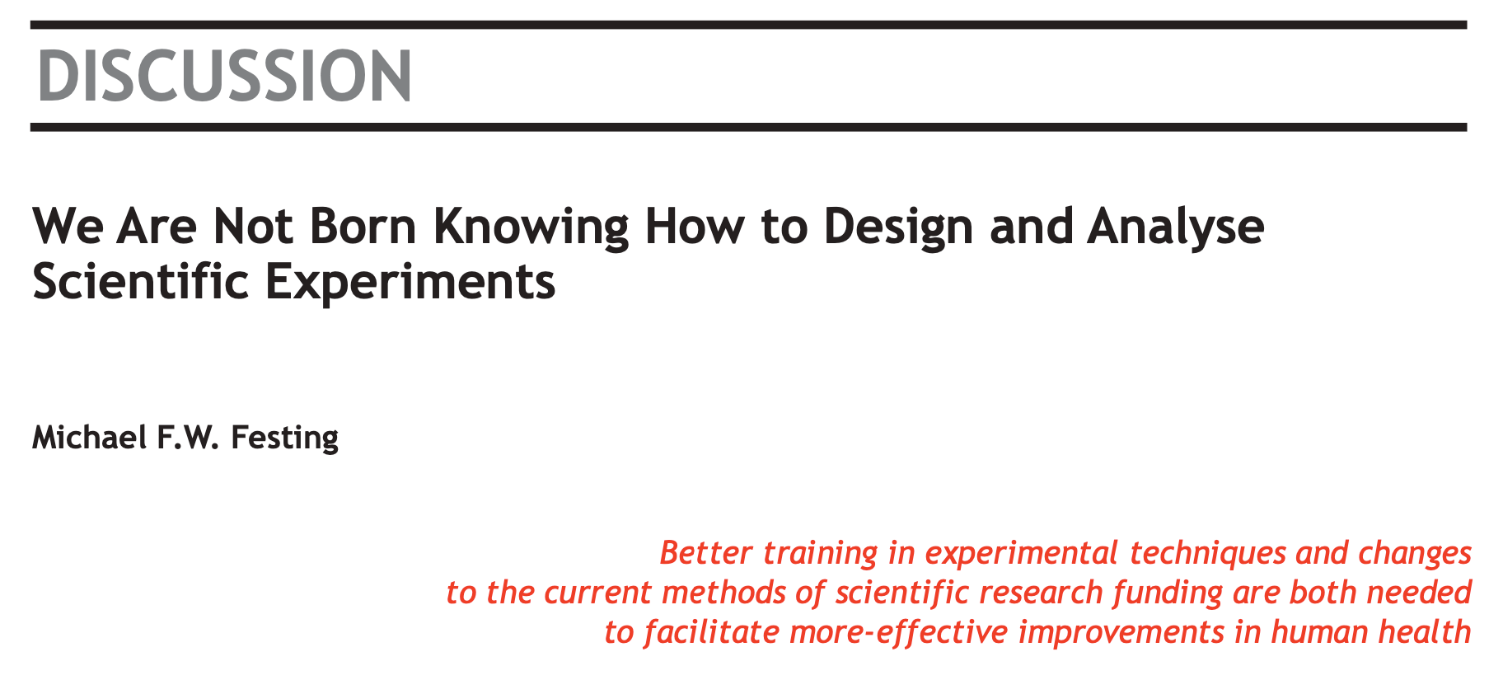
Festing MFW. We are not Born Knowing how to Design and Analyse Scientific Experiments. Alternatives to Laboratory Animals. 2013;41(2):P19-P21. doi:10.1177/026119291304100212

Slide 30
CRUK-CI Experimental Design Process
All sequencing and proteomics experiments require experimental design review meeting
Simple form asking about key aspects of experiment
Attended by Researcher and various Cores
Keys:
Form and meeting not onerous
(Currently) not chargeable
Scientists agree process improves experiments!

Slide 31
Experimental Design Meetings - Genomics
Wednesday 45 min slots (2:00-3:30pm) with Bioinformatics & Genomics Cores
Requirements:
Email CRIExperimentalDesign@cruk.cam.ac.uk to request meeting
Fill in Experimental Design Form and return 1 week prior to meeting
Your attendance
Provide project background (a few slides from you)
Discussion:
Planning, time-scale, cost, aims, scope, questions
Choosing the correct technology
Effect size & Sample-size calculation?
Sample collection and processing methods
Sample information (meta-data) collection
Randomisation, Blocking and Replication issues
Technical issues

Slide 32
Experimental Design Meetings - Proteomics
FRIDAY 45 min slots (11:30-13:00pm) with Bioinformatics proteomics Cores
Requirements:
Email ProteomicsProjectDesign@cruk.cam.ac.uk to request meeting
Fill in ProteomicsMetadataTemplate.xls Your attendance
Provide project background (a few slides from you)
Discussion:
Planning, time-scale, cost, aims, scope, questions
Choosing the correct technology
Sample collection and processing methods
Sample information (meta-data) collection
Randomisation, Blocking and Replication issues

Slide 33
Experimental Design Meetings – preclinical in vivo experiments
Please, seNd EMAIL FOR a stats CLINIC:
Email luca.porcu@cruk.cam.ac.uk or statistics@cruk.ca.ac.uk to request meeting (first meeting is not charged)
Provide project background and objectives (a few slides from you)
Discussion:
Background, objectives, endpoints
Efficient statistical design
Control of variability using randomization, blocking and replication
Effect size & sample-size calculation
Type of randomisation and producing randomization lists
NOTE: for Personal Project Licenses (PPLs) meetings with the statistician is useful to improve the statistical sections of the PPL, to better justify the number of animals, to demonstrate to the Home Office that a statistical support is present and to anticipate the statistical design of future pivotal experiments (first meeting is not charged. The ollowing meetings are charged based on a previous agreement with the PPL holder.

