Slide 1

INTRODUCTION TO EXPERIMENTAL DESIGN AT CRUK-CI
Stéphane Ballereau Chandra CHilamakuri
Abbi Edwards Mark fernandez
ash sawle Rory Stark
20 OCTOBER 2021
tinyurl.com/cruk-edesign

Slide 2

Agenda
Why perform experiments?
What makes for a well designed experiment?
Key Aspects of experimental design
Experimental variables
Power: variance and replicates
Bias: confounding factors, randomisation, and controls
Design parameters
Experimental design process at CRUK-CI
Breakout sessions: practicals

Slide 3
Why Perform Experiments?
Because my supervisor told me to
Because they did it in this other paper
Because we got a cool new piece of tech and I want to try it out
Because I don’t know what else to do

Slide 4
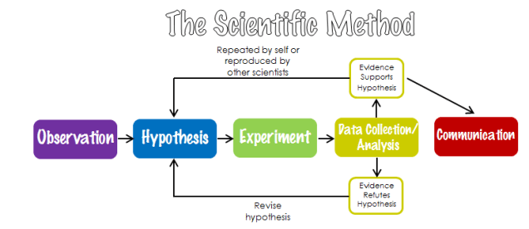
Experiment is to Test Hypothesis
Hypothesis
A prediction statement
Includes clearly defined independent and dependent variables
Includes measurable or testable scenario
Best experiments have clearly defined hypothesis
Image: https://allinonehighschool.com/scientific-method/

Slide 5

Reproducible Research
5

Slide 6
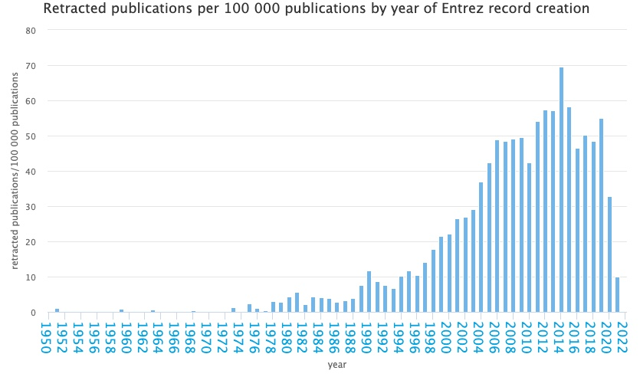
Crisis in Reproducible Research
http://neilfws.github.io/PubMed/pmretract/pmretract.html

Slide 7
47 of 53 high-profile cancer studies were not reproducible!

Slide 8
Need for Good Design
8

Slide 9
Consequences of Poor Experimental Design…
Cost of experimentation. We have a responsibility to CRUK donors!
Limited & Precious material, esp. clinical samples.
Immortalization of data sets in public databases and methods in the literature. Our bad science begets more bad science.
Ethical concerns of experimentation: animals and clinical samples.
Time and career of individuals.

Slide 10
A Well-Designed Experiment:
Should have
Clear objectives
Focus and simplicity
Sufficient power
Randomised comparisons
And be
Precise
Unbiased
Amenable to statistical analysis
Reproducible

Slide 11
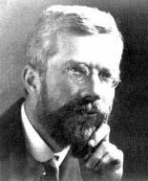
Ronald A. Fisher(1890-1962)
“To consult the statistician after an experiment is finished is often merely to ask him to conduct a post mortem examination. He can perhaps say what the experiment died of.”
“… VERY OFTEN, … THE MOST ELABORATE STATISTICAL REFINEMENTS POSSIBLE COULD INCREASE THE PRECISION BY ONLY A FEW PERCENT, YET A DIFFERENT DESIGN INVOLVING LITTLE OR NO ADDITIONAL EXPERIMENTAL LABOUR MIGHT INCREASE THE PRECISION TWO-FOLD, OR FIVE-FOLD OR EVEN MORE."

Slide 12
Aspects of Experimental Design
Experimental FACTORS
Power
Sources of Variance
Replicates
Errors
Confounding factors
Bias
Random errors
Notes:
Might want to say randomisation for treatment allocation, extraction batches and orders, plate layout, library pools, lanes on a flow cell, flow cell run etc etc etc.

Slide 13
Experimental Factors
13

Slide 14
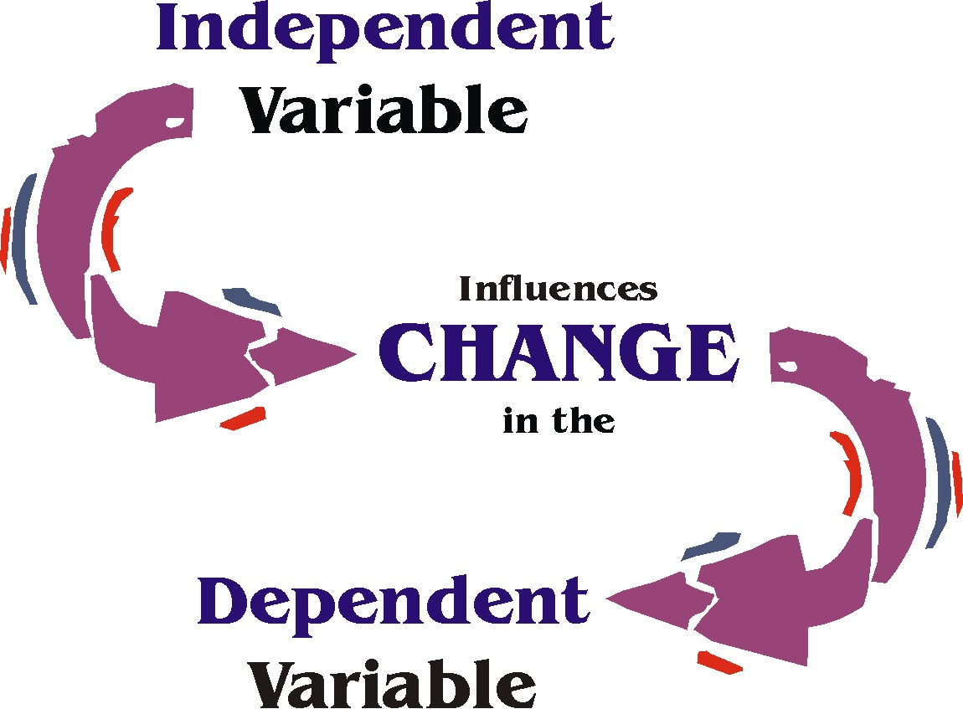
Experimental Factors
Independent and Dependent variables
Independent variable (IV): what you change
Dependent variable (DV): what changes due to IV
“If (independent variable), then (dependent variable)”
Variable type depends on type of measurement:
Categorical (nominal) , e.g. gender
Categorical with ordering (ordinal), e.g. tumour grade
Discrete, e.g. shoe size, number of cells
Continuous, e.g. body weight in kg, height in cm
Notes:
Might want to say here experiments have factors and data has variables, so gender could be a factor in the experiment and a variable in the data or data analysis.

Slide 15
Capturing Variance
15

Slide 16
Sources of Variance
Total Variance
Treatment variance
Captures the effect of treatment
Technical variance
Like using different instruments
Sample processing in batches
Natural Biological variance
stochastic in nature
Treatment var.
Total Variance
Natural Biological var.
Technical var.

Slide 17
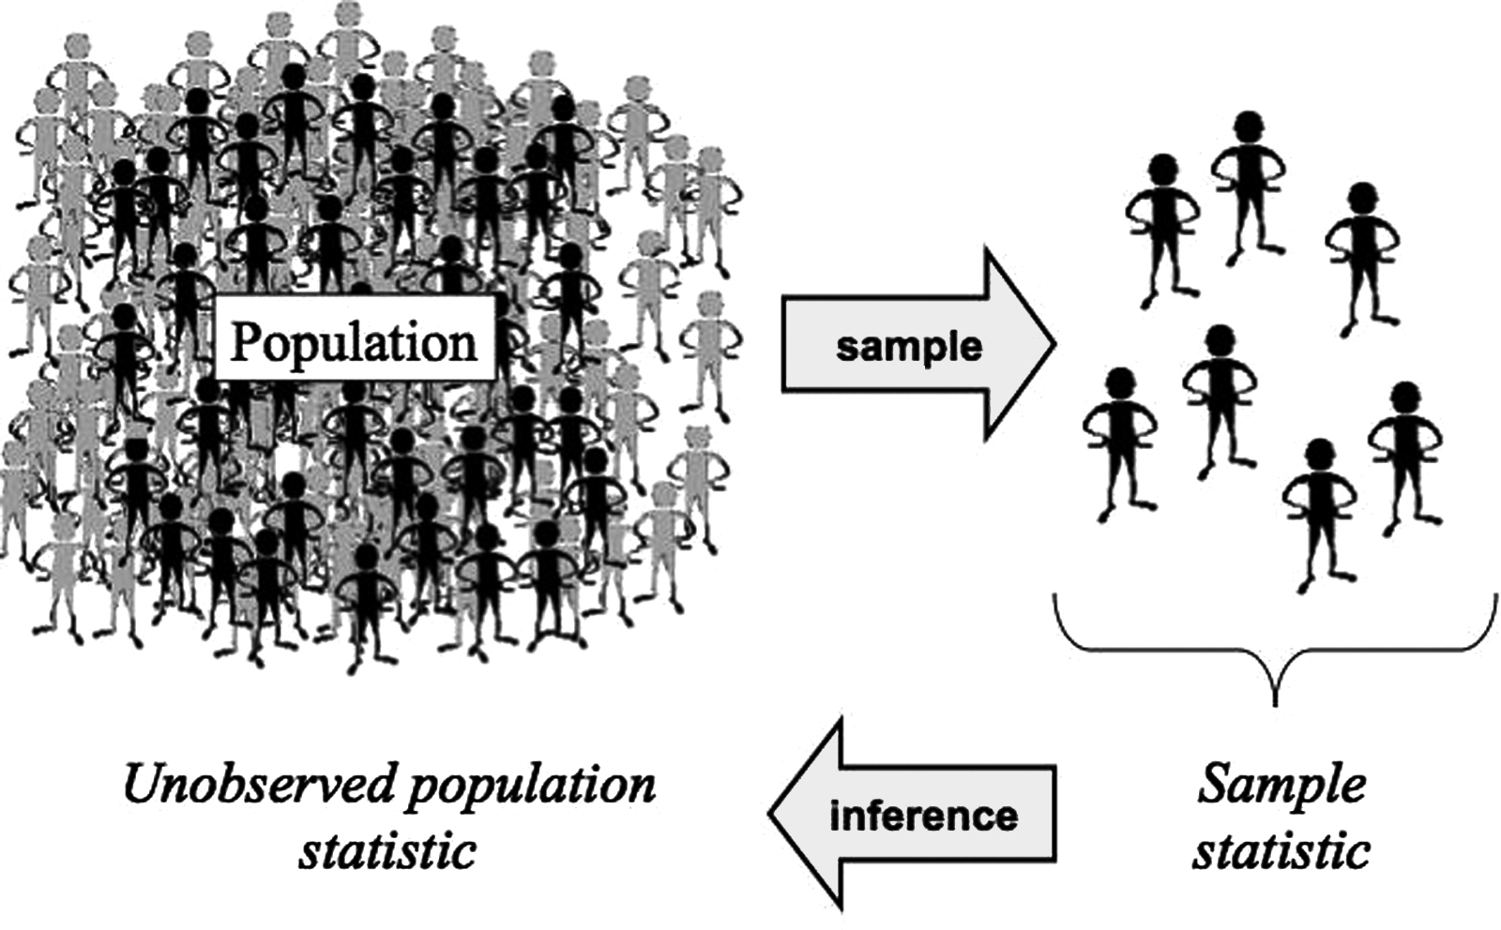
Central Dogma of Statistics
Two important parameters
Mean
Variance
Population mean and variance unknow and are constants
Estimated using sample
Estimated mean and variance used for inferring population parameters

Slide 18
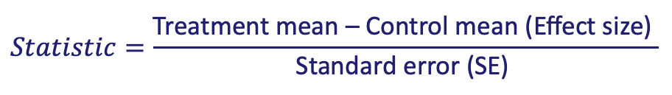
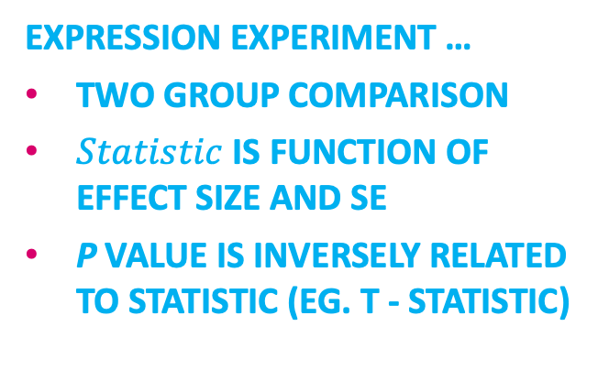
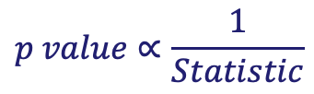

P-value gives significance of estimates
Expression Matrix
 | Treatment group |  |  | Control group
 | T1 | T2 | T3 | C1 | C2 | C3
Gene 1
Gene 2
Gene 3
Gene n
$$Statistic=\frac{\text{Treatment} \text{mean}\text{ – }\text{Control} \text{mean}\text{ (}\text{Effect} \text{size}\text{) }}{\text{Standard} \text{error}\text{ (}\text{SE}\text{) }}$$
expression experiment …
Two group comparison
$Statistic$ is function of effect size and SE
p value is inversely related to statistic (eg. t - statistic)
SE = variance of mean $=\frac{Sample Variance}{\sqrt{No. of Replicates}}$
$$p value∝\frac{1}{Statistic}$$

Slide 19




Replicates: Biological /Technical/ Experimental
Biological Replicates
Experimental replication:
Neither technical nor Biological
Independent units
Independent sample
processing
One Biological unit
Independent
sample processing
Biological
replication
Technical
replication
Biological replicate : sampling of individuals from a population
in order to make inferences about that population
Technical replicate addresses the measurement error of the assay.

Slide 20
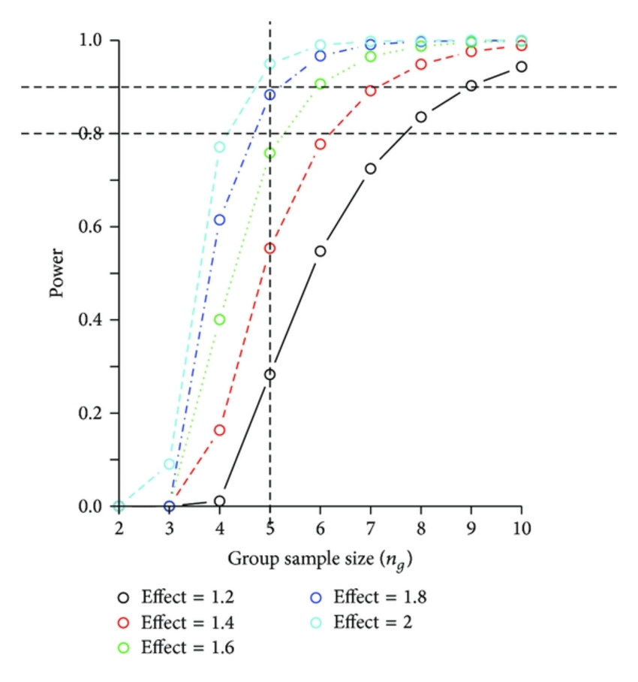

Sample size and experimental power
Why do you need replicates?
Calculating appropriate sample sizes
Power calculations
Planning for precision
Resource equation
EXPERIMENTAL POWER
Power: Probability of detecting an effect, if there is a true effect present to detect.
Statistical power increases with …
Higher sample sizes
Higher effect size
Low variance
Higher alpha values
HPB Surg. 2014;2014:310372.

Slide 21
Errors in the studies: Confounding, bias, chance
21

Slide 22
Experimental Errors
Independent and Dependent Variable Association
True association
Confounding errors
Bias errors
Random error

Slide 23



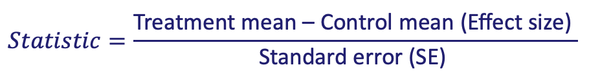
Confounding Errors: Thought experiment
Male mouse
Hypothesis: Drug X increases mouse weight
Resources: 8 mice (4 male + 4 female)
Female mouse
Control group
Control group
Confounded design
Non
confounded design
Treatment group
Treatment group
$$Statistic=\frac{\text{Treatment} \text{mean}\text{ – }\text{Control} \text{mean}\text{ (}\text{Effect} \text{size}\text{) }}{\text{Standard} \text{error}\text{ (}\text{SE}\text{) }}$$

Slide 24
How to deal with confounding factors?
Known confounding factors
E.g.: Sex, Processing batch, Age, strain, smoking status …
Careful planning of the experiment
Take into account during the analysis (E.g.: Multivariate analysis)
Randomization
Unknown confounding factors
Many confounding factors can not be observed
A way to deal with unknown confounders is randomization (E.g. randomly allocate samples to groups)

Slide 25
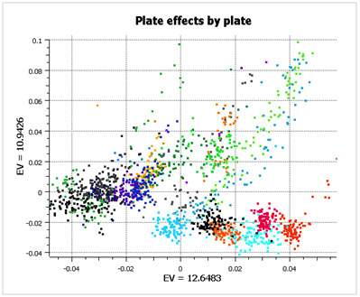
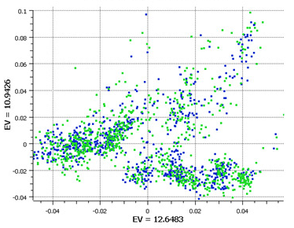
Randomised Block Design
Good design example: Alzheimer’s study from GlaxoSmithKline
Plate effects by plate
Plate effects by case/control
Left PCA plot show large plate effects.
Each colour corresponds to a different plate
Right PCA plot shows each plate cluster
contains equal proportions of
cases (blue) and controls (green).
http://blog.goldenhelix.com/?p=322

Slide 26
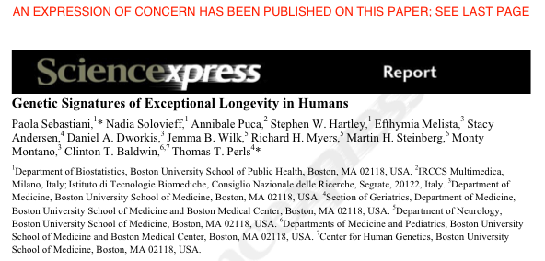
GWAS study: 800 centenarians vs. controls
Found 150 SNPs predicting centenarians with 77 % accuracy
Problem: they used different SNP chips for centenarians and controls
Retracted in 2011 following independent review and QC of data
http://www.the-scientist.com/blog/display/57558/

Slide 27
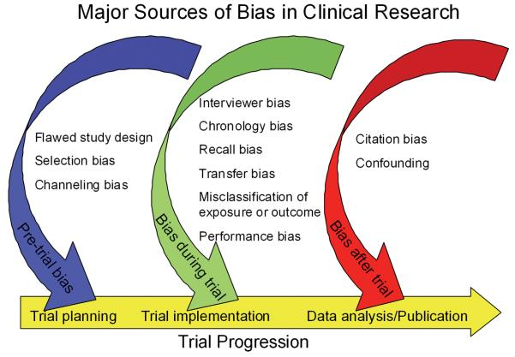
Bias errors
BIAS: Systematic Error in design/implementation of study
Selection bias: Error in selecting the samples/enrolling the patients
Measurement bias: Error in collecting data
How to deal with bias?
Randomization
Blinding
Pannucci CJ et al. Plast Reconstr Surg. 2010

Slide 28
Random errors
Random ERRORS Deviate from the truth without specific direction
Can not be avoided but can be reduced by repeated experiments.
Can also be reduced by using precise apparatus
Can be reduced by increasing the number of replicates

Slide 29
Experimental Controls
29

Slide 30
Experimental Controls
Controlling errors
Type I: False Positives (reject true H0)
Use Negative controls: A group that should have minimal or no effect
Type II: False Negative (fail to reject a false H0)
Use Positive controls: A group where known response expected
Technical controls
Detect/correct technical biases
Normalise measurements (quantification) e.g. spike-ins

Slide 31
Examples of Experimental Controls
Wild-type organism (knockouts)
Inactive siRNA (silencing)
Vehicle (treatments)
Input: fragmented chromatin (ChIP)
Spike-ins (quantification/normalisation)
“Gold standard” datapoints
Multi-level controls
e.g. contrast Vehicle/Input vs. Treatment/Input

Slide 32
Design Parameters for Sequencing Experiments
32

Slide 33
Design Issues: Sequencing Experiments
Platforms
Library preps
Multiplexing and pooling strategies
Single-end vs paired end
Sequencing depth
Coverage
Lanes
Validation
Knock-downs
Pull-downs

Slide 34
Experimental Design process at CRUK-CI
34

Slide 35
CRUK-CI Experimental Design Process
Students required to take (this) Experimental Design class
All sequencing and proteomics experiments require experimental design review meeting
Simple form with key aspects of experiment
Attended by Scientists, Genomics/Proteomics Core, Bioinformatics Core, Statistician
Project opened in LIMS afterwards
Randomisation and Layouts
Checkpoint for experiment
Project cleared for sample submission
Keys:
Form and meeting not difficult
(Currently) not chargeable
Scientists agree process improves experiments!

Slide 36
Experimental Design Meetings - Genomics
Wednesday 30 min slots (2:00-3:00pm) with Bioinformatics Genomics/ Cores
Requirements:
Email CRIExperimentalDesign@cruk.cam.ac.uk to request meeting
Fill in Experimental Design Form and return at least couple of days before meeting
Your attendance
Provide project background (a few slides from you)
Discussion:
Planning, time-scale, cost, aims, scope, questions
Choosing the correct technology
Effect size & Sample-size calculation?
Sample collection and processing methods
Sample information (meta-data) collection
Randomisation, Blocking and Replication issues
Technical issues e.g. what sequencing depth?
Will Bioinformatics Core help with/do analysis?
Analysis deliverables

Slide 37
Experimental Design Meetings - Proteomics
- Friday 45 min slots (10-11:30am) ) with Bioinformatics proteomics Cores
Requirements:
For proteomics EDMs: Email ProteomicsProjectDesign@cruk.cam.ac.uk to request meeting
Provide project background (a few slides from you)
Discussion:
Planning, time-scale, cost, aims, scope, questions
Choosing the correct technology
Sample collection and processing methods
Sample information (meta-data) collection
Randomisation, Blocking and Replication issues
Will Bioinformatics Core help with/do analysis?
Analysis deliverables

Slide 38
Experimental Design Guide
https://sharepoint.cri.camres.org/sites/bioinformatics/Public/InroductionToExperimentalDesign/ExperimentalDesignManual.pdf
tinyurl.com/cruk-edesign

Slide 39
Practicals
Genomic/Clinical: Identification of prognostic biomarkers in human prostate cancer patients (Stéphane)
RNA-seq/Animal: Effects of mutant vs wildtype HHEX in liver and brain development (Abbi/Ash)
Quantitative Proteomics/Cultured Cells: AR interactome differences between drug responsive/resistant conditions (Kamal/Mark)
ChIP-seq/Animal: Evolution of transcription factor binding in mouse strains (Chandu/Ash)

