Slide 1

INTRODUCTION TO EXPERIMENTAL DESIGN AT CRUK-CI
Chandra CHilamakuri
Kamal kishore
Jing Su
Rory Stark
29 october 2018
tinyurl.com/cruk-edesign

Slide 2

Agenda
Why perform experiments?
What makes for a well designed experiment?
Key Aspects of experimental design
Experimental variables
Power: variance and replicates
Bias: confounding factors, randomisation, and controls
Design parameters
Experimental design process at CRUK-CI
practicals

Slide 3
Why Perform Experiments?

Slide 4

Reproducible Research
4

Slide 5
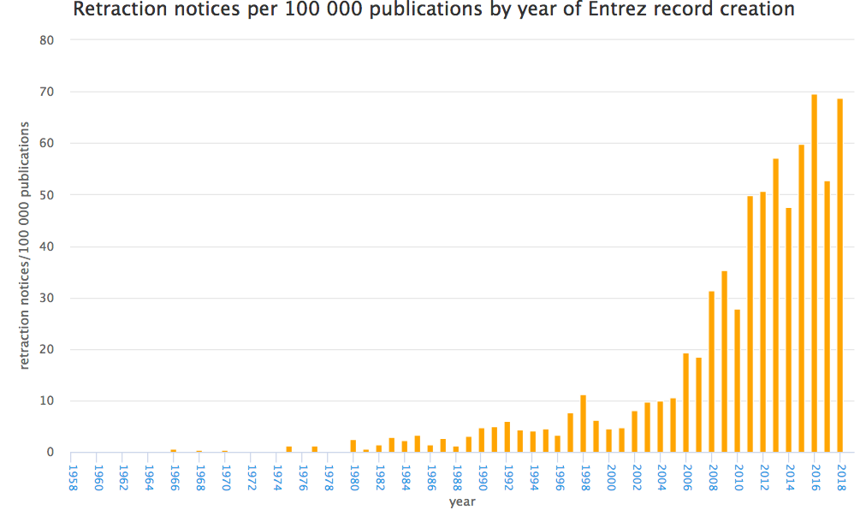
Crisis in Reproducible Research
http://neilfws.github.io/PubMed/pmretract/pmretract.html

Slide 6
47 of 53 high-profile cancer studies were not reproducible!

Slide 7
Need for Good Design
7

Slide 8
Consequences of Poor Experimental Design…
Cost of experimentation. We have a responsibility to CRUK donors!
Limited & Precious material, esp. clinical samples.
Immortalization of data sets in public databases and methods in the literature. Our bad science begets more bad science.
Ethical concerns of experimentation: animals and clinical samples.

Slide 9
A Well-Designed Experiment:
Should have
Clear objectives
Focus and simplicity
Sufficient power
Randomised comparisons
And be
Precise
Unbiased
Amenable to statistical analysis
Reproducible

Slide 10
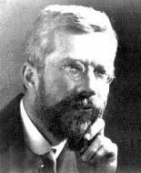
Ronald A. Fisher(1890-1962)
“To consult the statistician after an experiment is finished is often merely to ask him to conduct a post mortem examination. He can perhaps say what the experiment died of.”
“… VERY OFTEN, … THE MOST ELABORATE STATISTICAL REFINEMENTS POSSIBLE COULD INCREASE THE PRECISION BY ONLY A FEW PERCENT, YET A DIFFERENT DESIGN INVOLVING LITTLE OR NO ADDITIONAL EXPERIMENTAL LABOUR MIGHT INCREASE THE PRECISION TWO-FOLD, OR FIVE-FOLD OR EVEN MORE."

Slide 11
Aspects of Experimental Design
Experimental FACTORS
Power
Sources of Variance
Replicates
Bias
Confounding factors
Randomisation wherever a decision is to be made
Controls for both measured and unmeasured factors
Controls
Notes:
Might want to say randomisation for treatment allocation, extraction batches and orders, plate layout, library pools, lanes on a flow cell, flow cell run etc etc etc.

Slide 12
Experimental Factors
12

Slide 13
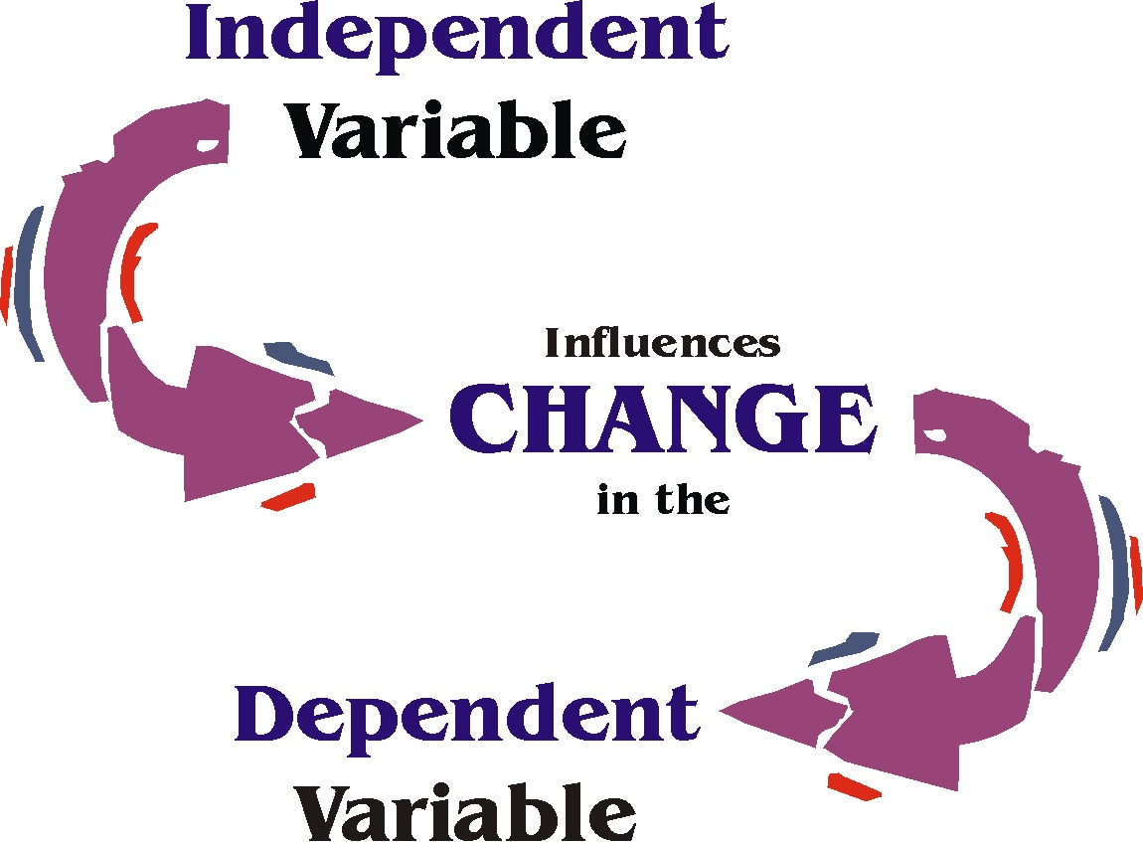
Experimental Factors
Factors: aspects of experiment that change and influence the outcome of the experiment
e.g. time, weight, drug, gender, ethnicity, country, plate, cage etc.
Variable type depends on type of measurement:
Categorical (nominal) , e.g. gender
Categorical with ordering (ordinal), e.g. tumour grade
Discrete, e.g. shoe size, number of cells
Continuous, e.g. body weight in kg, height in cm
Independent and Dependent variables
Independent variable (IV): what you change
Dependent variable (DV): what changes due to IV
“If (independent variable), then (dependent variable)”
Notes:
Might want to say here experiments have factors and data has variables, so gender could be a factor in the experiment and a variable in the data or data analysis.

Slide 14
Capturing Variance
14

Slide 15
Sources of Variation
Biological “noise”
Biological processes are inherently stochastic
Single cells, cell populations, individuals, organs, species….
Timepoints, cell cycle, synchronized vs. unsynchronized
Technical noise
Reagents, antibodies, temperatures, pollution
Platforms, runs, operators
Consider in advance and control
Replication required to capture variance

Slide 16
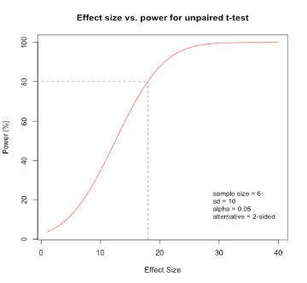

Sample size and experimental power
Why do you need replicates?
Calculating appropriate sample sizes
Power calculations
Planning for precision
Resource equation
EXPERIMENTAL POWER
Power: the probability of detecting an effect of a specified size if present.
Identify and control the sources of variability
Power calculations estimate sample size required to detect an effect if degree of variability is known
Using appropriate numbers of samples (sample size/replicates)
If adding samples increases variability, that alone won’t add power!

Slide 17
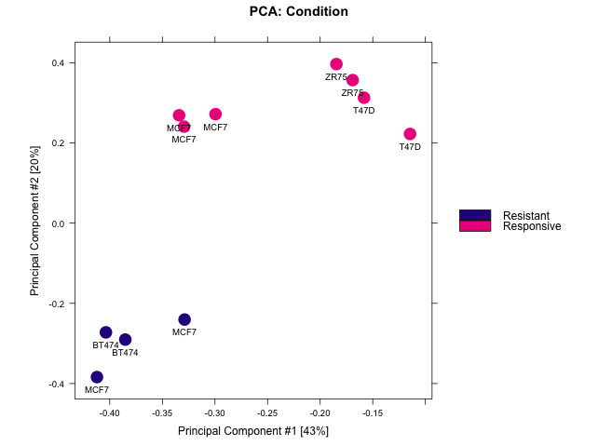
Types of Replication
Biological replication:
In vivo:
Patients
Mice
In vitro:
Different cell lines
Re-growing cells (passages)
Technical replication:
Experimental protocol
Measurement platform (i.e. sequencer)

Slide 18
Precision, Accuracy, Confounders, and Bias
18

Slide 19
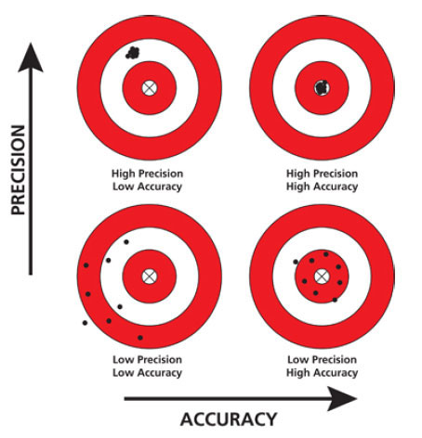
Precision and Accuracy

Slide 20
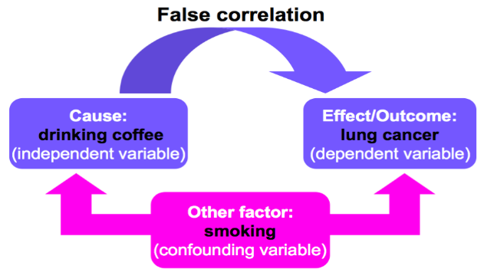
Confounding Factors
Also known as extraneous, hidden, lurking or masking factors,
or the third variable or mediator variable.
May mask an actual association or falsely demonstrate an apparent association between the independent & dependent variables.
Hypothetical Example would be a study of coffee drinking and lung cancer.
False association

Slide 21
Confounding Factors
Other examples:
Democrats were less satisfied with their sex lives than Republicans.
(ABC poll report).
Overweight (not obese) people have longer life expectancy than thin people
(US Centre for Disease Control).

Slide 22
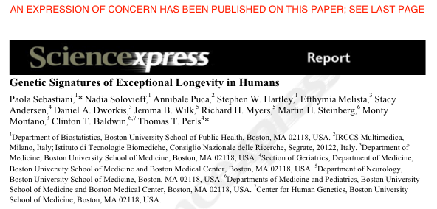
GWAS study: 800 centenarians vs. controls
Found 150 SNPs predicting centenarians with 77 % accuracy
Problem: they used different SNP chips for centenarians and controls
Retracted in 2011 following independent review and QC of data
http://www.the-scientist.com/blog/display/57558/

Slide 23
Solutions
Consider alternative explanations
Control technical effects:
Randomisation
Statistical analyses assume randomised comparisons
May not see issues caused by non-randomised comparisons
Make every decision random not arbitrary
Caveat: over-randomization can increase error
Blinding
Especially important where subjective measurements are taken
Potentially multiple degrees of blinding (eg. double-blinding)

Slide 24
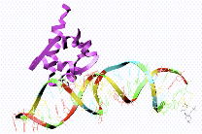
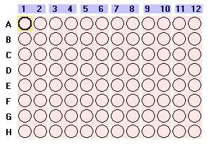
Technical Confounding Factors: Batch Effects
RNA Extraction
Day1, Plate 1
Day2, Plate 2
Day3, Plate 3
Control
Treatment 1
Treatment 2
The difference between Control, Treatment 1
and Treatment 2 is confounded by day and plate.

Slide 25
Randomised Block Design
Blocking is the arranging of experimental units in groups (blocks) that are similar to one another.
RBD across plates so that each plate contains spatially randomised equal proportions of:
Control
Treatment 1
Treatment 2
controlling plate effects.
Control
Treatment 1
Treatment 2
Plate 1
Plate 2
Plate 3
Plate 1
Plate 2
Plate 3
✔
✗
Notes:
25

Slide 26
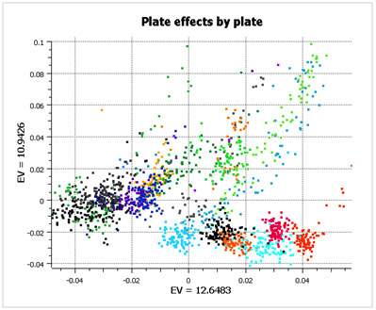
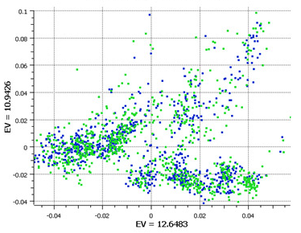
Randomised Block Design
Good design example: Alzheimer’s study from GlaxoSmithKline
Plate effects by plate
Plate effects by case/control
Left PCA plot show large plate effects.
Each colour corresponds to a different plate
Right PCA plot shows each plate cluster
contains equal proportions of
cases (blue) and controls (green).
http://blog.goldenhelix.com/?p=322
c

Slide 27
Experimental Controls
27

Slide 28
Experimental Controls
Controlling errors
Type I: FP
Negative controls: should have minimal or no effect
Type II: FN
Positive controls: known effect
Technical controls
Detect/correct technical biases
Normalise measurements (quantification)

Slide 29
Examples of Experimental Controls
Wild-type organism (knockouts)
Inactive siRNA (silencing)
Vehicle (treatments)
Input: fragmented chromatin (ChIP)
Spike-ins (quantification/normalisation)
“Gold standard” datapoints
Multi-level controls
e.g. contrast Vehicle/Input vs. Treatment/Input

Slide 30
Design Parameters for Sequencing Experiments
30

Slide 31
Design Issues: Sequencing Experiments
Platforms
Library preps
Multiplexing and pooling strategies
Single-end vs paired end
Sequencing depth
Coverage
Lanes
Validation
Knock-downs
Pull-downs

Slide 32
Experimental Design process at CRUK-CI
32

Slide 33
CRUK-CI Experimental Design Process
Students required to take (this) Experimental Design class
All sequencing and proteomics experiments require experimental design review meeting
Simple form with key aspects of experiment
Attended by Scientists, Genomics/Proteomics Core, Bioinformatics Core, Statistician
Project opened in LIMS afterwards
Randomisation and Layouts
Checkpoint for experiment
Project cleared for sample submission
Keys:
Form and meeting not onerous
(Currently) not chargeable
Scientists agree process improves experiments!

Slide 34
Experimental Design Meetings - Genomics
Tuesday 30 min slots (2:00-3:00pm) with Bioinformatics Genomics/proteomics Cores
Requirements:
Email CRIExperimentalDesign@cruk.cam.ac.uk to request meeting
Fill in Experimental Design Form and return 1 week prior to meeting
Your attendance
Provide project background (a few slides from you)
Discussion:
Planning, time-scale, cost, aims, scope, questions
Choosing the correct technology
Effect size & Sample-size calculation?
Sample collection and processing methods
Sample information (meta-data) collection
Randomisation, Blocking and Replication issues
Technical issues e.g. what sequencing depth?
Will Bioinformatics Core help with/do analysis?
Analysis deliverables

Slide 35
Experimental Design Meetings - Proteomics
Tuesday 30 min slots (2:00-3:00pm) with Bioinformatics Genomics/proteomics Cores
Requirements:
Email ProteomicsProjectDesign@cruk.cam.ac.uk to request meeting
Fill in ProteomicsMetadataTemplate.xls Your attendance
Provide project background (a few slides from you)
Discussion:
Planning, time-scale, cost, aims, scope, questions
Choosing the correct technology
Effect size & Sample-size calculation?
Sample collection and processing methods
Sample information (meta-data) collection
Randomisation, Blocking and Replication issues
Technical issues e.g. what sequencing depth?
Will Bioinformatics Core help with/do analysis?
Analysis deliverables

Slide 36
Experimental Design Guide
https://sharepoint.cri.camres.org/sites/bioinformatics/Public/InroductionToExperimentalDesign/ExperimentalDesignManual.pdf
tinyurl.com/cruk-edesign

Slide 37
Practicals
Genomic/Clinical: Identification of prognostic biomarkers in human prostate cancer patients (Rory)
RNA-seq/Animal: Effects of mutant vs wildtype HHEX in liver and brain development (Jing)
ChIP-seq/Cultured Cells: Transcription factor binding divergence in mice (Chandu)
Quantitative Proteomics/Cultured Cells: AR interactome differences between drug responsive/resistant conditions (Kamal)

