Slide 1


INTRODUCTION TO EXPERIMENTAL DESIGN AT CRUK-CI
Chandra Chilamakuri Abbi Edwards
Kamal Kishore ash sawle
Rory Stark
31 October 2022
tinyurl.com/cruk-edesign

Slide 2

Agenda
Why perform experiments?
What makes for a well designed experiment?
Key Aspects of experimental design
Experimental variables
Power: variance and replicates
Bias: confounding factors, randomisation, and controls
Design parameters
Experimental design process at CRUK-CI
Breakout sessions: practicals

Slide 3
Why Perform Experiments?
Because my supervisor told me to
Because they did it in this other paper
Because we got a cool new piece of tech and I want to try it out
Because I don’t know what else to do
To get evidence (hopefully) supporting a hypothesis

Slide 4


Reproducible Research
4

Slide 5
47 of 53 high-profile cancer studies were not reproducible!

Slide 6
Need for Good Design
6

Slide 7
Consequences of Poor Experimental Design…
Cost of experimentation. We have a responsibility to CRUK donors!
Limited & Precious material, esp. clinical samples.
Immortalization of data sets in public databases and methods in the literature. Our bad science begets more bad science.
Ethical concerns of experimentation: animals and clinical samples.
Time and career of individuals.

Slide 8
Statistical Aspects of Experimental Design
8

Slide 9
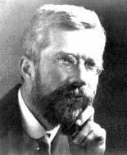
Ronald A. Fisher(1890-1962)
“To consult the statistician after an experiment is finished is often merely to ask him to conduct a post mortem examination. He can perhaps say what the experiment died of.”
“… VERY OFTEN, … THE MOST ELABORATE STATISTICAL REFINEMENTS POSSIBLE COULD INCREASE THE PRECISION BY ONLY A FEW PERCENT, YET A DIFFERENT DESIGN INVOLVING LITTLE OR NO ADDITIONAL EXPERIMENTAL LABOUR MIGHT INCREASE THE PRECISION TWO-FOLD, OR FIVE-FOLD OR EVEN MORE."

Slide 10
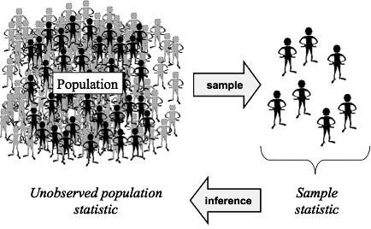
Central Dogma of Parametric Statistics
Data follow a distribution
Important parameters
Mean
Variance
Population parameters unknown
Estimated using sampling
Parameters estimated from samples used for inferring population parameters

Slide 11
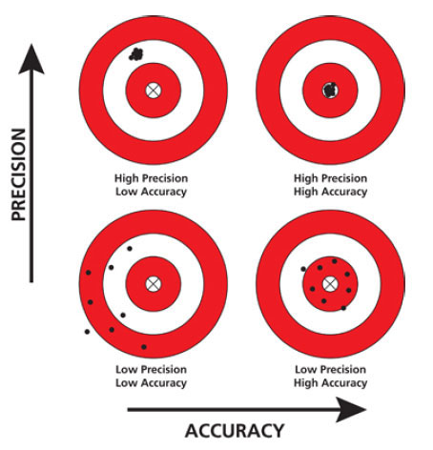
Precision and Accuracy

Slide 12
Aspects of Experimental Design
Experimental FACTORS
Power
Sources of Variance
Replicates
Errors
Confounding factors
Bias
Random errors
Notes:
Might want to say randomisation for treatment allocation, extraction batches and orders, plate layout, library pools, lanes on a flow cell, flow cell run etc etc etc.

Slide 13
Experimental Factors
13

Slide 14
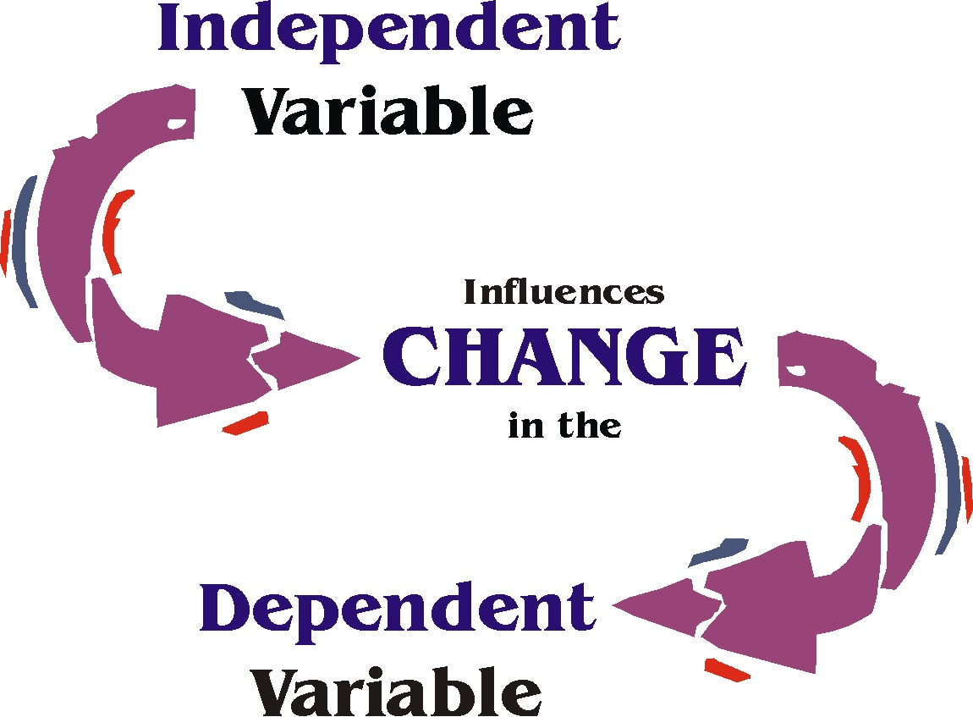
Experimental Factors
Independent and Dependent variables
Independent variable (IV): what you change
Dependent variable (DV): what changes due to IV
“If (independent variable), then (dependent variable)”
Variable type depends on type of measurement:
Categorical (nominal) , e.g. gender
Categorical with ordering (ordinal), e.g. tumour grade
Discrete, e.g. shoe size, number of cells
Continuous, e.g. body weight in kg, height in cm
Notes:
Might want to say here experiments have factors and data has variables, so gender could be a factor in the experiment and a variable in the data or data analysis.

Slide 15
Power: Charactertising Variance using Replication
15

Slide 16
Sources of Variance
Total Variance
Biological variance
Stochastic in nature
Technical variance
Like using different instruments
Sample processing in batches
Treatment variance
Captures the effect of treatment
Biological variance
Total Variance
Treatment variance
Technical variance

Slide 17
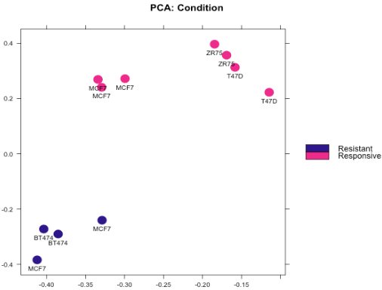
Types of Replication
Biological replication:
In vivo:
Patients
Mice
In vitro:
Different cell lines
Re-growing cells (passages)
Technical replication:
Experimental protocol
Measurement platform (i.e. sequencer)

Slide 18
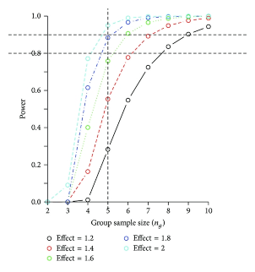

Sample size and experimental power
Why do you need replicates?
Calculating appropriate sample sizes
Power calculations
Planning for precision
Resource equation
EXPERIMENTAL POWER
Power: Probability of detecting an effect, if there is a true effect present to detect.
Statistical power increases with …
Higher sample sizes
Higher effect size
Low variance
Higher alpha values
HPB Surg. 2014;2014:310372.

Slide 19
Bias: Counfounders, Randomisation, and Controls
19

Slide 20
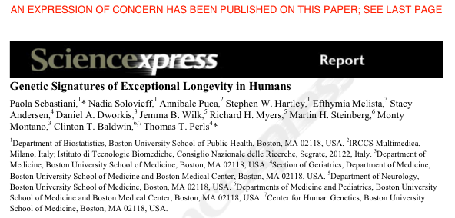
GWAS study: 800 centenarians vs. controls
Found 150 SNPs predicting centenarians with 77 % accuracy
Problem: they used different SNP chips for centenarians and controls
Retracted following independent review and QC of data
http://www.the-scientist.com/blog/display/57558/

Slide 21
Confounding Factors
What could account for these findings?
Democrats were less satisfied with their sex lives than Republicans.
(ABC poll report)
Overweight people have longer life expectancy than thin people
(US Centre for Disease Control)

Slide 22
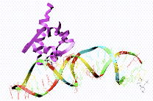
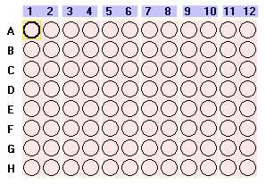
Technical Confounding Factors: Batch Effects
RNA Extraction
Day1, Plate 1
Day2, Plate 2
Day3, Plate 3
Control
Treatment 1
Treatment 2
The difference between Control, Treatment 1
and Treatment 2 is confounded by day and plate.

Slide 23
Randomised Block Design
Blocking is the arranging of experimental units in groups (blocks) that are similar to one another.
RBD across plates so that each plate contains spatially randomised equal proportions of:
Control
Treatment 1
Treatment 2
controlling plate effects.
Control
Treatment 1
Treatment 2
Plate 1
Plate 2
Plate 3
Plate 1
Plate 2
Plate 3
✔
✗
Notes:
23

Slide 24
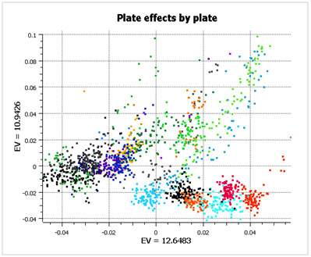
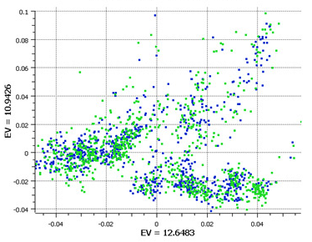
Randomised Block Design
Good design example: Alzheimer’s study from GlaxoSmithKline
Plate effects by plate
Plate effects by case/control
Left PCA plot show large plate effects.
Each colour corresponds to a different plate
Right PCA plot shows each plate cluster
contains equal proportions of
cases (blue) and controls (green).
http://blog.goldenhelix.com/?p=322

Slide 25
Experimental Controls
25

Slide 26
Experimental Controls
Controlling errors
Type I: False Positives (reject true H0)
Use Negative controls: A group that should have minimal or no effect
Type II: False Negative (fail to reject a false H0)
Use Positive controls: A group where known response expected
Technical controls
Detect/correct technical biases
Normalise measurements (quantification) e.g. spike-ins

Slide 27
Examples of Experimental Controls
Wild-type organism (knockouts)
Inactive siRNA (silencing)
Vehicle (treatments)
Input: fragmented chromatin (ChIP)
Spike-ins (quantification/normalisation)
“Gold standard” datapoints
Multi-level controls
e.g. contrast Vehicle/Input vs. Treatment/Input

Slide 28
Design Parameters for Sequencing Experiments
28

Slide 29
Design Issues: Sequencing Experiments
Platforms
Library preps
Multiplexing and pooling strategies
Single-end vs paired end
Sequencing depth
Coverage
Lanes
Validation
Knock-downs
Pull-downs

Slide 30
Experimental Design process at CRUK-CI
30

Slide 31
CRUK-CI Experimental Design Process
Students required to take (this) Experimental Design class
Experimental design review meetings for sequencing and proteomics experiments require
Simple form with key aspects of experiment
Attended by Scientists, Genomics/Proteomics Core, Bioinformatics Core, Statistician
Project opened in LIMS afterwards
Randomisation and Layouts
Checkpoint for experiment
Project cleared for sample submission
Keys:
Form and meeting not difficult
Not chargeable
Scientists agree process improves experiments!

Slide 32
Experimental Design Meetings - Genomics
Wednesday 30 min slots (2:00-3:00pm) with Bioinformatics Genomics/ Cores
Requirements:
Email CRIExperimentalDesign@cruk.cam.ac.uk to request meeting
Fill in Experimental Design Form and return at least couple of days before meeting
Your attendance
Provide project background (a few slides from you)
Discussion:
Planning, time-scale, cost, aims, scope, questions
Choosing the correct technology
Effect size & Sample-size calculation?
Sample collection and processing methods
Sample information (meta-data) collection
Randomisation, Blocking and Replication issues
Technical issues e.g. what sequencing depth?
Will Bioinformatics Core help with/do analysis?
Analysis deliverables

Slide 33
Experimental Design Meetings - Proteomics
- Friday 45 min slots (10-11:30am) ) with Bioinformatics proteomics Cores
Requirements:
Email ProteomicsProjectDesign@cruk.cam.ac.uk to request meeting
Provide project background (a few slides from you)
Discussion:
Planning, time-scale, cost, aims, scope, questions
Choosing the correct technology
Sample collection and processing methods
Sample information (meta-data) collection
Randomisation, Blocking and Replication issues
Will Bioinformatics Core help with/do analysis?
Analysis deliverables

Slide 34
Experimental Design Guide
https://sharepoint.cri.camres.org/sites/bioinformatics/Public/InroductionToExperimentalDesign/ExperimentalDesignManual.pdf
tinyurl.com/cruk-edesign

Slide 35
Practicals
Genomic/Clinical: Identification of prognostic biomarkers in human prostate cancer patients (Abbi)
RNA-seq/Animal: Effects of mutant vs wildtype HHEX in liver and brain development (Chandu)
Quantitative Proteomics/Cultured Cells: AR interactome differences between drug responsive/resistant conditions (Ash)
ChIP-seq/Animal: Evolution of transcription factor binding in mouse strains (Rory)

