Slide 1
INTRODUCTION TO EXPERIMENTAL DESIGN AT CRUK-CI 2016 Rory Stark Chandra Chilamakuri James Hadfield

Slide 2
Agenda
Why perform experiments?
Why think about experimental design?
What makes for a well designed experiment?
Aspects of experimental design
Experimental variables
Power: variance and replicates
Bias: confounding factors, randomisation, and controls
Experimental design at CRUK-CI

Slide 3
Why Perform Experiments?

Slide 4
Why Think About Experimental Design?

Slide 5
Consequence of Poor Experimental Design
Cost of experimentation
We have a responsibility to CRUK donors!
Limited & precious material
Especially clinical samples
Immortalization of data in public databases and methods in the literature
Our bad science begets more bad science
Ethical concerns with animals and patients

Slide 6
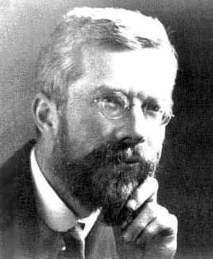
Ronald A. Fisher (1890-1962)
“To consult the statistician after an experiment is finished is often merely to ask him to conduct a post mortem examination. He can perhaps say what the experiment died of.” (1938)

Slide 7
47 of 53 high-profile cancer studies were not reproducible!

Slide 8
A Well-Designed Experiment
Should have
Clear objectives
Focus and simplicity
Sufficient number of replicates
Randomised comparisons
Should be
Precise
Unbiased
Amenable to statistical analysis
Reproducible

Slide 9
Aspects of Experimental Design
Factors are aspects of experiment that change and influence the outcome of the experiment e.g. time, weight, drug, gender, ethnicity, country, plate, cage etc. The independent variable is what you change and the dependent what is changed by the independent variables.
Experimental Factors
If independent variable then dependent variable
Sample size/number of replicates
Sources of Variance
Minimising Bias
Confounding factors
Randomisation wherever a decision is to be made
Controls for both measured and unmeasured factors
Controls
Notes:
Might want to say randomisation for treatment allocation, extraction batches and orders, plate layout, library pools, lanes on a flow cell, flow cell run etc etc etc.

Slide 10
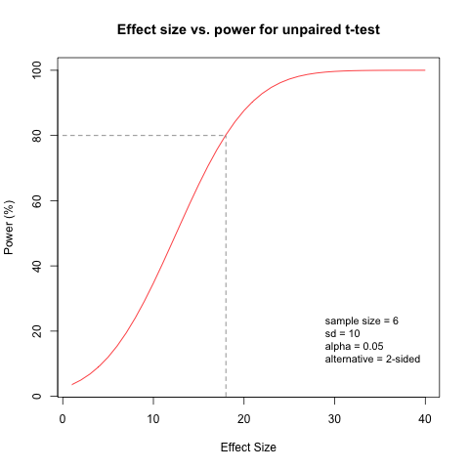
How Many Samples?
Although the most common way of calculating sample size, often there is insufficient information to perform a power calculation. An alternative is planning for precision, where the size of the confidence interval around the main result determines the sample size. This is often used in tests of diagnostic accuracy where the main result is sensitivity or specificity. In animal studies the resource equation is used, the determines the number of animals based on the number of degrees of freedom required for ANOVA after accounting for other factors.
Why are replicates needed?
How to calculate
Not just power calculations
Power is the probability of detecting a an effect size given that it exists in the population
Depends on variability, sample size, effect size, alternative hypothesis and the p-value cut-off
If adding samples adds variability this will not increase the power of the experiment

Slide 11
Sources of Variation
Biological “noise”
Biological processes are inherently stochastic
Single cells, cell populations, individuals, organs, species….
Timepoints, cell cycle, synchronized vs. unsynchronized
Technical noise
Reagents, antibodies, temperatures, pollution
Platforms, runs, operators
Consider in advance and control
Perhaps cut out some of the examples here and discuss types of replicate biological/experimental/technical as I think this is an important point currently missed.

Slide 12
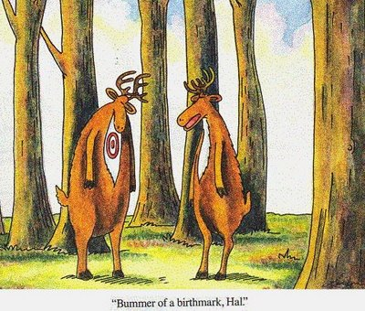
Precision, Accuracy & Bias
Accurate Biased
Mention here the description of different types of bias in the manual.
Think about the order that you present these 4.
Imprecise Precise

Slide 13
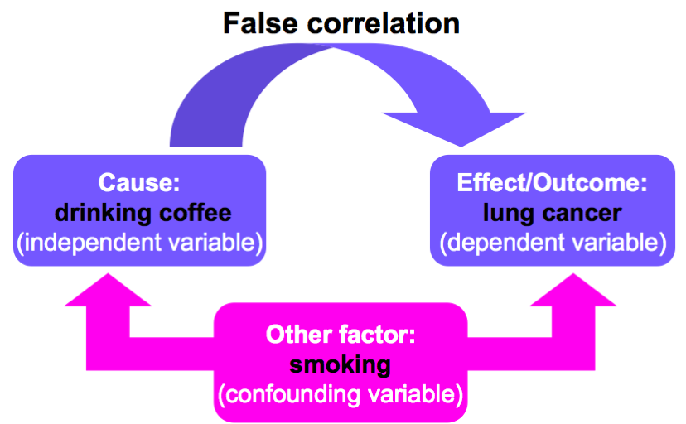
Confounding Factors
Extraneous/hidden/lurking/masking factors
Third variable or mediator variable
May mask an association or falsely demonstrate one
False association

Slide 14
Confounding Factors
Other examples:
Democrats were less satisfied with their sex lives than republicans
(ABC poll report)
Slightly overweight people live longer than thin people
(US Centre for Disease Control)
Inadequate monitoring/management of confounders
Common reason for wrongly assuming causality
When reading studies consider which confounders could have caused the association

Slide 15
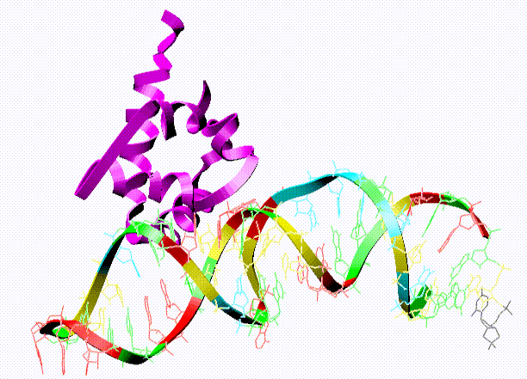
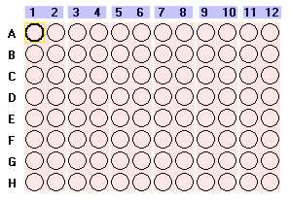
Technical Confounding Factors: Batch Effects
RNA Extraction
Day1, Plate 1
Day2, Plate 2
Day3, Plate 3
Control
Treatment 1
Treatment 2
The difference between Control, Treatment 1
and Treatment 2 is confounded by day and plate.

Slide 16
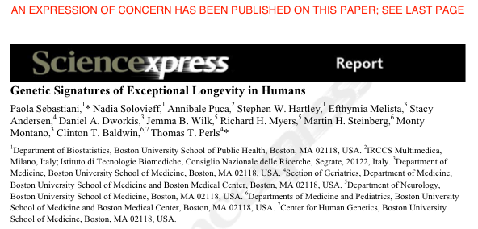
GWAS study: 800 centenarians vs. controls
Found 150 SNPs predicting centenarians with 77 % accuracy
Problem: they used different SNP chips for centenarians and controls
Retracted in 2011 following independent review and QC of data
http://www.the-scientist.com/blog/display/57558/

Slide 17
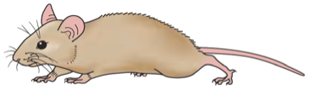



Litter Effects
In a recent experimental design meeting, we had settled on the design when it was mentioned in passing that all the wildtype mice were from litter 1 and the mutant mice were from litter 2. This is a bad design as litter is totally confounded with mouse type. So it is unclear if you are testing the effect of mutant gene or of litter.
Ideally the wildtype and mutants would be crossbred and pups paired by litter to control for litter effects would be included. This was thought to be too time consuming and waste too many animals.
As a compromise it was decided to include as many litters as possible, so that any quirk of one litter should be removed as it would not be present for all litters, so findings should be more robust.
This is not the ideal experiment but pragmatically is the best solution given the constraints.
Wildtype
Mutant
Litter 1
Litter 2

Slide 18
Solutions
Statistical theory assumes that you have randomised comparisons. You should randomise the subjects to the thing that you are going to compare. eg looking at treatment effect subjects should be randomised to treatment or control. One of the reasons that this is often not carried out is because the effects of non-randomised comparisons may not be evident, except that results do not validate due to unknown, unmeasured biases, but this would not be linked to lack of a randomised comparison so there is no potential to learn from the mistake. Wherever a decision is to be made it should be made randomly (truly random e.g. with random number generator) rather than arbitrarily.
Randomisation
Statistical analysis assume randomised comparisons
May not see issued caused by non-randomised comparisons
Make every decision random not arbitrary
Blinding
Especially important where subjective measurements are taken
Every experiment should reach its potential degree of blinding
Blinding is where one or more members of the experimental team are unaware of group allocation. This is especially important where subjective measurements are being made. In some cases it is not possible to blind, so each experiment should reach its potential degree of blinding. Treatment allocation should be concealed all the way through and only unbroken if there is cause for concern or when the analysis has been carried out.

Slide 19
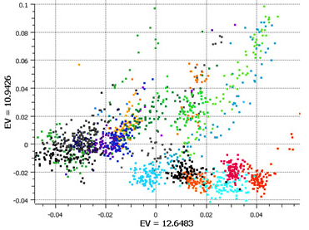
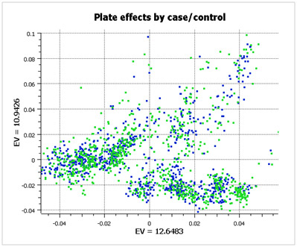
Randomised Block Design
Good design example: Alzheimer’s study from GSK
Plate effects by plate
Plate effects by case/control
Left PCA plot show large plate effects.
Each colour corresponds to a different plate
Right PCA plot shows each plate cluster
contains equal proportions of
cases (blue) and controls (green).
http://blog.goldenhelix.com/?p=322
c

Slide 20
Experimental Controls
Technical controls detect or correct bias, can be used in the normalisation process.
Negative controls, things that you don’t expect to change, minimal or no change, control false positive rate or type I error rate. Positive controls, known effect, often large, used to control false negatives, type II error rate
Detect or correct bias, negative, positive
Examples:
Wild-type organism (knockouts)
Inactive siRNA (silencing)
Vehicle (treatments)
Input: fragmented chromatin (ChIP)
Spike-ins (quantification/normalisation)
“Gold standard” datapoints
Multi-level controls
contrast Vehicle/Input vs. Treatment/Input

Slide 21
Design Issues: Sequencing Experiments
Platforms (MiSeq, HiSeq, etc.)
Library preps
Multiplexing and pooling strategies
Single-end vs paired end
Sequencing depth
Coverage
Lanes
Validation
Don’t think that this slide is necessary either

Slide 22
Summary
Experimental design is very important
Things that go wrong here may not be fixable
Important things to consider
Question to be answered
Randomised comparisons
Confounding
Bias
Sample size
Reproducibility

Slide 23
CRI Experimental Design Meetings
Tuesday 30 min slots (2:00-3:00pm) with Bioinformatics & Genomics Cores
Requirements:
Email CRIExperimentalDesign@cruk.cam.ac.uk to request meeting
Fill in Experimental Design Form and return 1 week prior to meeting
Your attendance
Provide project background (a few slides from you)
Discussion:
Planning, time-scale, cost, aims, scope, questions
Choosing the correct technology
Technical issues e.g. what sequencing depth?
Sample collection and processing methods
Sample information (meta-data) collection
Randomisation, Blocking and Replication issues
Analyst?
Pilot study?
Effect size & Sample-size calculation?

Slide 24
Experimental Design Guide
https://sharepoint.cri.camres.org/sites/bioinformatics/Public/InroductionToExperimentalDesign/ExperimentalDesignManual.pdf

Slide 25
Practicals
Clinical: Identification of prognostic biomarkers in human prostate cancer patients (Sarah)
Animal: Effects of mutant vs wildtype HHEX in liver and brain development (Chandu)
RNA-seq: effect of silencing a transcription factor on gene expression in a breast cancer cell line (Rory)
ChIP-seq: Transcription factor binding divergence in mice (James)

