Slide 1


CRUK CI HPC cluster introduction
(II of III)
Using the scheduler for job submission

Slide 2
SLURM will allow you to:
Submit jobs to the cluster.
Specify which queue/account to submit your jobs to.
Request memory resources for your jobs.
Set memory limits for your jobs.
Set time limits for your jobs
Check the status of the jobs you have submitted.
Check the status of the hosts within the cluster.
Kill jobs that you have submitted to the cluster.
The most useful SLURM commands
These are:
srun
sbatch
sacct
squeue
scancel
Type command followed by -h for usage details.

Slide 3
Usage: srun [OPTIONS...] executable [args...]
Parallel run options:
-A, --account=name charge job to specified account
--acctg-freq=<datatype>=<interval> accounting and profiling sampling
intervals. Supported datatypes:
task=<interval> energy=<interval>
network=<interval> filesystem=<interval>
…
Help options:
-h, --help show this help message
--usage display brief usage message
Other options:
-V, --version output version information and exit

Slide 4
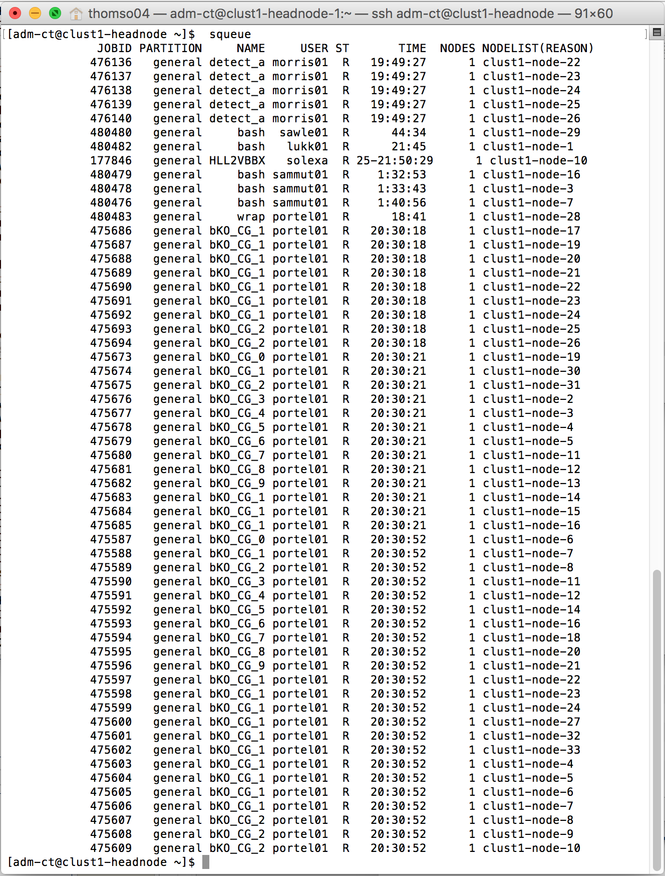
A Job
A command or series of commands submitted to the cluster with associated resource requirements and limits.
Status of jobs running on the cluster can be seen with the command
clust1-headnode $ squeue

Slide 5
Output from SLURM
clust1-headnode > squeue
[obrien04@clust1-headnode ~]$ squeue
JOBID PARTITION NAME USER ST TIME NODES NODELIST(REASON)
427309 general RK307bam lukk01 PD 0:00 1 (Dependency)
427311 general RK309bam lukk01 PD 0:00 1 (Dependency)
…
436869 general mutect2. wan01 R 4:25:25 1 clust1-node-16

Slide 6
A Queue:
A queue for job submissions associated with specified users and cluster hosts, and
providing specified default resources.
SLURM calls queues ‘partitions.’
We have a single general ‘partition’, with few restrictions (currently).

Slide 7
Checking the status of hosts within the cluster
SLURM
Clust1-headnode > sinfo
[obrien04@clust1-headnode ~]$ sinfo
PARTITION AVAIL TIMELIMIT NODES STATE NODELIST
general* up infinite 15 mix clust1-node-[1-7,9,12-16,18,21]
general* up infinite 18 idle clust1-node-[8,10-11,17,19-20,22-33]

Slide 8
Killing jobs with scancel
clust1-headnode $ scancel <job-id>

Slide 9

Simple Parallel Computing
Most HPC at CRI consists of breaking up your
dataset into chunks and firing off a separate job
for each chunk.
‘ Magnetisation Transfer Map Example
Here small groups of pixels from T2 weighted image slices are processed to calculate the elements of the MT map.’
(Example courtesy of Dominick McIntyre, Griffiths Group)

Slide 10
Job dependency
SLURM allows many different ways to express dependencies, using the
--dependency switch
Some SLURM dependencies:
after:job_id[:jobid...]
This job can begin execution after the specified jobs have begun execution.
afterany:job_id[:jobid...]
This job can begin execution after the specified jobs have terminated.
afterok:job_id[:jobid...]
This job can begin execution after the specified jobs have successfully executed (ran to completion with an exit code of zero).
[clust1-headnode ~] $ sbatch job1.sh
11254323
[clust1-headnode ~] $ sbatch --dependency=afterok:11254323 job2.sh

Slide 11
Practical session II

