Slide 1


CRUK CI HPC cluster introduction
(II of III)
Using the scheduler for job submission

Slide 2
SLURM will allow you to:
Submit jobs to the cluster.
Specify which queue/account to submit your jobs to.
Request memory resources for your jobs.
Set memory limits for your jobs.
Set time limits for your jobs
Check the status of the jobs you have submitted.
Check the status of the hosts within the cluster.
Kill jobs that you have submitted to the cluster.
The most useful SLURM commands
These are:
sinfo
squeue
sbatch
scancel
salloc
srun
scontrol
sstat
sacct
sacctmgr
Type command followed by -h for usage details.
Notes:
https://www.dkrz.de/up/systems/mistral/running-jobs/slurm-introduction
sinfo show information about all partitions and nodes managed by SLURM as well as about general system state. It has a wide variety of filtering, sorting, and formatting options.
squeue query the list of pending and running jobs. By default it reports the list of pending jobs sorted by priority and the list of running jobs sorted separately according to the job priority. The most relevant job states are running (R), pending (PD), completing (CG), completed (CD) and cancelled (CA). The TIME field shows the actual job execution time. The NODELIST (REASON) field indicates on which nodes the job is running or the reason why the job is pending. Typical reasons for pending jobs are waiting for resources to become available (Resources) and queuing behind a job with higher priority (Priority).
sbatch submit a batch script. The script will be executed on the first node of the allocation. The working directory coincides with the working directory of the sbatch directory. Within the script one or multiple srun commands can be used to create job steps and execute parallel applications.
scancel cancel a pending or running job or job step. It can also be used to send an arbitrary signal to all processes associated with a running job or job step.
salloc request interactive jobs/allocations. When the job is started a shell (or other program specified on the command line) is started on the submission host (login node). From this shell you should use srun to interactively start a parallel applications. The allocation is released when the user exits the shell.
srun initiate parallel job steps within a job or start an interactive job.
scontrol (primarily used by the administrators) provides some functionality for the users to manage jobs or get some information about the system configuration such as nodes, partitions, jobs, and configurations.
sstat query near-realtime status information related to CPU, task, node, RSS and virtual memory for a running job.
sacct retrieve accounting information about jobs and job steps. For completed jobs sacct queries the accounting database.
sacctmgr (primarily used by the administrators) query information about accounts and other accounting information.

Slide 3
man <COMMAND>
<COMMAND> --usage, lists options
<COMMAND> --help, explain options
Usage: srun [OPTIONS...] executable [args...]
Parallel run options:
-A, --account=name charge job to specified account
--acctg-freq=<datatype>=<interval> accounting and profiling sampling
intervals. Supported datatypes:
task=<interval> energy=<interval>
network=<interval> filesystem=<interval>
…
Help options:
-h, --help show this help message
--usage display brief usage message
Other options:
-V, --version output version information and exit
SLURM documentation: https://slurm.schedmd.com/
SLURM summary: https://slurm.schedmd.com/pdfs/summary.pdf

Slide 4
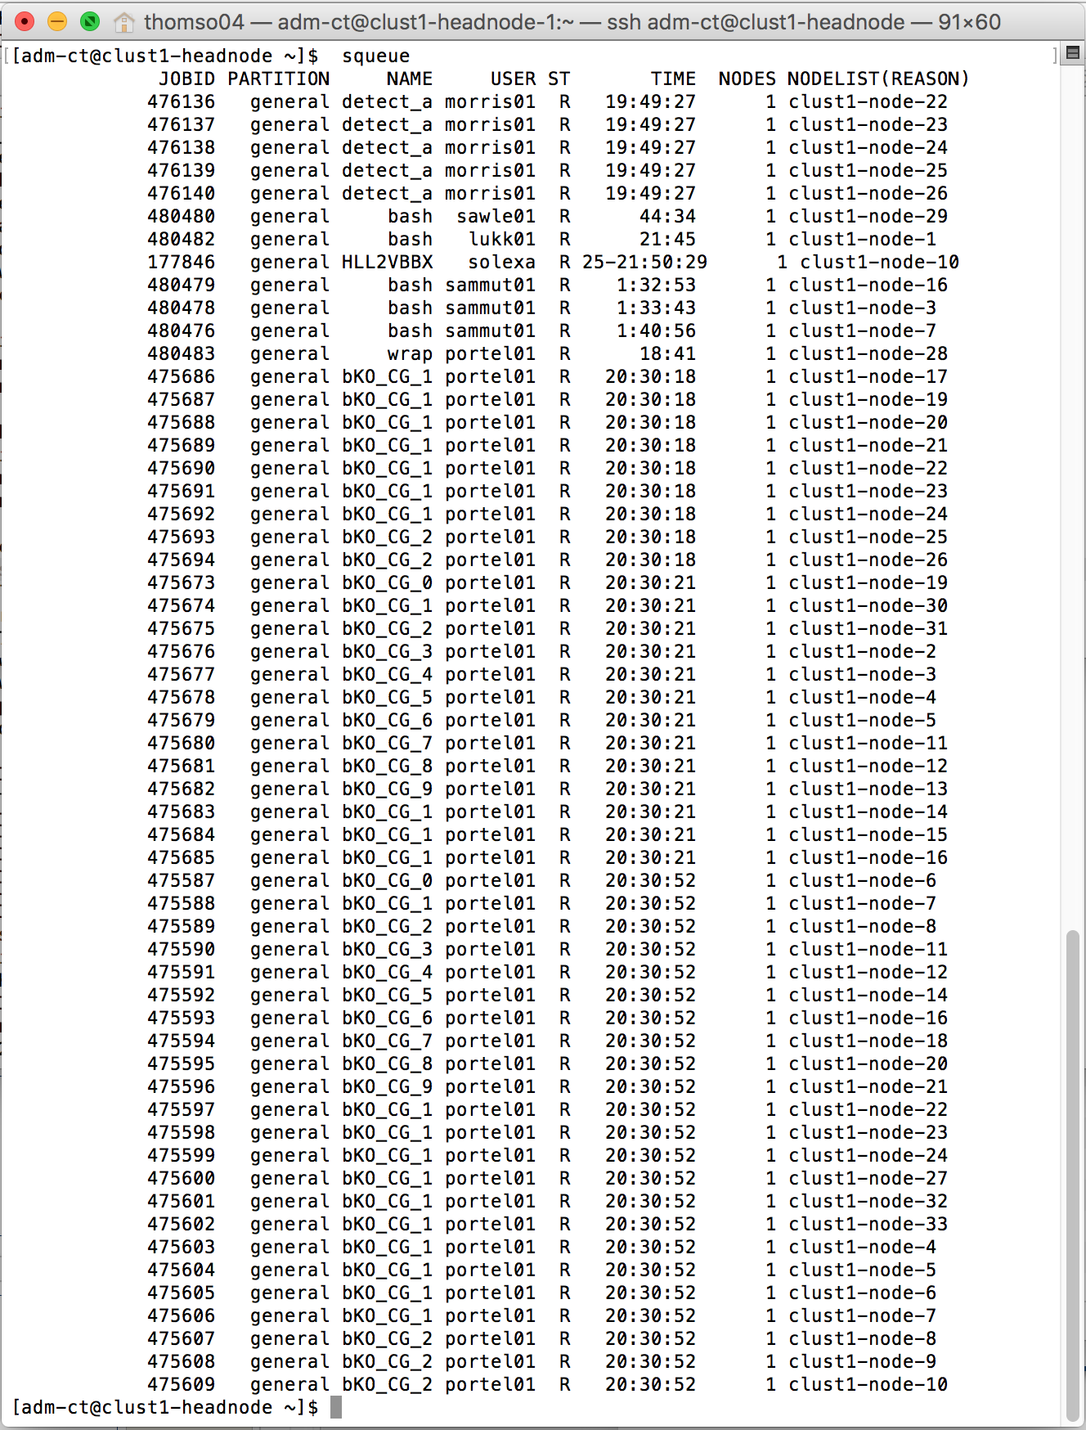
A Job
Job = SLURM instructions + your program
srun [OPTIONS...] executable [args...]
Can be a single command or a complex piece of BASH programming
In CI, many jobs are done in parallel
A command or series of commands submitted to the cluster with associated resource requirements and limits.
Status of jobs running on the cluster can be seen with the command
clust1-headnode $ squeue
clust1-headnode $ squeue –u <USERNAME>

Slide 5
Output from SLURM
clust1-headnode > squeue
[obrien04@clust1-headnode ~]$ squeue
JOBID PARTITION NAME USER ST TIME NODES NODELIST(REASON)
427309 general RK307bam lukk01 PD 0:00 1 (Dependency)
427311 general RK309bam lukk01 PD 0:00 1 (Dependency)
…
436869 general mutect2. wan01 R 4:25:25 1 clust1-node-16

Slide 6
A Queue:
A queue for job submissions associated with specified users and cluster hosts, and
providing specified default resources.
SLURM calls queues ‘partitions.’
We have a single general ‘partition’, with few restrictions (currently).

Slide 7
Checking the status of hosts within the cluster
SLURM
Clust1-headnode > sinfo
Clust1-headnode > squeue
Clust1-headnode > sacct
[obrien04@clust1-headnode ~]$ sinfo
PARTITION AVAIL TIMELIMIT NODES STATE NODELIST
general* up infinite 15 mix clust1-node-[1-7,9,12-16,18,21]
general* up infinite 18 idle clust1-node-[8,10-11,17,19-20,22-33]

Slide 8
Checking the status of hosts within the cluster
SLURM
Clust1-headnode > sinfo
Clust1-headnode > squeue
Clust1-headnode > sacct
[obrien04@clust1-headnode ~]$ sinfo
PARTITION AVAIL TIMELIMIT NODES STATE NODELIST
general* up infinite 15 mix clust1-node-[1-7,9,12-16,18,21]
general* up infinite 18 idle clust1-node-[8,10-11,17,19-20,22-33]

Slide 9
Submitting a simple command job
SLURM
<COMMAND> [OPTIONS...] executable [args...]
Clust1-headnode > srun –n2 -l hostname
Allocate Resources
The more specific your jobs are, the more likely they are to be run soon
sbatch option
--mem-per-cpu
--time=<walltime>
-t <walltime>
--nodes=<number>
-N <number>
--ntasks=<number> -n <number>
-n <number>
--output=<path>/<file pattern>
-o <path>/<file pattern>
--error=<path>/<file pattern>
-e <path>/<file pattern>
--mail-user=<email>
--job-name=<jobname>
-J <jobname>
--account=<project account>
-A <project_account>
--requeue or --no-requeue

Slide 10
Submitting a batch script job
SLURM
Clust1-headnode > sbatch myscript.sh
#!/bin/bash#
#SBATCH -p general # partition (queue)
#SBATCH -N 1 # number of nodes
#SBATCH -n 1 # number of cores
#SBATCH --mem 100 # memory pool for all cores
#SBATCH -t 0-2:00 # time (D-HH:MM)
#SBATCH -o slurm.%N.%j.out # STDOUT
#SBATCH -e slurm.%N.%j.err # STDERR
for i in {1..100}; do
echo $RANDOM >> SomeRandomNumbers.txt
Done
sort SomeRandomNumbers.txt

Slide 11
Killing jobs with scancel (jing)
clust1-headnode $ scancel <job-id>

Slide 12

Simple Parallel Computing
(marc)
Most HPC at CRI consists of breaking up your
dataset into chunks and firing off a separate job
for each chunk.
‘ Magnetisation Transfer Map Example
Here small groups of pixels from T2 weighted image slices are processed to calculate the elements of the MT map.’
(Example courtesy of Dominick McIntyre, Griffiths Group)

Slide 13
Simple Parallel Computing
Example

Slide 14
Job dependency
SLURM allows many different ways to express dependencies, using the
--dependency switch
Some SLURM dependencies:
after:job_id[:jobid...]
This job can begin execution after the specified jobs have begun execution.
afterany:job_id[:jobid...]
This job can begin execution after the specified jobs have terminated.
afterok:job_id[:jobid...]
This job can begin execution after the specified jobs have successfully executed (ran to completion with an exit code of zero).
[clust1-headnode ~] $ sbatch job1.sh
11254323
[clust1-headnode ~] $ sbatch --dependency=afterok:11254323 job2.sh

Slide 15
Practical session II

