Slide 1


CRUK CI HPC cluster introduction
(I of III)
Using the Cambridge Institute’s High Performance Computing Facilities

Slide 2
Overview
This brief course will give you two things:
A refresher on unix and an introduction to cluster computing
Basic instruction on using our scheduler
Some performance hints
It won’t make you an expert on parallel computing and HPC, but will let you get to work.
This course has a practical component, for which you will need an ssh client and cluster account.
Session I
1 Unix refresher
2 Cluster introduction
3 Practical – unix processes
Session II
4 Using the scheduler
5 Practical – job submission
Session III
6 Some performance hints

Slide 3
Unix refresher
(we have a course if this is all new…)

Slide 4
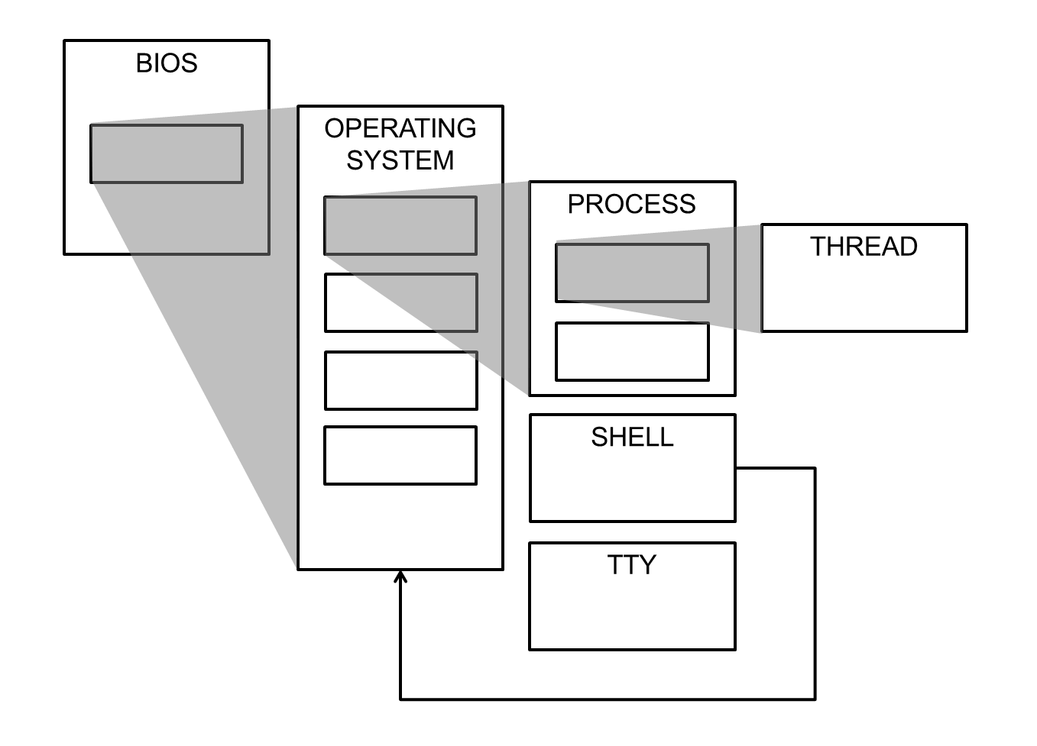
Operating Systems and Processes
‘Unix’ or ‘linux’ (or ‘UNIX’) is our operating system – the program that controls the processes and their access to the network, screen, etc.
The shell is a process – it happens to be one that can see its own OS, which is one of the reasons it’s so useful.

Slide 5
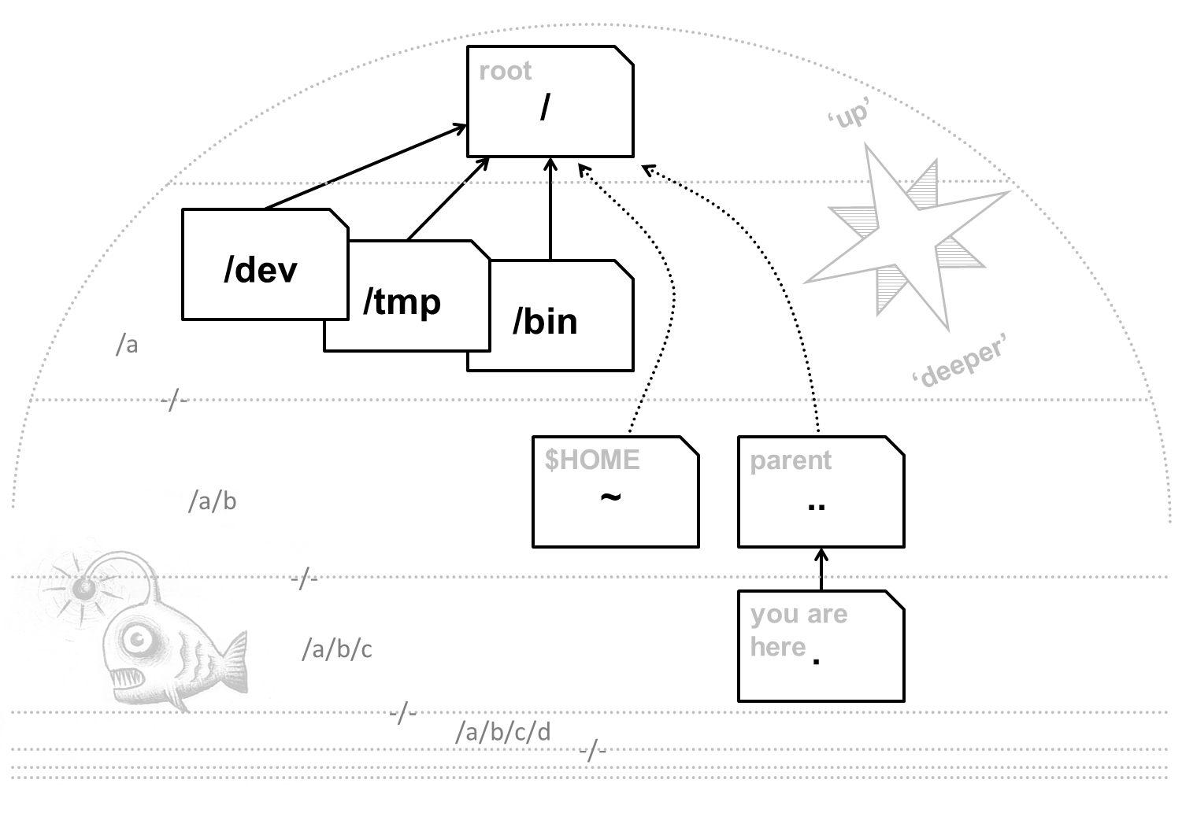
Navigation concepts
You need to be able to navigate without a GUI.
Fortunately some things are always in the same place.
Unix file systems are trees, with the roots at the top.

Slide 6
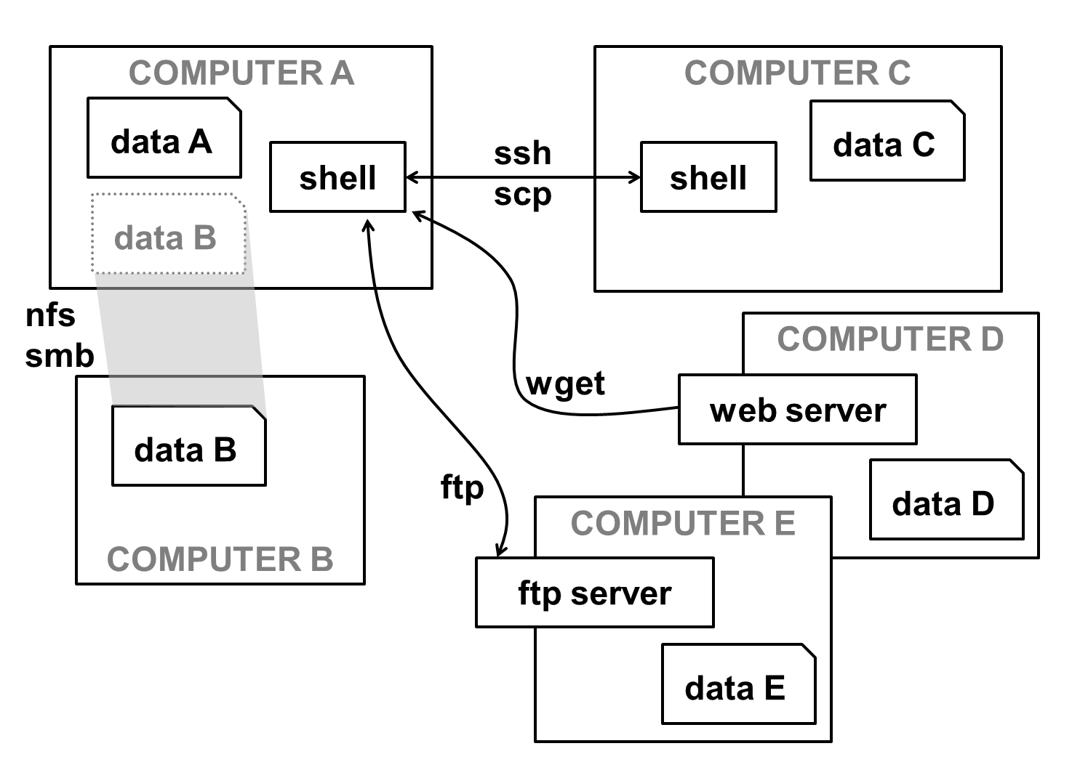
Moving data, or yourself
Most of the ways of moving data around the internet were developed for Unix first. You also have the option of going to where the data is, with a remote shell.

Slide 7





A cluster is just many computers together…
Each one with its own OS, processes, and shell environments.
CLUSTER

Slide 8
CRUK CI HPC
cluster

Slide 9
Key Cluster-related Staff
Nigel Berryman (Head of IT & SC)
Marc O’Brien (Technical Architect)
Charles Thomson (IT Specialist)
Jon Marshall (Systems Administor)
CRUK CI IT & SC Help Desk
Use the usual helpdesk route for day-to-day problems – if an issue is affecting you it may be affecting many people.
helpdesk-it@cruk.cam.ac.uk
01223 769600

Slide 10
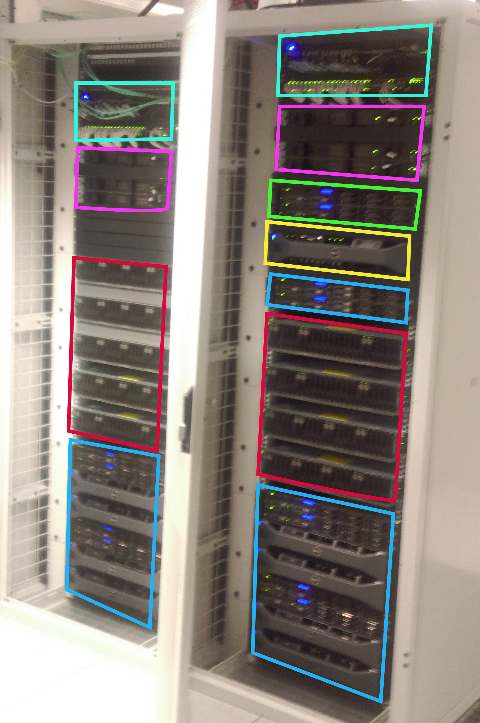
Cluster1
Ethernet
Infiniband
Headnodes
Home storage
Compute Blades
Lustre file systems

Slide 11
CRUK CI HPC Cluster
Specifications
33 compute nodes
2 x 20 core Intel Broadwell CPUs
1320 cores
320 GB RAM per node
2 x 196TB Lustre parallel file-systems
Job scheduler (SLURM)
CentOS 7.3

Slide 12
Other ways of computing: Dedicated Servers
Database servers
BioInformatics database servers
Many 10s TB storage
Group Servers
Dedicated server for individual research groups
Virtual Servers
- VMware cluster (virtual servers)
- Ideal for non-CPU intensive applications, such as web servers

Slide 13
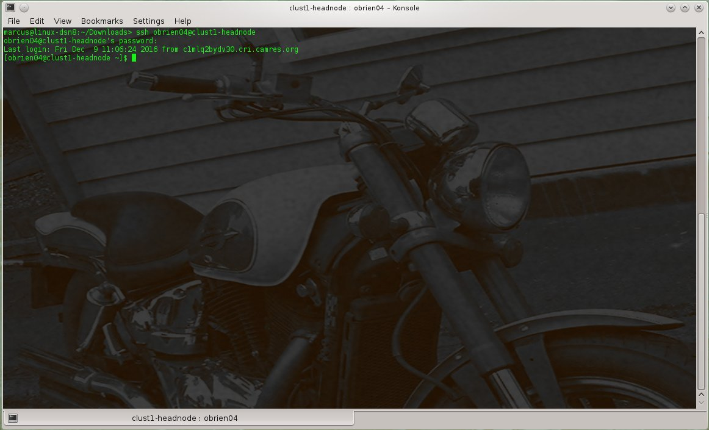
Accessing the HPC cluster
Login to the head node via secure shell (ssh)
[user@computer ~] ssh user@clust1-headnode

Slide 14
/home Directory
19TB file system shared over NFS4
Intended for source code and common user applications & libraries
Group quota
Mounted on head node and all compute nodes
Daily backed up
[user@clust1-headnode~ ]$ xfs-quota –c “quota –g”
Disk quotas for Group computing (1048)
Filesystem Blocks Quota Limit Warn/Time Mounted on
/dev/mapper/mpatha 244 0 0 00 [--------] /home

Slide 15
Transfer data into and out of the cluster
Use SSH scp (SCoPy) to transfer data
Bulk transfers using rsync (delta-transfer algorithm)
user@laptop:~> scp -r data/ clust1-headnode:/scratchb/xxlab/
file01.dat 100% 100KB 100.0KB/s 00:00
file02.dat 100% 100KB 100.0KB/s 00:00
file03.dat 100% 100KB 100.0KB/s 00:00
user@laptop:~> rsync -av data/ clust1-headnode:/scratchb/xxlab/data
sending incremental file list
file01.dat
file02.dat
file03.dat
sent 307464 bytes received 72 bytes 615072.00 bytes/sec
total size is 307200 speedup is 1.00

Slide 16
Cluster Storage
What's wrong with NFS or CIFS?
The Lustre parallel file-system
Working with Lustre

Slide 17
The Problem
Extreme I/O demand on storage
HPC cluster can have 10s to 1000s compute nodes
x Many users
x 1000s jobs
+ Millions of small and large files
Required shared filesystem
Breaks most filesystems !!!
Lustre: Parallel Filesystem
Lustre is a massively parallel distributed file system
Deployed in 7 out of 10 most powerful supercomputers
POSIX compliant (ish!)
Lustre design paradigm concepts
Separation of file meta-data and storage allocation
Scalable data serving through parallel data striping
Aggregate network bandwidth
Distributed operation
·

Slide 18
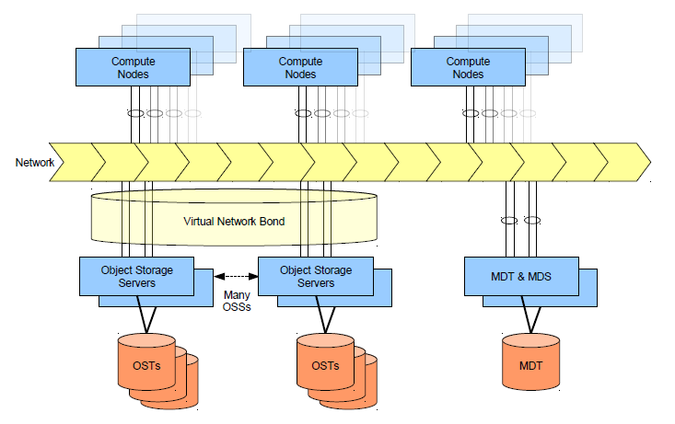
Lustre Architecture

Slide 19
Lustre Quotas
Lustre file system quotas are applied to each group
Units in kilobytes (oddity)
“quota” & “limit” of zero signifies no quota (as shown for user)
clust1-headnode ~ $ lfs quota /mnt/scratchb
Disk quotas for user user321 (uid 442255):
Filesystem kbytes quota limit grace files quota limit grace
/mnt/scratchb 275648748 0 0 - 984 0 0 -
Disk quotas for group xxlab (gid 987):
Filesystem kbytes quota limit grace files quota limit grace
/mnt/scratchb 3471466428 3600000000 4000000000 - 681541 0 0 -

Slide 20
Lustre Health Check
Check the status of each lustre
Display the usage of each distributed Object Storage Target component
clust1-headnode ~ $ lfs check servers
lfs check servers
scratcha-MDT0000-mdc-ffff81041158cc00 active.
scratcha-OST0000-osc-ffff81041158cc00 active.
...
scratchb-OST0007-osc-ffff81041158cc00 active.
clust1-headnode ~ $ lfs df -h
UUID bytes Used Available Use% Mounted on
scratcha-MDT0000_UUID 239.0G 856.7M 224.5G 0% /mnt/scratcha[MDT:0]
scratcha-OST0000_UUID 5.4T 2.2T 2.9T 40% /mnt/scratcha[OST:0]
...
scratchb-OST0007_UUID 5.4T 2.1T 3.0T 39% /mnt/scratchb[OST:7]
filesystem summary: 42.9T 16.3T 26.6T 37% /mnt/scratcha

Slide 21

Practical session I
etc

