Slide 1


CRUK cluster practical sessions
(SLURM)
Part I – processes & scripts

Slide 2
login
Log in to the head node, clust1-headnode, using ssh and your usual user name & password.
You’re ready to start.
SSH Secure Shell 3.2.9 (Build 283)
Copyright (c) 2000-2003 SSH Communications Security Corp - http://www.ssh.com/
This copy of SSH Secure Shell is a non-commercial version.
This version does not include PKI and PKCS #11 functionality.
Last login: Mon Sep 19 10:44:07 2016 from bp7r25j.cri.camres.org
[user@cluster ~]$

Slide 3
navigate
Find out where you are using pwd.
Make a directory (mkdir) and move into it (cd)
[user@cluster ~]$ pwd
/home/user
[user@cluster ~]$ mkdir training
[user@cluster ~]$ cd training/
[user@cluster training]$

Slide 4
processes
You can see your current processes using ps.
You can see what else this computer is doing using top
[user@cluster training]$ ps
PID TTY TIME CMD
14859 pts/22 00:00:00 bash
18511 pts/22 00:00:00 ps
[user@cluster training]$ top

Slide 5
top output
top uses the whole screen. Type ‘q’ to get your screen back.
top - 16:26:38 up 58 days, 22:33, 36 users, load average: 0.12, 0.14, 0.12
Tasks: 618 total, 1 running, 617 sleeping, 0 stopped, 0 zombie
Cpu(s): 0.1%us, 0.2%sy, 0.0%ni, 99.5%id, 0.2%wa, 0.0%hi, 0.0%si, 0.0%st
Mem: 16437908k total, 10473016k used, 5964892k free, 2611564k buffers
Swap: 16779852k total, 162896k used, 16616956k free, 2158536k cached
PID USER PR NI VIRT RES SHR S %CPU %MEM TIME+ COMMAND
975 root 0 -20 22712 3832 2196 S 1 0.0 28:44.67 lim
4686 root 15 0 0 0 0 S 0 0.0 3:11.36 nfsd
19175 user 15 0 11048 1592 864 R 0 0.0 0:00.14 top
1 root 15 0 10364 600 564 S 0 0.0 0:12.04 init

Slide 6
The ‘sleep’ command
The sleep command doesn’t do much – but you can control how many seconds it does it for, and it doesn’t use much CPU or I/O
[user@cluster training]$ sleep 10
[user@cluster training]$

Slide 7
Stop and suspend
If we get bored, change our mind, or think something is wrong we can interrupt jobs.
To stop a job, type ‘^C’ at the command line ( that’s [Ctrl]+[C] together).
If you don’t want to stop the job, you can suspend it. Type ‘^Z’ (that’s [Ctrl]+[Z]).
Type ‘fg’ to bring the job back to the foreground.
[user@cluster training]$ sleep 100
[user@cluster training]$
[user@cluster training]$ sleep 100
[1]+ Stopped sleep 100
[user@cluster training]$ fg

Slide 8
backgrounding
When we have suspended a job (which will never finish). To get it to carry on, we can put it in the ‘background’ using bg
You can put a job in the background deliberately using the ‘&’ character at the end of the command.
[user@cluster training]$ sleep 100
[1]+ Stopped sleep 100
[user@cluster training]$ bg
[1]+ sleep 100 &
[user@cluster training]$ ps
PID TTY TIME CMD
14859 pts/22 00:00:00 bash
24799 pts/22 00:00:00 sleep
25377 pts/22 00:00:00 ps
[user@cluster training]$ sleep 100 &
[1] 787
[user@cluster training]$ ps
PID TTY TIME CMD
787 pts/22 00:00:00 sleep
804 pts/22 00:00:00 ps
14859 pts/22 00:00:00 bash

Slide 9
Killing processes
If you don’t want to wait for it to finish, or think it is broken in some way, you can terminate it using the kill command.
Kill has a variety of gentle options to allow the process to exit gracefully. If these fail one – signal -9, or –KILL will normally remove the process.
[user@cluster training]$ sleep 100 &
[1] 787
[user@cluster training]$ ps
PID TTY TIME CMD
787 pts/22 00:00:00 sleep
804 pts/22 00:00:00 ps
14859 pts/22 00:00:00 bash
[user@cluster training]$ kill -KILL 787
[user@cluster training]$
[1]+ Killed sleep 100
[user@cluster training]$

Slide 10
A simple example
Sleep is a good example, but it doesn’t produce any output. We want to wrap it up with messages – in unix you use echo to do this.
The colon here allows us to put multiple commands on a single line.
[user@cluster training]$ echo start; sleep 1; echo finish
start
finish
[user@cluster training]$

Slide 11
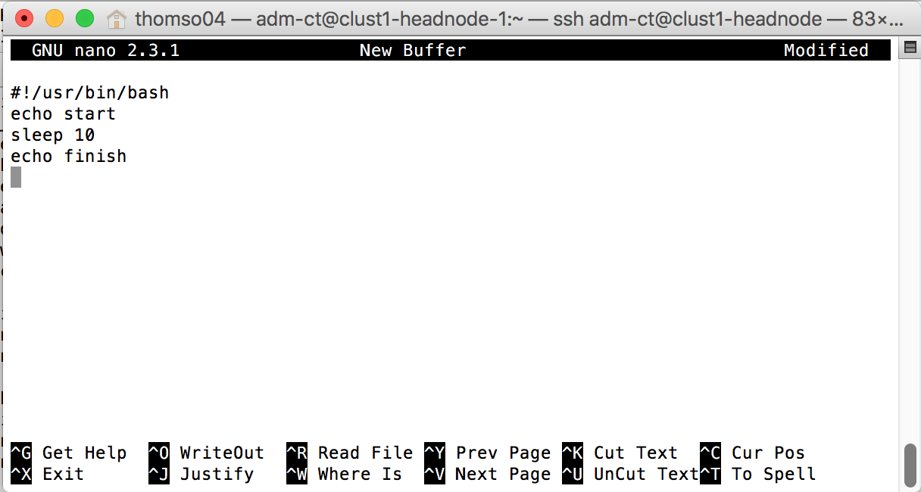
Creating a script
Cluster programming makes use of scripts, so we’ll turn this list of commands into a script.
Use the nano text editor to enter the following script:
You can run a script by executing bash <scriptname> or by making it directly executable with chmod. The ‘./’ is important – the shell only looks for executables in certain places – the ‘PATH’.
[user@cluster training]$ nano script.sh
#!/usr/bin/bash
echo start
sleep 10
echo finish
[user@cluster training]$ chmod u+x script.sh
[user@cluster training]$ ./script.sh
start
finish

Slide 12
Running the script
Now we are ready to start running our script, or sending it as a cluster job.
[user@cluster training]$ ./script.sh > script.out &
[1] 7594
[user@cluster training]$ ps
PID TTY TIME CMD
7594 pts/22 00:00:00 bash
7595 pts/22 00:00:00 sleep
7598 pts/22 00:00:00 ps
14859 pts/22 00:00:00 bash
[user@cluster training]$
[1]+ Done ./script.sh > script.out

Slide 13
Cluster practical sessions
Part II – cluster job submission

Slide 14
Submitting a job
Now we know enough to run our script on the cluster.
Simply submit the job using sbatch.
the output file is written to a Lustre file system directory
Create directory with username if it doesn’t exist – e.g. mkdir /scratcha/stlab/garret01
/home is writeable from cluster nodes, but won’t perform as well.
All read and write operations from within jobs running on nodes should use either
/scratchb or /scratcha directories.
[user@cluster training]$ sbatch –-time=10 --output=/scratcha/stlab/garret01/%N-%j.out script.sh
Submitted batch job 200875
SLURM time formats
Acceptable time formats include "minutes", "minutes:seconds",
"hours:minutes:seconds", "days-hours", "days-hours:minutes" and
"days-hours:minutes:seconds".

Slide 15
Look at running jobs
While the job is running, you can see it with squeue.
Once it’s finished, you can see the output.
[user@cluster training]$ squeue
JOBID PARTITION NAME USER ST TIME NODES NODELIST(REASON)
200876 general script.s user R 0:02 1 clust1-node-3
200867 general bash sawle01 R 4:01:05 1 clust1-node-2
175393 general MB99.6.v eldrid01 R 9-00:28:46 1 clust1-node-30
175330 general vardict_ eldrid01 R 9-01:40:03 1 clust1-node-1
[user@cluster training]$ squeue
JOBID PARTITION NAME USER ST TIME NODES NODELIST(REASON)
200867 general bash sawle01 R 4:01:33 1 clust1-node-2
175393 general MB99.6.v eldrid01 R 9-00:29:14 1 clust1-node-30
175330 general vardict_ eldrid01 R 9-01:40:31 1 clust1-node-1
[user@cluster training]$ ls /scratcha/group/user/
clust1-node-3-200877.out

Slide 16
What happened?
The output went into the file as expected:
Other information is stored, and available via sacct:
[user@cluster training]$ cat /scratcha/group/user/clust1-node-3-200877.out
start
finish
[user@cluster training]$ sacct -j 200877
JobID JobName Partition Account AllocCPUS State ExitCode
------------ ---------- ---------- ---------- ---------- ---------- --------
200877 script.sh general group 1 COMPLETED 0:0
200877.batch batch group 1 COMPLETED 0:0
[user@cluster training]$ sacct -j 200877 --format JobID,MaxRSS,State,AllocCPUS
JobID MaxRSS State AllocCPUS
------------ ---------- ---------- ----------
200877 COMPLETED 1
200877.batch 2012K COMPLETED 1

Slide 17
An alternative way to submit
You can submit a job directly to SLURM with srun. This still requires resources – it’s more commonly used as part of an existing job.
You can also generate an interactive session:
sintr is a local implementation of a script written by Pär Andersson (National Supercomputer Centre, Sweden) which will sort out X Forwarding, launch screen on a node, and connect you to the session.
[user@cluster training]$ srun --time=1-12:30:59 /usr/bin/bash script.sh
start
finish
[user@cluster training]$ sintr
[user@clust1-node-3 training]$

Slide 18
Killing a job
Just as for processes, but using scancel
NOTE: Do not use skill it is NOT a SLURM command!
[user@cluster training]$ sbatch --output=/scratcha/group/user/%N-%j.out script.sh
Submitted batch job 200889
[user@cluster training]$ squeue
JOBID PARTITION NAME USER ST TIME NODES NODELIST(REASON)
200889 general script.s user R 0:02 1 clust1-node-3
200867 general bash sawle01 R 4:28:21 1 clust1-node-2
175393 general MB99.6.v eldrid01 R 9-00:56:02 1 clust1-node-30
175330 general vardict_ eldrid01 R 9-02:07:19 1 clust1-node-1
[user@cluster training]$ scancel 200889
[user@cluster training]$ squeue
JOBID PARTITION NAME USER ST TIME NODES NODELIST(REASON)
200867 general bash sawle01 R 4:28:21 1 clust1-node-2
175393 general MB99.6.v eldrid01 R 9-00:56:02 1 clust1-node-30
175330 general vardict_ eldrid01 R 9-02:07:19 1 clust1-node-1

Slide 19
Killing isn’t bad…
The scheduler manages the shutdown and still records details of the job.
[user@cluster training]$ sacct -j 200889
JobID JobName Partition Account AllocCPUS State ExitCode
------------ ---------- ---------- ---------- ---------- ---------- --------
200889 script.sh general group 1 CANCELLED+ 0:0
200889.batch batch group 1 CANCELLED 0:15

Slide 20
Basic parallelism
Now we’re ready to use the cluster at full power!
One way to do this is with a job array. You can create one of these using the
--array=1-N syntax in sbatch
Or using the srun with the –n or –N parameters.
[user@cluster training]$ sbatch --time=10 --array=1-10 --output=/scratcha/group/user/%N-%j.out script.sh
Submitted batch job 200900
[user@cluster training]$ ls /scratcha/group/user
clust1-node-10-200908.out clust1-node-12-200900.out clust1-node-4-200902.out
clust1-node-10-200904.out clust1-node-12-200906.out clust1-node-11-200909.out
clust1-node-3-200901.out clust1-node-5-200903.out clust1-node-7-200905.out
clust1-node-9-200907.out
[user@cluster training]$ srun --time=10 –n hostname
clust1-node-9.cri.camres.org
…
clust1-node-13.cri.camres.org
[user@cluster training]$
[user@cluster training]$ srun --time=10 –N 3 hostname
clust1-node-19.cri.camres.org
clust1-node-25.cri.camres.org
clust1-node-8.cri.camres.org
[user@cluster training]$

Slide 21
The final example maps specific names to their file position in a reference file list.
The map is written to names-list.out
#!/bin/bash
for i in Matthew Luca Mohammed Lochlan Leighton Keegan Dawid Magnie Zygmunt Zen
do
srun --time=10 -e /<YOUR SCRATCH DIR/%j-names-list.err -o /<YOUR SCRATCH DIR/names-list.out grep -n $i /scratchb/training/refdata/names-list.txt 2>&1 &
done

Slide 22
Fin

