Slide 1

Time Series Analysis
7th of February 2023
R. Nicholls / D.-L. Couturier / C.S.R. Chilamakuri

Slide 2
Time series analysis
Example: Monthly Southern Oscillation Index
Monthly difference in sea-surface air pressure between Darwin and Tahiti
Used for predicting rainfall in parts of Australia

Slide 3
Time series analysis
A time series is a process in which a given observation
depends on other datapoints in the same series.
Linear regression models:
Response variable (y)
Independent variables (x)
Time series:
Single process (y)
Idea:
Exploit correlations within the data in order to understand and model the data
Potentially forecast likelihood of future events

Slide 4
Time series analysis
When analysing time series, we are interested in how two values in the series – separated by k time-steps – affect each other.
k^{th} autocovariance:
Average covariance between pairs of values that are k time steps apart in the series.
Since these are dependent on the scale of the process, these need to be standardised:
k^{th} autocorrelation:
The autocorrelation function is useful for characterising time series.
K: Lag

Slide 5
Time series analysis
Autocorrelation function:
Nile annual flow:

Slide 6
Time series analysis
Autocorrelation function:
Nile annual flow:
Lynx trappings:

Slide 7
Time series analysis
Autoregressive (AR) time series models:
AR(1):

Slide 8
Time series analysis
Autoregressive (AR) time series models:
AR(1):
AR(2):

Slide 9
Time series analysis
Autoregressive (AR) time series models:
AR(1):
AR(2):
AR(p):
Similarities to multiple regression model, except for the dependencies
Parameters estimated using least squares or maximum likelihood
Assumptions:
Independent Gaussian errors
Covariance stationary process (trend doesn’t change over time)

Slide 10
Time series analysis
Autoregressive (AR) time series models:
AR(2) with c=0, ϕ₁=0.4 and ϕ₂=0.2
How to interpret ACF?
Positive parameters: ACF should decay, not oscillate.
Should decay gradually until within the confidence interval, then stay there.
Can’t infer order…

Slide 11
Time series analysis
Autoregressive (AR) time series models:
AR(2) with c=0, ϕ₁=0.4 and ϕ₂=0.2
Partial autocorrelation function: α(p) = ϕ_{p} from a AR(p) model
Parsimonious modelling:
First try AR(1), then AR(2), etc. until H₀ : α(p) = 0 is not rejected.
Failure to reject leads us to conclude that AR(p) is more appropriate than AR(p-1).

Slide 12
Time series analysis
Moving Average (MA) time series models:
MA(1):

Slide 13
Time series analysis
Moving Average (MA) time series models:
MA(1):
MA(2):

Slide 14
Time series analysis
Moving Average (MA) time series models:
MA(1):
MA(2):
MA(q):
Unlike multiple regression model there are multiple error terms
However, the current state is only ever dependent on a known no. of previous states
Since the current state only depends on the previous q states,
the ACF should suddenly drop to zero, unlike AR(p) processes

Slide 15
Time series analysis
More general models:
Auto Regressive, Moving Average:
ARMA(p,q):
AR(p)
MA(q)

Slide 16
Time series analysis
More general models:
Auto Regressive, Moving Average:
ARMA(p,q):
ARIMA(p,1,q):
AR(p)
MA(q)
Auto Regressive, Integrated, Moving Average:
then model as ARMA(p,q)

Slide 17
Time series analysis
More general models:
Auto Regressive, Moving Average:
ARMA(p,q):
ARIMA(p,1,q):
ARIMA(p,d,q):
AR(p)
MA(q)
Auto Regressive, Integrated, Moving Average:
then model as ARMA(p,q)
take d^{th} order differences
Considering ARIMA models can be a useful “transformation” if assumptions are violated

Slide 18
Time series analysis
Example: Monthly Southern Oscillation Index
Monthly difference in sea-surface air pressure between Darwin and Tahiti
Used for predicting rainfall in parts of Australia

Slide 19
Time series analysis
Example: Monthly Southern Oscillation Index
Monthly difference in sea-surface air pressure between Darwin and Tahiti

Slide 20
Time series analysis
Example: Monthly Southern Oscillation Index
Monthly difference in sea-surface air pressure between Darwin and Tahiti

Slide 21
Time series analysis
Example: Monthly Southern Oscillation Index
Monthly difference in sea-surface air pressure between Darwin and Tahiti

Slide 22
Time series analysis
Example: Monthly Southern Oscillation Index
Monthly difference in sea-surface air pressure between Darwin and Tahiti

Slide 23
Time series analysis
Example: Monthly Southern Oscillation Index
Monthly difference in sea-surface air pressure between Darwin and Tahiti
Try ARIMA(0,1,1) model:
arima(x = x$Index, order = c(0, 1, 1))
Coefficients:
ma1
-0.5579
s.e. 0.0308
sigma^2 estimated as 52.94: log likelihood = -2477.98, aic = 4959.96

Slide 24
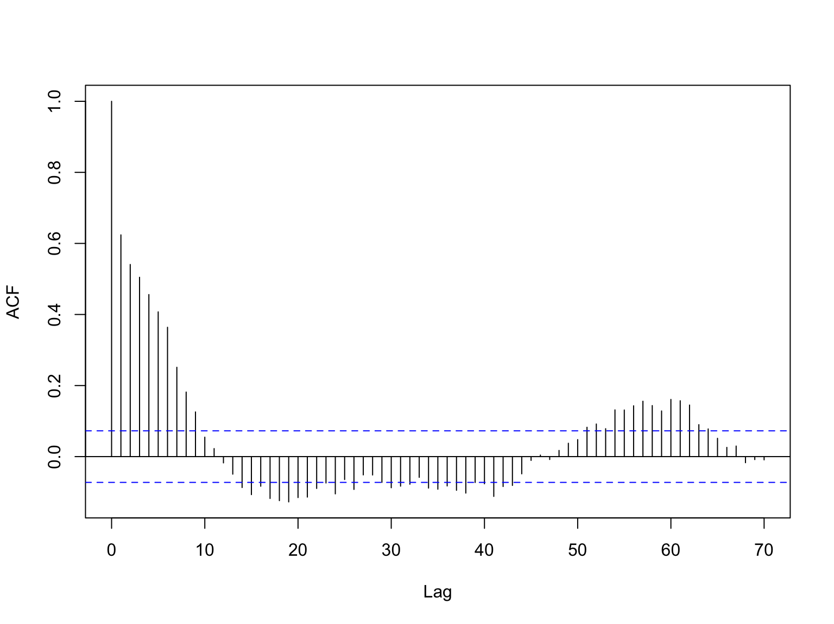
Time series analysis
R functions:
acf(x,lag.max=70)

Slide 25
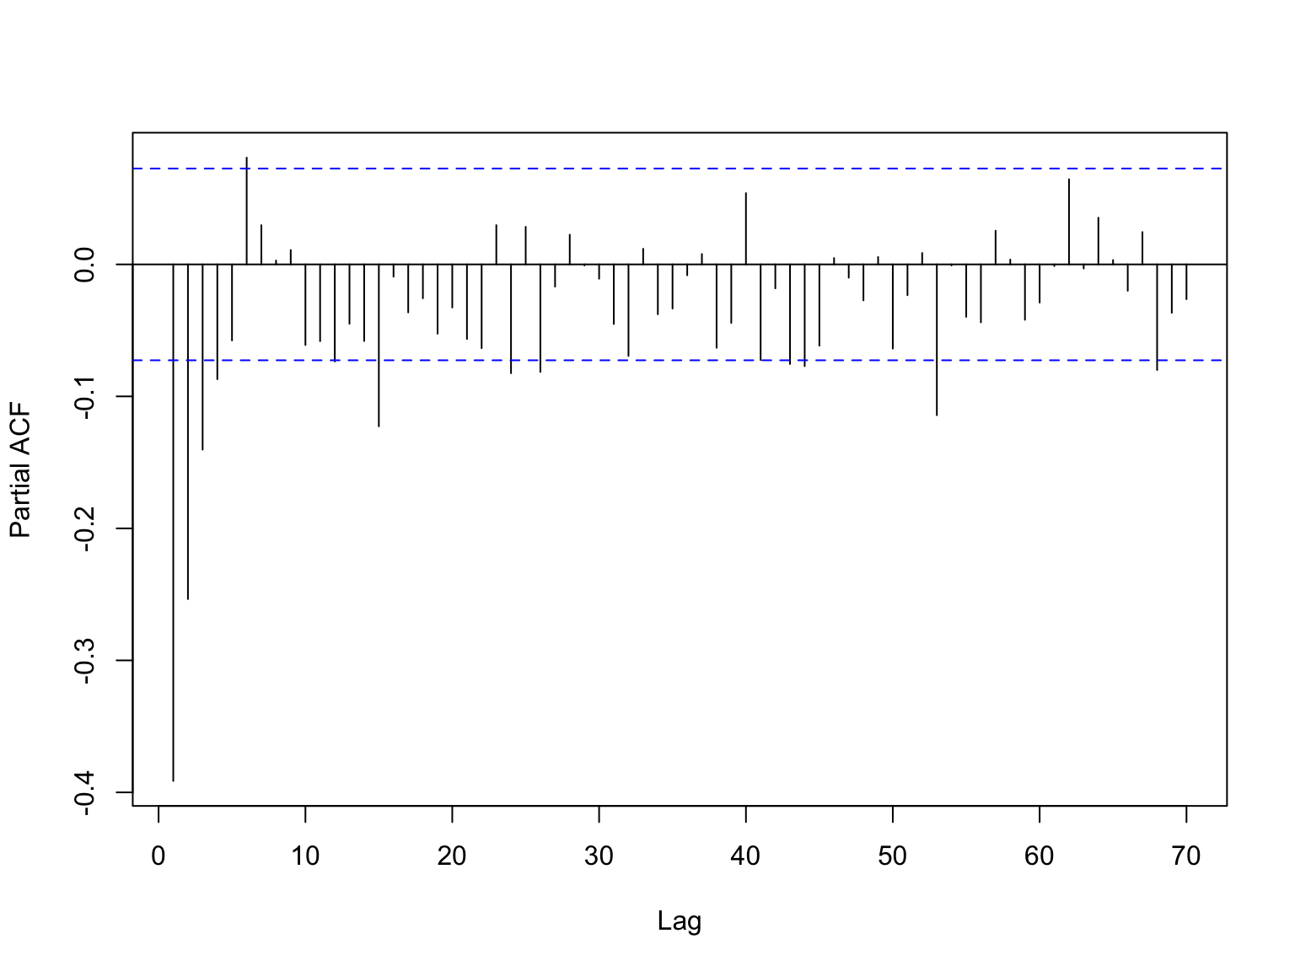
Time series analysis
R functions:
acf(x,lag.max=70)
diff(x)
pacf(diff(x),lag.max=70)

Slide 26
Time series analysis
R functions:
acf(x,lag.max=70)
diff(x)
pacf(diff(x),lag.max=70)
arima(x,order=c(0,1,1))
##
## Call:
## arima(x = x$Index, order = c(0, 1, 1))
##
## Coefficients:
## ma1
## -0.5579
## s.e. 0.0308
##
## sigma^2 estimated as 52.94: log likelihood = -2477.98, aic = 4959.96

