Slide 1

The role of journals and publishers in reproducible research
CASIM Reproducible Research Workshop, 27th November 2015
Iain Hrynaszkiewicz
Head of Data and HSS Publishing, Open Research Nature Publishing Group & Palgrave Macmillan
iain.hrynaszkiewicz@nature.com
@iainh_z

Slide 2
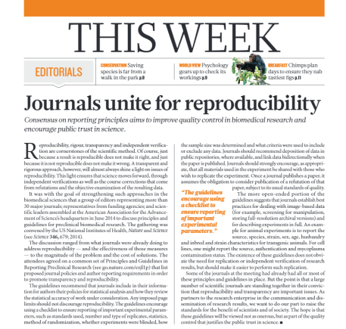
Why do publishers care?
More reliable evidence and papers
Supporting journal and society goals
Supporting research community expectations and expectations of funding agencies
Content innovation
More visible and widely reused publications
Notes:
Provide services to the research community, particularly with increasing amount of open access publishers. Publishers are business to consumer

Slide 3
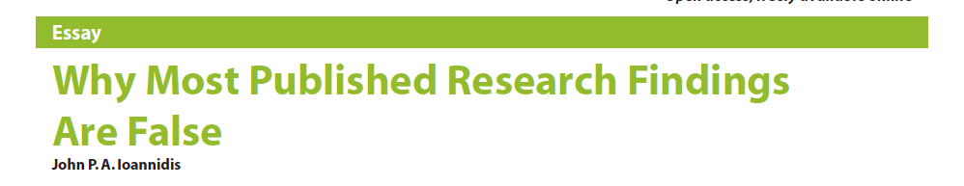
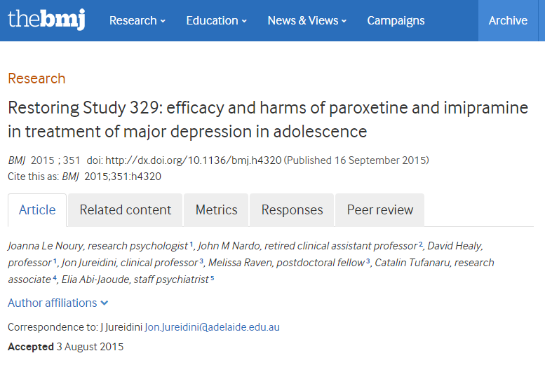

PloS Medicine 2005
doi: 10.1371/journal.pmed.0020124
Nature 2015 doi:10.1038/525426a
Notes:
We’ve probably all read the headlines but what can we do – practically and pragmatically – about it as publishers?
Possible addition? http://news.stanford.edu/news/2015/november/fraud-science-papers-111615.html

Slide 4
Irreproducibility: underlying issues
Misconduct
Publication bias and refutations – where?
Experimental design
Statistics
Lab supervision and training
Reporting and sharing information
Gels, microscopy images
Statistical reporting
Methods description
Data deposition
Notes:
Bias – many examples and Editors and journals have often been exonerated. Examples of reboxetine, oseltamvir
Experimental design issues: randomization, blinding, sample size determinations
NIH developed a training module on reproducibility and transparency with an emphasis on good experimental design
While problems of reproducibility often arise in the lab or clinic – in methodology – publishers can potentially compound the issue

Slide 5
Transparency vs. Reproducibility
Both require significant effort but transparency more pragmatic/achievable
Promoting transparency and reuse helps reproducibility
Access to materials to reduce bias and support reproducible research:
Methods
Protocols
Code
Data
Pre-registration
Miguel et al. (2014). Promoting transparency in social science research. Science (New York, N.Y.), 343(6166), 30–1. doi:10.1126/science.1245317

Slide 6

Reproducibility: roles for publishers
Content
Policies
Incentives
Licenses
Access
Reliability
Innovation
Image credit: DS Pugh [CC-BY-SA-2.0 (http://creativecommons.org/licenses/by-sa/2.0)], via Wikimedia Commons. http://commons.wikimedia.org/wiki/File%3AHarlow_Carr_-_geograph.org.uk_-_32309.jpg
Further reading: Hrynaszkiewicz I, Li P, Edmunds SC: Open science and the role of publishers in reproducible research. In: Implementing Reproducible Research. Edited by Stodden V, Leisch F, Peng RD. Chapman & Hall/CRC; 2014

Slide 7
Reproducibility: Content - details
Glasziou et al. (2008) BMJ – inadequate methods descriptions for medical interventions BMJ 2008;336:1472
Length restrictions removed on Methods (Nature)
No length restrictions in open access journals
Reporting guidelines e.g. MIAME but implementation/enforcement is patchy
Format of content also important when literature used a resource for research e.g. structured XML versions of articles in PubMed Central

Slide 8
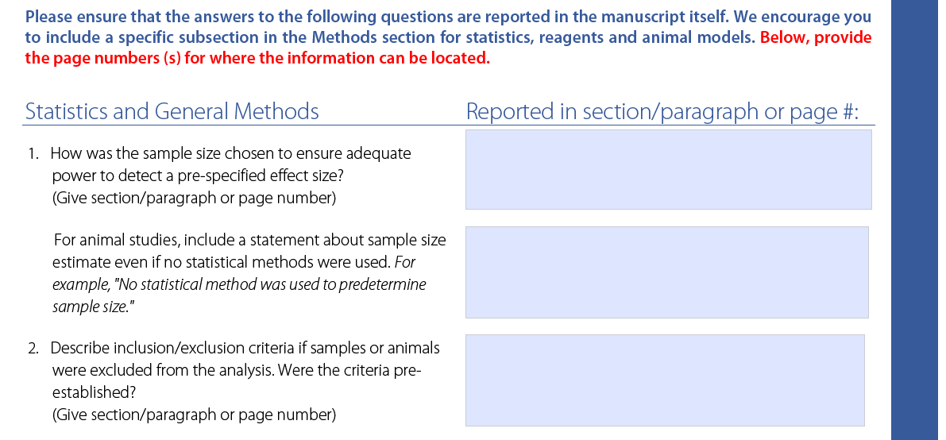
Reporting checklist of statistical and methodological details
Reproducibility checklist also currently being trialled at various BMC journals, including BMC Biology, BMC Neuroscience, Genome Biology, and GigaScience.
Notes:
No length restrictions online methods

Slide 9
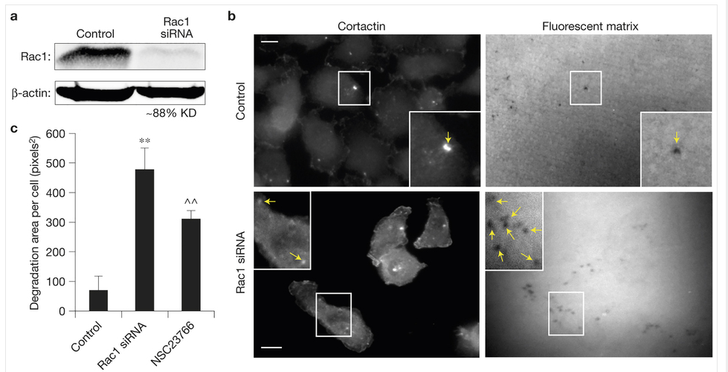
Example
statement of replication
(a) Western blot of cell lysates of control and Rac1-siRNA-treated MTLn3 cells, blotted for Rac1 and β-actin. A representative image is shown from 3 blots. (b) MTLn3 cells transfected with control or Rac1 siRNA and plated on Alexa-405-conjugated gelatin overnight. Arrows point to invadopodia and sites of degradation. Scale bars, 10 μm. Representative image sets are shown from 50 image sets each for the control and Rac1 siRNA. (c) Quantification of mean degradation area per cell from b, including Rac1 inhibitor NSC23766 treatment at 100 μM. n = 60 fields for each condition, pooled from 5 independent experiments; error bars are s.e.m. Student’s t-test was used. **P = 0.00022,^ ^P = 0.011639. Uncropped images of blots are shown in Supplementary Fig. 9.
definition of n
definition of statistic tests
raw source data
Nature Cell Biology 16, 571–583 (2014) doi:10.1038/ncb2972
Notes:
One good example of detail we now find in figure legends and methods sections
Not working

Slide 10
Reproducibility: Content - format
Format of content also important when literature used a resource for research e.g. structured XML versions of articles in PubMed Central
Building a “GenBank for the published literature” (Roberts, Varmus et al Science, 2001)
Growing amount of open access articles (e.g. >60% of articles at NPG in 2015)

Slide 11
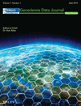









Reproducibility: Content - types
Notes:
BMCRN, ESSD – among first data journals (2008-9)

Slide 12
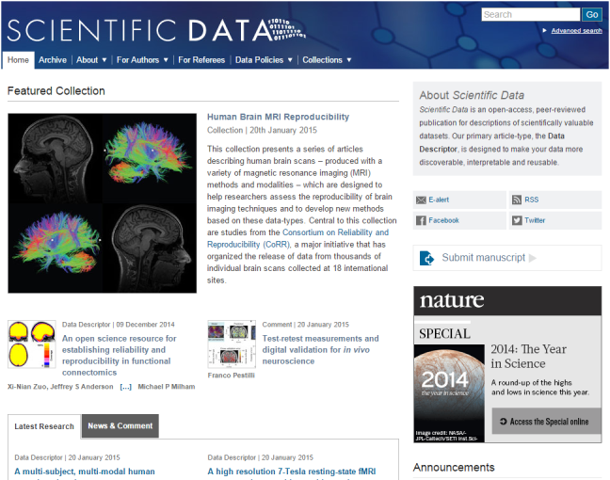
http://www.nature.com/sdata/

Slide 13




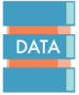
Get Credit for Sharing Your Data
Publications will be indexed and citeable.
Open-access
Creative Commons licenses (CC-BY/CC-BY-NC) for the main Data Descriptor. Each publication supported by CCO metadata.
Focused on Data Reuse
All the information others need to reuse the data; no interpretative analysis, or hypothesis testing
Peer-reviewed
Rigorous peer-review focused on technical data quality and reuse value
Promoting Community Data Repositories
Not a new data repository; data stored in community data repositories
Notes:
Key features of Scientific Data – driven by market research about researchers would value in a data publication
Promotes community repositories. Approved list of more than 80. Offer Dryad and figshare

Slide 14
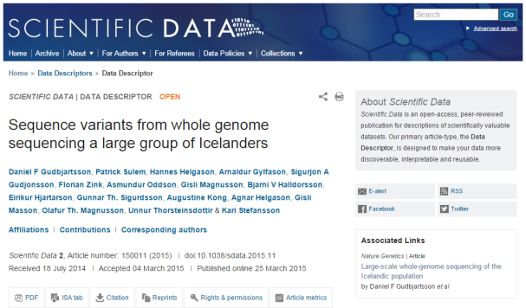
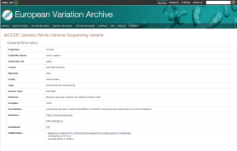
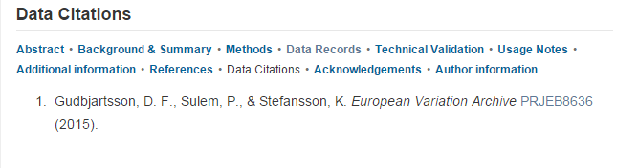
Sequence variants (EVA)
Associated Nature Genetics article
Data at European Variation Archive
Notes:
We now have several examples of data descriptors derived from different sources and linking data to publications in various/multiple ways.
Following up on the previous publication at Nature, the authors provide a richer description and release of valuable gene expression data from an iPS cell reprogramming time-course, including data from four early time points, not analyzed or released in the original publication (figshare data).

Slide 15
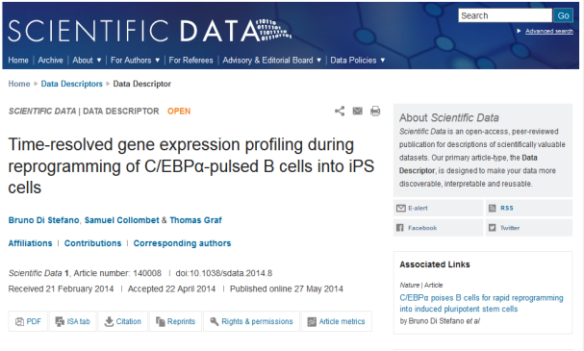
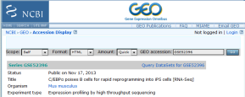

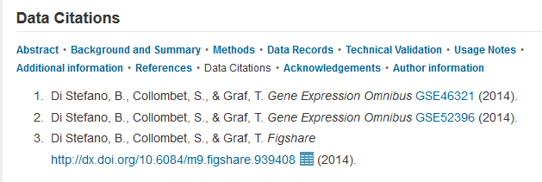
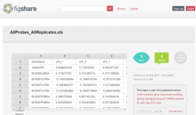
Gene expression
Associated Nature Article
Data at figshare & NCBI GEO
Integrated figshare data viewer
Notes:
We now have several examples of data descriptors derived from different sources and linking data to publications in various/multiple ways.
Following up on the previous publication at Nature, the authors provide a richer description and release of valuable gene expression data from an iPS cell reprogramming time-course, including data from four early time points, not analyzed or released in the original publication (figshare data).

Slide 16
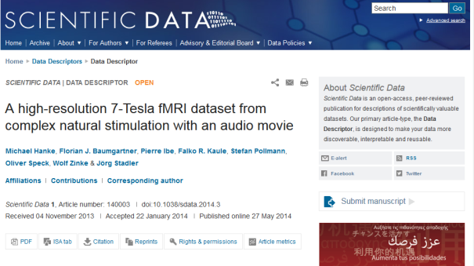
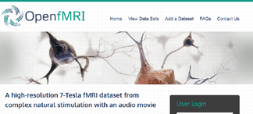
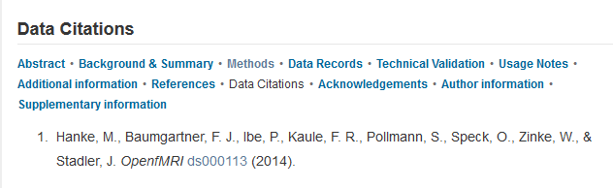
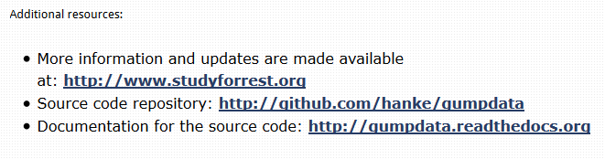
Neuroscience
New Dataset
Data in OpenfMRI
Source code in GitHub
Big Data
Code in GitHub
Notes:
In this Data Descriptor, the authors present a high-resolution brain imaging dataset from participants listening to an audio version of 'Forrest Gump‘. This rich dataset is being used in a brain cognition challenge organized by the authors. The Data Descriptor includes rich methodological details, and links to source code stored at github to help maximize the reusability of these data.
Genomes of icelanders example?

Slide 17

Policies: on data
Willingness to share stated (Annals Internal Medicine)
Data sharing implied by submission (BioMed Central*)
Data sharing implied as a condition of publication (Nature*)
Mandated data sharing with statement in paper (PLOS, BMJ - for clinical trials)
Mandated data sharing with statement and link to data (non-medical journals e.g. ecology, animal genomics)
Mandated open data as a condition of submission (Scientific Data, GigaScience, F1000Research)
*Minimum requirement – some disciplines/journals may mandate
STRONGER
1. Vines, T. H. et al. Mandated data archiving greatly improves access to research data. FASEB J. fj.12–218164– (2013). doi:10.1096/fj.12-218164
Notes:
Public repositories preferred

Slide 18
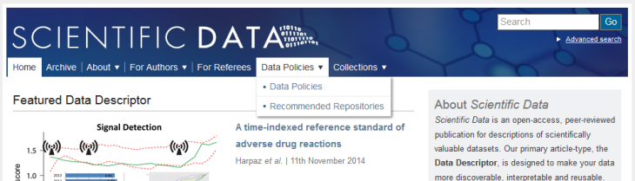
Finding the right repository
Lists more than 80 repositories, across the biological, physical and social sciences http://www.nature.com/sdata/data-policies/repositories
Advise authors on the best place to store their data
List made available under CC-BY in figshare http://dx.doi.org/10.6084/m9.figshare.1434640
Notes:
http://www.nature.com/sdata/data-policies/repositories
GigaScience – journal that focuses on big data from life sciences, in particular whole genome sequences, has its own repository for many giga/terabyte datasets

Slide 19
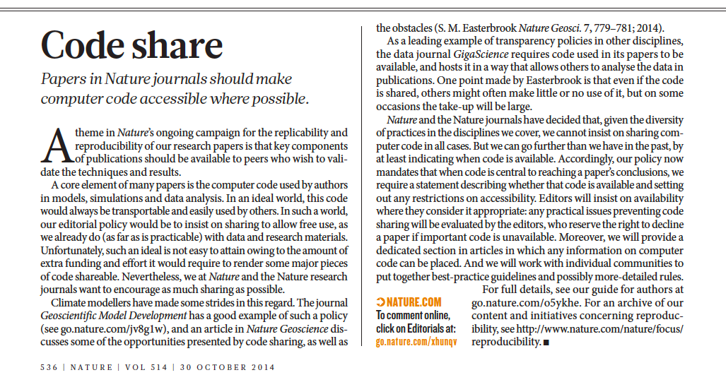
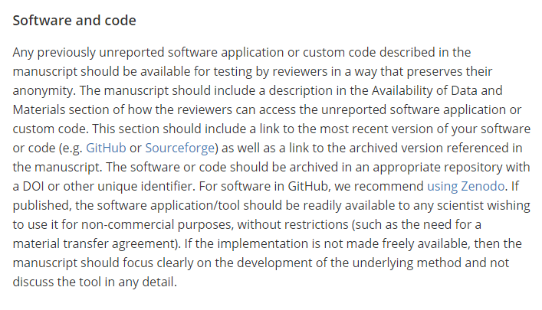

Policies: on code
Notes:
Add GB/BMC example

Slide 20
Policies: it’s in the implementation
Meta-analysis fails when <40% data available Systematic Reviews 2014, 3:97 doi:10.1186/2046-4053-3-97
Poor availability of psychological datasets (64/249 available) American Psychologist, Vol 61(7), Oct 2006, 726-728. doi:10.1037/0003-066X.61.7.726
Data received from 1/10 PLOS Medicine and PLOS Clinical Trials authors PLoS ONE 4(9): e7078. doi:10.1371/journal.pone.0007078
38% of 394 researchers contacted sent their data Collabra 2015 1(1) doi:10.1525/collabra.13
Notes:
Make a table?

Slide 21
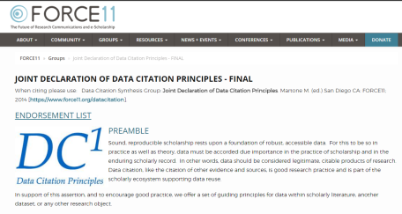

Reproducibility: Incentives
Enabling data and code citation
Data articles and journals
Recognising reproducibility – collaborating with challenges, awards

Slide 22


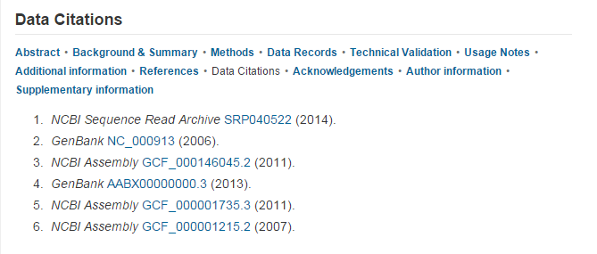
Data citation
Scientific Data (2014)
​doi:10.1038/sdata.2014.45
Notes:
Examples of Genbank, EGA data citations in Sci Data
Systems for referencing accessions in Nature articles

Slide 23






Reproducibility: Licenses
Articles: Creative Commons licenses
Metadata: released under the CC0 waiver to maximize reuse and aid data miners
Data: depends on public repositories. Some repositories e.g. figshare and Dryad both use the CC0 waiver.
Notes:
All publications at Scientific Data are open-access. Authors choose from three CC licences to cover the main human-readable article, and the data and metadata are released under open terms that permit the widest reuse.
Other examples of differential licensing: BMC and F1000R implementation of CC0 for data

Slide 24
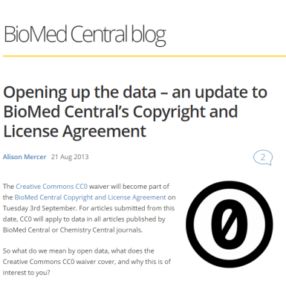
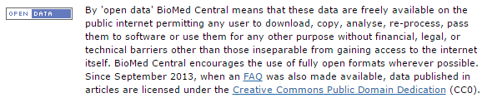
Licensing for maximum reuse
Further reading:
BMC Research Notes (2012) doi:10.1186/1756-0500-5-494

Slide 25
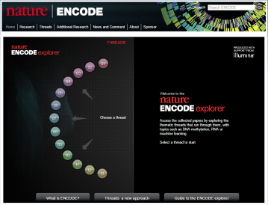
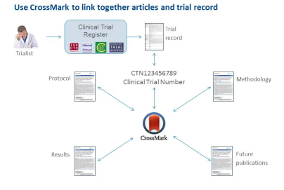
Reproducibility: Access
Discoverability and links to other digital products of research
More useful links between papers
Nature ENCODE explorer
BMC “Threaded Publications”

Slide 26
Reproducibility: Reliability/quality
Peer review at Scientific Data focuses on:
Completeness (can others reproduce?)
Consistency (were community standards followed?)
Integrity (are data in the best repository?)
Experimental rigour and technical quality (were the methods sound?)
Does not focus on:
Perceived impact/importance
Size/complexity of data

Slide 27
Reproducibility: Innovation
Collaboration between publishers and software/tools for science
Connect doing with communicating
Data and article submission integration (figshare, Dryad)
Various publisher-repository partnerships

Slide 28
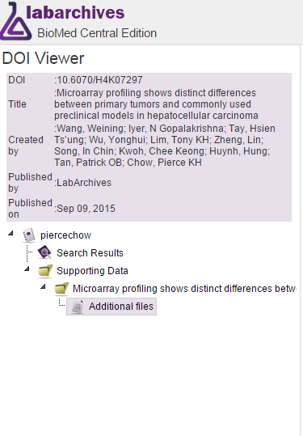
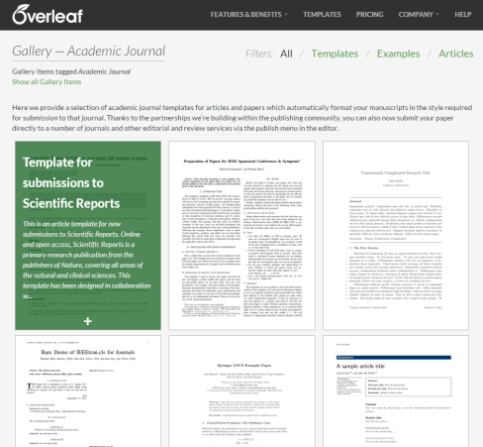
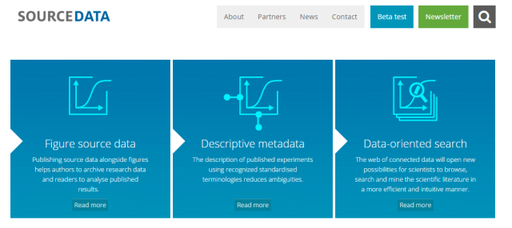
Reproducibility: Innovation
http://sourcedata.embo.org/

Slide 29
Thank you for listening
Iain Hrynaszkiewicz
Head of Data and HSS Publishing, Open Research Nature Publishing Group & Palgrave Macmillan
iain.hrynaszkiewicz@nature.com
@iainh_z

