Slide 1


An introduction to Unix* and the† shell
(*) unix-like operating systems
(†) actually, a shell
etc

Slide 2
Overview
This brief course will give you two things:
An introduction to Unix
An introduction to using the shell
…both of which will help you if you plan to attend the cluster training course or the bioinformatics programming courses.
This course has a practical component, you will need a ‘virtual machine’ on your laptop.
Session I
1 Introduction
2 Files and directories
3 Creating things
Session II
4 Pipes and filters
5 Finding things
Session III
6 Transferring files
7 Loops
8 Shell scripts

Slide 3
Bad reasons to be here
The shell is intutive and easy to use.
We’ll let you judge…
Shell tools let us process all kinds of data.
Only if the data is suitably ‘retro’.
The shell is a good programming language.
The shell pre-dates 40 years of important advances in software engineering.
Good reasons to be here
Unix-like operating systems are everywhere, and you can control them through the shell.
The shell allows you to automate workflows and eliminate repetetive tasks.
The shell is the natural route to other power tools like C, perl, R, & Java.
The shell is your gateway to the world’s supercomputers.

Slide 4
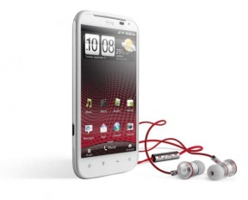


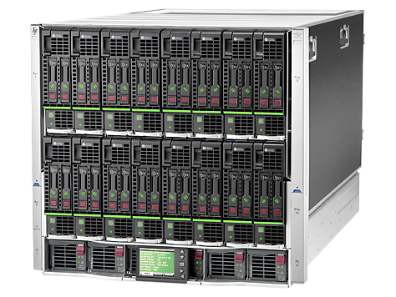
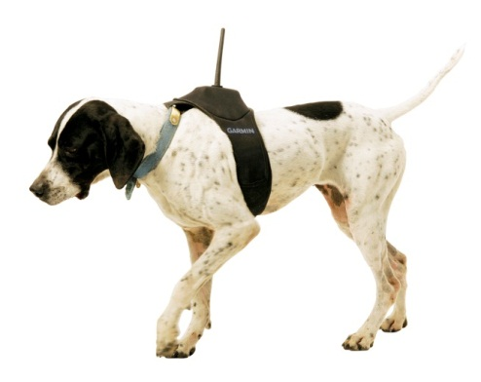
Places you will find unix
Android mobile devices
Apple
computers
cars
servers
things*
(As in ‘internet-of-things’)

Slide 5

But first, a warning.
It’s always 1969, and we are all American.

Slide 6
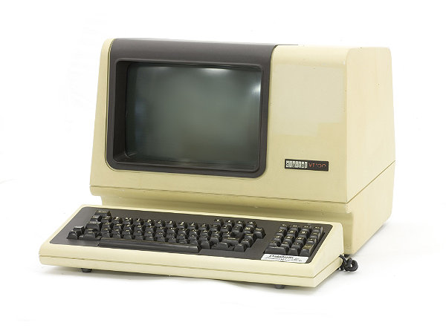
‘unix time’
Time stamps are encoded as the number of seconds since 00:00 on Thursday 01 January 1970.
Unix systems administrators have big parties every 1,000,000,000 seconds.
terminals
Unix and the shell pre-date windows and mice so everything works fine on an old terminal.
Text is entered and printed left to right, top to bottom.
‘Advanced’ software had moving flashing cursors and paging.
retro files
In 1970, most ‘files’ were lists of typewriter commands. Many unix commands still assume this to be true.
cccc ccc ccccc\n
cccccc\n
cccc cccc ccc\n
[EOF]

Slide 7
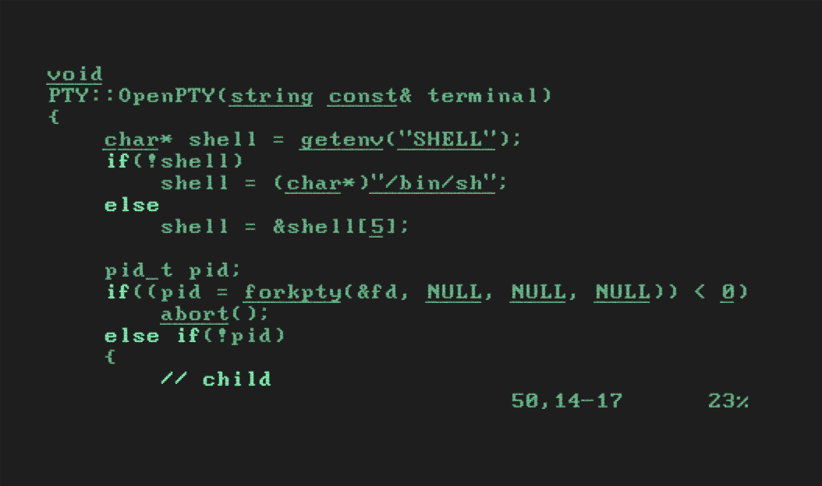

Slide 8
Warning – non-SI units!
Computers use binary internally, not base10, so powers of two have a special status.
2¹⁰ bytes = 1,024 B
When that was a lot of data, it was loosely termed a ‘kilobyte’ (KB).
An SI kilobyte would be 1,000 bytes (kB).
So what is a MB?
1MB = 1,000 x 1,024 KB ?
1MB = 1,024 x 1,024 KB ?
And so on for GB, TB, PB. Definitions of the value of a petabyte vary by ~125 TB!
caveat emptor!
ASCII
One standard was adopted – the “American Standard Code for Information Interchange”.
This defines 128 characters, based on US English typewriter keyboards and teletype commands – whitespace, carriage returns, beeps.
…no European accents, no Kanji, no Traditional Chinese.
Punctuation and special characters (, ; $ * ? ) were the only ‘spares’ to use as special commands. Interesting, strange or very bad things can happen if you have these in your file names.

Slide 9
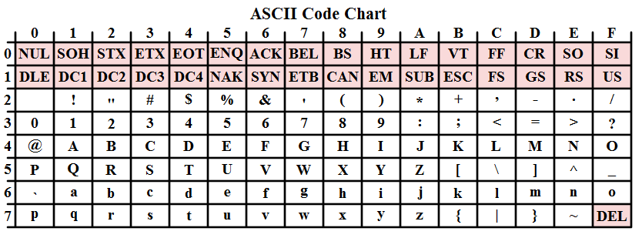

Slide 10
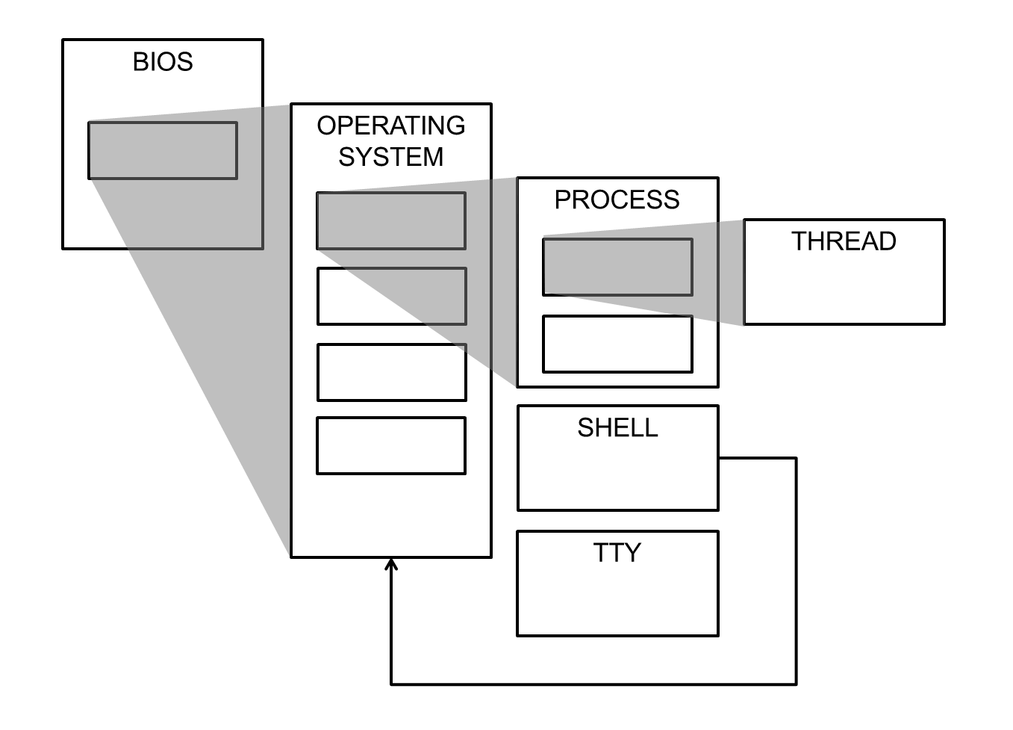
Operating Systems and Processes
‘Unix’ or ‘linux’ (or ‘UNIX’) is our operating system – the program that controls the processes and their access to the network, screen, etc.
The shell is a process – it happens to be one that can see its own OS, which is one of the reasons it’s so useful.

Slide 11
Session I
Basic navigation
Creating things
Practical session

Slide 12
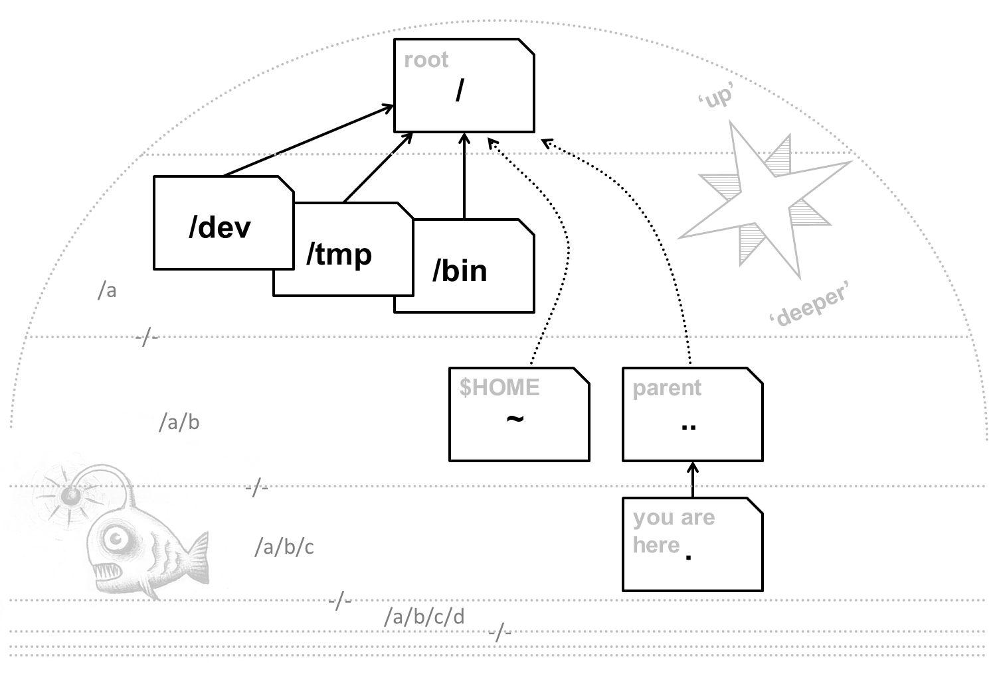
Navigation concepts
You need to be able to navigate without a GUI.
Fortunately some things are always in the same place.
Unix file systems are trees, with the roots at the top.

Slide 13
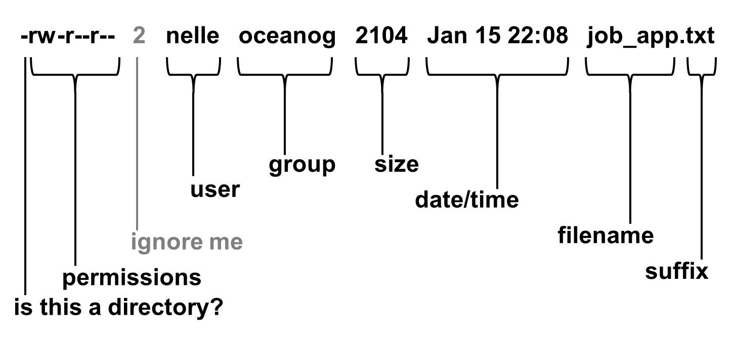
Directories and files
This is the output from the command ‘ls –l’.
It shows how unix likes to think about files and directories.

Slide 14
Files and directories
You’ll learn how to navigate a file system, see some of the sights, and get HOME when you are lost.
Creating things
You’ll make some files and directories of your own – without using your mouse once! – and learn how to clean up after yourself.
Editors…
Ah, yes, editing. We’re sorry. Editing before the invention of windows wasn’t pretty.

Slide 15
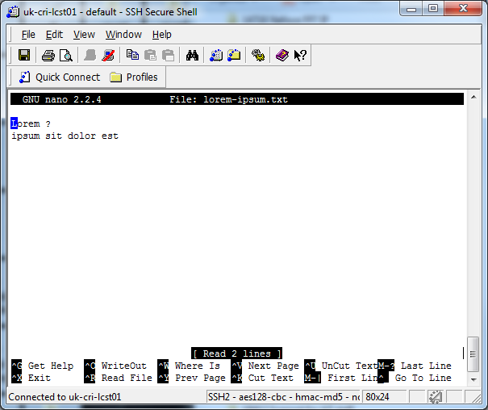
nano
The course uses ‘nano’ as its text editor. Those ^X characters mean “Ctrl+X”, they are often used in unixland to get at the “missing” ASCII characters not on the keyboard.
It’s easy to use, but sadly it’s not standard and you might not find it everywhere.

Slide 16
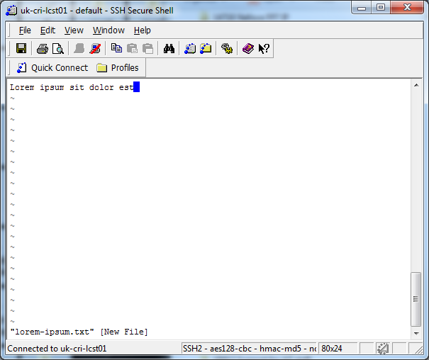
vi
You will find vi everywhere.
Unfortunately, you need to memorise the commands to use it –
i – enter insert mode
a – enter insert mode
ESC, :, w, NL – write
ESC, :, q, !, NL – quit without save
…

Slide 17
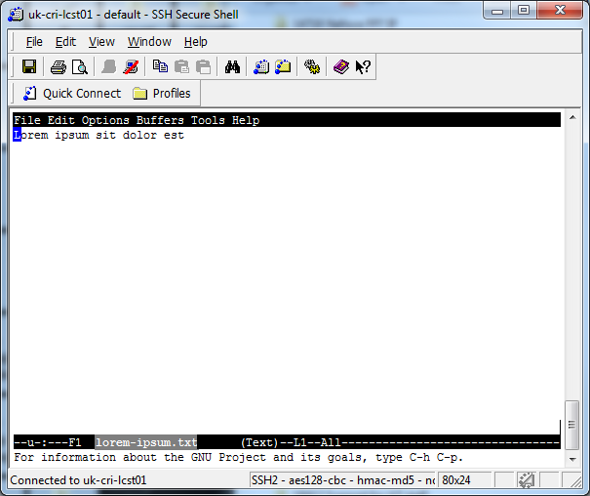
emacs
emacs was as good as editors got before windows GUI editors arrived. It allows you to open multiple files, has online help, and powerful search and replace.

Slide 18
pwd
‘print working directory’
This tells you where you are in the file system, and how deep.
cd
‘change directory’
The command that moves you from place to place.
whoami
‘who am I (logged in as)?’
Not as stupid as it sounds – it tells you which username you are logged in with. No spaces!
ls, ls -F
‘list’
Shows the content of the current directory.

Slide 19
mkdir
‘make directory’
Creates a new directory, in the current directory.
vi
‘visual editor’
Some day you will need to learn vi. Not today.
touch
Literally, ‘touch’
Updates the timestamp on a file, or creates it if it doesn’t exist.
rmdir
‘remove directory’
It removes a directory – but is relatively forgiving.
nano
‘an editor called nano’
A simple text editor for use in a terminal window.
rm, rm -r
‘remove’
Removes a file, or (with flags) a whole branch. rm does not forgive. There is no wastebasket.

Slide 20
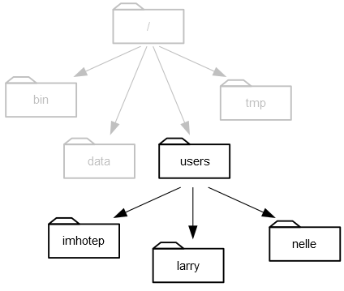

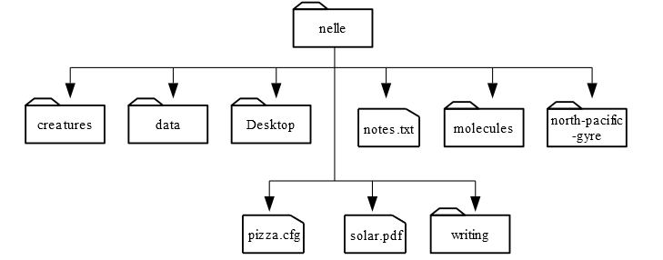
Hands-on sessions
None of this will make sense until you have tried it yourself. It’s easy to get access to a shell, but to give you all identical environments we’ve used some advanced machinery (Virtual Machines, Docker).
Nelle’s data
Nelle’s group share a file system:
And Nelle’s data is in her home directory:
The problem:
You are ‘Nelle Nemo’, a marine biologist. Your supervisor has given you a great project: but you have to use his analysis tools, and they are command line tools that only work on Unix machines…

Slide 21
Practical Session I
eOur practical sessions come courtesy of software-carpentry.org
Get your virtual machine working
Go to:
http://tiny.cc/crukUnix
( Which is http://bioinformatics-core-shared-training.github.io/shell-novice/)
Work through sections I.2, and I.3
Q & A session

Slide 22
Session II
Pipes and filters
Finding things
Practical session
etc

Slide 23
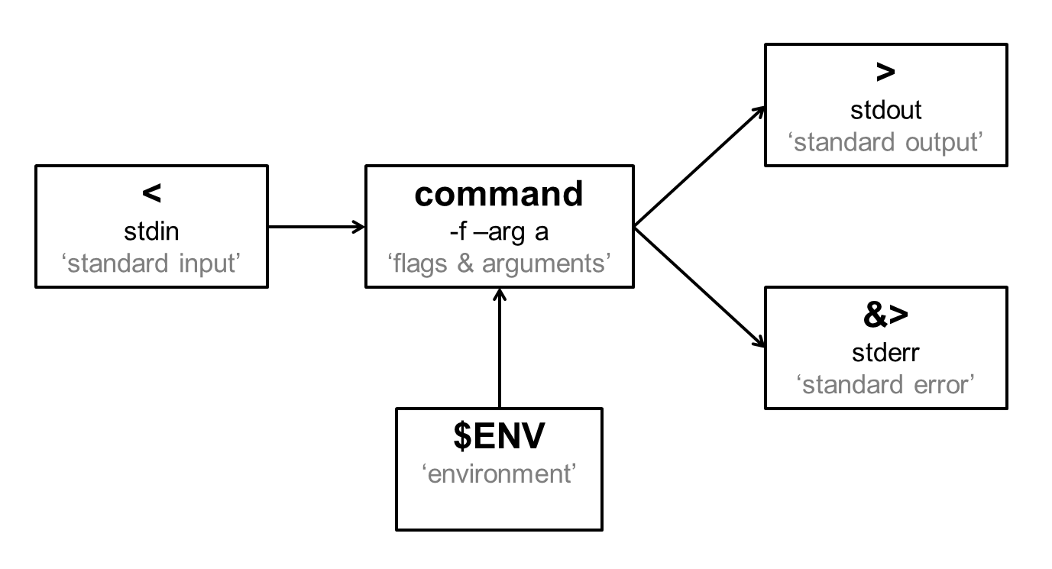
The anatomy of a unix command.
Unix processes have some standard ways of handling input and output.
The “environment” is the list of properties the process picks up from its parent. Your processes will all have the shell as their parent.

Slide 24
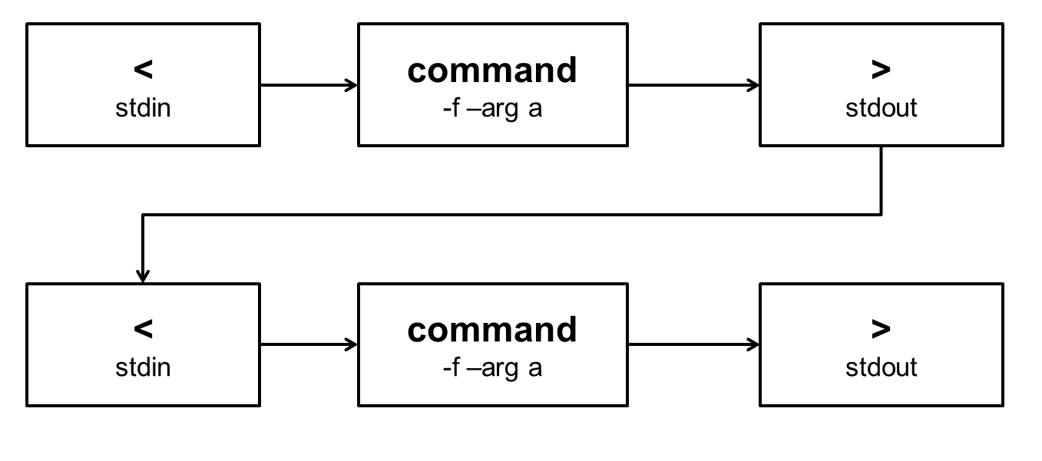
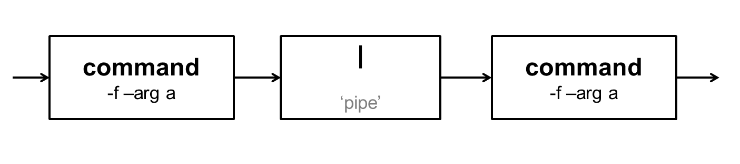
Pipes
Laziness is seen as a virtue among computer programmers. Rather than carry out this pattern over and over:
…you can short-circuit the stdout/stdin using a ‘pipe’.

Slide 25
We’ve lost <, >, and | from our keyboard – time to lose some more.
Globbing
In the shell, * ? and […] are treated as wildcards:
*.txt – any text file
bob*.txt – matches bob.txt and bobcat.txt
bo?.txt – matches bob.txt not bobcat.txt
bo[bg].txt – matches bob.txt and bog.txt
Regular expressions
There are more complex patterns called regular expressions which add even more complex rules (with slightly different syntax):
^[a-zA-Z0-9._%+-]+@[a-zA-Z0-9.-]+\.[a-zA-Z]{2,4}$
If you like regular expressions, you’ll love Perl…

Slide 26
Pipes and filters
You’ll learn how to use pipes, and then you’ll connect together a pipeline of commands to do some actual data filtering.
Finding things
This exercise shows you how to look for patterns in text files, and some of the ways to find individual files in a large file system.

Slide 27
wc
‘word count’
Counts the number of characters, words and lines in a text file.
head, head -N
‘head’
Prints the first few lines of a file, you can choose how many.
cat
‘concatenate’
Prints a single file or list of files to the screen.
tail, tail -N
‘tail’
Prints the last few lines of a file.
sort, sort -n
Yes, ‘sort’
Sorts the lines of a text file alphabetically or by number.

Slide 28
grep
‘global regular expression print’
Search for lines in a file containing a pattern.
man command
‘manual page’
Prints the manual page for a unix command. Very useful for flags and parameters.
find, find –name
‘find’
Search for files whose name (or other properties) match the search parameters.

Slide 29
Practical Session II
Go to:
http://tiny.cc/crukUnix
( Which is http://bioinformatics-core-shared-training.github.io/shell-novice/)
Work through II.4 and II.5
Q & A session

Slide 30
Session III
Traversing the internet
Loops and scripts
Practical session

Slide 31
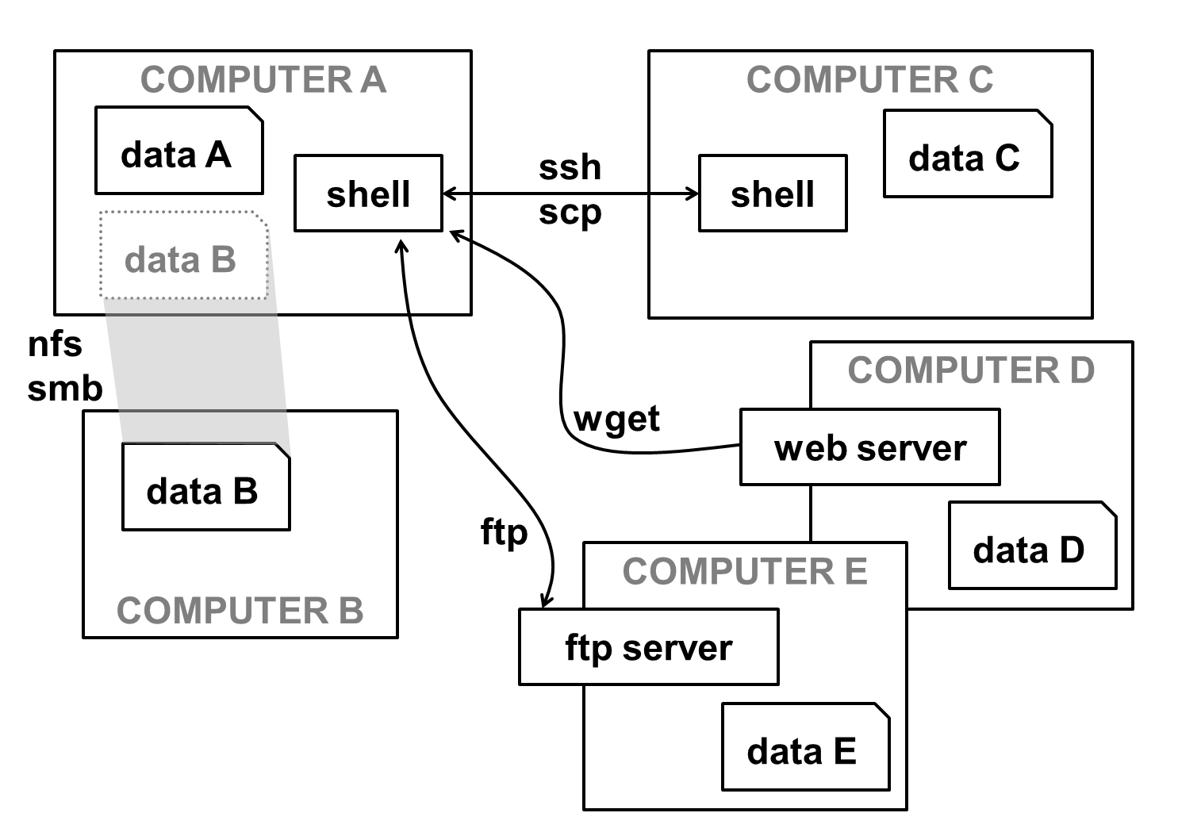
Moving data, or yourself
Most of the ways of moving data around the internet were developed for Unix first. You also have the option of going to where the data is, with a remote shell.

Slide 32
Shell programming
The shell gets to each line you type before it is passed to a unix command. So not everything you type is a unix command, some are instructions to the shell’s own language.
Beware! There are many different shells, and each is programmed in a slightly different way. We’re using bash
In the next exercises you will use
history
…giving access to the shell’s memory of what commands you have typed, and loops which let you repeat operations:
for x in a b c
do
echo $x
done

Slide 33
Transferring files
In this exerise you will experience telepresence, 1970-style, and rescue some files from other computers across the world.
Loops and shell scripts
The final exercises will introduce you to the basics of shell programming and scripting.

Slide 34
ssh
‘secure shell’
Opens up a shell session on a remote machine, over an encrypted channel.
ftp
‘file transfer protocol’
Creates another shell-like environment (with a different command set), from which you can connect to other machines and push or retrieve files.
scp
‘secure copy’
Carries out a copy between two machines, using the ssh machinery.
wget
‘web get’
Lets you grab a file using a url, without all that messing around with web browsers.

Slide 35
Other shells
Just for completeness, be aware that there are different shells…
bash
‘Bourne again shell’
The most widely used ‘user-friendly’ shell.
csh
‘the Berkeley UNIX C shell’
A hard-core sys admin’s shell.
sh
‘shell’
The original shell – sometimes the default.

Slide 36
Practical Session III
http://tiny.cc/crukUnix
( Which is http://bioinformatics-core-shared-training.github.io/shell-novice/)
Work through III.6
Q & A session
There are two more sections III.7, III.8 – these introduce some programming skills, and are a bit much for a half day introduction.

Slide 37
Feedback please: http://tiny.cc/unix-june22
Credits:
Cancer Research UK Cambridge Institute www.cruk.cam.ac.uk
Simon Bell, computing
Mark Dunning, bioinformatics
Peter Maccallum, computing
Marc O’Brien, computing
Anne Pajon, bioinformatics
The Software Carpentry Foundation
www.software-carpentry.org

