Slide 1
1st June-31st October 2019
1st June-31st October 2020
3551 FDG PET/CT
3443 FDG PET/CT
No staging purposes (e.g. response to treatment, recurrence suspicion)
Inflammation-infection disease
Neurodegenerative disease
798 eligible FDG PET/CT
1143 eligible FDG PET/CT
Oncological disease not confirmed
No follow-up data
No consent for partecipation to research
240 staging FDG PET/CT
371 staging FDG PET/CT

Slide 2
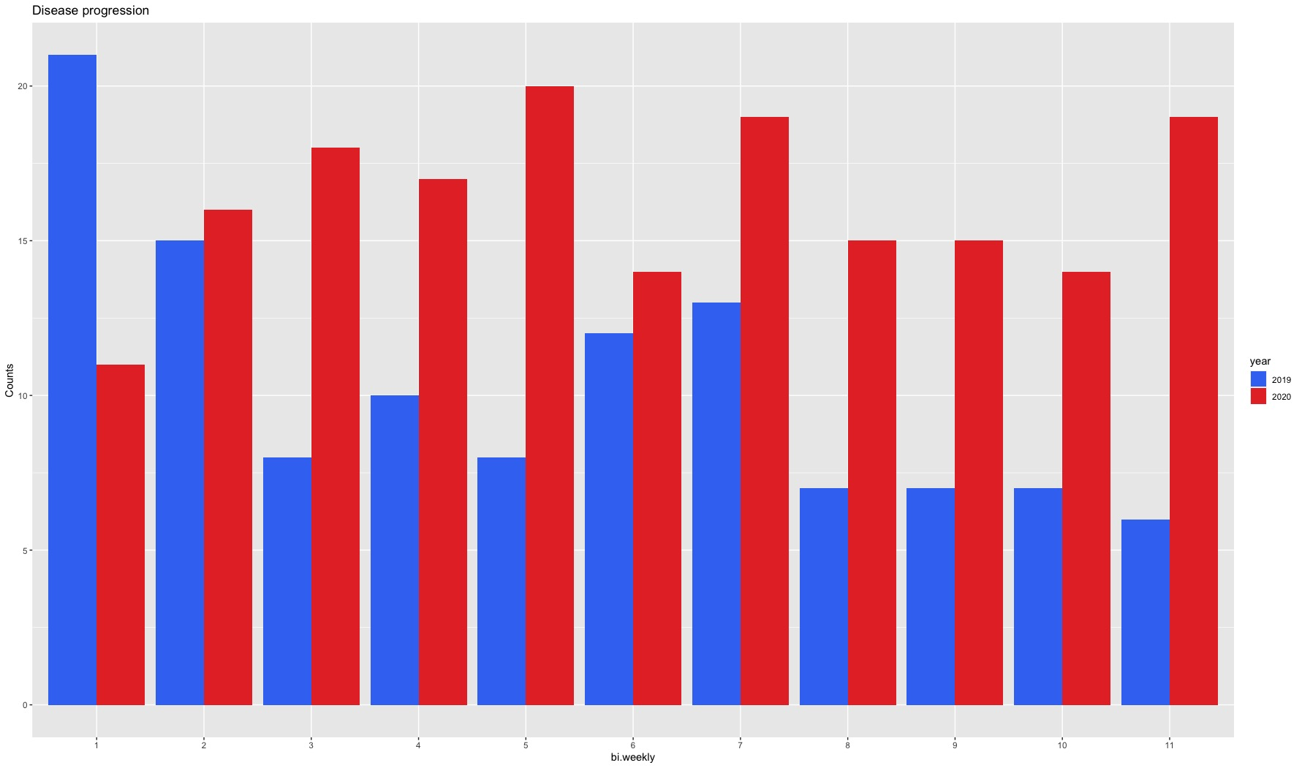

Slide 3
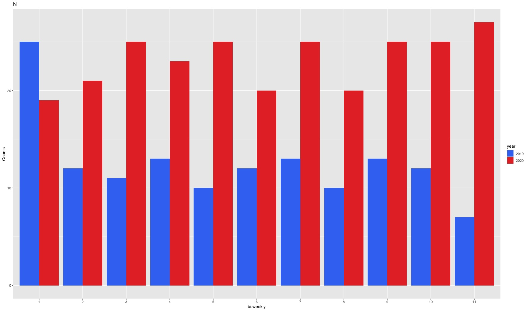

Slide 4
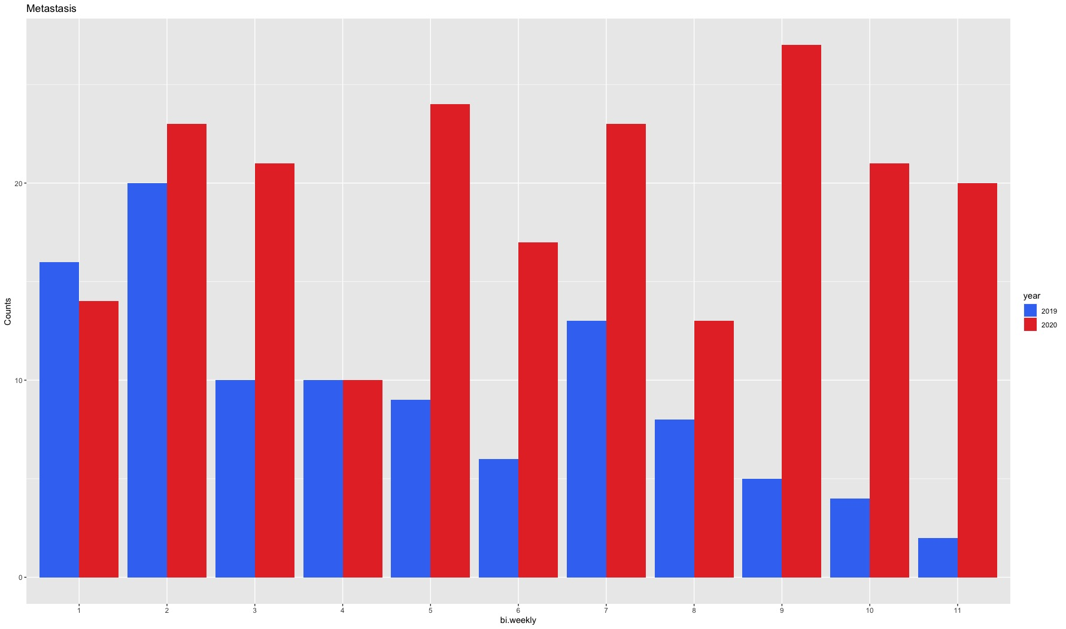

Slide 5
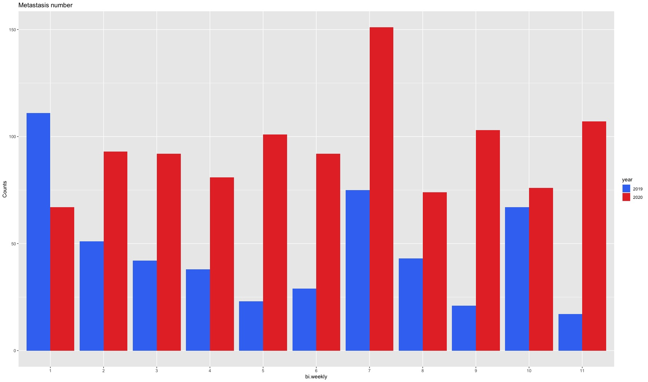

Slide 6
