Slide 1

bioinformatics.ca
bioinformaticsdotca.github.io

Slide 2
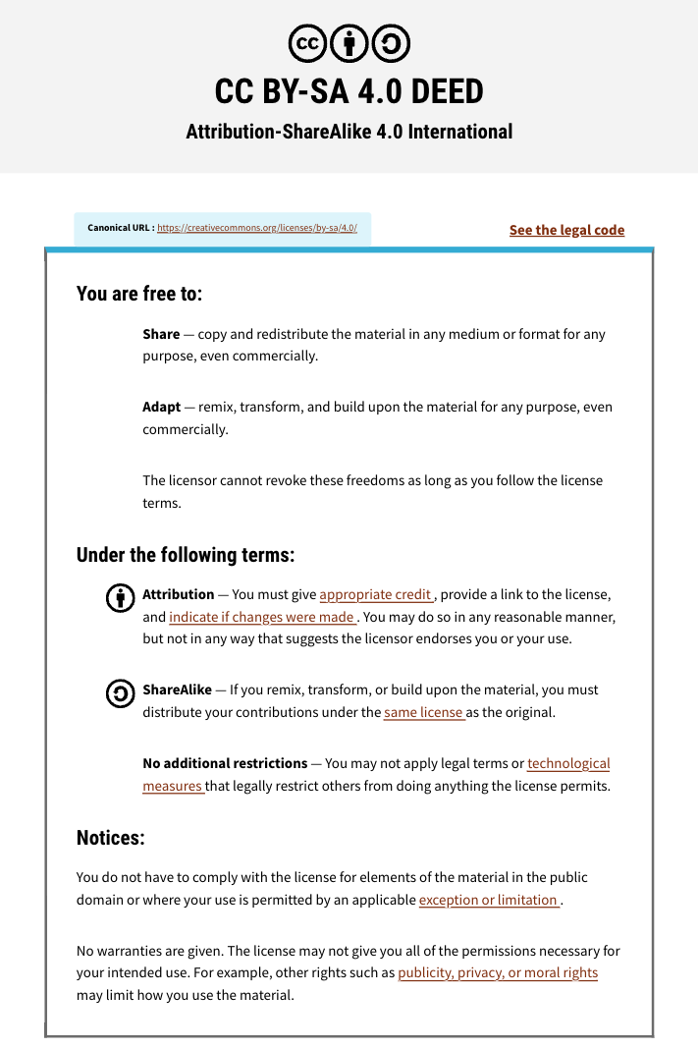

Slide 3


Module #1a:
Intro to Sequencing Technologies
Dr. Erin Pleasance
CBW High-Throughput Genomics
November 4-6, 2026
Some slides adapted from Jared Simpson and previous instructors

Slide 4
Learning Objectives
Sequencing trends
Understand the technology behind Illumina, Nanopore and PacBio sequencing
Compare and contrast the approaches
Be aware of newer technologies becoming available
Understand basic sequencing reads and quality measures

Slide 5
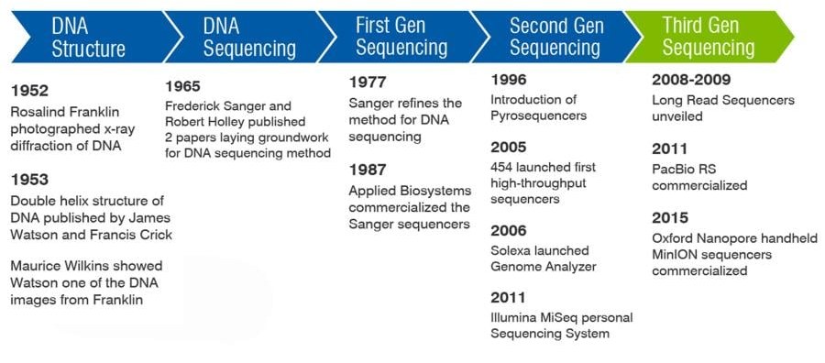
DNA sequencing history
Newer technologies competing in short-read space:
2022
AVITI (Element Biosciences)
2023
Complete Genomics
2024
Ultima
https://www.criver.com/eureka/history-dna-sequencing

Slide 6
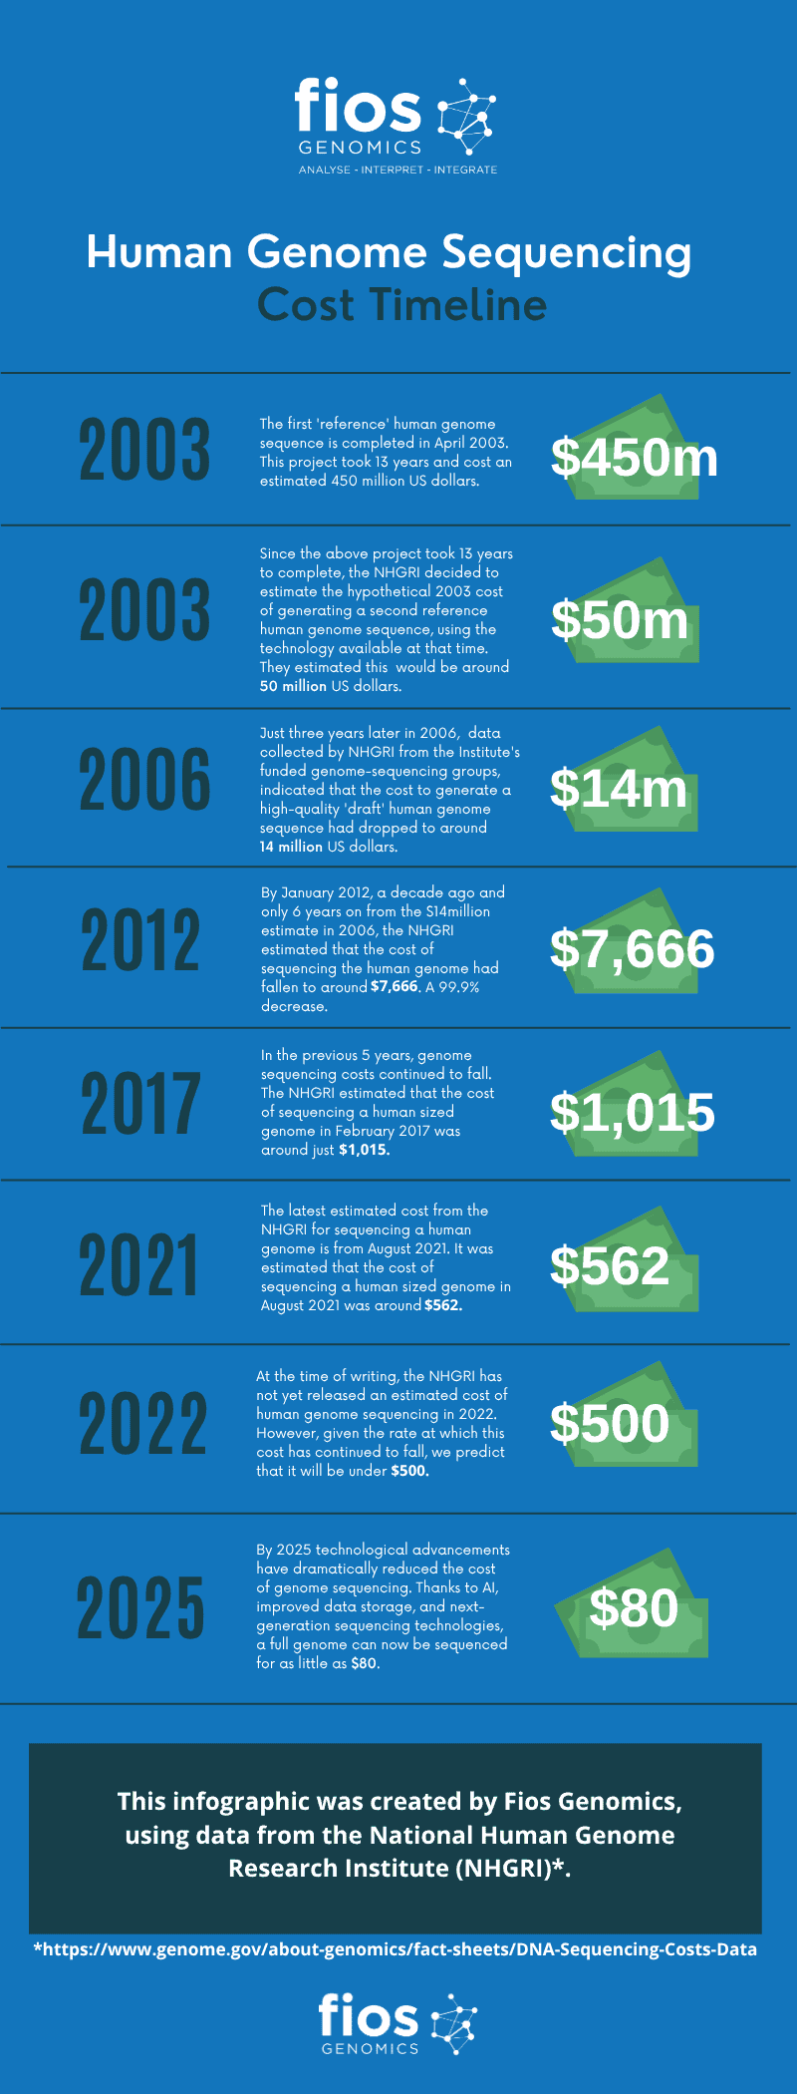
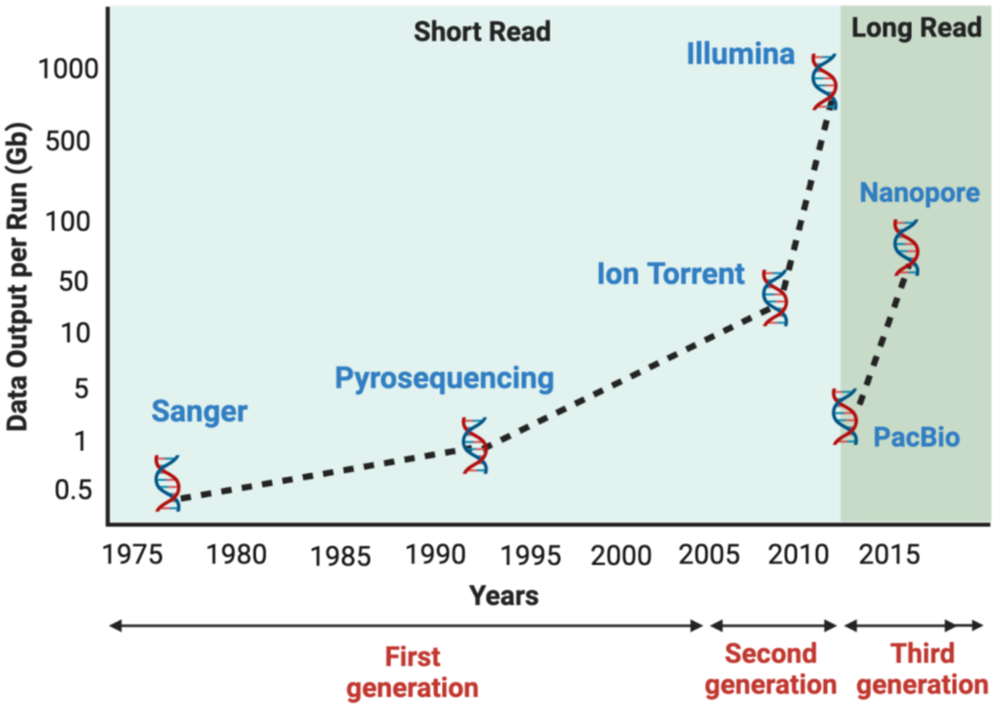
Throughput and cost
Human genome project complete
1,000 genomes project complete
100,000 genomes project complete
All Of Us /
1+ Million Genomes
PMID: 37508427
https://www.fiosgenomics.com/genomics-sequencing-data-analysis-a-cost-timeline/

Slide 7
Established players in sequencing
Illumina
Oxford Nanopore
PacBio

Slide 8
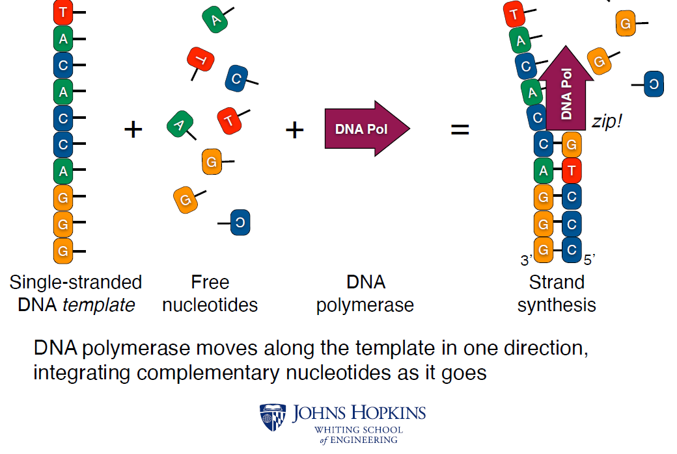
DNA sequencing: DNA polymerase

Slide 9
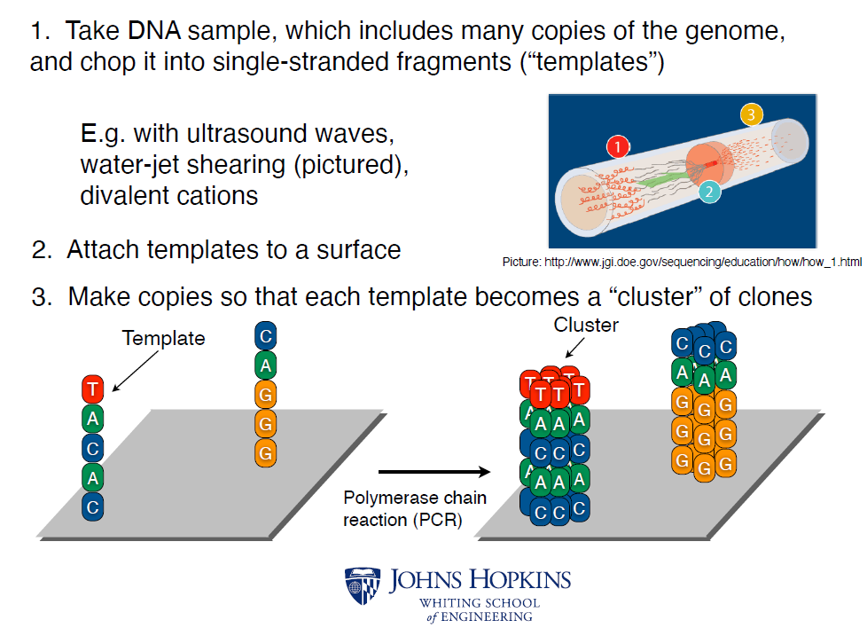
Illumina sequencing by synthesis

Slide 10
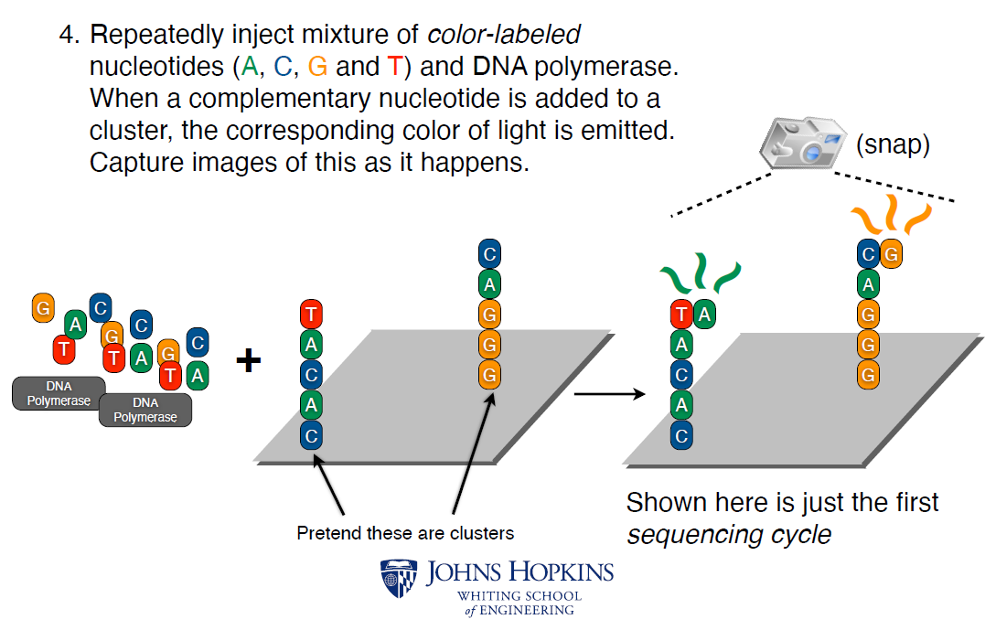
Illumina sequencing by synthesis

Slide 11
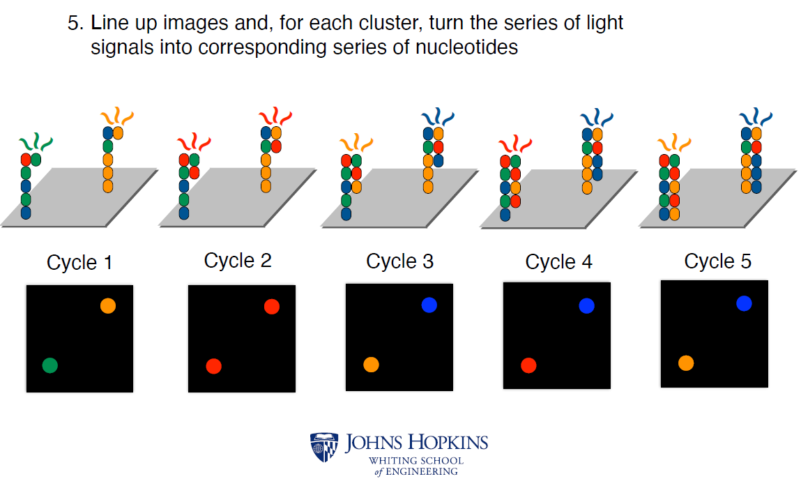
Illumina sequencing by synthesis

Slide 12
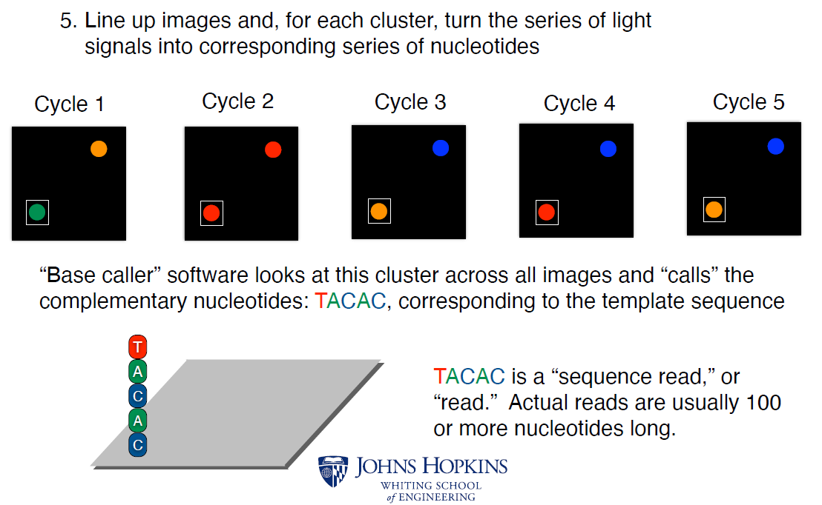
Illumina sequencing by synthesis

Slide 13
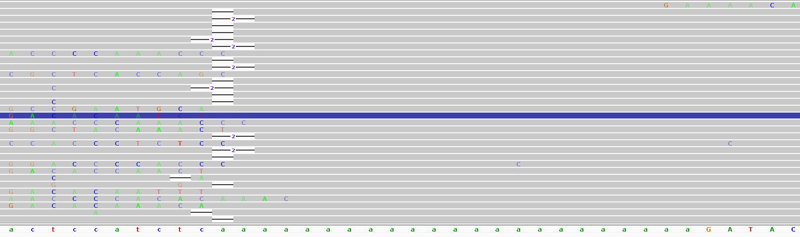
Homopolymers are tricky to sequence
Polymerases can slip on long sequences of the same nucleotide
Get lots of indels

Slide 14
Illumina read profile
Read pairs facing inwards
Length usually 150 bp each end of pair
Accuracy > 99.9%
Only ACTG, no modified bases

Slide 15
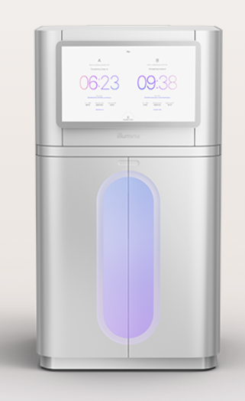

Illumina summary
High throughput, high accuracy, low cost
Different platforms for different needs
Most commonly used technology
Read length limited to ~150 bp each pair
No base modifications read
NovaSeq X Plus
MiSeq i100

Slide 16
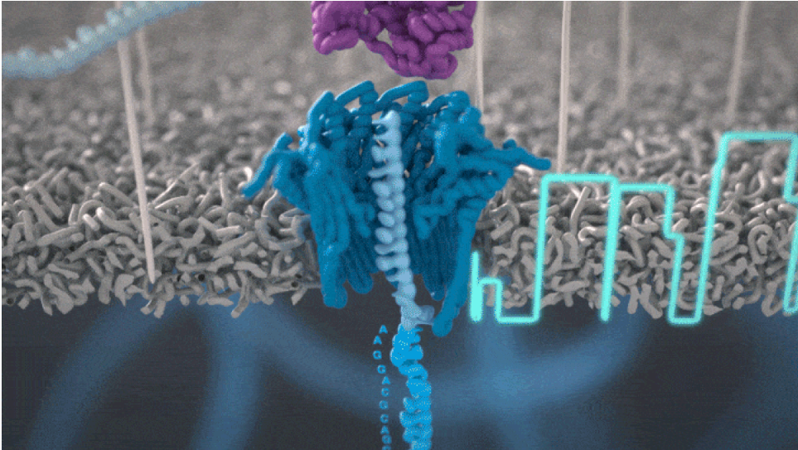
Oxford Nanopore (ONT) sequencing
Unique nanopore technology
Not sequencing by synthesis
https://nanoporetech.com/platform/technology

Slide 17
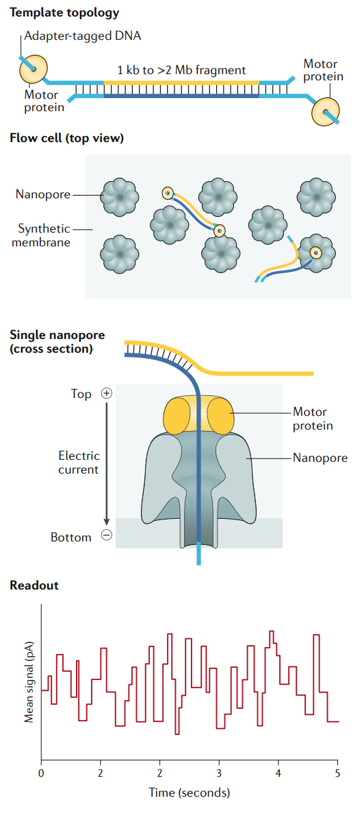
Oxford Nanopore sequencing
Native DNA or RNA
No amplification
Size selection not necessary
PMID: 32504078

Slide 18
Oxford Nanopore sequencing
Motor protein moves DNA through the pore
Detect changes in electrical signal depending on sequence in the pore (“squiggle”)
PMID: 32504078

Slide 19
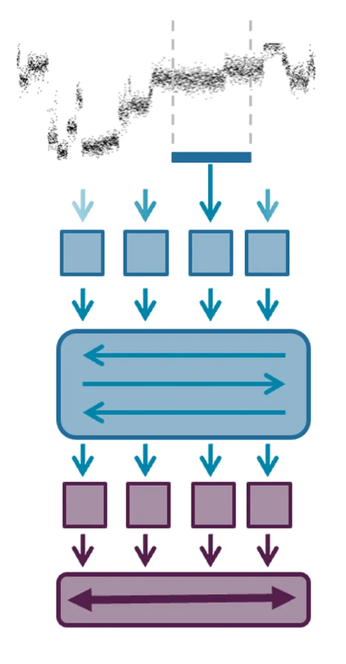
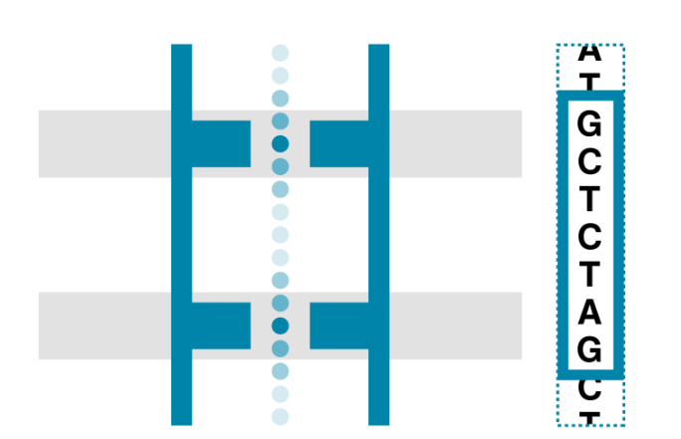
Oxford Nanopore sequencing
Signal depends on multiple bases
Basecaller decodes
https://nanoporetech.com/platform/technology

Slide 20
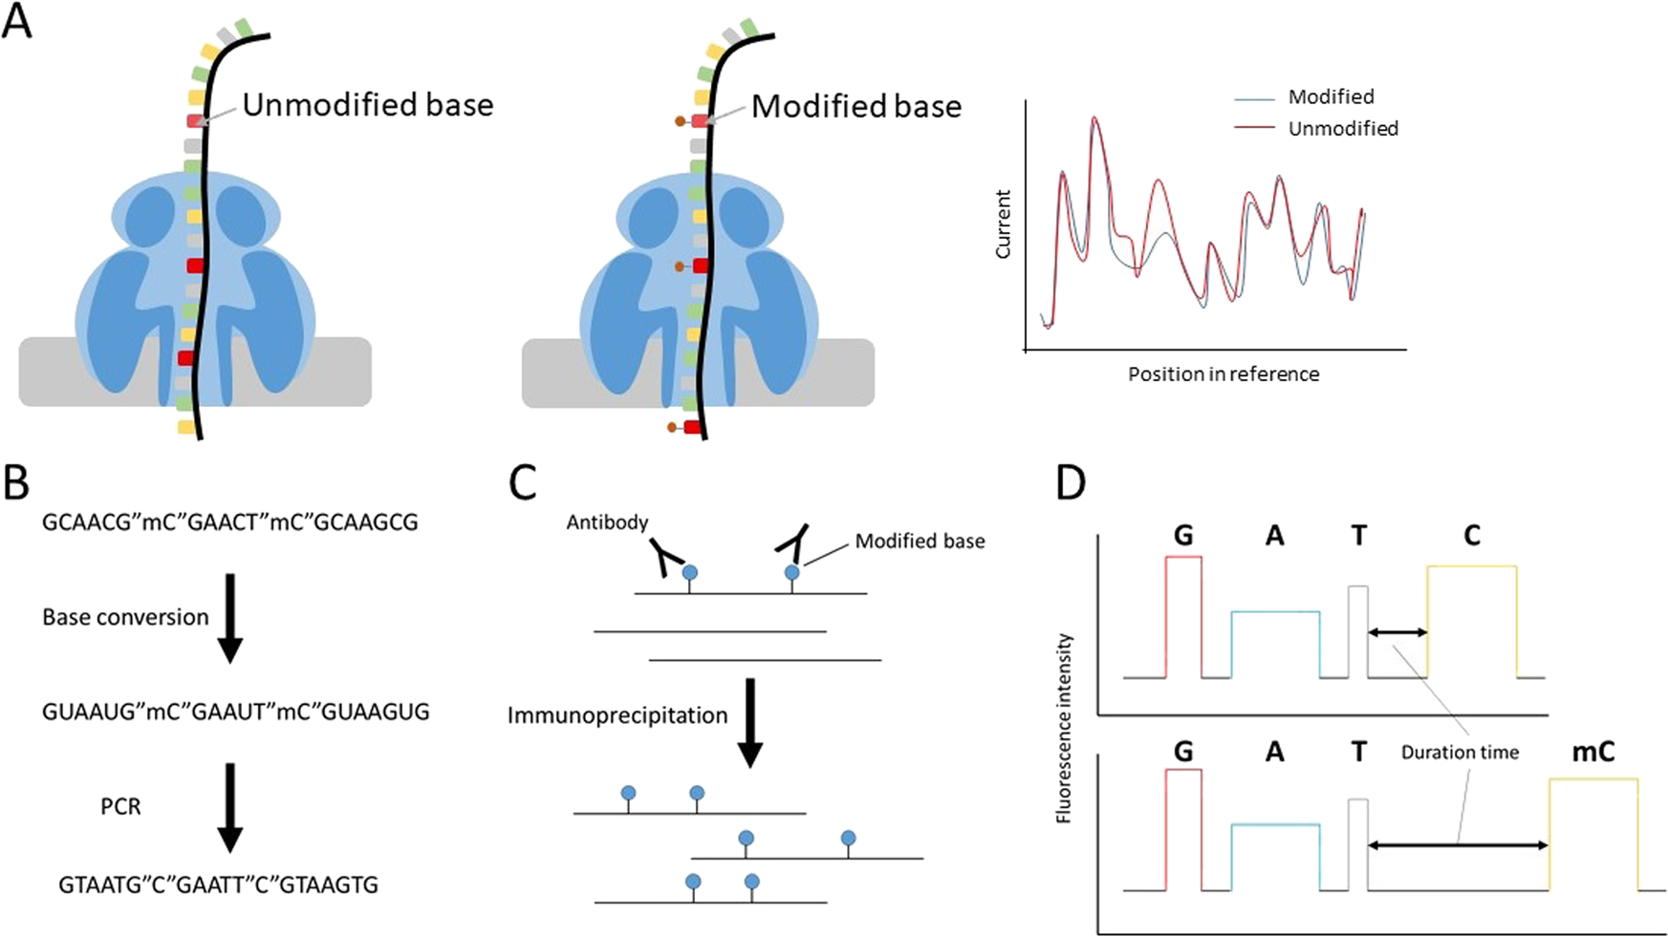
Oxford Nanopore sequencing
Includes base modifications:
  5mC in DNA
  m6A in RNA
  Others with variable accuracy
PMID: 31602005

Slide 21
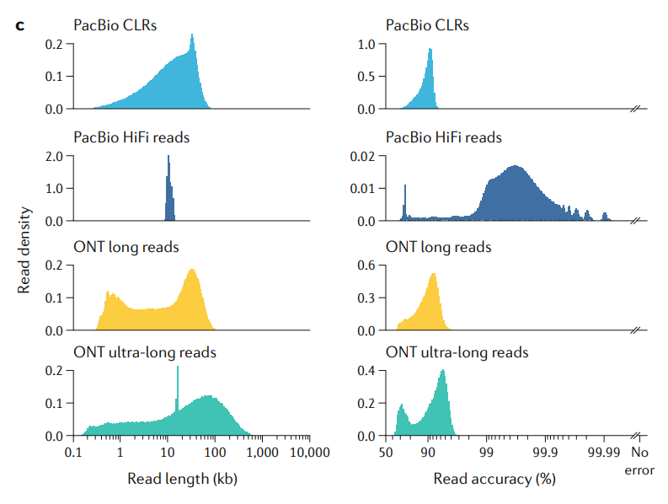
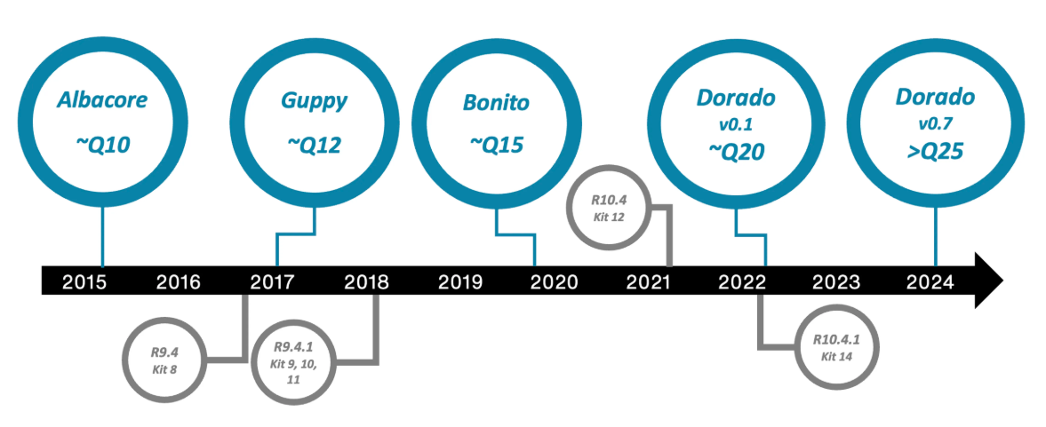
Oxford Nanopore read profile
Single end
Very long reads (10 kb – 1M+)
Higher error rate especially at homopolymers
Captures base modifications
PMID: 32504078
https://nanoporetech.com/platform/technology

Slide 22
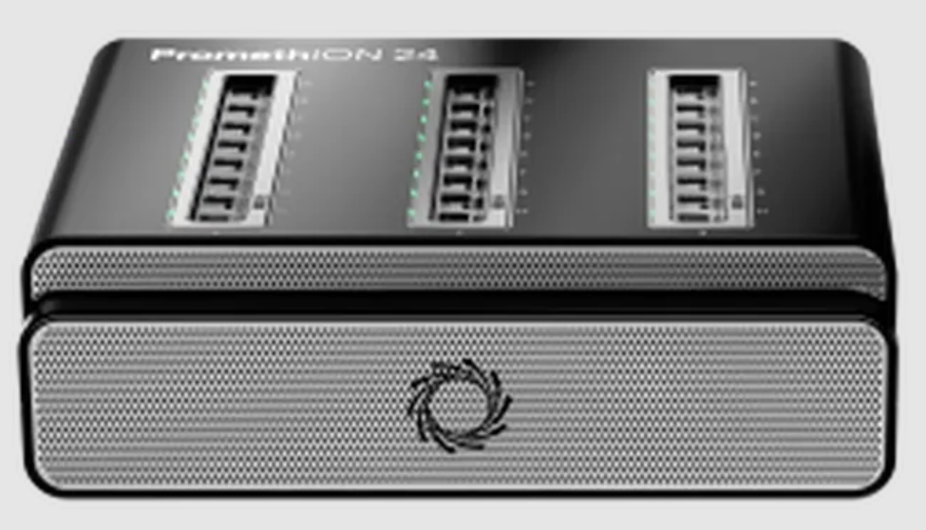
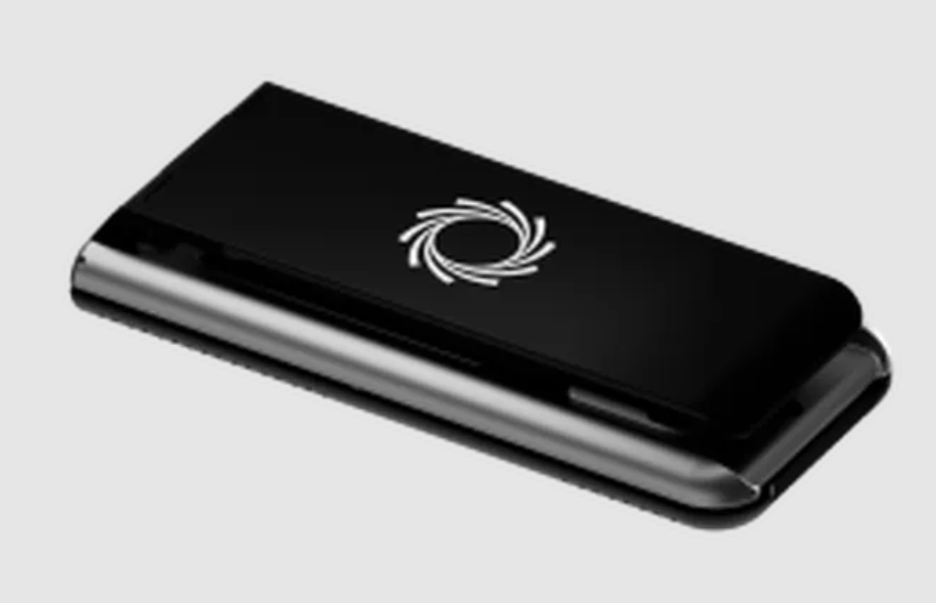
Oxford Nanopore summary
Very long reads
Lower accuracy
Minimal prep, highly flexible
PromethION
MinION

Slide 23
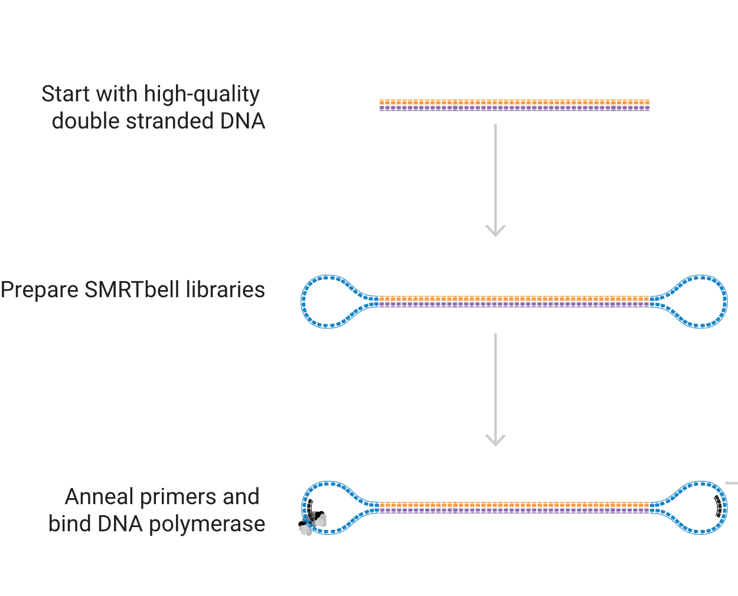
Pacific Biosciences HiFi sequencing
Create circular template
https://www.pacb.com/technology/hifi-sequencing/how-it-works/

Slide 24
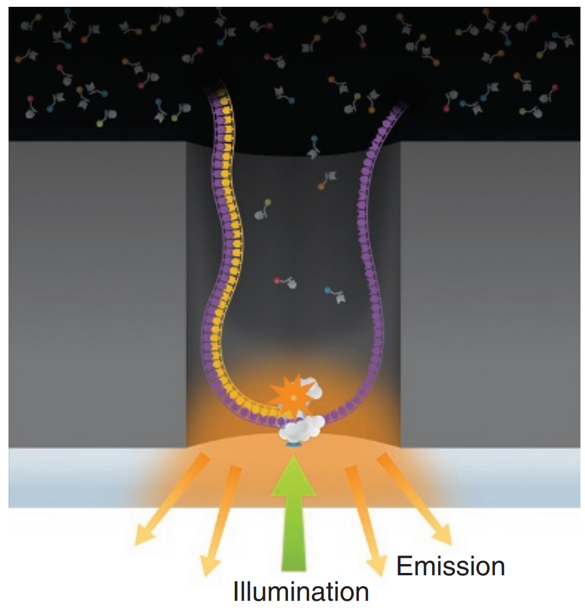
Pacific Biosciences HiFi sequencing
Millions of nanowells (Zero-Mode Waveguide, ZMW)
One polymerase each
Sequencing by synthesis
PMID: 32504078

Slide 25
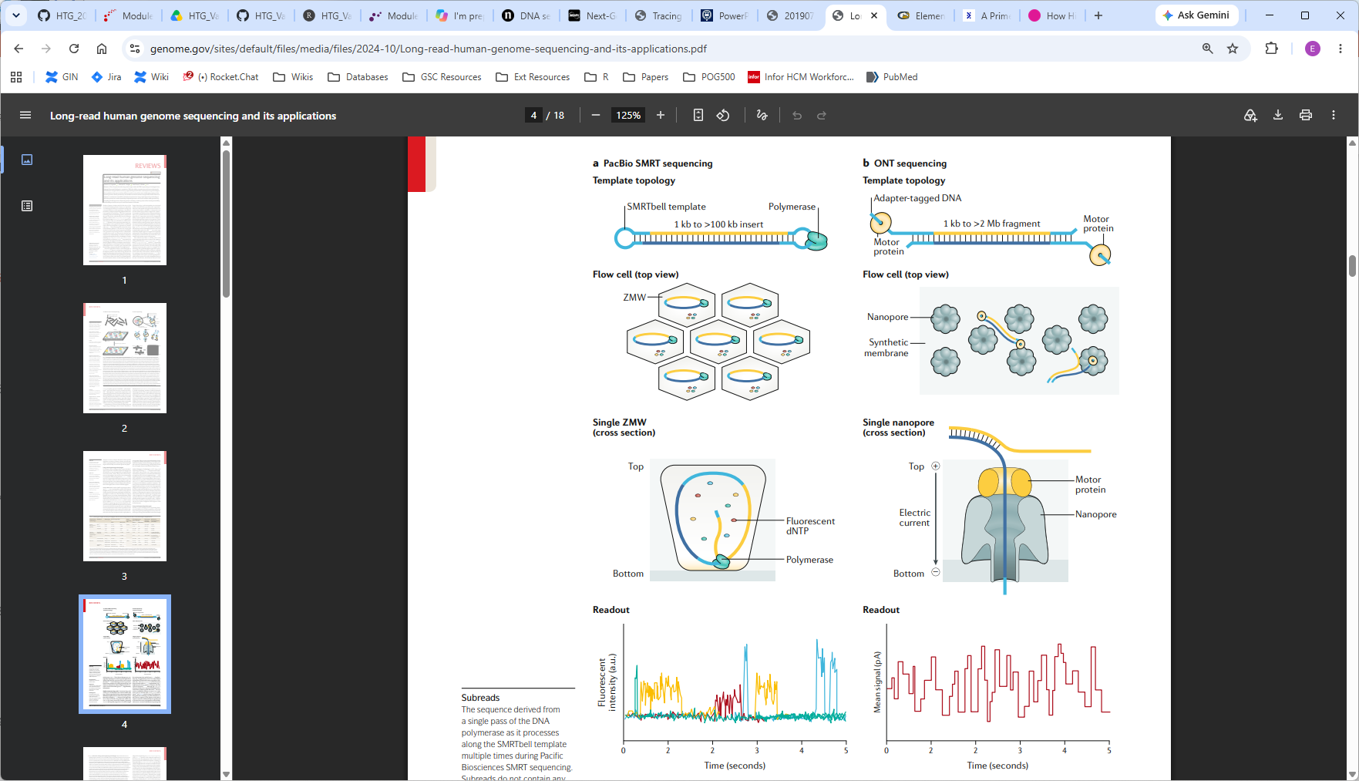
Pacific Biosciences HiFi sequencing
Create circular template
Millions of nanowells (Zero-Mode Waveguide, ZMW)
One polymerase each
Sequencing by synthesis
Detect light emitted in nucleotide incorporation
PMID: 32504078

Slide 26
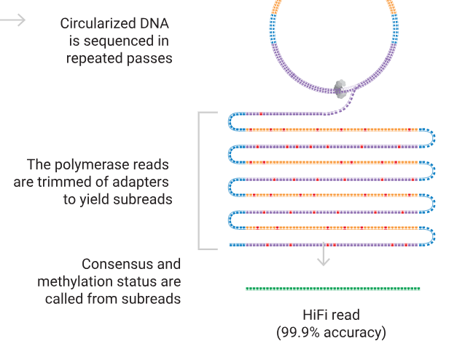
Pacific Biosciences HiFi sequencing
Sequence repeatedly around circle and take consensus
Individual accuracy < 90%
Consensus accuracy > 99.9%
https://www.pacb.com/technology/hifi-sequencing/how-it-works/

Slide 27
PacBio read profile
Single end
Long reads (> 10 kb)
Extremely low error rate
Captures base modifications

Slide 28
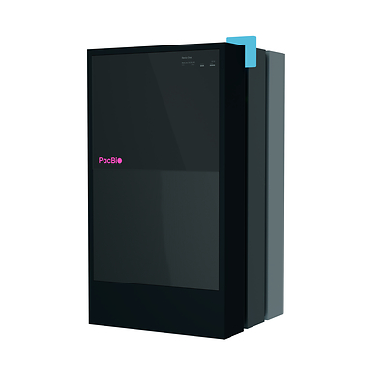
PacBio summary
Very high accuracy, long reads
Widely used for genome assembly
Higher cost per base
Large footprint
Revio

Slide 29
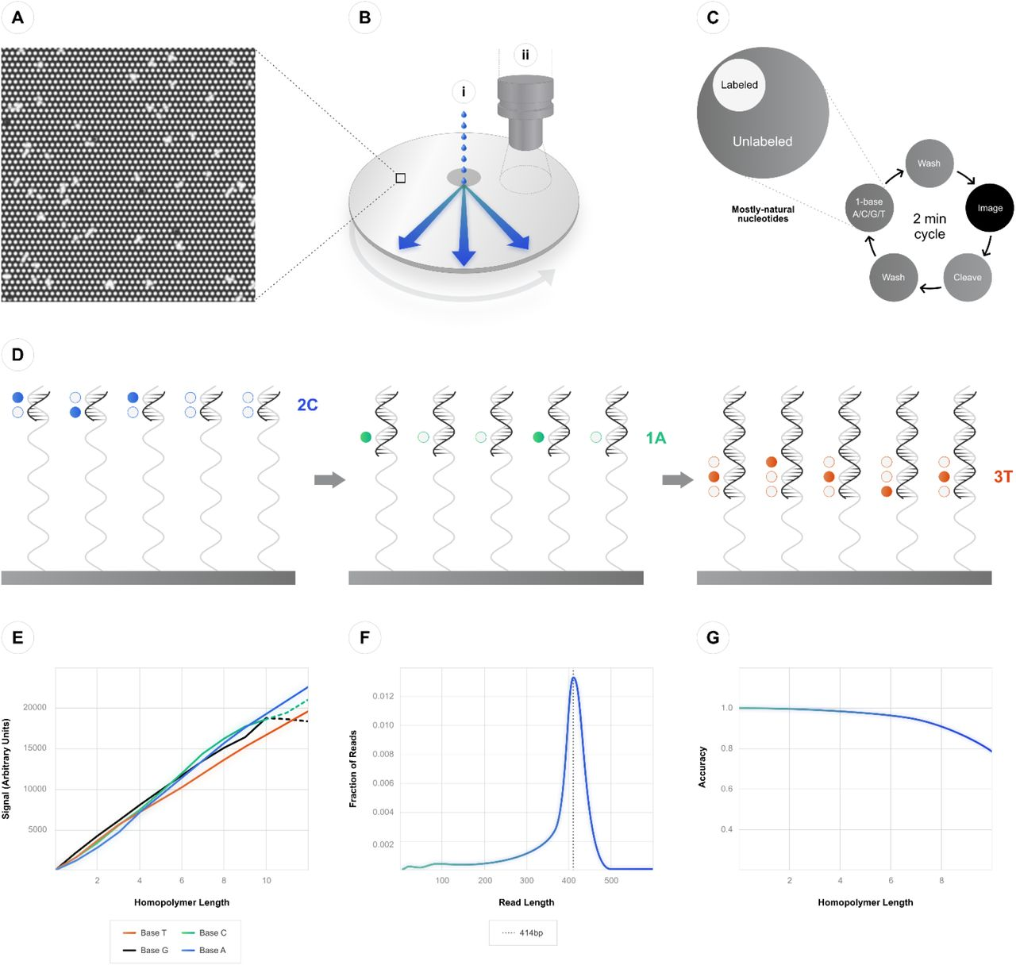
Newer technologies: Ultima
Short read sequencing by synthesis
Wafer chip
Reduced use of expensive labelled dNTPs
Recently released paired reads
Pushing for $80 whole genome
https://www.biorxiv.org/content/10.1101/2022.05.29.493900v4.full

Slide 30
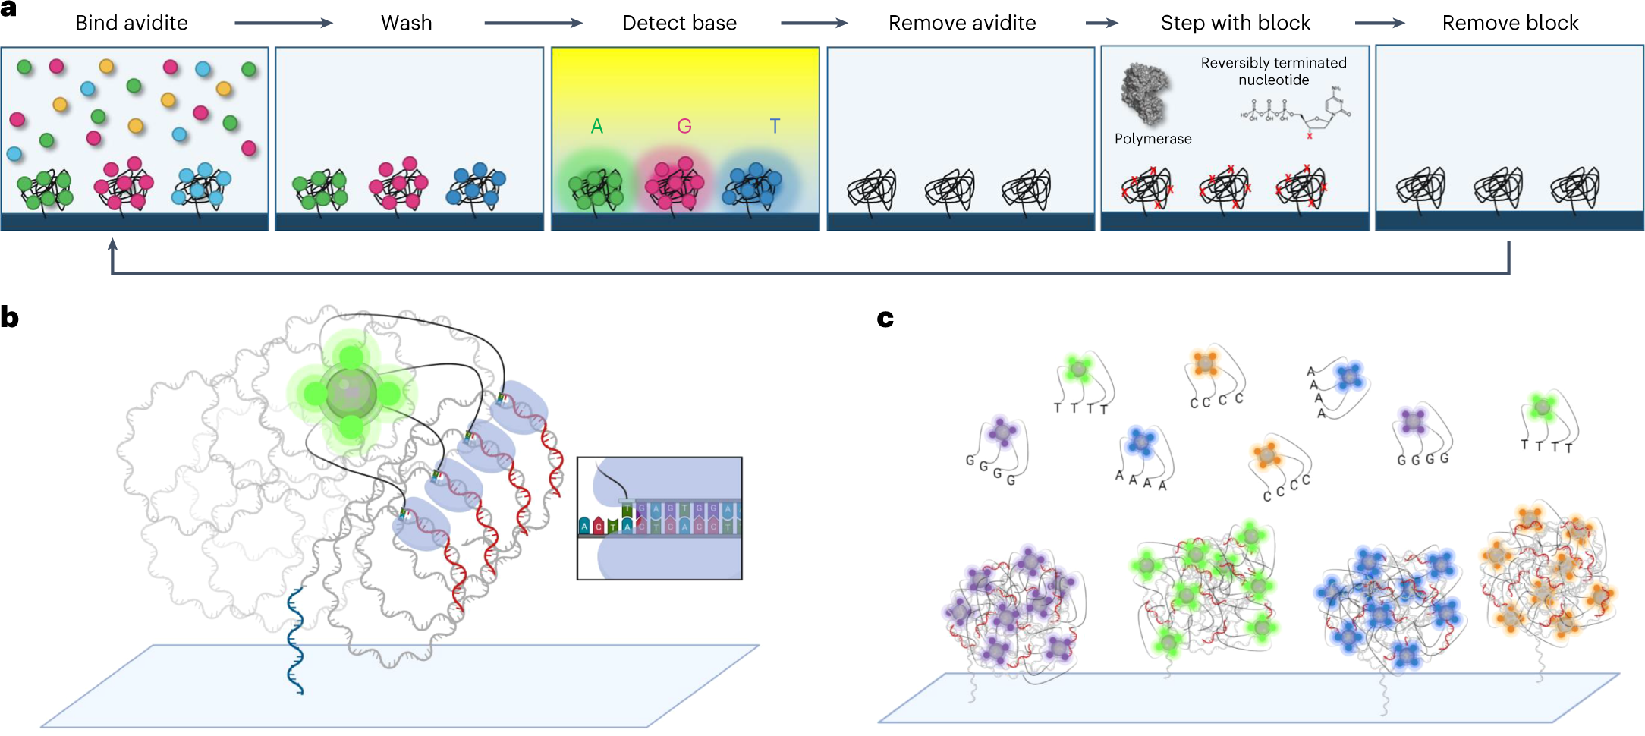
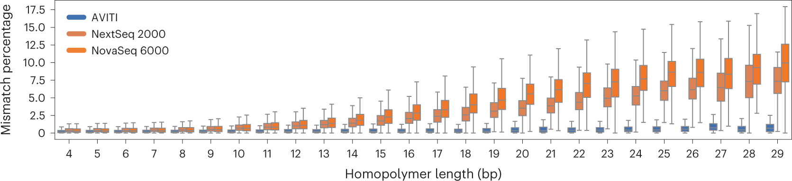
Newer technologies: AVITI
Polymerase based
Multivalent nucleotide binding
Better homopolymer accuracy
Paired short reads
Not cheaper

Slide 31
Sequencing formats
FASTA: Base sequences
FASTQ: Base sequences and quality scores
BAM/CRAM: Alignment formats (compared to a reference)
>chromosome1
AGTCGATCGATCAGACTAACGATCGATCGAATCGAAT
>chromosome1
AGTCGATCGATCAGACTAACGATCGATCGAATCGAAT
+
CFHIGIGIJIIJFHIJJIIJIHFFFEDDDDDDDDDDD

Slide 32

Sequencing quality
Quality is measured by the Phred score (named after software Phred, used for Sanger sequencing analysis in the 1990s). Eg a “Q40 base” is highly accurate
Q = -10log10P_{error}
P
(obs. base)
Base Quality 3
5
10
20
30
40
ASCII Character $
&
+
5
?
I
error
50 % 32 % 10 %
1 % 0.1 % 0.01 %

Slide 33
Representing aligned reads
Mapping/aligning reads to a reference genome is a core component of many analysis workﬂows. You’ll hear more about this in later Modules
Mapping describes where in the reference genome a read matches. This read maps to position 1,020 on chr10
chr10:1,020
ATGAGAGAGTATCTCGACTCTAGGCCGATACCA
||||||||||||||| AGTAACTCGACTCTA
read-a
Alignment describes how the bases in the read line up against the reference genome at the mapped location. This read has 14 matches and 1 mismatch.
The location of the read on the reference genome and pattern of mismatches/indels is represented in bam/cram format.

Slide 34
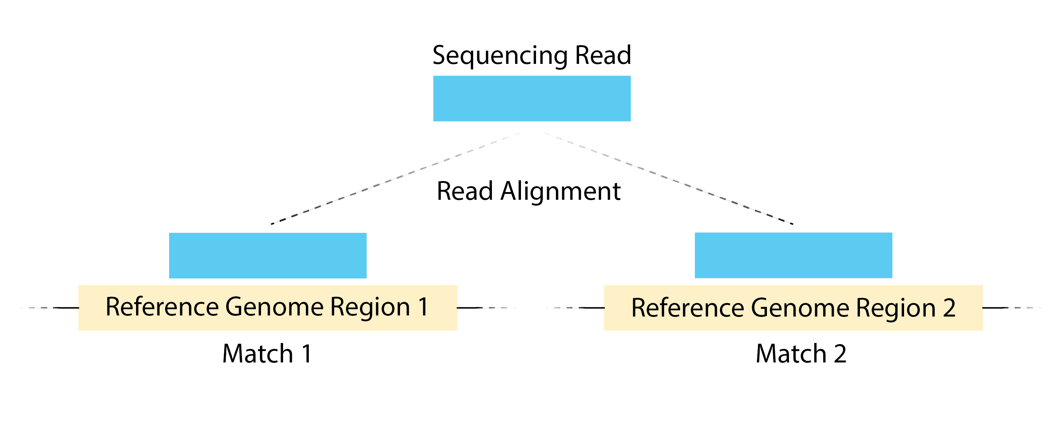
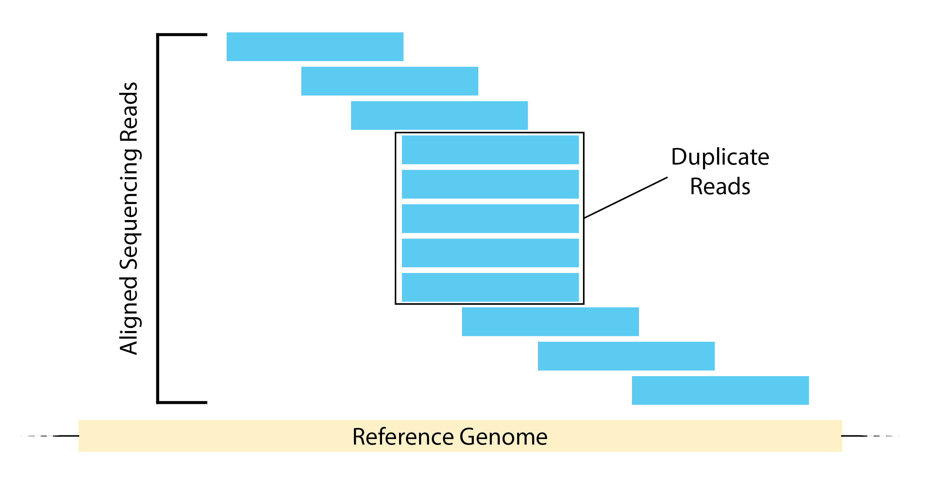
Mapping quality
Mapping quality is dependent on the similarity of the match and the uniqueness of the match
More likely to be low in repetitive regions
Also uses a Phred score
Single mapping location →
Good mapping quality, if few mismatches
Multi-mapped read →
Poor mapping quality (MQ0)
https://hbctraining.github.io/

Slide 35
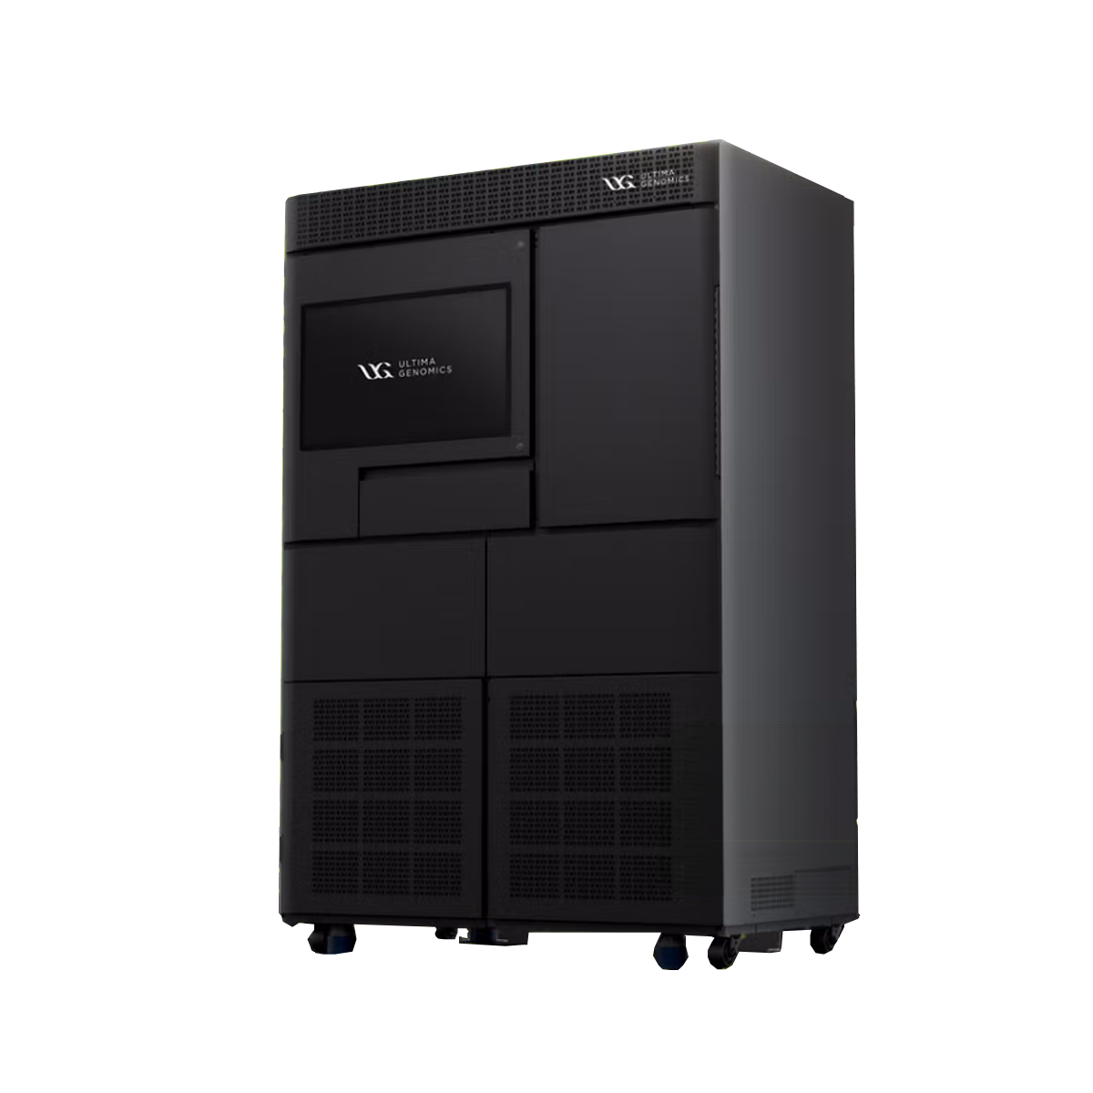
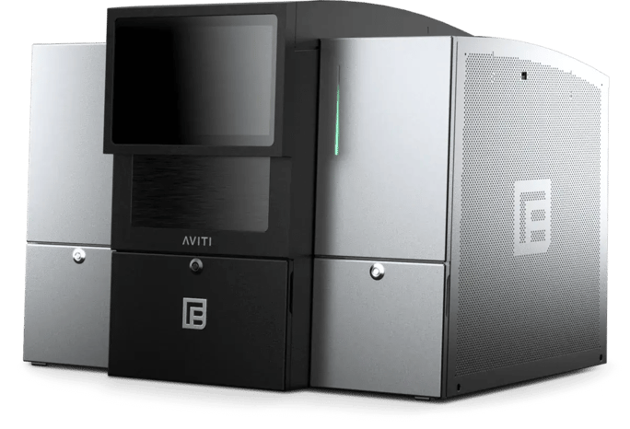
We have a lot of tools

Slide 36





Coffee Break & Networking Session
Workshop Sponsors

