Slide 1

bioinformatics.ca
bioinformaticsdotca.github.io

Slide 2
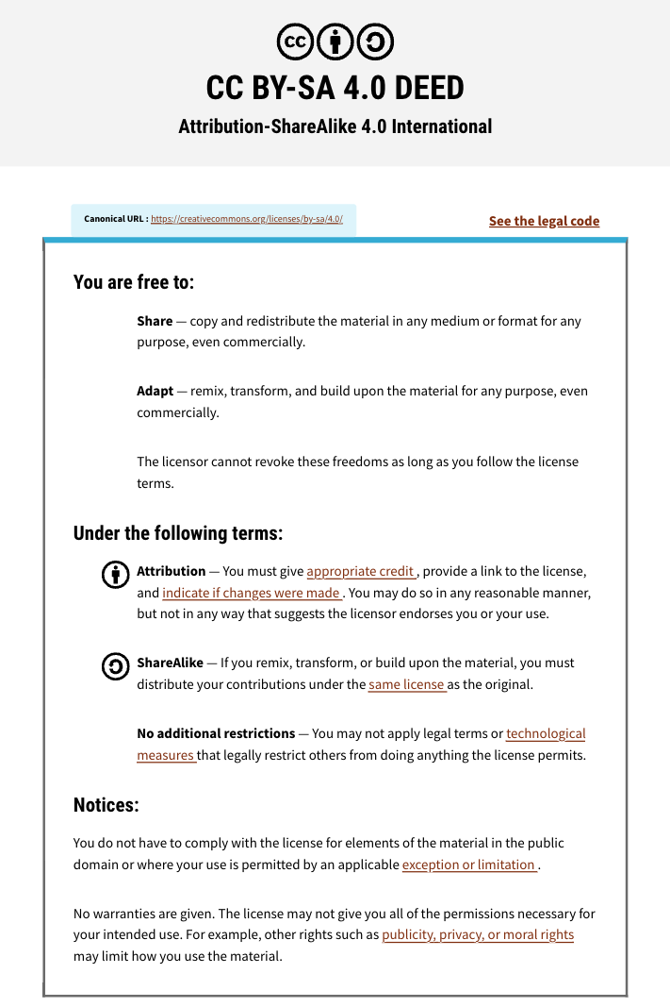

Slide 3


Module #1b:
Sequencing Technology Applications
Dr. Erin Pleasance
CBW High-Throughput Genomics
November 4-6, 2026

Slide 4
Learning Objectives
Considerations in analysing large genomic datasets
Data sharing in genomics
Overview of applications of sequencing technologies
Considerations in choosing your approach

Slide 5
Genomics produces a lot of data
… this brings complexities
Data storage size
Data sharing
Statistical considerations

Slide 6
Data size
One Illumina NovaSeqX 25B flowcell can create 10 Tb (10,000,000,000,000 bases) in one run
Files are large – eg. one human genome bam/cram can be easily 50-300 GB
Storage costs are significant
Data processing can require significant compute
Decisions about local vs. cloud storage/processing

Slide 7
Some common genomics databases
SRA (NCBI): Publicly available large sequencing datasets
EGA, dbGAP: Individual sequencing datasets with metadata
GEO: Other genomics data eg. expression data
dbSNP, DGV, ClinVar: Databases of variation

Slide 8
Data sharing in genomics
Data sharing is central to genomics
Findable, Accessible, Interoperable, and Reusable (FAIR) principles
  Findable: Data are in a searchable database, with a unique ID, and metadata
  Accessible: Data and metadata can be accessed in a standard way, with authorization as appropriate
  Interoperable: Data and metadata are in standard format using standard ontologies
  Reusable: Clear licensing, clear metadata, meet community standards
  See https://www.nature.com/articles/sdata201618
Required by many journals for publication
Code sharing is also commonly required

Slide 9
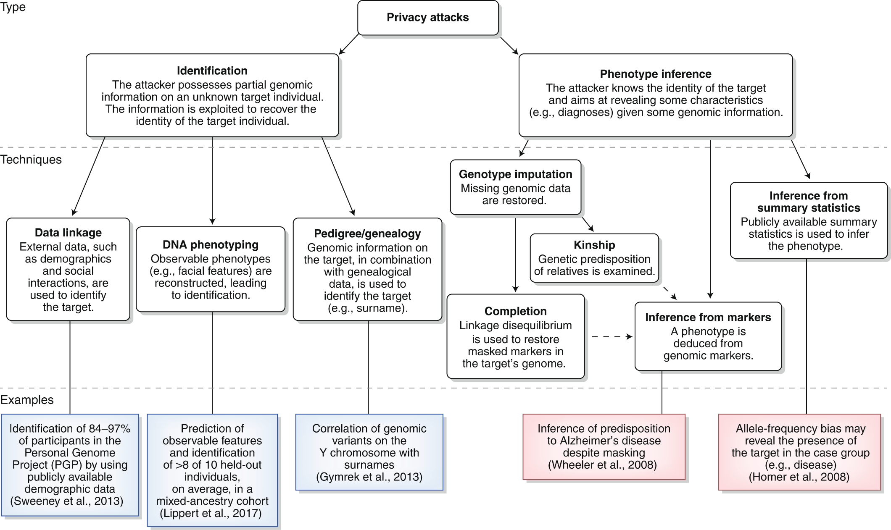
Data sharing and privacy
Genomic data can be inherently identifiable
Manage through anonymization and access control
PMID: 32601475

Slide 10
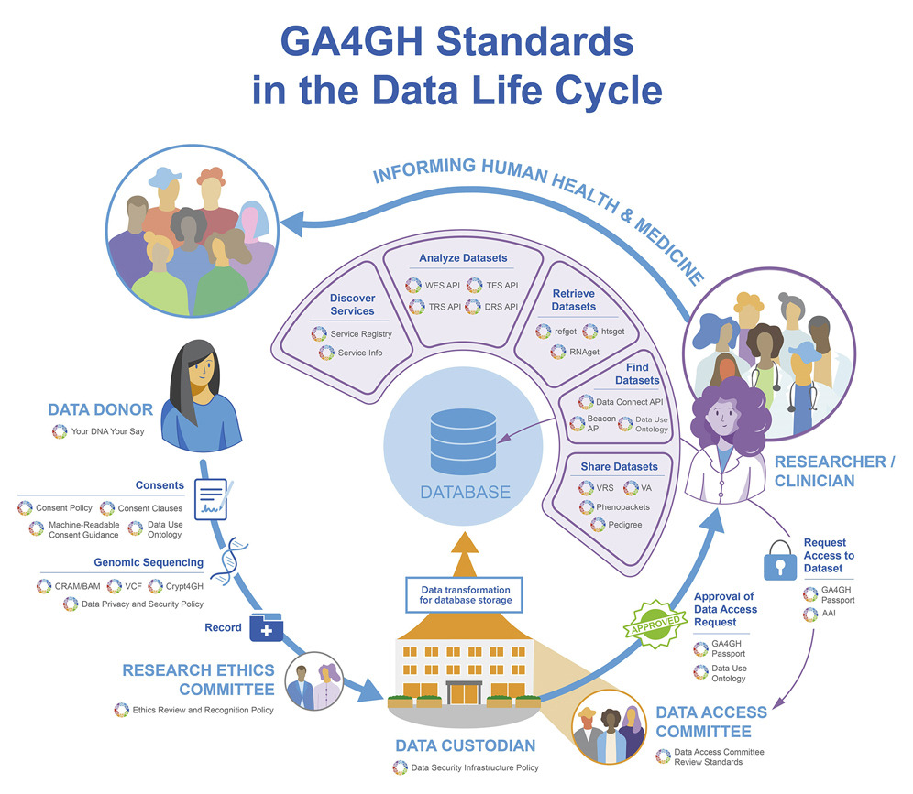
Global Alliance for Genomics and Health (GA4GH)
PMID: 35072136

Slide 11
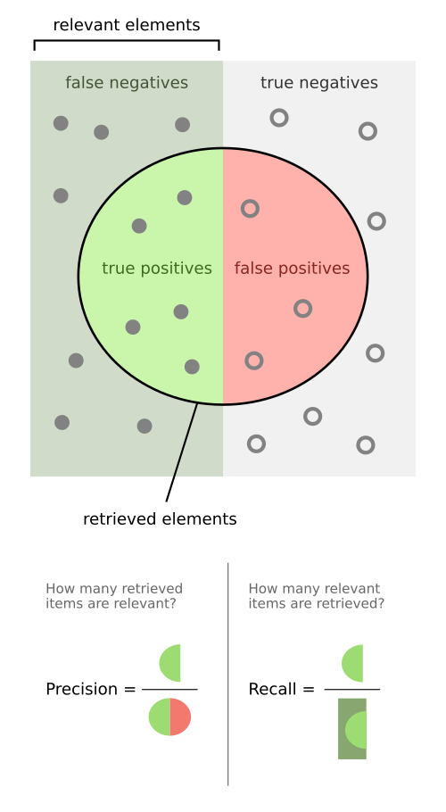
Scientific principles in genomics
Positive controls, negative controls
Measure false positives, false negatives and report sensitivity, specificity etc
Appropriate statistics
Adapted from Wikipedia.org and manishmazumder5.substack.com

Slide 12
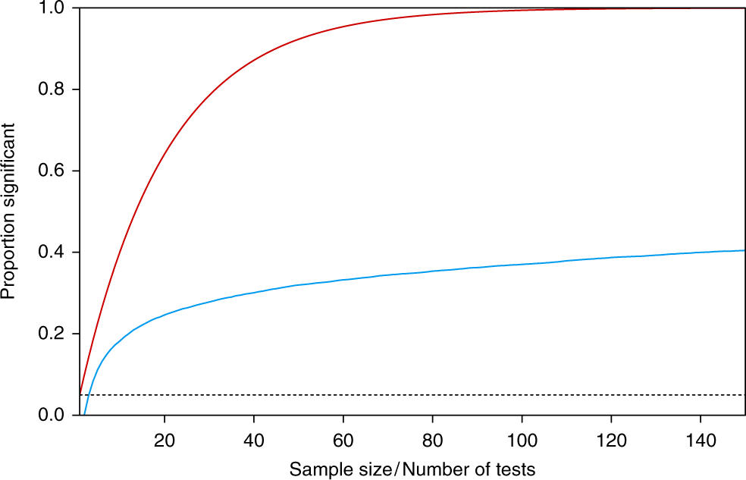
Statistical challenges with large datasets
Statistical significance with alpha = 0.05 assumes you are doing one test
What if you are testing every gene for differential expression? Every organism in a microbiome sample? Every base for the presence of a motif?
Probability of having a “significant” test that is actually a false positive
PMID: 31015469

Slide 13
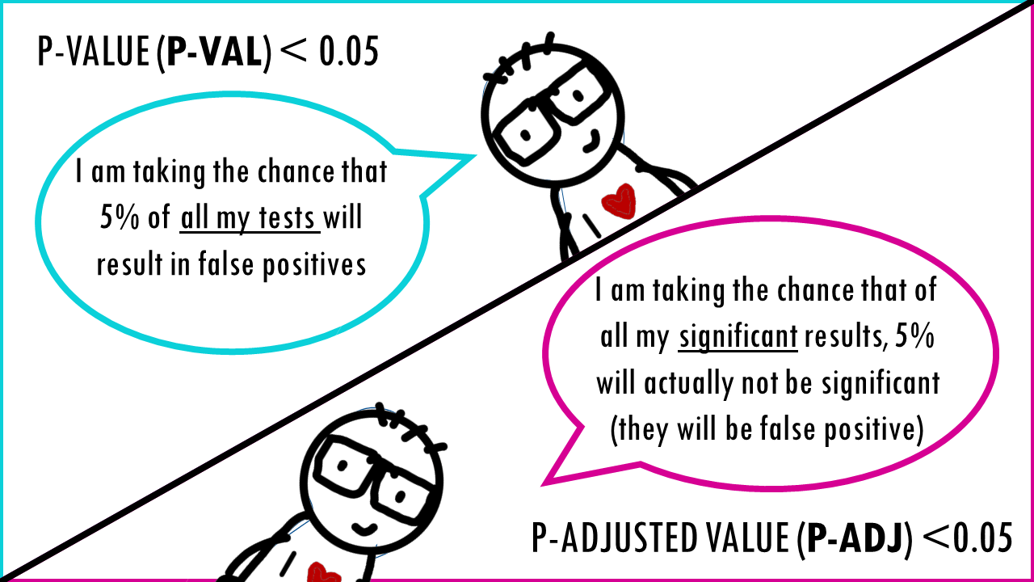
Statistical approaches with large datasets
Consider Bonferroni correction or False Discovery Rate (FDR) adjusted p value
A useful collection of commentaries: Nature Methods’ Points of Significance https://www.nature.com/collections/qghhqm/pointsofsignificance
https://biostatsquid.com/multiple-testing-correction-fdr/

Slide 14
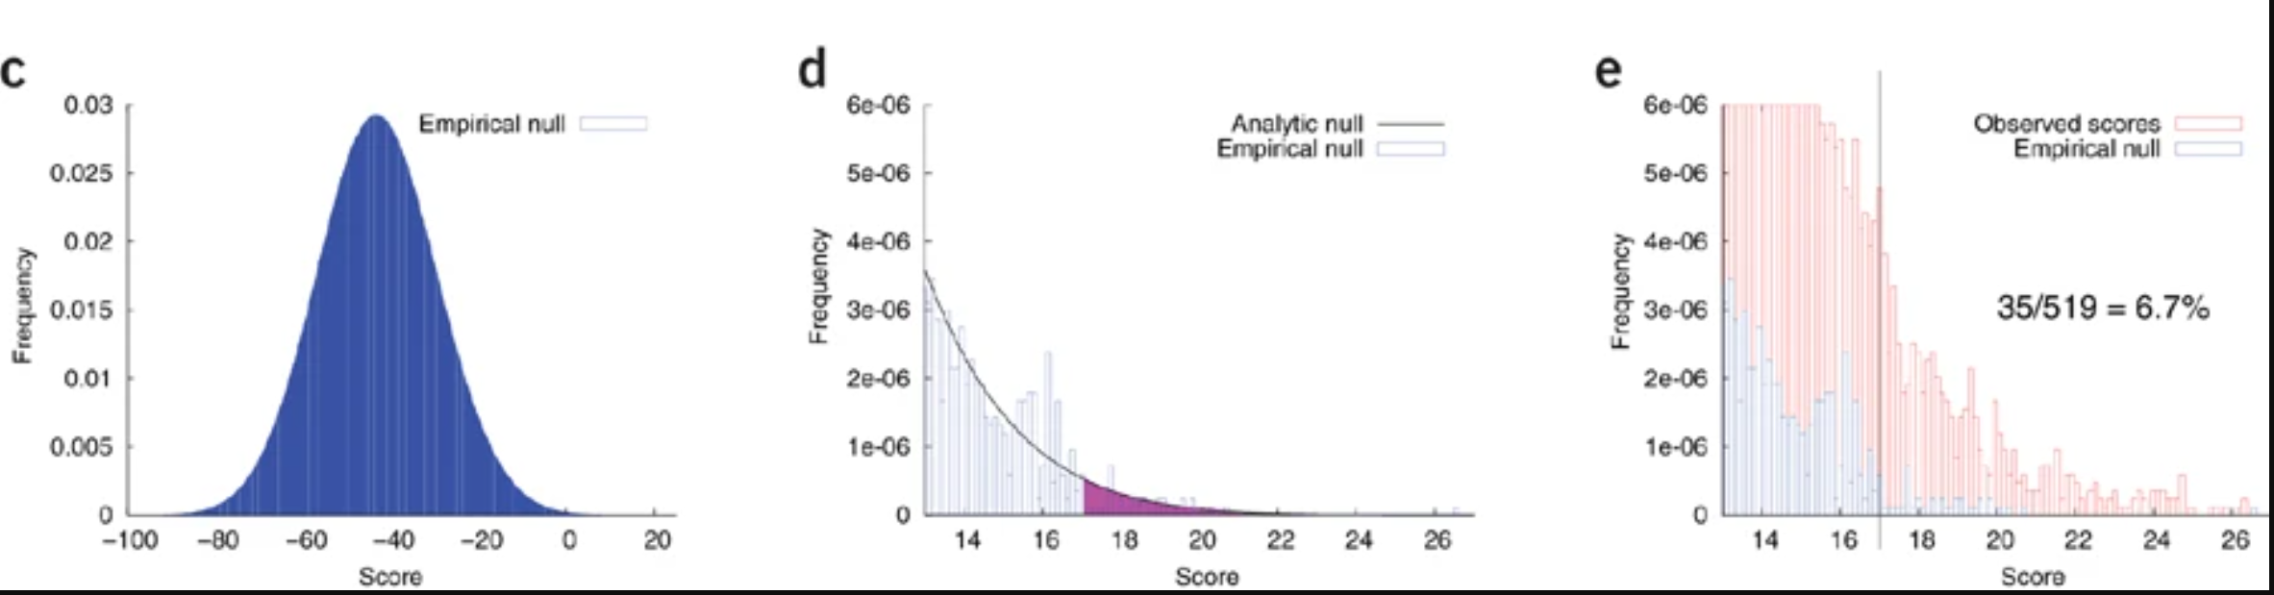
Statistical approaches with large datasets
Simulations/bootstrapping/shuffling are useful to make null distributions if your data doesn’t follow a known distribution
PMID: 31015469

Slide 15
Using AI in genomics
ML (machine learning) models have been used for decades
  Things to be aware of:
    How many features do you have compared to your training data? Do you need to do feature reduction?
    Is your data overfit?
    Is the model interpretable? (Eg. use SHAP)
    Do you have an independent validation set?
LLMs (large language models) are now being applied everywhere
  Things to be aware of:
    Hallucinations
    Reproducibility
    Transparency / explainability
    Be aware of token usage, it can get expensive
    Privacy

Slide 16
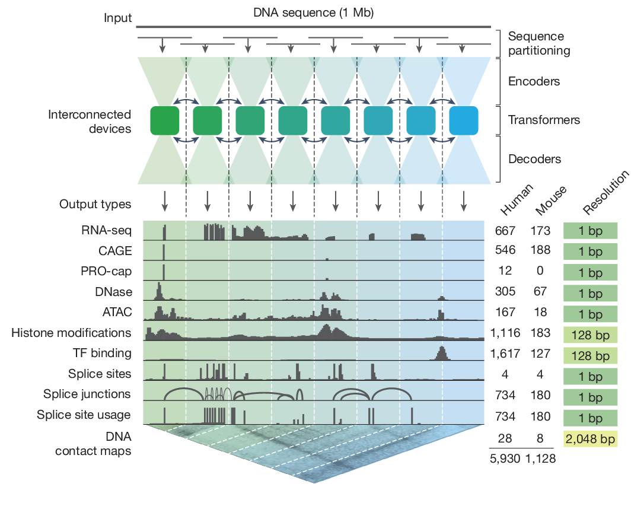
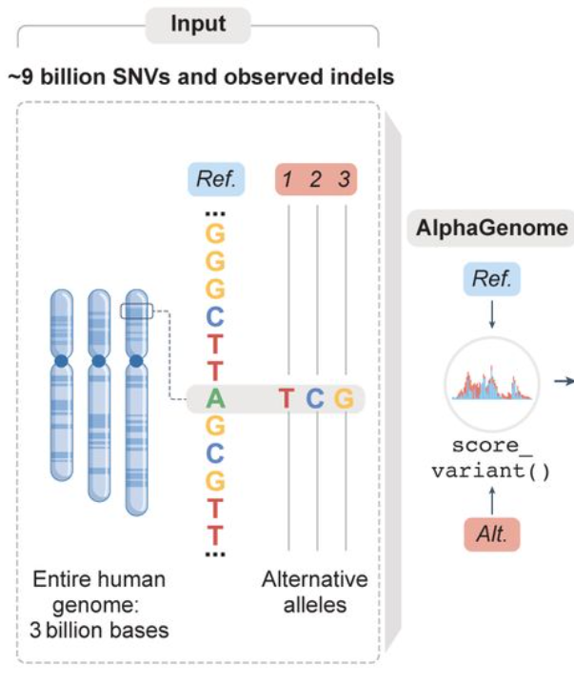
Using AI in genomics
AlphaGenome recently published predictions for every possible base change in the human genome
PMID: 41606153
https://www.medrxiv.org/content/10.64898/2026.09.16.26363192v1

Slide 17
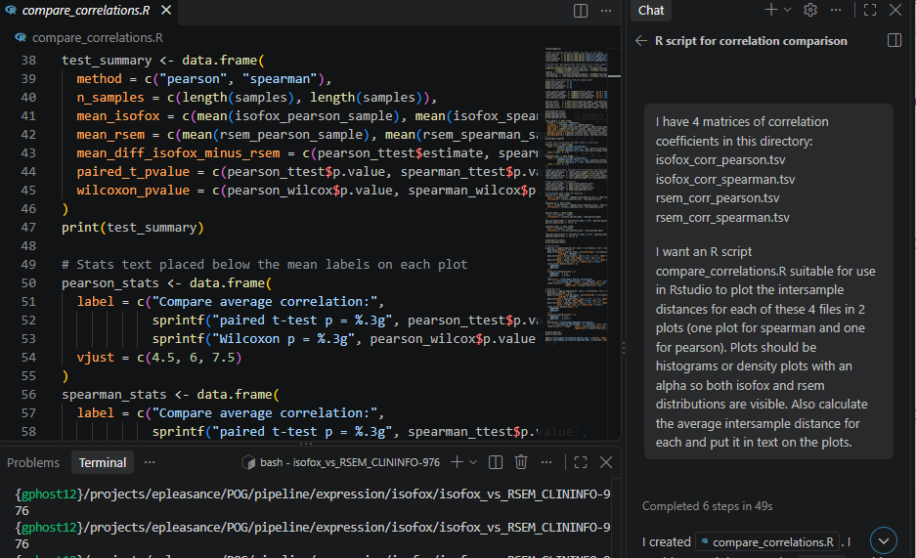
Using AI in genomics: coding
Code completion
Documentation
Code review
Coding English first (vibe coding)
Examples:
  Github Copilot
  Claude Code CLI
You are ultimately responsible for making sure your code is correct. AI can make assumptions

Slide 18
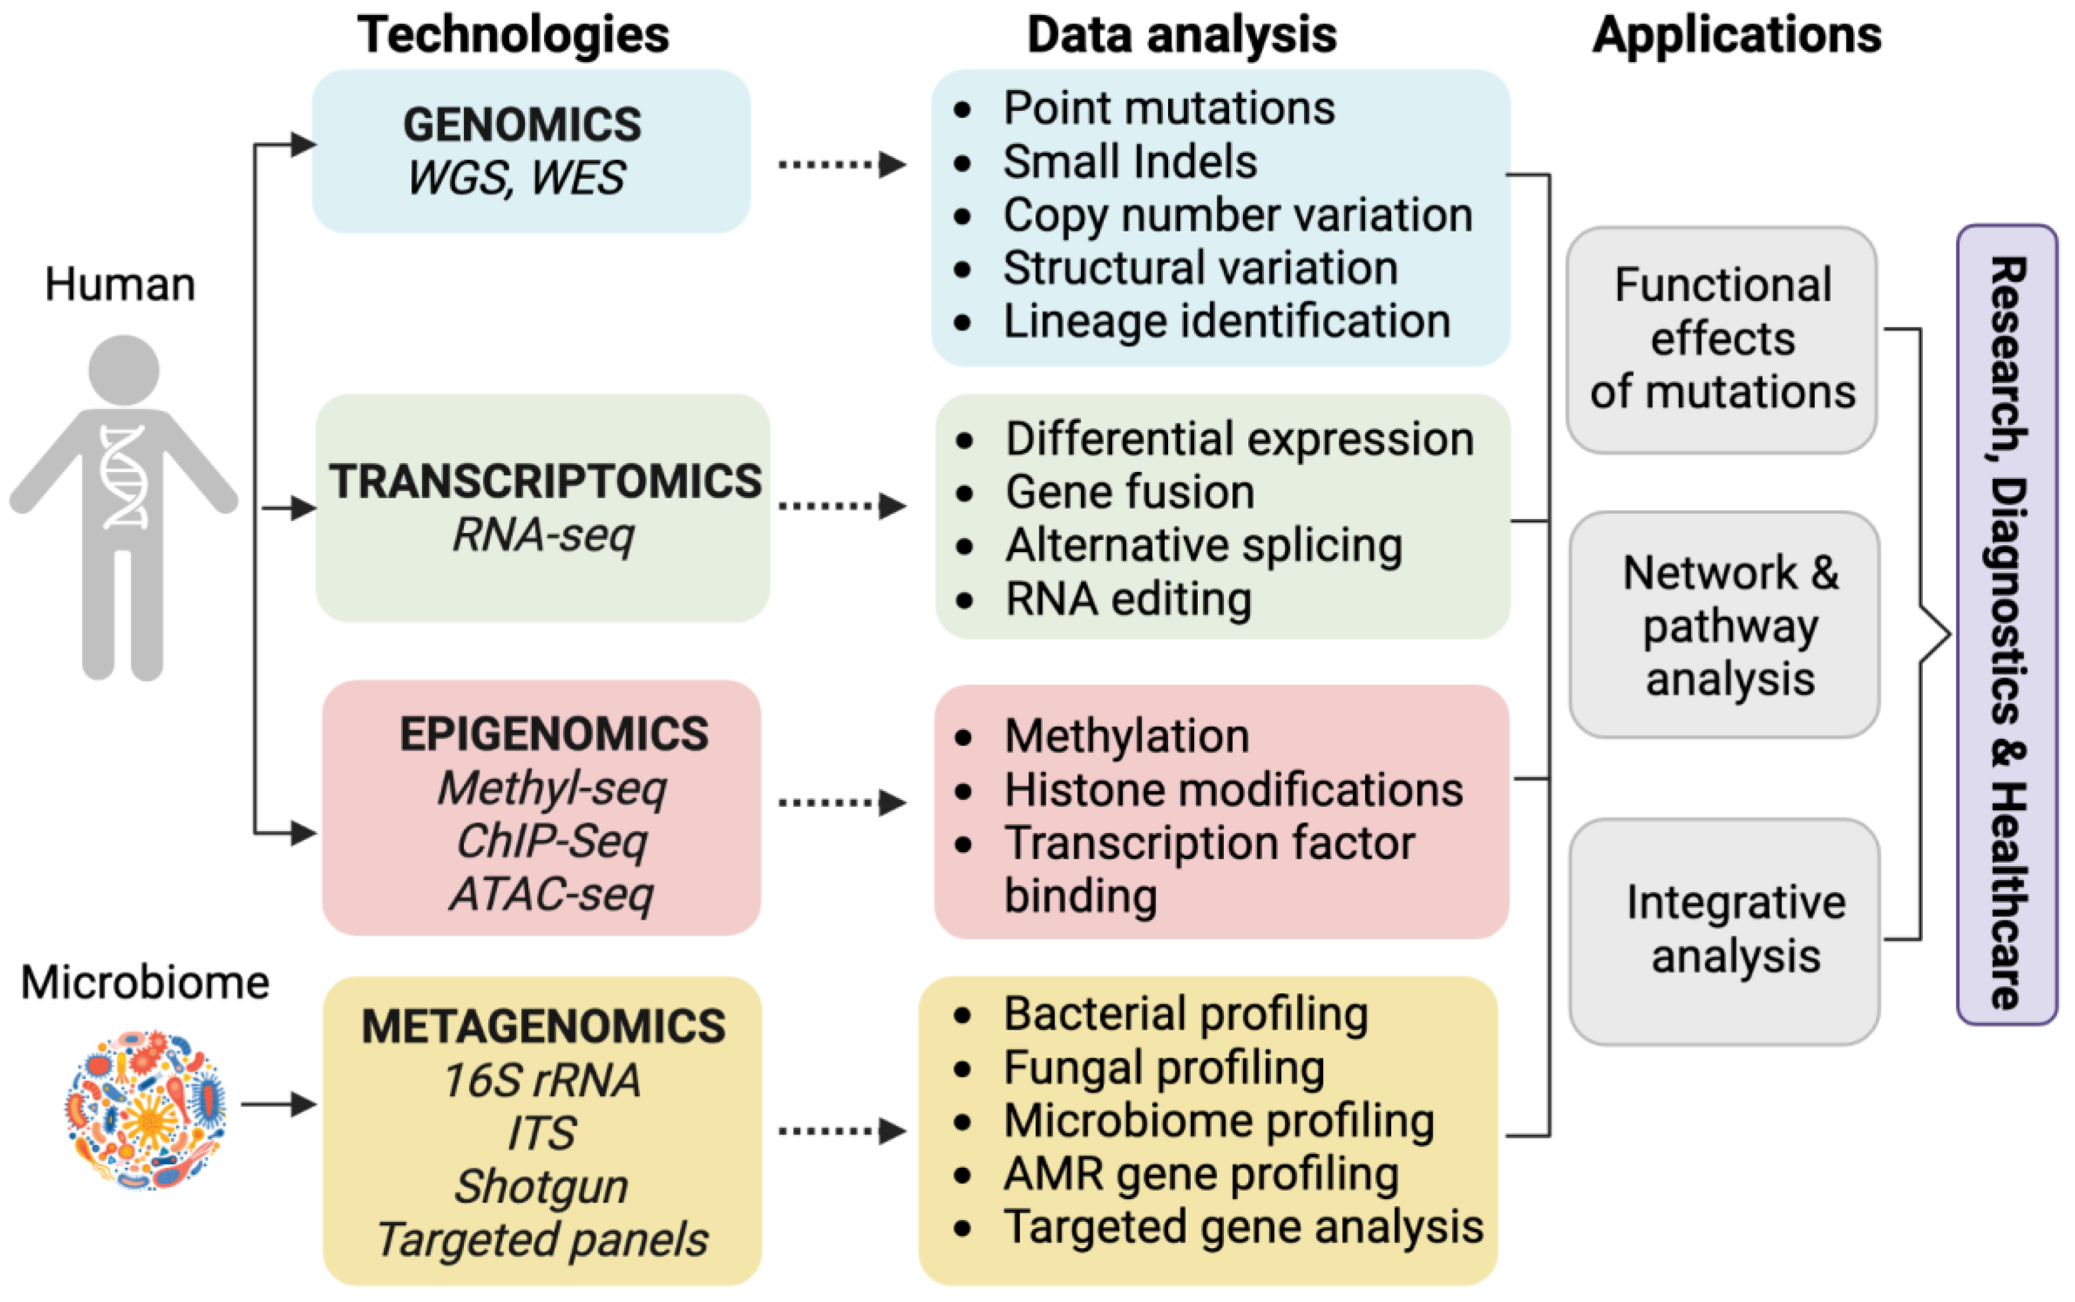
Sequencing applications
Type of organism/sample
Type of molecule
Specialized prep
PMID: 37508427

Slide 19
Human genomics
WGS: whole genome sequencing (~3 Gb)
  Often 30X coverage, more for tumour samples
  Also commonly used for novel genome assembly
WES: whole exome sequencing (~30 Mb)
  Usually go for 200+ X coverage
Targeted panels (~1-5 Mb; dozens to 100s of genes)
  Coverage typically > 1000X
  In library prep or using adaptive sampling
RNA-Seq
  Usually convert RNA -> cDNA for sequencing
  Some tech can do direct RNA sequencing

Slide 20
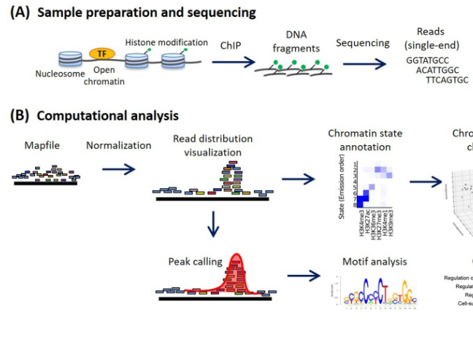
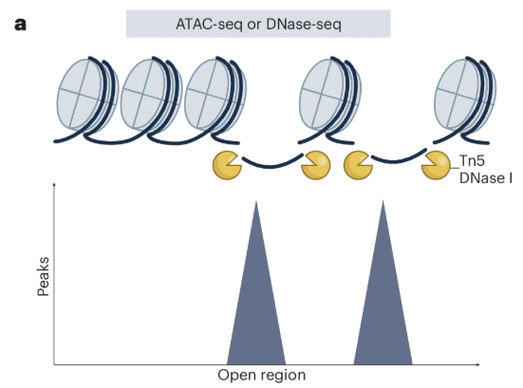
Epigenomics
DNA methylation
  Bisulfite sequencing (Illumina), direct sequencing (Oxford Nanopore, PacBio)
Histone modifications
  Chromatin immunoprecipitation (ChIP-Seq)
Open chromatin
  ATAC-seq
PMID: 39779955
PMID: 32240773

Slide 21
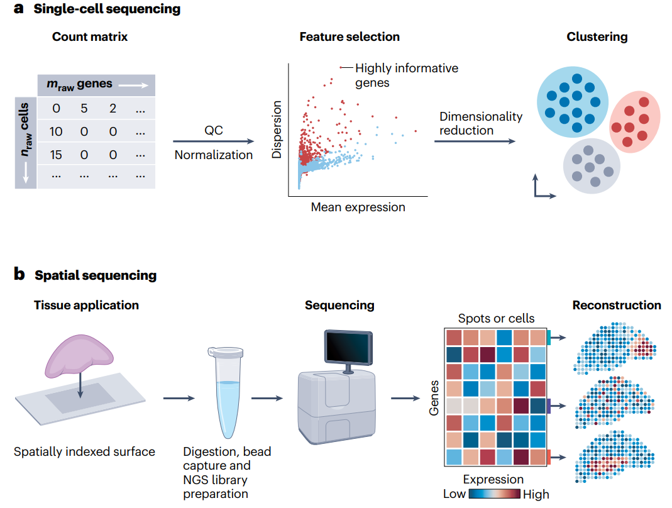
Specialized approaches
Single-cell sequencing
Spatial profiling
PMID: 40817395

Slide 22
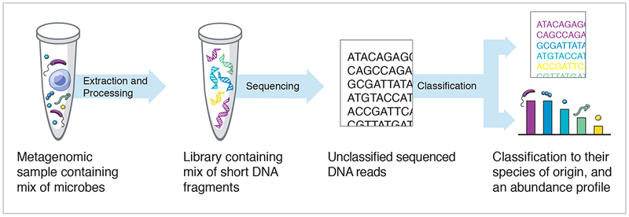
Metagenomics
Amplicon-based (16S/18S/ITS)
Shotgun (short read or long read)
PMID: 31398336

Slide 23
Scenarios
We will go through a few example scenarios and discuss what approaches might be relevant
You will be discussing in groups of 3-4 people
The slide deck we go through will be posted at the end of today’s workshop

Slide 24





Short stretch break
Workshop Sponsors

