Slide 1

bioinformatics.ca
bioinformaticsdotca.github.io

Slide 2
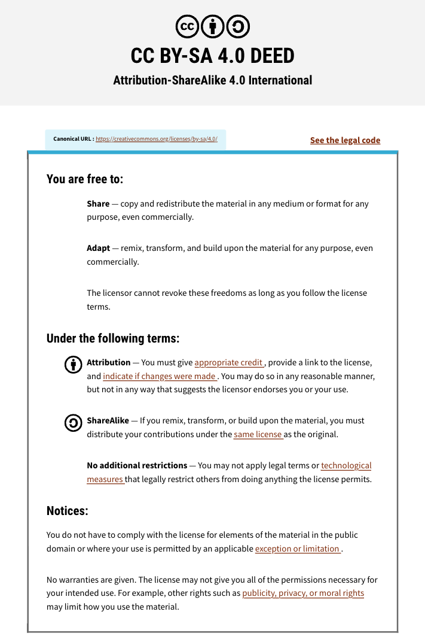

Slide 3


Module #1b:
Application Scenarios
Dr. Erin Pleasance
CBW High-Throughput Genomics
November 4-6, 2026

Slide 4
Scenarios
We will go through a few example scenarios and discuss what approaches might be relevant
You will be discussing in groups of 3-4 people
The slide deck we go through will be posted at the end of today’s workshop

Slide 5
Introductions (10 mins)
Find a group of 3-4 people
Introduce yourself and your research background/interests
Share with your group: What is something you learned or found interesting so far today?

Slide 6
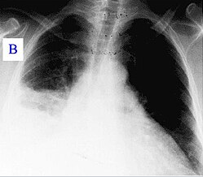
Scenario 1: Pneumonia outbreak
Several hospitals have reported patients admitted with severe pneumonia
We have samples from their respiratory tract
We want to know what is causing the pneumonia and whether these outbreaks are related
Wikipedia.org

Slide 7
Scenario 1: Pneumonia outbreak
Several hospitals have reported patients admitted with severe pneumonia
We have samples from their respiratory tract
We want to know what is causing the pneumonia and whether these outbreaks are related
Discuss:
What kind of sequencing approaches might be useful?
What would be the benefits or limitations of these approaches?
Wikipedia.org

Slide 8
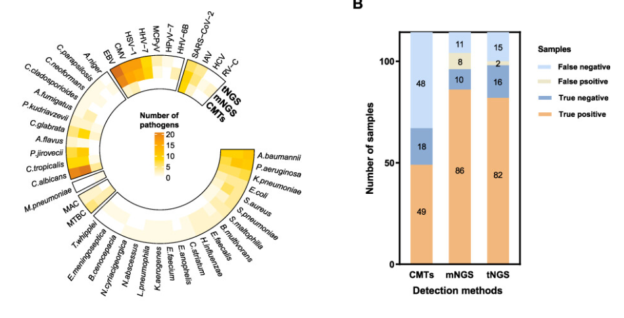
Scenario 1: Pneumonia outbreak
Targeted vs. metagenomic: Cost, complexity, comprehensiveness
PMID: 39872133

Slide 9
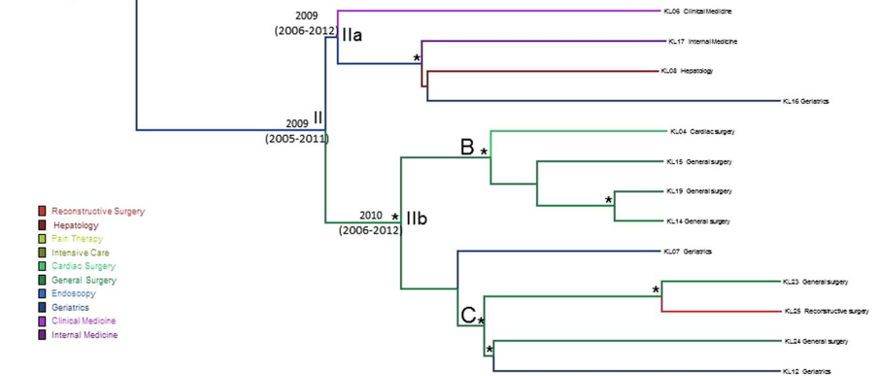
Scenario 1: Pneumonia outbreak
Targeted vs. metagenomic: Phylogeny and drug resistance
PMID: 28615687

Slide 10
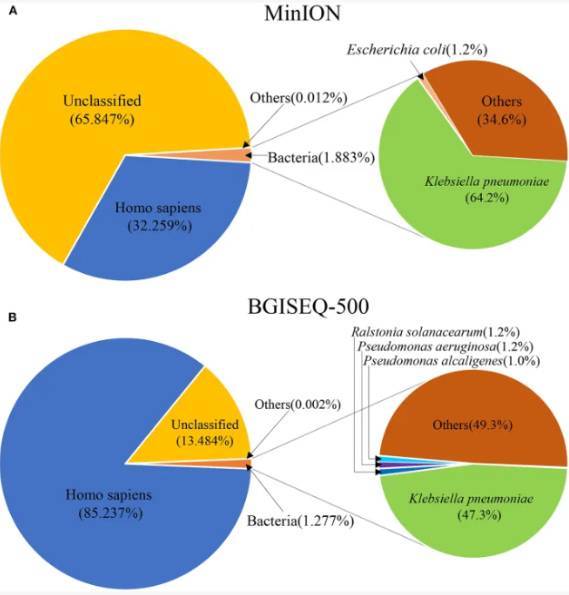
Scenario 1: Pneumonia outbreak
Long vs short read: Time and accuracy
  “It took ~1 min from beginning of sequencing to obtain the first specific reads of K. pneumoniae by MinION ... resistance genes including blaSHV-12, aac(3)-IIa and blaKPC-2 were detected within one and a half hours"
PMID: 32432051

Slide 11
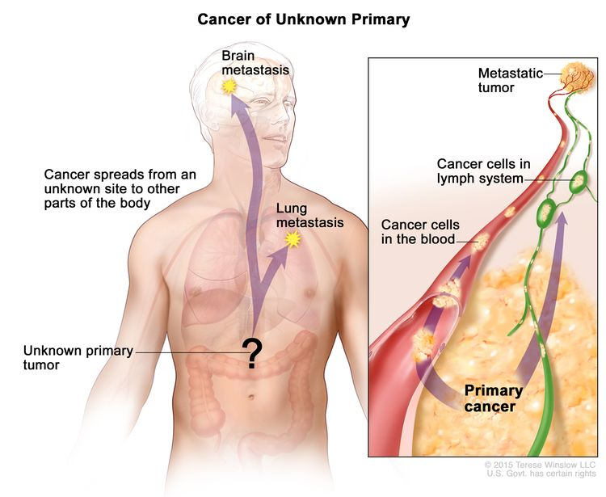
Scenario 2: Unknown cancer
A patient has a cancer of unknown origin with unclear pathology
We have a sample of the tumour from the lung and of the patient’s normal blood
We want to know what type of cancer it is and how it might be treated
www.cancer.gov/types/unknown-primary/patient/unknown-primary-treatment-pdq

Slide 12
Scenario 2: Unknown cancer
A patient has a cancer of unknown origin with unclear pathology
We have a sample of the tumour from the lung and of the patient’s normal blood
We want to know what type of cancer it is and how it might be treated
Discuss:
What kind of sequencing approaches might be useful?
What would be the benefits or limitations of these approaches?
www.cancer.gov/types/unknown-primary/patient/unknown-primary-treatment-pdq

Slide 13
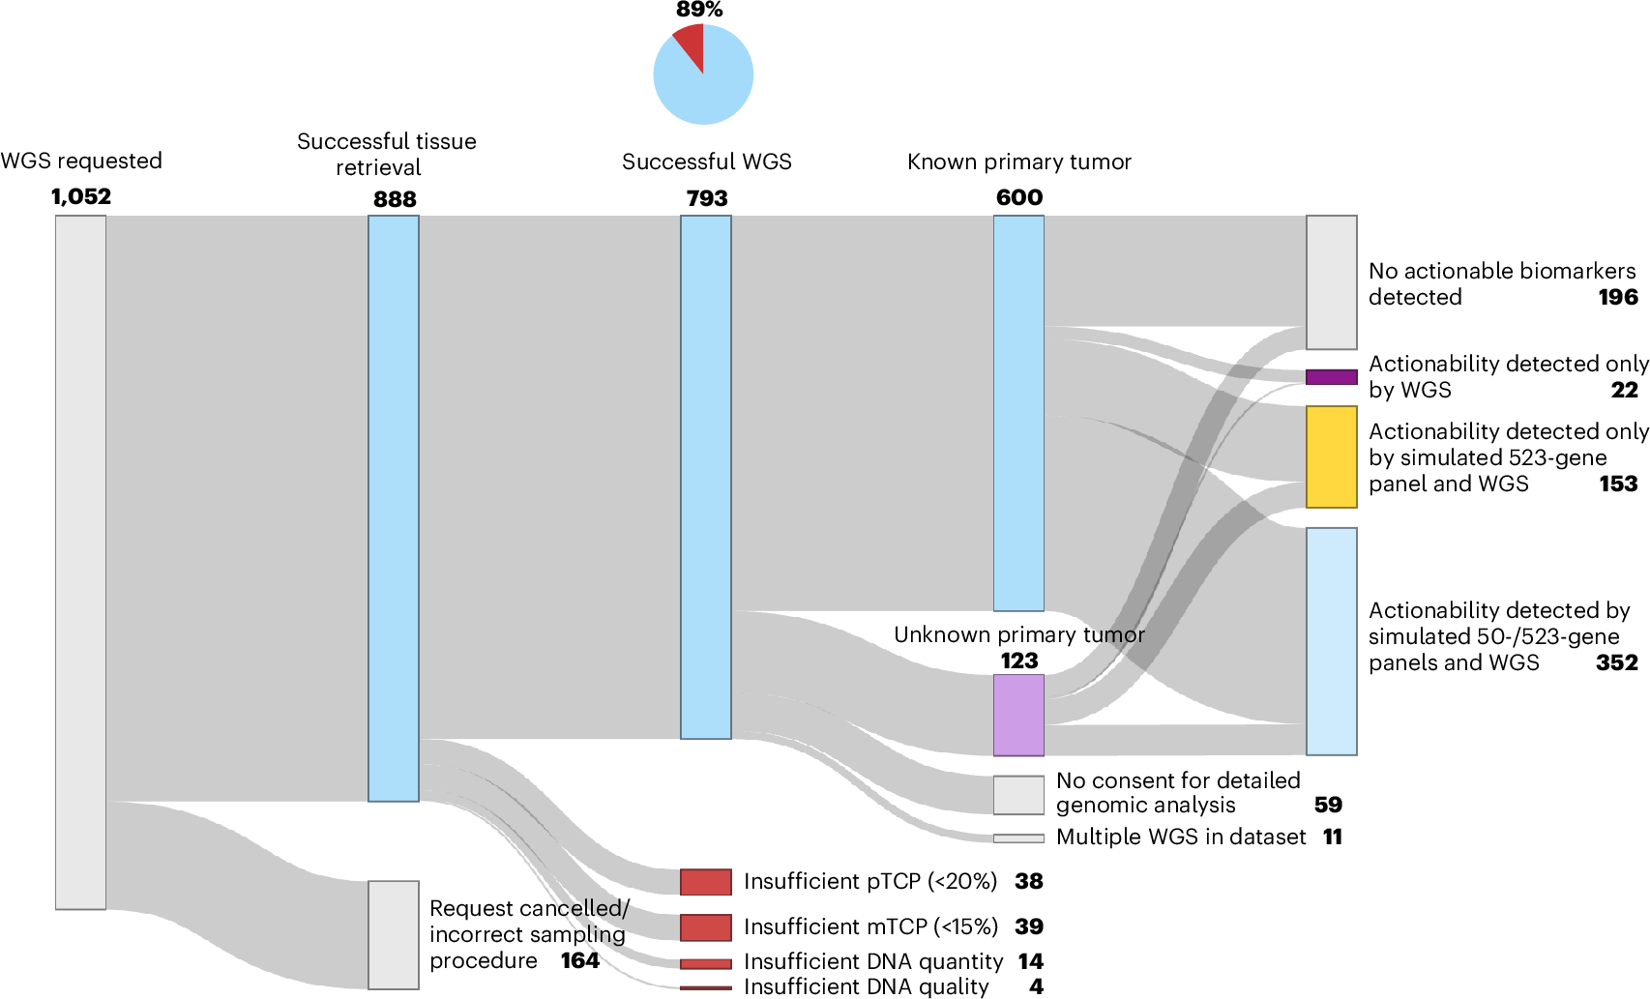
Scenario 2: Unknown cancer
Targeted vs. whole genome: Cost, complexity, comprehensiveness
PMID: 41862707

Slide 14
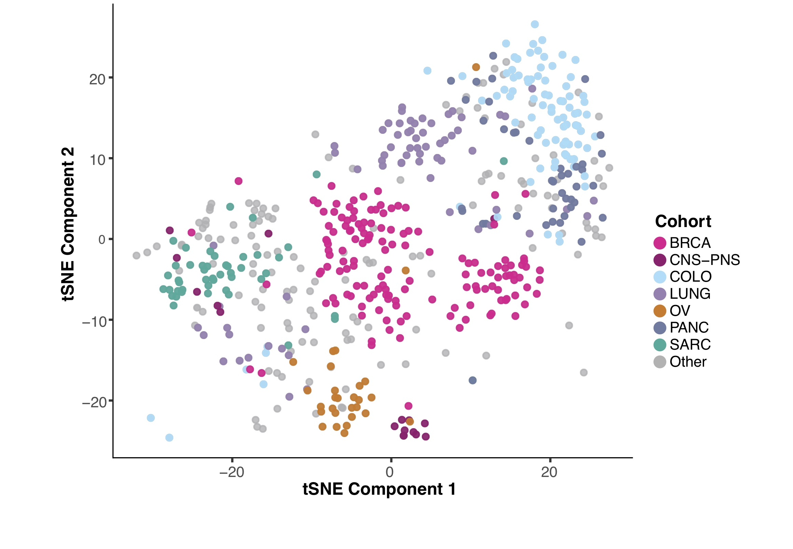
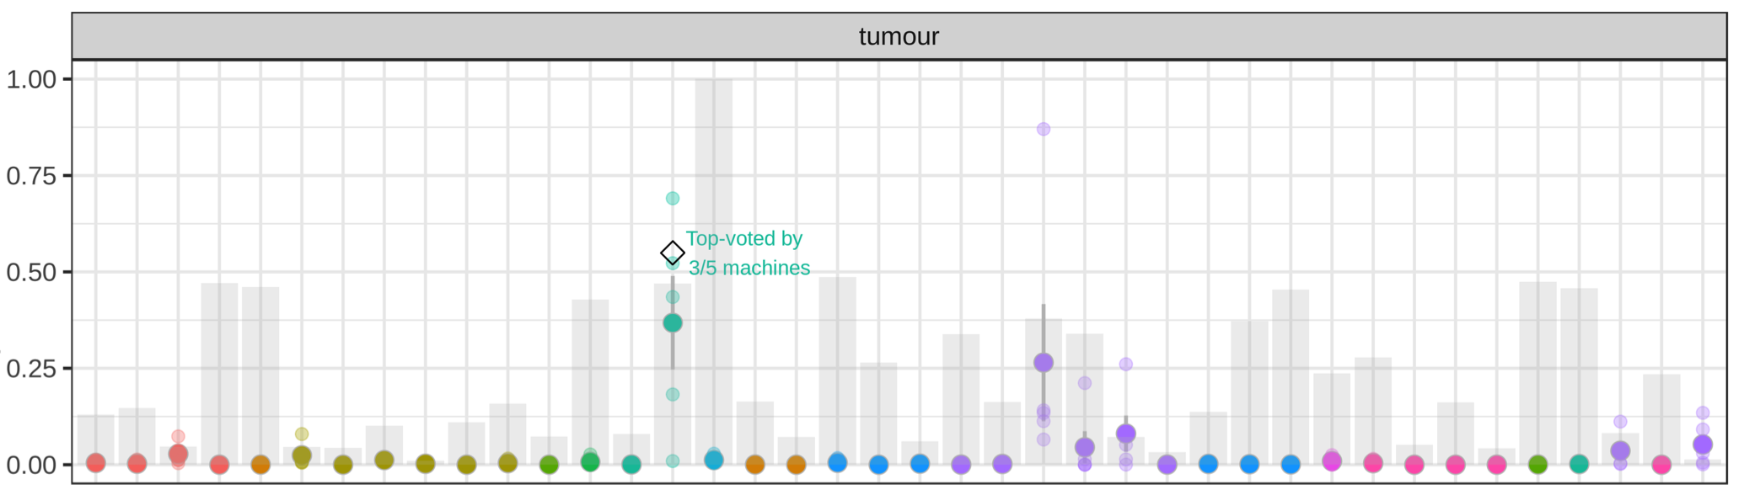
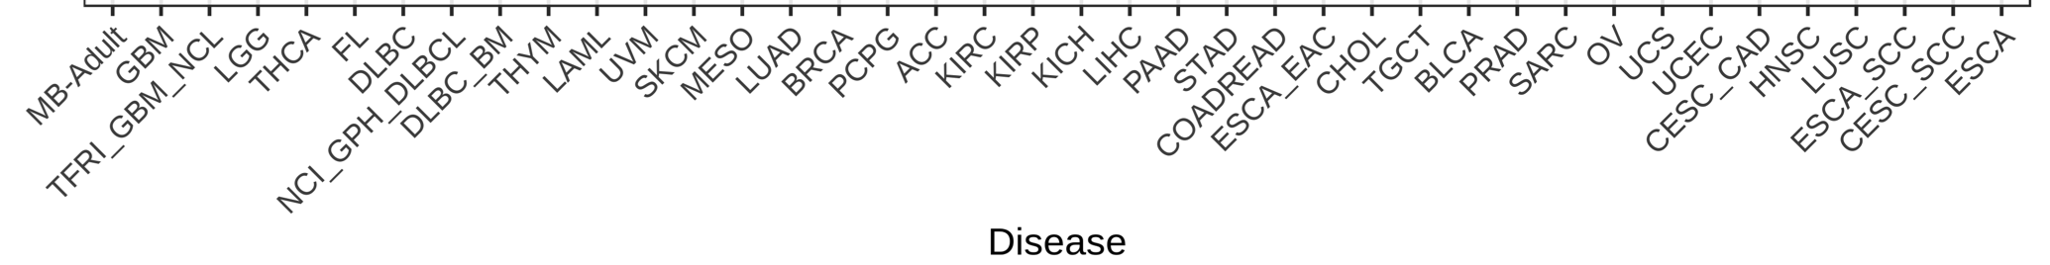
Scenario 2: Unknown cancer
RNA-Seq to aid with diagnosis
PMID: 31026023
PMID: 35121966

Slide 15
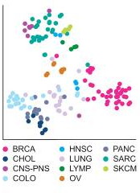
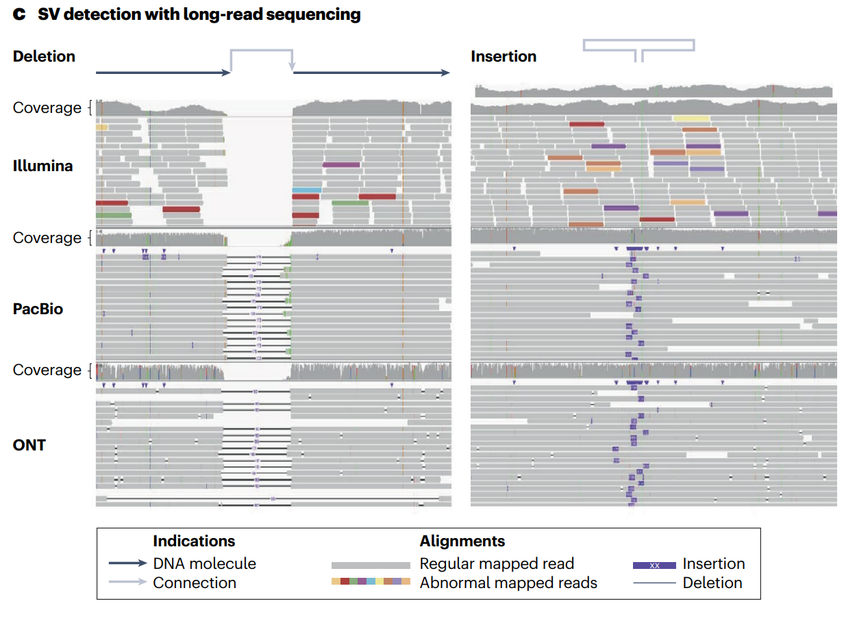
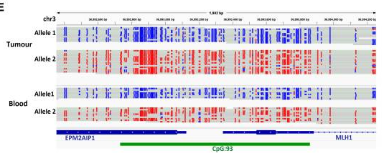
Scenario 2: Unknown cancer
Long read vs short read: SV detection and methylation
PMID: 40817395
PMID: 39406235

Slide 16
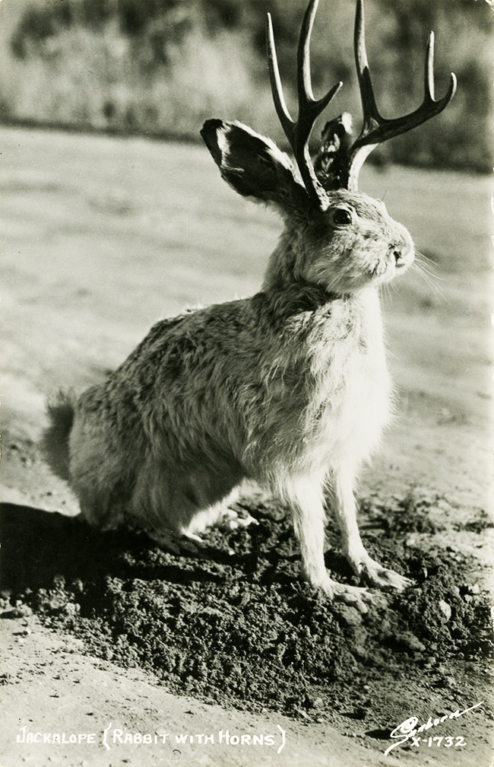
Scenario 3: Novel species
A rare new species has been discovered, the jackalope
We have obtained tissue and blood samples
We want to assemble a reference genome and understand what this species is related to
Harold Sanborn

Slide 17
Scenario 3: Novel species
A rare new species has been discovered, the jackalope
We have obtained tissue and blood samples
We want to assemble a reference genome and understand what this species is related to
Discuss:
What kind of sequencing approaches might be useful?
What would be the benefits or limitations of these approaches?
Harold Sanborn

Slide 18
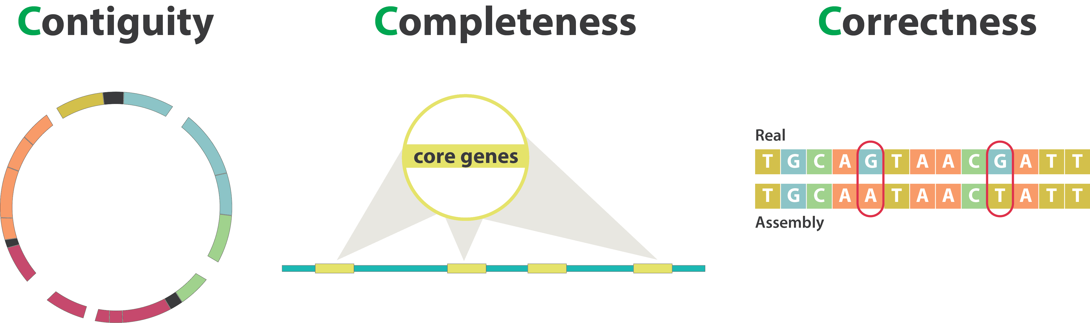
Scenario 3: Novel species
Assembly quality
https://training.galaxyproject.org/training-material/topics/assembly/tutorials/assembly-quality-control/slides-plain.html

Slide 19
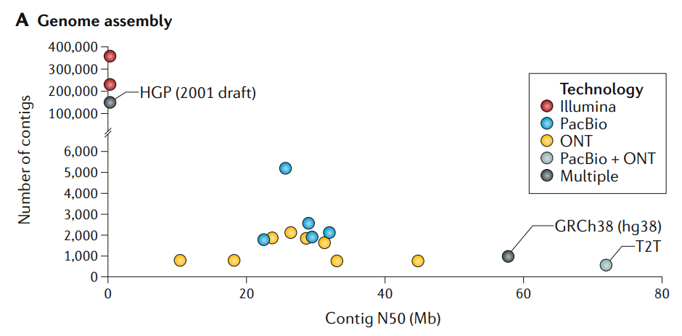
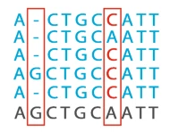
Scenario 3: Novel species
Assembly quality: Long reads and short reads are complementary
PMID: 32504078
PMID: 34775997

Slide 20
Your own research
What is a research question you have? Explain it briefly to your group.
What technologies do you think might best apply to this question and why?
What would be some of the limitations or challenges of using these technologies for your application?

Slide 21
Summary
Illumina sequencing | • Widely used with mature protocols and analysis tools • Highest throughput and lowest cost per base • Extremely accurate for SNVs and small indels • Ideal for WGS, RNA-Seq, single-cell seq, large cohorts | • Short reads, typically paired 150 bp • Structural variants, repeats, phasing can be challenging • Requires additional prep to detect epigenetic changes
PacBio SMRT sequencing | • Long reads, typically 10-25kb • Very high accuracy, with error rates less than 0.1% • Native methylation detection • Excellent for de novo assembly and structural variants | • High cost per base, making it the most expensive option for most applications • Lower throughput compared to other technologies • Requires high quality, molecular weight DNA
Oxford Nanopore | • Very long reads, 10K-100K+ bp • Direct detection of DNA & RNA epigenetic modifications • Portable and flexible, allowing for sequencing in remote locations or in real-time | • Somewhat higher cost and lower throughput than short read sequencing • Higher variability in accuracy compared to other technologies, particularly in homopolymers
Adapted from https://pmc.ncbi.nlm.nih.gov/articles/PMC10703097/table/t1/

Slide 22
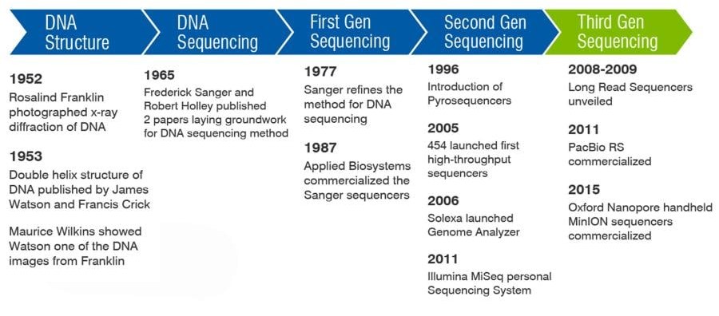
DNA sequencing history
Newer technologies competing in short-read space:
2022
AVITI (Element Biosciences)
2023
Complete Genomics
2024
Ultima
https://www.criver.com/eureka/history-dna-sequencing

Slide 23
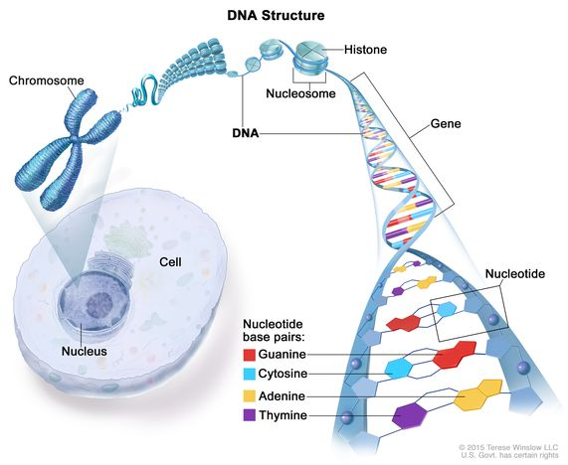

Summary
Technology is constantly changing
Enables more science:
What can I ask now that I never could before?

Slide 24





Lunch Break
Workshop Sponsors

