Slide 1

bioinformatics.ca
bioinformaticsdotca.github.io

Slide 2
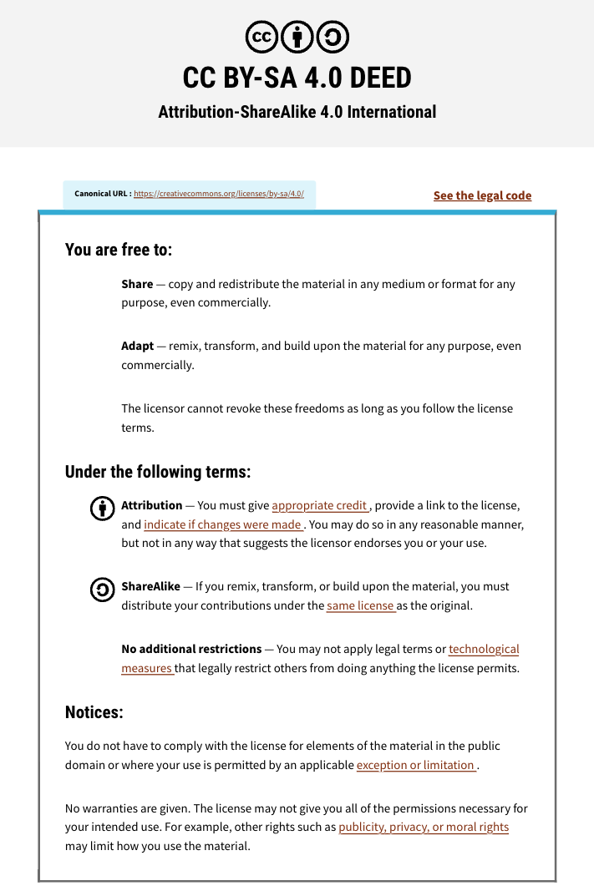

Slide 3


Module 2:
Genome Visualization
Dr. Erin Pleasance
CBW High-Throughput Genomics
November 4-6, 2026
Some slides adapted from Rob Syme and previous instructors

Slide 4
Learning Objectives
Understand the value and diversity of data visualization
Gain experience with genome browsers
Explore variation inspection

Slide 5
Overview
Part I (lecture)
  Discussion of visualization goals and approaches
  Overview of IGV
  Overview of UCSC
Part II (lab)
  Load data and references in IGV
  Visualize variants in IGV
  Explore UCSC tutorial

Slide 6
Why visualize?

Slide 7
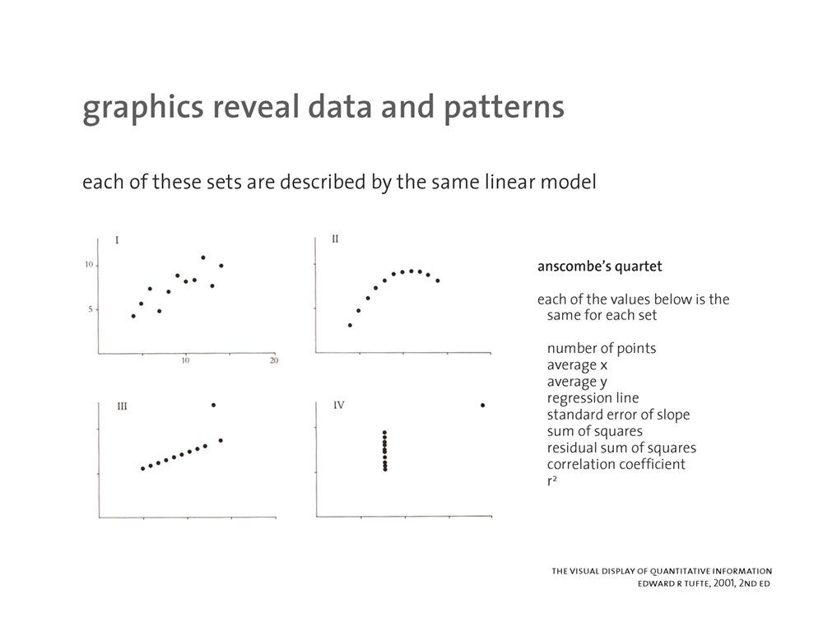
Data interpretation
Summary statistics don’t tell the whole story

Slide 8
Data interpretation
Summary statistics don’t tell the whole story
https://mk.bcgsc.ca/talks/datavisualization/

Slide 9
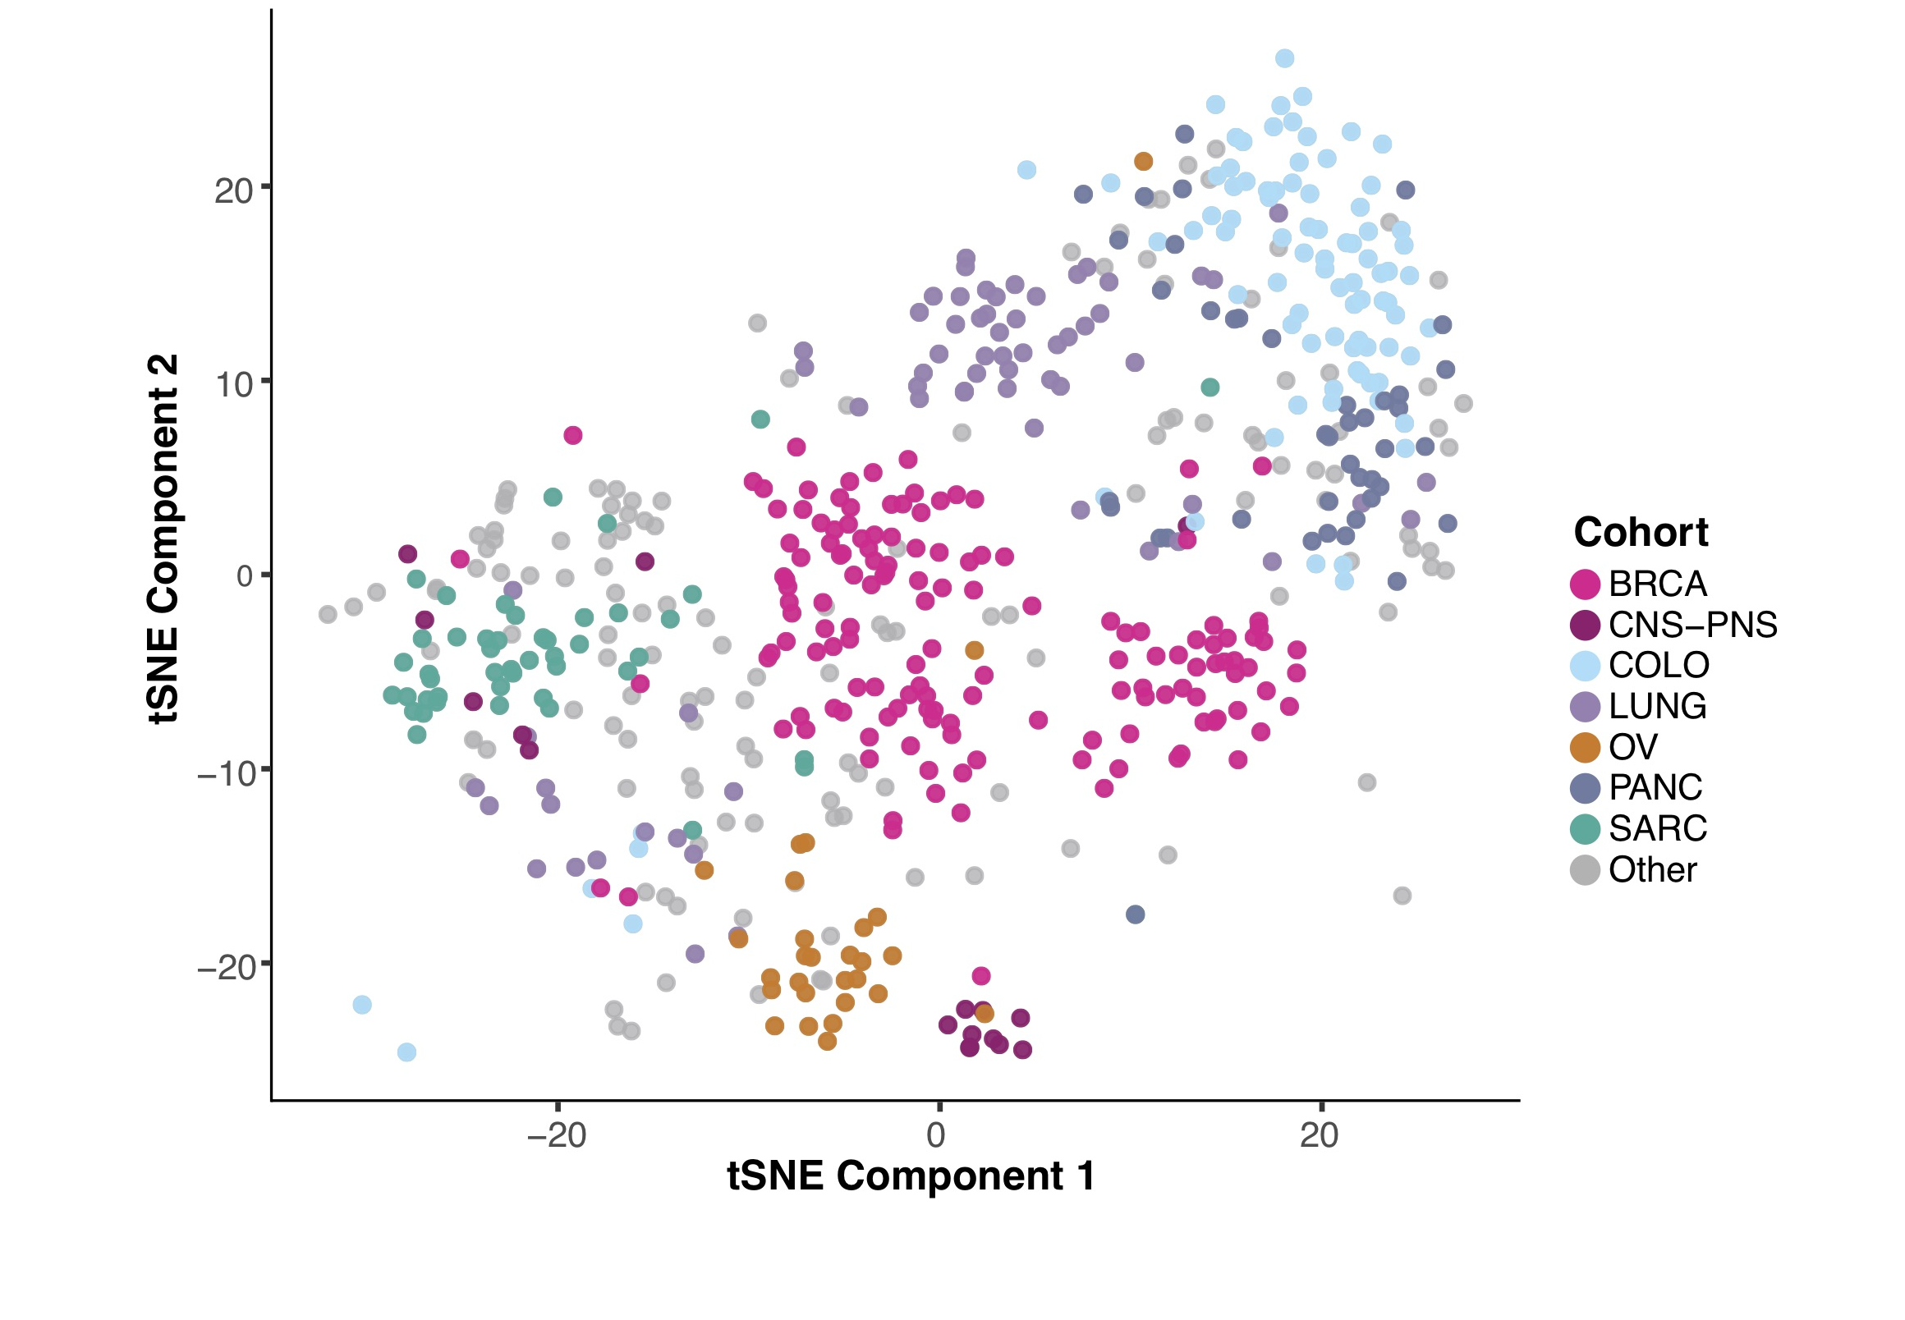
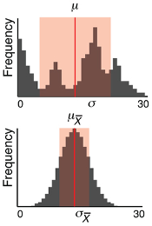
Data interpretation
How is the data distributed?
Are there outliers?
Are there batch effects?
Does the data make sense?
https://blogs.nature.com/methagora/2013/08/giving_statistics_the_attention_it_deserves.html
PMID: 35121966

Slide 10

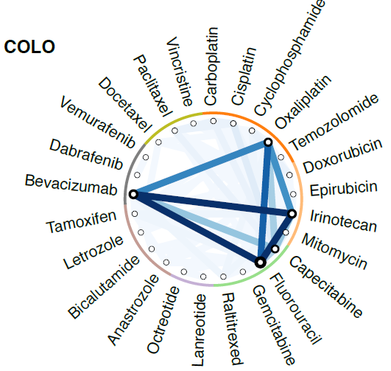
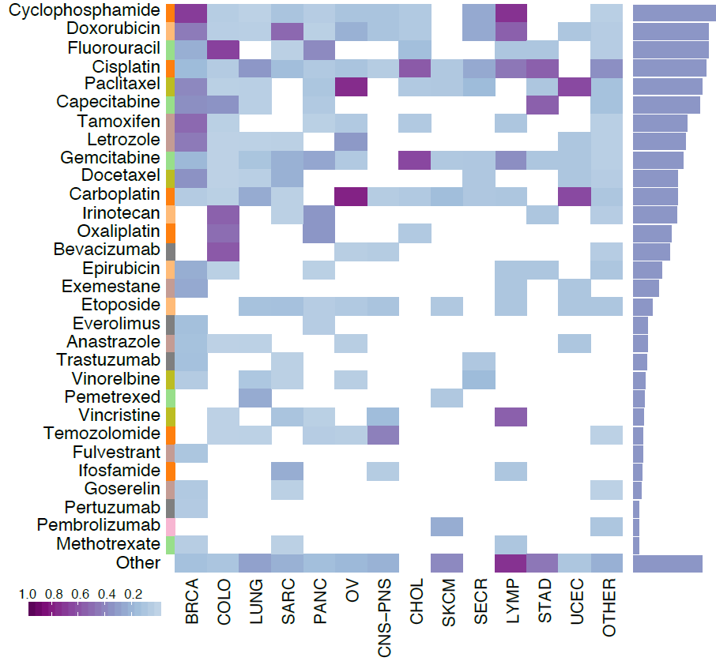
Data size & complexity
Understanding, finding patterns and relationships in large datasets
Look at the data multiple ways
PMID: 35121966

Slide 11
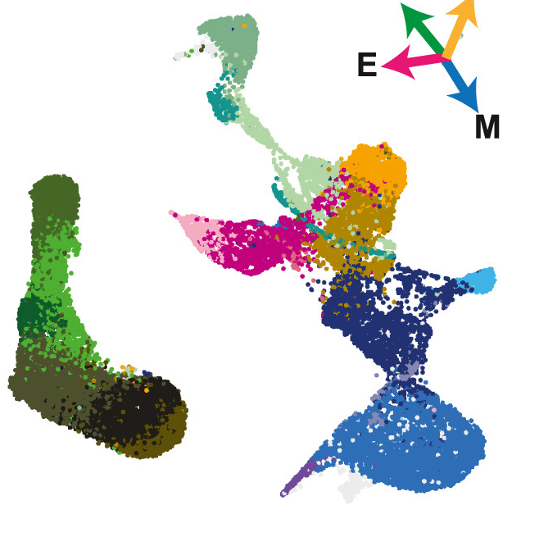
PCA/tSNE/UMAP
Can use eg. R ggplot2, PCAtools, Rtsne
PMID: 37977148
PMID: 35121966

Slide 12
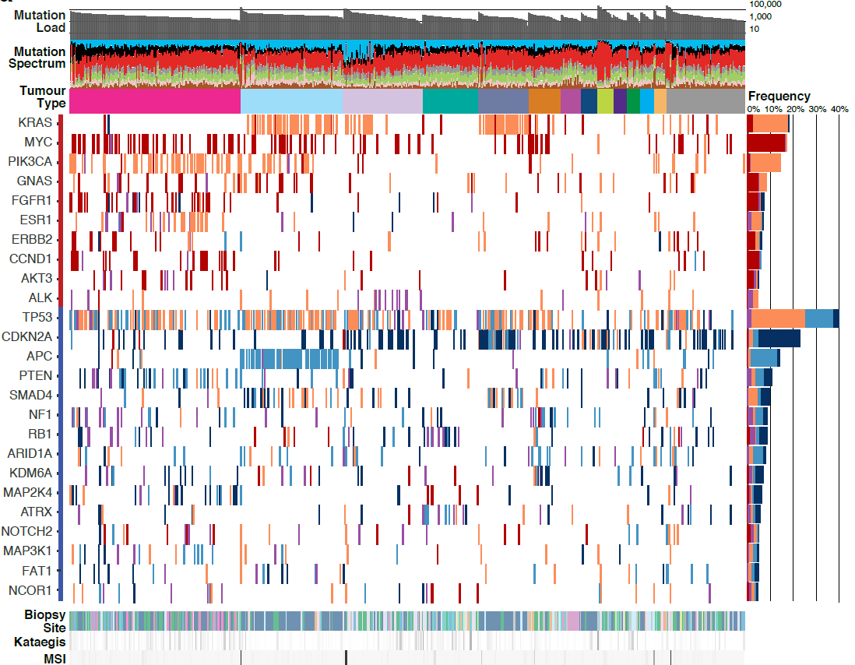
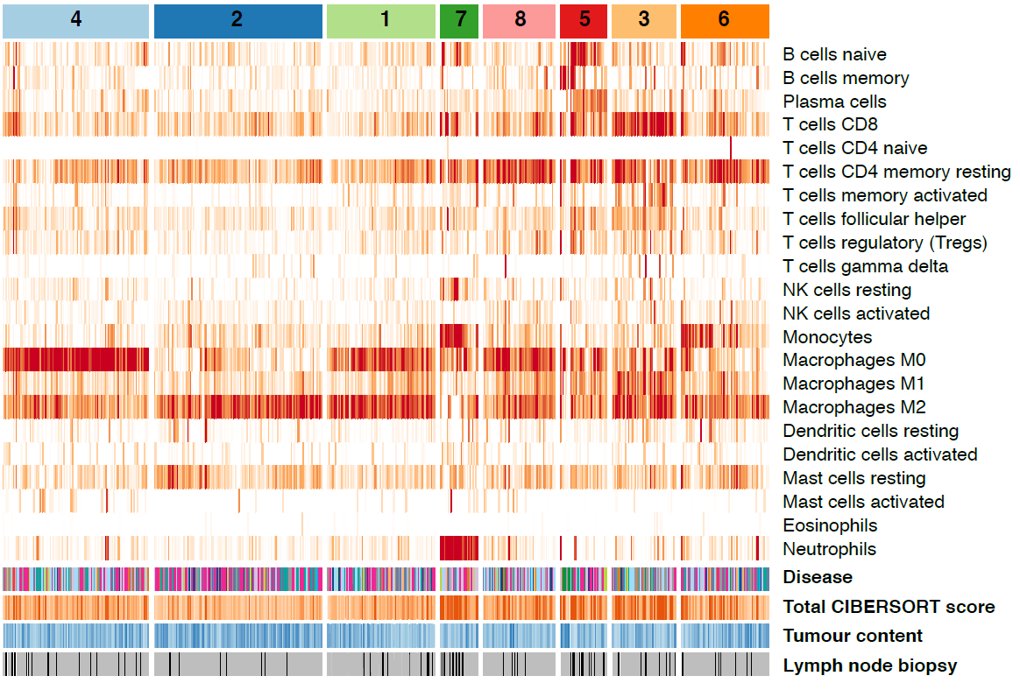
Heatmaps / oncoplots
Can use eg. R complexheatmap/pheatmap, maftools
PMID: 35121966

Slide 13
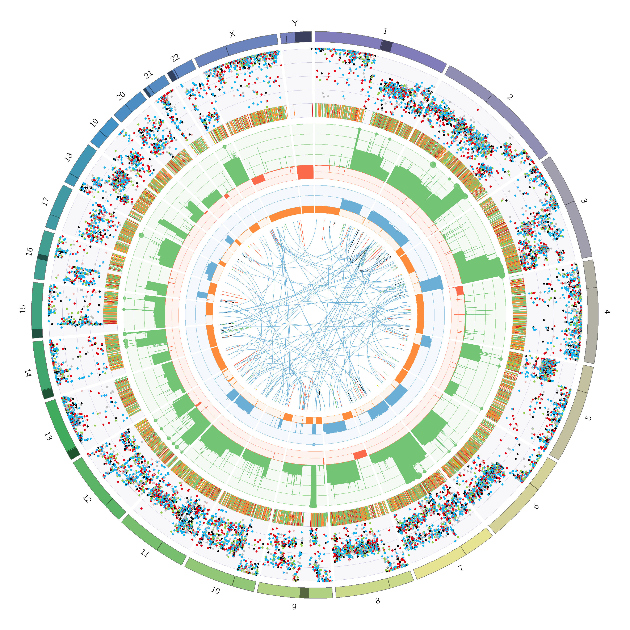
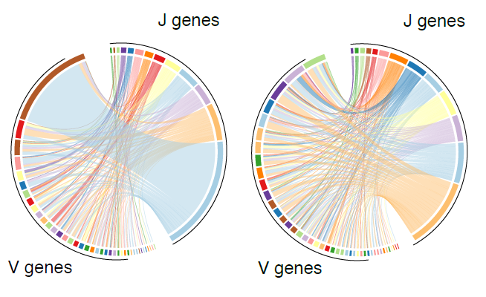
Circos diagrams
Can use eg. R circlize, Perl circos
  Check out mk.bcgsc.ca, circos.ca
PMID: 35121966
Circos diagram from Purple (https://github.com/hartwigmedical/hmftools/blob/master/purple)

Slide 14
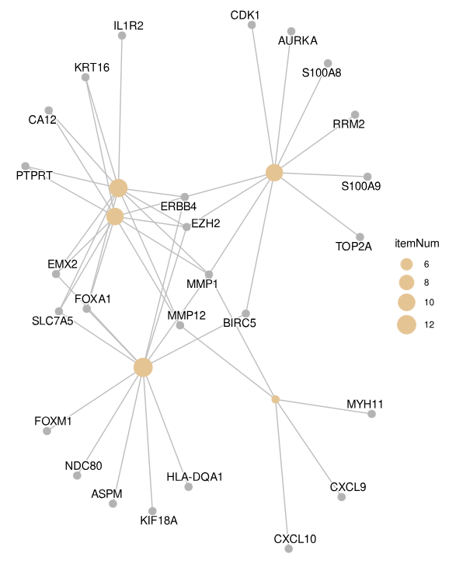
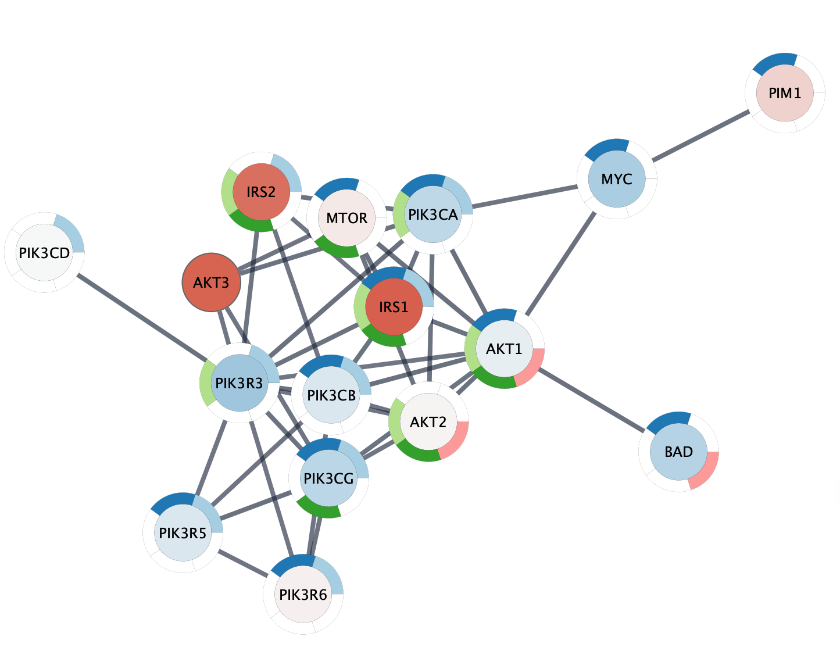
Pathways/networks
Can use eg. R clusterprofiler, Cytoscape
https://cytoscape.org/cytoscape-tutorials/protocols/pathway-figure-gene-set-analysis
https://yulab-smu.top/biomedical-knowledge-mining-book/enrichplot-networks.html

Slide 15
Genome browsers
Sequencing data files are huge
  Bam/cram file of a human genome is 100-300GB
  Require specialized tools for fast interactive viewing
Typical tasks:
  Visualizing reads
  Inspecting variants

Slide 16




Popular genome browsers
 | Runs on local computer Excellent for bam/cram visualization The first choice for variant review
 | Runs in browser Excellent for viewing public genomic data (annotations, regulatory elements, conservation, variation) Can add custom data tracks
 | Runs in browser Excellent for comparing transcript models and variant effects Ensembl annotations frequently used in genomic annotation pipelines
 | Locally hosted, runs in browser Excellent for visualizing and sharing custom/local genomic datasets

Slide 17
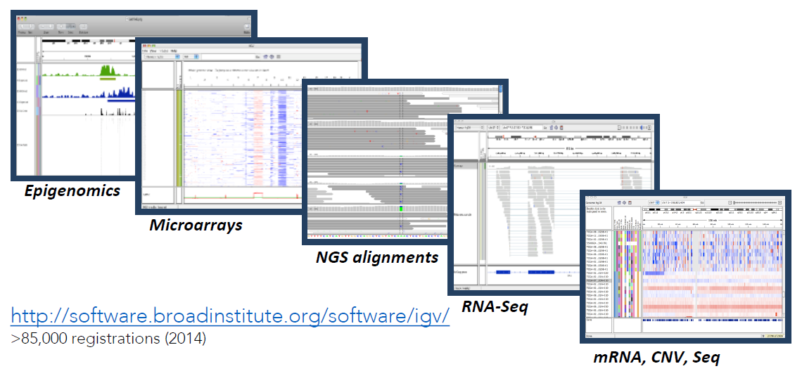
Integrative Genomics Viewer (IGV)
Desktop application for the interactive
visual exploration of integrated genomic datasets
https://igv.org/

Slide 18
Features
With IGV you can…
  Explore large genomic datasets with an intuitive, easy-to-use interface
  Integrate multiple data types with clinical and other sample information
  View data from multiple sources: local, remote, and “cloud-based”
  Automation of specific tasks using command-line interface

Slide 19
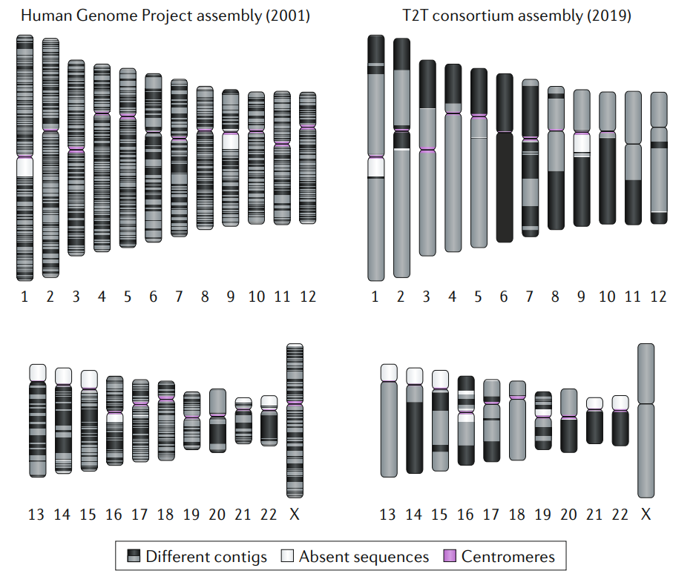
A note about genome assemblies
Reads are usually shown in alignment to the reference genome for a species
Reference genomes are imperfect and being improved
For human:
  hg19/GRCh37: Older version, still used in clinical settings
  hg38/GRCh38: Newest version of a the standard reference
    Many annotations available
    Most commonly used in genomics
    Still contains gaps, does not capture all variation
  T2T-CHM13: Telomere-to-telomere assembly from one haplotype
    Fewer gaps, excellent for repetitive regions
    Incomplete annotation resources
  Pangenome: Graph-based
    Not just one version of the reference - captures the most variation
    Requires specialized approaches to make use of it
PMID: 32504078

Slide 20
IGV data sources
AWS cloud
Local files
AWS cloud
HTTP/FTP server
HTTP/FTP server
TCGA
View local files without uploading
View remote files with downloading the whole dataset

Slide 21
Using IGV: The basics
Launch IGV
Select a reference genome
Load data
Navigate through the data
  WGS data
  SNVs
  Structural variants

Slide 22
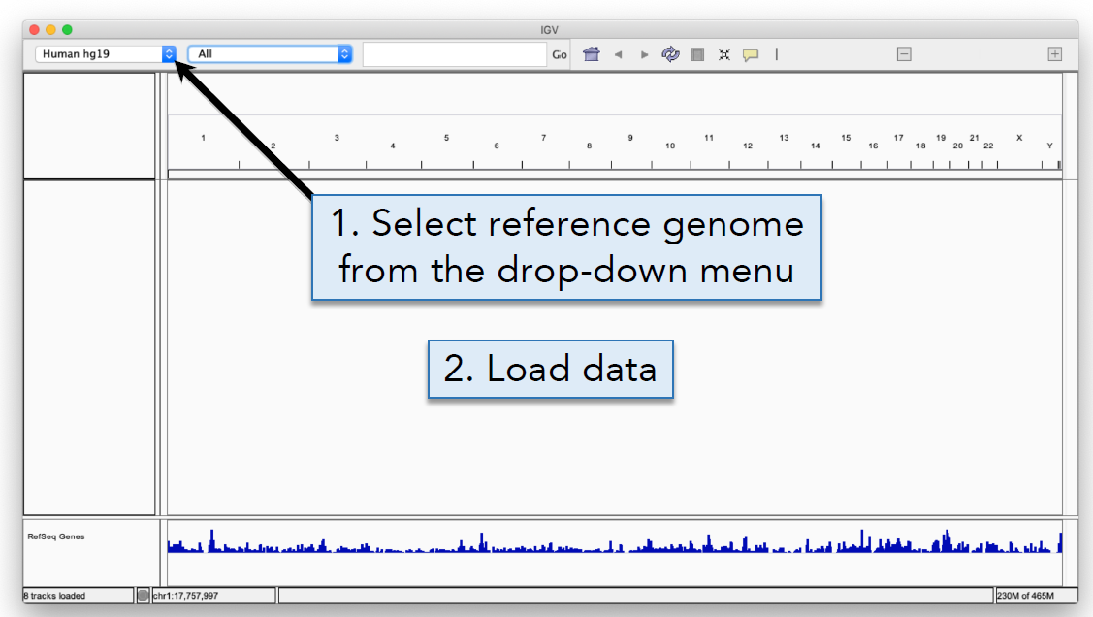
Launch IGV and select genome

Slide 23
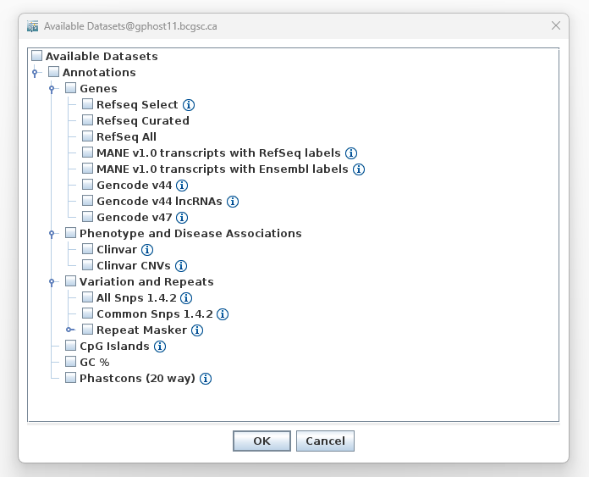
Load data

Slide 24
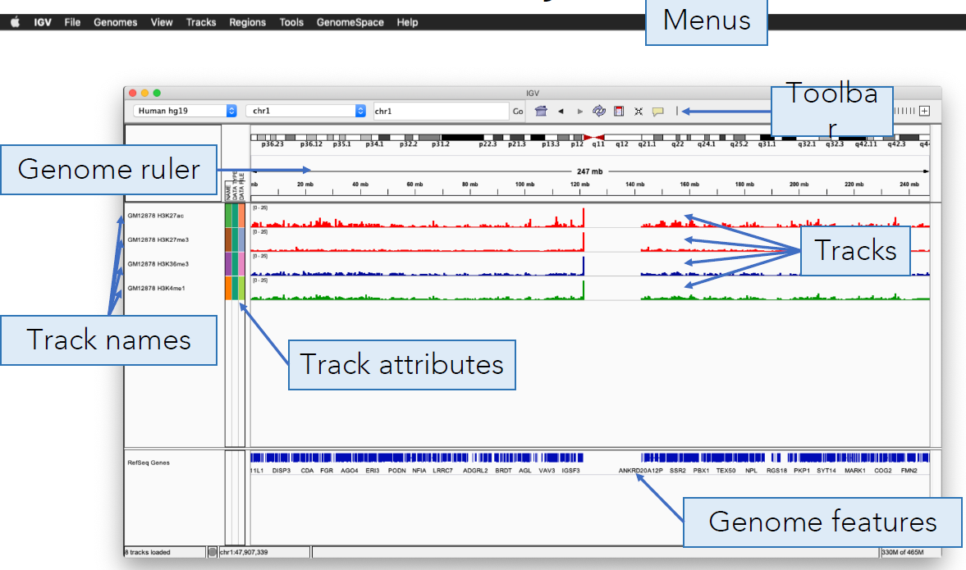
Screen layout

Slide 25
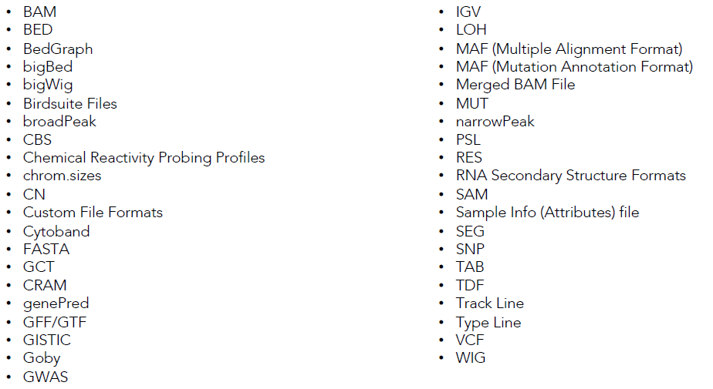
File formats and track types
The file format defines the track type
The track type determines the display options
Compatible data formats:

Slide 26
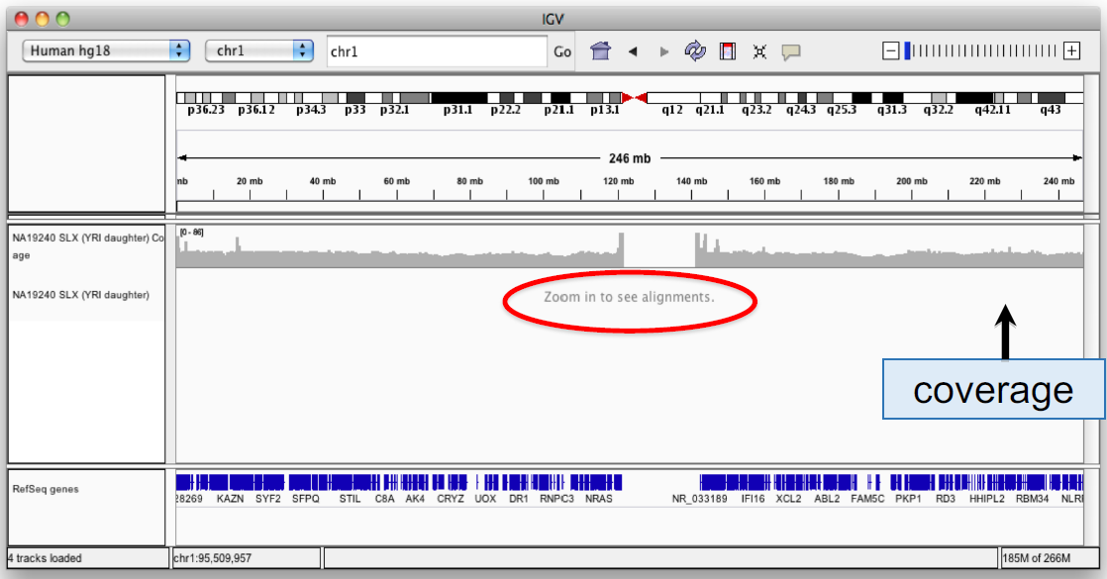
Viewing alignments

Slide 27
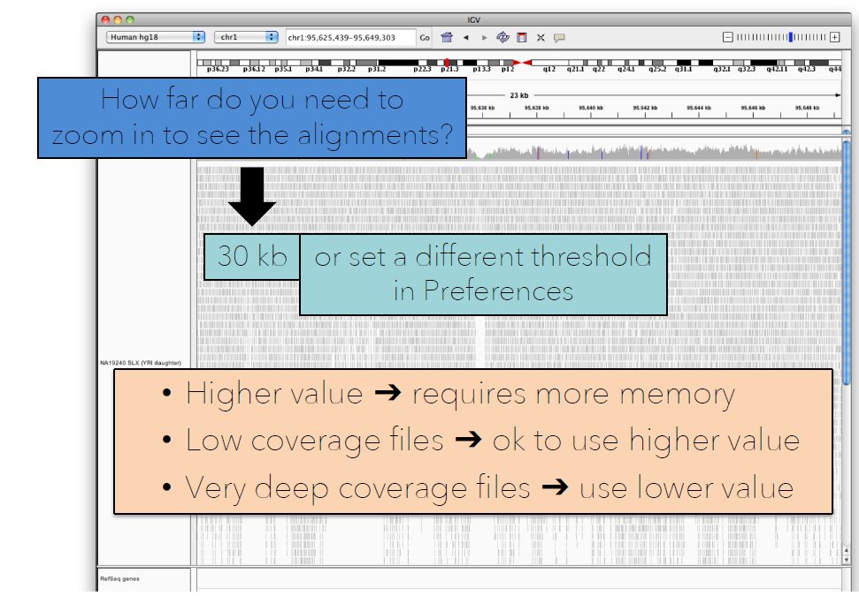
Viewing alignments – Zoom in

Slide 28
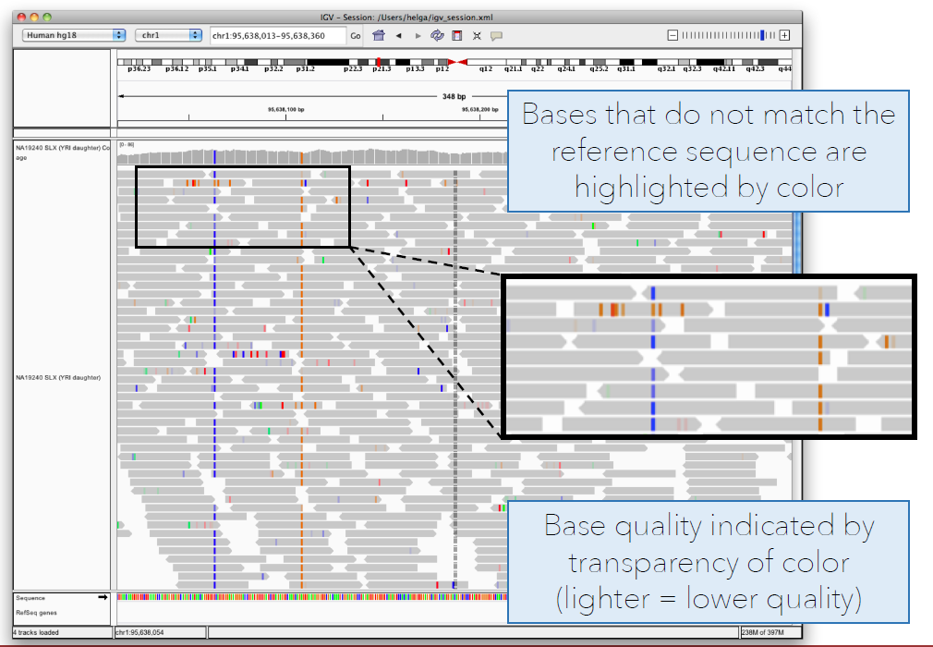
Viewing alignments – Zoom in

Slide 29
SNVs and structural variants
Important metrics for evaluating the validity of SNVs:
  Coverage
  Amount of support
  Strand bias / PCR artifacts
  Mapping qualities
  Base qualities
Important metrics for evaluating SVs:
  Coverage
  Insert size
  Read pair orientation

Slide 30
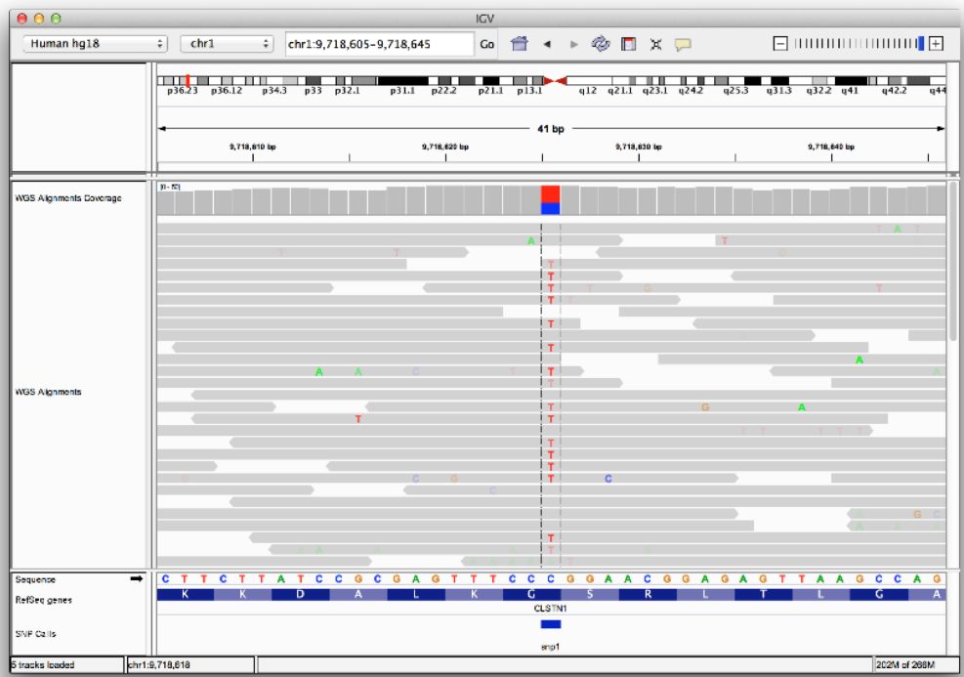
Viewing SNPs and SNVs
Things to watch for:
  variant allele frequency (VAF)
  number of supporting reads
  poor quality bases
  nearby mismatches

Slide 31
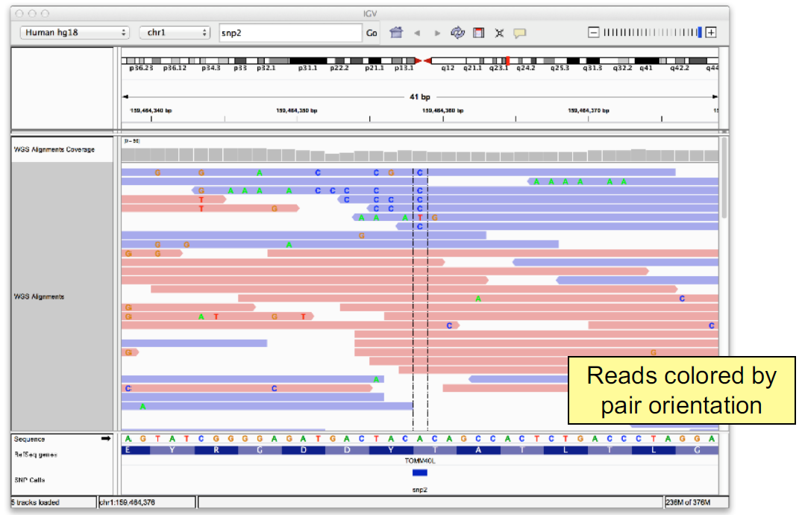
Viewing SNPs and SNVs
Things to watch for:
  strand bias
  variants near read ends
  read mapping quality
  repetitive sequence

Slide 32
Viewing structural variants
Paired reads can yield evidence for genomic “structural events”, such as deletions, translocations, and inversions
Alignment coloring options help highlight these events based on:
  Inferred insert size (template length)
  Pair orientation (relative strand of pair)

Slide 33
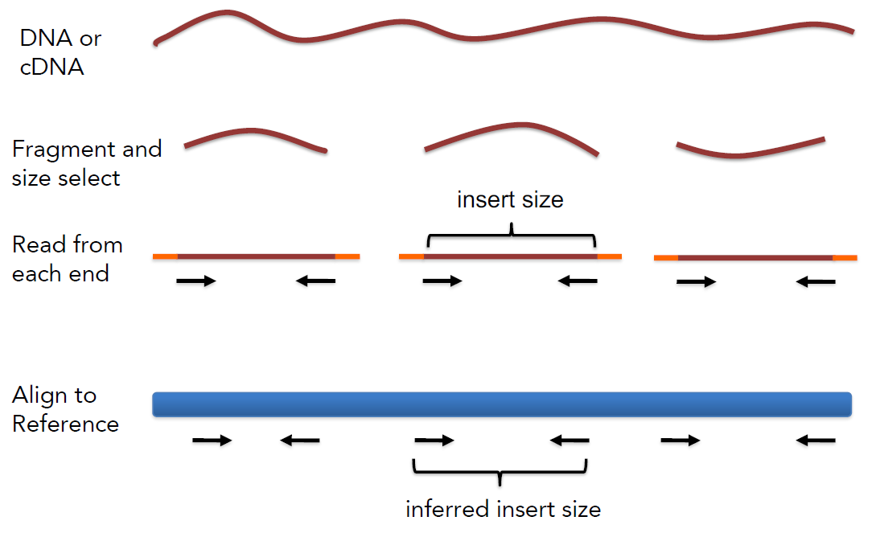
Paired-end sequencing

Slide 34
Interpreting inferred insert size
The “inferred insert size” can be used to detect structural variants including:
  Deletions
  Insertions

Slide 35
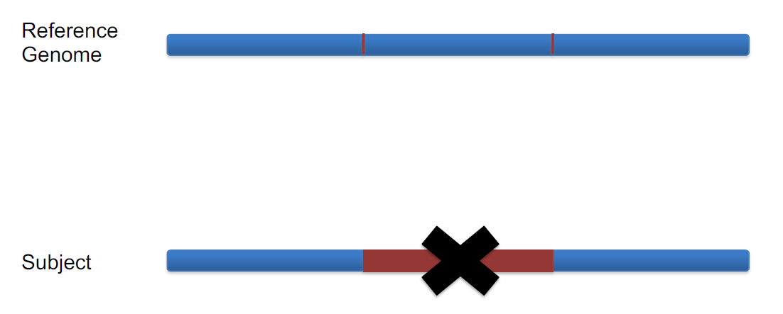
Deletion

Slide 36
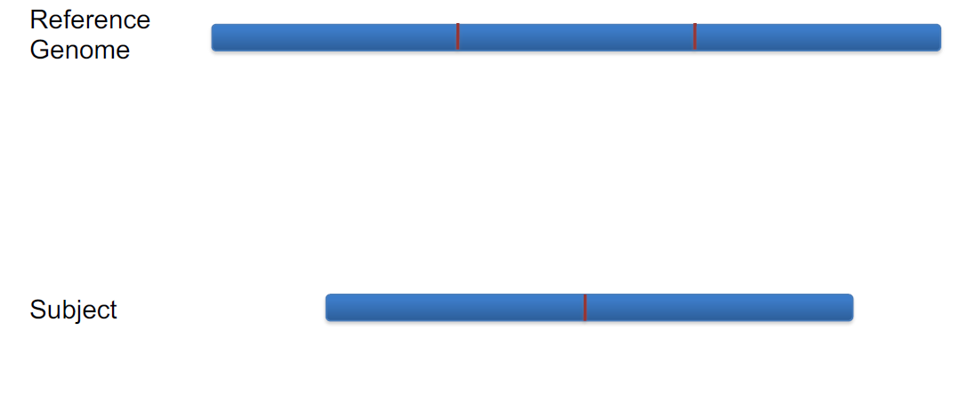
Deletion

Slide 37
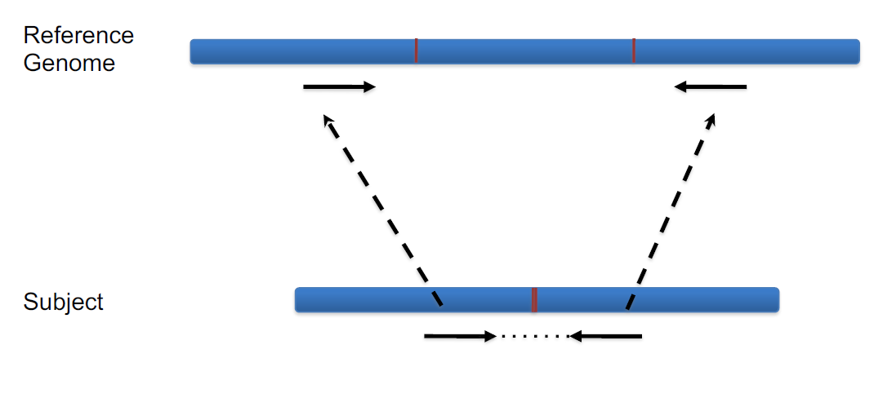
Deletion

Slide 38
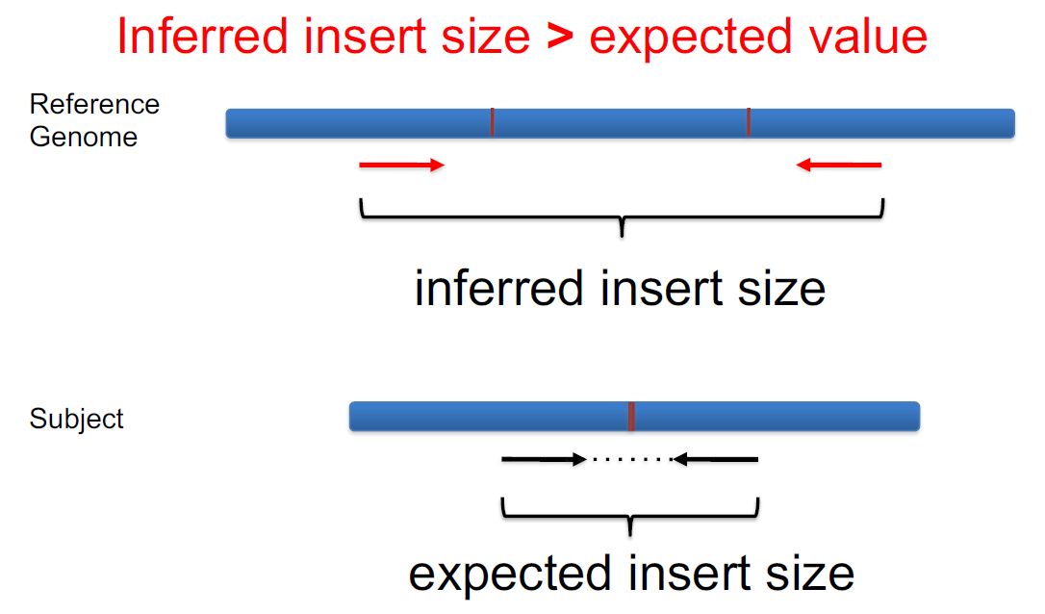
Deletion

Slide 39
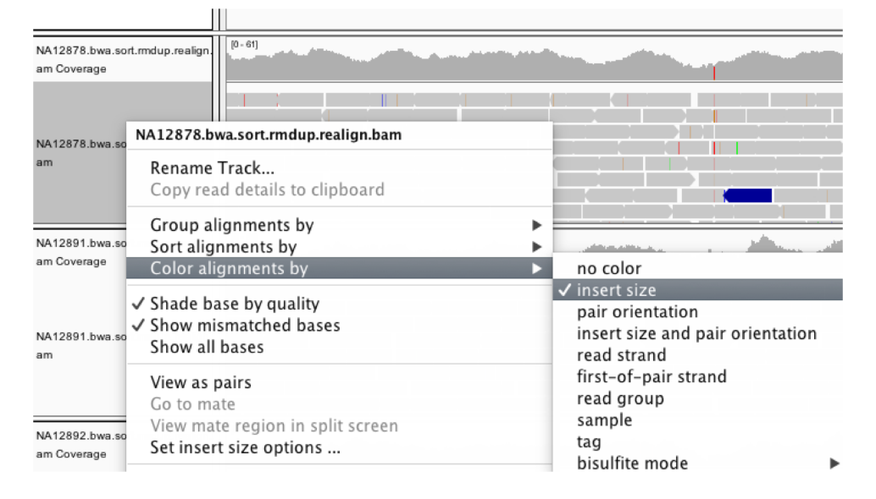
Colour by insert size

Slide 40
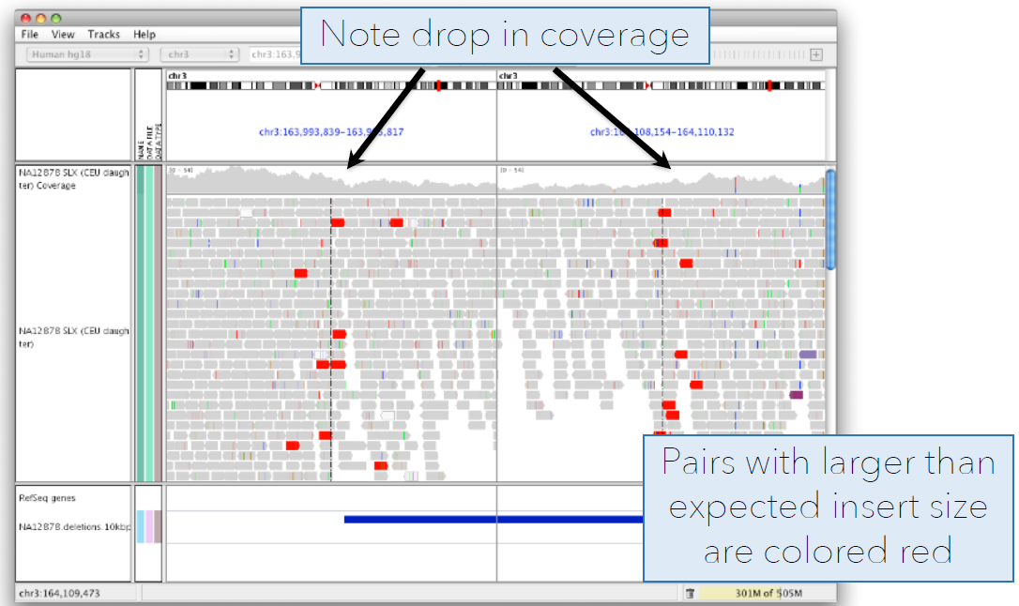
Deletion

Slide 41
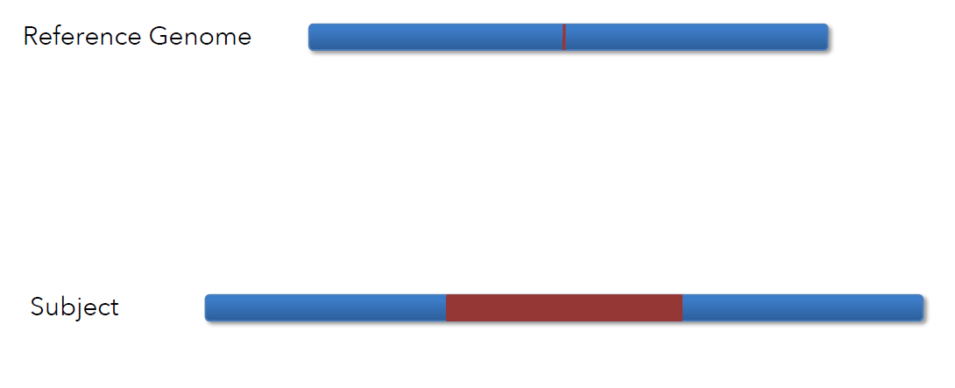
Insertion

Slide 42

Insertion

Slide 43
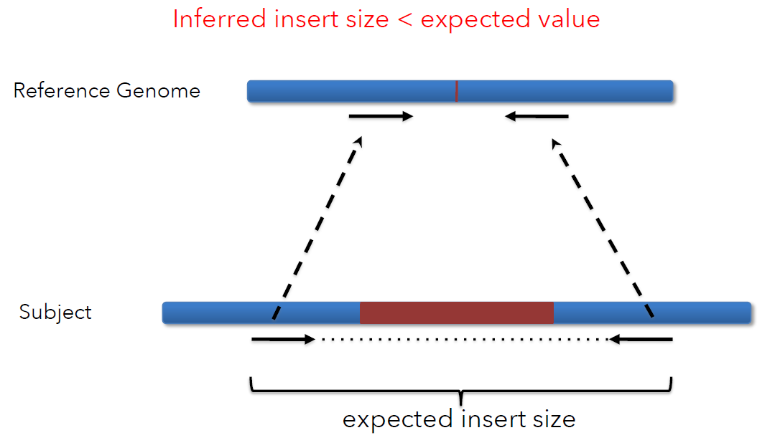
Insertion

Slide 44
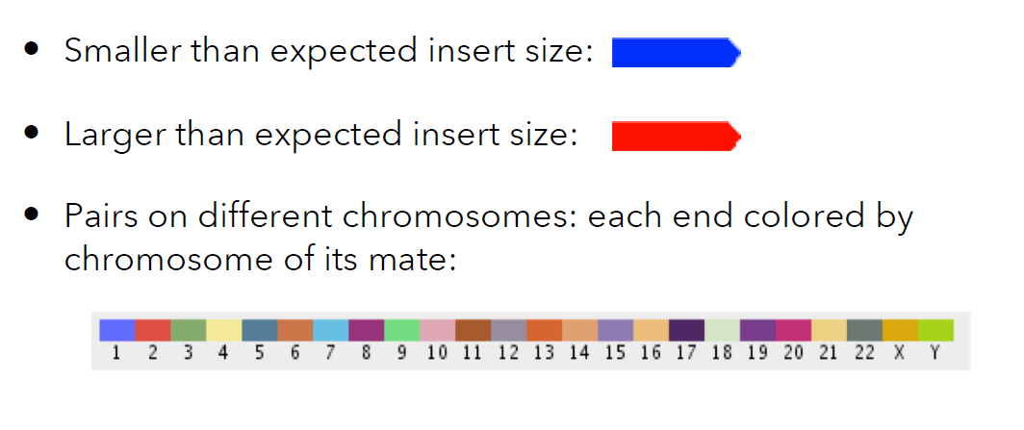
Insert size colour scheme

Slide 45
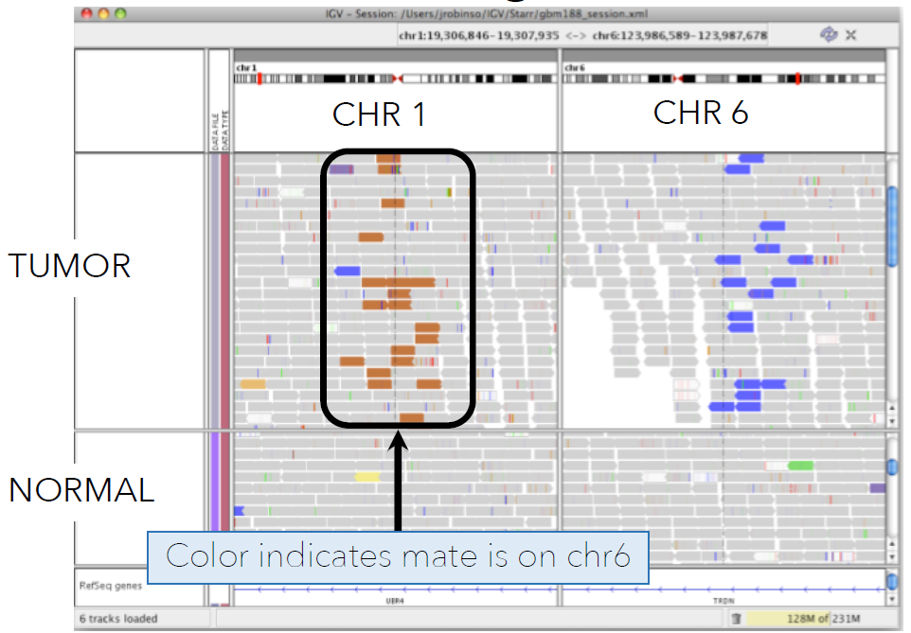
Translocation

Slide 46
Interpreting read-pair orientations
Orientation of paired reads can reveal structural events:
  Inversions
  Duplications
  Translocations
  Complex rearrangements
Orientation is defined in terms of
  read strand, left vs right, and
  read order, first vs second

Slide 47
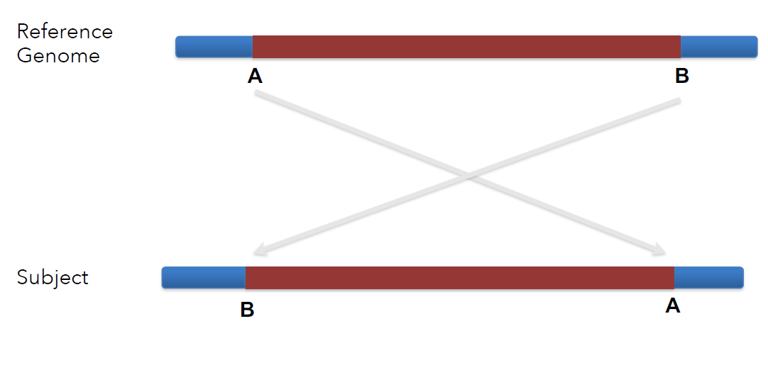
Inversion

Slide 48
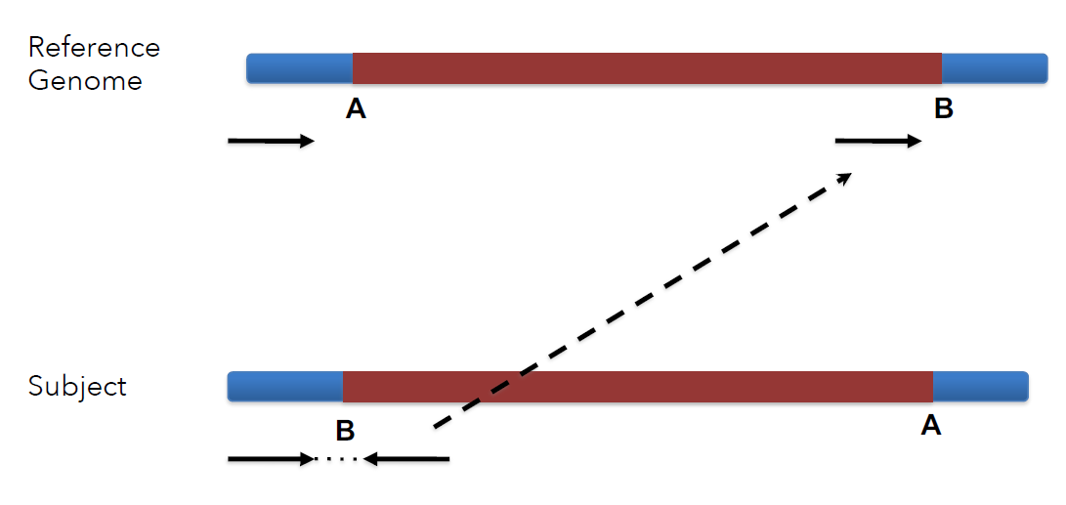
Inversion

Slide 49
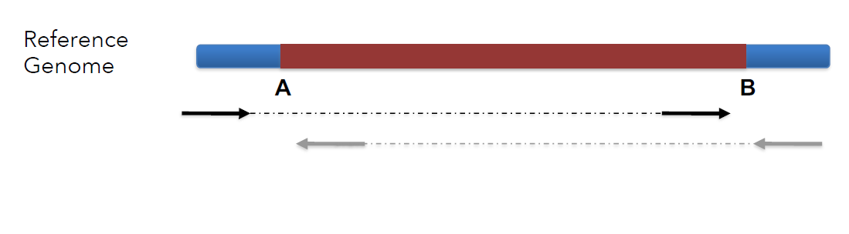
Inversion
Change in read pair orientation and insert size

Slide 50
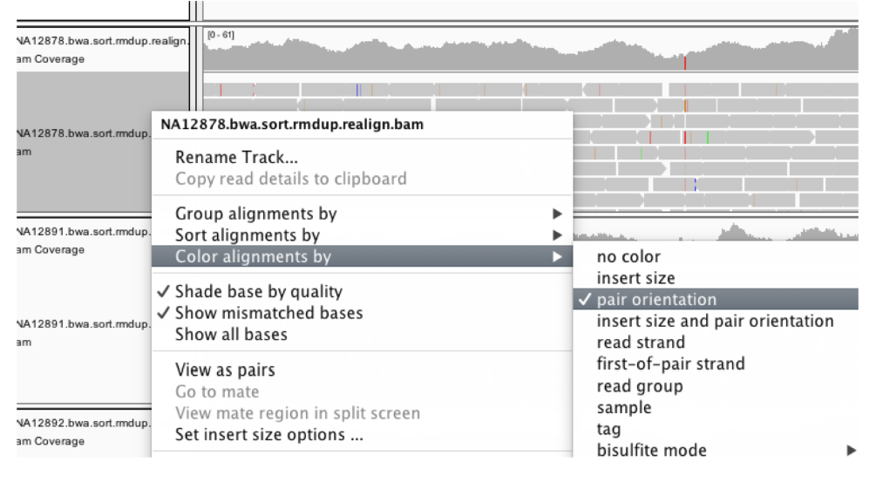
Colour by pair orientation

Slide 51
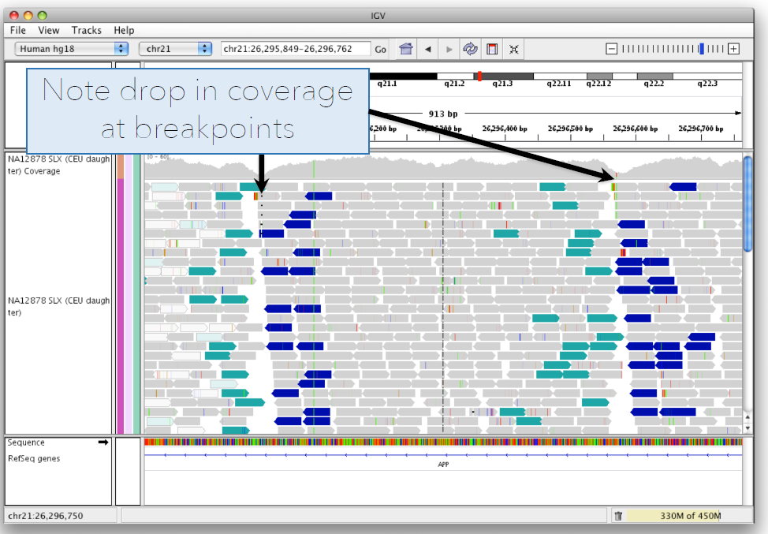
Inversion

Slide 52
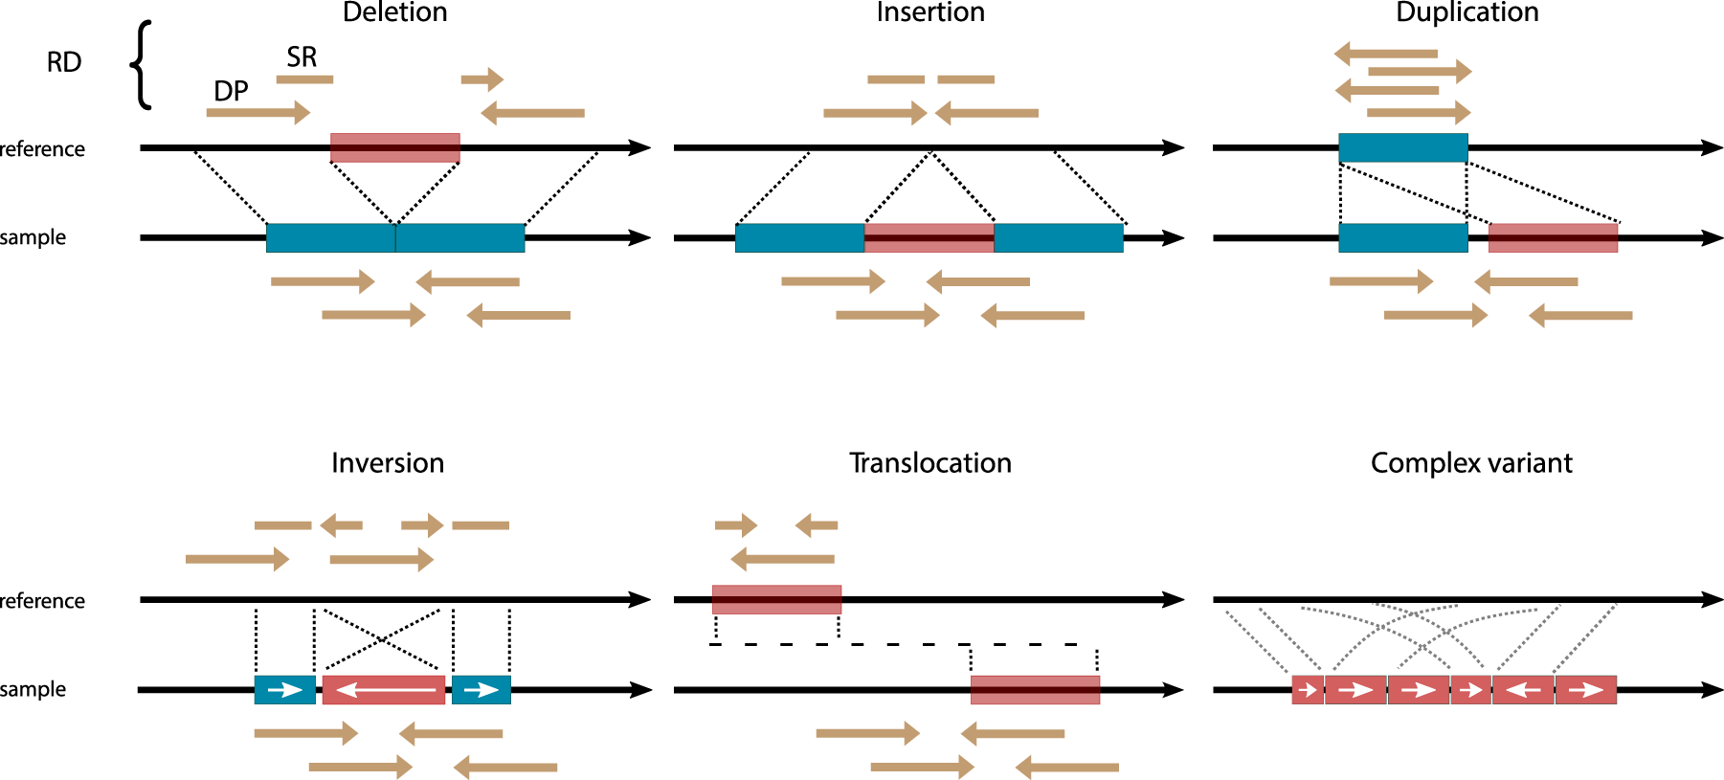
Summary of SV interpretation
PMID: 33654267

Slide 53
Online genome browsers: UCSC
Rich annotations, easy web access
Less suitable for detailed review of BAM/CRAM sequencing alignments
View genes, transcripts, variants, regulatory regions, conservation, and many other annotations
Navigate from whole chromosomes down to individual nucleotides
Integrates hundreds of public datasets (ClinVar, dbSNP, ENCODE, GTEx, etc.)
Supports custom tracks for visualizing your own BED, VCF, BigWig, and other data files
Includes tools for sequence retrieval, coordinate conversion (liftOver), and data mining (Table Browser)
https://genome.ucsc.edu

Slide 54
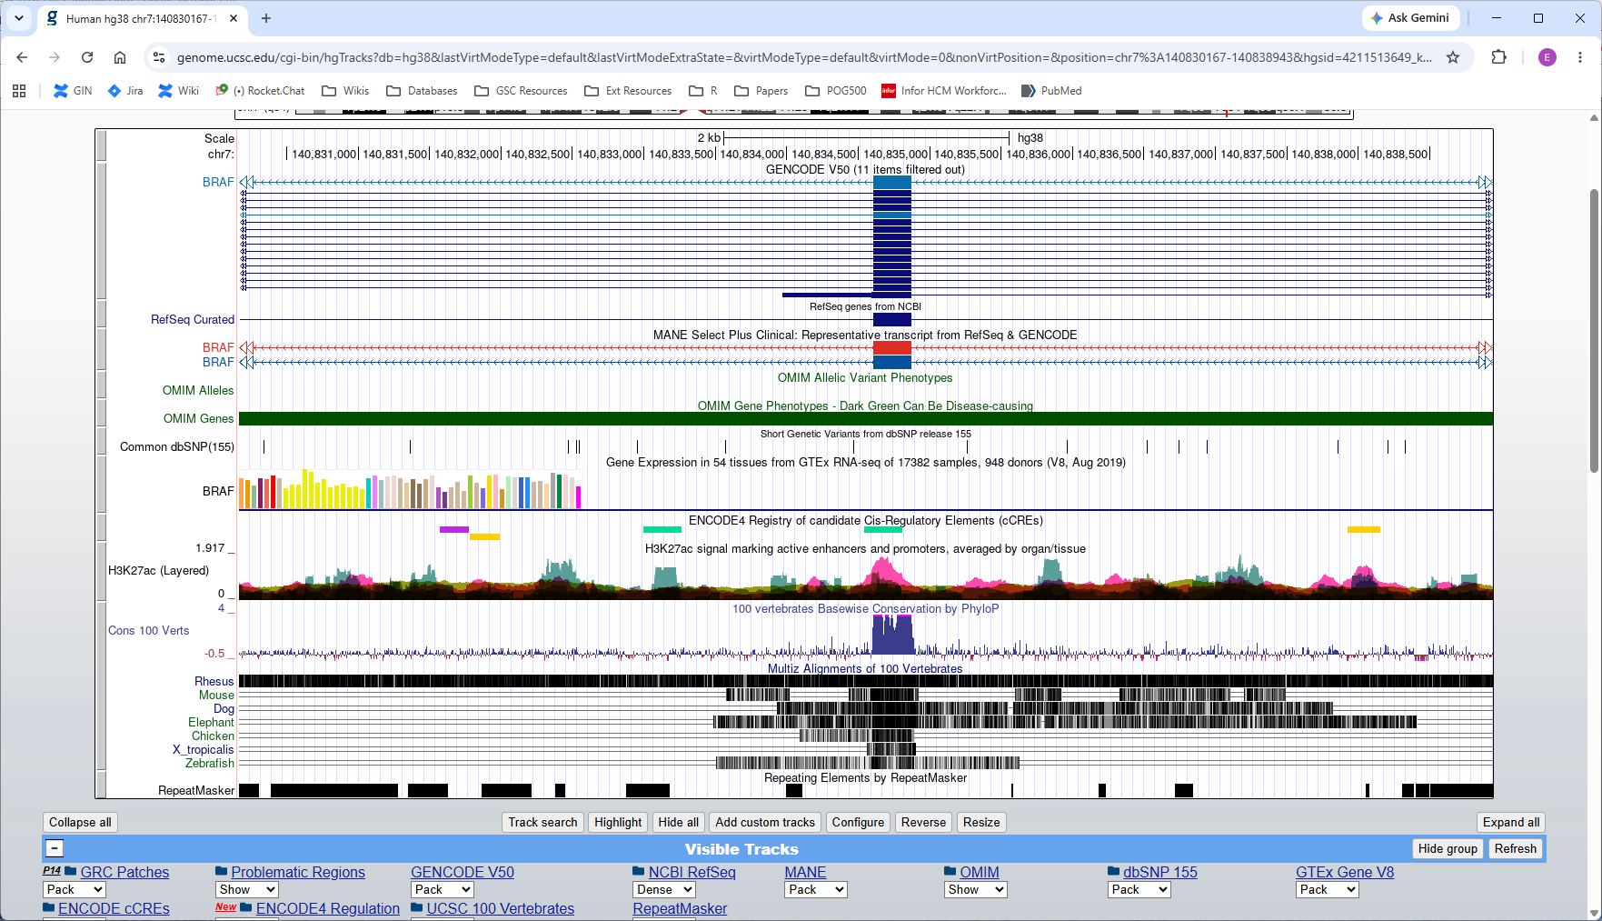
Online genome browsers: UCSC

Slide 55
Online genome browsers: UCSC
Genes and transcripts
Variation
Regulation
Conservation
Repeats

Slide 56
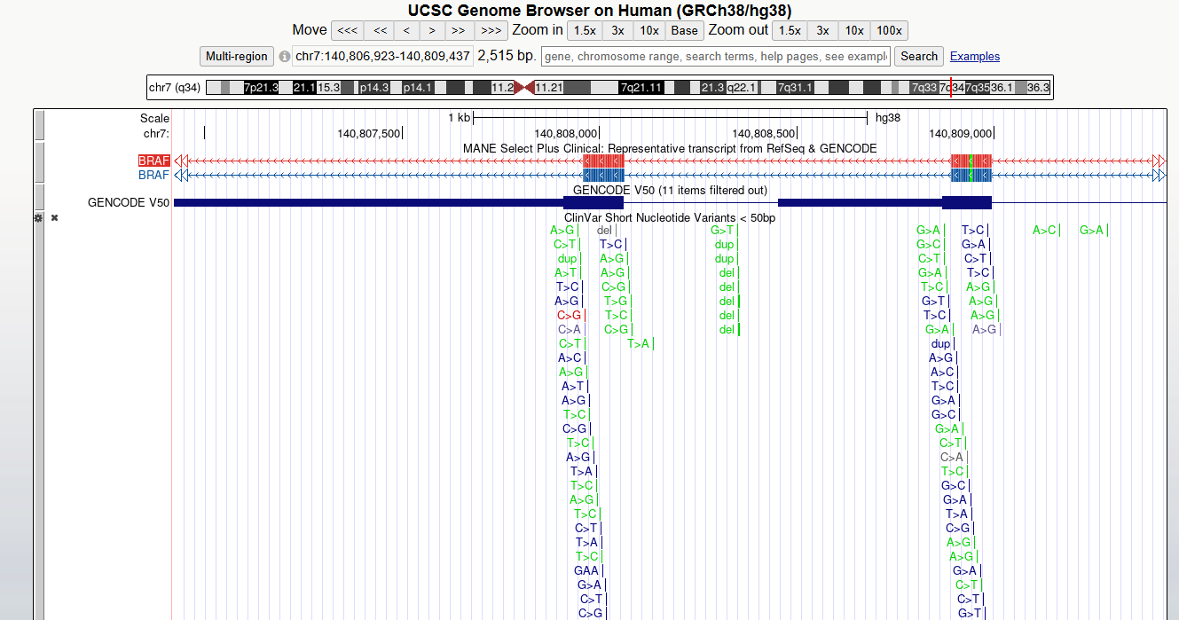
View variation

Slide 57
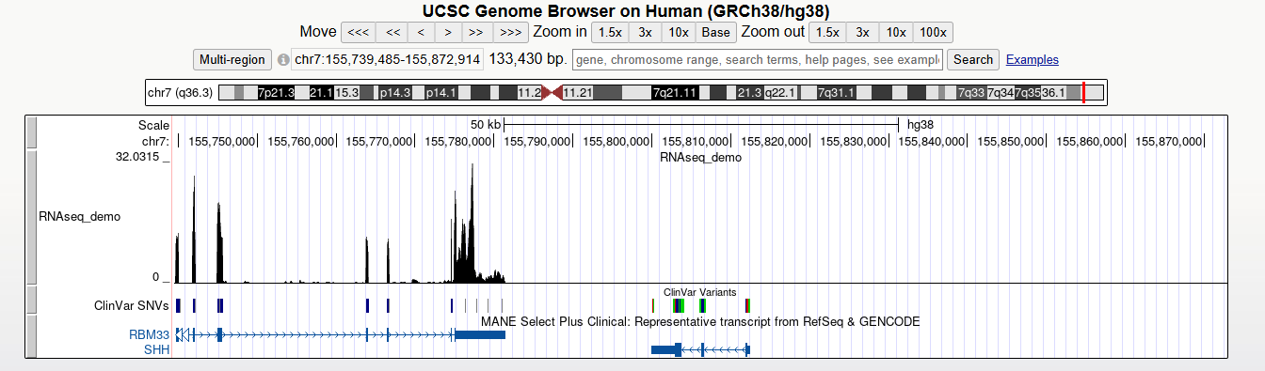
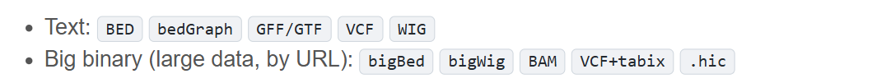
Load custom data tracks

Slide 58
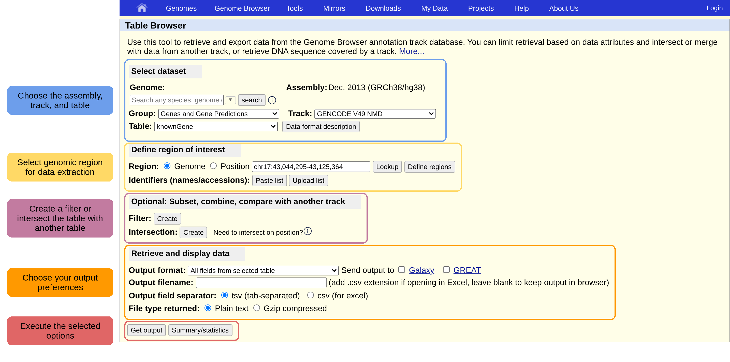
Table browser
https://genome.ucsc.edu/docs/tableBrowserTutorial.html

Slide 59
Visualization summary
No single visualization works for every genomic question
IGV for detailed sequencing review
UCSC Genome Browser or Ensembl for public annotations
PCA, heatmaps, network diagrams etc for data analysis
Choose the visualization that best answers the biological question

Slide 60





Coffee Break & Networking Session
Workshop Sponsors

