Slide 1
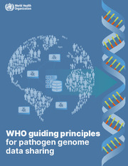
WHO Guiding Principles for Genomic Data Sharing
Published Nov 2022
Summaries by
Dr. Vasee Moorthy
Senior Advisor R&D – World Health Organization

Slide 2
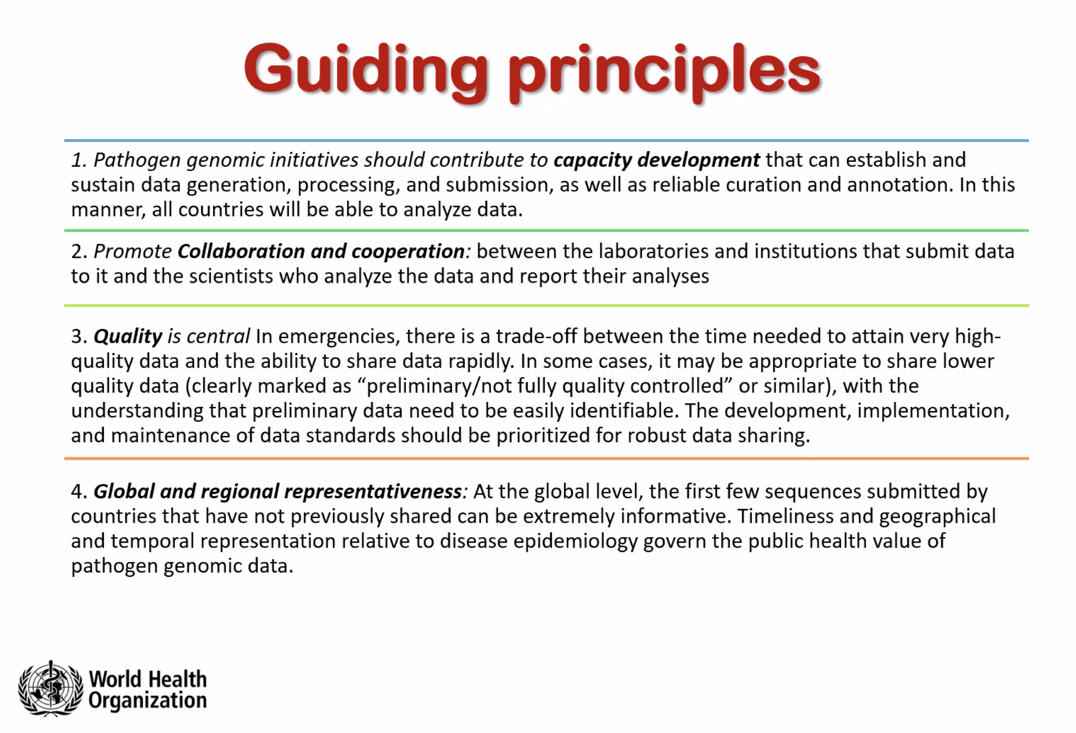
Courtesy of Vasee Moorthy, WHO, 2023

Slide 3
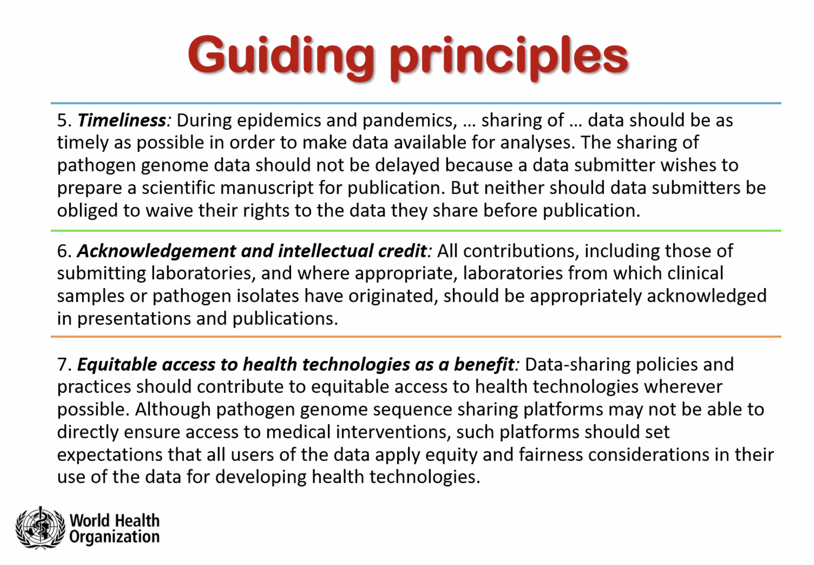
Courtesy of Vasee Moorthy, WHO, 2023

Slide 4
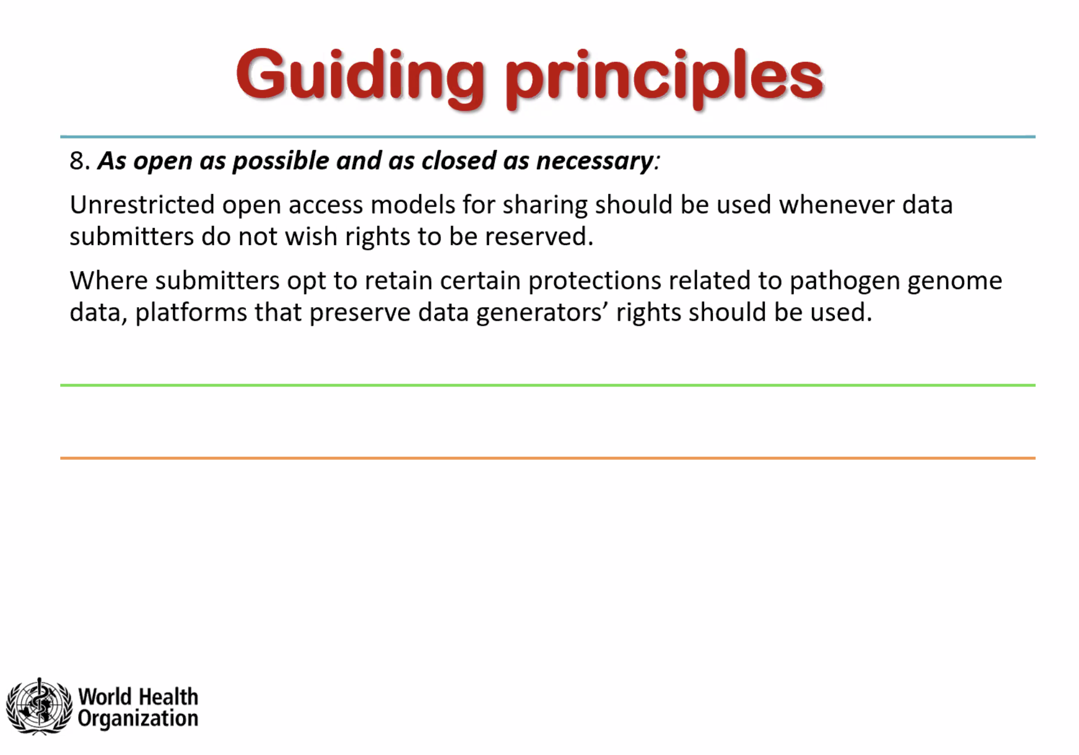
Courtesy of Vasee Moorthy, WHO, 2023

Slide 5
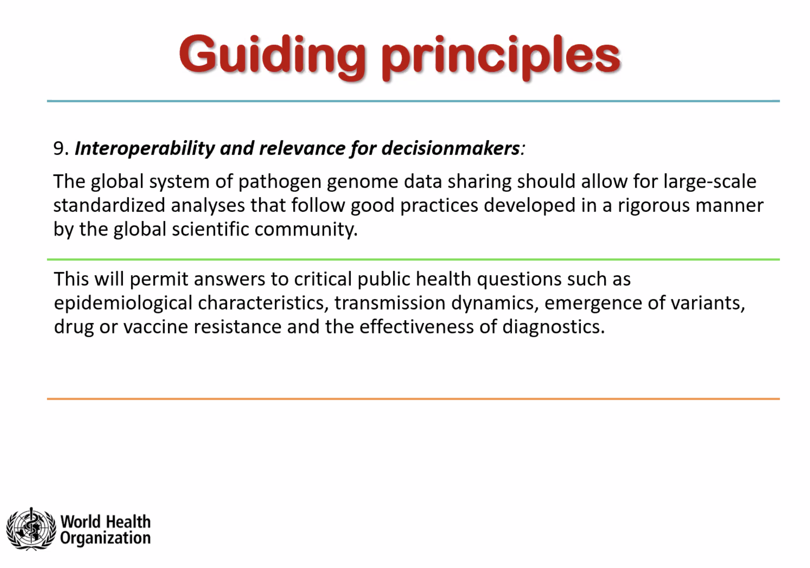
Courtesy of Vasee Moorthy, WHO, 2023

Slide 6
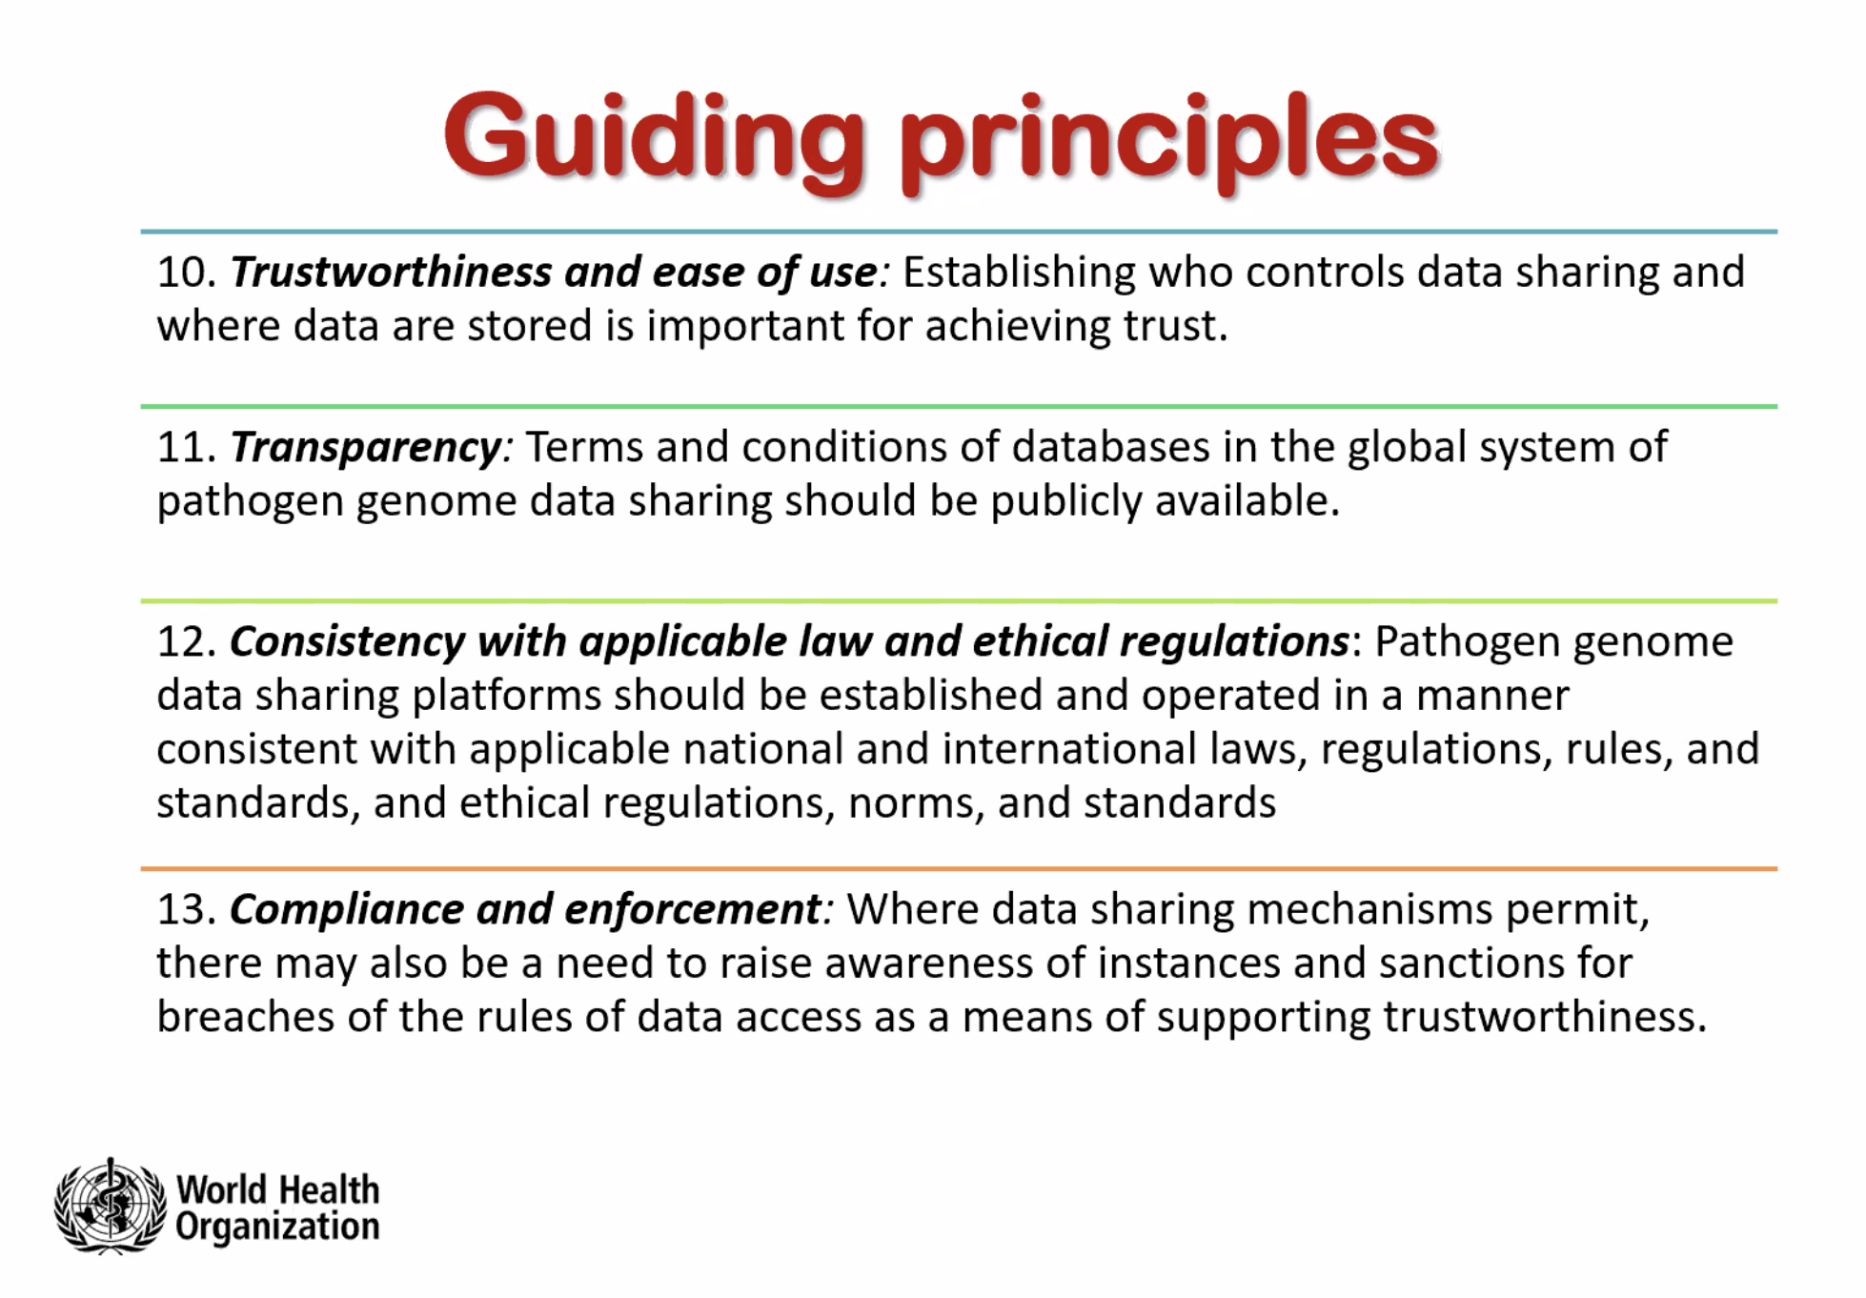
Courtesy of Vasee Moorthy, WHO, 2023

Slide 7
Common data sharing questions…
Will there be adverse repercussions to my sharing the data more openly?
Will I be scooped if I submit my sequence data to an international platform?
Will I be acknowledged?
Will my country have access to medical products developed based on sequences?
How can sequence sharing align with the open science movement?
Discussion

