Slide 1

bioinformatics.ca
bioinformaticsdotca.github.io

Slide 2
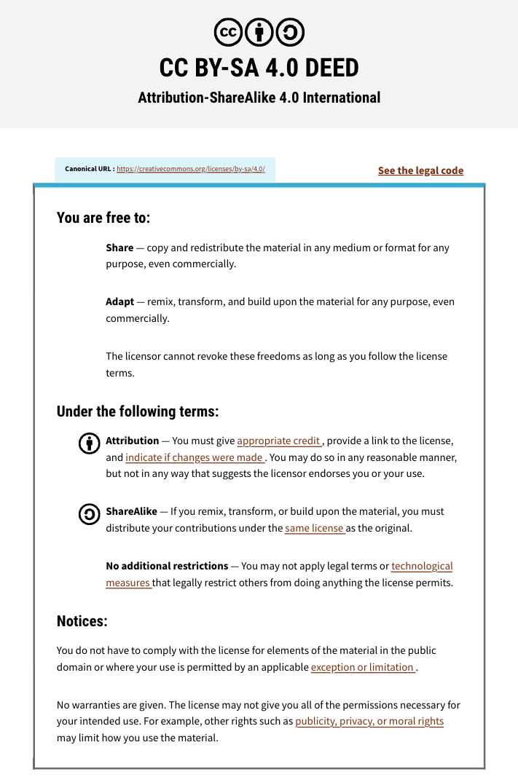

Slide 3



Module 6: Git & GitHub
Adrien Osakwe
INTRODUCTION TO R
October 1st-2nd, 2025

Slide 4
Outline
VCS and Git
Managing your local repository within Rstudio
Interacting with GitHub
Hosting your reports (Module 5)

Slide 5
Learning Objectives
What you WILL learn
Basic theory and features behind Git and GitHub
How to manage local and remote repositories
What you will NOT learn
How to code
Data Analysis Pipelines

Slide 6
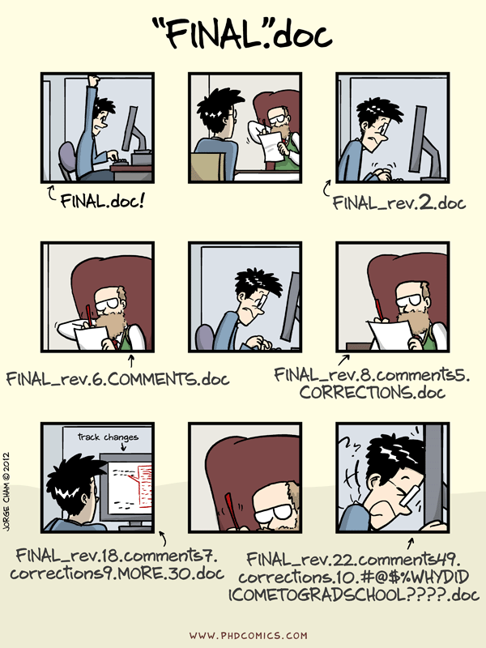

Slide 7
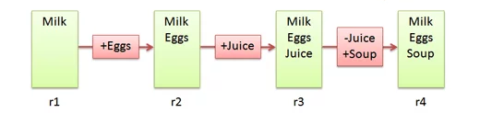
Version Control Systems
Make it easier to document changes
Less confusion
Like an unlimited “undo” button
Groceries.txt

Slide 8

Git
A type of version control system
Open-source
Most popular VCS currently in use
Creates a “Git Repository” which stores all the modified instances of your project

Slide 9
What kind of files does Git track?
Can track any file but works best for pure text files (.txt,.R,.py etc.)
Word/PowerPoint are in binary; Git cannot display the changes occurring in these files
Still useful for storing such files, just cannot use all of Git’s features
Markdown and LaTeX can be used instead of these binary files

Slide 10
Git vs. GitHub
Git
GitHub
A version control system
Works locally and remotely
Is open-source
A server that hosts Git repositories
Works solely as a cloud-based service
Owned by Microsoft

Slide 11
Working Directory ≠ Git Repository
Working directory is your project folder
Git Repository is a hidden file stored inside your working directory
The Git Repository contains the staging area and your commit history/local repository

Slide 12
Git Pipeline
Git Repository
Working
Directory
Staging
Area
Local Repository
Add
Commit
Code.py
*New*
Code.py
*New*
Code.py
*New*
Code.py
TRACKED
Code.py
*Modified*
Code.py
*Modified*
Code.py
*Modified*

Slide 13
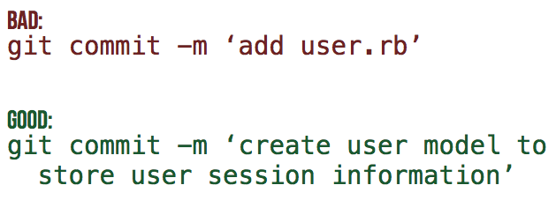
Commit Messages
Every commit MUST have an attached message/description
This helps others identify what changes have been made and why
[filename added/changed ; what change ; why]

Slide 14
Poll #1
T/F – Both untracked and modified files must be added to the staging area
T/F - GitHub is a type of VCS
T/F – The repository keeps track of changes by storing each version of a file/project
Notes:
T
Staging Area
F

Slide 15
Summary
Untracked or modified files are first added to the staging area
Changes that have been staged can then be committed to the local repository
Commits can then be used to revert to previous instances of the project or simply to keep track of what changes have been made

Slide 16
Part II – Basic Git Features

Slide 17
How to access Git
Command Line (e.g: UNIX, Powershell)
Most common – lightweight, works on servers
Con: learning curve
GitHub Desktop App
GUI interface
Within a Text Editor
VsCode extension
Rstudio (what we will use)

Slide 18
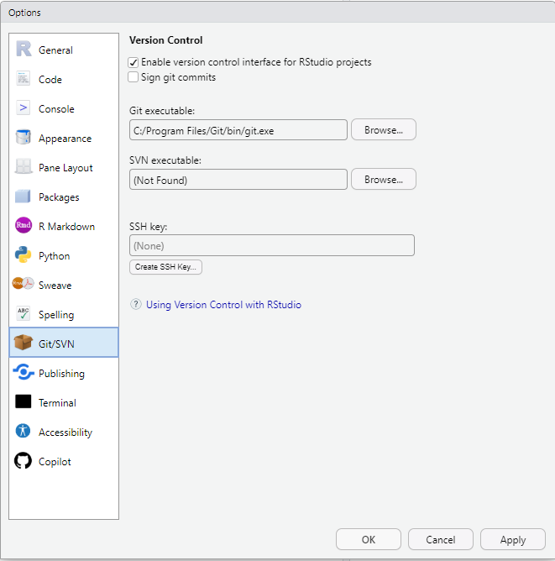
How to access Git (Rstudio)
Go to Help → Global Options → Git/SVN
Ensure the git.exe file is located
Can now initialize Git repositories

Slide 19
Activity #0 – Initialize a Git Repository
Notes:
Make a new git repo through desktop App
Add a file to the directory
Return to desktop app and track the file
Create it, edit it, move it, remove it

Slide 20

Activity #0 – Initialize a Git Repository
Create a new R Project using the project icon in the top-right
Click to Tools tab in the top of the window
Select Version Control and set the version control system to Git
You should now see a Git tab in the top-right pane
Notes:
Make a new git repo through desktop App
Add a file to the directory
Return to desktop app and track the file
Create it, edit it, move it, remove it

Slide 21
Activity #1 – Create and track a Text File with Git
Notes:
Make a new git repo through desktop App
Add a file to the directory
Return to desktop app and track the file
Create it, edit it, move it, remove it

Slide 22
Activity #1 – Create and track a Text File with Git
Create a text file (or code script) within the project
Open the Git tab and see if the file is detected. If yes, create a commit.
Look at your commit history to see your commit!
Modify the file and commit the changes. Try and make informative commit messages!
Notes:
Make a new git repo through desktop App
Add a file to the directory
Return to desktop app and track the file
Create it, edit it, move it, remove it

Slide 23
Activity #2 – Revert a file to a previous commit
Notes:
Edit your text file with an error
Go to desktop app and reset the file to the previous commit
Repeat BUT this time commit it
Revert changes of the commit

Slide 24
Activity #2 – Revert a file to a previous commit
Make an unwanted change to your file
Use your staging area to discard the changes
Make another unwanted change and commit it
Now use your commit history to revert the commit!
Extra: Try using the reset feature – when would this be helpful?
Notes:
Edit your text file with an error
Go to desktop app and reset the file to the previous commit
Repeat BUT this time commit it
Revert changes of the commit

Slide 25
Poll #2
T/F – After initialisation, a project folder becomes a git repository
T/F – After making a commit, you cannot revert to a previous version of your repository
Is it possible for two commits to have the same ID?
Notes:
T
F
No

Slide 26
Git Branches
A specific “timeline” of your commit history
Allows us to implement new features without harming viable releases
New Feature
Debugged New Feature
Dev
Initial Commit
Debug Commit
Release 1.0.0
Patched Release
Main/Master

Slide 27
Activity #3 – Create a new branch
Notes:
Create new branch and make changes

Slide 28
Activity #3 – Create a new branch
Click the “new branch” button in the Git tab
Make changes to your file in the new branch and commit it
Switch back to the main branch and open the file, what do you notice?
Notes:
Create new branch and make changes

Slide 29
Now that your test feature works, you might want to make it part of your official release
Merge

Slide 30
Merging Branches
Action that will “merge” the commits from one branch into another
New Feature
Debugged New Feature
New Feature + Patch
Dev
Release 1.0.0
Patched Release
Release 1.1.0
Main/Master

Slide 31
Activity #4 – Merging Branches

Slide 32
Activity #4 – Merging Branches
Switch to the main branch
Open the terminal in the console
Run ```git merge other_branch_name```
Compare both branches – they should now be identical!

Slide 33
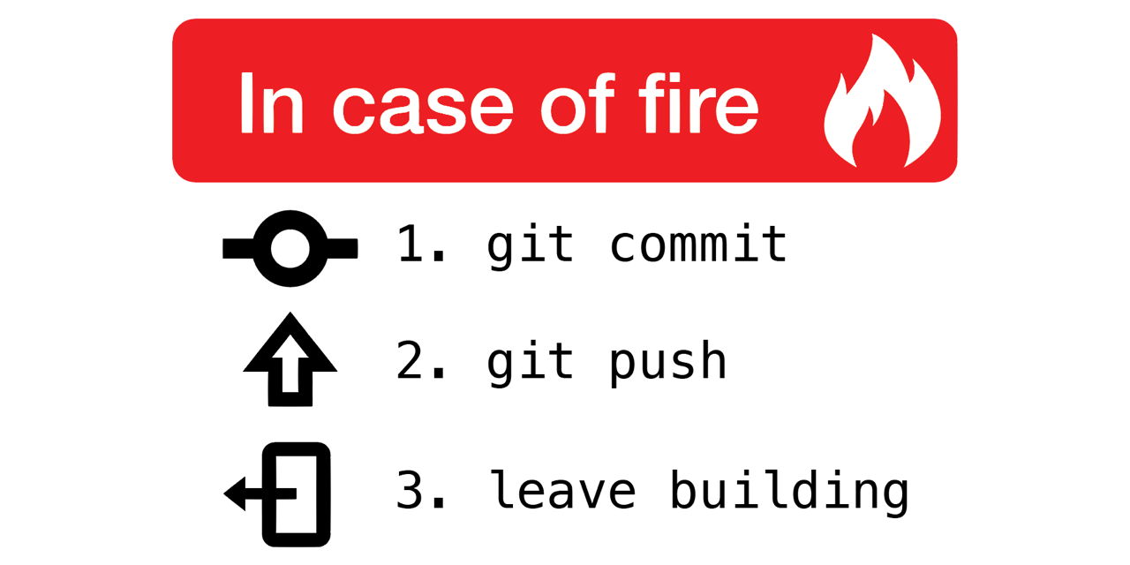
Why use remote repositories like GitHub?
Backup for your code
Can access the repository from anywhere
Collaborations
Easy to keep track of changes made by you and collaborators
Open Science
Easy to access, download and use others’ code
Easy to discuss with users of your code

Slide 34
Pushing and Pulling
Push: Updates your remote repository with recent commits from your local repository
Pull: Updates your local repository with recent commits from your remote repository

Slide 35
Local-Remote Pipeline
Working
Directory
Staging
Area
Local Repository
Remote Repository
Add
Commit
Code.py
*New*
Code.py
*New*
Code.py
*New*
Code.py
TRACKED
Notes:
https://www.google.com/url?sa=i&url=https%3A%2F%2Fcourses.csail.mit.edu%2F6.S194%2F13%2Flessons%2F03-git%2Fgit-commands-and-metaphors.html&psig=AOvVaw0eLwNte0CymnSwNKJIL7Zi&ust=1654357234965000&source=images&cd=vfe&ved=0CAwQjRxqFwoTCLifgozPkfgCFQAAAAAdAAAAABAk

Slide 36
Local-Remote Pipeline
Working
Directory
Staging
Area
Local Repository
Remote Repository
Pull
Push
Code.py
*New*
Code.py
*New*
Code.py
*Modified*
Code.py
TRACKED
Code.py
*Modified*
Code.py
*Modified*
Notes:
https://www.google.com/url?sa=i&url=https%3A%2F%2Fcourses.csail.mit.edu%2F6.S194%2F13%2Flessons%2F03-git%2Fgit-commands-and-metaphors.html&psig=AOvVaw0eLwNte0CymnSwNKJIL7Zi&ust=1654357234965000&source=images&cd=vfe&ved=0CAwQjRxqFwoTCLifgozPkfgCFQAAAAAdAAAAABAk

Slide 37








Coffee Break & Networking Session
Workshop Sponsors

