Slide 1
CANADIAN BIOINFORMATICS WORKSHOP
Get ready for
LLMs in
Bioinformatics
A short, practical setup guide for students
NOVEMBER 14-15, 2026
10 minutes required / local setup optional

Slide 2
START HERE
A light-touch pre-work check
1
Laptop + charger
Bring a laptop you can use in a browser.
Not required for this pre-work
Google Colab access
Sign in and run one tiny Python cell.
Paid plans
GPU access
GitHub or Copilot account
A pre-installed package bundle
2
3
Slides + notebook
Open the module slides beside its linked notebook.
4
Questions are welcome
If setup fails, bring the error; a TA can help.
If the final lab instructions change a requirement, the organizers will say so explicitly.

Slide 3

REQUIRED · ABOUT 10 MINUTES
Open Colab and test one cell
Run this in a code cell
print("Hello, bioinformatics!")
Your check is complete when the output appears below the cell.
Colab landing page, signed out. Captured Nov 9, 2026.
Save a copy of a workshop notebook before editing. Colab sessions are temporary; save work you want to keep.
Open colab.research.google.com and sign in with a Google account.

Slide 4
DURING THE WORKSHOP
Let the slides and notebook work as a pair
01
02
03
04
Slides
Notebook
Run + inspect
Return to slides
Frame the biological question and the method.
Open the linked lab, save a Drive copy, follow setup notes.
Execute cells in order. Read the output; do not just race to the end.
Use the checkpoint to connect results back to the concept.
Your instructor will share the notebook link for each lab before the activity.

Slide 5
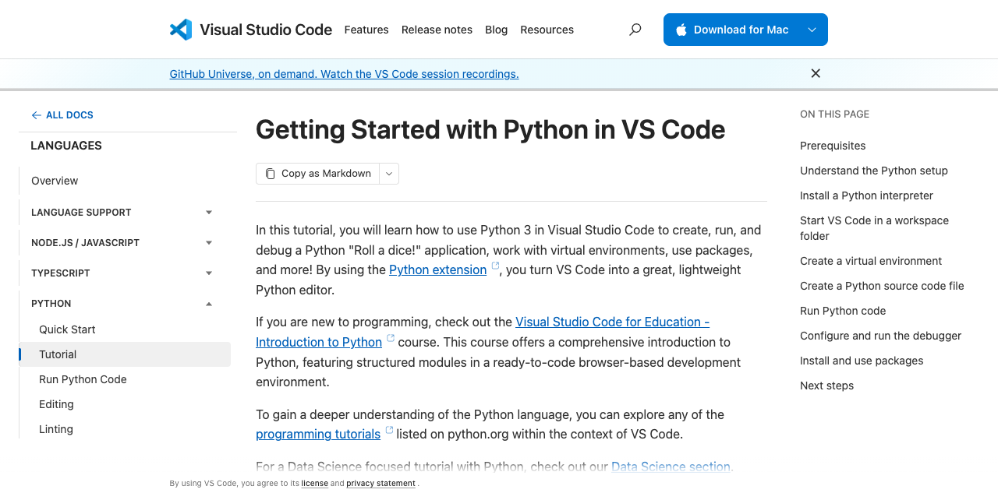
ONLY IF YOU WANT TO PREPARE
Local Python setup is optional
What you need
1. Python 3 interpreter
2. VS Code editor
3. Microsoft Python extension
4. Optional: Jupyter extension for local notebooks
print("Hello, bioinformatics!")
Official VS Code Python tutorial, captured Nov 9, 2026.
Use the current vendor instructions if the page changes.
Do not install workshop libraries until exact lab requirements are confirmed.

Slide 6
Ready is enough.
Bring your laptop, your questions, and your curiosity.
Keep research data safe
If setup fails, bring the error message with private details removed. A TA can help.
Use public or synthetic workshop data only. Never upload identifiable, clinical, confidential, unpublished, or restricted data to personal cloud notebooks or AI tools.
See the student guide for official links and step-by-step instructions.
CANADIAN BIOINFORMATICS WORKSHOP / NOVEMBER 2026

Slide 7
NOT NEEDED FOR THIS WORKSHOP
Optional AI access programs
GitHub Copilot Student
Claude for research labs
For verified students in eligible degree- or diploma-granting programs. Apply through GitHub Education with current enrollment proof, then activate Copilot Student separately after approval.
Anthropic’s scientist plan is PI-led: an eligible academic/nonprofit PI verifies first, then may add lab members. Announced standard seats are free and premium seats are US$15/month for one year; confirm current availability and terms.
Start: github.com/settings/education/benefits
Students: ask your PI; workshop registration alone does not qualify you.
See the guide for official application instructions.
No paid AI account is required for pre-work.

Slide 8
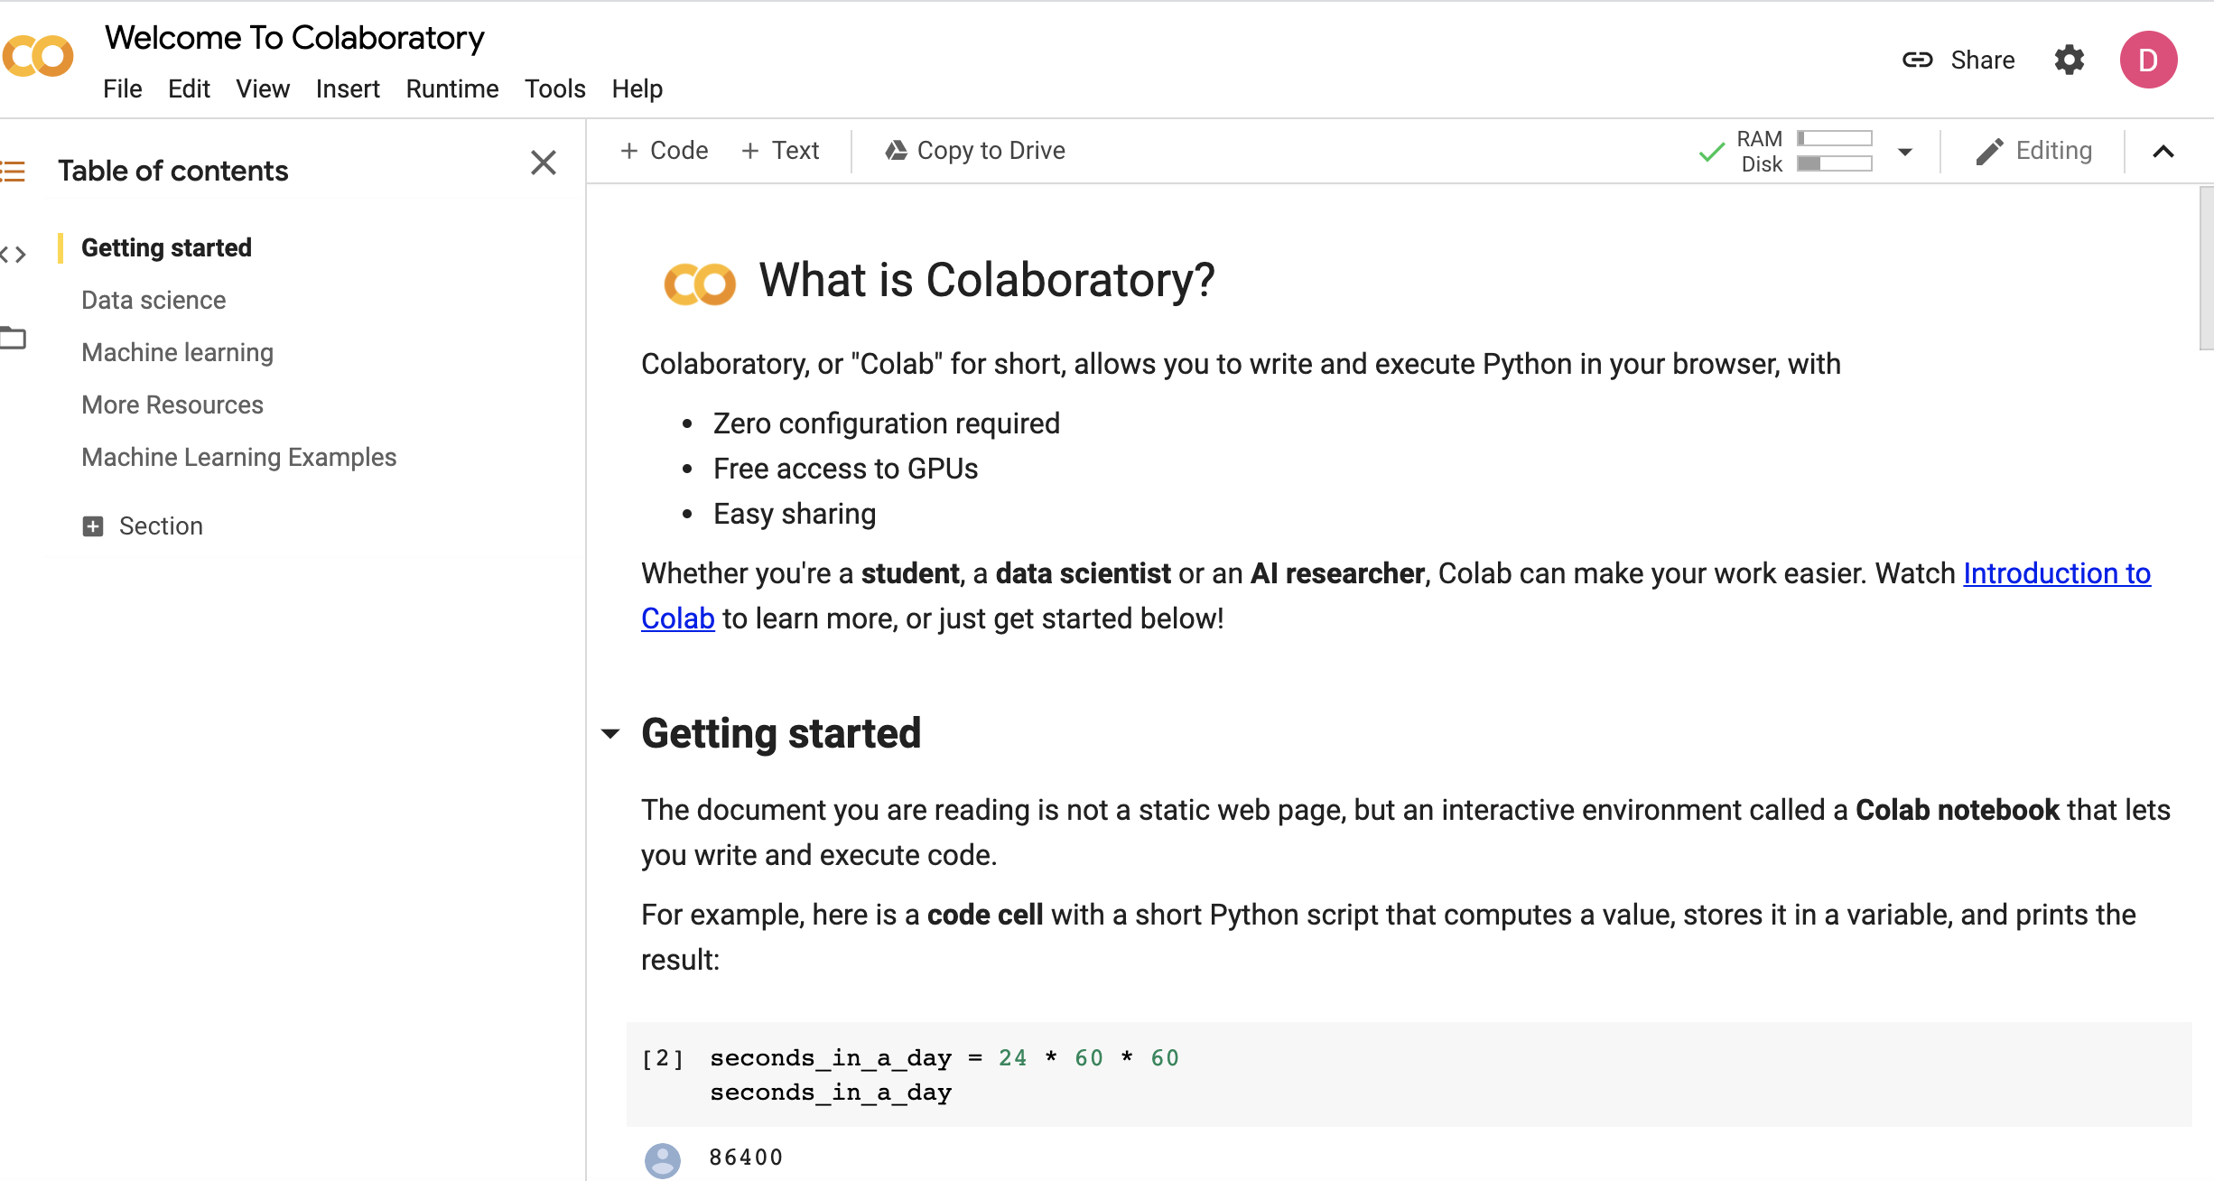
INTERFACE EXAMPLE · APRIL 2026
Inside a Colab notebook
A notebook has
Code cells
Outputs beneath cells
Text and explanation
Controls to add cells and save a copy
Historical screenshot reused from Module 1 of the April 2026 Machine Learning workshop. Current Colab screens may differ.
Use the current official Colab page and the workshop-provided notebook link.

Slide 9
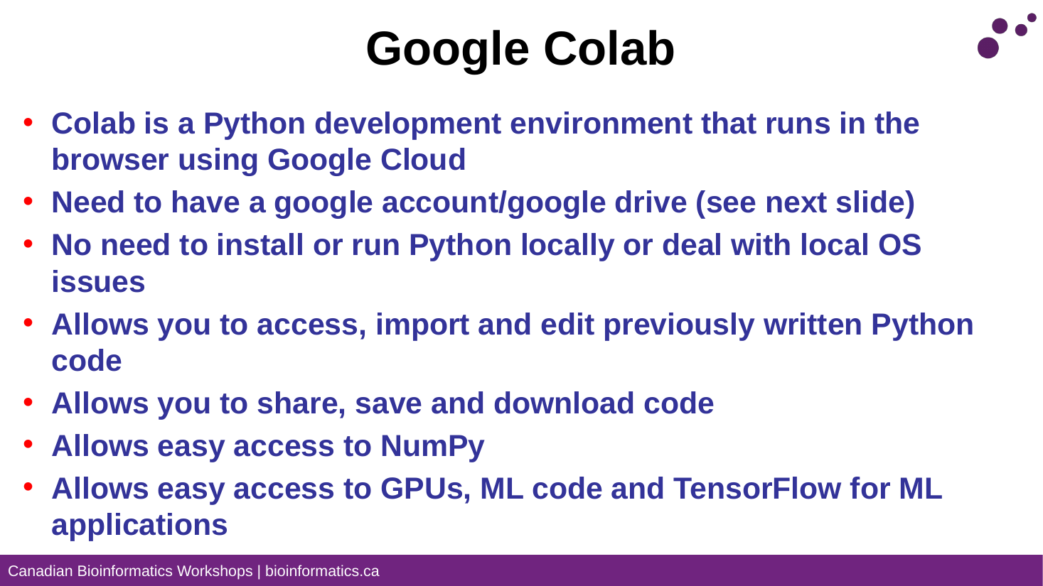
HISTORICAL MLE MODULE 1 SLIDE 090 · APRIL 2026
Google Colab introduction
Historical example
MLE 0426
Module 1
Slide 090
April 2026
This is a historical interface walkthrough. Colab screens and service features can change; follow current official instructions.

Slide 10
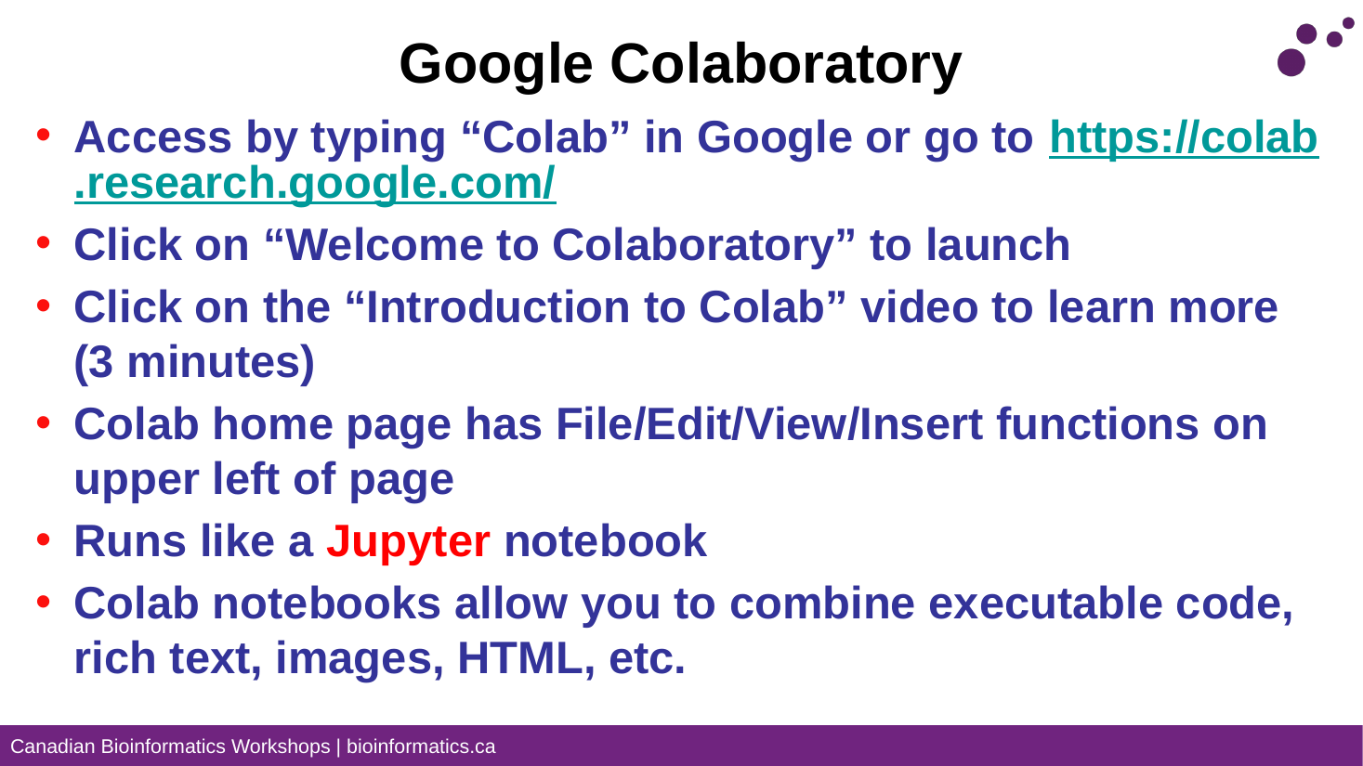
HISTORICAL MLE MODULE 1 SLIDE 097 · APRIL 2026
Colab access
Historical example
MLE 0426
Module 1
Slide 097
April 2026
This is a historical interface walkthrough. Colab screens and service features can change; follow current official instructions.

Slide 11
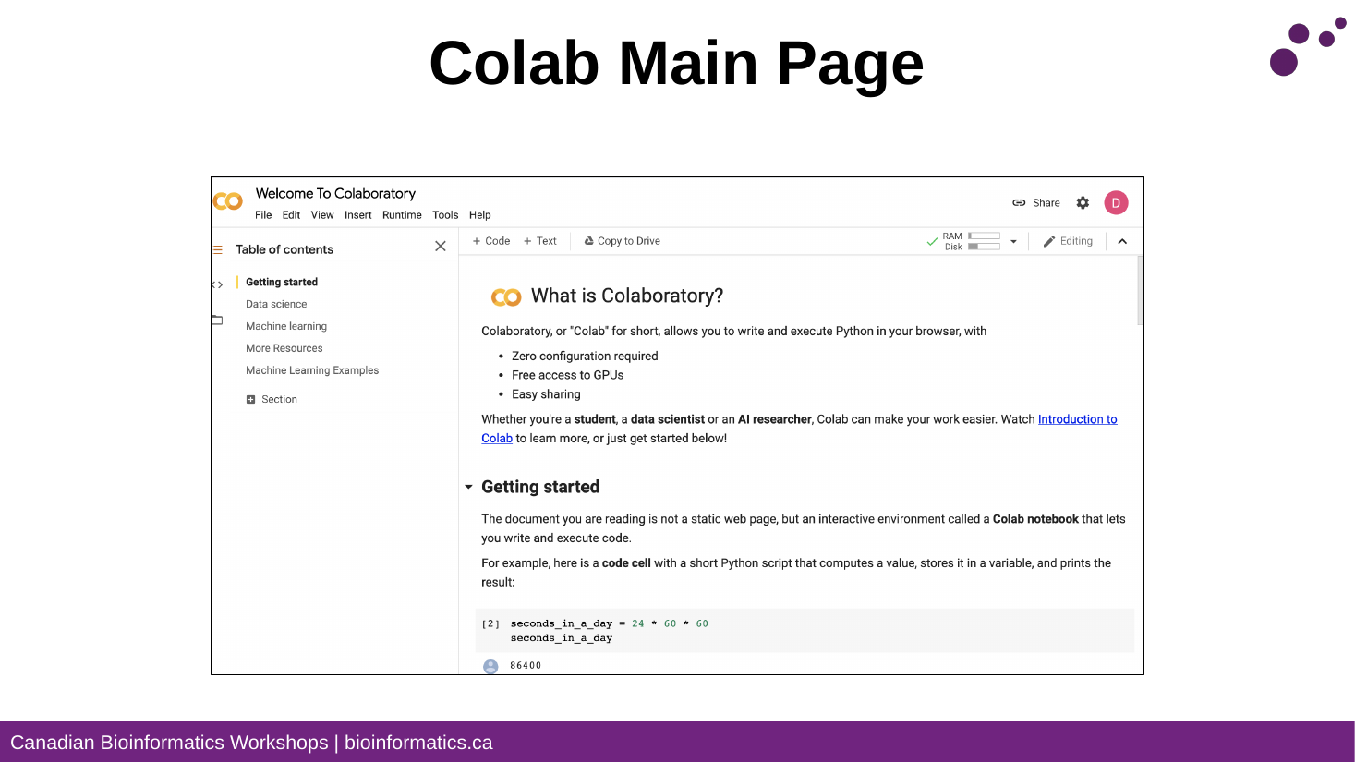
HISTORICAL MLE MODULE 1 SLIDE 108 · APRIL 2026
Colab notebook interface
Historical example
MLE 0426
Module 1
Slide 108
April 2026
This is a historical interface walkthrough. Colab screens and service features can change; follow current official instructions.

Slide 12
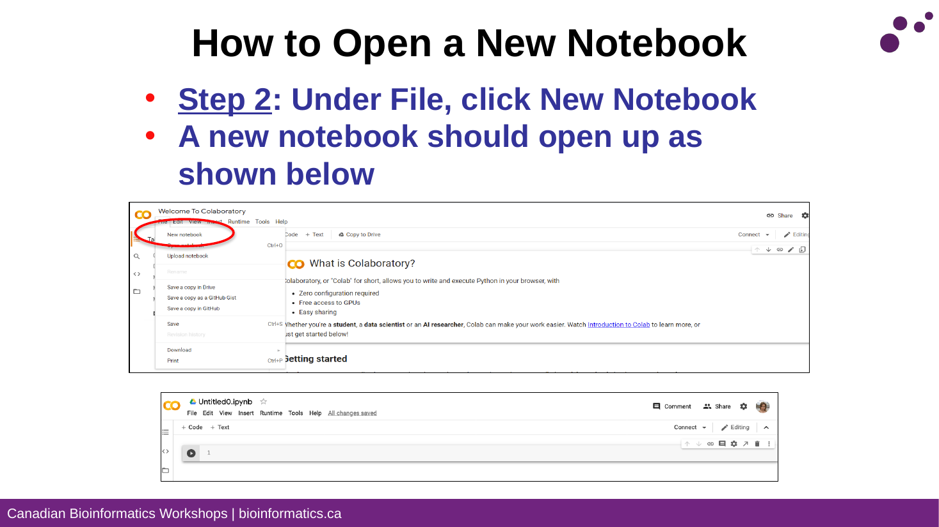
HISTORICAL MLE MODULE 1 SLIDE 111 · APRIL 2026
Creating a notebook
Historical example
MLE 0426
Module 1
Slide 111
April 2026
This is a historical interface walkthrough. Colab screens and service features can change; follow current official instructions.

Slide 13
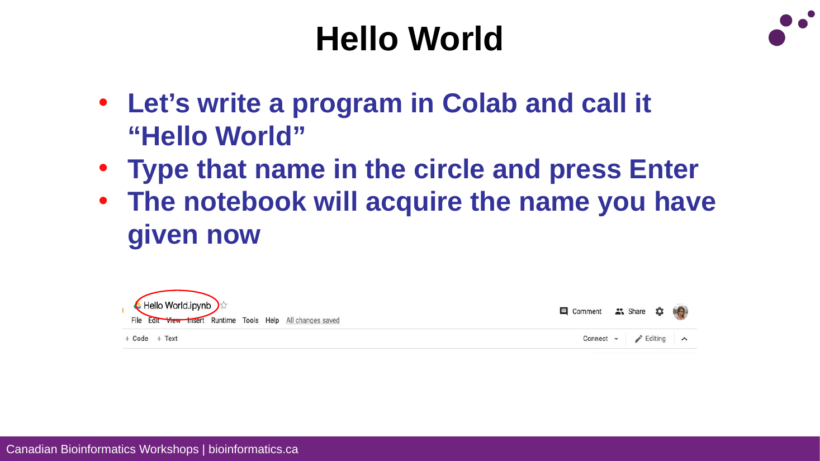
HISTORICAL MLE MODULE 1 SLIDE 115 · APRIL 2026
Hello World example
Historical example
MLE 0426
Module 1
Slide 115
April 2026
This is a historical interface walkthrough. Colab screens and service features can change; follow current official instructions.

Slide 14
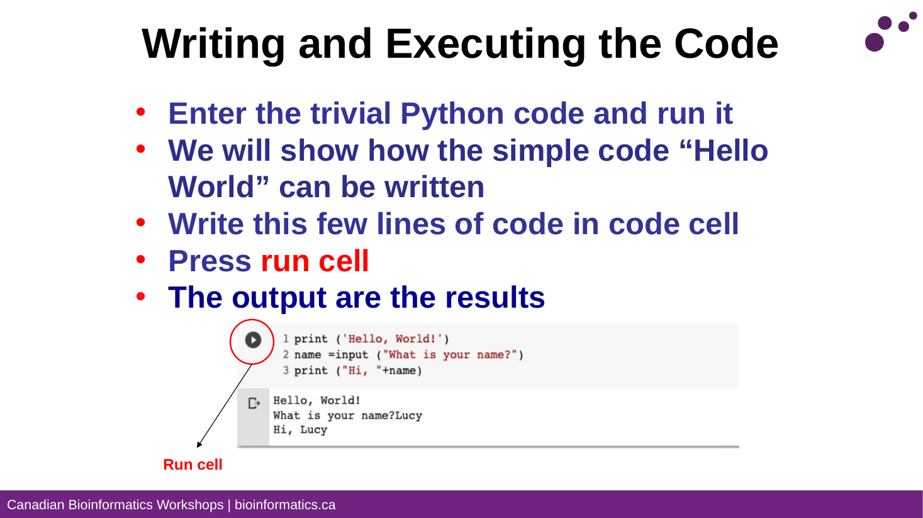
HISTORICAL MLE MODULE 1 SLIDE 116 · APRIL 2026
Running a code cell
Historical example
MLE 0426
Module 1
Slide 116
April 2026
This is a historical interface walkthrough. Colab screens and service features can change; follow current official instructions.

Slide 15
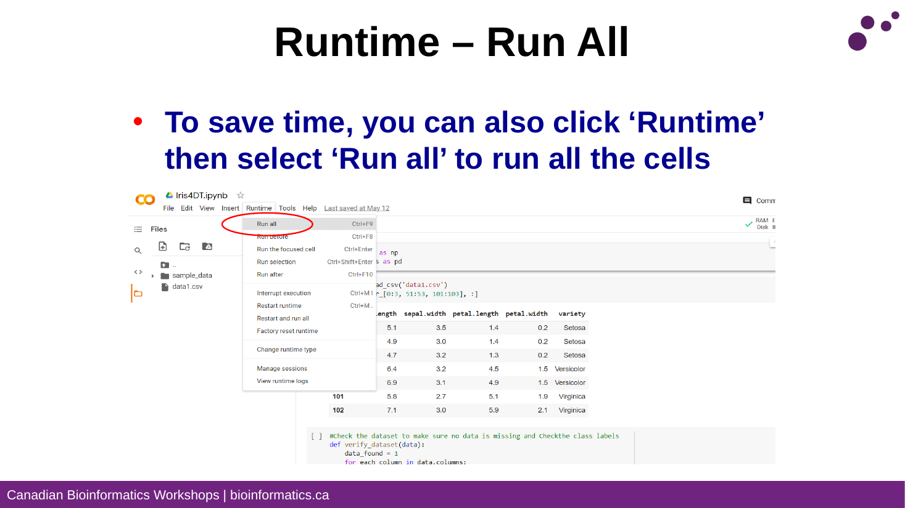
HISTORICAL MLE MODULE 1 SLIDE 125 · APRIL 2026
Running all cells
Historical example
MLE 0426
Module 1
Slide 125
April 2026
This is a historical interface walkthrough. Colab screens and service features can change; follow current official instructions.

