Slide 1
Google Colab
Colab is a Python development environment that runs in the browser using Google Cloud
Need to have a google account/google drive (see next slide)
No need to install or run Python locally or deal with local OS issues
Allows you to access, import and edit previously written Python code
Allows you to share, save and download code
Allows easy access to NumPy
Allows easy access to GPUs, ML code and TensorFlow for ML applications

Slide 2
Google Colaboratory
Access by typing “Colab” in Google or go to https://colab.research.google.com/
Click on “Welcome to Colaboratory” to launch
Click on the “Introduction to Colab” video to learn more (3 minutes)
Colab home page has File/Edit/View/Insert functions on upper left of page
Runs like a Jupyter notebook
Colab notebooks allow you to combine executable code, rich text, images, HTML, etc.

Slide 3
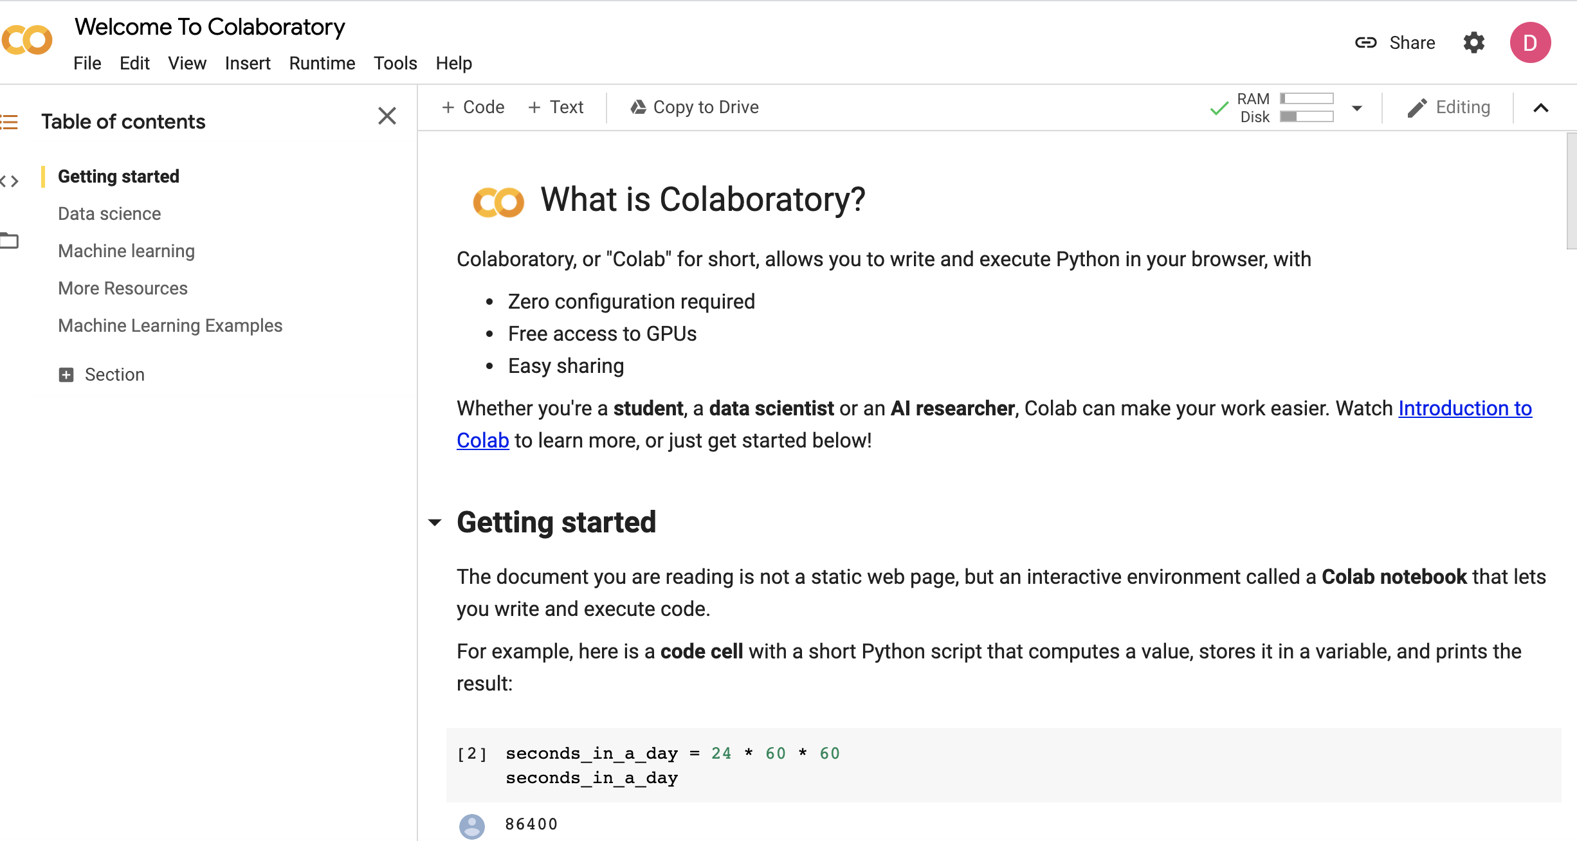
Colab Main Page

Slide 4
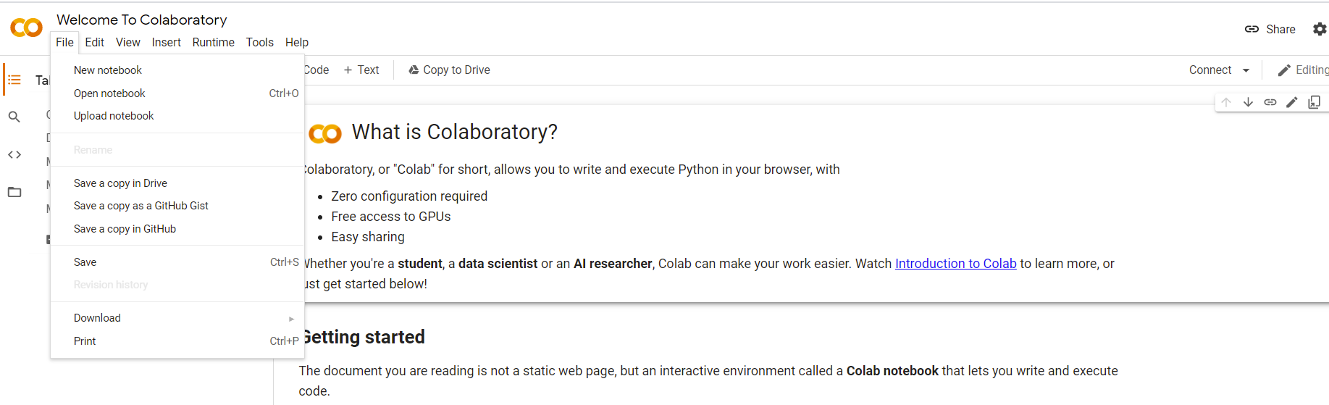
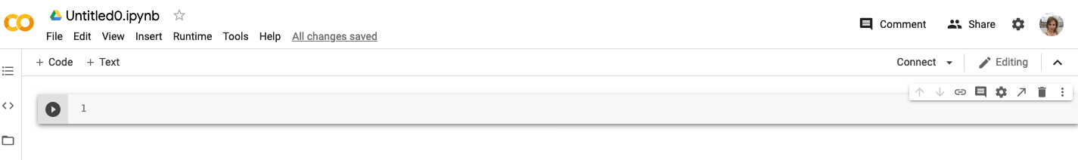
How to Open a New Notebook
Step 2: Under File, click New Notebook
A new notebook should open up as shown below

Slide 5
Hello World
Let’s write a program in Colab and call it “Hello World”
Type that name in the circle and press Enter
The notebook will acquire the name you have given now

Slide 6
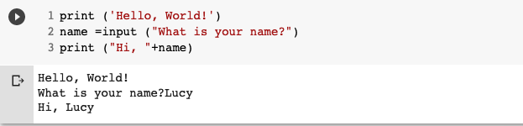
Writing and Executing the Code
Enter the trivial Python code and run it
We will show how the simple code “Hello World” can be written
Write this few lines of code in code cell
Press run cell
The output are the results
Run cell

Slide 7
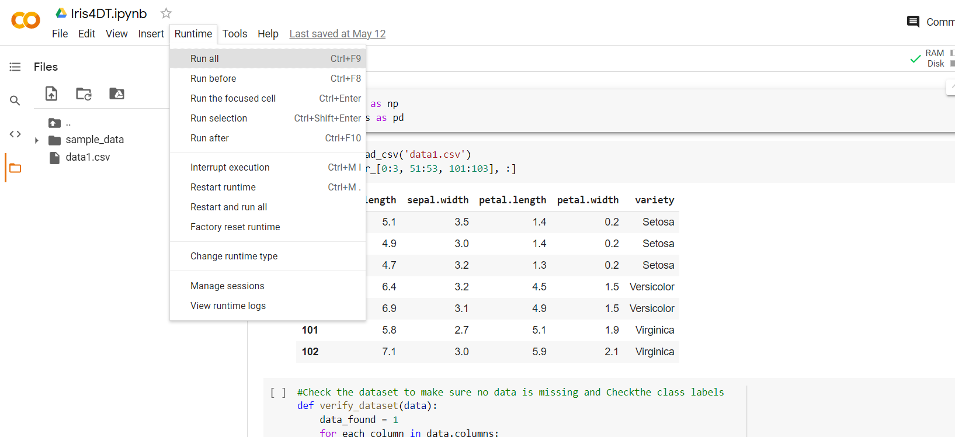
Runtime – Run All
To save time, you can also click ‘Runtime’ then select ‘Run all’ to run all the cells

