Slide 1

Module 2b - Defined Gene Lists
Diogo Pellegrina
May 12, 2026

Slide 2
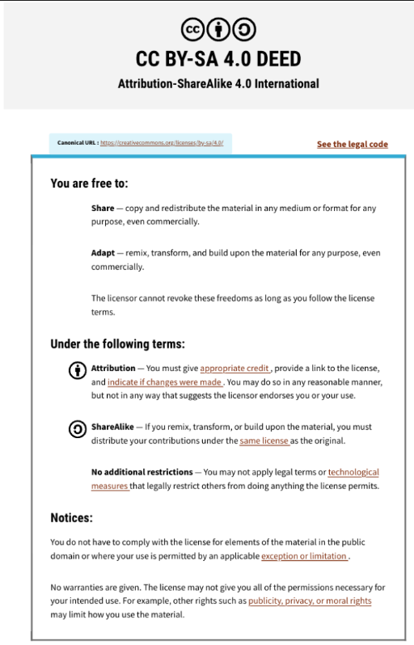
This presentation is an adaptation of 2024 lecture from Ruth Isserlin

Slide 3
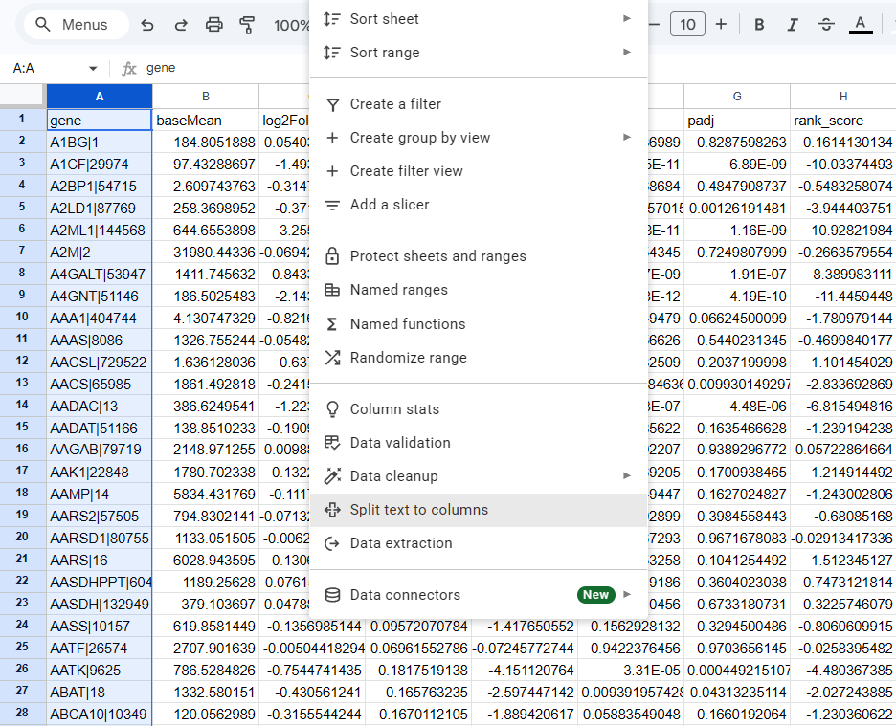
As a first example we will use gProfiler in the most basic way possible.
Starting from the data generated last class, let’s get a list of gene names or IDs
Separate text into columns
Sort them by p-value

Slide 4
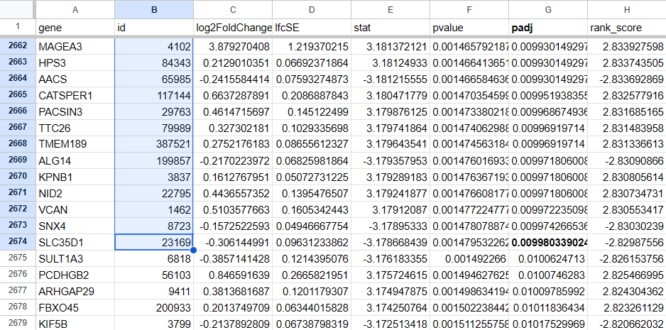
Let’s copy all gene IDs that have an FDR of at least 1%
Why not take the gene names?
Why 1%?

Slide 5
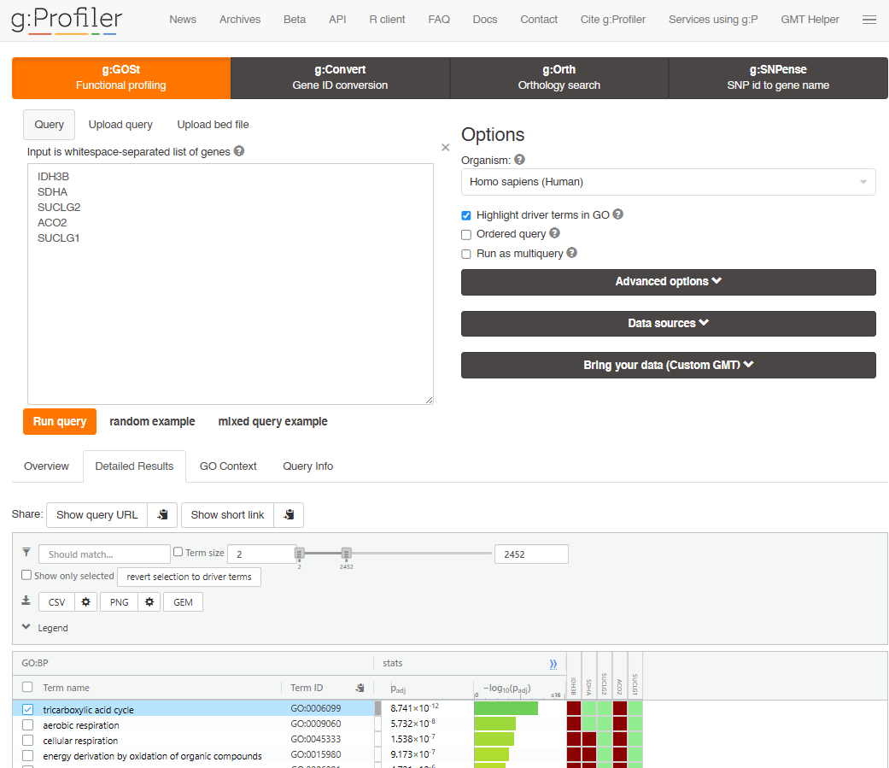
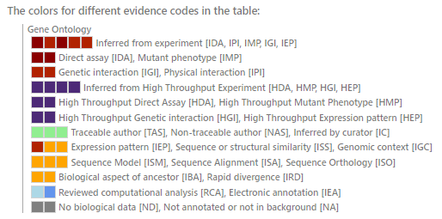

Slide 6
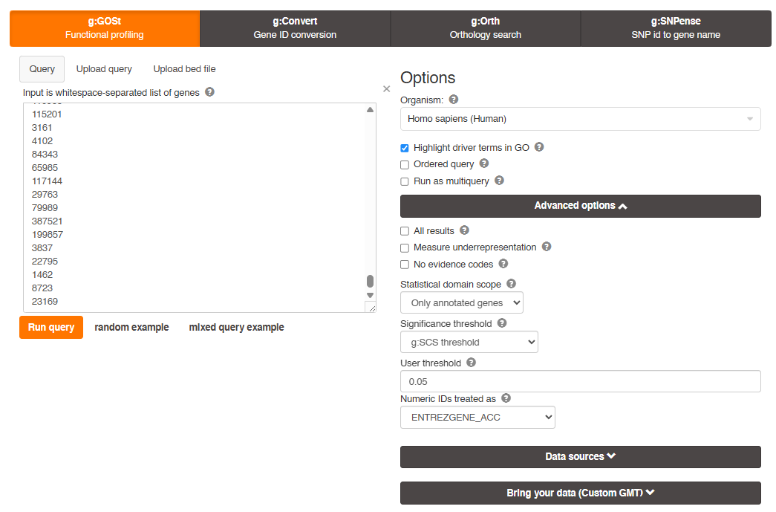
Open gProfiler and paste the numbers you copied
Since we are using IDs that are just numbers, we need to make sure that we have the correct source here!

Slide 7
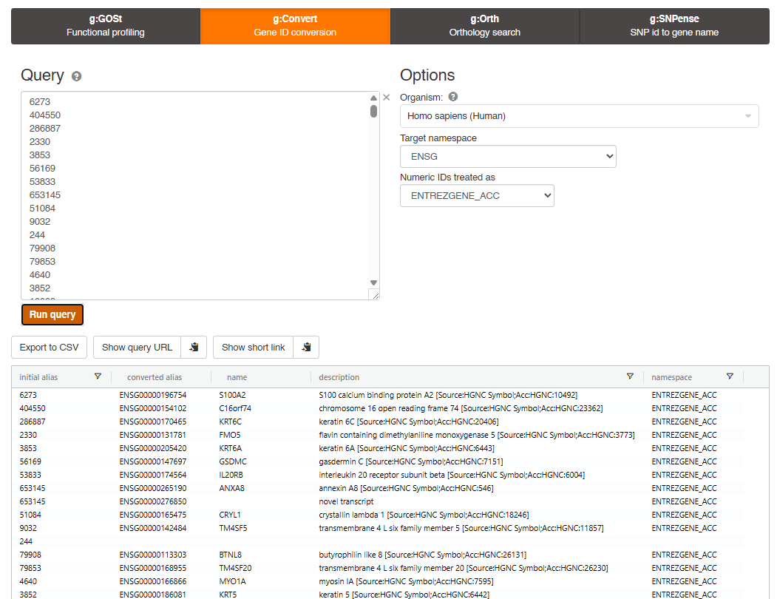
Open gProfiler and paste the numbers you copied
The second tab in the top is just to check ID names and descriptions
The 3rd tab converts IDs to closest genes on different species
The 4th tab is for mutation IDs

Slide 8
Open gProfiler and paste the numbers you copied
The second tab in the top is just to check ID names and descriptions
The 3rd tab converts IDs to closest genes on different species
The 4th tab is for mutation IDs
Save this file as translator.csv (will be used later)

Slide 9
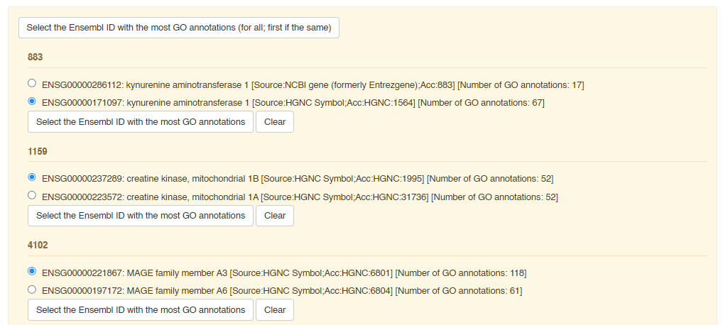
Sometimes an ID from database A will match with 2 IDs from database B

Slide 10
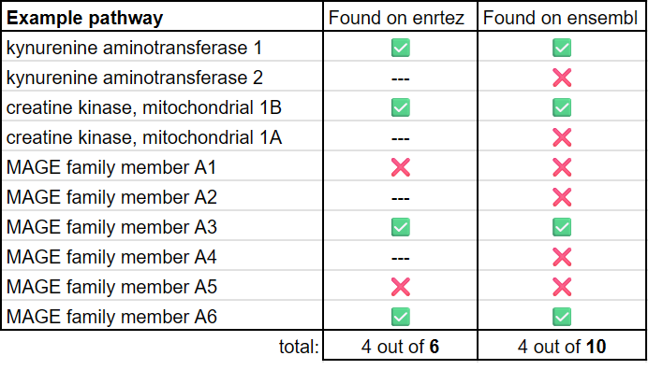
This change in database can interfere with the results!

Slide 11
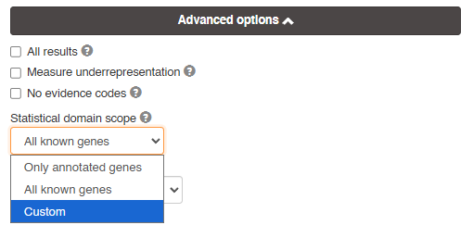
Remember to include a custom statistical domain!
The default will consider all genes found in at least one of the pathways being compared.
In most cases you will want to include a custom background list, for example, in an RNAseq you should add all genes in the gtf/gff file you used to align reads.

Slide 12
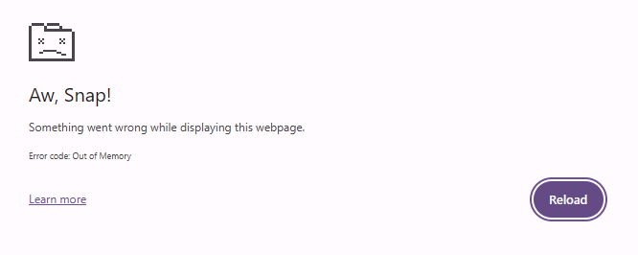
So we open tcga_paad_rsem_counts_cleaned.txt to get the list of genes used for the alignment

Slide 13
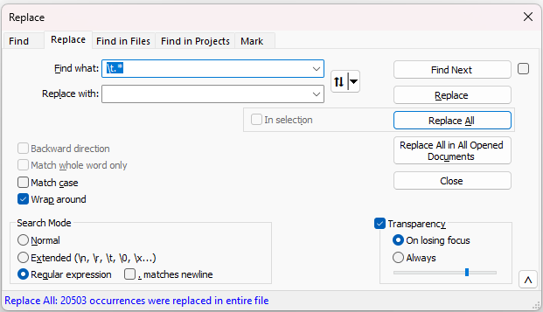
Notepad++
\t.*
.*|

Slide 14
Notepad++
\t.*
.*\|

Slide 15
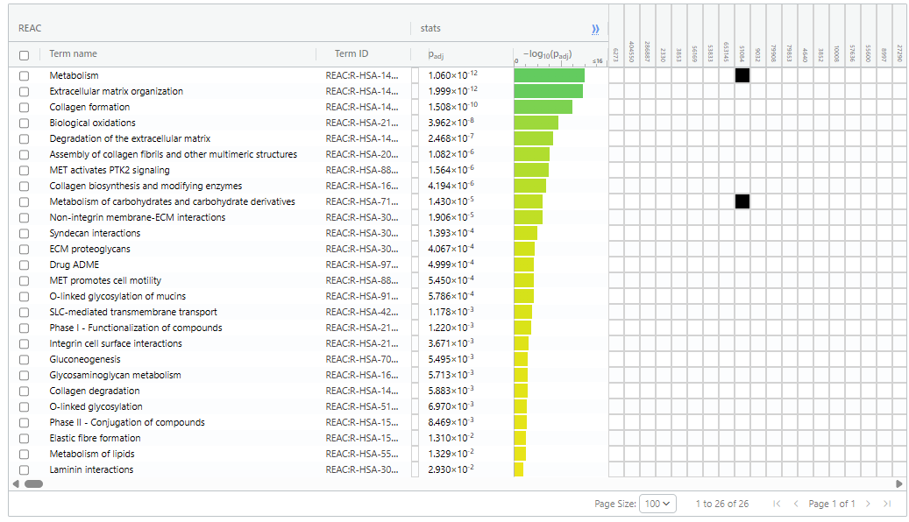
Most of these pathways are very large!

Slide 16
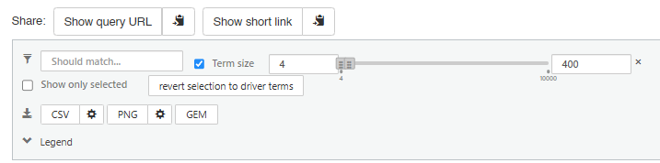
We can adjust min-max size and download as csv

Slide 17
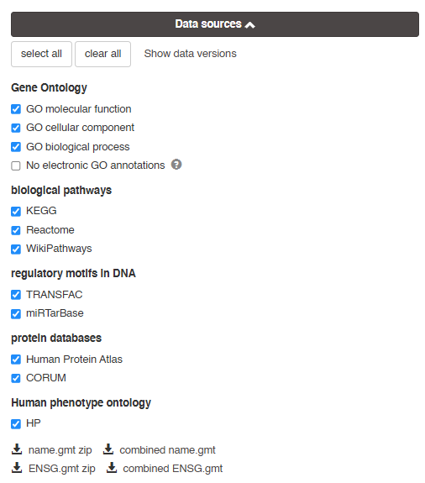
You can later filter redundant pathways, 1st we need to download the gmt files

Slide 18
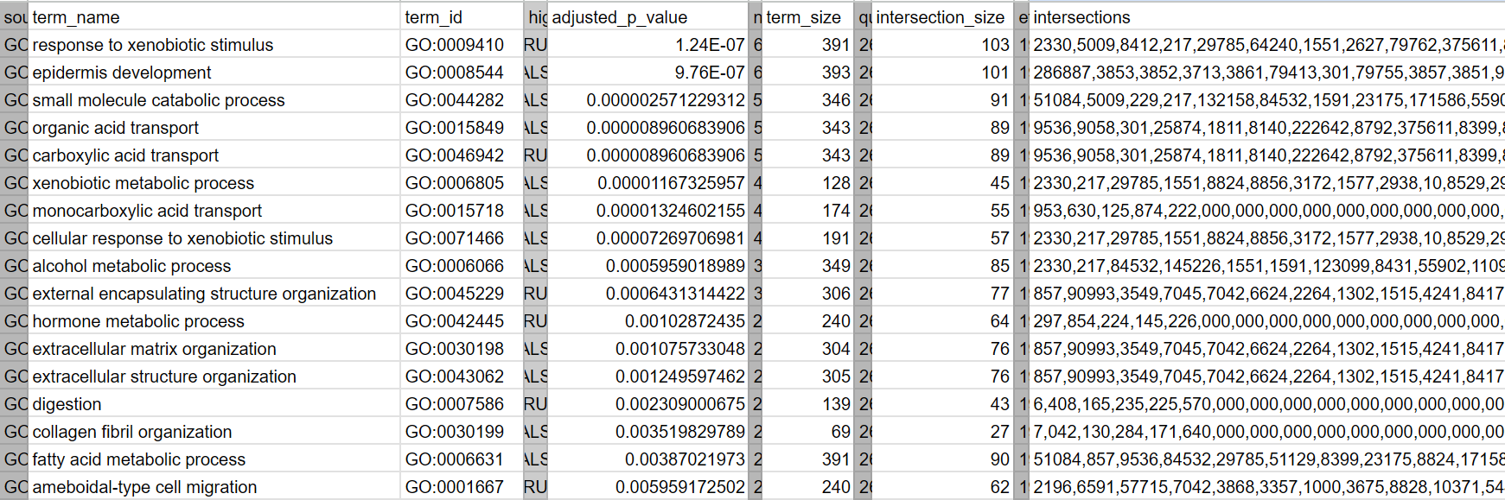
This is how the results file looks like:
I greyed and condensed a few columns just for this slide

Slide 19
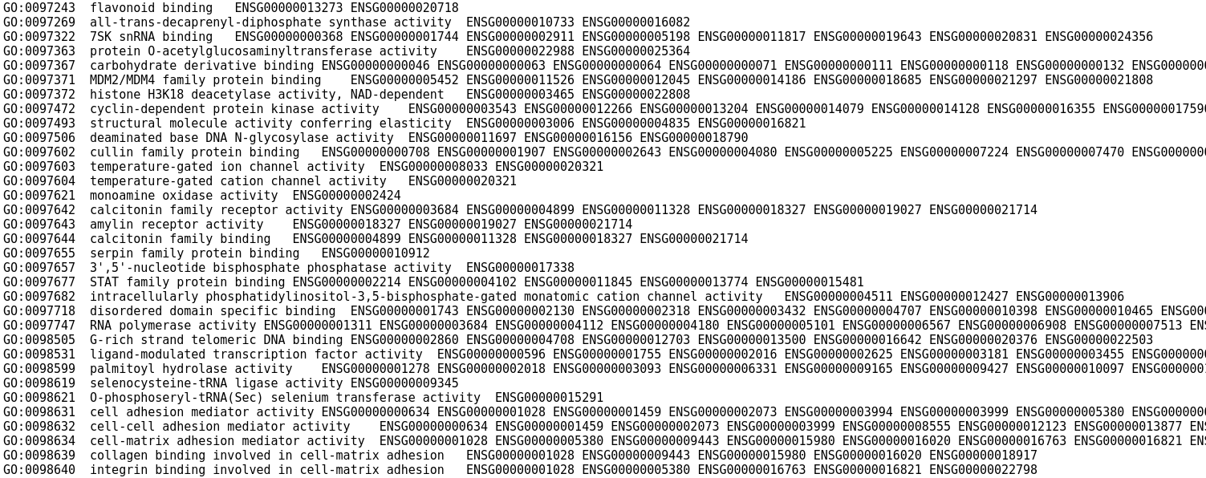
This is how the gmt file looks like:

Slide 20
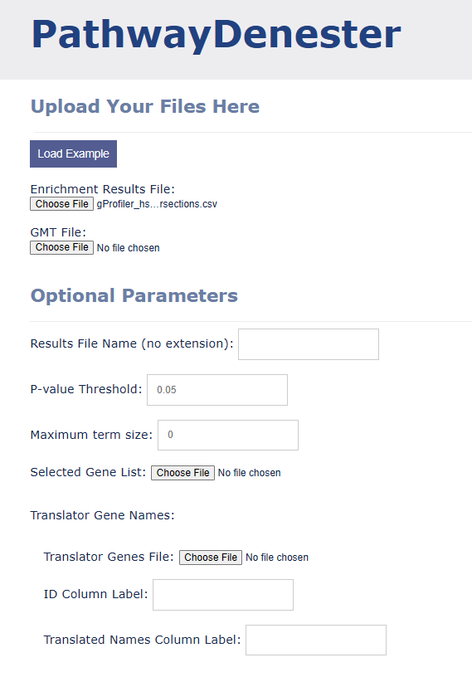
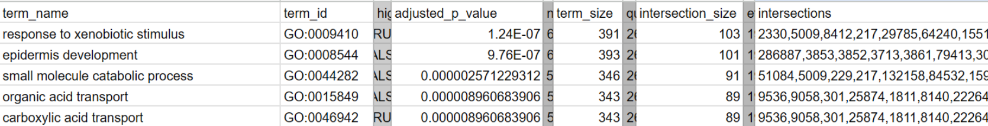
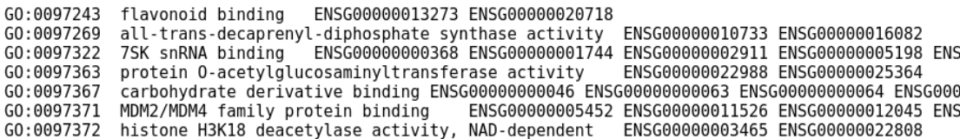
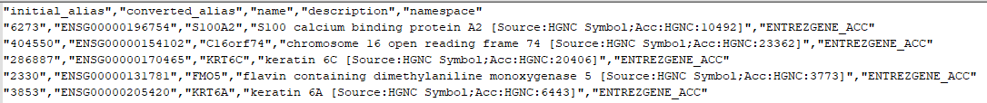

Slide 21
Now, let’s do it like pros:
Open Module2B_lab.r

Slide 22


