Slide 1

bioinformatics.ca
bioinformaticsdotca.github.io

Slide 2
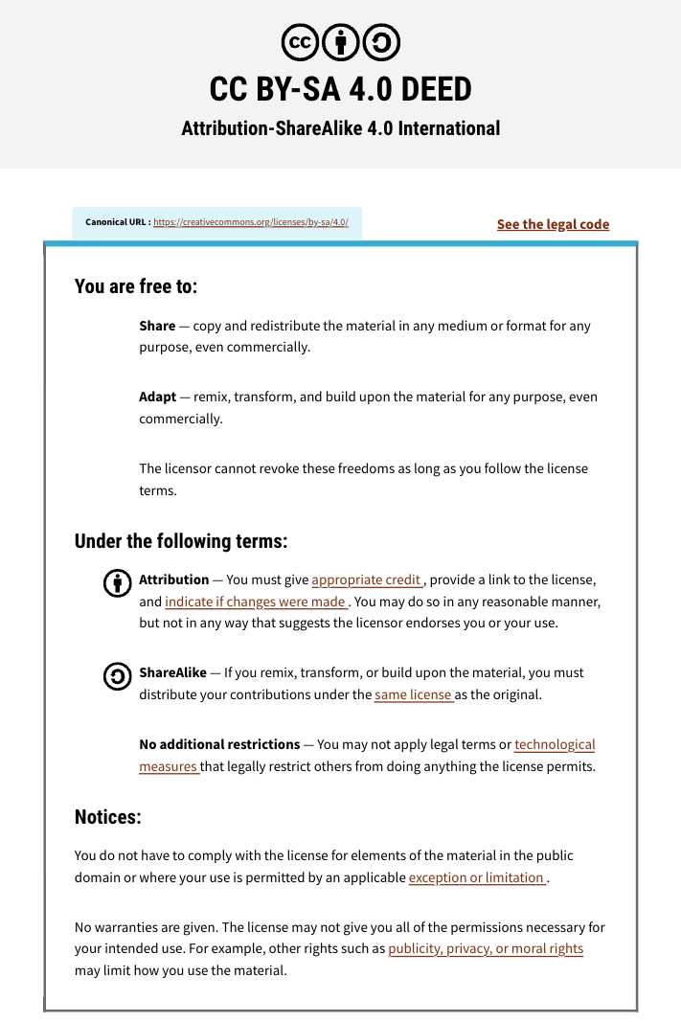

Slide 3

Pathway and Network Analysis
Riya Roy & Mark Berjanskii
May 12-13, 2026

Slide 4









Thank you to our sponsors

Slide 5
Land Acknowledgement
As a pan-Canadian organization, we acknowledge that we operate on the traditional, ancestral, and unceded territories of Indigenous Peoples who have cared for these lands since time immemorial. We honor the enduring presence of First Nations, Inuit, and Métis Peoples across Canada and express gratitude for the privilege of living and working here. With respect and reflection on our shared responsibilities, we commit to taking actions to foster understanding, collaboration, and reconciliation.

Slide 6
House Rules
Be respectful to your TAs, faculty, and classmates
To get the most out of this course, avoid multitasking
Stay on schedule
Zoom chat is disabled, put your questions in Slack, please

Slide 7
Schedule
Day 1 |  |  | Day 2
May 12, 2026 |  |  | May 13, 2026
Time (West) | Time (East) | Module | Time (West) | Time (East) | Module
8:30 | 9:30 | Arrivals & Check-in | 8:30 | 9:30 | Arrivals
9:00 | 10:00 | Welcome (Coordinator) | 9:00 | 10:00 | Module 3 - Cytoscape (Diogo Pellegrina)
9:30 | 10:30 | Module 1 - Introduction (Richard LeDuc)
10:30 | 11:30 | Break (30min) | 10:00 | 10:30 | Break (30min)
11:00 | 11:45 | Module 2a - Differential Expression (Constance Li)
11:45 | 12:45 | Module 2a Lab (Constance Li) | 10:30 | 11:30 | Module 3 Lab (Diogo Pellegrina)
12:45 | 13:45 | Lunch (1h) | 12:30 | 13:30 | Class photo + Lunch (1h)
13:45 | 14:45 | Module 2b - Defined Gene Lists (Diogo Pellegrina) | 13:30 | 14:30 | Module 4 - Integrative Assignment (Constance Li)
14:30 | 15:30 | Break (30min) | 14:30 | 15:30 | Break (30min)
15:00 | 16:00 | Module 2b Lab (Diogo Pellegrina) | 15:00 | 16:00 | Module 4 Lab (Constance Li)
16:00 | 17:00 | Module 2c - Ranked Gene Lists (Constance Li) | 17:00 | 18:00 | Survey & Closing Remarks
16:30 | 17:30 | Module 2c Lab (Constance Li)
17:30 | 18:30 | Finished | 17:30 | 18:30 | Finished

Slide 8
Getting Help
bioinformaticsdotca.github.io
Slack channel
Raise your hand/Unmute yourself

Slide 9
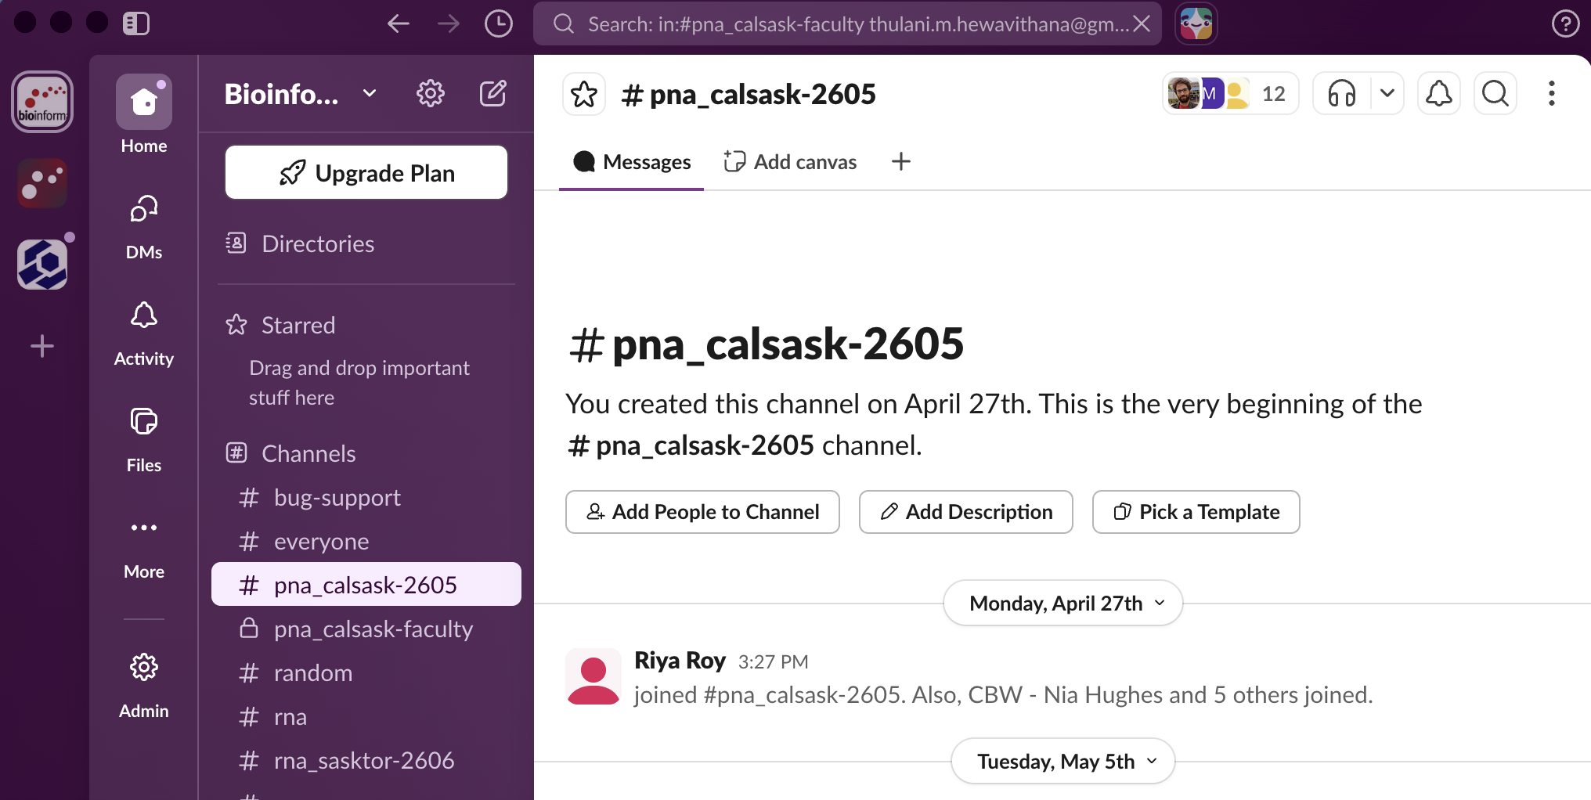

Slack

Slide 10
Post-Workshop
Materials are available at bioinformaticsdotca.github.io
Lecture recordings will be uploaded to our Youtube channel
For those who agreed to share contact info, a mailing list will be sent out

Slide 11
Introducing Your Faculty
Instructors:
Dr. Richard LeDuc – Winnipeg
Dr. Constance Li – Calgary
Dr. Diogo Pellegrina - Saskatoon
Teaching Assistants:
Jinsu An - Calgary
Thulani Hewavithana - Saskatoon

Slide 12
Introducing You!
Tell us about yourself in 30 seconds:
Name
Institution
Research
One surprising fact about you

Slide 13
Let’s get started!
Workshop Sponsors

