Slide 1

bioinformatics.ca
bioinformaticsdotca.github.io

Slide 2
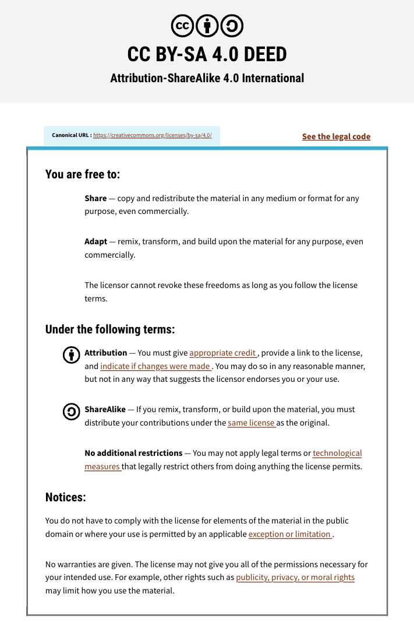

Slide 3

Closing Remarks
Riya Roy & Mark Berjanskii
Pathway and Network Analysis
May 12-13, 2026

Slide 4









Thank you to our sponsors

Slide 5
Thank you to our faculty and TAs!

Slide 6
Survey (10 minutes)
We want to hear about your experience! Post-workshop surveys have a huge impact on how we deliver workshops.
The post-workshop survey has been emailed to you and posted in the Slack.
It is completely anonymous by default; if you’d like us to contact you about your answers, there is a space to leave your email address. Thank you for helping us improve!
We will wrap up once we’ve received the surveys.

Slide 7
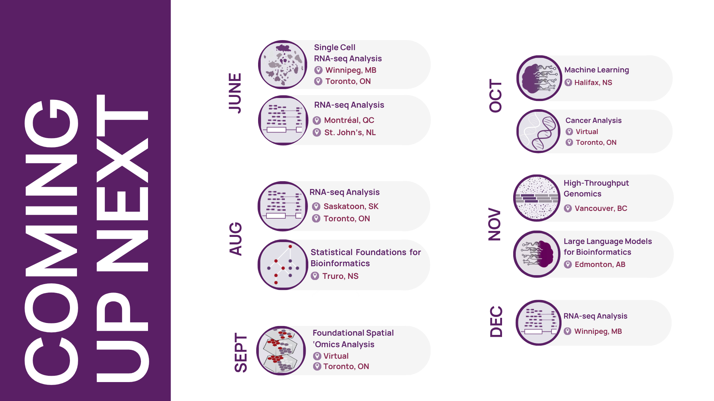

Slide 8
Get involved
Slack
Mailing lists
Training awards
Mentorship upcoming
BUGs

Slide 9
Post-workshop
Materials are at bioinformaticsdotca.github.io forever(ish)
Lecture recordings will be uploaded to our Youtube channel and linked on Github
For those who agreed to share contact info, a mailing list will be sent out
Certificate will be emailed to you
Slack channel is available (history expires after 3 months)
Please keep in touch!

Slide 10
Thank you!
Workshop Sponsors

